Slide 1
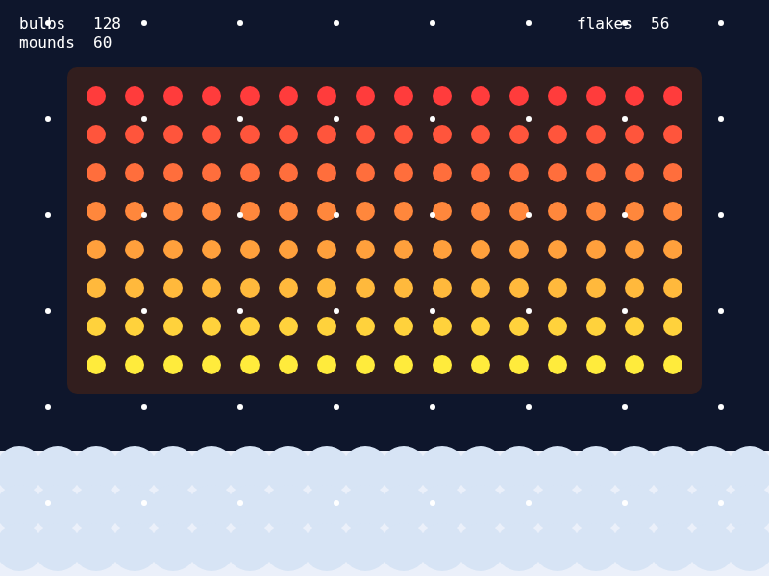
UNIT 3 · LESSON 4
Rows of Rows
nested loops · grids
Today's build
Notes:
RUN SHEET (41 min)
0-1 Preview: the light wall.
1-3 WARM-UP: one row. Copy it 8 times?
3-7 The new thing: a loop inside a loop.
7-10 TRACE TABLE: r stays, c runs, c resets.
10-13 LAB 1: crossy road tiles.
13-15 Which variable for what?
15-17 LAB 2: a grid of stars - count before you run.
17-18 Two loops, two names.
18-20 The exam version: nested REPEAT n TIMES.
20-21 OPEN THE STARTER.
21-35 BUILD: the light wall, TODOs 1-5.
35-39 Check yourself.
39-41 CED (point only), save, // TODO, log off.
IF BEHIND
1. Lab 2 - but keep its question "predict the count" as a board question.
2. The names slide - say it while they build.
Do NOT cut the trace table or the exam slide (the count question is on it).
BEFORE CLASS
Post u3l04-lightwall-starter.js. Hold back the solution.
TURN IN
The light wall (TODOs 1-5).

Slide 2
Today
01
One row
02
Nested loops
You can already do this.
A loop inside a loop.
03
On the exam
04
Build
Nested REPEAT n TIMES
The light wall: u3l04-lightwall-starter.js
Notes:
20 seconds. The four parts of the period.

Slide 3
01
One row
You can already do this.
Notes:
Transition.

Slide 4
One row of lights
for (let c = 0; c < 16; c++) {
circle(100 + c * 40, 100, 20);
}
YOU KNOW THIS
16 bulbs in a row. x from c, y is always 100.
NOW I WANT 8 ROWS
Copy and paste the loop 8 times and change the y? What is wrong with that?
Notes:
TIME
2 min
SAY
Same problem as Lesson 1, one level up: the only thing that changes from
copy to copy is the y - by 40 each time. "What do we do when only one
number changes by the same amount?" A loop.

Slide 5
02
Nested loops
A loop inside a loop.
Notes:
Transition.

Slide 6
A loop inside a loop
for (let r = 0; r < 8; r++) {
for (let c = 0; c < 16; c++) {
circle(100 + c * 40,
100 + r * 40, 20);
}
}
OUTER · R
Picks the row. y comes from r.
INNER · C
Walks across that row. x comes from c.
INNER FINISHES FIRST
For each row, the inner loop runs all 16 times.
Notes:
TIME
4 min
SAY
Read it out loud: "for each row, for each column, draw a bulb."
The inner loop is the whole one-row loop from the last slide, unchanged
except for its y.
Indentation shows which braces belong to which loop. Line them up.
WATCH FOR
Students who think the loops take turns: one c, one r, one c... No - the
inner loop runs to the end before r changes at all.

Slide 7
r stays, c runs, c resets
r | c | x, y
0 | 0 | 100, 100
0 | 1 | 140, 100
0 | 2 | 180, 100
1 | 0 | 100, 140
1 | 1 | 140, 140
1 | 2 | 180, 140
C RESETS
When r goes up, the inner loop starts again: c is 0 again.
HOW MANY?
2 rows × 3 columns = 6. So 8 × 16 = 128.
Notes:
TIME
3 min
SAY
On the board, small: r < 2, c < 3. Students call out each line.
Point at the jump from row 3 to row 4 of the table: c goes 2 -> 0.
That reset is the thing that makes it a grid.
How many: outer trips times inner trips.

Slide 8
Crossy road: a grid of tiles
function setup() { createCanvas(800, 600); }
function draw() {
background(30);
noStroke();
for (let r = 0; r < 6; r++) {
for (let c = 0; c < 8; c++) {
fill(80 + r * 20, 160, 80 + c * 15);
rect(c * 100, r * 100, 96, 96);
}
}
}
TRY, IN ORDER
c < 8 → c < 4 · r < 6 → r < 3 · color only by r (drop the c)
LIVE VERSION
Run and edit this in the interactive lesson page.
Notes:
TIME
3 min
SAY
c < 4: only the left half - columns. r < 3: only the top half - rows.
The color uses both r and c: down gets more red, across more blue.
Drop the c from the color: every ROW becomes one color. TODO 3.

Slide 9
Which variable for what?
x ← c
y ← r
Columns go across.
Rows go down.
Color by row
Color by column
fill(255, 60 + r * 25, 60)
fill(255, 60 + c * 12, 60)
Notes:
TIME
2 min
SAY
If you mix them up - r in the x - you get a diagonal or a single column.
Quick check: "a stripe that goes across - which variable?" r.

Slide 10
Asteroids: a grid of stars
function setup() { createCanvas(800, 600); }
function draw() {
background(8, 10, 24);
fill(255); noStroke();
let count = 0;
for (let r = 0; r < 5; r++) {
for (let c = 0; c < 10; c++) {
circle(40 + c * 80, 60 + r * 120, 8);
count = count + 1;
}
}
textSize(28);
text("stars " + count, 20, 590);
}
PREDICT, THEN RUN
r < 5 → r < 7: what will count say? Then try c < 10 → c < r. What shape?
LIVE VERSION
Run and edit this in the interactive lesson page.
Notes:
TIME
2 min
SAY
Boards up before each Run. 7 x 10 = 70.
c < r: row 0 gets 0 stars, row 1 gets 1 ... a staircase triangle.
The inner loop can depend on the outer variable. Early finisher 2 uses it.

Slide 11
Do not reuse i
for (let i = 0; i < 8; i++) {
for (let i = 0; i < 16; i++) {
circle(100 + i * 40, 100 + i * 40, 20);
}
}
WHAT YOU GET
A diagonal of 16 bulbs, drawn 8 times. The inner i hides the outer one.
FIX
Use r and c (or i and j). Then 100 + c * 40, 100 + r * 40 says what it means.
Notes:
TIME
1 min
SAY
JavaScript lets you make a second i inside - and then you cannot reach
the first one. Different names, every time.

Slide 12
03
On the exam
Nested REPEAT n TIMES
Notes:
Transition.

Slide 13
Nested REPEAT
JAVASCRIPT
AP EXAM
for (let r = 0; r < 8; r++) {
for (let c = 0; c < 16; c++) {
bulbs = bulbs + 1;
}
}
REPEAT 8 TIMES
{
REPEAT 16 TIMES
{
bulbs ← bulbs + 1
}
}
The exam's favorite question: how many times does the inner body run? Outer trips × inner trips = 8 × 16 = 128.
Notes:
TIME
2 min
SAY
If the inner count depends on the outer (like c < r), you cannot just
multiply - you add up each row: 0 + 1 + 2 + ...
That variant shows up too.

Slide 14
04
Build
The light wall: u3l04-lightwall-starter.js
Notes:
TIME
1 min
SAY
File > New, paste, rename, SAVE.

Slide 15
One row, then all of them
TODO 1
TODO 2
One row of 16. Run it. Readout: 16.
Wrap it in a rows loop. y = TOP + r * SP. Predict the readout first.
TODO 3
Save first
Color by row: fill(255, 60 + r * 25, 60). Where does it go?
Before every Run of a new loop.
Notes:
TIME
7 min (of the 14-minute build)
SAY
Build it in this order on purpose: one row that works, then wrap it.
TODO 3: the fill can go in the outer loop (once per row) or the inner
(once per bulb). Both work - outer is less work for the computer.
WATCH FOR
bulbs = 0 inside a loop: readout says 1 or 16.
TOP + c * SP for y: a diagonal.

Slide 16
Mounds and snow
TODO 4 · mounds
TODO 5 · snow
3 rows of 20 along the ground. Readout: 60.
7 rows of 8 flakes. y uses frameCount % 100 so the grid drifts.
DONE EARLY?
Puzzle (swap the loops) and early finishers at the bottom of the starter.
Notes:
TIME
7 min (of the 14-minute build)
SAY
TODO 4 is the same shape as TODO 2 with different numbers.
TODO 5: frameCount % 100 counts 0..99 and wraps - every flake moves
down 100 pixels then jumps back, which looks like falling.

Slide 17
Four questions
1
2
for (r < 3) { for (c < 5) { count++; } } — what is count?
Outer r < 4, inner c < r. How many times does the inner body run?
3
4
In a grid, which variable should x come from?
x ← 0, then REPEAT 2 TIMES { REPEAT 3 TIMES { x ← x + 1 } }. x?
Notes:
TIME
4 min
SAY
Boards. Q2 is the one that trips people: you cannot multiply when the
inner loop depends on r.
ANSWERS
1) 15
2) 6 (0 + 1 + 2 + 3)
3) The column variable, c
4) 6

Slide 18
Where this fits: 3.8 Iteration
AAP-2.K
Write iteration statements, and determine the result or side effect of iteration statements.
2.B
Implement and apply an algorithm.
4.B
Determine the result of code segments.
Notes:
TIME
0 min - point, do not read.
SAY
Nested loops are still 3.8 - iteration inside iteration.

Slide 19
Before you log off
Save your sketch
Last line of your file: // TODO: and what you would add next
Every bulb is lit. Tomorrow: every other one, checkerboards and skipping one - loops plus if.
Notes:
TIME
1 min
SAY
Light wall due end of period or as homework.
AFTER CLASS
Post u3l04-lightwall-solution.js to Classroom (not the public website).

