Slide 1
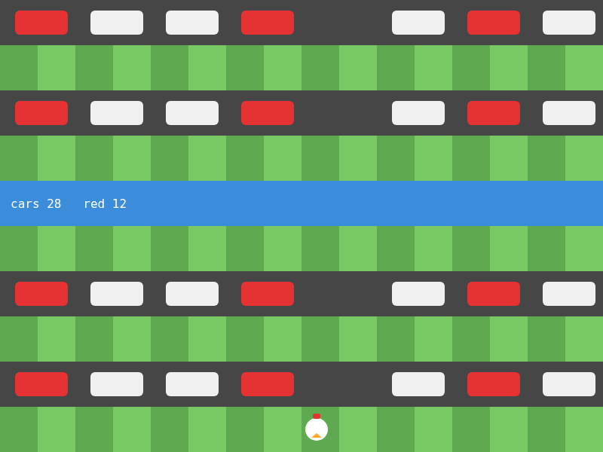
UNIT 3 · LESSON 5
Every Other One
loops + if · patterns
Today's build
Notes:
RUN SHEET (41 min)
0-1 Preview: the Crossy Road level.
1-3 WARM-UP: Lesson 1's red/green bulbs.
3-6 The new thing: an if inside the loop.
6-9 Patterns: every other, every third, skip one.
9-12 LAB 1: lights with a broken bulb.
12-15 Checkerboards: (r + c) % 2.
15-17 LAB 2: snowy quilt.
17-19 Special case first: else if order.
19-20 The exam version: IF inside REPEAT, MOD.
20-21 OPEN THE STARTER.
21-35 BUILD: the level, TODOs 1-5.
35-39 Check yourself.
39-41 CED (point only), save, // TODO, log off.
IF BEHIND
1. Lab 2 - the checkerboard slide covers it.
2. The exam slide - say "MOD is %".
Do NOT cut the patterns table or the else-if order slide.
BEFORE CLASS
Post u3l05-level-starter.js. Hold back the solution.
TURN IN
The level (TODOs 1-5).

Slide 2
Today
01
You have done this
02
Loops + if
Lesson 1's red and green bulbs.
Decide on every trip.
03
On the exam
04
Build
IF inside REPEAT. MOD means %.
Crossy Road level: u3l05-level-starter.js
Notes:
20 seconds. The four parts of the period.

Slide 3
01
You have done this
Lesson 1's red and green bulbs.
Notes:
Transition.

Slide 4
Lesson 1, TODO 3
if (bulbs % 2 == 0) {
fill(230, 60, 60);
} else {
fill(60, 190, 90);
}
circle(x, 268, 16);
REMEMBER
bulbs was a counter you added to by hand.
NOW
In a for loop, i already is the count. What would you write instead of bulbs?
Notes:
TIME
2 min
SAY
They already wrote a loop with an if inside. Today: more patterns than
even/odd, and patterns in two directions.

Slide 5
02
Loops + if
Decide on every trip.
Notes:
Transition.

Slide 6
An if inside the loop
for (let i = 0; i < 14; i++) {
if (i % 2 == 0) {
fill(230, 60, 60);
} else {
fill(60, 190, 90);
}
circle(80 + i * 50, 300, 30);
}
EVERY TRIP
14 trips, 14 decisions. The if is asked fresh each time, with the new i.
% 2
i % 2 goes 0, 1, 0, 1 … even, odd, even, odd.
Notes:
TIME
3 min
SAY
The loop decides how many. The if decides what each one looks like.
The circle() line is outside the if: every trip draws one, the if only
chose its color.

Slide 7
Which trips does the if pick?
condition | true for i =
i % 2 == 0 | 0, 2, 4, 6 …
i % 2 == 1 | 1, 3, 5, 7 …
i % 3 == 0 | 0, 3, 6, 9 …
i != 4 | all but 4
i == 4 | only 4
i < 5 | the first five
EVERY OTHER
% 2
EVERY THIRD
% 3 (any n works: % n)
SKIP ONE
!= — draw only when it is NOT that one.
Notes:
TIME
3 min
SAY
Cover the right column; call them out.
Every third starts at 0 - the FIRST one. That surprises people who
expect 3, 6, 9.

Slide 8
Christmas: one bulb is broken
function setup() { createCanvas(800, 600); }
function draw() {
background(20, 30, 50);
noStroke();
for (let i = 0; i < 14; i++) {
if (i == 6) {
fill(60); // broken
} else if (i % 2 == 0) {
fill(230, 60, 60);
} else {
fill(60, 190, 90);
}
circle(80 + i * 50, 300, 30);
}
}
TRY
i % 2 → i % 3 · break bulb 9 instead · make bulb 6 disappear (skip it)
LIVE VERSION
Run and edit this in the interactive lesson page.
Notes:
TIME
3 min
SAY
% 3: red every third, green the rest.
To make 6 disappear: wrap the whole if AND the circle in if (i != 6).
Grey vs gone is the difference between "decide the color" and "decide
whether to draw at all".

Slide 9
Checkerboards: (r + c) % 2
for (let r = 0; r < 6; r++) {
for (let c = 0; c < 8; c++) {
if ((r + c) % 2 == 0) {
fill(240);
} else {
fill(120, 160, 220);
}
rect(c * 100, r * 100, 100, 100);
}
}
WHY R + C?
One step right or one step down changes r + c by 1, so the color flips both ways.
ONLY C % 2?
Vertical stripes. Only r % 2: horizontal stripes.
Notes:
TIME
3 min
SAY
Draw a 3x3 on the board with r + c written in each square:
0 1 2 / 1 2 3 / 2 3 4. Circle the evens. Checkerboard.

Slide 10
Snowy days: a quilt
function setup() { createCanvas(800, 600); }
function draw() {
noStroke();
for (let r = 0; r < 6; r++) {
for (let c = 0; c < 8; c++) {
if ((r + c) % 2 == 0) {
fill(240);
} else {
fill(120, 160, 220);
}
rect(c * 100, r * 100, 100, 100);
}
}
}
TRY
(r + c) % 2 → c % 2 · → r % 2 · → (r + c) % 3
LIVE VERSION
Run and edit this in the interactive lesson page.
Notes:
TIME
2 min
SAY
% 3 with two colors: diagonal stripes, two of one color for every one
of the other. Patterns are just conditions.

Slide 11
else if order matters
if (i == RIVER) { // 4
water
} else if (i % 2 == 1) {
grass
} else {
road
}
WHY FIRST?
RIVER is 4: an even row. If the road check came first, it would grab row 4 and the river would never appear.
ONE BRANCH PER TRIP
if / else if / else: exactly one runs. The first true one wins.
Notes:
TIME
2 min
SAY
Rule of thumb: the most specific condition goes first. "Row 4" is more
specific than "even rows".

Slide 12
03
On the exam
IF inside REPEAT. MOD means %.
Notes:
Transition.

Slide 13
IF inside REPEAT
JAVASCRIPT
AP EXAM
for (let i = 0; i < 14; i++) {
if (i % 2 == 0) {
count = count + 1;
}
}
i ← 0
REPEAT 14 TIMES
{
IF (i MOD 2 = 0)
{
count ← count + 1
}
i ← i + 1
}
MOD is %. In pseudocode = compares (like ==) and ← assigns (like =).
Notes:
TIME
1 min
SAY
The two different equals signs are the exam trap: = in pseudocode is
a question; = in JavaScript is an instruction.

Slide 14
04
Build
Crossy Road level: u3l05-level-starter.js
Notes:
TIME
1 min
SAY
File > New, paste, rename, SAVE.

Slide 15
Roads, grass, river
TODO 1
TODO 2
Road and grass take turns. Row 0 is road. Which rows are grass?
Grass becomes a checkerboard: a loop over c, (i + c) % 2.
TODO 3
Save first
Row RIVER is water. It goes first.
Before every Run of a new loop.
Notes:
TIME
7 min (of the 14-minute build)
SAY
TODO 1: odd rows are grass (row 1, 3 ...). Bottom row 9 is grass - the
chicken stands on it.
TODO 2 puts a loop inside the grass branch of an if inside a loop.
Indent carefully.
WATCH FOR
c % 2 in TODO 2: stripes. The puzzle is exactly this.
River check placed last: no river.

Slide 16
Red cars and a gap
TODO 4 · every third
TODO 5 · skip one
c % 3 == 0 is red, the rest white. Count the reds.
Only draw when c != 4. Readout: cars 28, red 12.
DONE EARLY?
Puzzle (c % 2) and early finishers at the bottom of the starter.
Notes:
TIME
7 min (of the 14-minute build)
SAY
TODO 5 wraps TODO 4 AND the rect AND the count - skipping means none of
that happens for c = 4.
28 = 4 road lanes x 7 cars. 12 = 4 lanes x 3 red (0, 3, 6).
WATCH FOR
Readout cars 32: the skip only wraps the rect, not the count.

Slide 17
Four questions
1
2
How many i from 0 to 9 make i % 3 == 0 true?
Write the condition that skips only i = 7.
3
4
Is (r + c) % 2 == 0 true at r = 2, c = 3?
for (i < 10) { if (i % 2 == 1 && i != 5) count++; } — count?
Notes:
TIME
4 min
SAY
Boards. Q4 combines every idea from today in one line.
ANSWERS
1) 4 (0, 3, 6, 9)
2) i != 7
3) No: 5 % 2 is 1
4) 4 (1, 3, 7, 9)

Slide 18
Where this fits: 3.8 Iteration · 3.6 Conditionals
AAP-2.K
Write iteration statements, and determine the result or side effect of iteration statements.
AAP-2.H
Write conditional statements, and determine the result of conditional statements.
2.B
Implement and apply an algorithm.
4.B
Determine the result of code segments.
Notes:
TIME
0 min - point, do not read.
SAY
Two topics combined: iteration and selection. Tomorrow adds the third
building block - sequencing them into an algorithm.

Slide 19
Before you log off
Save your sketch
Last line of your file: // TODO: and what you would add next
Every trip made a decision. Tomorrow: loops that remember - count, total, and find the biggest.
Notes:
TIME
1 min
SAY
Level due end of period or as homework.
AFTER CLASS
Post u3l05-level-solution.js to Classroom (not the public website).

