Slide 1
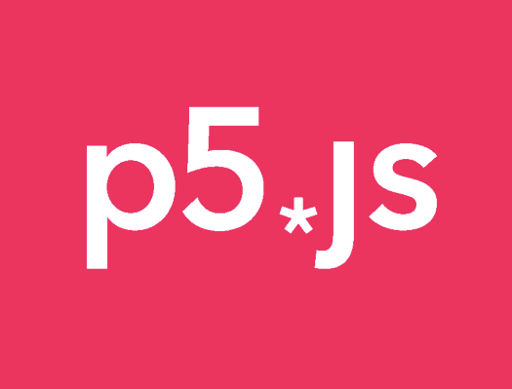
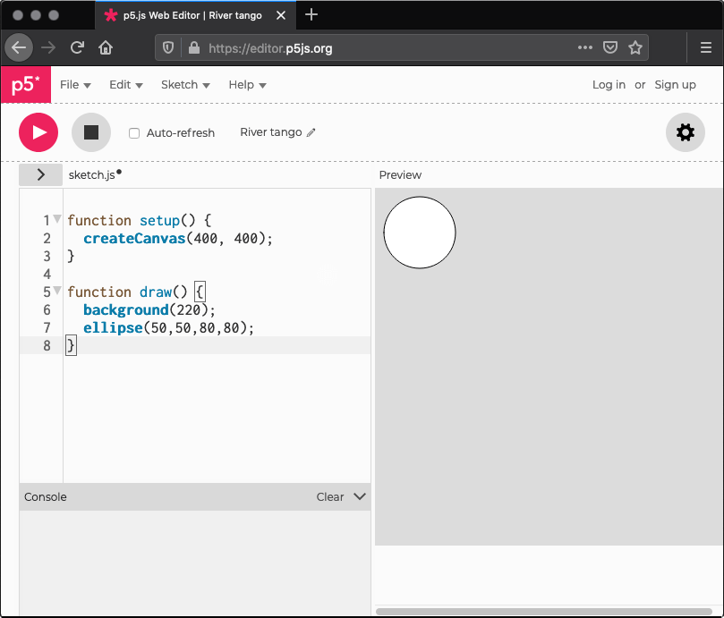
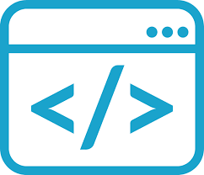
p5.js is a JS ( JavaScript) library.
Using the original metaphor of a software sketchbook, p5.js has a full set of drawing functionality.
Interactive web applications and prototypes
For this, p5.js offers add-on libraries that make it easy to interact with other HTML5 objects, including text, input, video, webcam, and sound.
www.p5js.org
P5.js Online Code Editor
https://editor.p5js.org/
Practice Examples

Slide 2
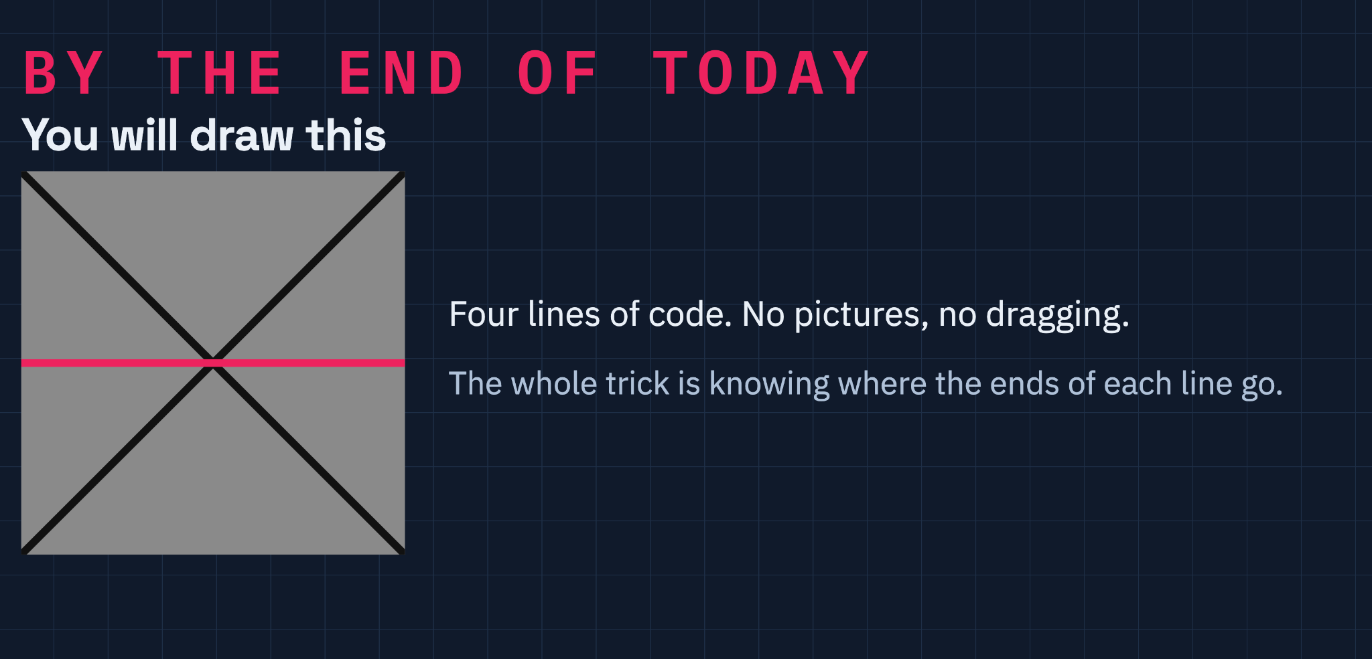

Slide 3
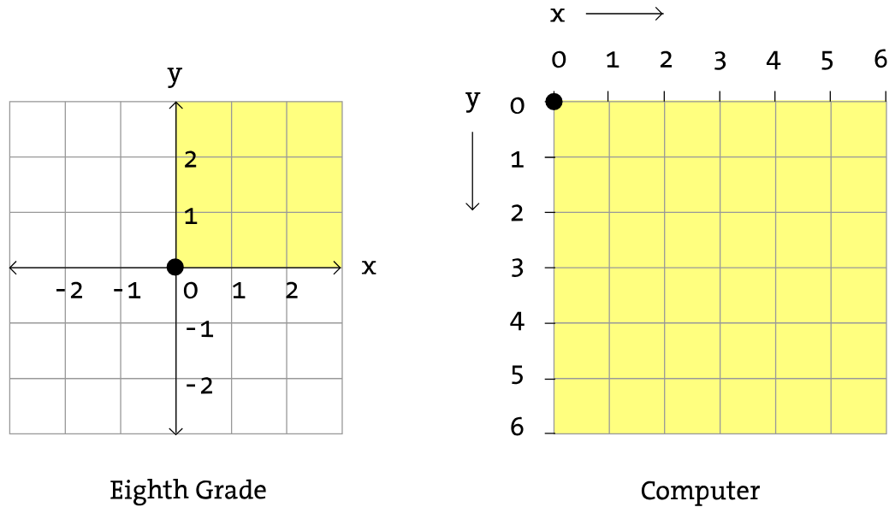
You already know grid but this is different one
A pixel is one of the small dots or squares that make up an image on a computer screen.

Slide 4
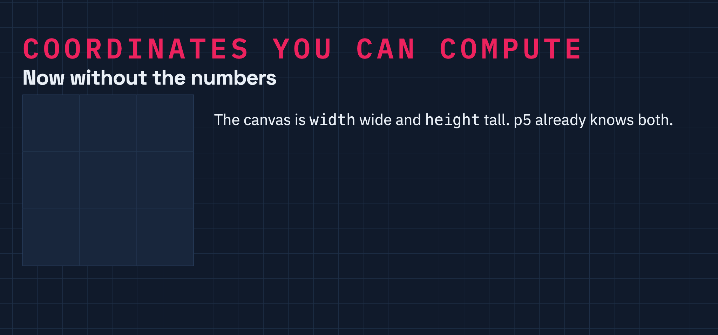

Slide 5
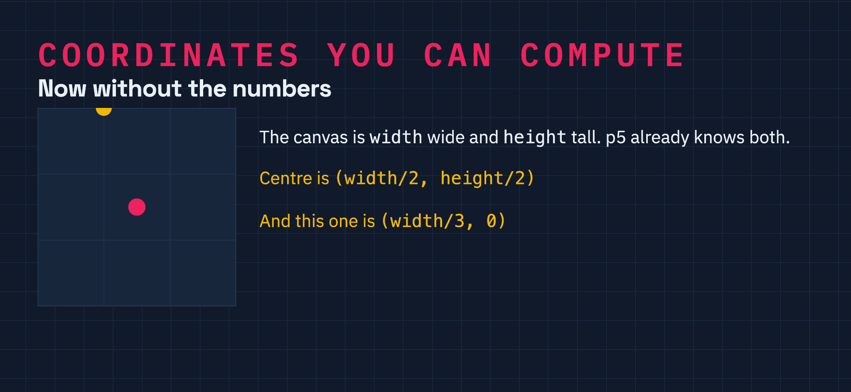

Slide 6
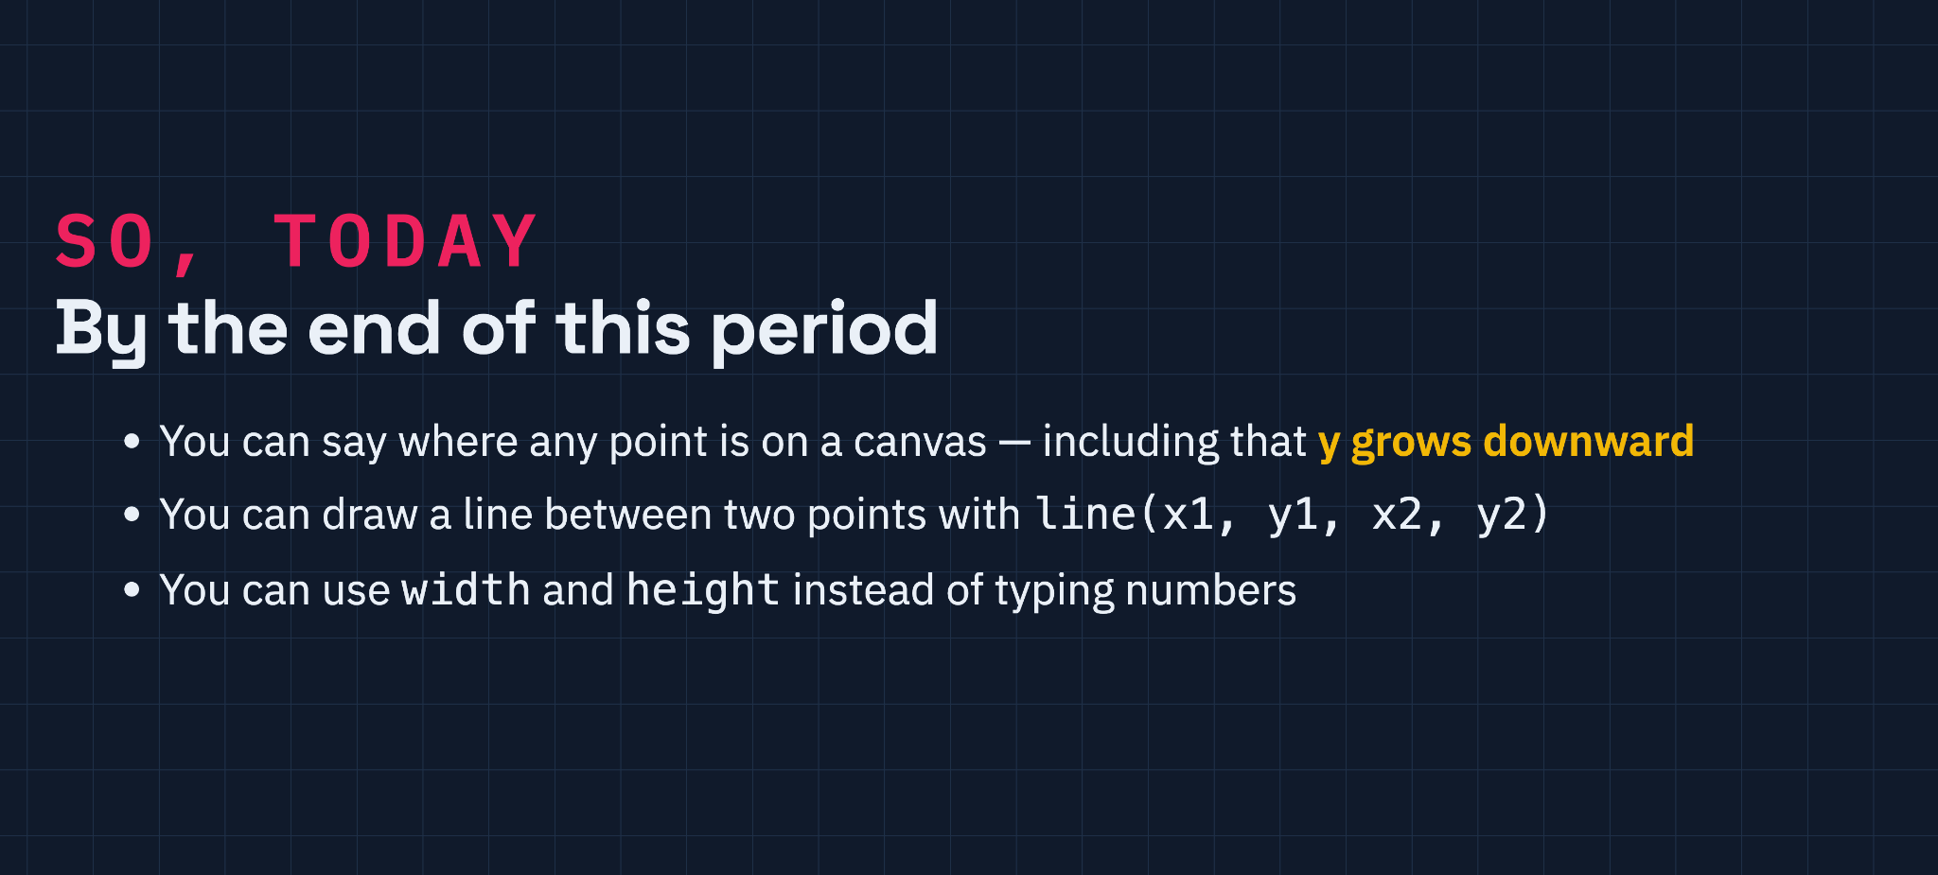

Slide 7
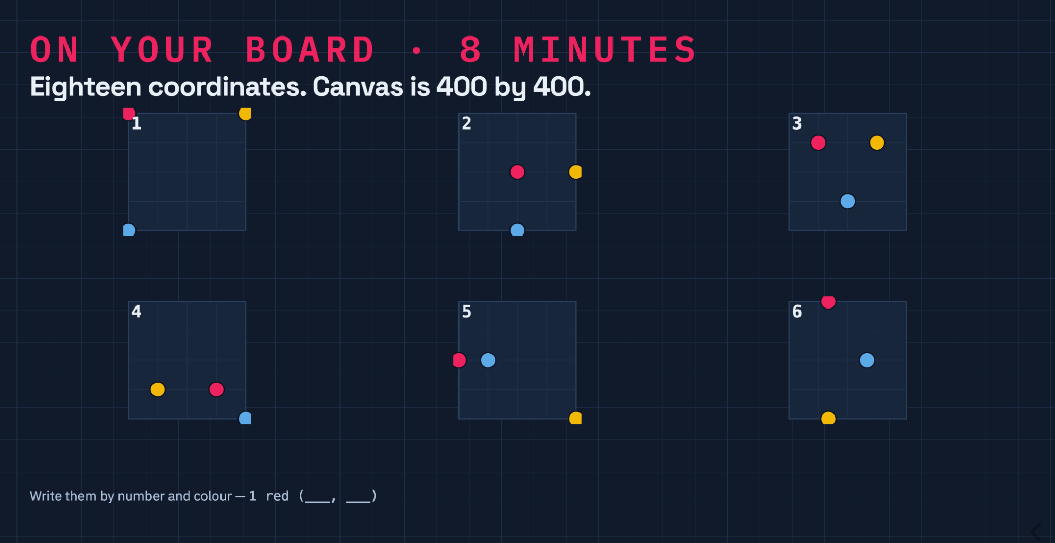

Slide 8
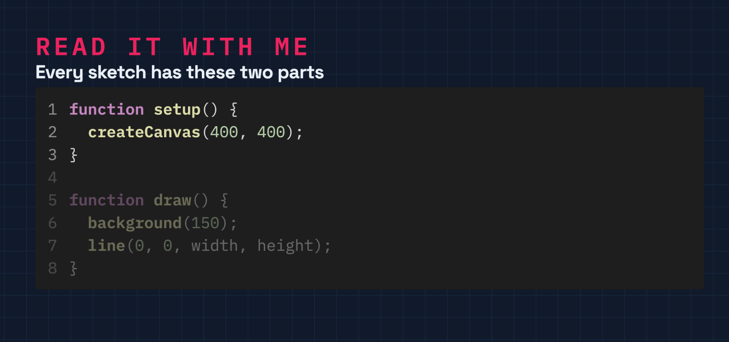

Slide 9
p5.js is a JavaScript library.
Using the original metaphor of a software sketchbook, p5.js has a full set of drawing functionality.
www.p5js.org
Interactive web applications and prototypes
For this, p5.js offers add-on libraries that make it easy to interact with other HTML5 objects, including text, input, video, webcam, and sound.

Slide 10

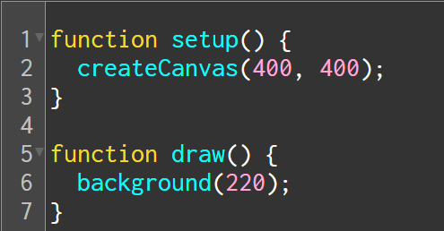
Structure
https://p5js.org/reference/
setup()
The setup() function is called once when the program starts. It's used to define initial environment properties such as screen size and background color and to load media (images, fonts, etc.) as the program starts.
There can only be one setup() function for each program and it shouldn't be called again after its initial execution.
draw()
Called directly after setup(), the draw() function continuously executes( 60 times in a second) the lines of code contained inside its block until the program is stopped or noLoop() is called.
***If noLoop() is called in setup(), draw() will still be executed once before stopping.

Slide 11

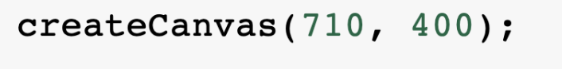
Program Statement: a command or instruction. Sometimes also referred to as a code statement and generally terminated with ;
The createCanvas() command is also called a function, method, or procedure. That line tells the computer to call the procedure named createCanvas that knows how to create a drawing area .
The createCanvas() procedure expects two parameters which specifies what width and height the canvas should have. In this program, the value passed in width is 710, height is 400.

Slide 12
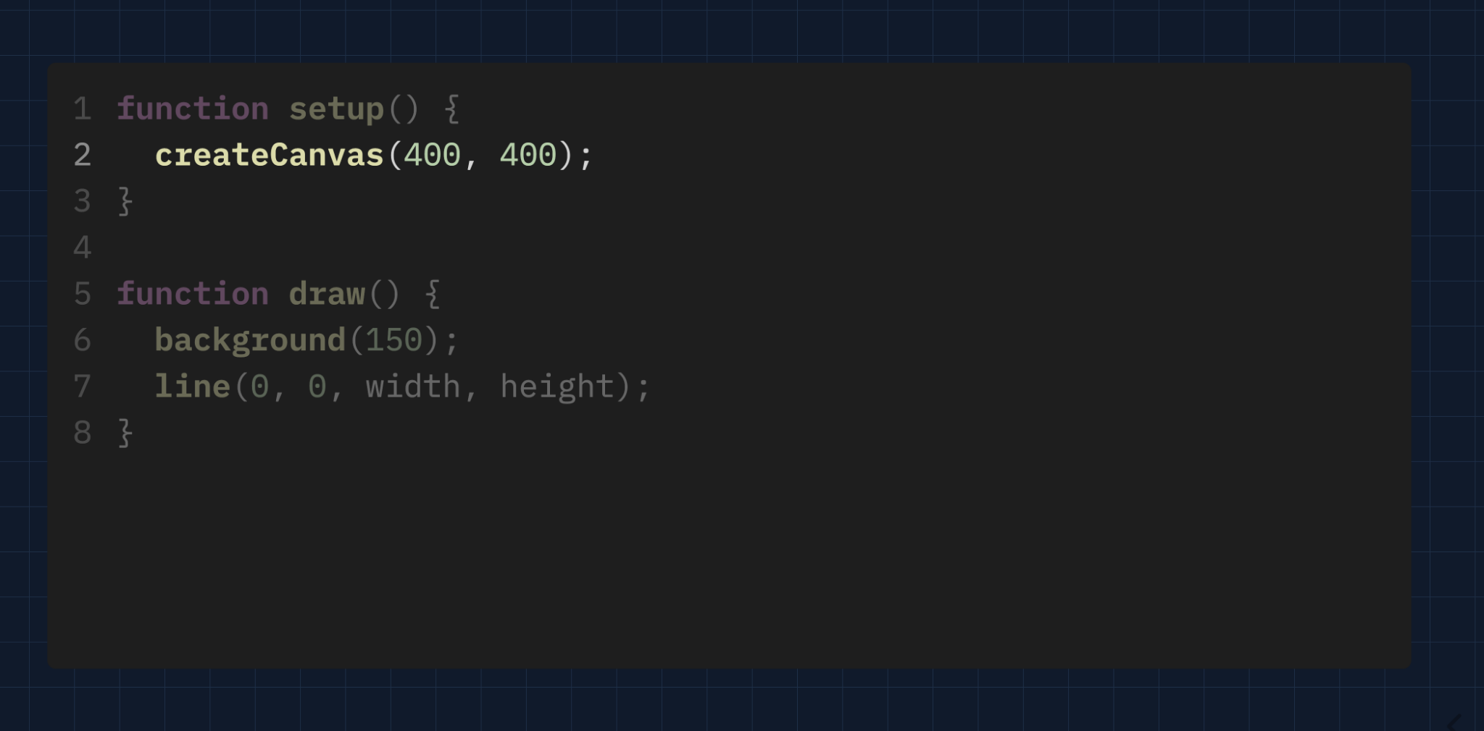

Slide 13
Program: a collection of program statements. Programs run (or “execute”) one command at a time.
Command Runs
(yellow outline while running)
Before
After

Slide 14
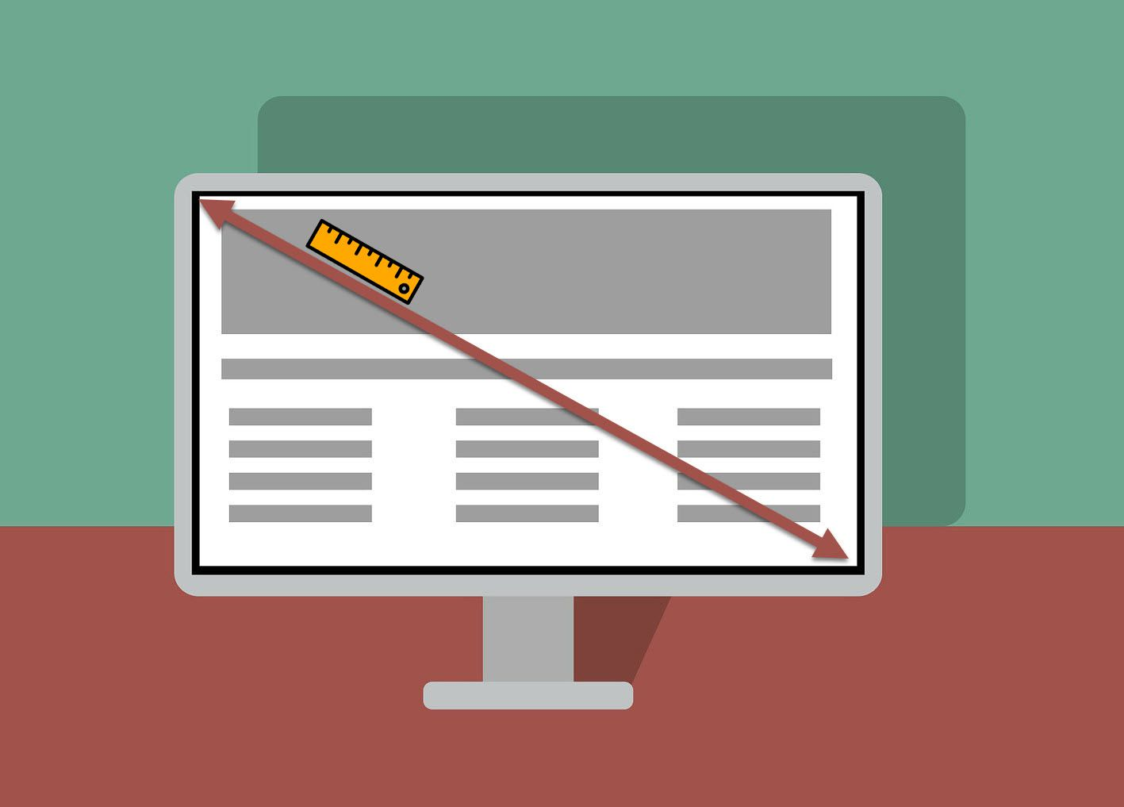

Slide 15
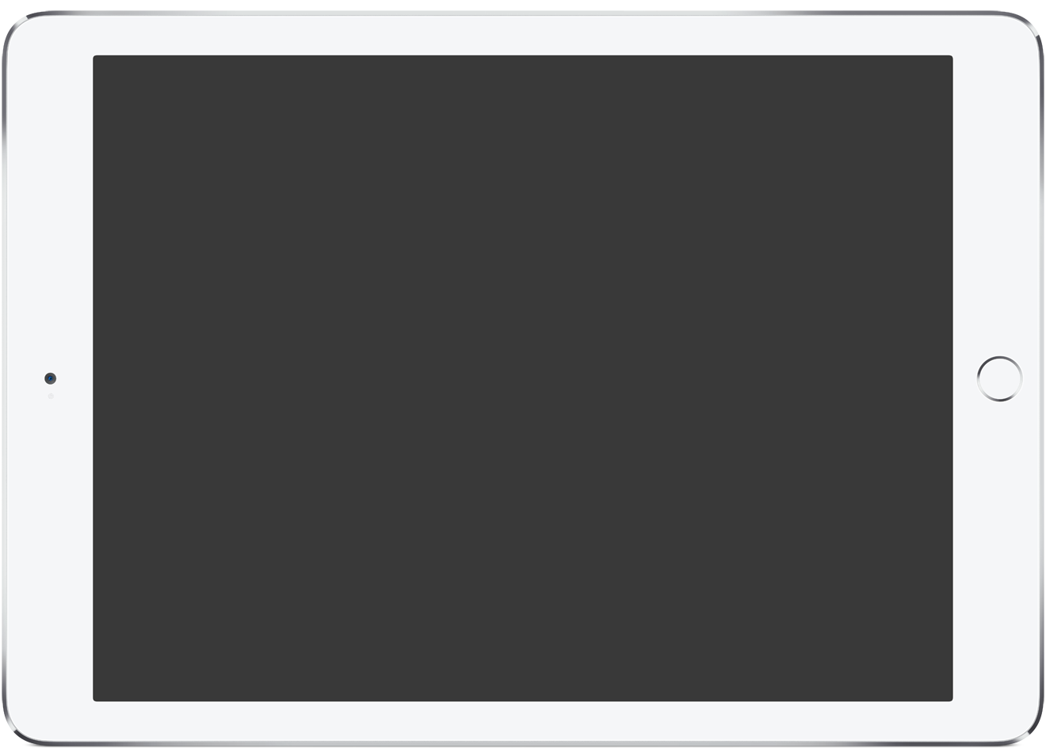
width
(0,0)
(width,0)
height
(width/2,height/2)
(0,height)
(width,height)

Slide 16

width
(width/3,0)
(width*2/3,0)
height
(width/3,height)
(width*2/3,height)

Slide 17
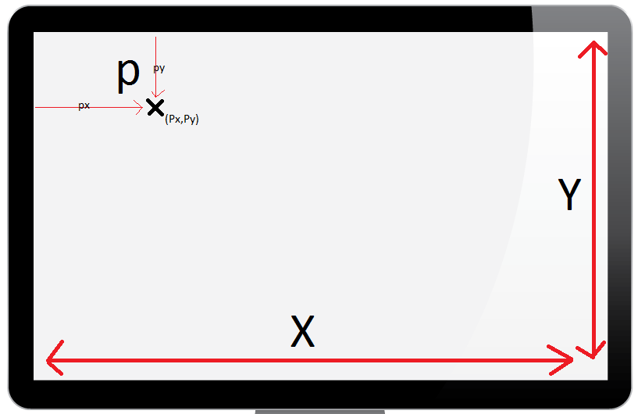
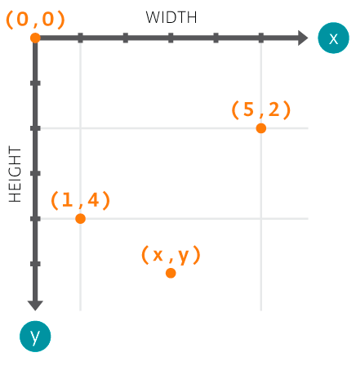
width
height
height
width

Slide 18
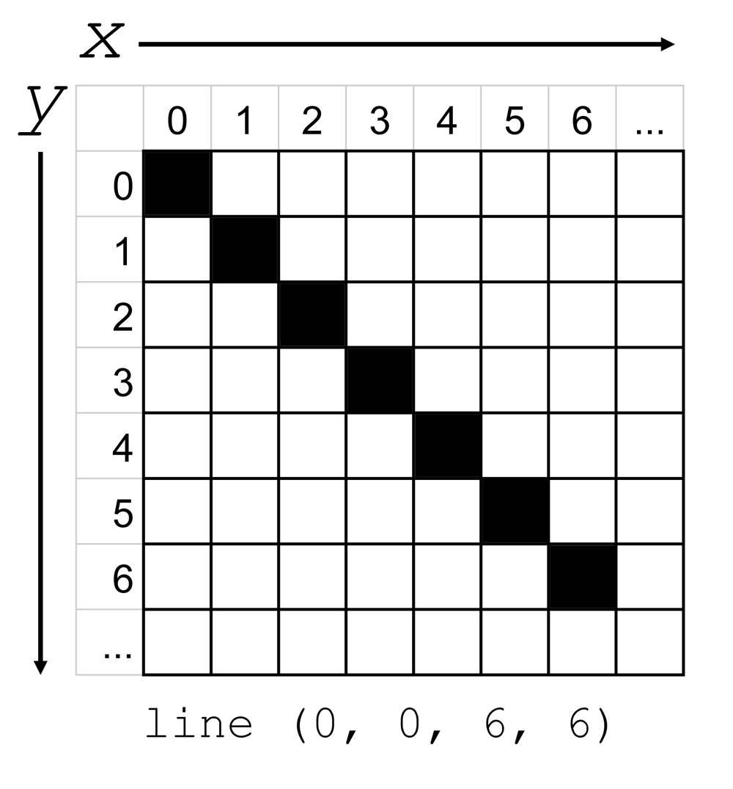
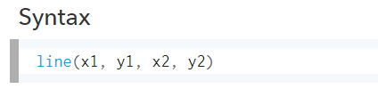
line(0, 50, 100, 50);
A
B
(x1,y1)
(x2,y2)

Slide 19
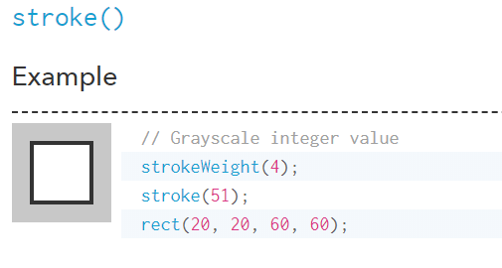

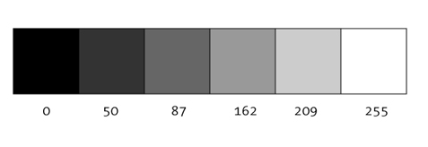

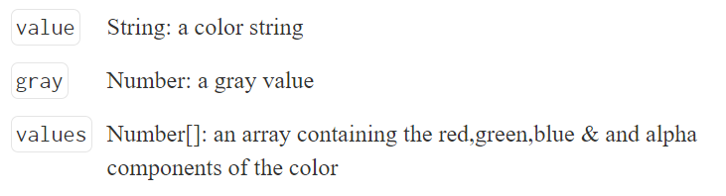
GRAY SCALE
background(127)
Syntax
strokeWeight(value)
stroke(value)
stroke(color)

Slide 20
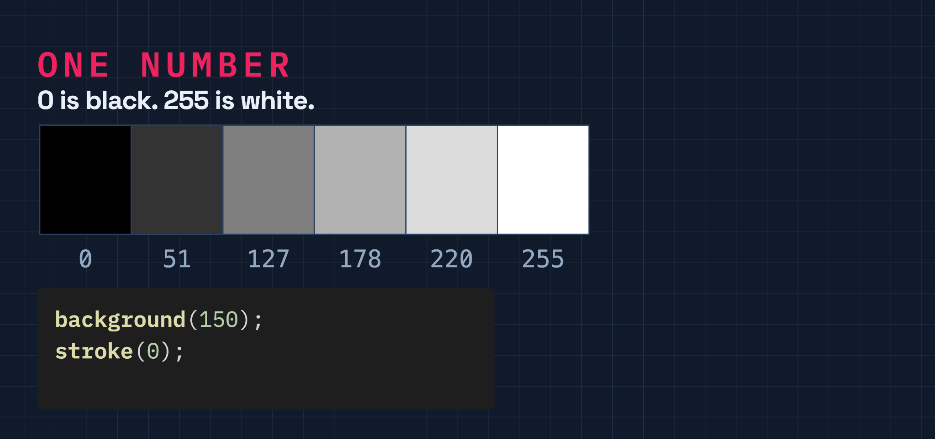

Slide 21
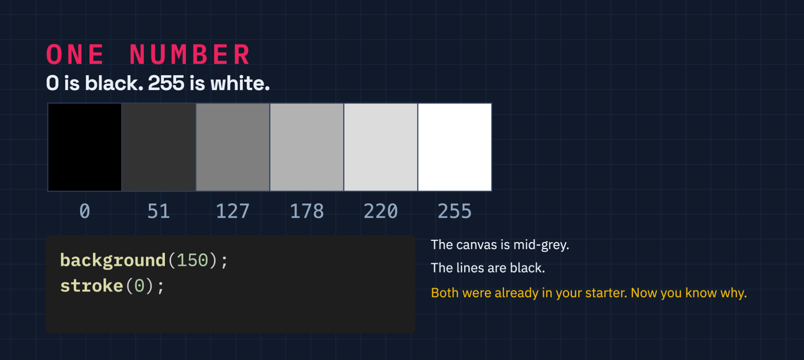

Slide 22
Complete MP1CW1 - Lines

Slide 23
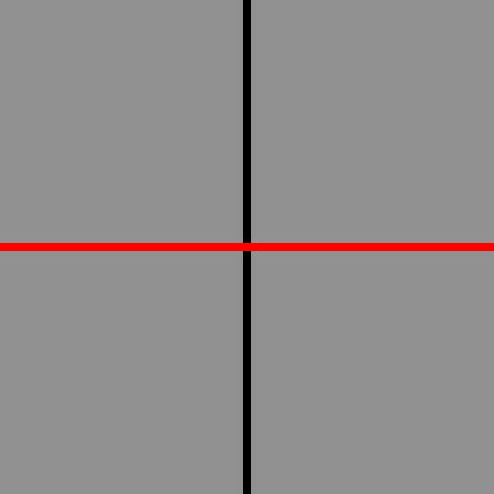
Let’s do it together!
400px
stroke(0)
strokeWeight(5)
line(width/2,0,width/2,height);
……..
………
400px
stroke(‘red’)
line(0,height/2,width, height/2)

Slide 24


Slide 25
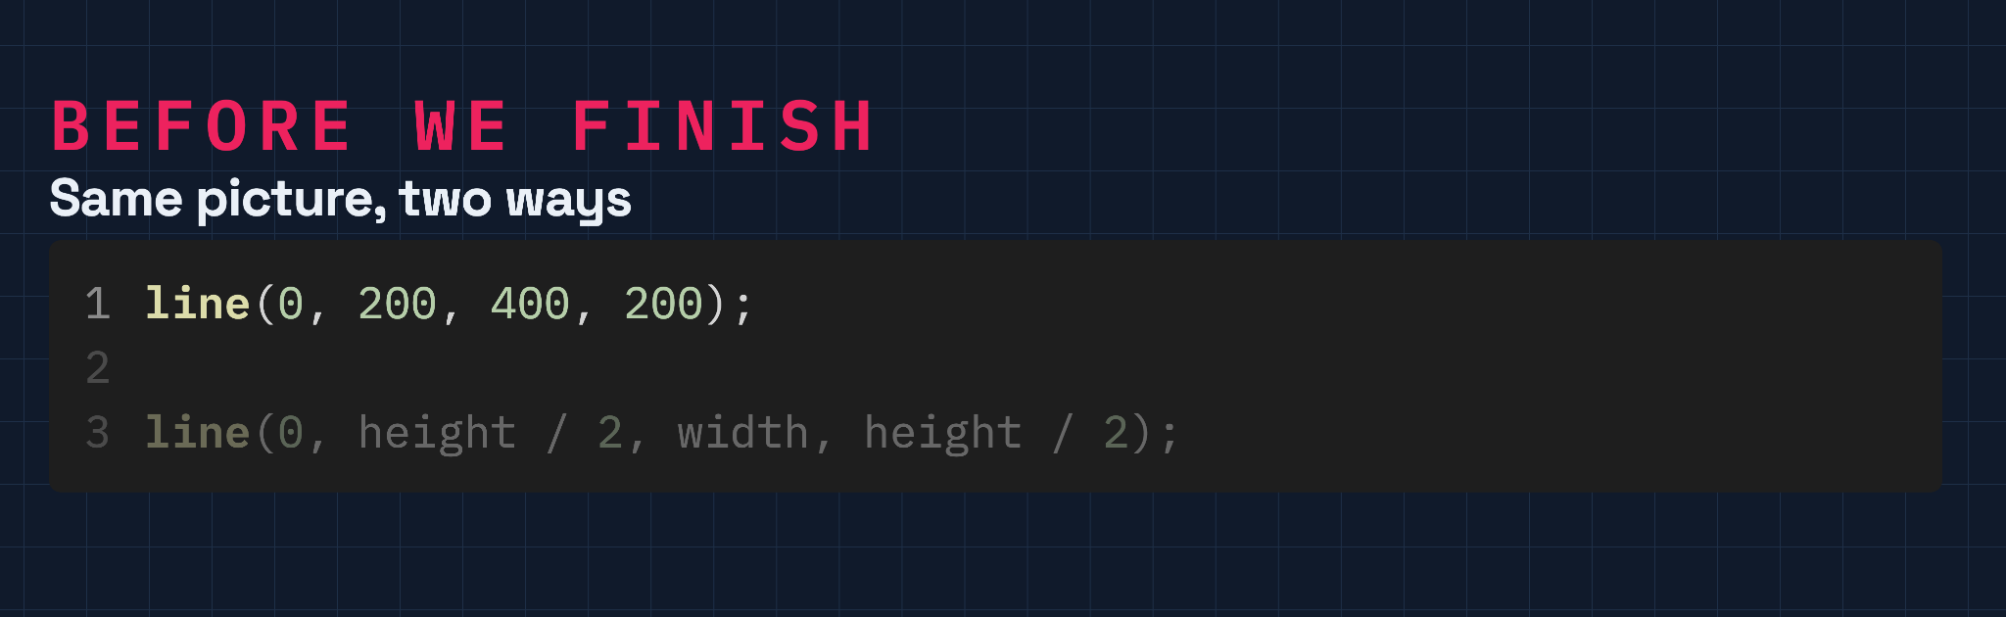

Slide 26
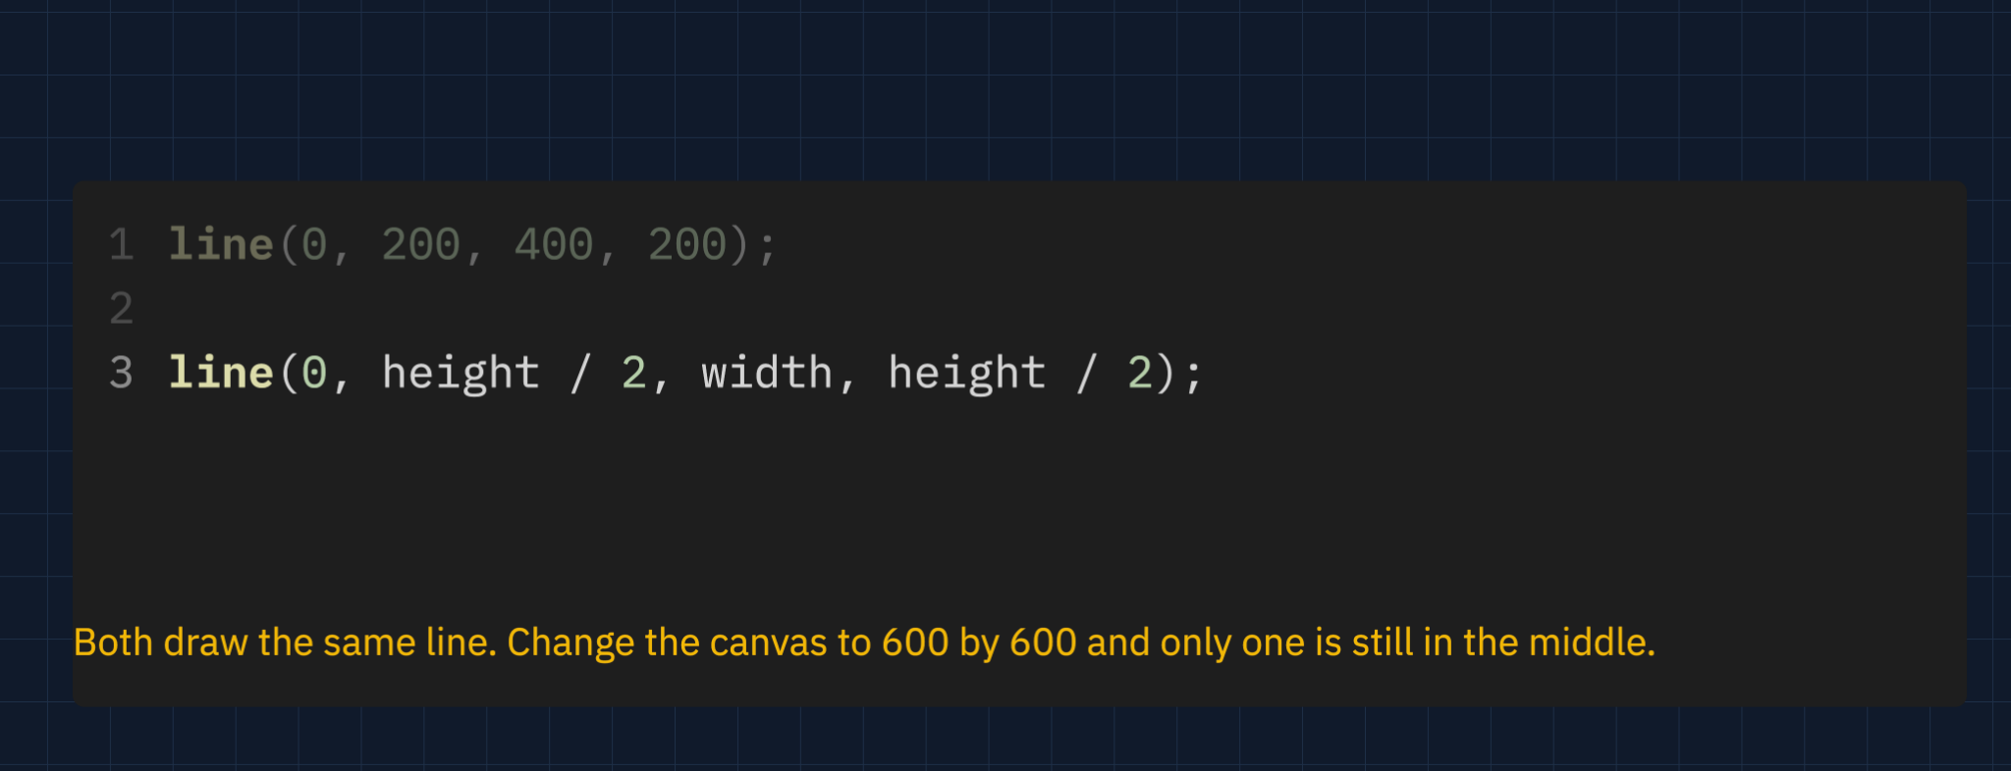

Slide 27
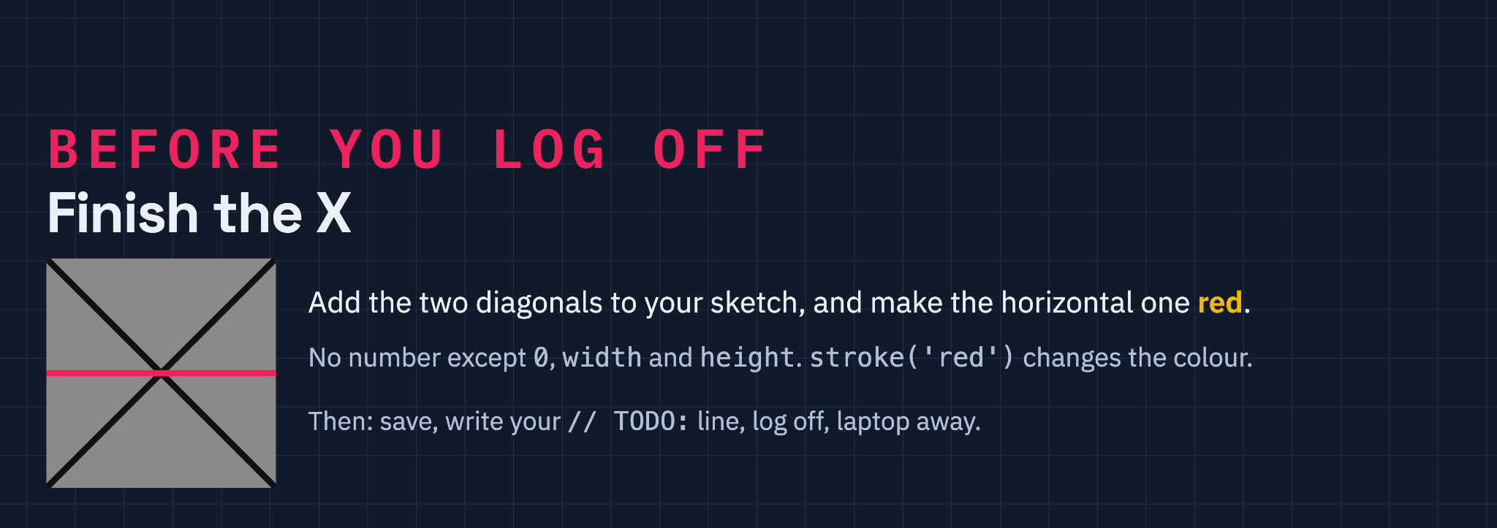

Slide 28
