Slide 1



We will be able to:
You can work out where a rectangle ends, not just where it starts
You can switch between CORNER and CENTER, and say why
You have built the rocket and shared the link

Slide 2
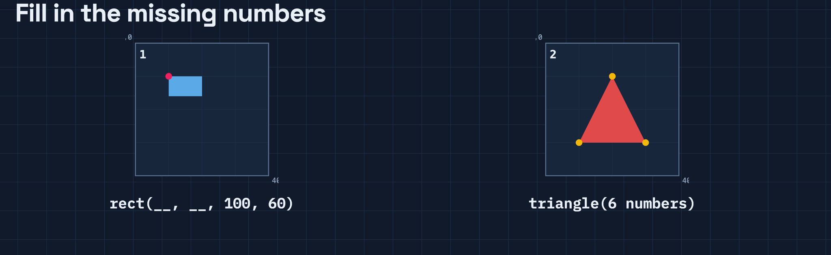

Slide 3
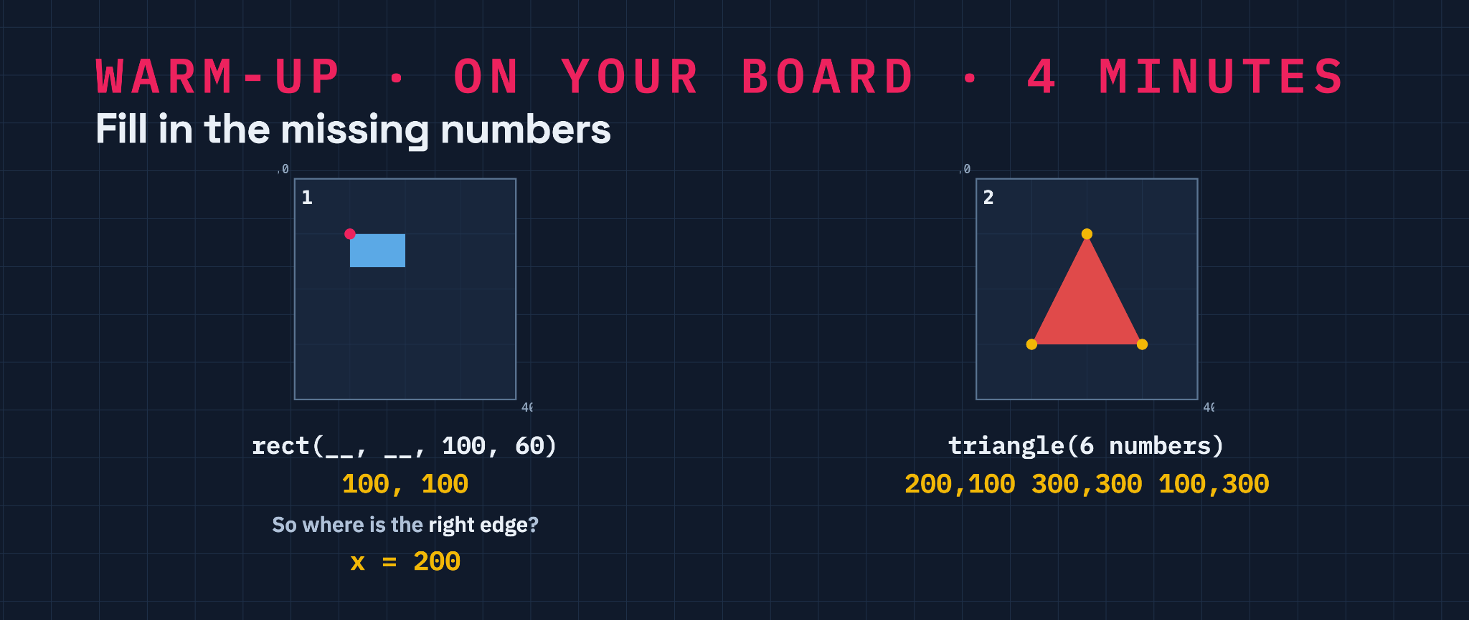

Slide 4
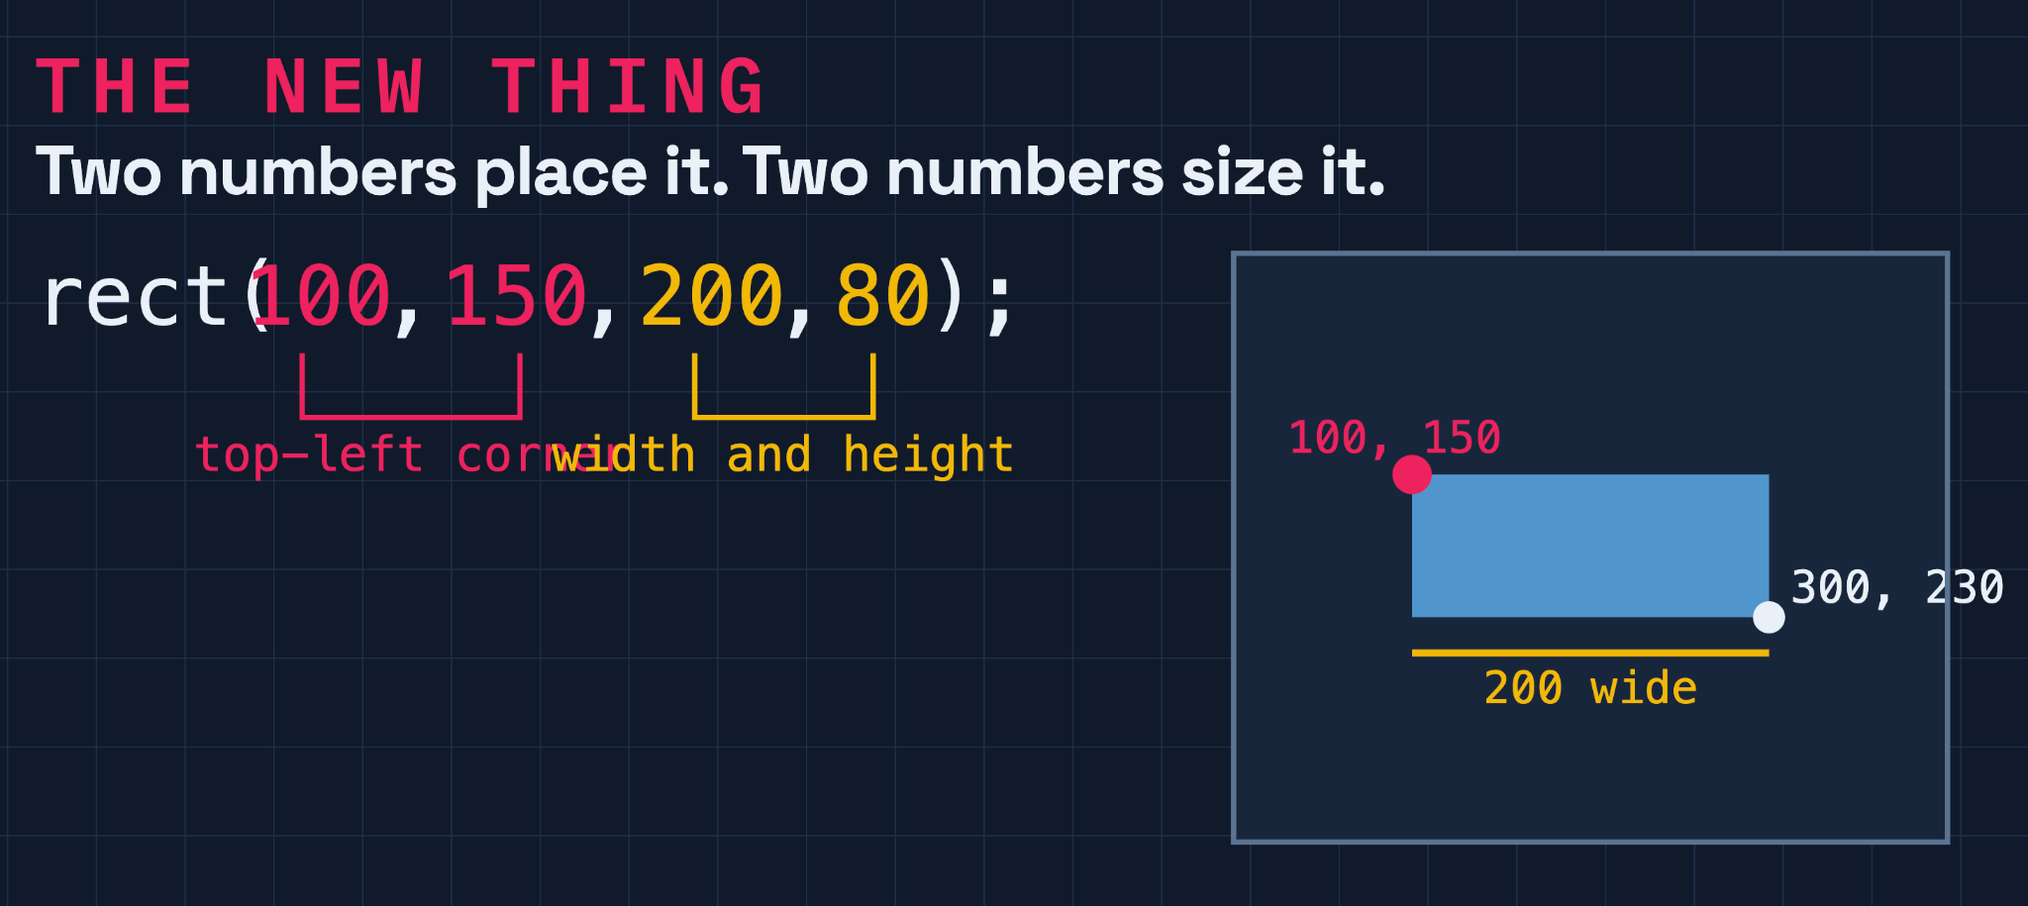

Slide 5
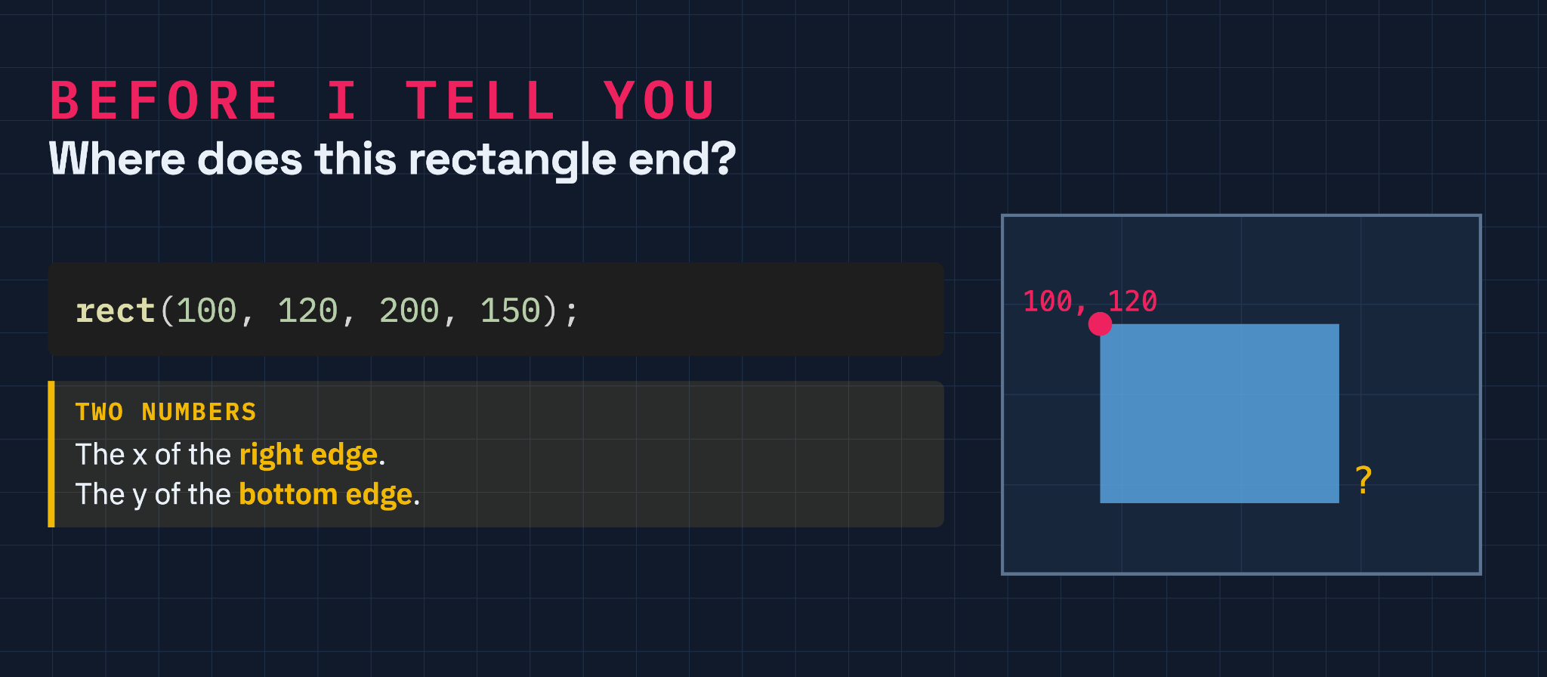

Slide 6
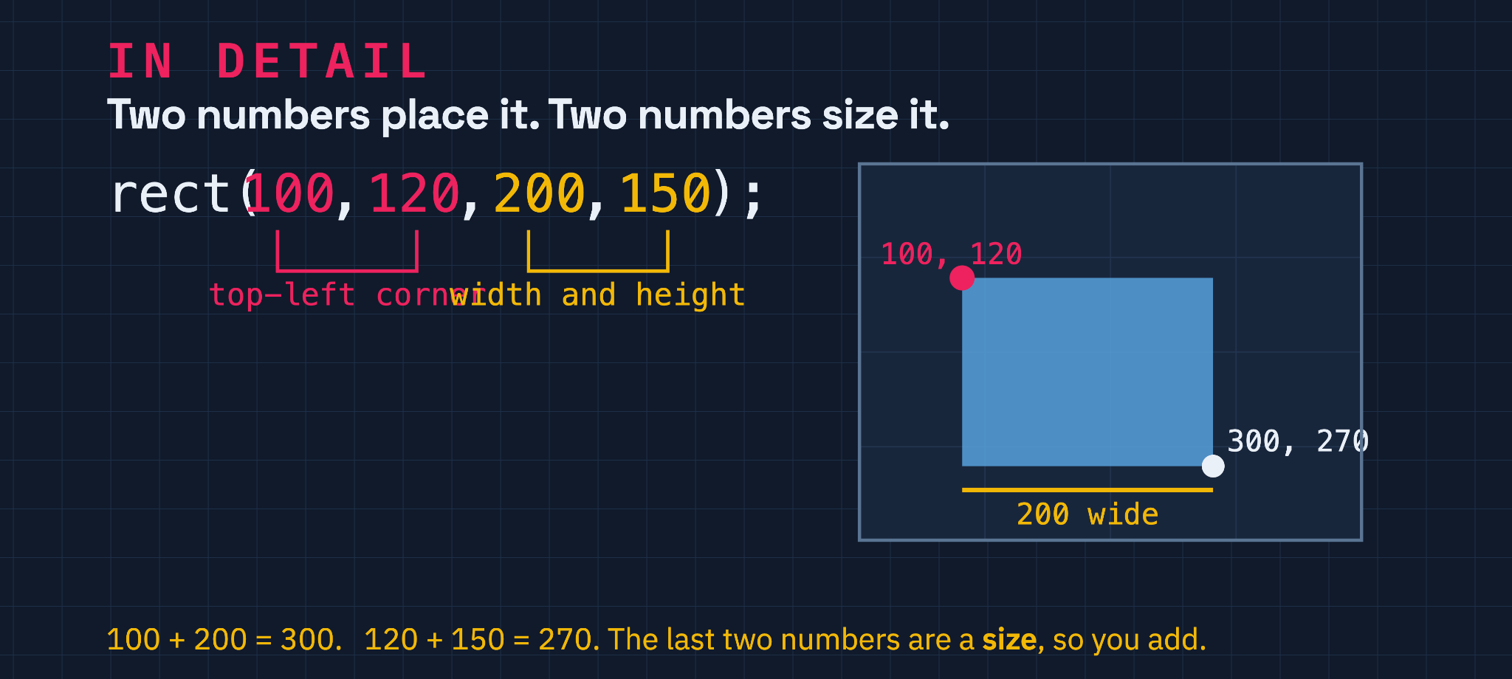

Slide 7
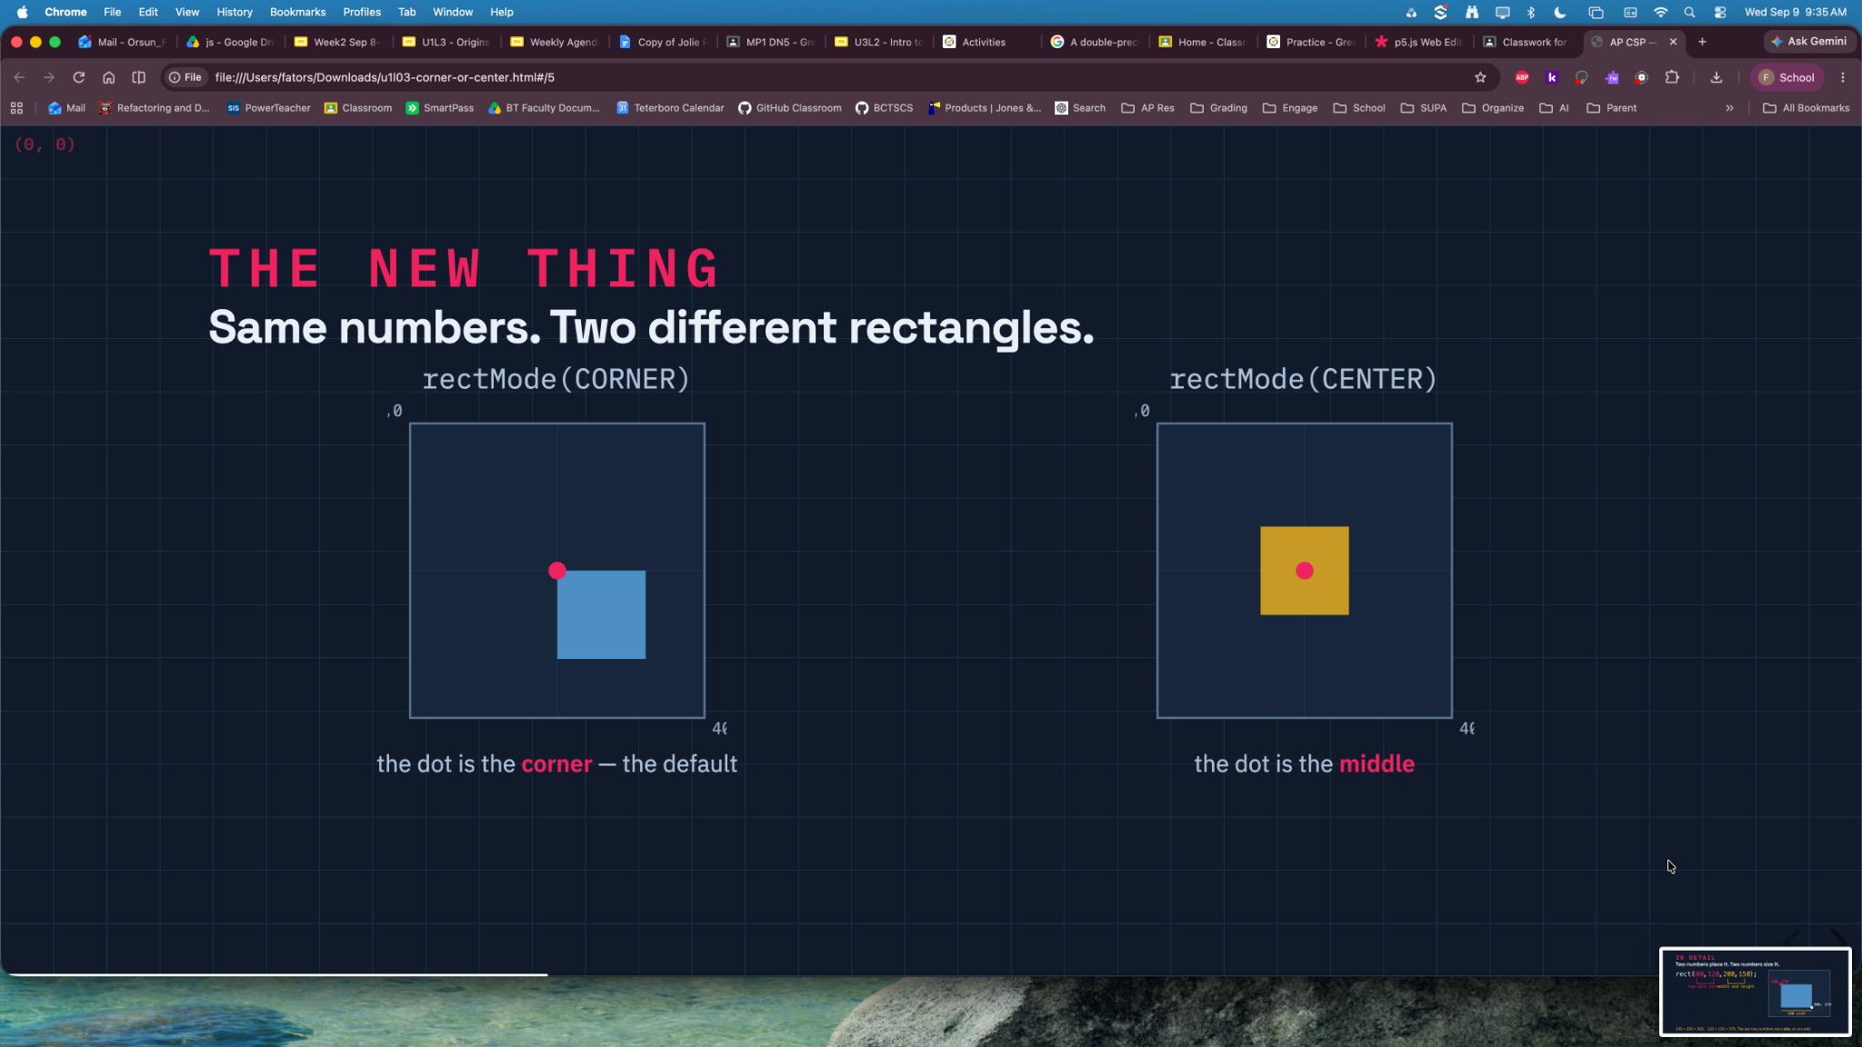

Slide 8
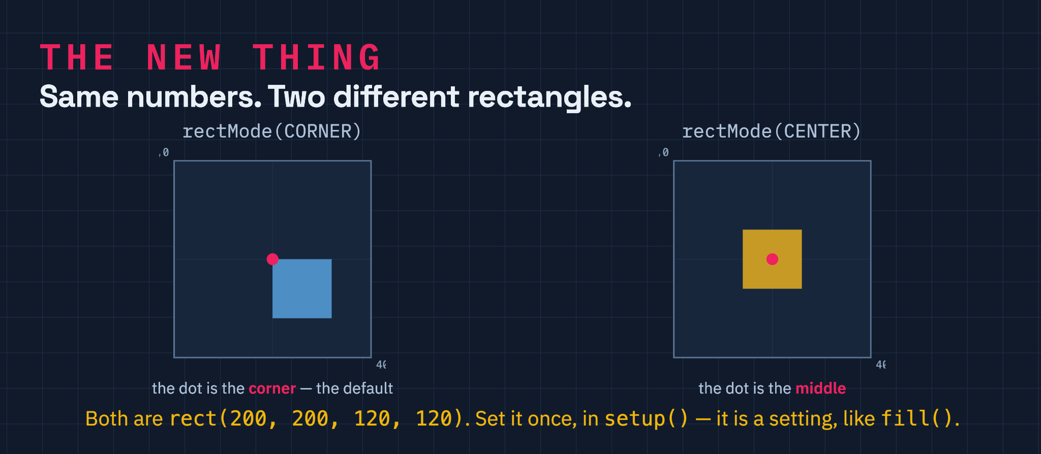

Slide 9
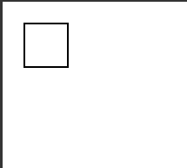
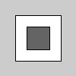
rectMode(CORNER); // Default rectMode is CORNER
fill(255); // Set fill to white
rect(25, 25, 50, 50); // Draw white rect using CORNER mode
The default mode is rectMode(CORNER), which interprets the first two parameters of rect() as the upper-left corner of the shape, while the third and fourth parameters are its width and height.
rectMode(CENTER); // Set rectMode to CENTER
fill(100); // Set fill to gray
rect(50, 50, 30, 30); // Draw gray rect using CENTER mode
rectMode(CENTER) interprets the first two parameters of rect() as the shape's center point, while the third and fourth parameters are its width and height.

Slide 10
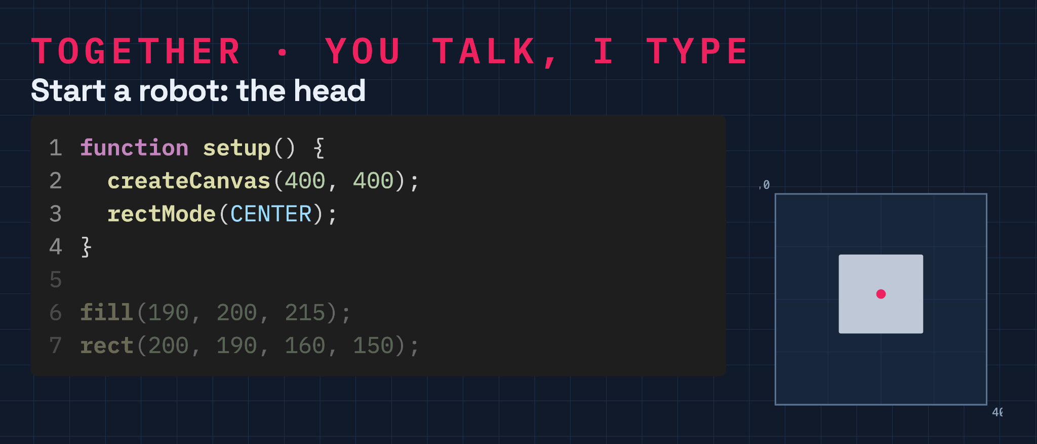

Slide 11
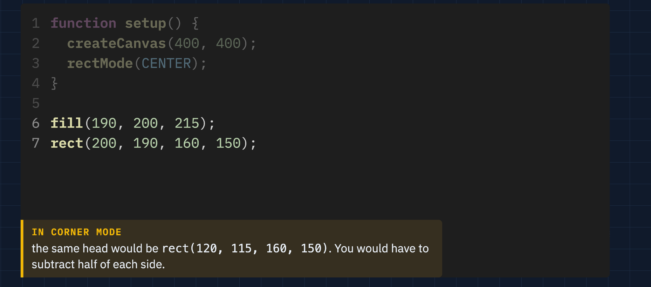

Slide 12
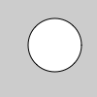
ellipse()
ellipse(x, y, width,height)
circle(x, y, radius)
x: x-coordinate of the ellipse
y: y-coordinate of the ellipse
width: width of the ellipse
height: height of the ellipse

Slide 13

ellipseMode(CENTER); // Set ellipseMode to CENTER
fill(100); // Set fill to gray
ellipse(50, 50, 30, 30); // Draw gray ellipse using CENTER mode
30
The default mode is ellipseMode(CENTER), which interprets the first two parameters of ellipse() as the shape's center point, while the third and fourth parameters are its width and height.
ellipseMode(RADIUS); // Set ellipseMode to RADIUS
fill(255); // Set fill to white
ellipse(50, 50, 30, 30); // Draw white ellipse using RADIUS mod
30
ellipseMode(RADIUS) also uses the first two parameters of ellipse() as the shape's center point, but uses the third and fourth parameters to specify half of the shapes's width and height.

Slide 14
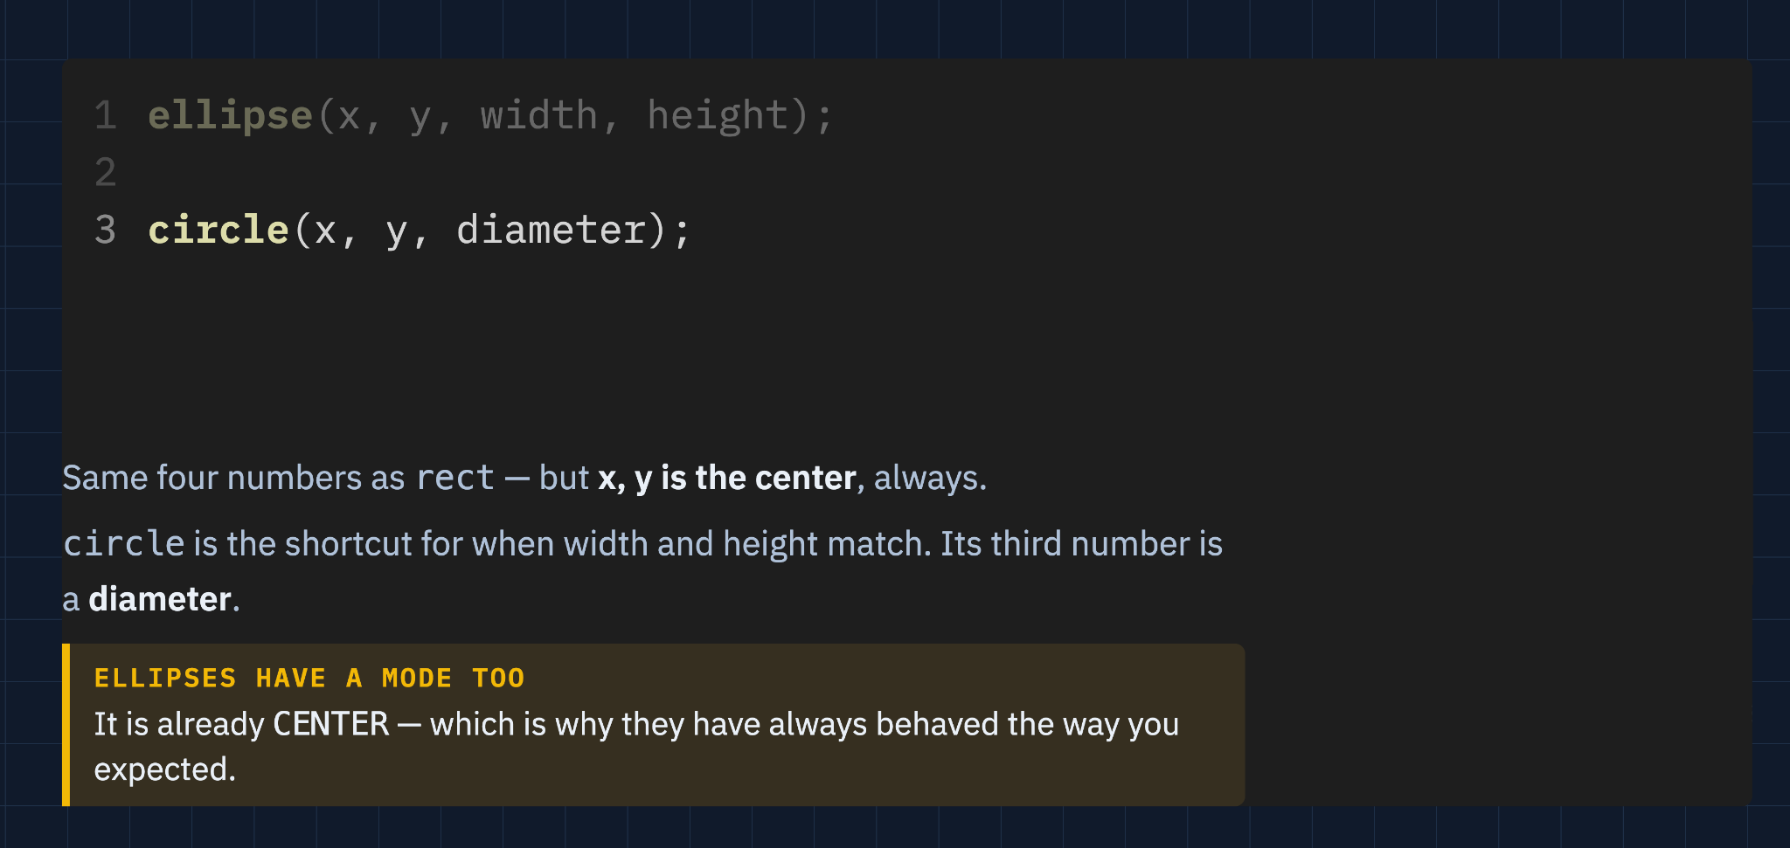

Slide 15
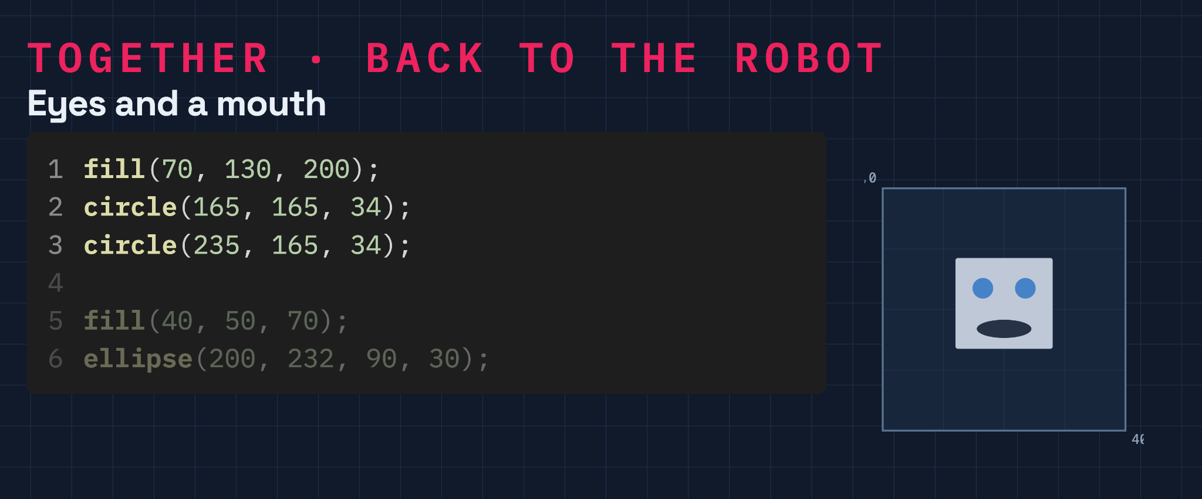

Slide 16
