Slide 1



We will be able to:
handle program events when the mouse is moved.

Slide 2
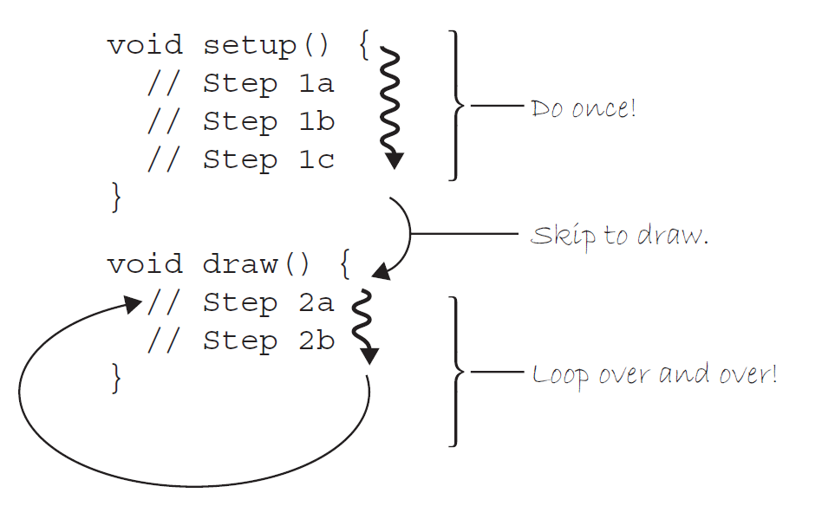
SETUP() & DRAW() FUNCTIONS
function
How does it work?
When we run the program, it will follow our instructions precisely, executing the steps in setup( ) first, and then move on to the steps in draw( ).
The order ends up being something like:
1a, 1b, 1c, 2a, 2b, 2a, 2b, 2a, 2b, 2a, 2b, 2a, 2b, 2a, 2b …
function

Slide 3
Let’s create!
How you write a variable
let landerY=90;
Make a name
Use one when
the number has to change while the sketch runs
the same number appears in several places

Slide 4
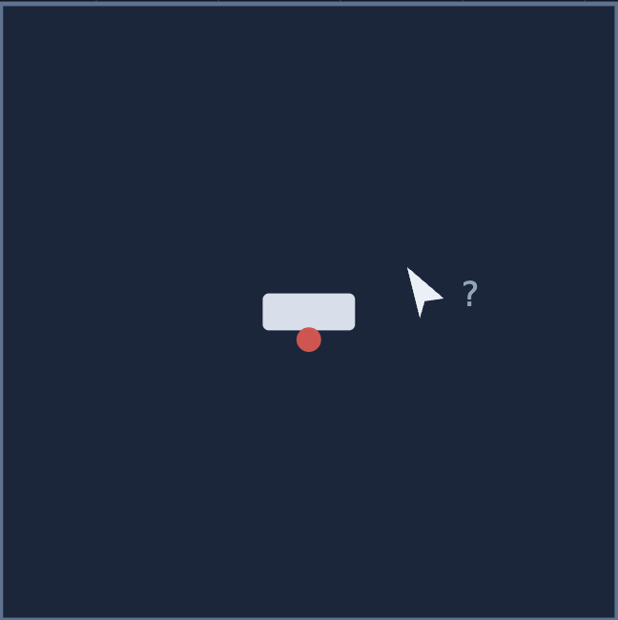
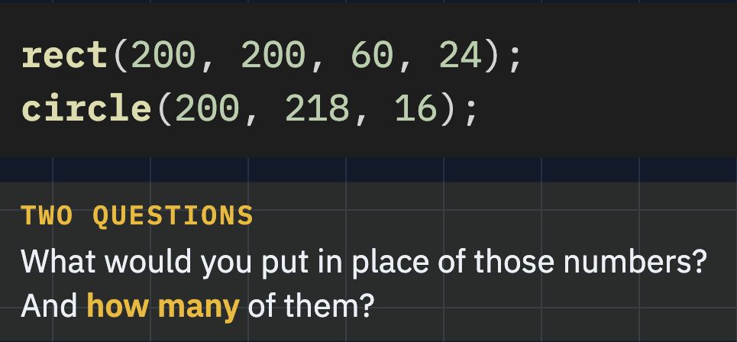
Let’s create!

Slide 5
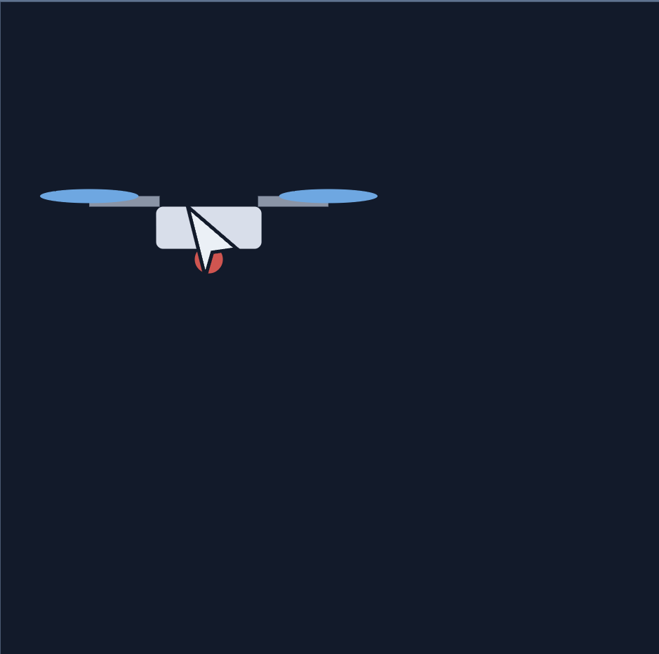
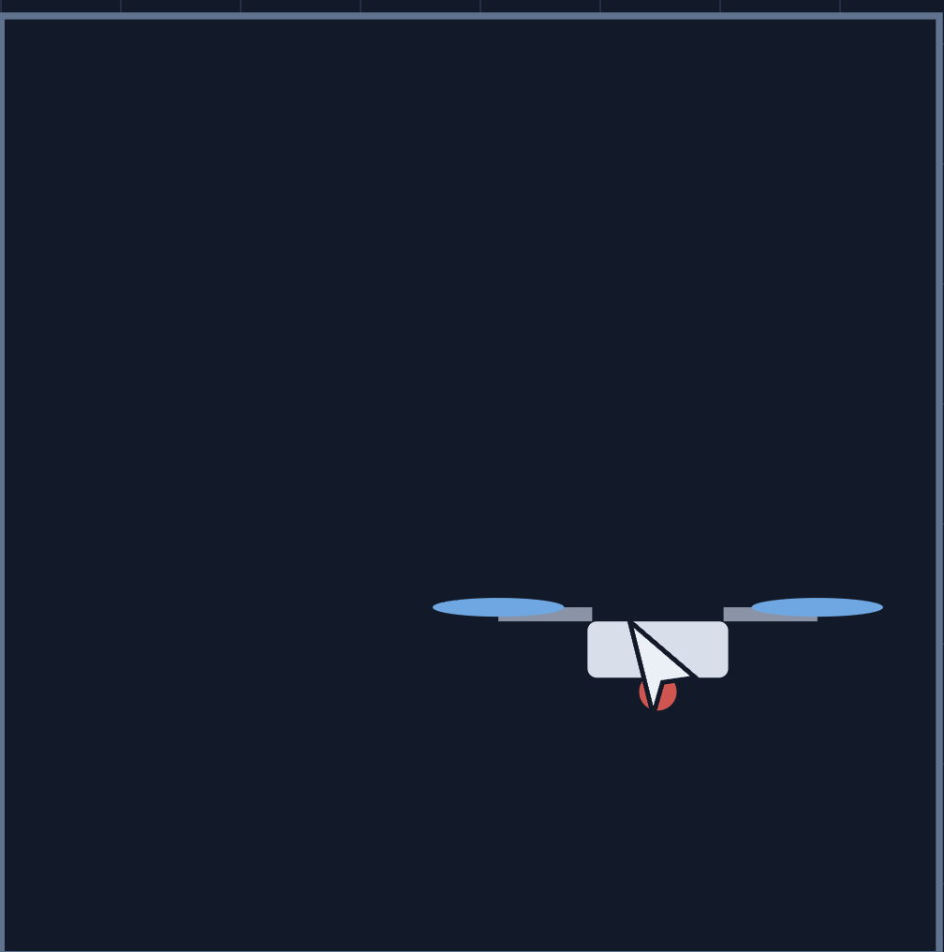

Slide 6
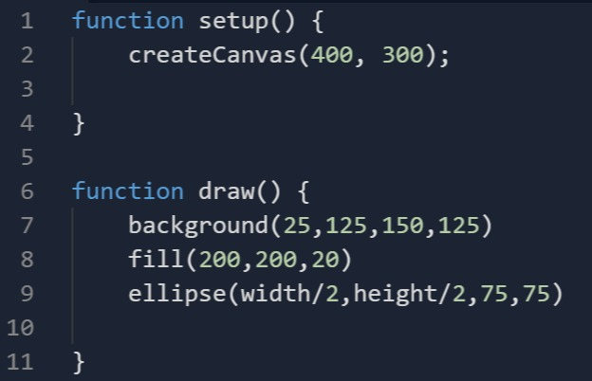

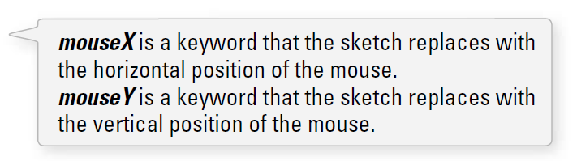
Replace width/2 with mouseX
Replace height/2 with mouseY
mouseX
mouseY

Slide 7
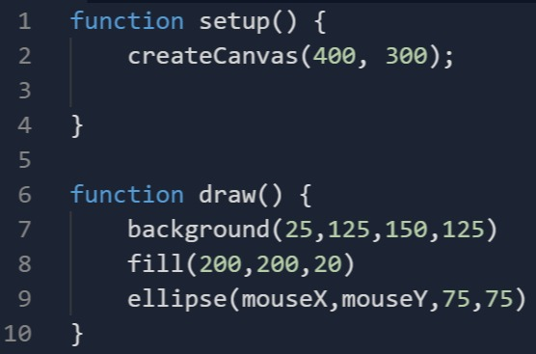
mouseX() & mouseY
Try moving background()
from draw() to setup() and see the difference!

Slide 8
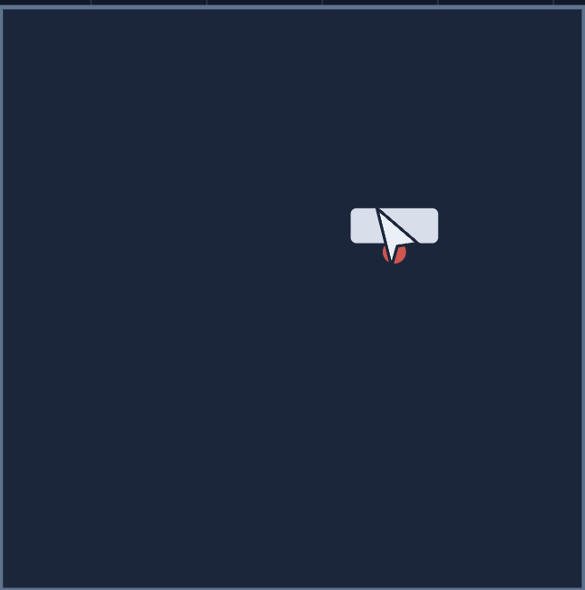
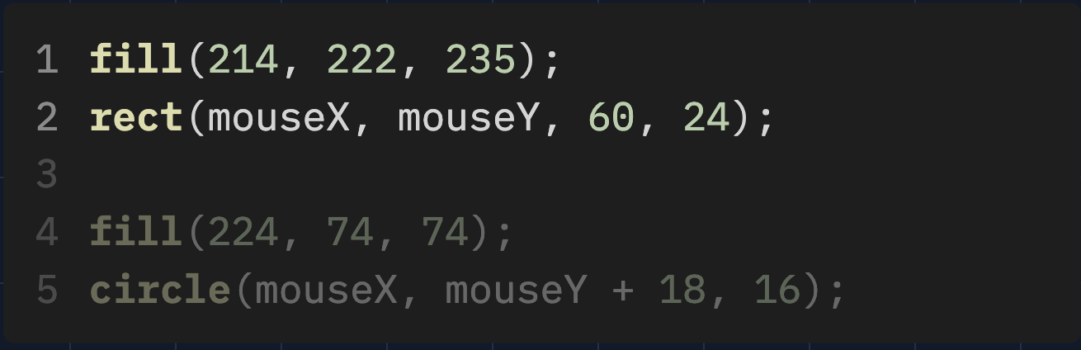

Slide 9
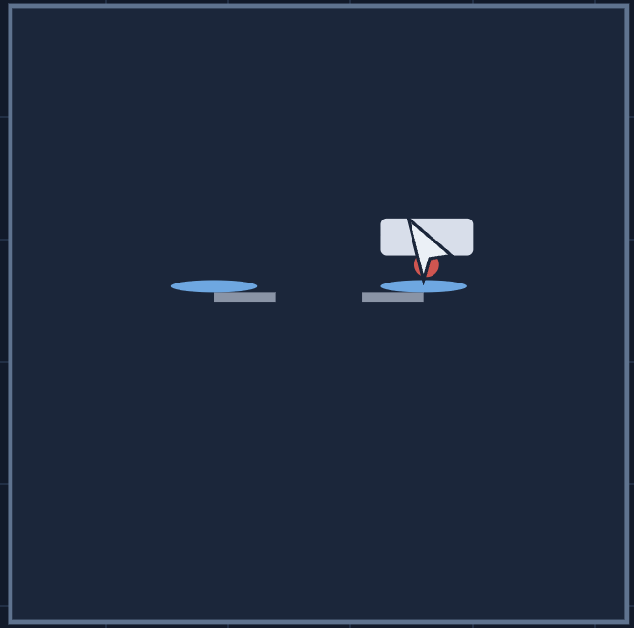
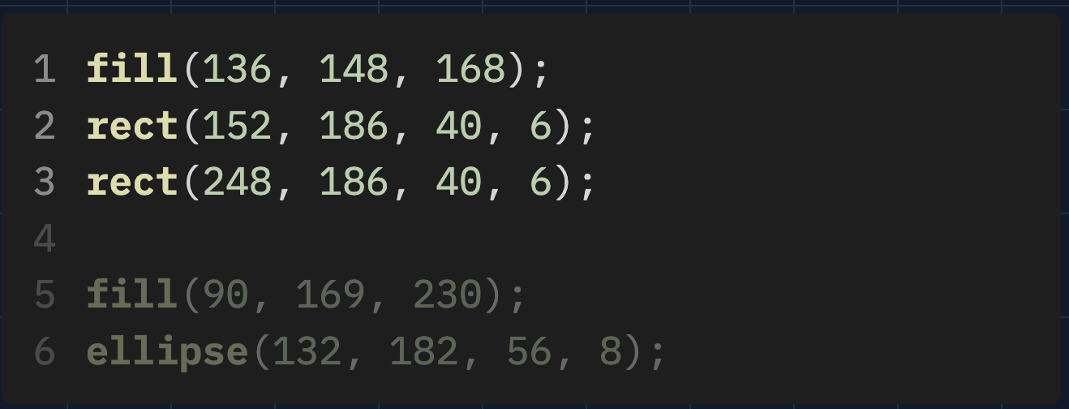

Slide 10
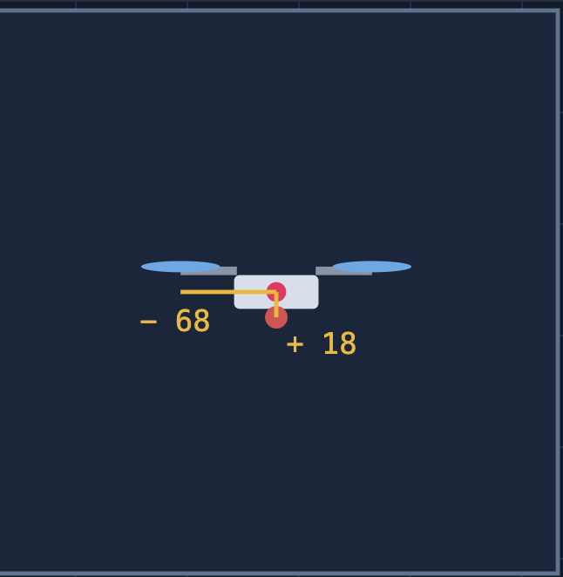
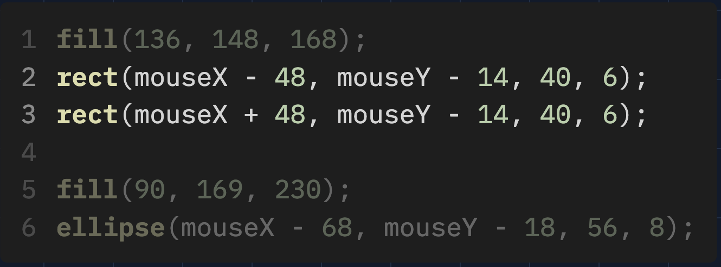

Slide 11
Extensions
Draw a camera light and spot on the ground: same x, but always at y = 370
Draw a shadow on the ground: same x, but always at y = 370
Add a second drone that stays 100 to the left of the first
Make the rotors wider than they are — only two numbers change

Slide 12

A game begins with a set of initial conditions:
your name
your character
score of zero
Start on level one
Let’s think of this part as the program’s SETUP. After these conditions are initialized, you begin to play the game.
At every instant,
the computer checks what you are doing with the mouse
calculates all the appropriate behaviors for the game characters
and updates the screen to render all the game graphics.
This cycle of calculating and drawing happens over and over again, ideally 30 or more times per second for a smooth animation.
GAMES

Slide 13
FLYING DRONE (mouseX,mouseY)
 | x | y
A
B
C
D
E
mouseX
mouseY
E
D
B
A
C
mouseX-48
mouse-14
mouseX+48
mouse-14
mouseX+68
mouseY-18
mouseX-68
mouseY-18

Slide 14

mouseX
mouseY
pmouseX
pmouseY
random()
frameRate()

Slide 15

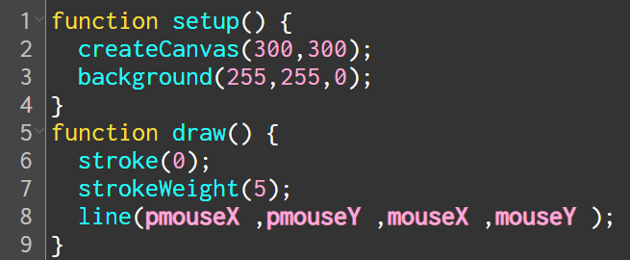
pmouseX & pmouseY
Previous mouse location

