Slide 1



We will be able to:
Use mouseIsPressed built-in boolean variable to create mouse click reactions.
Use keyIsPressed built-in boolean variable to create key press reactions.

Slide 2

mouseX
mouseY
pmouseX
pmouseY
random()
frameRate()

Slide 3
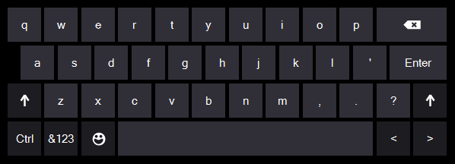
KEYBOARD CONTROL
P5 REFERENCE
keyIsPressed
key
keyCode
keyPressed()
keyReleased()
keyTyped()
keyIsDown()

Slide 4
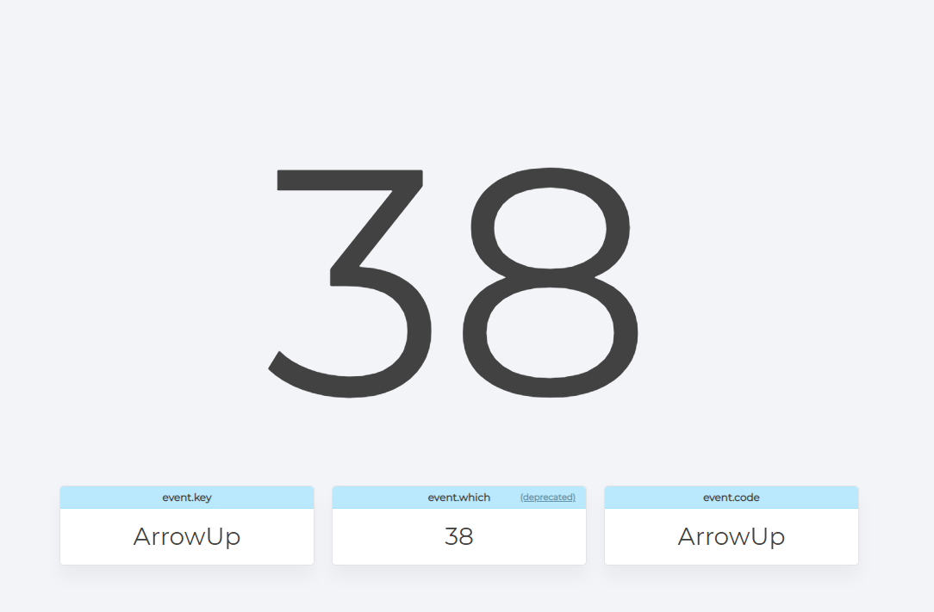
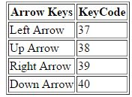
www.keycode.info

Slide 5
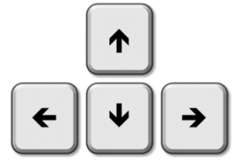
KEYBOARD CONTROL
function keyPressed() {
if (keyCode == UP_ARROW) {
//execute code
} else if (keyCode == DOWN_ARROW) {
//execute code
}
}

Slide 6
KEYBOARD CONTROL
function keyPressed() {
if (keyCode == 38) {
//execute code
} else if (keyCode == 40) {
//execute code
}
}
38
37
39
40

Slide 7
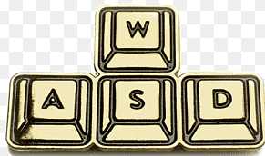
KEYBOARD CONTROL
function keyPressed() {
if (keyCode == 38) {
//execute code
} else if (keyCode == 40) {
//execute code
}
}
87
65
68
83

Slide 8
Continuous Execution
If you have an object that moves, and you want several keys to be able to affect its behaviour simultaneously.
function draw() {
//Runs every single frame as long as the key stays held down.
if (keyIsPressed) {
if (key == 'w' || key == 'W') {
//execute code
}
else if (key == 's' || key == 'S') {
//execute code
}
}
Call out keyIsPressed
In the function draw()
This will continuously execute the code once the intended key is pressed.

Slide 9
KEYBOARD CONTROL
function keyPressed() {
if (keyCode == 38) {
if (car1.y - car1.h / 2 > 250) {
car1.y += -2;
}
} else if (keyCode == 40) {
if (car1.y + car1.h / 2 < 350) {
car1.y += 2;
}
}
}
38
37
39
40

Slide 10
Execute only when the key is down!
If you have an object that moves, and you want several keys to be able to affect its behaviour simultaneously.
function draw() {
keyPressed();
}
Call out keyPressed()
In the function draw()
function keyPressed() {
if (keyIsDown(38)) {
//execute code
} else if (keyIsDown(40)) {
//execute code
}
}
This will continuously execute the code only when the intended KEY is DOWN!

Slide 11

ANY QUESTION

