Slide 1
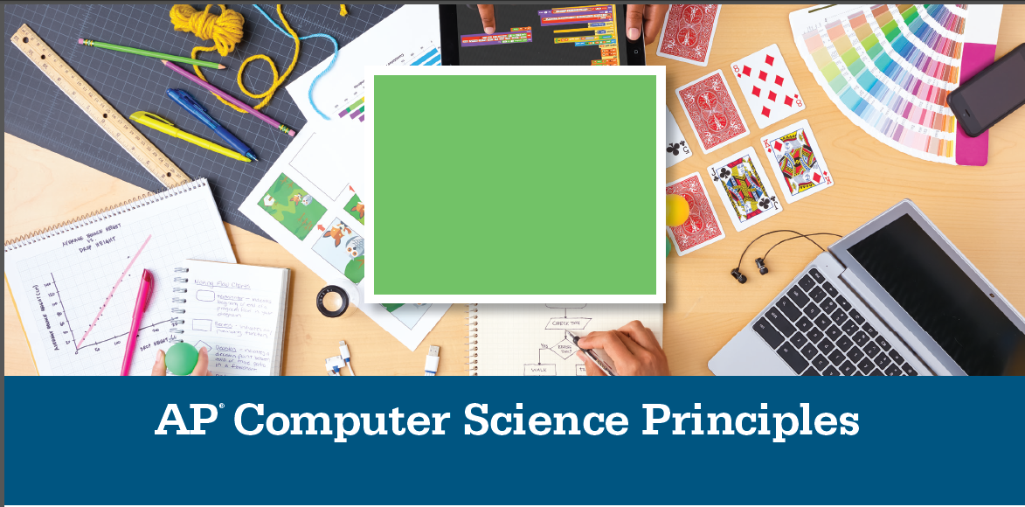


UNIT 3 - LESSON 07
Mouse and Key Press in P5

Slide 2



We will be able to:
Use mouseIsPressed built-in boolean variable to create mouse click reactions.
Use keyIsPressed built-in boolean variable to create key press reactions.

Slide 3
function mousePressed() & keyPressed()
function mousePressed( ){
background(random(256)
}
Triggers the code lines inside the function when mouse is pressed anytime.
function keyPressed( ){
background(255)
}
Triggers the code lines inside the function when any key is pressed anytime.

Slide 4
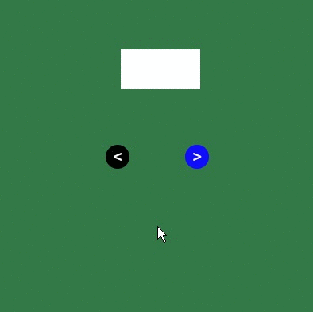
What does the following code do?
if (dist(mouseX, mouseY, 150, 200) < 15) {
x = x - 1
} else if ((dist(mouseX, mouseY, 250, 200) < 15)) {
x = x + 1
}
What if we want to click on the circles instead hover?
mouseIsPressed | A built-in variable that is True when the mouse button is pressed, and False when it is not pressed.
if(mouseIsPressed){
fill(‘black)
}

Slide 5
What if we want to click on the circles instead hover?
mouseIsPressed | A built-in variable that is True when the mouse button is pressed, and False when it is not pressed.
if (dist(mouseX, mouseY, 150, 200) < 15) {
if (mouseIsPressed) {
x = x - 1
}
} else if ((dist(mouseX, mouseY, 250, 200) < 15)) {
if (mouseIsPressed) {
x = x + 1
}
}

Slide 6

mouseX
mouseY
pmouseX
pmouseY
random()
frameRate()

Slide 7
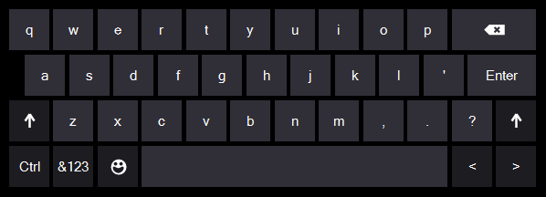
KEYBOARD CONTROL
P5 REFERENCE
keyIsPressed
key
keyCode
keyPressed()
keyReleased()
keyTyped()
keyIsDown()

Slide 8
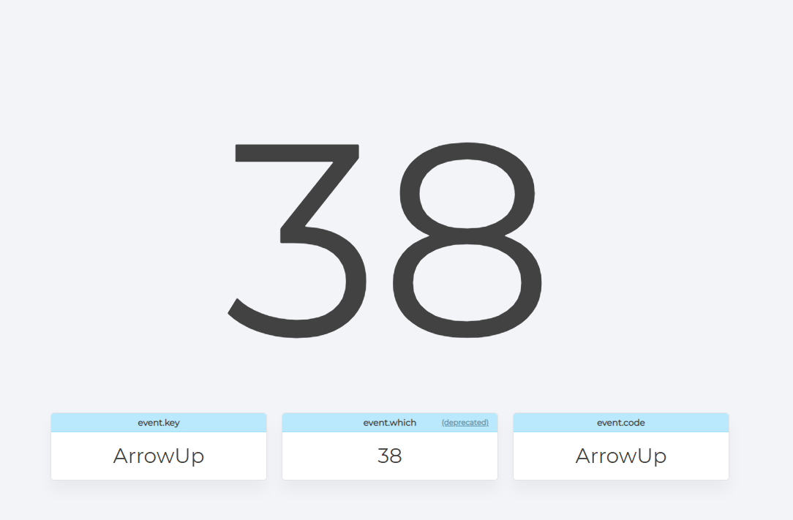
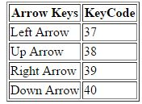
www.keycode.info

Slide 9
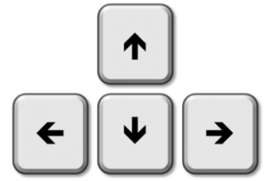
KEYBOARD CONTROL
function keyPressed() {
if (keyCode == UP_ARROW) {
//execute code
} else if (keyCode == DOWN_ARROW) {
//execute code
}
}

Slide 10
KEYBOARD CONTROL
function keyPressed() {
if (keyCode == 38) {
//execute code
} else if (keyCode == 40) {
//execute code
}
}
38
37
39
40

Slide 11
KEYBOARD CONTROL
function keyPressed() {
if (keyCode == 38) {
if (car1.y - car1.h / 2 > 250) {
car1.y += -2;
}
} else if (keyCode == 40) {
if (car1.y + car1.h / 2 < 350) {
car1.y += 2;
}
}
}
38
37
39
40

Slide 12
Continuous Execution
If you have an object that moves, and you want several keys to be able to affect its behaviour simultaneously.
function draw() {
keyPressed();
}
Call out keyPressed()
In the function draw()
function keyPressed() {
if (keyCode == 38) {
//execute code
} else if (keyCode == 40) {
//execute code
}
}
This will continuously execute the code once the intended key is pressed.

Slide 13
Execute only when the key is down!
If you have an object that moves, and you want several keys to be able to affect its behaviour simultaneously.
function draw() {
keyPressed();
}
Call out keyPressed()
In the function draw()
function keyPressed() {
if (keyIsDown(38)) {
//execute code
} else if (keyIsDown(40)) {
//execute code
}
}
This will continuously execute the code only when the intended KEY is DOWN!

Slide 14
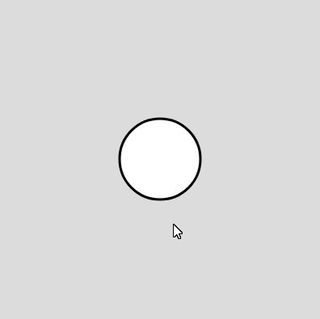
When you click on the circle, you can drag it around.
function setup() {
createCanvas(400, 400)
}
function draw() {
background(220)
strokeWeight(3)
circle(width/2,height/2,100)
}
mouseX
mouseY
pmouseX
pmouseY
isMousePressed

Slide 15
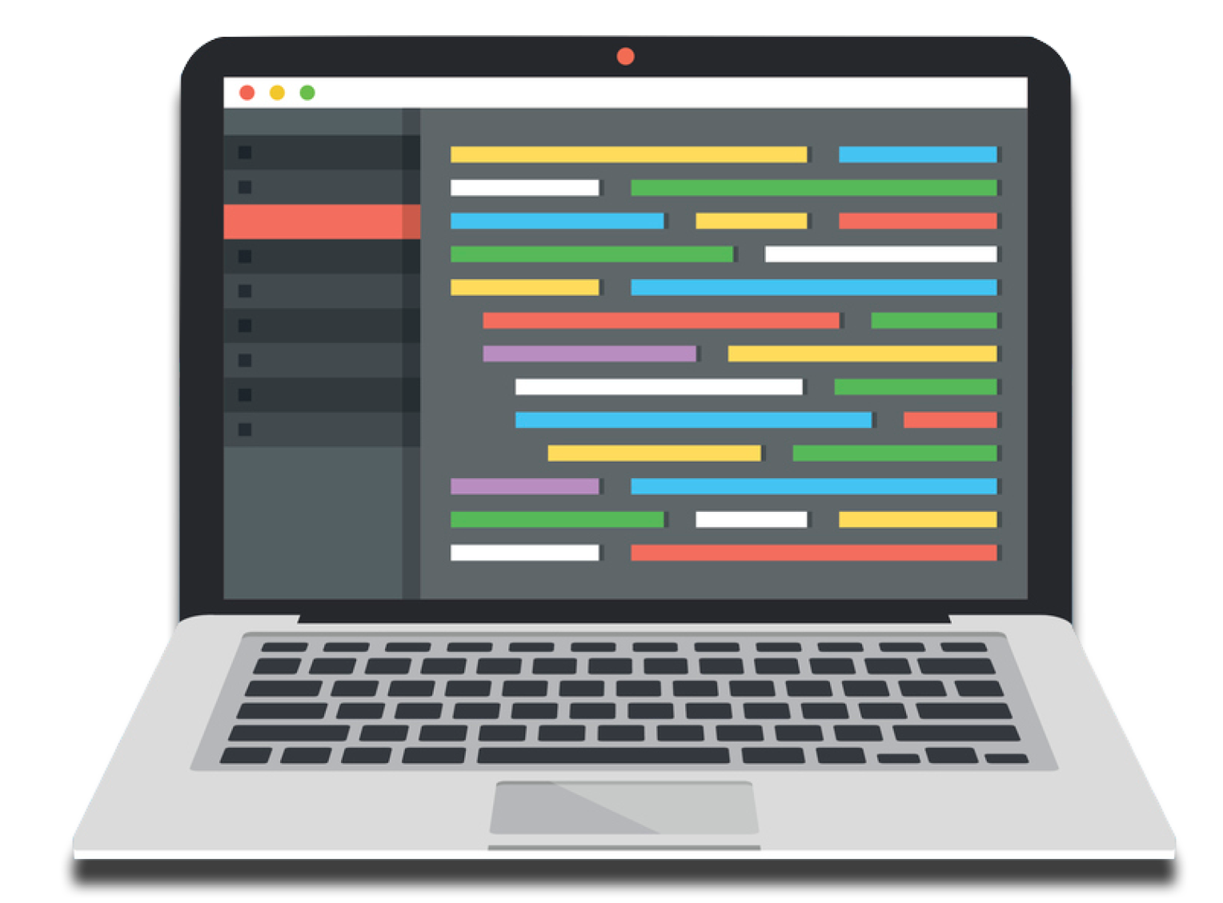
When you click on the circle, you can drag it around.
function setup() {
createCanvas(400, 400)
}
function draw() {
background(220)
strokeWeight(3)
circle(width/2,height/2,100)
}
mouseX
mouseY
pmouseX
pmouseY
isMousePressed

Slide 16
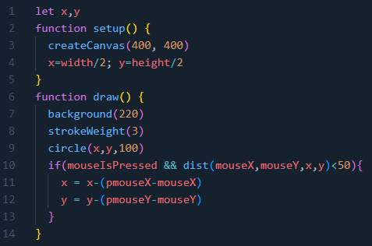
mouseX
mouseY
pmouseX
pmouseY
isMousePressed

Slide 17
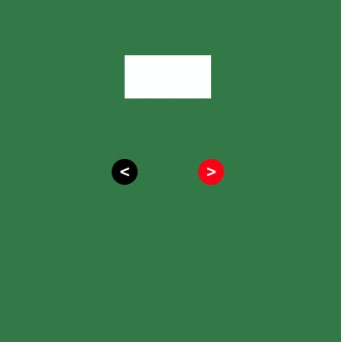
U
D
B
S
https://keycode.info/
Up Down Bigger Smaller
keyIsPressed | A built-in variable that is True when a key is pressed, and False when not pressed.
key | The system variable key always contains the value of the most recent key on the keyboard that was typed
if (keyIsPressed && key == 'u') {
y = y - 1
}
Figure it out!
D
B
S
Down Bigger Smaller

Slide 18
U
D
B
S
https://keycode.info/
Up Down Bigger Smaller
keyIsPressed | A built-in variable that is True when a key is pressed, and False when not pressed.
key | The system variable key always contains the value of the most recent key on the keyboard that was typed
if (keyIsPressed && key == 'u') {
y = y - 1
} else if (keyIsPressed && key == 'd') {
y = y + 1
}else if(keyIsPressed && key == 'b'){
w = w + 1
h = h + 1
}else if(keyIsPressed && key == 's'){
w = w - 1
h = h - 1
}

Slide 19


150
250
What does the following code do?
200
if (dist(mouseX, mouseY, 150, 200) < 15) {
x = x - 1
} else if ((dist(mouseX, mouseY, 250, 200) < 15)) {
x = x + 1
}

Slide 20

150
250
What does the following code do?
200
if (dist(mouseX, mouseY, 150, 200) < 15) {
x = x - 1
} else if ((dist(mouseX, mouseY, 250, 200) < 15)) {
x = x + 1
}

Slide 21
let bgColor
let x, y, radius = 20
let lightColor = 'white'
function setup() {
createCanvas(400, 400)
bgColor = color(5, 20, 69)
ellipseMode(RADIUS)
}
function mousePressed(){
if (dist(mouseX, mouseY, 300, 150) < radius) {
lightColor = 'yellow'
bgColor = color(237,213,158)
} else if ((dist(mouseX, mouseY, 300, 200) < radius)) {
lightColor = 'white'
bgColor = color(5, 20, 69)
}
}

Slide 22

ANY QUESTION

Slide 23



