Slide 1
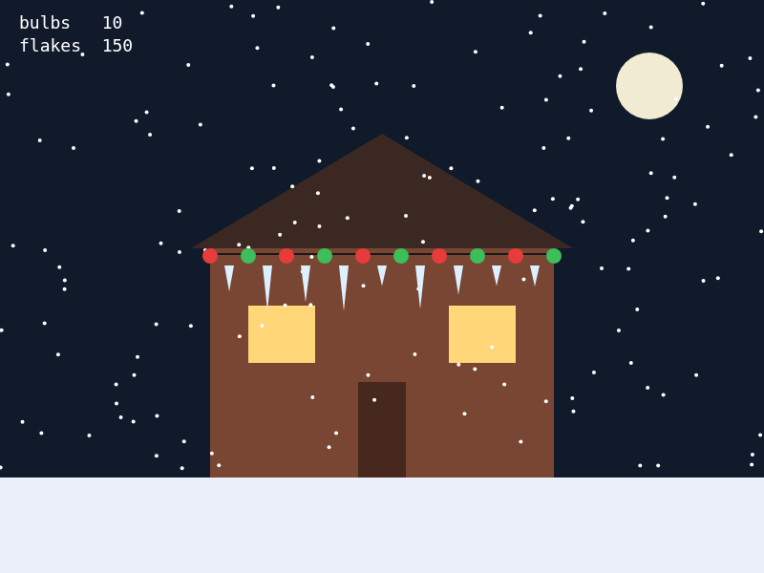
UNIT 3 · LESSON 1
Keep Going Until
while loops · repeat until a condition
Today's build
Notes:
41-minute lesson. Show the finished sketch. Ask: count the bulbs, now guess how many circle() lines I typed. Answer: one. That is today.

Slide 2
Today
01
The copy-paste problem
02
while loops
Why ten circle() lines is the wrong way
Start, question, body, update
03
REPEAT UNTIL
04
Build
The exam version is the opposite question
Light up the house: lights, icicles, snow
Notes:
One slide, 20 seconds. Four parts to the period. The build is the longest - about 12 minutes.

Slide 3
01
The copy-paste problem
Ten lines that differ by one number.
Notes:
Transition. Go straight to the next slide.

Slide 4
Here is how you would do it right now
circle(220, 268, 16);
circle(260, 268, 16);
circle(300, 268, 16);
circle(340, 268, 16);
circle(380, 268, 16);
circle(420, 268, 16);
circle(460, 268, 16);
circle(500, 268, 16);
circle(540, 268, 16);
circle(580, 268, 16);
THREE QUESTIONS
What is the only thing that changes from line to line?
By how much?
The house gets twice as wide. What do you have to do?
Notes:
3 min. Out loud. Q1: only x. Q2: 40 each time. Q3: type ten more lines, and change every one again if the spacing changes. Land it: the computer is good at doing the same thing over and over. You should not be.

Slide 5
02
while loops
Keep going while the question is true.
Notes:
Transition.

Slide 6
A loop repeats a block of code
let x = 220;
while (x <= 580) {
circle(x, 268, 16);
x = x + 40;
}
START
Before the loop. Never inside the braces.
let x = 220;
QUESTION
True? Go round again. False? Skip past.
(x <= 580)
BODY
The work you want repeated.
while means: as long as the question is true, do the braces again.
circle(...)
UPDATE
Moves x toward false.
x = x + 40;
Notes:
3 min. Four parts, and every while loop this unit has all four. The question is a Boolean, like Unit 2. while is an if that goes back up and asks again. Say that sentence twice.

Slide 7
How many times does the body run?
x | x <= 580? | bulb
220 | true | 1
260 | true | 2
300 | true | 3
… | … | …
540 | true | 9
580 | true | 10
620 | false | stop
COUNT THE QUESTIONS
The question was asked 11 times. The body ran 10 times.
PREDICT
Change <= to <. How many bulbs now? Which one disappears?
Notes:
3 min. Draw the table on the board; students call out each row. The red row matters most: the loop only ends because a check came back false, and that check costs a turn. Predict: 9 bulbs, the right-corner one goes (580 < 580 is false). Do not run it - it is the puzzle in the starter.

Slide 8
The whole loop finishes inside one frame
FRAME 1
FRAME 2
FRAME 3
all 10 bulbs
all 10 again, from scratch
… 60 times a second
So a while loop does not animate
draw() repeats over time. while repeats right now, before anything shows. You never see bulb 1, then bulb 2.
Notes:
2 min. Ask first: if I slowed this down, would you see the bulbs appear one at a time? Most say yes. No - p5 only shows the canvas when draw() ends, and draw() cannot end until the loop has.

Slide 9
A loop that never ends freezes the tab
let x = 220;
while (x <= 580) {
circle(x, 268, 16);
} // no update
Two rules
Save before you run a new loop.
Find the update line. Does it move x toward false?
x is 220 forever, so 220 <= 580 is true forever.
Frozen? Close the tab and reopen the editor. Your saved version is there.
Notes:
2 min. Do NOT run this. The tab stops responding and p5 never shows anything. The exam calls it an infinite loop (AAP-2.K). Second way to get one: x = x - 40, which moves away from false.

Slide 10
03
REPEAT UNTIL
The AP exam asks the opposite question.
Notes:
Transition.

Slide 11
REPEAT UNTIL is the opposite question
JAVASCRIPT · WHILE IT IS TRUE
AP EXAM · UNTIL IT IS TRUE
while (x <= 580) {
circle(x, 268, 16);
x = x + 40;
}
REPEAT UNTIL (x > 580)
{
circle(x, 268, 16)
x ← x + 40
}
REPEAT UNTIL (…) | while (…)
x > 580 | x <= 580
flakes = 150 | flakes != 150 or flakes < 150
lives = 0 | lives > 0
Notes:
2 min. Same loop, opposite question. while keeps going WHILE true; REPEAT UNTIL keeps going UNTIL true. The flip is the Unit 2 one: the opposite of > is <=, not <. Exam detail (AAP-2.K): if the condition is already met at the start, the body runs zero times.

Slide 12
Translate it
1
2
3
REPEAT UNTIL (y ≥ 600)
REPEAT UNTIL (count = 0)
REPEAT UNTIL (tries > 5)
while ( ________ )
while ( ________ )
while ( ________ )
Boards up. Flip the condition; watch the = sign.
Notes:
Optional, 1 min, if time. Answers: 1) while (y < 600) 2) while (count > 0) or count != 0 3) while (tries <= 5). Number 3 is the trap - the opposite of > is <=.

Slide 13
04
Build
Light up the house: u3l01-lights-starter.js
Notes:
Open the starter: class website > Unit 3 > Lesson 1. File > New, paste, rename to u3l01-lights, SAVE.

Slide 14
Five TODOs, five loops
1
The lights
4
Icicles
A bulb every 40 from HOUSE_LEFT to HOUSE_RIGHT. One on both corners.
One between every two bulbs. Predict: 9.
2
Count them
5
Snow
bulbs goes up by 1 each bulb. Readout: 10.
Written as REPEAT UNTIL (flakes = 150). Flip it.
3
Red, green
SAVE before every Run of a new loop
Use bulbs and % to pick the fill.
Notes:
12 min. TODO 1 is the slide-6 loop with names instead of numbers. TODO 2 is ONE line inside the loop. TODO 3 uses % from Unit 2. TODO 4 starts at HOUSE_LEFT + 20 and uses <. TODO 5: the opposite of flakes = 150 is flakes != 150; accept flakes < 150 too. WATCH FOR: bulbs + 1 after the loop (readout 1); color check after circle() (colors one behind); let len outside the loop (all icicles the same).

Slide 15
Check yourself
1
2
let x = 0; while (x < 100) { x = x + 25; }
Same loop with x <= 100
How many times does the body run?
How many times now?
3
4
REPEAT UNTIL (lives = 0)
let x = 900; while (x < 800) { … }
Write the while.
How many times?
Notes:
2 min. Answers: 1) 4 (x is 100 at the end). 2) 5 (x is 125). 3) while (lives > 0) or lives != 0. 4) 0 - the first check is false. Q4 is on the exam: a loop can run zero times.

Slide 16
Before you log off
Save your sketch
Last line of your file: // TODO: and what you would add next
Tomorrow: what if you already know exactly how many?
Notes:
1 min. Lights sketch due end of period or as homework. Tease: every loop today had a counter or an x you managed by hand. Tomorrow's loop (for) does that bookkeeping for you.

