Slide 1
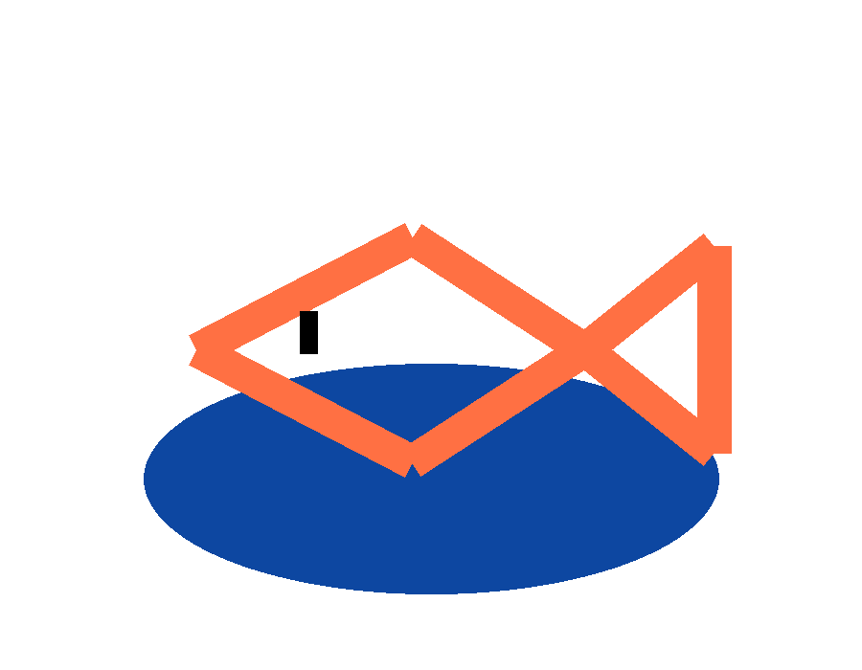
Rows of rows:
Ice Fishing
Unit 3 · Lesson 4
One loop draws a row of ice holes. A loop inside a loop draws the whole lake.
Notes:
RUN SHEET (41 min)
0-1 Preview: play the finished game (HTML deck) or show the screenshot.
1-3 WARM-UP: one row of holes. Copy it 3 times?
3-6 The new thing: a loop inside a loop.
6-9 TRACE TABLE: r stays, c runs, c resets.
9-11 LAB 1: a bigger lake - count the holes.
11-12 Which variable for what?
12-13 Two loops, two names.
13-15 The exam version: nested REPEAT n TIMES.
15-16 Same formula for the fish.
16-18 LAB 2: the jumping fish.
18-19 Catch it: mousePressed + if.
19-20 OPEN THE STARTER.
20-36 BUILD: lake TODOs 1-3, game TODOs 4-7.
36-39 Check yourself.
39-41 CED (point only), save, // TODO, log off.
IF BEHIND
1. Names slide - say it while they build.
2. Lab 2 - demo it yourself, do not hand it over.
Do NOT cut the trace table or the exam slide.
If the period runs out, TODOs 4-7 are homework. TODOs 1-3 are the
nested-loop part and must be done in class.
LABS
The two lab slides are static here. Run the code live from the HTML
deck (u3l04-rows-of-rows.html) or paste it into the p5 editor.
BEFORE CLASS
Post u3l04-icefishing-starter.js. Hold back the solution.
TURN IN
Ice Fishing (TODOs 1-7).

Slide 2
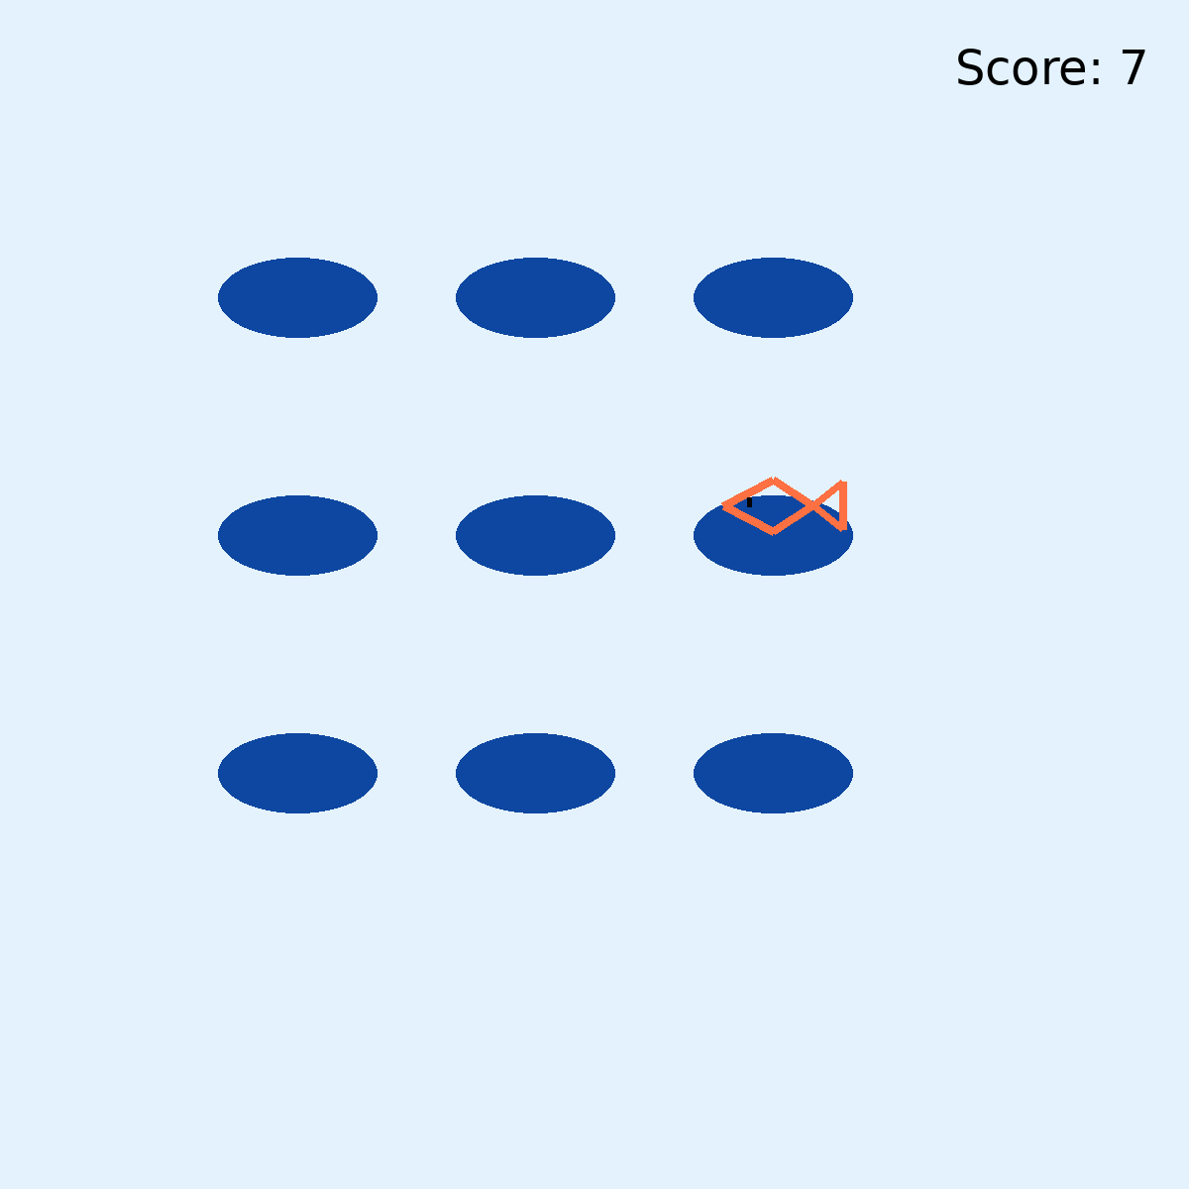
Your game will play like this
By the end of today
9 ice holes.
From two nested loops and one ellipse() line.
Then a fish that jumps up and a click that catches it.
Notes:
TIME
1 min
SAY
Play the finished game from the HTML deck, or show this screenshot.
"How many holes?" Three across, three down - what is the fast way?
Multiply. That multiplication is today.

Slide 3
One row of holes
Before we start
for (let c = 0; c < 3; c++) {
ellipse(150 + c * 120,
150, 80, 40);
}
You know this
3 holes in a row. x from c, y is always 150.
Now I want 3 rows
Copy the loop 3 times and change the y? What about 10 rows?
Notes:
TIME
2 min
SAY
Same problem as Lesson 1, one level up: the only thing that changes from
copy to copy is the y - by 120 each time. "What do we do when only one
number changes by the same amount?" A loop.

Slide 4
A loop inside a loop
The new thing
for (let r = 0; r < 3; r++) {
for (let c = 0; c < 3; c++) {
ellipse(150 + c * 120,
150 + r * 120,
80, 40);
}
}
outer · r
Picks the row. y comes from r.
inner · c
Walks across that row. x comes from c.
inner finishes first
For each row, the inner loop runs all 3 times.
Notes:
TIME
3 min
SAY
Read it out loud: "for each row, for each column, draw a hole."
The inner loop is the whole one-row loop from the last slide, unchanged
except for its y.
Indentation shows which braces belong to which loop. Line them up.
WATCH FOR
Students who think the loops take turns: one c, one r, one c... No - the
inner loop runs to the end before r changes at all.

Slide 5
r stays, c runs, c resets
Trace it · 2 rows × 3 columns
r | c | x, y
0 | 0 | 150, 150
0 | 1 | 270, 150
0 | 2 | 390, 150
1 | 0 | 150, 270
1 | 1 | 270, 270
1 | 2 | 390, 270
c resets
When r goes up, the inner loop starts again: c is 0 again.
How many?
2 rows × 3 columns = 6. So 3 × 3 = 9 holes.
Notes:
TIME
3 min
SAY
On the board, small: r < 2, c < 3. Students call out each line.
Point at the jump from row 3 to row 4 of the table: c goes 2 -> 0.
That reset is the thing that makes it a grid.
How many: outer trips times inner trips.

Slide 6
A bigger lake: count the holes
Your turn · change it, run it
function setup() { createCanvas(800, 600); }
function draw() {
background('#e3f2fd');
noStroke(); fill('#0d47a1');
let count = 0;
for (let r = 0; r < 3; r++) {
for (let c = 0; c < 3; c++) {
ellipse(150 + c * 120, 150 + r * 120, 80, 40);
count = count + 1;
}
}
fill(0); textSize(28);
text("holes " + count, 20, 580);
}
Notes:
TIME
2 min
RUN IT
Live in the HTML deck, or paste into the p5 editor.
SAY
Boards up before each Run. c < 5: 3 x 5 = 15, wider lake.
r < 4: 4 x 5 = 20, taller lake.
c < r: row 0 gets 0 holes, row 1 gets 1, row 2 gets 2... a staircase.
The inner loop can depend on the outer variable - Q2 in Check yourself.

Slide 7
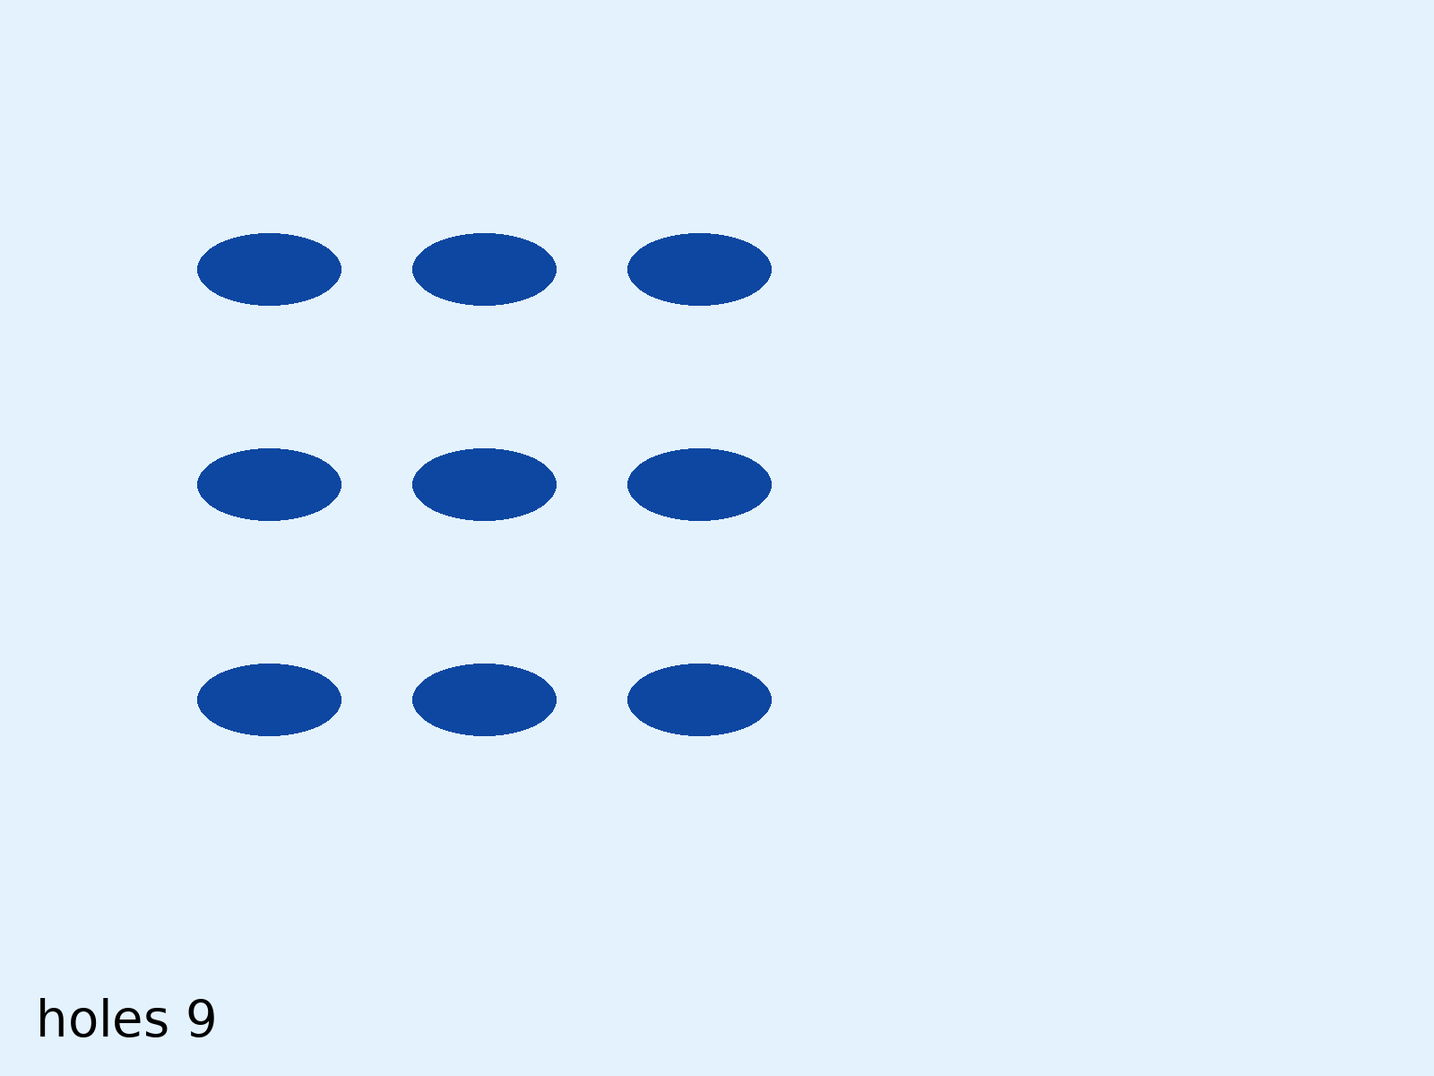
A bigger lake: what changes?
Predict, then run
Change 1
c < 3 → c < 5
Change 2
r < 3 → r < 4
Change 3
c < 5 → c < r
Notes:
Boards up before each Run. Answers: 15 holes, 20 holes, a staircase (0 + 1 + 2 + 3 = 6).

Slide 8
Which variable for what?
Keep them straight
x ← c
Columns go across.
y ← r
Rows go down.
Color by row
fill(0, 0, 100+r*40)
Color by column
fill(0, 0, 100+c*40)
Notes:
TIME
1 min
SAY
If you mix them up - r in the x - you get a diagonal or a single column.
Quick check: "a stripe that goes across - which variable?" r.

Slide 9
Do not reuse i
Two loops, two names
for (let i = 0; i < 3; i++) {
for (let i = 0; i < 3; i++) {
ellipse(150 + i * 120,
150 + i * 120,
80, 40);
}
}
What you get
3 holes on a diagonal, drawn 3 times. The inner i hides the outer one.
Fix
Use r and c (or i and j), never two i’s.
Notes:
TIME
1 min
SAY
JavaScript lets you make a second i inside - and then you cannot reach
the first one. Different names, every time.

Slide 10
Nested REPEAT
What this looks like on the AP exam
JAVASCRIPT
AP EXAM
for (let r = 0; r < 4; r++) {
for (let c = 0; c < 5; c++) {
holes = holes + 1;
}
}
REPEAT 4 TIMES
{
REPEAT 5 TIMES
{
holes ← holes + 1
}
}
Inner body runs: 4 × 5 = 20
Notes:
TIME
2 min
SAY
The exam's favorite question: how many times does the inner body run?
Outer trips x inner trips = 4 x 5 = 20.
If the inner count depends on the outer (like c < r), you cannot just
multiply - you add up each row: 0 + 1 + 2 + ...
That variant is Q2 in Check yourself.

Slide 11
One hole, same formula
From lake to game
// the loop visits EVERY hole
let x = startx + c * s;
let y = starty + r * s;
// the fish visits ONE hole
fishx = startx + fishcol * s;
fishy = starty + fishrow * s;
Pick the hole
floor(random(3))
gives 0, 1, or 2
Why floor?
random(3) gives numbers like 1.84. No hole 1.84.
Notes:
TIME
1 min
SAY
The fish uses the exact same math as one trip through the loops.
Instead of c going 0, 1, 2, we pick one c at random.
random(3) is 0 up to but NOT including 3. floor chops the decimal:
0.x -> 0, 1.x -> 1, 2.x -> 2. Never 3.
fishx and fishy are global: moveFish sets them once, and drawFish and
mousePressed both read them.

Slide 12
The jumping fish
Your turn · change it, run it
let fc = 0; let fr = 0;
function setup() { createCanvas(800, 600); }
function draw() {
background(227, 242, 253);
if (frameCount % 60 === 0) {
fc = floor(random(3)); fr = floor(random(3));
}
noStroke(); fill(13, 71, 161);
for (let r = 0; r < 3; r++) {
for (let c = 0; c < 3; c++) {
ellipse(250 + c * 150, 150 + r * 150, 110, 50);
}
}
stroke(255, 112, 67); strokeWeight(8);
line(220 + fc*150, 125 + fr*150, 280 + fc*150, 125 + fr*150);
}
Notes:
TIME
2 min
RUN IT
Live in the HTML deck, or paste into the p5 editor.
SAY
The orange bar stands in for the fish - the real fish is given in the
starter.
frameCount counts up 60 times a second. frameCount % 60 is 0 once every
60 frames - once a second. 20 means three times a second.
random(2) -> floor gives only 0 or 1: the fish is stuck in the top-left
4 holes. The random range has to match the grid size - that is why the
starter uses random(cols) and random(rows), not random(3).

Slide 13
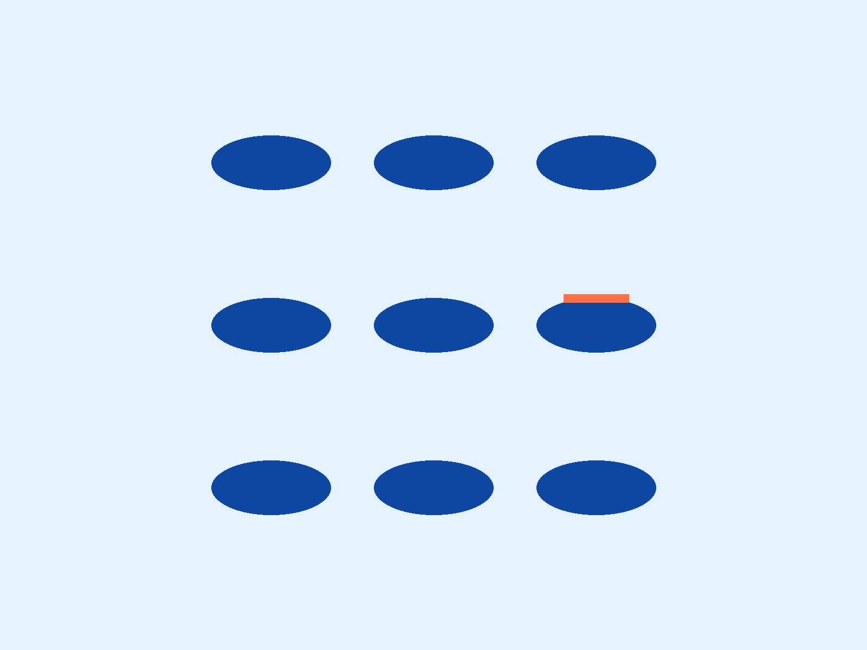
The jumping fish: what changes?
Predict, then run
Change 1
60 → 20
Faster or slower?
Change 2
random(3) → random(2)
Which holes now?
Notes:
Answers: 20 = three times a second (faster). random(2) -> only 0 or 1: stuck in the top-left 4 holes.

Slide 14
Catch or miss
Catch it
function mousePressed() {
let d = dist(mouseX, mouseY,
fishx, fishy - 15);
if (fv && d < 30) {
score++;
fv = false;
moveFish();
}
}
dist
How far the click is from the fish. Under 30 = on it.
&&
Fish showing AND click on it.
Notes:
TIME
1 min
SAY
mousePressed runs once per click - p5 calls it for you, like draw.
The fish is drawn 15 pixels above the hole, so we measure to fishy - 15.
30 pixels covers the body with a little forgiveness.
That is TODO 6.

Slide 15
The Ice Fishing starter
Open this now
1
Class website → Unit 3 → Lesson 4 → u3l04-icefishing-starter.js
2
p5 editor: File → New, paste over everything
3
Rename to u3l04-icefishing and save
fators22.github.io/APCSP-2627
Also linked in Google Classroom
Notes:
TIME
1 min
SAY
File > New, paste, rename, SAVE. The functions are there but empty -
Run shows nothing until TODO 1. drawFish is finished; do not change it.

Slide 16
Draw the lake
Build · Part 1 · TODOs 1 to 3
TODO 1
setup: 600 × 600 canvas. draw: the ice background.
TODO 2
drawGrid: one row. x = startx + c * s. Run: 3 holes.
TODO 3
Wrap it in a rows loop. y = starty + r * s. Predict the count first.
Save first
Before every Run of a new loop.
Notes:
TIME
6 min (of the 16-minute build)
SAY
Build it in this order on purpose: one row that works, then wrap it.
Use cols and rows in the loops, not 3.
WATCH FOR
Nothing draws: drawGrid() never called in draw().
starty + c * s for y: holes on a diagonal.
Both loops using i: holes on a diagonal.

Slide 17
Make it a game
Build · Part 2 · TODOs 4 to 7
TODO 4 · moveFish
Random hole, set fishx, fishy. Call it in setup; drawFish in drawGrid.
TODO 5 · timer
In draw: every f frames, call moveFish().
TODO 6 · catch
mousePressed: on the fish? Score up, hide, move.
TODO 7 · readout
drawReadout: the score, top right.
Notes:
TIME
10 min (of the 16-minute build)
SAY
TODO 4: the fish appears once, at the start (setup calls moveFish).
TODO 5: now it moves every second.
TODO 6: now it is a game. TODO 7: now you can see the score.
WATCH FOR
Fish never shows: drawFish() not called in drawGrid, or fv never true.
Fish in the wrong place: fishx uses fishrow, or fishx/fishy not set in
moveFish (drawFish reads them).
random(3) instead of random(cols): works now, breaks on a bigger lake.
Fish never moves: frameCount % f = 0 (one equals sign).
Readout invisible: fill is still the hole color - set fill(0).

Slide 18
Four questions
Check yourself
1
Outer r < 4, inner c < 5, body count++. What is count?
2
Outer r < 4, inner c < r. How many times does the inner body run?
3
startx = 150, s = 120, fishcol = 2. What is the fish’s x?
4
floor(random(4)): which values are possible?
Notes:
TIME
3 min
ANSWERS
1. 20
2. 6 (0 + 1 + 2 + 3)
3. 150 + 2 x 120 = 390
4. 0, 1, 2, 3 - never 4
SAY
Boards. Q2 is the one that trips people: you cannot multiply when the
inner loop depends on r.

Slide 19
3.8 Iteration · 3.15 Random Values
Where this fits
AAP-2.K
Write iteration statements, and determine the result or side effect of iteration statements.
AAP-3.E
Write expressions to generate possible random values, and evaluate them to determine the possible results.
2.B
Implement and apply an algorithm.
4.B
Determine the result of code segments.
Notes:
TIME
0 min - point, do not read.
SAY
Nested loops are still 3.8 - iteration inside iteration.
floor(random(cols)) is a preview of 3.15.

Slide 20
Two things
Before you log off
1
Save your sketch
2
Last line of your file: // TODO: and what you would add next
Every hole is the same. Tomorrow: every other one, checkerboards and skipping one - loops plus if.
Notes:
TIME
1 min
SAY
Ice Fishing due end of period or as homework (TODOs 4-7 can go home).
AFTER CLASS
Post u3l04-icefishing-solution.js to Classroom (not the public website).

