Slide 1
State of the Art Testability
By Chad Parry

Slide 2
Background
The industry offers great advice on testability
Projects that follow that advice look different than projects that don’t
It’s important that we all recognize what testable code looks like

Slide 3
Objective
Start with a simple example
Identify helpful coding idioms one by one
Apply these improvements in steps 1 - 9
Arrive at a testable example
Examine best practices in the result

Slide 4
Step 1: Naïve Example
Command-line tool to execute a “buy” order
3 classes that need testing
  TradingApplication
  Trade
  MarketClient
Some external classes not part of this project: ApplicationWrapper, Account, MarketService

Slide 5
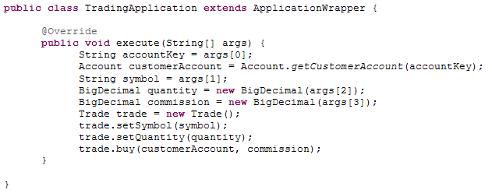
Step 1: Naïve TradingApplication

Slide 6
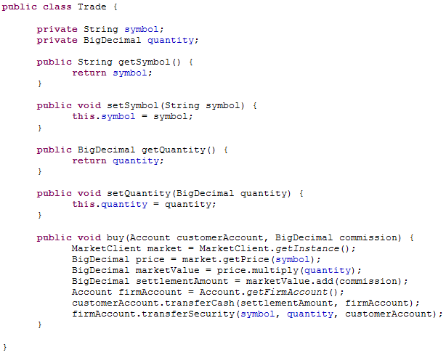
Step 1: Naïve Trade

Slide 7
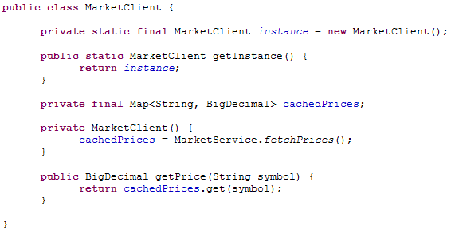
Step 1: Naïve MarketClient

Slide 8
Step 2 Pain Points
“That code to create fake Trade objects is repeated in enough places that we should put it in a testing library.”
“The three—well, actually four—things that this object is responsible for are…”

Slide 9
Step 2 Principle: Value Objects
Separate service objects from value objects
Value objects
  Hold state
  Are easy to create in tests
Service objects
  Perform work
  Are harder to fake in tests

Slide 10
Step 2 Code: Move Trade Services
Many objects in the system are going to pass around Trade objects
Trades depend on market prices and accounts
Tests would be easier to write if those dependencies didn’t need to be mocked
The “buy” method should be moved out
The resulting class is a simple value object

Slide 11
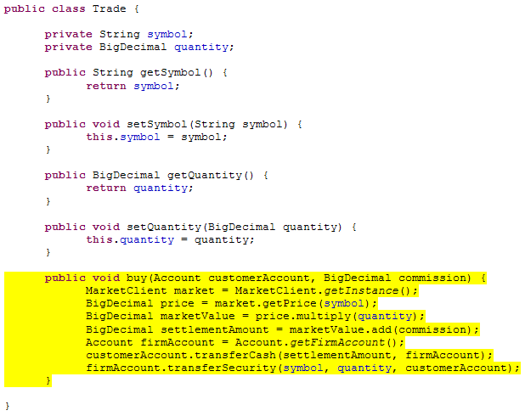
Step 2: Trade Before

Slide 12
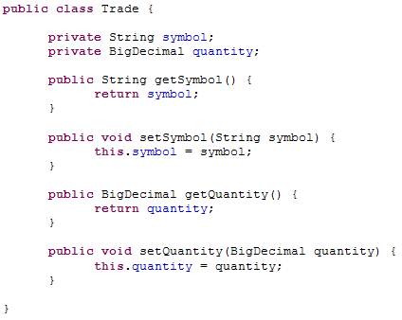
Step 2: Trade After

Slide 13
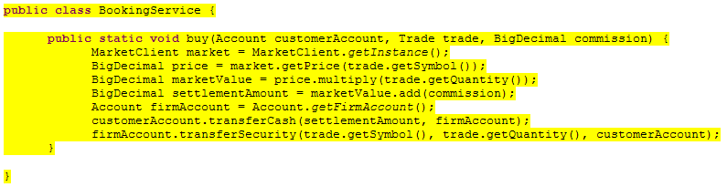
Step 2: BookingService After

Slide 14
Step 3 Pain Points
“How do I mock a static method?”
“When I modify static variables in my tests, I sometimes start seeing unpredictable failures.”
“Did I call all the setters I need to so I can use this object?”

Slide 15
Step 3 Principle: Constructor Injection
The best way to acquire dependencies is through constructor injection
This just means creating constructor parameters for all required objects
Objects won’t give errors or behave differently because of missing dependencies
Tests can easily substitute test doubles
Avoid static methods and the “new” operator

Slide 16
Step 3 Code: Add Trade Constructor
The Trade class is not immediately usable when it is created
This could result in guess-and-check programming while clients figure out which methods are necessary to make it viable
Trade objects would be even easier to handle if they were immutable

Slide 17
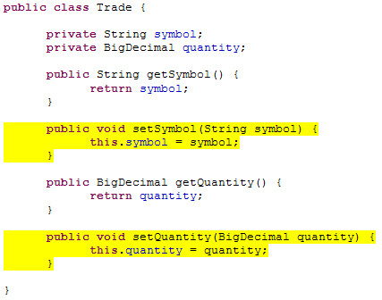
Step 3: Trade Before

Slide 18
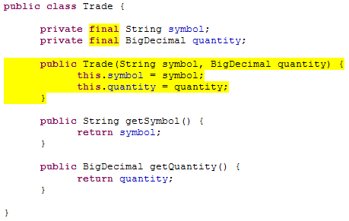
Step 3: Trade After

Slide 19
Step 3 Code: BookingService Parameters
The BookingService calls static methods in the MarketClient and Account classes
These dependencies make testing difficult, because tests cannot substitute their own implementations
A constructor should be added for tests
For product code, another constructor can be added, which retains the production bindings

Slide 20
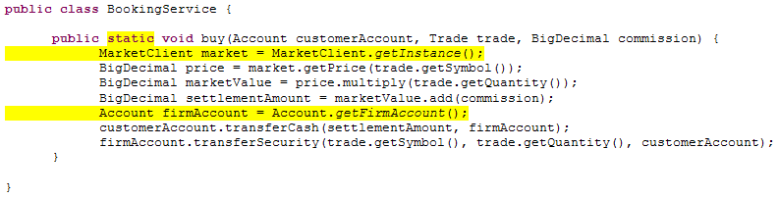
Step 3: BookingService Before

Slide 21
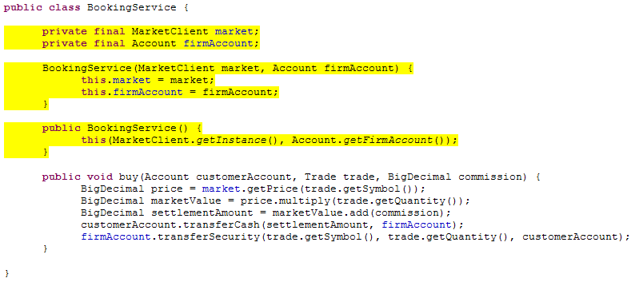
Step 3: BookingService After

Slide 22
Step 4 Pain Points
“We would have tested that class if the constructor didn’t always throw an exception.”
“The test ‘setUp’ methods are hard to write because we have to fake so many objects in the environment.”
“How do you guarantee that the ‘init’ method gets called for your object?”

Slide 23
Step 4 Principle: Trivial Constructors
Tests are forced to invoke constructors and static initializers and init methods
Expensive initialization code thwarts unit tests
All constructors should be trivial
A constructor that does real work, (such as opening a connection), should be refactored so that it accepts an initialized resource, (such as an opened connection), as a parameter

Slide 24
Step 4 Code: Lazy MarketClient Singleton
Any use of the MarketClient class triggers a static initializer, which calls the expensive “MarketService.fetchPrices()” method
MarketClient should create its singleton lazily
A constructor should be added for tests that avoids the expensive initialization entirely
A backwards-compatible constructor can be added for product code

Slide 25
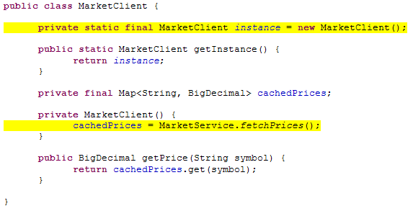
Step 4: MarketClient Before

Slide 26
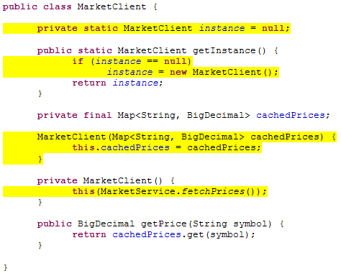
Step 4: MarketClient After

Slide 27
Step 5 Pain Points
“How do you create a fake ‘HttpServletRequest?’”
“It’s not worth it to test servlet code.”

Slide 28
Step 5 Principle: Thin Harness
The entry point into your application is sometimes required to extend a third-party object, such as “HttpServlet”
Business logic should be moved somewhere easier to test
The entry point itself will only need to be covered by scenario tests, not unit tests

Slide 29
Step 5 Code: Simplify TradingApplication
The TradingApplication class extends an ApplicationWrapper
An ApplicationWrapper is probably difficult to construct in tests
All business logic should be moved elsewhere
The command-line argument parsing can be moved to a helper class that gets its own tests

Slide 30
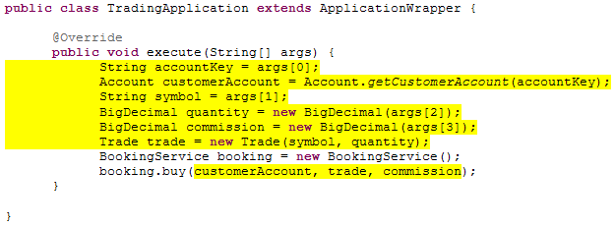
Step 5: TradingApplication Before

Slide 31
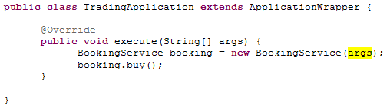
Step 5: TradingApplication After

Slide 32
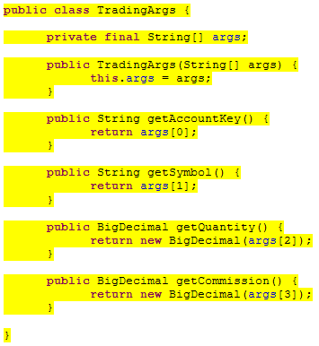
Step 5: TradingArgs After

Slide 33
Intermission
Half of the steps have been performed
It’s possible to unit test the business logic now
Unfortunately the tests are long and awkward
The remaining steps make testing simple

Slide 34
Step 6 Pain Points
“Removing the hard-coded dependencies from my code always makes my constructors difficult to read, because there are so many parameters.”
“In the real world, most classes contain at least some code that is really hard to test.”
“The code coverage report always shows gaps that we can’t do anything about.”

Slide 35
Step 6 Principle: Injector
Business logic and glue code are best separated
Moving glue code to its own injector file conveys intention and keeps it organized
Creating many small injection helpers, one to create each object, makes the production bindings easy to read

Slide 36
Step 6 Code: Create TradingInjector
A new TradingInjector class should be created
All the production bindings that we had implemented in constructors should be moved to the injector class
Complicated bindings become simpler because they can be broken out into multiple small injection helpers

Slide 37
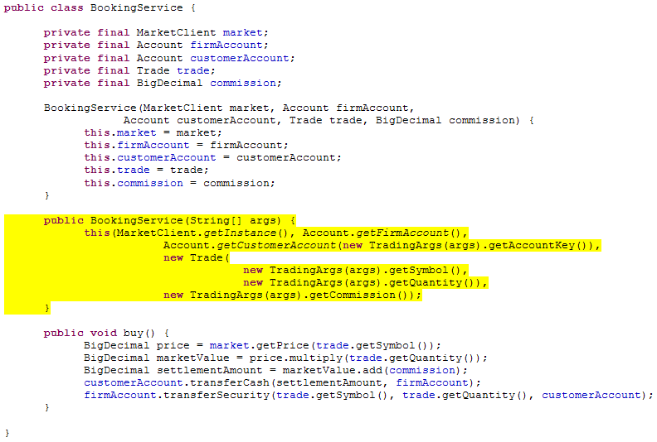
Step 6: BookingService Before

Slide 38
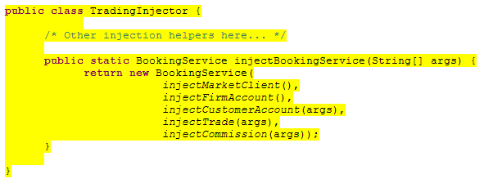
Step 6: Injection Helper After

Slide 39
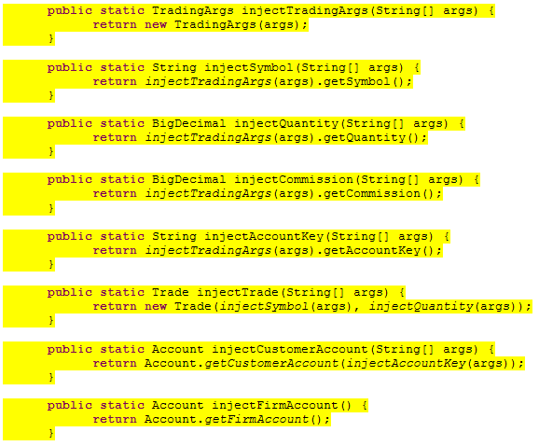
Step 6: More Injection Helpers

Slide 40
Step 6: Injection Guidelines
Injection helpers contain too many sprawling dependencies to be unit tested
Injection helpers need to be trivial
Injection helpers can call other injection helpers but product code never should

Slide 41
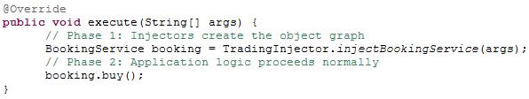
Step 6: Injection Control Flow
First, the top-most injection helper is called
It delegates to other injection helpers, which in turn delegate to others
The return value is a complete object graph
After that the injectors are out of the picture while the application executes

Slide 42
Step 7 Pain Points
“Can a mock object return a mock that returns a mock?”
“Can you add some comments to this test code so I can tell what is going on?”
“It took me forever to refactor that class because of all the tests that needed to expect the new contract.”

Slide 43
Step 7 Principle: Demeter
The Law of Demeter says objects should avoid asking for dependencies that they don’t need
For example, instead of asking for a factory, ask for the object produced by the factory
In practice, this is hard to follow unless the project uses injection helpers

Slide 44
Step 7 Code: Simplify BookingService
The BookingService should remove its dependency on the MarketClient and ask directly for the settlement amount instead
A new SettlementCalculator helper can calculate the settlement amount
The SettlementCalculator also only needs a price, not the whole MarketClient
The glue code is the only place that needs to reference the MarketClient

Slide 45
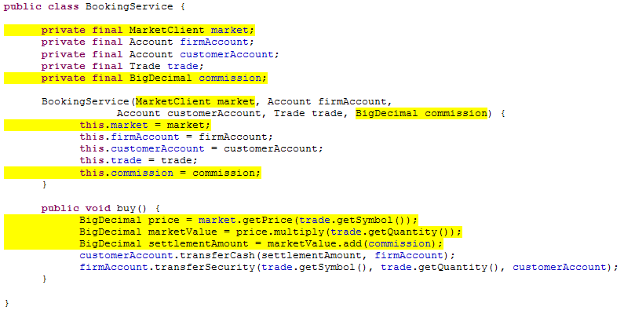
Step 7: BookingService Before

Slide 46
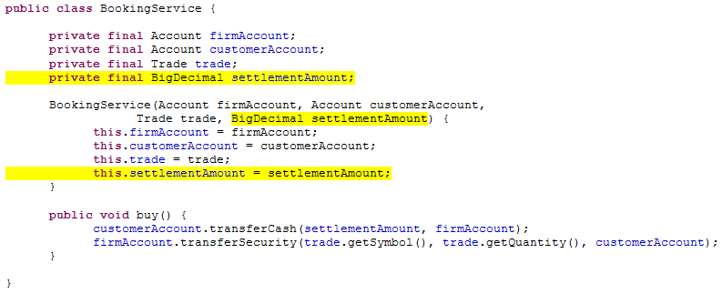
Step 7: BookingService After

Slide 47
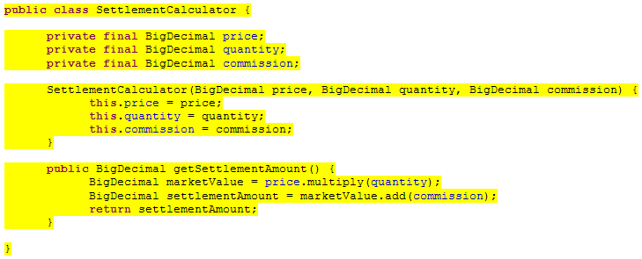
Step 7: SettlementCalculator After

Slide 48
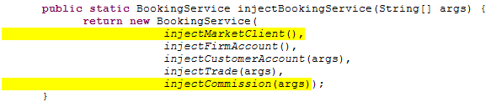
Step 7: Injection Helpers Before

Slide 49
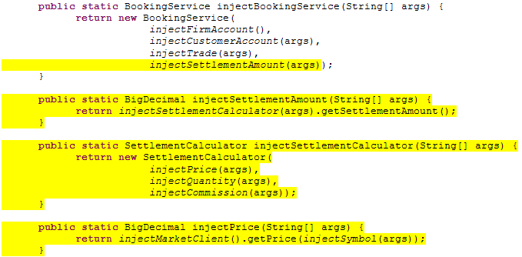
Step 7: Injection Helpers After

Slide 50
Step 8 Pain Points
“In the real world, classes can be decoupled up to a certain point, but then you always have a factory or a service that you can’t get rid of.”
“I can’t specify all my dependencies up front because the class performs lazy instantiation.”

Slide 51
Step 8 Principle: Providers
Sometimes it’s necessary to keep a dependency on a factory
  Multiple instances are needed
  Lazy construction is desired
The dependency should be made as simple as possible
The “Provider” pattern can be tested without needing mock objects

Slide 52

Step 8 Code: Provider Interface
The Provider interface can be created once and used throughout the application

Slide 53
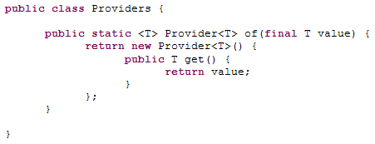
Step 8 Code: Providers Utility
The Providers utility can be created once and used in all the tests
Tests just need to invoke “Providers.of(value)” to create a test double

Slide 54
Step 8 Code: Fetch Prices Lazily
Instead of asking for prices, objects could ask for a provider of prices
The expensive fetching of the prices will then be delayed until they are actually needed

Slide 55

Step 8: Injection Helper Before

Slide 56
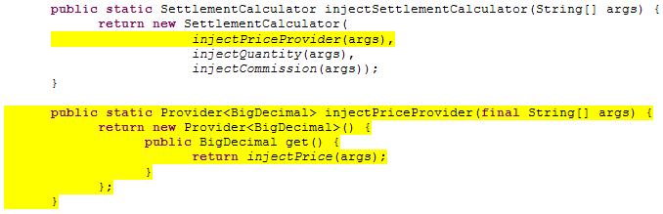
Step 8: Injection Helper After

Slide 57
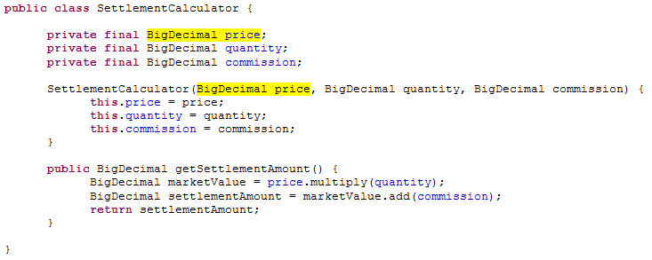
Step 8: SettlementCalculator Before

Slide 58
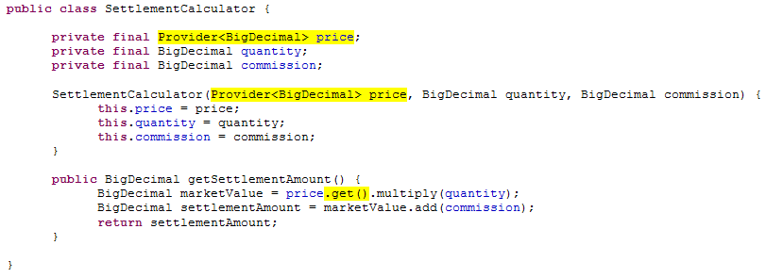
Step 8: SettlementCalculator After

Slide 59
Step 9 Pain Points
“I hate it when a change in one class propagates through all the package’s classes.”
“I’ll just add a static method here because I don’t want to change the class’s dependencies.”
“That bug snuck in because I had to fix the plumbing in so many places.”

Slide 60
Step 9 Principle: Scopes
Most projects have a concept of scopes
  Application scope
  Request scope
An explicit scope object lends uniformity to the plumbing in the injection helpers
Scopes can also hold singletons or other objects with the same lifetime as the scope

Slide 61
Step 9 Code: Use an ApplicationScope
The injection helpers all pass around a parameter for “String[] args”
If this variable type changed, or if a second variable were needed, every injection helper signature would be affected
Instead the injection helpers should pass around an “ApplicationScope”
Changes can be encapsulated in the scope

Slide 62
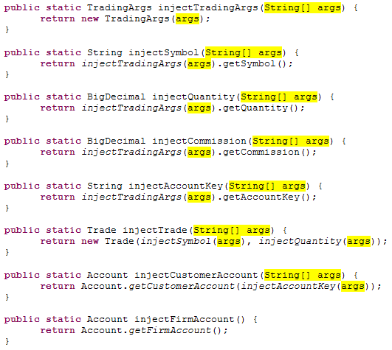
Step 9: Injection Helpers Before

Slide 63
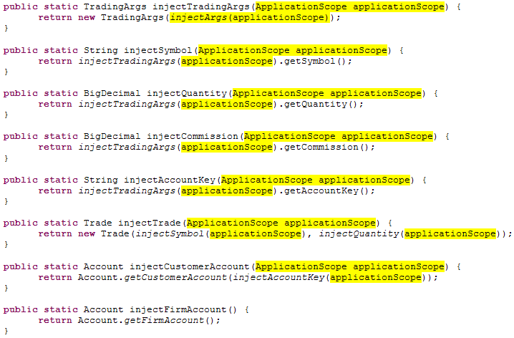
Step 9: Injection Helpers After

Slide 64
Step 9 Code: Create ApplicationScope
The ApplicationScope class is simple
It holds the “String[] args” that were being passed around
It can also hold the MarketClient singleton, so that the singleton implementation doesn’t need statics
It could hold any other objects that need to be cached for the lifetime of the application

Slide 65
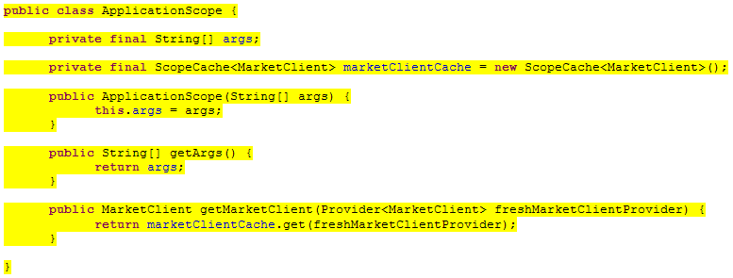
Step 9: ApplicationScope After

Slide 66
Step 9: Anti-Patterns
Service locators and context objects tend to grow and grow, making tests brittle
Scope objects are neither of these
Scope objects stay simple and decoupled, even when the application gets complicated
Scope objects and production objects don’t even have a knowledge of each other

Slide 67
Testable Example
After making those changes, everything is easy to test
Teams tend to write more tests and better tests when they are easy
Once introduced, these patterns are easy to follow

Slide 68
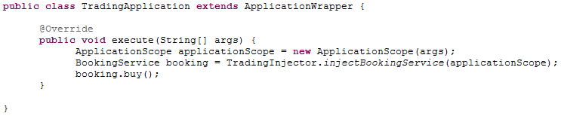
Simple TradingApplication

Slide 69
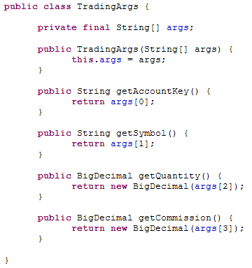
Testable TradingArgs

Slide 70
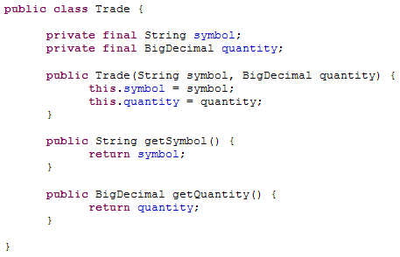
Testable Trade

Slide 71
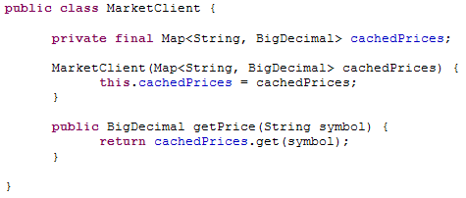
Testable MarketClient

Slide 72
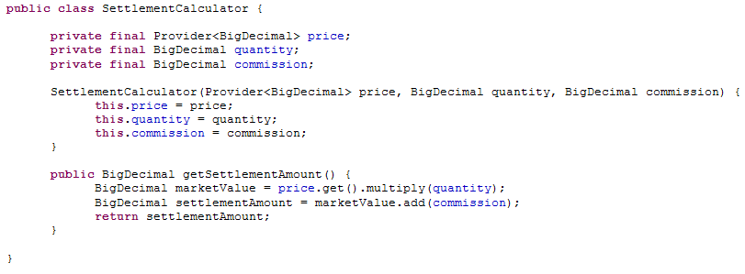
Testable SettlementCalculator

Slide 73
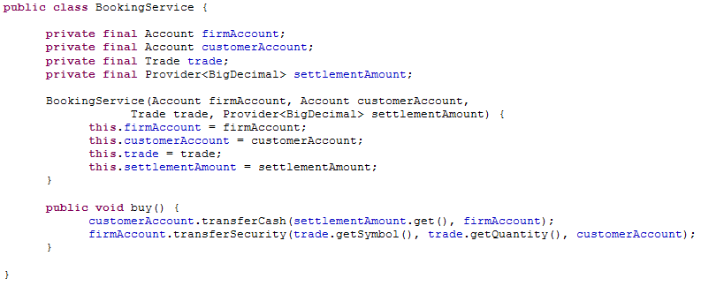
Testable BookingService

Slide 74
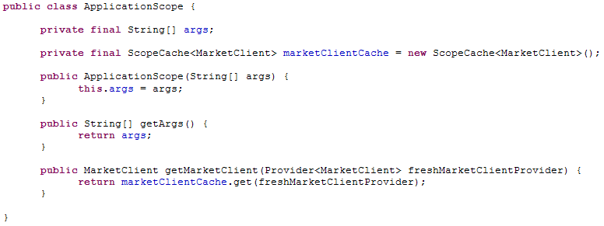
Simple ApplicationScope

Slide 75
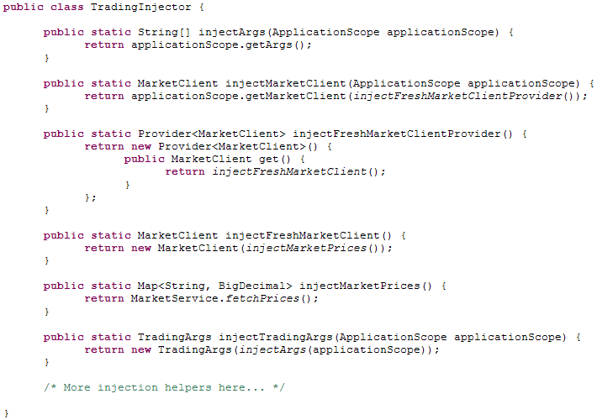
Simple TradingInjector

Slide 76
Conclusions
The right coding idioms can make hard tests easy and impossible tests possible
This coding style is the logical conclusion of the current state of the art in testability
Each coding idiom would still be valuable taken individually

Slide 77
Summary of Steps
Separate value objects from service objects
Prefer constructor injection
Require trivial constructors
Create a thin application harness
Move glue code to an injector class
Follow the Law of Demeter
Use the Provider interface
Add explicit scope objects

Slide 78
Training
Only an experienced developer can understand all these techniques individually
On the other hand, using dependency injection is simple even for junior developers
In a project that already has injector classes, anyone can follow the pattern
The team then enjoys high testability without the burden of confronting the same testing problems over and over

Slide 79
Result
The final result is a codebase infected with dependency injection
Long-term sustained testability is more likely
Code readability is even better once the idioms become familiar

Slide 80
Further Information
Read the complete how-to manual: DIY-DI
Browse the source code from the case study: dipresentation
Questions?

