Slide 1
Part 1 The Entrepreneurial Perspective
Chapter 1
The Entrepreneurial Mind-Set

Slide 2
The Nature of Entrepreneurship
Entrepreneurial actions begin at the nexus of a lucrative opportunity and an enterprising individual.
An entrepreneurial opportunity could stem from:
A new market.
A new product for an existing market.
Or, a new product for a new market.

Slide 3
Entrepreneurial Action and Thinking
The McMullen-Shepherd model explains how knowledge and motivation influence two stages of entrepreneurial action.
Stage 1 is the realization an opportunity exists for someone.
Stage 2 is determining whether it is an opportunity for themselves.
Acting on and pursuing the identified opportunity involves entrepreneurial thinking.

Slide 4
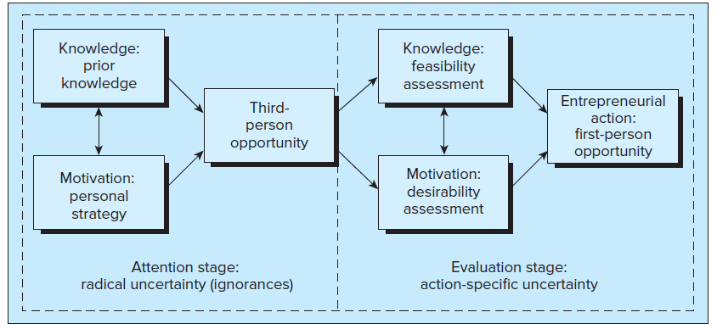

Slide 5
How Entrepreneurs Think
Entrepreneurs sometimes make decisions in highly uncertain environments, with high stakes and immense time pressures. They need to think:
structurally,
engage in bricolage,
effectuate, and
cognitively adapt.

Slide 6
Think Structurally
Forming opportunity beliefs often requires creative mental leaps launched from the entrepreneur’s existing knowledge.
Superficial similarities and structural similarities between the source (e.g., the market) and the destination (e.g., technology) help the entrepreneur make these creative mental leaps.
The challenge often lies in making creative mental leaps based on structural similarities – when the technology matches the market.

Slide 7
Bricolage
Entrepreneurs often lack resources.
They sometimes seek resources from others to provide the slack necessary to experiment and generate entrepreneurial opportunities or engage in bricolage.
Bricolage refers to taking existing resources and experimenting, tinkering, repackaging , and/or reframing them to be used in a way they were not originally designed or conceived.
From this process of “making do,” entrepreneurs can create opportunities.

Slide 8
Effectuation
A causal process involves thinking of a desired outcome and then coming up with a plan to achieve that outcome.
The effectuation process looks at what a person has and then selects from several possible outcomes.
Allows entrepreneurs to think in a highly uncertain environment.
Most managers need to take an entrepreneurial mind-set.
To develop this mindset, managers must:
attempt to make sense of opportunities,
constantly question their dominant logic, and
revisit what they think true about markets and firms.

Slide 9
Cognitive Adaptability
To be good at effectuation, you must have cognitive adaptability.
The extent entrepreneurs are dynamic, flexible, self-regulating, and engaged in sensing and acting on changes in their environments.
Reflected in an entrepreneur’s ability to reflect upon, understand, and control their thinking and learning.
Learn to be more cognitive by asking questions in four areas:
Comprehension questions.
Connection tasks.
Strategic tasks.
Reflection tasks.
Those able to increase cognitive adaptability can adapt to new situations, be creative, and communicate one’s reasoning behind a particular response.

Slide 10
The Intention to Act Entrepreneurially
Entrepreneurial action is most often intentional.
When actions are feasible and desirable, there are stronger intentions to act.
Entrepreneurial intentions can be explained the same way.
Entrepreneurial self-efficacy refers to the conviction that one can successfully execute the behavior required.
Perceived desirability refers to an individual’s attitude toward entrepreneurial action.
The degree to which the entrepreneur has a favorable or unfavorable evaluation of the potential entrepreneurial outcomes.

Slide 11
Entrepreneur Background and Characteristics
Education.
A broad knowledge allows for the discovery of potential opportunities and assists adaptability.
Provides transferable knowledge, skills, and problem solving abilities.
Age.
Entrepreneurial age reflects the entrepreneur’s experience.
Most entrepreneurs are between 22 and 45 when starting their career.
Milestone ages every five years (25, 30, 35, 40, and 45)
Work History.
Work history plays a role in the growth and success of a new venture.
Experience in financing, product development, manufacturing, distribution, and marketing are particularly important.

Slide 12
Role Models and Support Systems
A role model is an important factor influencing an entrepreneur’s career path.
Can be relatives or successful community entrepreneurs.
Can serve as mentors before and after launch of the venture.
As contacts expand, they form a network with density and centrality.
The entrepreneur should establish a moral-support network of family and friends…a cheering squad.
The entrepreneur also needs advice and counsel obtained from members of a professional-support network.
Mentors, business associates, suppliers, trade associations, and other personal affiliations.

Slide 13
Interpersonal Networks
Entrepreneurial activity is embedded in networks of interpersonal relationships.
These networks offer:
Access to resources.
Assistance in discovering and exploiting new opportunities.
Opportunities to exchange goods and services.
Perceived feasibility that strengthens entrepreneurial intentions.

Slide 14
Sustainable Entrepreneurship (ESG)
Entrepreneurial action can help us to sustain and develop.
Sustainable entrepreneurship is focused on preserving nature, supporting life and community, transparent leadership in the pursuit of opportunities to bring future products and services into existence for gain.

Slide 15
Sustainable Entrepreneurship (ESG)
Entrepreneurial action can help us both sustain and develop.
Sustainable entrepreneurship is focused on preserving nature, supporting life and community, transparent leadership in the pursuit of opportunities to bring future products and services into existence for gain.
Environment | Social | Governance
Publishes a carbon or sustainability report Limits harmful pollutants and chemicals Seeks to lower greenhouse gas emissions and CO₂ footprint Uses renewable energy sources Reduces waste | Operates an ethical supply chains Avoids overseas labor that may have questionable workplace safety or employ child labor Supports LGBTQ+ rights and encourages all forms of diversity Has policies to protect against sexual misconduct Pays fair (living) wages | Embraces diversity on board of directors Embraces corporate transparency Someone other than the CEO is chair of the board Staggers board elections

Slide 16
Entrepreneurial Impact
Entrepreneurs can generate economic wealth for themselves, but their impact on development can be far greater.
They can generate economic, environmental, and social gains for others including job opportunities or revenues for the government.
Environmental gains could be reduced air pollution, increased drinking-water quality, and other improved living conditions.
Social gains include improved child survival rates, longer life expectancy, superior education, equal opportunity, and so on.

