Slide 1
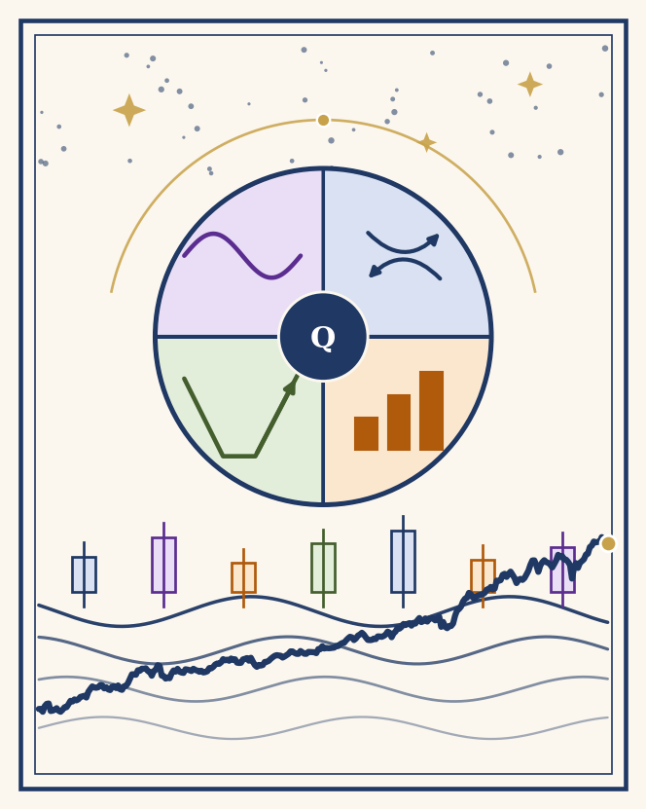
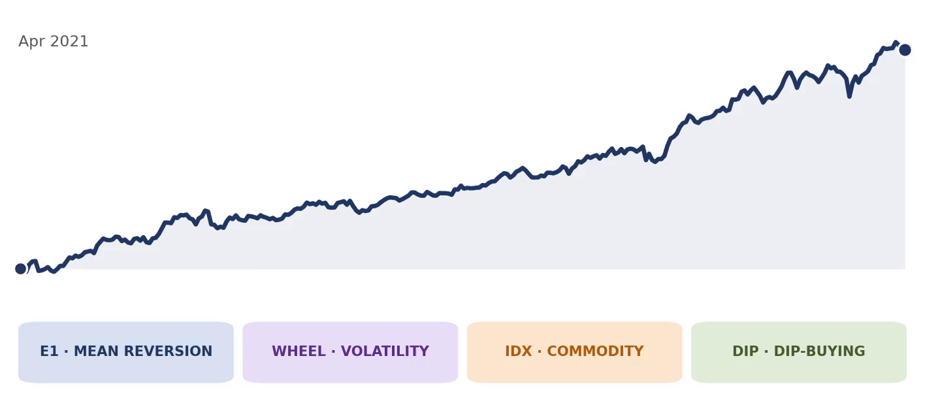
QF5210
GROUP PROJECT
THE
Quadrant
Strategy.
Four Market Structures
One book, four engines — each harvesting a different named premium.
1.54 Sharpe · 15.4% CAGR · −8.1% Max DD · +14.1% in 2022
The book, animated
Equity curve, Apr 2021 — Oct 2026, net of costs. +121.0% total
Andrew Wiraatmaja · Edward Sujono · Michael Japardi · Victoria Chan · Wielly Halim
QF5210 · Financial Time Series · Oct 2026
Notes:
Speaker 1 of 5: Andrew. You open the deck (title), then slides 2 (Hook) and 3 (Why a book). About 2 minutes for your three slides. Hand over to Edward for Sleeve 1. Title slide: 'The Quadrant Strategy' in the Baloo 2 display treatment (approved 23 Oct); both videos on it (illustration with rotating quadrant wheel, chart card) autoplay and loop in PowerPoint slideshow mode.

Slide 2
SPEAKER 1 · ANDREW
THE HOOK · WHY THIS BOOK, WHY NOW
Tariffs, a yen unwind, a crypto winter
Five regimes in five years. Each paid a different premium and punished a different flaw. Here is which sleeve answered each one.
2021–22 · Crypto winter
BTC fell 74% peak-to-trough; buy-and-hold wore all of it.
Wheel: max drawdown −43%, and USD 476K of modelled premium across the window.
2022 · The rate shock
Stocks and bonds fell together; the classic hedge failed.
IDX carried the year: coal and nickel +98.7% on the energy shock. E1 −2.2%, the wheel bled, dip sat in cash (−1.1%). Book: +14.1%.
Aug 2024 · The yen unwind
A three-day global deleveraging as the carry trade burst.
Book: +0.4%. Nothing in the book trades the yen; nothing had to.
Apr 2025 · The Trump tariff shock
Policy whiplash: tariffs announced, paused, re-announced within weeks.
The dip sleeve bought the tariff dip (+9.3% in a week). Book: +1.1%.
2023–26 · The gold supercycle
Speculative positioning pinned at the 79th percentile (Oct 2026).
IDX loads on gold (β +0.38); the gold basket and COT brake are design variants outside the book.
No single strategy survived all five regimes. The book is built so no single headline can fire every sleeve at once.
2
Notes:
Speaker 1 of 5: Andrew (slides 2-3). Hook: target about 50 seconds. Five regimes, one line each; land the closing line at the bottom.

Slide 3
SPEAKER 1 · ANDREW
THE BOOK · WHY FOUR ENGINES
Why a book, not a strategy
Sleeve
Premium
Market
What kills it
1. Mean reversion
Relative value
SGX + US equities
Crowding; regime change
2. BTC wheel
Volatility
Bitcoin options
A full bear market, held naked
3. IDX commodities
Commodity beta
Indonesian equities
Commodity downcycles; IDR
4. Dip buying
Short-term reversal
Nasdaq-100 equities
A bear that keeps dipping; no stop loss
Measured on the common window (Apr 2021 to Oct 2026), every pair of sleeves correlates between −0.09 and +0.23. The four signals are differentiated, not independent — the wheel carries BTC beta and IDX loads on gold — so the book can be more than the sum of its parts, if it is sized honestly.
The shared flaw, stated before the results: sleeves 2, 3 and 4 are all long risk. What stands against a crash is Sleeve 1’s near-zero measured factor exposure (R² 0.01), Sleeve 4’s trend filter (it held −1.1% in 2022 by sitting mostly in cash), and the book brake. The portfolio slide tests whether that is enough.
1.54
Book Sharpe (common window)
≤ 0.23
Highest pairwise sleeve correlation
+14.1%
Book return in 2022
−8.1%
Book max drawdown
3
Notes:
Speaker 1 of 5: Andrew (last of your pair). Target about 50 seconds: correlations -0.09 to +0.23 are the point. Hand over to Edward.

Slide 4
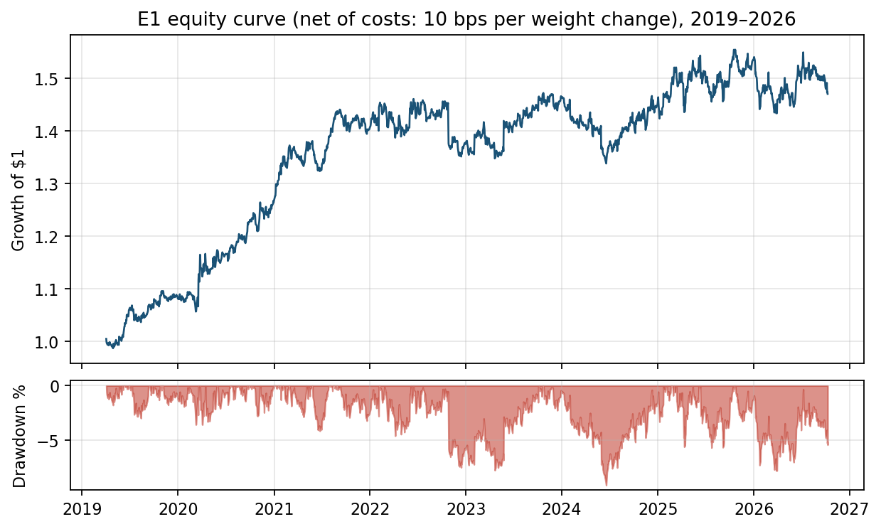
SPEAKER 2 · EDWARD
SLEEVE 1 · RELATIVE VALUE
Mean reversion engine (PCA statistical arbitrage)
0.67
Sharpe, net (2019–2026)
−9.1%
Max drawdown
1,541
Trades · 59.1% win rate
0.06
Sharpe since 2024 — decaying
Frozen spec. Residuals from a 3-factor PCA model (60-day window) on 34 names (9 SGX + 25 US). Trade the OU s-score: open at ±1.5, close at ∓0.5, stop at |s| > 3.5, half-life ≤ 30 days. Costs: 10 bps on every change in position weight (entries, exits and daily rebalancing).
Net results, Apr 2019 to Oct 2026
Return
5.6%/yr
Sharpe
0.67
Volatility
8.5%
Max drawdown
−9.1%
Trades / win rate
1,541 / 59.1%
Avg hold / profit per trade
11.8 days / +2.7 bps
Equity curve and drawdown, net of costs. The engine made money through the 2020 crash; 2022 was a small loss (−2.2%) once every rebalance is charged, and its flat years are recent.
Lecture exhibits: factor attribution (A6) · cointegration and residual diagnostics (A9)
The flaw, on the record: the edge is real and decaying, so this engine is the book's ballast at 40%, not its return promise.
4
Notes:
Speaker 2 of 5: Edward (slides 4-5). E1: target about 50 seconds. The costs line matters: 10 bps on every weight change. Since-2024 Sharpe 0.06 is the disclosed flaw.

Slide 5
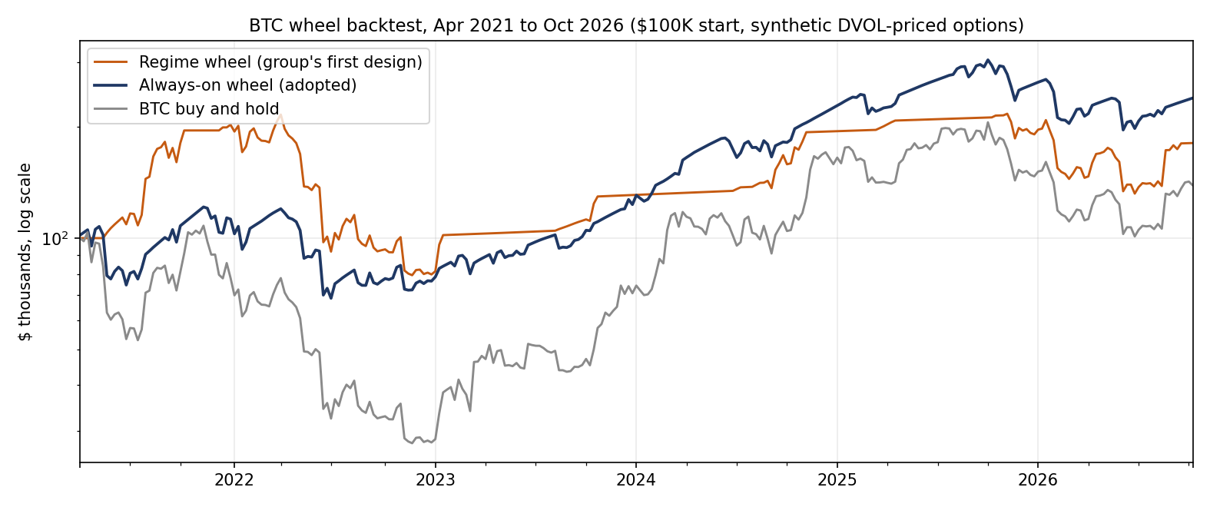
SPEAKER 2 · EDWARD
SLEEVE 2 · VOLATILITY PREMIUM
Bitcoin options wheel
0.65 vs 0.38
Sharpe vs buy-and-hold
$476K
Modelled gross premium, 289 sales
−43% vs −74%
Max DD vs buy-and-hold
≈22%
1-wk 99% ES — the tail (A7)
Mechanism. Weekly cycle, 25-delta options, 1 week to expiry, priced off Deribit's DVOL index. Flat: sell cash-secured puts. Holding: sell covered calls. Cash earns the T-bill rate. Apr 2021 to Oct 2026, USD 100K.
Sharpe
CAGR
Max DD
Regime wheel (first design)
0.48
11.3%
−63.3%
Always-on wheel (adopted)
0.65
17.2%
−43.4%
BTC buy and hold
0.38
6.2%
−74.3%
Adopted vs rejected vs buy-and-hold. The regime overlay is kept in the rejection log (A3), not buried.
What the test killed: the first design sold puts only in bear regimes and calls only in bull regimes. In 2022 it returned −60.7%, close to buy-and-hold (−64%): once assigned, it sold nothing and rode the bear naked. The plain wheel kept harvesting calls through the decline and lost −32.0%.
Lecture exhibits: implied vs GARCH volatility (A8) · tail risk, EVT (A7)
Always-on, never idle: the regime filter was the flaw. Short volatility by construction, so it stays the smallest sleeve at 15%. Its 17.2% CAGR is the wheel's own window from 2 Apr 2021; on the book's common window it is 16.7%.
5
Notes:
Speaker 2 of 5: Edward (last of your pair). Wheel: about 50 seconds. The regime wheel is the kill story: -60.7% in 2022 vs -32.0% always-on. Hand over to Wielly.

Slide 6
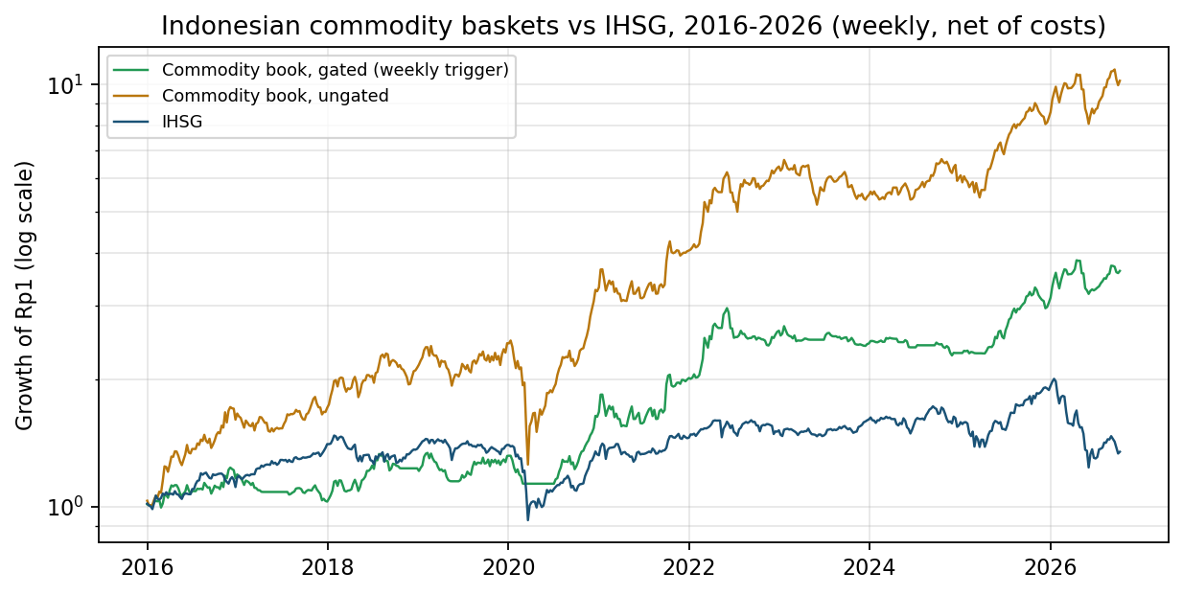
SPEAKER 3 · WIELLY
SLEEVE 3 · COMMODITY BETA
IDX commodity sleeve (weekly signals)
1.11 vs 0.25
Sharpe vs IHSG benchmark
30.2%
CAGR (IDR)
+0.38
IDX beta to gold (A6)
OFF · OFF
Design-variant gates, 9 Oct
Design. Equal-weight Indonesian commodity baskets, weekly, 25 bps per side, IDR. Coal: ADRO, PTBA, ITMG, BYAN. Nickel: ANTM, INCO, MDKA, NCKL, MBMA. Gold miners: ANTM, BRMS, PSAB, MDKA, ARCI.
Sharpe
CAGR
Max DD
Coal + nickel (growth)
1.11
30.2%
−41.8%
IHSG benchmark
0.25
4.1%
−38.4%
Findings: (1) the alpha is asset selection: IHSG is bank-heavy and dilutes the commodity torque. (2) Trend gates are insurance, not alpha (coal drawdown −51% → −22%, no Sharpe added). (3) In the gated variant, a COT positioning brake lifted the gold-miner basket's Sharpe 0.81 → 0.86; the naive version failed (A3).
Weekly books vs IHSG, 2016 to 2026. Returns in IDR; SGD investors earn less after FX. The book series is the ungated coal + nickel growth baskets; gates and the gold basket are design variants.
CAGR here is the annualised mean weekly return; geometric: IDX 30.3%, IHSG 2.8%. · Exhibits: A6 · A9
Selection is the alpha: concentrated commodity torque the benchmark dilutes, with gates that insure rather than pretend to predict.
6
Notes:
Speaker 3 of 5: Wielly (slides 6-7). IDX: about 50 seconds. Selection is the alpha; gates are insurance. Gates today: coal OFF, nickel OFF.

Slide 7
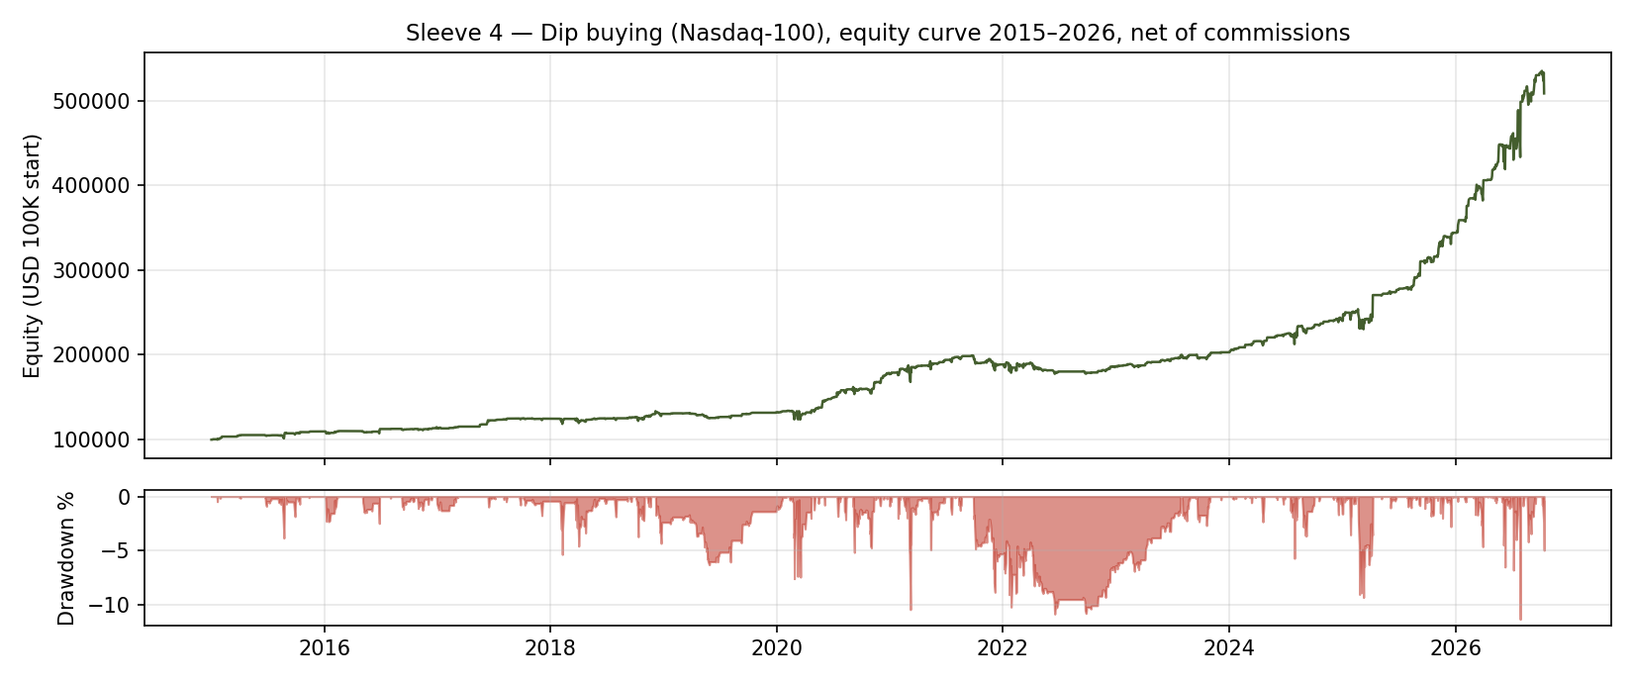
SPEAKER 3 · WIELLY
SLEEVE 4 · SHORT-TERM REVERSAL
Dip buying, Nasdaq-100
1.07
Sharpe, long run 2015–2026
1.70
Sharpe since 2024
−1.1%
2022: sat the bear out
≈13%
Average capital use
Design. Our rebuild of a published dip-buying rule set, verified against its reported results. Nasdaq-100 names above their 200-day average; a one-day drop over 3% at high ATR triggers a next-day limit buy 0.9×ATR below the close. Exits: a +0.5×ATR target, a close above the prior day's high, or day 11. Max 10 positions. No stop loss.
Long run 2015–2026
Sharpe 1.07 daily (1.50 weekly), CAGR 14.8%
Trades / win rate / hold
853 / 69.9% / 4.7 days
Equity curve and drawdown, 2015 to 2026, net of IBKR commissions. The flat stretches are the design working: no qualifying dips, no trades. Universe: today's constituents applied backwards (slide 10).
Max drawdown
−11.3%
COVID crash, Feb–Mar 2020
−3.7%
Since 2024 (published test window)
Sharpe 1.70, CAGR 39.1% (to 14 Oct 2026)
Lecture exhibits: factor attribution (A6) · tail risk, EVT (A7)
A long-only sleeve that survives bears by absence: the 200-day filter keeps it in cash when dips turn into downtrends. Its risk is the mirror image: a crash that starts at all-time highs.
7
Notes:
Speaker 3 of 5: Wielly (last of your pair). Dip: about 50 seconds. No stop loss by design; the 200-day filter is the defence. Hand over to Michael.

Slide 8
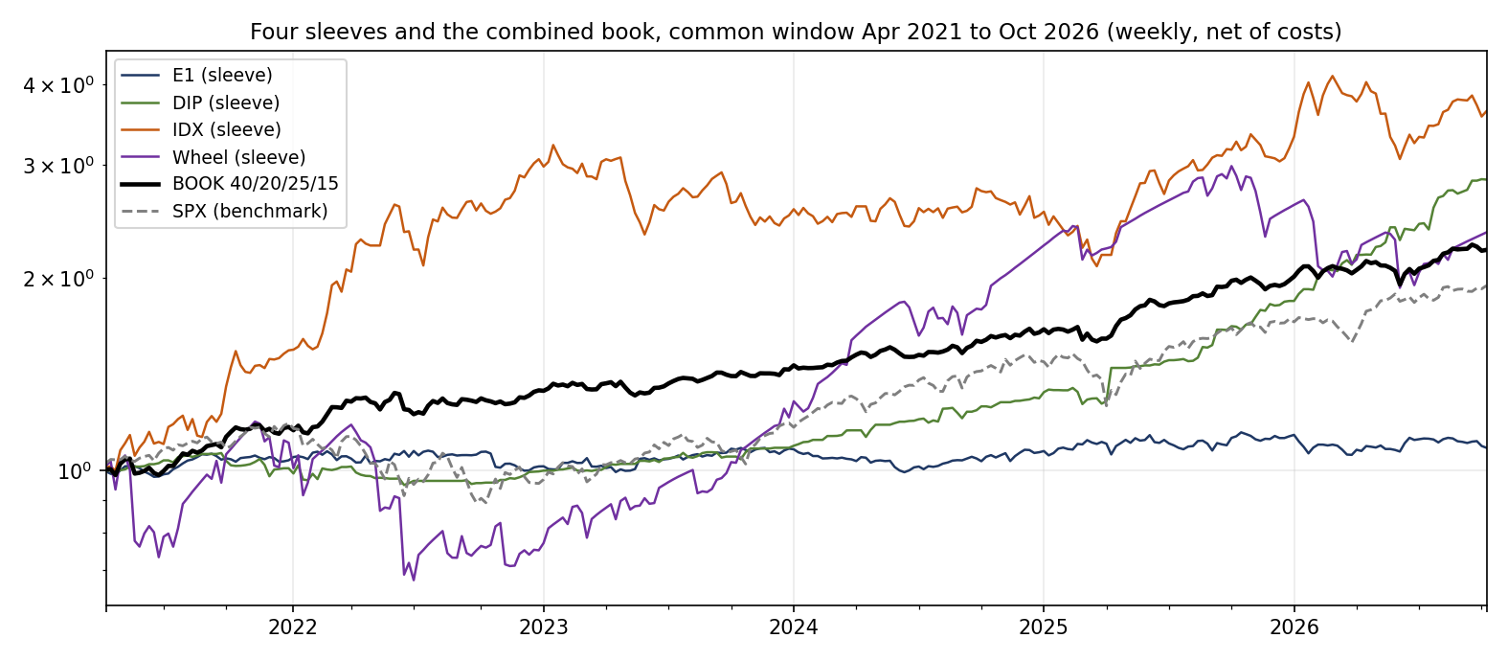
SPEAKER 4 · MICHAEL
PORTFOLIO · CONSTRUCTION
The whole falls less than every part
1.54
Book Sharpe (common window)
+14.1%
2022: BTC −64%, equities −19%
−8.1%
Book max drawdown
+0.07
Book equity beta (A6)
Allocation, quarterly rebalanced: E1 40% Dip 20% IDX 25% Wheel 15%. Sleeves are aggregated in native currencies (IDX in IDR, unhedged): a model composite, not a single-currency fund return.
Sharpe*
CAGR
Vol
Max DD
E1
0.22
1.5%
8.2%
−8.4%
DIP
1.73
20.8%
11.3%
−10.9%
IDX
1.04
26.3%
25.5%
−35.3%
Wheel
0.65
16.7%
32.4%
−43.4%
BOOK
1.54
15.4%
9.6%
−8.1%
Correlations: E1–DIP −0.09, E1–IDX −0.03, E1–Wheel −0.01, DIP–IDX −0.08, DIP–Wheel +0.16, IDX–Wheel +0.23. The grey dashed line is the S&P 500: +94.3% over the window with a −24.8% drawdown, against the book's +121.0% and −8.1%. The dip sleeve trades E1’s market and still correlates at −0.09: it deploys only ≈13% of its capital on average, with positions open on about half of days. Lecture exhibits: A5 · A7 · A6.
SPX
0.84
12.7%
15.7%
−24.8%
Stress record: 2022 +14.1%; Aug 2024 +0.4%; Apr 2025 +1.1%. The 12% vol-target overlay (Sharpe 1.45, DD −10.7%) levers the book up from 9.6% vol: CAGR 19.0%, deeper drawdown. Kept out.
*Sharpe = annualised mean weekly return ÷ standard deviation, no risk-free rate deducted (all rows); net of T-bills (avg 3.4%): book 1.18, SPX 0.63.
Diversification is still the strategy at book level: Sharpe 1.54, max drawdown −8.1%, positive in all three stress windows; 2022 is IDX-driven (+98.7%), without which the other sleeves lose about 7%. SPX: Sharpe 0.84, drawdown −24.8%, −19.4% in 2022.
8
Notes:
Speaker 4 of 5: Michael (slides 8-9). Portfolio: about 50 seconds. Book Sharpe 1.54 against sleeves 0.22 to 1.73 and the SPX at 0.84 with a -24.8% drawdown; correlations near zero, VT overlay kept out.

Slide 9
SPEAKER 4 · MICHAEL
LIVE WINDOW · OPERATIONS
Operating plan
Discipline before performance.
Reporting, in the brief's own metrics: annual return, Sharpe, maximum drawdown and drawdown count, win rate, volatility, number of trades, average holding period, profit per trade.
Reported per sleeve and for the book, with trade counts beside every ratio. A few weeks of live data can validate operations and discipline, not a premium, and we will not present it as if it does.
Freeze log: frozen 1 Oct; two changes inside the window, both on pre-window evidence: (1) 15 Oct, Sleeve 4 CTA futures replaced by dip buying (verified 1.07 vs 0.34, A3); (2) 22 Oct, E1 costing rerun at full turnover (returns fell). Brake, quantified: at or below −5% in 10 weeks (5 episodes); −8% breached once (5 Jun 2026, −8.12%); return effect not simulated. The swap was no response to the live loss: the dip sleeve fell in October too.
• Rules frozen 1 Oct; the freeze log at right records two changes made inside the window, with reasons.
• Weekly tear sheet per sleeve and for the book, produced at every Friday close in the window.
• Book brake: halve gross at −5% drawdown; stop and review at −8% (backtests exclude the brake). October crossed −5% in the week ending 16 Oct; test returns are unbraked.
The operating rhythm
DAILY
WEEKLY
QUARTERLY
FRIDAY CLOSE
E1 s-scores and dip triggers checked. Orders only from frozen rules; every fill logged.
IDX coal and nickel baskets rebalanced; gate status logged. The wheel rolls the next 25-delta BTC contracts.
Book rebalanced back to 40 / 20 / 25 / 15. The weights are not negotiable in between.
Tear sheet per sleeve and for the book, in the brief's metrics, trade counts beside every ratio.
The brake, as a gauge
−8.1% backtest max (unbraked) ▼
0% to −5% · full gross
−5% · halve gross
−8% · stop and review
The window grades discipline, not luck: frozen rules, Friday tear sheets, and a brake whose −5% line the book crossed in the week ending 16 Oct.
9
Notes:
Speaker 4 of 5: Michael (last of your pair). Live plan: about 50 seconds. Discipline before performance; the window grades discipline, not luck. Hand over to Victoria.

Slide 10
SPEAKER 5 · VICTORIA
HONESTY · LIMITATIONS
Limitations, stated plainly
• Wheel: no option quotes were used. Premiums are Black–Scholes at one flat vol (Deribit's 30-day DVOL) on 1-week 25-delta options: no skew, no bid–ask, no term structure, less a 5% haircut. The $476K premium and the A8 vol gap are model outputs that likely flatter calm markets. Venue and assignment mechanics simplified.
• E1: the 34-name universe (9 SGX, 25 US) is today's large-cap list applied backwards; decay documented, not explained away; SGX borrow assumed at modelled cost.
• Dip: today's Nasdaq-100 applied backwards, so names that fell out after a decline are absent; a buy-the-dip rule is the design most flattered by this, so read its 1.73 Sharpe as an upper bound. Sizing is reconstructed. Idle cash earns nothing in the backtest.
• IDX: baskets are today's known winners (survivorship flatters levels; same-basket comparisons are insulated). The nickel basket held three names until Apr 2023 (NCKL and MBMA listed later), so 2022's +98.7% is a seven-stock result. IDR unhedged; coal and nickel are one cycle, not two.
• Book: the window starts Apr 2021 (BTC options history); no 2008/2020-style crash for the full book, and the live window is weeks long.
Where each sleeve is most exposed
Synthetic / estimated inputs
Costs & frictions
Edge decay
Tail / regime break
E1 · Mean reversion
Wheel · BTC options
IDX · Commodities
Dip · NDX reversal
High
Med
Low
Severity:
10
Notes:
Speaker 5 of 5: Victoria (slides 10-11). Limitations: about 50 seconds. State them plainly; do not apologise for them.

Slide 11
SPEAKER 5 · VICTORIA
RISK · PRE-COMMITMENT
Kill criteria, pre-committed
Sleeve
Kill rule
E1
Stop if live profit per trade is negative after 200 trades, or if the freeze log shows a parameter change.
Wheel
Stop if cumulative assignment losses exceed the trailing two years of premium collected.
IDX
Stop if the sleeve's live drawdown exceeds −42%, beyond its full-history backtest maximum (−41.8% since 2016; −35.3% on the common window).
Dip
Stop if sleeve drawdown exceeds −13%, beyond its backtest maximum of −11.3% (July 2026, long run and since 2024 alike): the design has no stop loss, so the drawdown limit is the stop.
Book
The −8% brake is the kill criterion for the combination itself.
The book brake, on one line
0% to −5%: full gross
−5%: halve gross
−8%: stop and review
Backtest maximum drawdown without the brake: −8.1% (Apr 2021 to Oct 2026). The −8% stop sits just inside it, so a live repeat is cut at the stop, not after it.
Four premia, four market structures, one book: sized by damage, frozen in advance,
and reported the way we would want to read it.
11
Notes:
Speaker 5 of 5: Victoria (last of your pair). Kill criteria: about 50 seconds, then hand to the group close on slide 12.

Slide 12
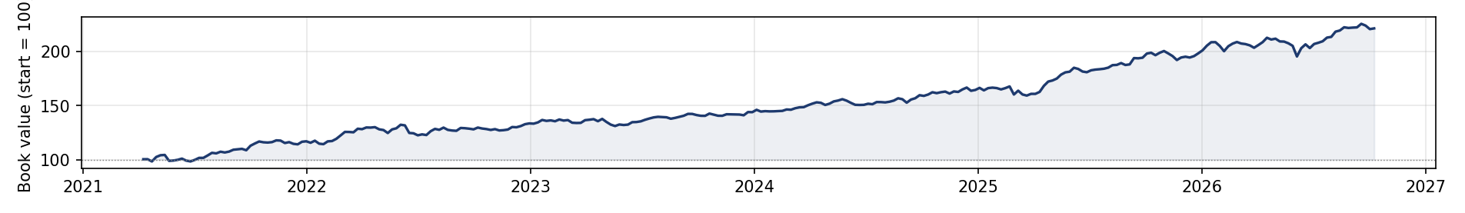
CONCLUSION
What we built, and what would change our minds
1 · Four premia, no single dominant driver.
Pairwise correlations −0.09 to +0.23; the book's equity beta is +0.07; but three sleeves are long risk (slide 3). Diversification here is measured in sample, over 288 weeks.
2 · The book falls less than its parts.
The book: Apr 2021 to Oct 2026, 100 → 221.
Sharpe 1.54 vs 0.22 to 1.73 for the sleeves; maximum drawdown −8.1%, shallower than every sleeve; +14.1% in 2022. The dip sleeve rivals it, but deploys only ≈13% of capital on average (in cash on about half of days): it cannot be the whole book.
THE HOOK, ANSWERED
Crypto winter
Wheel −43% vs −74%
3 · Four designs dropped; the record is public.
Three designs died on their own evidence, and a fourth, the working CTA futures sleeve, was still substituted when the dip strategy verified stronger (A3).
Rate shock 2022
Book +14.1%
4 · Sized by damage, frozen in advance.
Yen unwind
Book +0.4%
EVT tails set the weights' conscience: the wheel is smallest because its shortfall is largest (A7). The brake is pre-committed (slide 11).
Tariff shock
Book +1.1%
What would change our minds: a sleeve breaching its kill rule in the live window. We stop it, and we report that too.
Gold supercycle
Indirect only: IDX gold β +0.38
The claim of this project is not that we found four edges. It is that we built a book that can survive being wrong about one of them.
12
Notes:
Group close: all five speakers, one takeaway each, about 40 seconds total. Andrew: the hook, answered. Edward: Sleeve 1. Wielly: Sleeves 3 and 4. Michael: the book in numbers. Victoria: the kill discipline. End on the verdict strip, then Q&A. Appendix A1-A9 is backup for Q&A, not presented.

Slide 13
APPENDIX A1 · SPECIFICATIONS
Frozen specification sheet
Sleeve
Specification
E1
3 PCA factors, 60d window, s open ±1.5 / close ∓0.5, stop |s| > 3.5, OU half-life ≤ 30d; 34 names (9 SGX, 25 US); 10 bps on every change in position weight (entries, exits, daily rebalancing).
Wheel
Weekly Fri cycle; 25-delta 1-week options; puts when flat, calls when holding; full cash cover; T-bill on cash; 5% premium haircut; DVOL pricing (30d IV).
IDX
EW baskets, weekly; coal (ADRO, PTBA, ITMG, BYAN), nickel (ANTM, INCO, MDKA, NCKL, MBMA), gold (ANTM, BRMS, PSAB, MDKA, ARCI); sleeve gates: coal on BTU trend, nickel on own 40wk trend, gold on gold 40wk trend + COT Brake B; 25 bps/side; IDR. Book series: ungated coal + nickel growth baskets; gates and the gold basket are design variants (A3).
Dip
Nasdaq-100 (101 current constituents); close > 200d SMA; signal: 1-day drop > 3% and ATR(5)/close > 3%; next-day limit at signal close − 0.9×ATR(5); rank ATR(5)/close desc; max 10 positions; size = prior-close equity / 10 (reconstructed); exits: +0.5×ATR target, close > prior day high, or day 11; no stop; IBKR tiered commissions.
Book
40/20/25/15, quarterly rebalance; brake at −5% (halve) and −8% (stop) book drawdown.
FROZEN
Final specification, fixed Oct 2026; two changes logged (slide 9)
LIVE WINDOW
Oct 2026; final tear sheet at the 30 Oct close
NO SILENT CHANGES
Any change enters the freeze log, with reasons
→
→
13

Slide 14
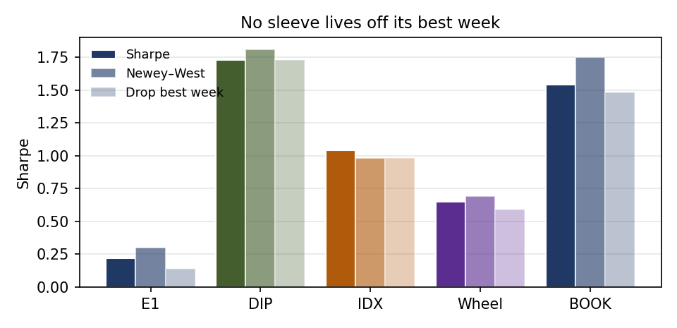
APPENDIX A2 · ROBUSTNESS
Robustness (common window, weekly)
Sharpe
Newey–West
Drop-best
E1
0.22
0.30
0.14
DIP
1.73
1.81
1.73
IDX
1.04
0.98
0.98
Wheel
0.65
0.69
0.59
BOOK
1.54
1.75
1.48
SPX
0.84
0.98
0.78
No sleeve, and not the book, depends on its single best week. Newey–West Sharpe is above raw Sharpe for every row except IDX, consistent with mild negative weekly autocorrelation in the others.
Parameter sensitivity: E1 Sharpe peaks at the frozen 3 factors (0.43/0.67/0.48/0.26 for 2/3/4/5 factors), so the frozen spec is the in-sample best on that axis. s-entry 1.75 gives 0.99 against the frozen 1.5 (drawdown −14.8% vs −9.1%); it was measured and deliberately not taken.
14

Slide 15
APPENDIX A3 · REJECTION LOG
What we tested and killed
Candidate
Evidence
CTA futures trend (built, then substituted)
Verified as designed (Sharpe 0.34; 2022 +17.4%), then replaced as Sleeve 4 by the dip strategy on the group's direction, for its stronger verified record (1.07 long run, 1.70 since 2024). Cost: the book no longer shorts bonds or the dollar.
BTC regime wheel
Sharpe 0.48 vs 0.65 always-on; 2022 −60.7% vs −32.0%. Replaced by the plain wheel.
COT Brake A (gold)
Exit at 90th positioning percentile: Sharpe 0.54 vs 0.56 (gold), 0.67 vs 0.81 (miners); out of the market 32% of weeks. Brake B (percentile + momentum) adopted instead.
CPO basket (IDX)
Sharpe 0.24 to 0.40 in every variant, drawdowns −53% to −68%. Dropped; gold miners took the third-basket slot.
Pairs trading
Set aside by the group as a well-trodden design before testing; the PCA engine generalises it.
5
Entries in this log
4
Killed or substituted
1
Set aside untested (pairs)
0
Killed designs still in the book
15

Slide 16
APPENDIX A4 · DATA & PROTOCOLS
Data and anti-look-ahead protocols
Sources. Prices: Yahoo Finance (equities, futures, BTC). Options: Deribit DVOL volatility index (daily, Mar 2021 onwards), options priced by Black–Scholes at 25 delta. Positioning: CFTC Commitments of Traders, COMEX gold, legacy noncommercial net as % of open interest. Rates: 13-week T-bill (^IRX).
Anti-look-ahead protocols. COT: a Tuesday report is used only at Friday evaluations at least 7 days later (it is published Friday, after the IDX close). All signals are computed on data dated on or before the decision close; execution is at the next session or the same close as stated per sleeve. Point-in-time caveat: IDX baskets and the E1 universe are today's constituents; the limitation is disclosed on slide 10, not buried here.
SOURCES
Yahoo prices · Deribit DVOL · CFTC COT · T-bill rate
PROTOCOLS
COT lagged 7+ days · signals on or before the decision close · costs per sleeve
OUTPUT
Friday tear sheet: the brief's nine metrics, per sleeve and for the book
→
→
16

Slide 17
APPENDIX A5 · ALLOCATION
Why these weights (sensitivity)
Weights were set by design and frozen for the live window; the study validates the choice rather than fitting it. Anchor: risk parity on measured sleeve vols (E1 8.2%, Dip 11.3%, IDX 25.5%, Wheel 32.4%) gives ≈44/31/14/11, adjusted for E1's alpha decay, the dip sleeve’s long-only equity exposure, and the wheel’s short-vol tail.
E1
40%
IDX
25%
Dip
20%
Wheel
15%
Weights
Sharpe
CAGR
Vol
Max DD
2022
Chosen 40/20/25/15
1.54
15.4%
9.6%
−8.1%
+14.1%
Risk parity ≈44/31/14/11
1.78
13.8%
7.4%
−4.9%
+6.2%
Equal weight 25 each
1.48
18.4%
12.0%
−10.5%
+10.8%
E1-heavy 50/15/20/15
1.42
13.0%
8.9%
−7.4%
+9.8%
The optimum is no longer flat: parity reaches 1.78 by loading the low-volatility dip sleeve to 31%. The chosen weights accept 1.54 in exchange for the best crisis year (+14.1% in 2022 vs parity’s +6.2%) and less riding on two equity sleeves. Either is defensible; the trade-off is disclosed, not hidden.
17

Slide 18
APPENDIX A6 · LECTURE: FACTOR MODELS
Factor attribution: the premia are different, measurably
Weekly return betas
SPX
BTC
Gold
Coal
R²
E1
+0.03
−0.00
−0.02
−0.01
0.01
DIP
+0.16
+0.00
+0.08
+0.00
0.08
IDX
+0.03
+0.08
+0.38
+0.07
0.17
Wheel
+0.16
+0.47
−0.02
+0.02
0.66
BOOK
+0.07
+0.09
+0.10
+0.02
0.41
OLS of each sleeve's weekly returns on S&P 500, BTC, gold and coal futures, common window (Apr 2021 to Oct 2026, n = 288). Bold: |t| > 2.6. Cell shading deepens with |β|.
E1 loads on nothing (R² = 0.01): near-zero measured factor exposure, not neutrality by claim. The book's equity beta is +0.07: about +0.03 from the dip sleeve (+0.16 at a 20% weight), +0.02 from the wheel (+0.16 at 15%), the rest from E1 and IDX. The book's largest betas are to gold (+0.10) and BTC (+0.09). IDX loads on gold (+0.38) more than coal (+0.07): its nickel names (ANTM and MDKA are also gold miners) dominated the window.
18

Slide 19
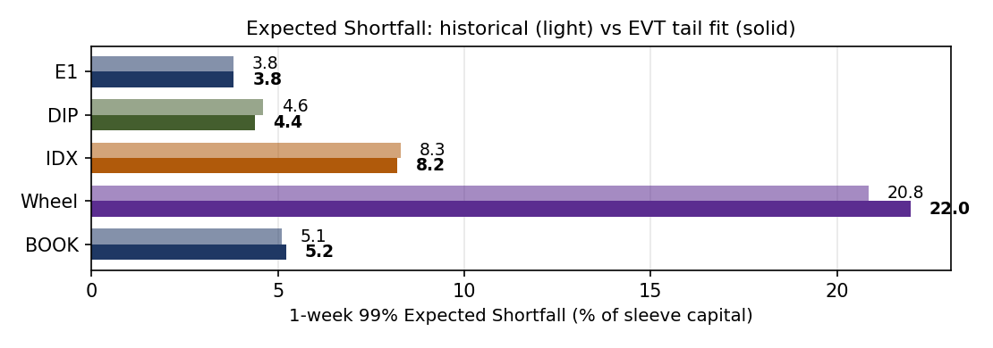
APPENDIX A7 · LECTURE: RISK & EVT (L7)
Tail risk: one-week 99% VaR and Expected Shortfall
Losses, % of sleeve capital
VaR (hist)
ES (hist)
VaR (EVT)
ES (EVT)
Tail ξ
E1 (40%)
2.8
3.8
3.1
3.8
−0.03
DIP (20%)
4.1
4.6
3.6
4.4
−0.20
IDX (25%)
7.6
8.3
7.7
8.2
−0.53
Wheel (15%)
15.9
20.8
15.9
22.0
+0.12
BOOK
4.5
5.1
3.5
5.2
+0.26
Historical quantiles on weekly returns plus an EVT peaks-over-threshold fit (GPD, 90% threshold, ≈29 exceedances; ξ is indicative, not precise), common window.
The wheel owns the tail, a 1-week ES of about 21 to 22% of its own capital, and is the smallest sleeve for exactly that reason.
The EVT fit and history now agree on the book (ES ≈ 5.1 to 5.2%): the dip sleeve’s truncated tail (ξ −0.20; its exits cap the holding period, not the loss) thins the book’s tail versus the earlier CTA-futures Sleeve 4 (A3). The −8% brake still sits beyond one very bad week.
19

Slide 20
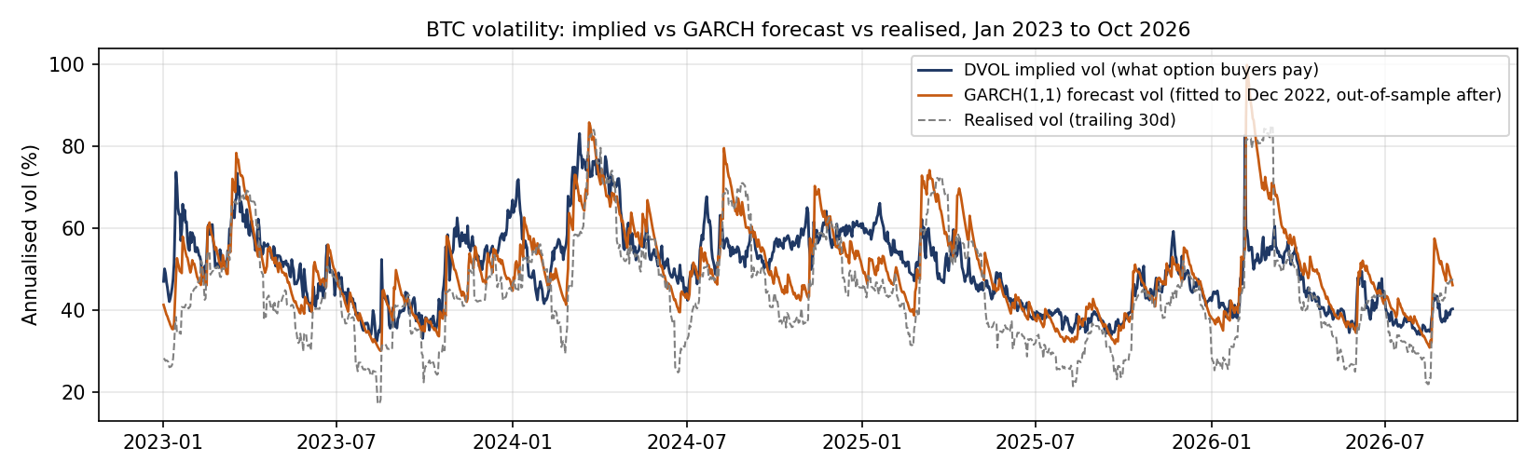
APPENDIX A8 · LECTURE: ARCH / GARCH
The wheel's premium, measured: implied vs forecast vs realised vol
GARCH(1,1) on BTC daily returns, fitted Jan 2015 to Dec 2022: α 0.055, β 0.945, persistence ≈ 1.00. Volatility shocks barely decay, which is why a premium seller respects vol regimes.
Out-of-sample, Jan 2023 to Sep 2026 (means): DVOL implied 49.7%, GARCH forecast 49.7%, vol that subsequently arrived 44.4%.
Implied exceeded subsequent realised vol on 69% of days.
Implied and GARCH agree as forecasts; both sit above what volatility delivered. The ≈5-vol-point average gap is the implied-minus-realised vol spread — the premium, quoted in vol points. The wheel sells that gap and nets assignment losses against it in the backtest (Sleeve 2); the chart's 30-day IV input flatters calm-market levels, as disclosed.
20

Slide 21
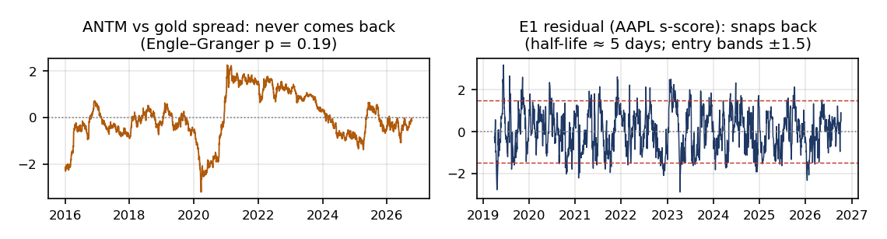
APPENDIX A9 · LECTURE: COINTEGRATION
Cointegration exhibits: beta without an anchor
Pair
β
EG p
Spread HL
Engle–Granger verdict: no pair cointegrates (all p ≥ 0.19; spread half-lives of 5 months to effectively never). The miners carry commodity *return beta* without a price-level anchor, so Sleeve 3's design research used trend gates, not spreads against the commodity.
Contrast, Sleeve 1: ADF rejects a unit root for all 34 factor-residual series; residual half-lives cluster at 5 to 6 days, inside the engine's 30-day admission filter. That is what a tradeable spread looks like.
Sleeve 4’s filter is the same logic used defensively: dip entries require a close above the 200-day average, so in 2022 the sleeve returned −1.1% while sitting mostly in cash (average capital use 10%). An uptrend filter is a crude but effective regime gate.
ADRO vs coal (BTU)
0.39
0.95
>500d
PTBA vs coal (BTU)
0.24
0.83
312d
ITMG vs coal (BTU)
0.49
0.79
325d
BYAN vs coal (BTU)
0.55
0.73
>500d
ANTM vs gold
1.40
0.19
153d
MDKA vs gold
1.47
0.89
497d
Daily log prices, Jan 2016 to Oct 2026. β from OLS of log miner on log commodity; EG p is the Engle–Granger cointegration p-value; HL is the spread's AR(1) half-life.
21

