Slide 1
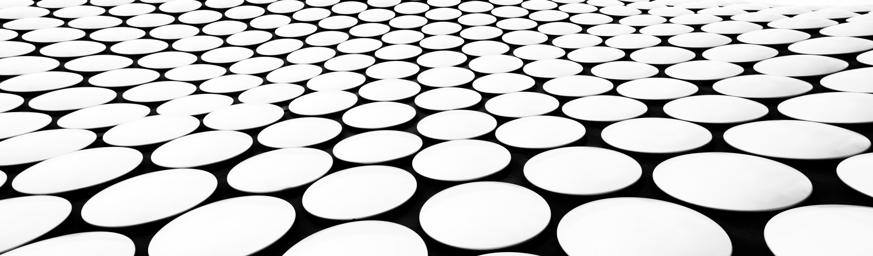
Photoshop or not?
Joey chew, Ga-dsi-13

Slide 2
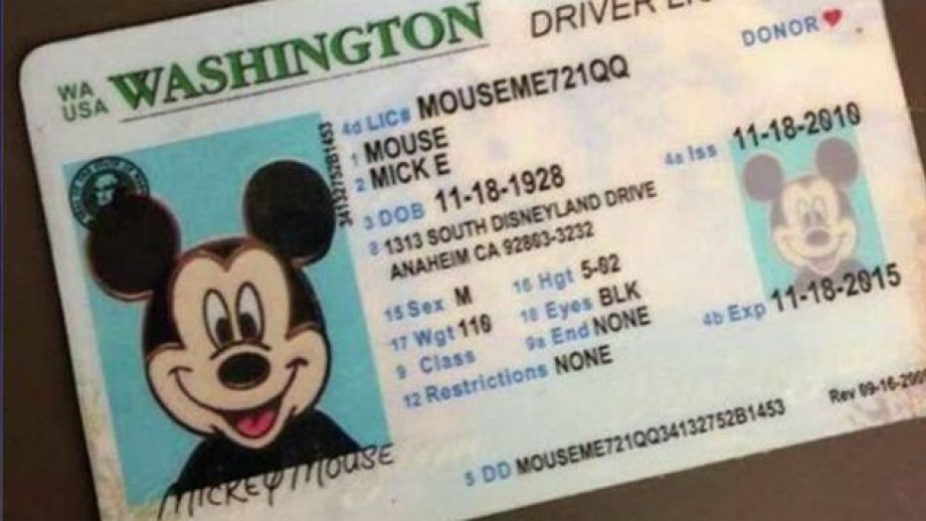
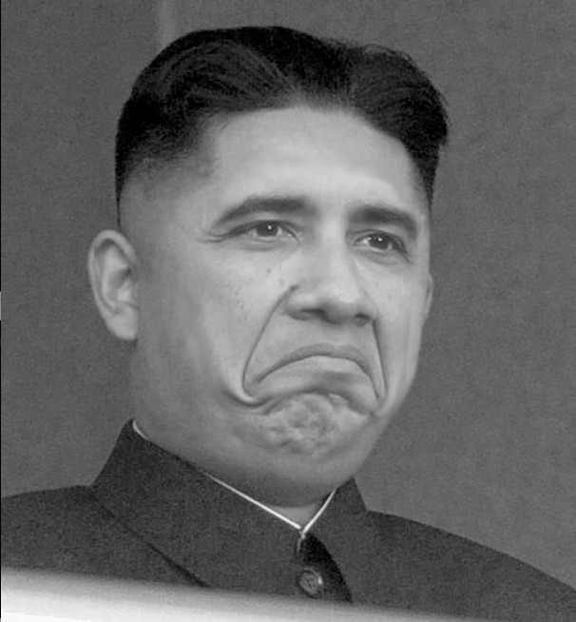
Problem Statement
Identify Modified Digital Images
Combat Criminal Fraud
Academic Falsification
Common Mischief
Notes:
We live in a world where digital images pervade all aspects of our lives. Traditional cameras still exist, primarily for hobbies or art, otherwise, the convenience of digital images, and to a wider extent, digital videos lead to them being the media of choice over traditional analog methods.
Unfortunately, with the ease of editing digital images, abuse of such has gained traction too. Tampering of images may range from the helpful, sharpening of desired features, to benign/minor mischief spliced joke photos, to malicious intent such as misleading, swaying of public opinions, or even fraud.
Due to limitations on computational power and resources, I have chosen to limit my addressing of these issues by creating a supervised machine learning model which, upon being presented with a RGB image (full colored image made up of primary colors), executes a binary classification prediction based on trained weights into Class 0 (Unmodified Image) and Class 1 (Modified Image).
My model's predictions will not be limited to any specific domain (eg. humans, specific sports activities). I have set the target for my intended model have better accuracy than a baseline naive prediction of the majority class, as well as aim for a minimum of 85% accuracy on test set used in the model.

Slide 3
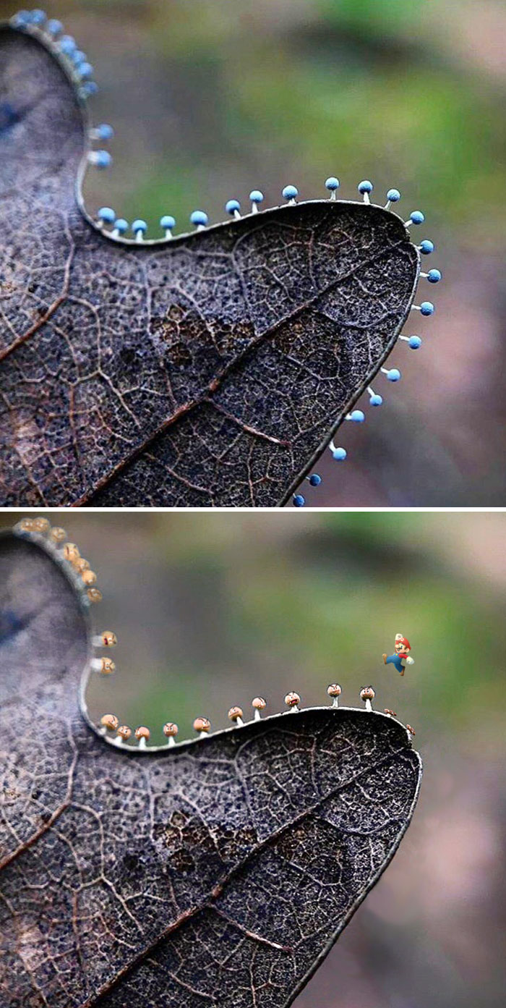
GOAL - Model Predicting Binary Classification
Class 0: Unmodified Images
Class 1: Modified Images
Notes:
We live in a world where digital images pervade all aspects of our lives. Traditional cameras still exist, primarily for hobbies or art, otherwise, the convenience of digital images, and to a wider extent, digital videos lead to them being the media of choice over traditional analog methods.
Unfortunately, with the ease of editing digital images, abuse of such has gained traction too. Tampering of images may range from the helpful, sharpening of desired features, to benign/minor mischief spliced joke photos, to malicious intent such as misleading, swaying of public opinions, or even fraud.
Due to limitations on computational power and resources, I have chosen to limit my addressing of these issues by creating a supervised machine learning model which, upon being presented with a RGB image (full colored image made up of primary colors), executes a binary classification prediction based on trained weights into Class 0 (Unmodified Image) and Class 1 (Modified Image).
My model's predictions will not be limited to any specific domain (eg. humans, specific sports activities). I have set the target for my intended model have better accuracy than a baseline naive prediction of the majority class, as well as aim for a minimum of 85% accuracy on test set used in the model.

Slide 4
Data Source
https://github.com/dbisUnibas/PS-Battles,
Databases and Information Systems Research Group
Department of Mathematics and Computer Science, University of Basel, Switzerland.
10, 000 Original Images
90, 000 Photoshopped Images
Notes:
We live in a world where digital images pervade all aspects of our lives. Traditional cameras still exist, primarily for hobbies or art, otherwise, the convenience of digital images, and to a wider extent, digital videos lead to them being the media of choice over traditional analog methods.
Unfortunately, with the ease of editing digital images, abuse of such has gained traction too. Tampering of images may range from the helpful, sharpening of desired features, to benign/minor mischief spliced joke photos, to malicious intent such as misleading, swaying of public opinions, or even fraud.
Due to limitations on computational power and resources, I have chosen to limit my addressing of these issues by creating a supervised machine learning model which, upon being presented with a RGB image (full colored image made up of primary colors), executes a binary classification prediction based on trained weights into Class 0 (Unmodified Image) and Class 1 (Modified Image).
My model's predictions will not be limited to any specific domain (eg. humans, specific sports activities). I have set the target for my intended model have better accuracy than a baseline naive prediction of the majority class, as well as aim for a minimum of 85% accuracy on test set used in the model.

Slide 5
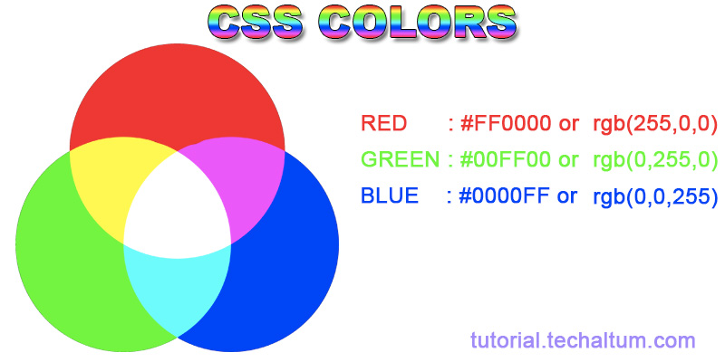
Color CHannels
Red Value. Green Value, Blue Value
Notes:
We live in a world where digital images pervade all aspects of our lives. Traditional cameras still exist, primarily for hobbies or art, otherwise, the convenience of digital images, and to a wider extent, digital videos lead to them being the media of choice over traditional analog methods.
Unfortunately, with the ease of editing digital images, abuse of such has gained traction too. Tampering of images may range from the helpful, sharpening of desired features, to benign/minor mischief spliced joke photos, to malicious intent such as misleading, swaying of public opinions, or even fraud.
Due to limitations on computational power and resources, I have chosen to limit my addressing of these issues by creating a supervised machine learning model which, upon being presented with a RGB image (full colored image made up of primary colors), executes a binary classification prediction based on trained weights into Class 0 (Unmodified Image) and Class 1 (Modified Image).
My model's predictions will not be limited to any specific domain (eg. humans, specific sports activities). I have set the target for my intended model have better accuracy than a baseline naive prediction of the majority class, as well as aim for a minimum of 85% accuracy on test set used in the model.

Slide 6
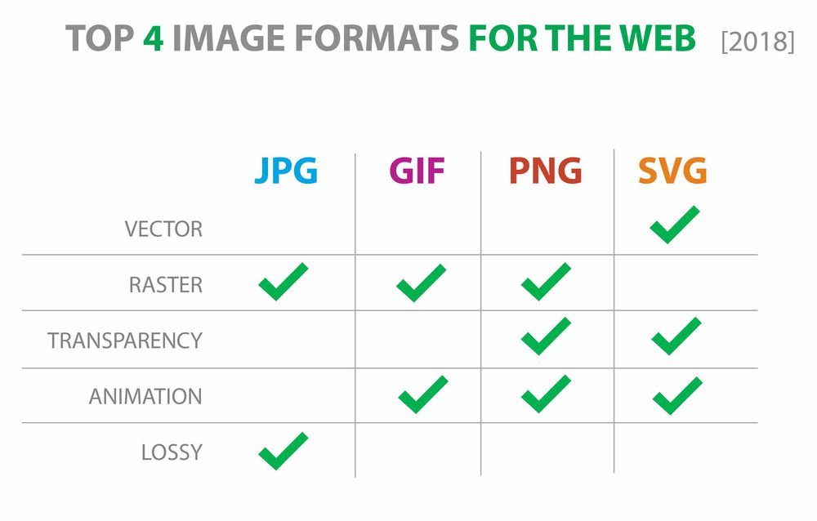
Notes:
We live in a world where digital images pervade all aspects of our lives. Traditional cameras still exist, primarily for hobbies or art, otherwise, the convenience of digital images, and to a wider extent, digital videos lead to them being the media of choice over traditional analog methods.
Unfortunately, with the ease of editing digital images, abuse of such has gained traction too. Tampering of images may range from the helpful, sharpening of desired features, to benign/minor mischief spliced joke photos, to malicious intent such as misleading, swaying of public opinions, or even fraud.
Due to limitations on computational power and resources, I have chosen to limit my addressing of these issues by creating a supervised machine learning model which, upon being presented with a RGB image (full colored image made up of primary colors), executes a binary classification prediction based on trained weights into Class 0 (Unmodified Image) and Class 1 (Modified Image).
My model's predictions will not be limited to any specific domain (eg. humans, specific sports activities). I have set the target for my intended model have better accuracy than a baseline naive prediction of the majority class, as well as aim for a minimum of 85% accuracy on test set used in the model.

Slide 7
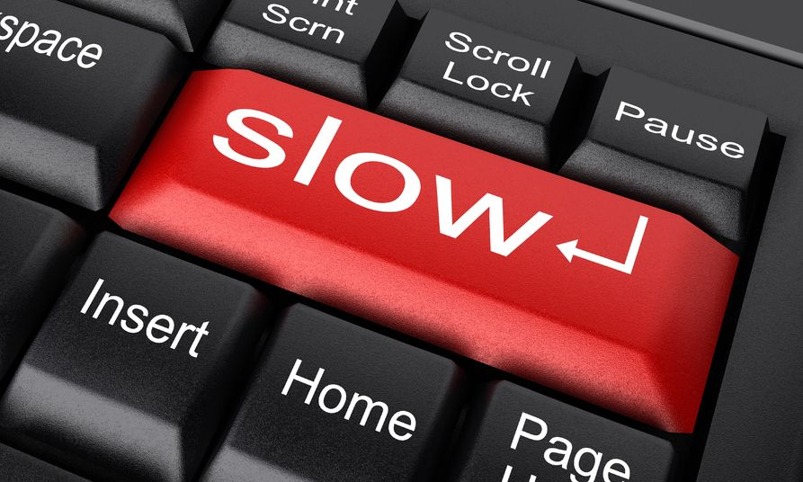
Insufficient Computing Power
Notes:
We live in a world where digital images pervade all aspects of our lives. Traditional cameras still exist, primarily for hobbies or art, otherwise, the convenience of digital images, and to a wider extent, digital videos lead to them being the media of choice over traditional analog methods.
Unfortunately, with the ease of editing digital images, abuse of such has gained traction too. Tampering of images may range from the helpful, sharpening of desired features, to benign/minor mischief spliced joke photos, to malicious intent such as misleading, swaying of public opinions, or even fraud.
Due to limitations on computational power and resources, I have chosen to limit my addressing of these issues by creating a supervised machine learning model which, upon being presented with a RGB image (full colored image made up of primary colors), executes a binary classification prediction based on trained weights into Class 0 (Unmodified Image) and Class 1 (Modified Image).
My model's predictions will not be limited to any specific domain (eg. humans, specific sports activities). I have set the target for my intended model have better accuracy than a baseline naive prediction of the majority class, as well as aim for a minimum of 85% accuracy on test set used in the model.

Slide 8

Insufficient RAM
32 GB RAM
Thumbnail (256, 256, 3)
100,000 >> 3,000 Images
Batch Processing
Notes:
We live in a world where digital images pervade all aspects of our lives. Traditional cameras still exist, primarily for hobbies or art, otherwise, the convenience of digital images, and to a wider extent, digital videos lead to them being the media of choice over traditional analog methods.
Unfortunately, with the ease of editing digital images, abuse of such has gained traction too. Tampering of images may range from the helpful, sharpening of desired features, to benign/minor mischief spliced joke photos, to malicious intent such as misleading, swaying of public opinions, or even fraud.
Due to limitations on computational power and resources, I have chosen to limit my addressing of these issues by creating a supervised machine learning model which, upon being presented with a RGB image (full colored image made up of primary colors), executes a binary classification prediction based on trained weights into Class 0 (Unmodified Image) and Class 1 (Modified Image).
My model's predictions will not be limited to any specific domain (eg. humans, specific sports activities). I have set the target for my intended model have better accuracy than a baseline naive prediction of the majority class, as well as aim for a minimum of 85% accuracy on test set used in the model.

Slide 9
Data Transformation and Engineering
Balance Classes
More Base Reference Images
Padding to Uniform Size
Notes:
We live in a world where digital images pervade all aspects of our lives. Traditional cameras still exist, primarily for hobbies or art, otherwise, the convenience of digital images, and to a wider extent, digital videos lead to them being the media of choice over traditional analog methods.
Unfortunately, with the ease of editing digital images, abuse of such has gained traction too. Tampering of images may range from the helpful, sharpening of desired features, to benign/minor mischief spliced joke photos, to malicious intent such as misleading, swaying of public opinions, or even fraud.
Due to limitations on computational power and resources, I have chosen to limit my addressing of these issues by creating a supervised machine learning model which, upon being presented with a RGB image (full colored image made up of primary colors), executes a binary classification prediction based on trained weights into Class 0 (Unmodified Image) and Class 1 (Modified Image).
My model's predictions will not be limited to any specific domain (eg. humans, specific sports activities). I have set the target for my intended model have better accuracy than a baseline naive prediction of the majority class, as well as aim for a minimum of 85% accuracy on test set used in the model.

Slide 10
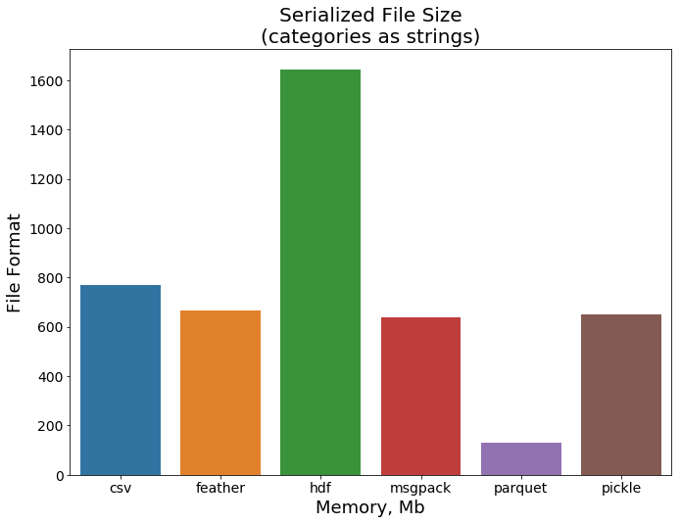
File Transfer Formats
Notes:
We live in a world where digital images pervade all aspects of our lives. Traditional cameras still exist, primarily for hobbies or art, otherwise, the convenience of digital images, and to a wider extent, digital videos lead to them being the media of choice over traditional analog methods.
Unfortunately, with the ease of editing digital images, abuse of such has gained traction too. Tampering of images may range from the helpful, sharpening of desired features, to benign/minor mischief spliced joke photos, to malicious intent such as misleading, swaying of public opinions, or even fraud.
Due to limitations on computational power and resources, I have chosen to limit my addressing of these issues by creating a supervised machine learning model which, upon being presented with a RGB image (full colored image made up of primary colors), executes a binary classification prediction based on trained weights into Class 0 (Unmodified Image) and Class 1 (Modified Image).
My model's predictions will not be limited to any specific domain (eg. humans, specific sports activities). I have set the target for my intended model have better accuracy than a baseline naive prediction of the majority class, as well as aim for a minimum of 85% accuracy on test set used in the model.

Slide 11
Model Results
Baseline Majority Class of 53%
Notes:
We live in a world where digital images pervade all aspects of our lives. Traditional cameras still exist, primarily for hobbies or art, otherwise, the convenience of digital images, and to a wider extent, digital videos lead to them being the media of choice over traditional analog methods.
Unfortunately, with the ease of editing digital images, abuse of such has gained traction too. Tampering of images may range from the helpful, sharpening of desired features, to benign/minor mischief spliced joke photos, to malicious intent such as misleading, swaying of public opinions, or even fraud.
Due to limitations on computational power and resources, I have chosen to limit my addressing of these issues by creating a supervised machine learning model which, upon being presented with a RGB image (full colored image made up of primary colors), executes a binary classification prediction based on trained weights into Class 0 (Unmodified Image) and Class 1 (Modified Image).
My model's predictions will not be limited to any specific domain (eg. humans, specific sports activities). I have set the target for my intended model have better accuracy than a baseline naive prediction of the majority class, as well as aim for a minimum of 85% accuracy on test set used in the model.

Slide 12
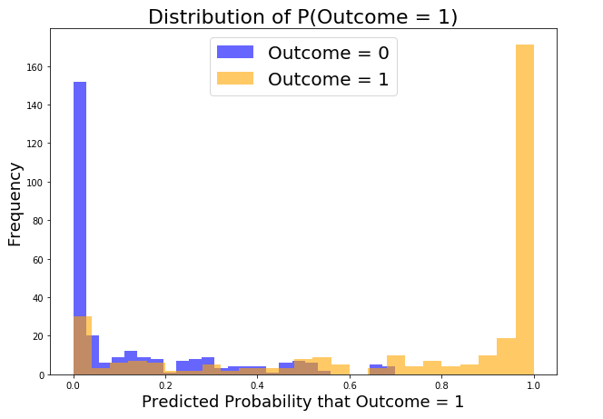
Distribution of Probabilities
Notes:
We live in a world where digital images pervade all aspects of our lives. Traditional cameras still exist, primarily for hobbies or art, otherwise, the convenience of digital images, and to a wider extent, digital videos lead to them being the media of choice over traditional analog methods.
Unfortunately, with the ease of editing digital images, abuse of such has gained traction too. Tampering of images may range from the helpful, sharpening of desired features, to benign/minor mischief spliced joke photos, to malicious intent such as misleading, swaying of public opinions, or even fraud.
Due to limitations on computational power and resources, I have chosen to limit my addressing of these issues by creating a supervised machine learning model which, upon being presented with a RGB image (full colored image made up of primary colors), executes a binary classification prediction based on trained weights into Class 0 (Unmodified Image) and Class 1 (Modified Image).
My model's predictions will not be limited to any specific domain (eg. humans, specific sports activities). I have set the target for my intended model have better accuracy than a baseline naive prediction of the majority class, as well as aim for a minimum of 85% accuracy on test set used in the model.

Slide 13
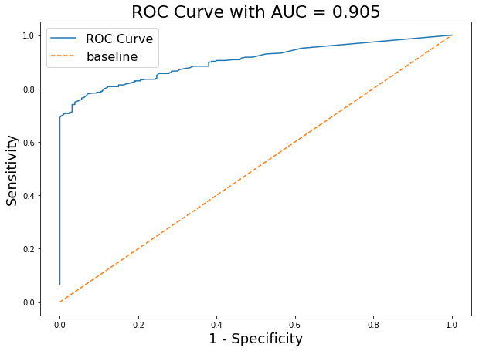
ROC AUC
Notes:
We live in a world where digital images pervade all aspects of our lives. Traditional cameras still exist, primarily for hobbies or art, otherwise, the convenience of digital images, and to a wider extent, digital videos lead to them being the media of choice over traditional analog methods.
Unfortunately, with the ease of editing digital images, abuse of such has gained traction too. Tampering of images may range from the helpful, sharpening of desired features, to benign/minor mischief spliced joke photos, to malicious intent such as misleading, swaying of public opinions, or even fraud.
Due to limitations on computational power and resources, I have chosen to limit my addressing of these issues by creating a supervised machine learning model which, upon being presented with a RGB image (full colored image made up of primary colors), executes a binary classification prediction based on trained weights into Class 0 (Unmodified Image) and Class 1 (Modified Image).
My model's predictions will not be limited to any specific domain (eg. humans, specific sports activities). I have set the target for my intended model have better accuracy than a baseline naive prediction of the majority class, as well as aim for a minimum of 85% accuracy on test set used in the model.

Slide 14
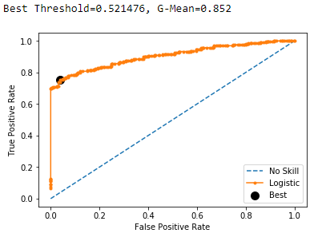
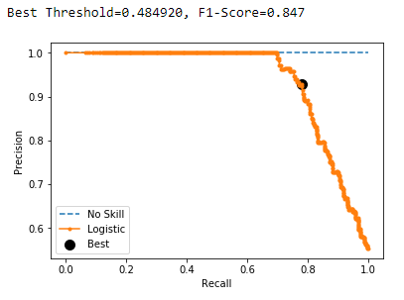
Additional Tweaking
Notes:
We live in a world where digital images pervade all aspects of our lives. Traditional cameras still exist, primarily for hobbies or art, otherwise, the convenience of digital images, and to a wider extent, digital videos lead to them being the media of choice over traditional analog methods.
Unfortunately, with the ease of editing digital images, abuse of such has gained traction too. Tampering of images may range from the helpful, sharpening of desired features, to benign/minor mischief spliced joke photos, to malicious intent such as misleading, swaying of public opinions, or even fraud.
Due to limitations on computational power and resources, I have chosen to limit my addressing of these issues by creating a supervised machine learning model which, upon being presented with a RGB image (full colored image made up of primary colors), executes a binary classification prediction based on trained weights into Class 0 (Unmodified Image) and Class 1 (Modified Image).
My model's predictions will not be limited to any specific domain (eg. humans, specific sports activities). I have set the target for my intended model have better accuracy than a baseline naive prediction of the majority class, as well as aim for a minimum of 85% accuracy on test set used in the model.

Slide 15
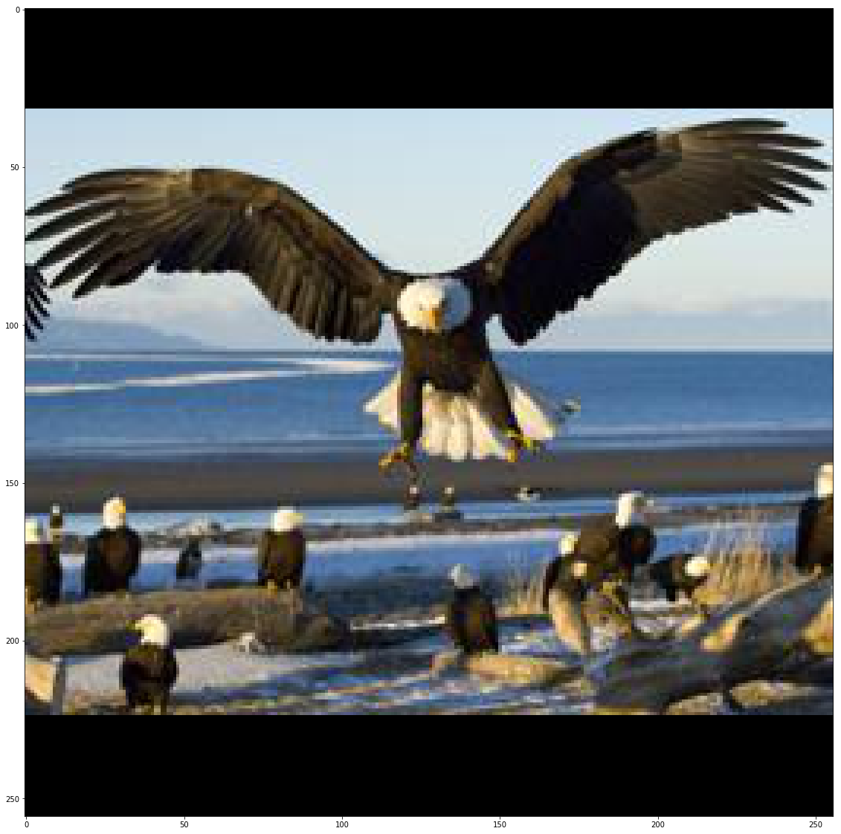
visualisation in CNN Network – Sample Image
Notes:
We live in a world where digital images pervade all aspects of our lives. Traditional cameras still exist, primarily for hobbies or art, otherwise, the convenience of digital images, and to a wider extent, digital videos lead to them being the media of choice over traditional analog methods.
Unfortunately, with the ease of editing digital images, abuse of such has gained traction too. Tampering of images may range from the helpful, sharpening of desired features, to benign/minor mischief spliced joke photos, to malicious intent such as misleading, swaying of public opinions, or even fraud.
Due to limitations on computational power and resources, I have chosen to limit my addressing of these issues by creating a supervised machine learning model which, upon being presented with a RGB image (full colored image made up of primary colors), executes a binary classification prediction based on trained weights into Class 0 (Unmodified Image) and Class 1 (Modified Image).
My model's predictions will not be limited to any specific domain (eg. humans, specific sports activities). I have set the target for my intended model have better accuracy than a baseline naive prediction of the majority class, as well as aim for a minimum of 85% accuracy on test set used in the model.

Slide 16
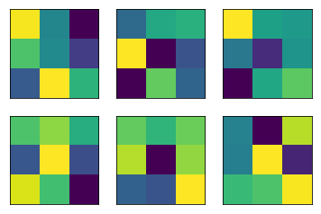
Visualisation in CNN Network – 1st layer FIlters
Notes:
We live in a world where digital images pervade all aspects of our lives. Traditional cameras still exist, primarily for hobbies or art, otherwise, the convenience of digital images, and to a wider extent, digital videos lead to them being the media of choice over traditional analog methods.
Unfortunately, with the ease of editing digital images, abuse of such has gained traction too. Tampering of images may range from the helpful, sharpening of desired features, to benign/minor mischief spliced joke photos, to malicious intent such as misleading, swaying of public opinions, or even fraud.
Due to limitations on computational power and resources, I have chosen to limit my addressing of these issues by creating a supervised machine learning model which, upon being presented with a RGB image (full colored image made up of primary colors), executes a binary classification prediction based on trained weights into Class 0 (Unmodified Image) and Class 1 (Modified Image).
My model's predictions will not be limited to any specific domain (eg. humans, specific sports activities). I have set the target for my intended model have better accuracy than a baseline naive prediction of the majority class, as well as aim for a minimum of 85% accuracy on test set used in the model.

Slide 17
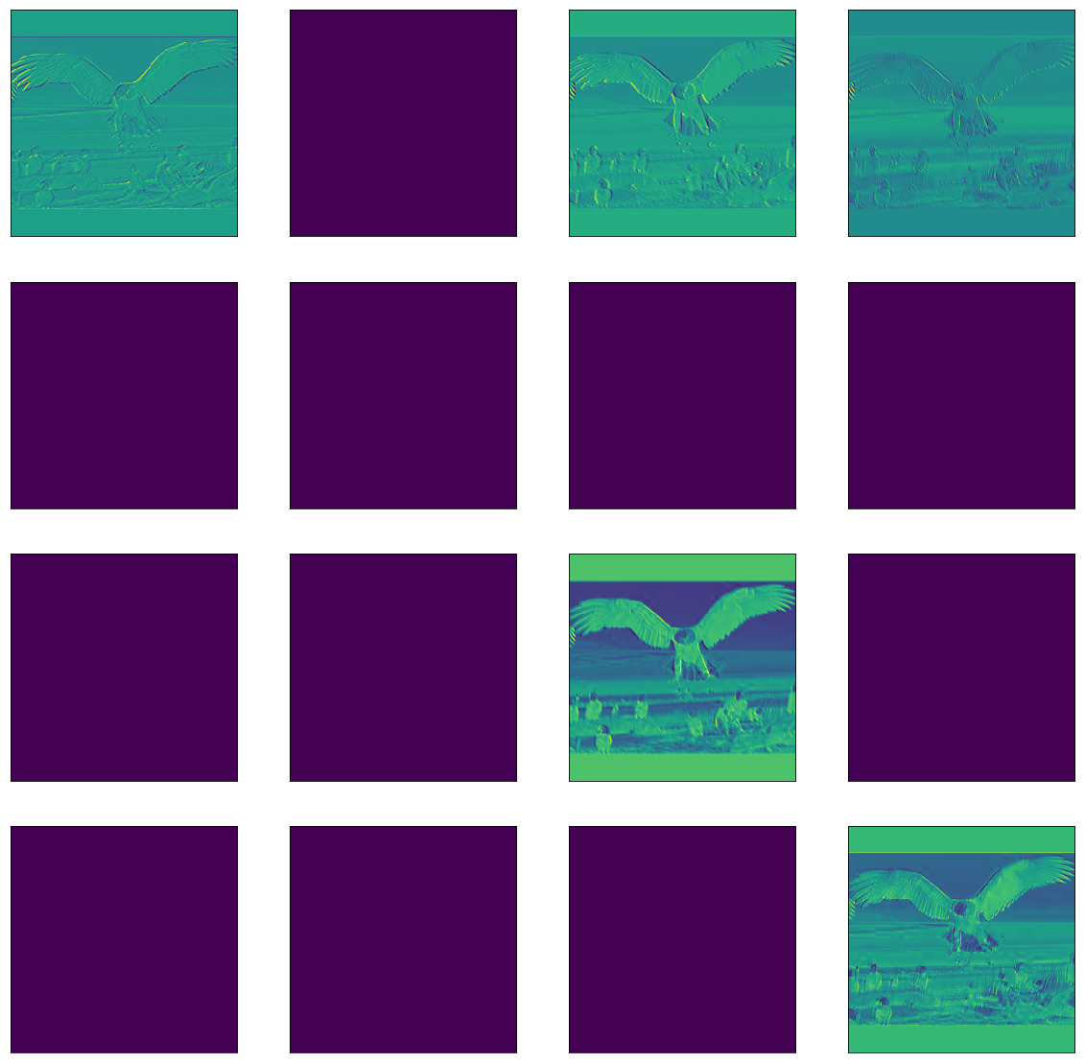
Visualisation in CNN Network – feature maps
Notes:
We live in a world where digital images pervade all aspects of our lives. Traditional cameras still exist, primarily for hobbies or art, otherwise, the convenience of digital images, and to a wider extent, digital videos lead to them being the media of choice over traditional analog methods.
Unfortunately, with the ease of editing digital images, abuse of such has gained traction too. Tampering of images may range from the helpful, sharpening of desired features, to benign/minor mischief spliced joke photos, to malicious intent such as misleading, swaying of public opinions, or even fraud.
Due to limitations on computational power and resources, I have chosen to limit my addressing of these issues by creating a supervised machine learning model which, upon being presented with a RGB image (full colored image made up of primary colors), executes a binary classification prediction based on trained weights into Class 0 (Unmodified Image) and Class 1 (Modified Image).
My model's predictions will not be limited to any specific domain (eg. humans, specific sports activities). I have set the target for my intended model have better accuracy than a baseline naive prediction of the majority class, as well as aim for a minimum of 85% accuracy on test set used in the model.

Slide 18
conclusion
85% Accuracy – Good but not Great!
Launchpad for Improvement and Further Development
Need for More Base Reference Images
Videos (SARIMAX, KNN)
Masking, Partial Extraction
Pre-defined Filters
Notes:
We live in a world where digital images pervade all aspects of our lives. Traditional cameras still exist, primarily for hobbies or art, otherwise, the convenience of digital images, and to a wider extent, digital videos lead to them being the media of choice over traditional analog methods.
Unfortunately, with the ease of editing digital images, abuse of such has gained traction too. Tampering of images may range from the helpful, sharpening of desired features, to benign/minor mischief spliced joke photos, to malicious intent such as misleading, swaying of public opinions, or even fraud.
Due to limitations on computational power and resources, I have chosen to limit my addressing of these issues by creating a supervised machine learning model which, upon being presented with a RGB image (full colored image made up of primary colors), executes a binary classification prediction based on trained weights into Class 0 (Unmodified Image) and Class 1 (Modified Image).
My model's predictions will not be limited to any specific domain (eg. humans, specific sports activities). I have set the target for my intended model have better accuracy than a baseline naive prediction of the majority class, as well as aim for a minimum of 85% accuracy on test set used in the model.

