Slide 1





PROJECT 3
CLASSIFICATION OF SUBREDDIT POSTS
Russell
Boon Jun
Umar

Slide 2






DATA
Russell
Boon Jun
Umar
r/History
r/NoStupidQuestions
r/UpliftingNews
r/worldnews
r/Environment
r/ZeroWaste
A place for discussions about history.
A place where no questions are stupid
A place to read and share positive and uplifting, feel good news stories.
A place for major news from around the world, excluding US-internal news.
Current news, information and issues related to the environment.
We are responsible citizens who try to minimize our overall environmental impact.

Slide 3





WORKFLOW
Web Scraping With Json API
Data Cleaning
EDA
Model Validation: Logistic Regression & Multinomial Classification
Model Fitting & Prediction

Slide 4
DATA
Russell
Baseline Accuracy: 0.51
r/History
r/NoStupidQuestions
A place for discussions about history.
A place where no questions are stupid

Slide 5
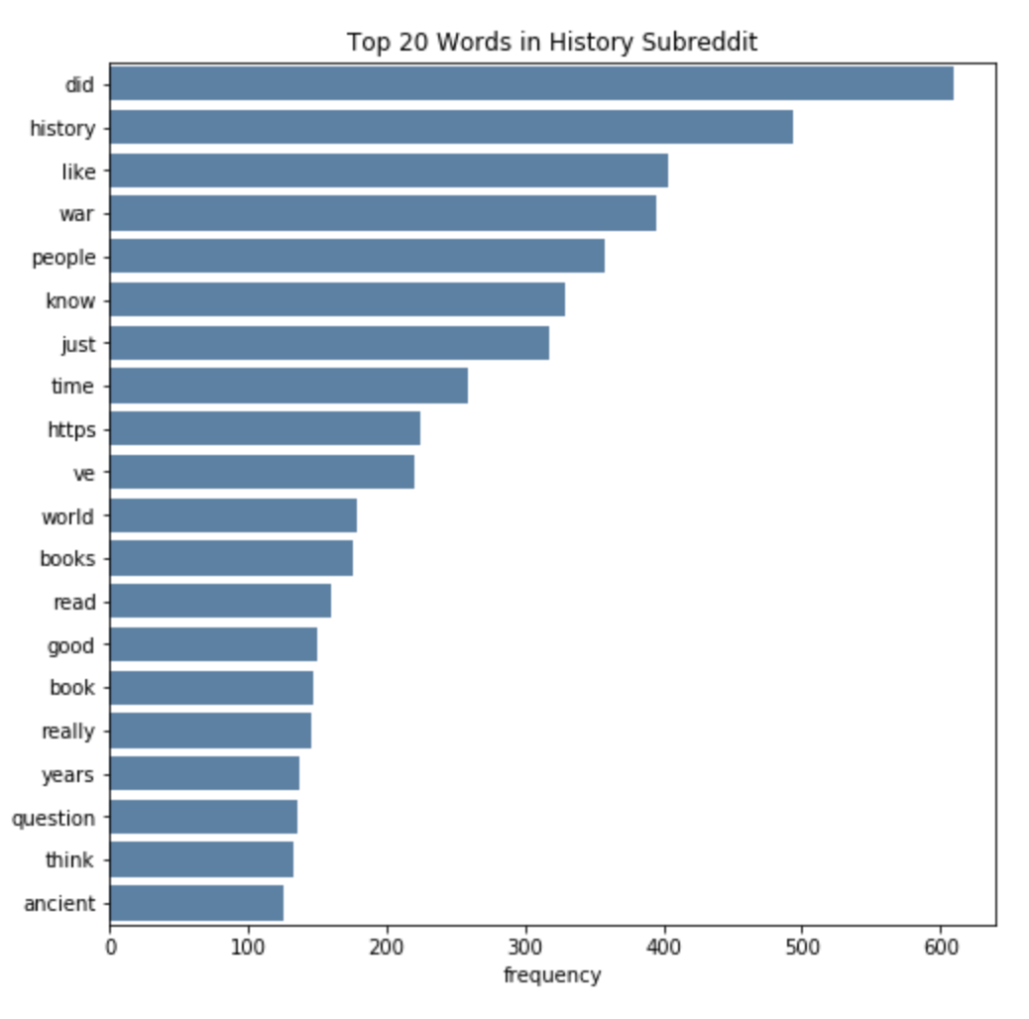
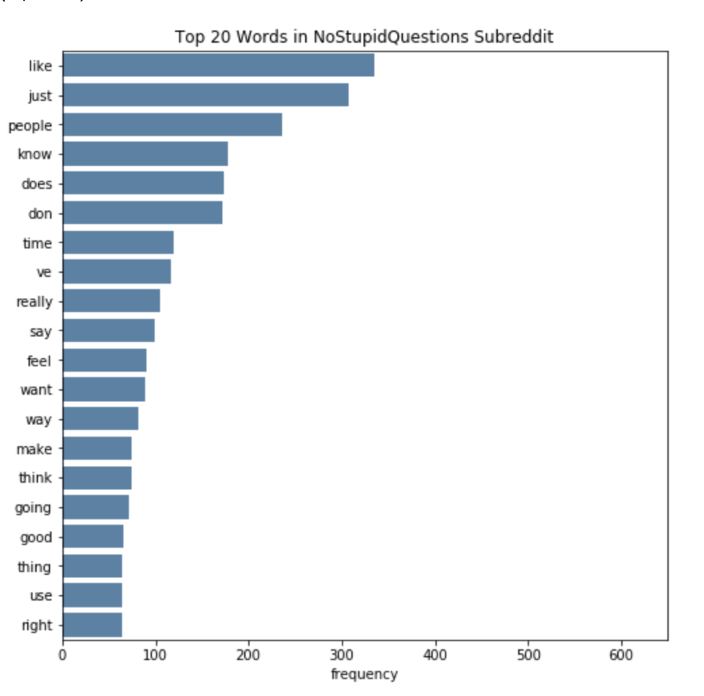
WORKFLOW - EDA
Russell

Slide 6
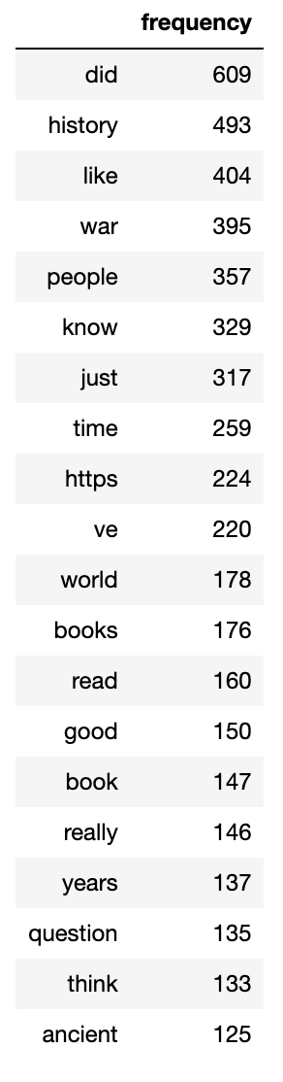
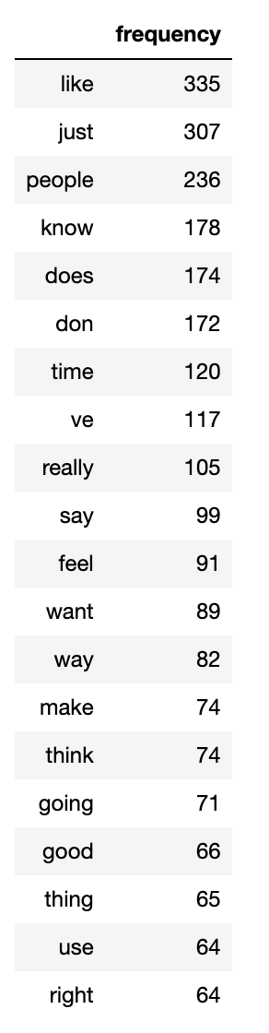
WORKFLOW - EDA
Russell

Slide 7
WORKFLOW - EDA
Russell

Slide 8


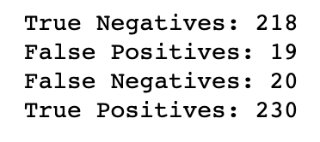
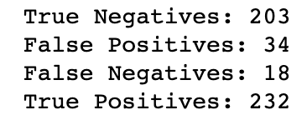
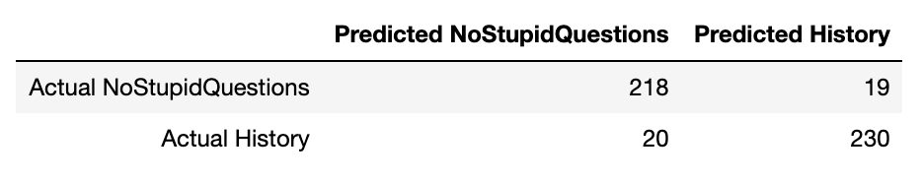
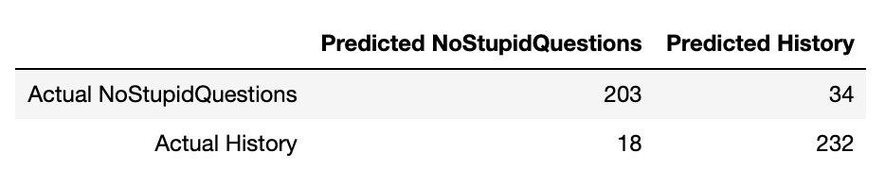
WORKFLOW – MODEL VALIDATION
Russell
VS
Logistic Regression
Multinomial

Slide 9
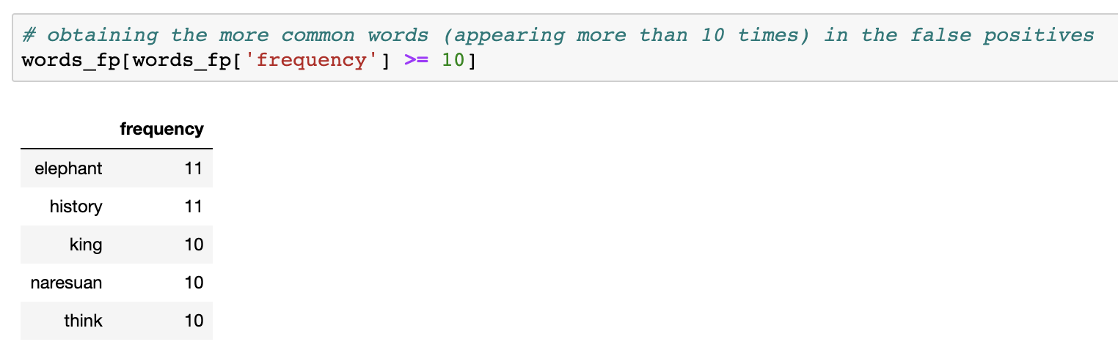
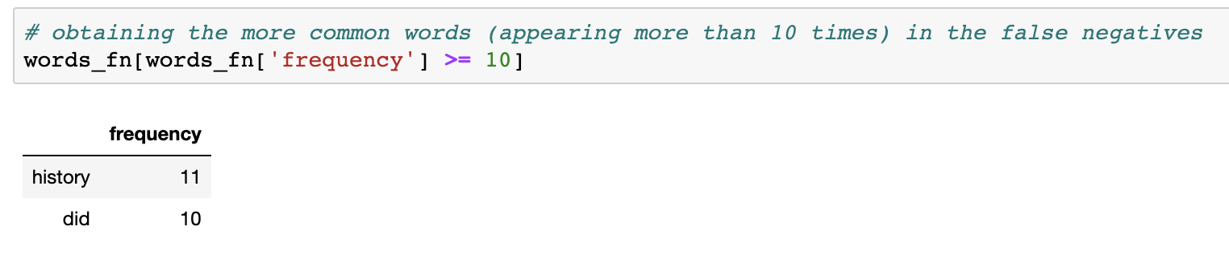
MISCLASSIFCATION
Russell
Logistic Regression

Slide 10
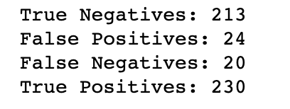
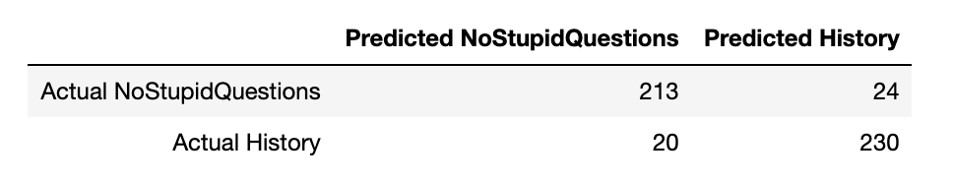
MISCLASSIFCATION
Russell
Logistic Regression

Slide 11

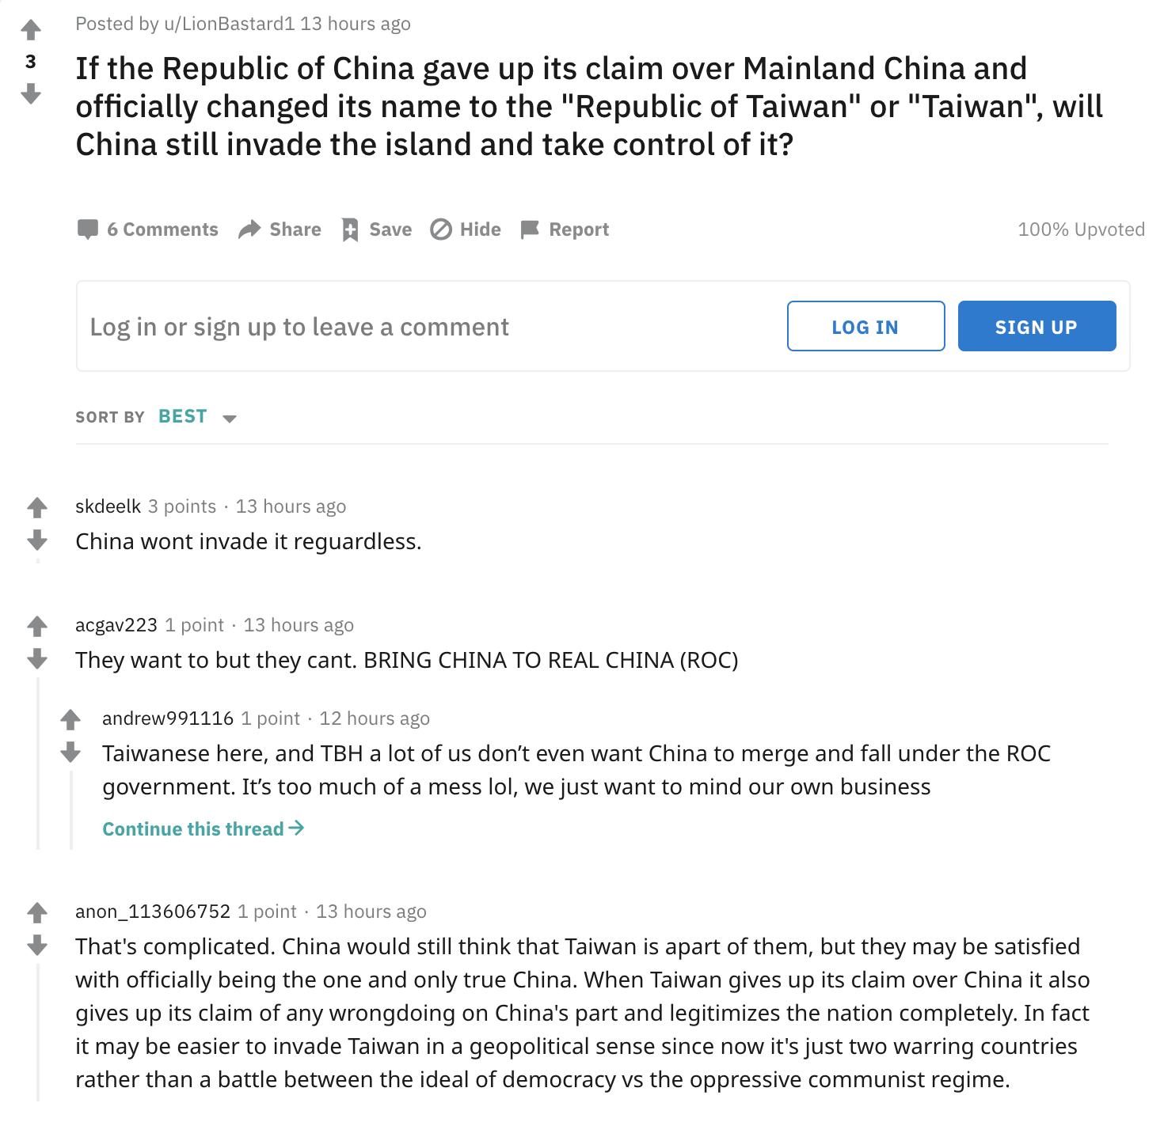
CONCLUSION
Russell

Slide 12
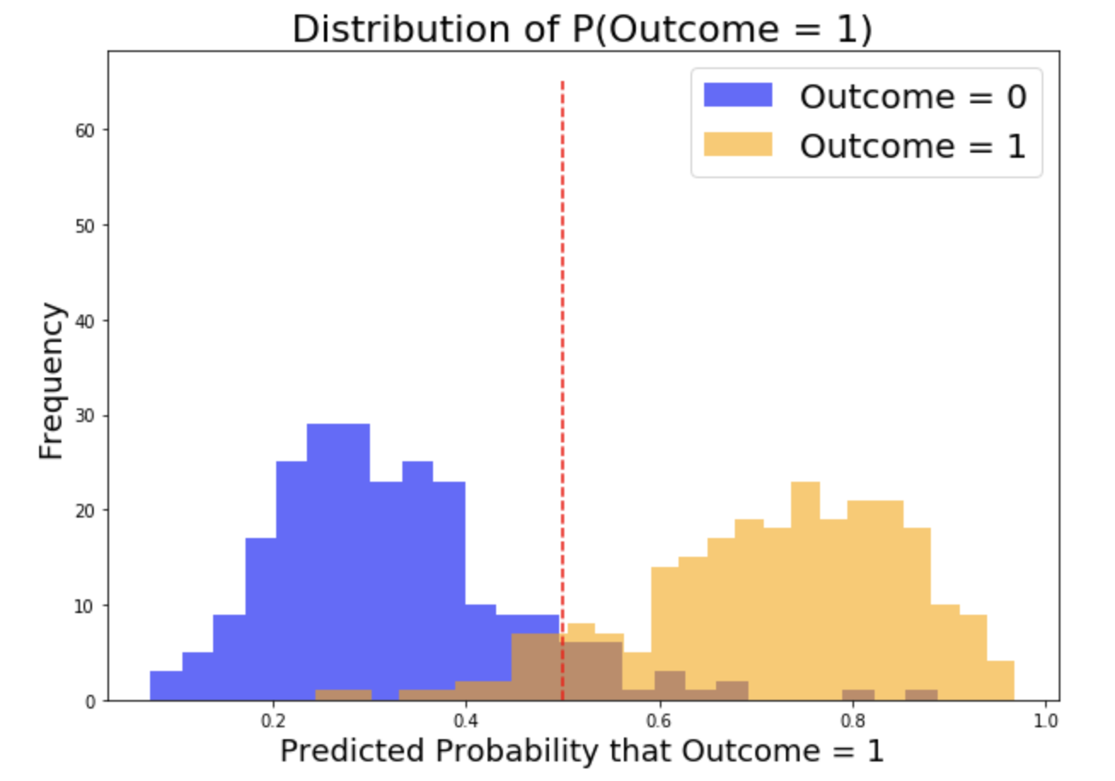
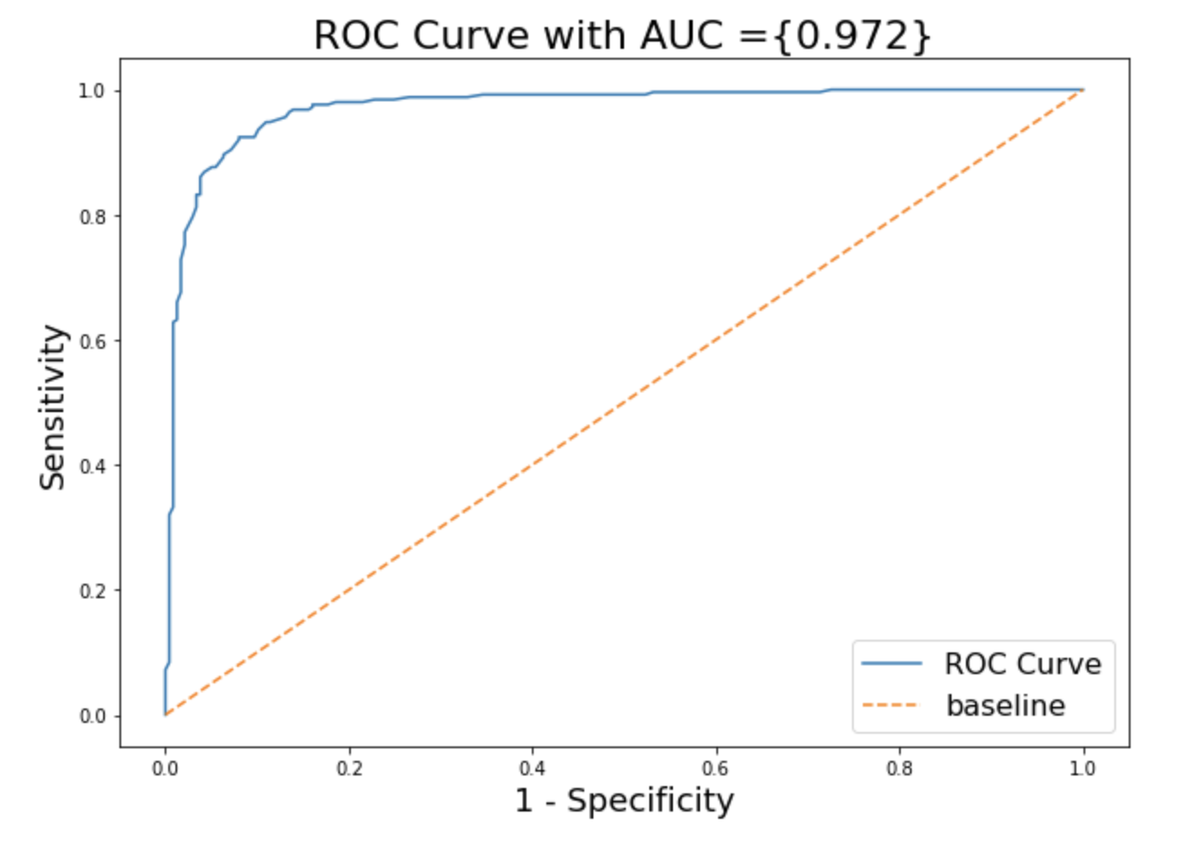
CONCLUSION
Russell

Slide 13
DATA
Boon Jun
Baseline Accuracy: 0.62
r/UpliftingNews
r/worldnews
Y=0
410 Posts
410 Titles
0 Selftext
Y=1
672 Posts
672 Titles
0 Selftext

Slide 14
PROBLEM STATEMENT
Boon Jun
To classify whether a post is an uplifting news for reddit to boost positivity within the community.

Slide 15
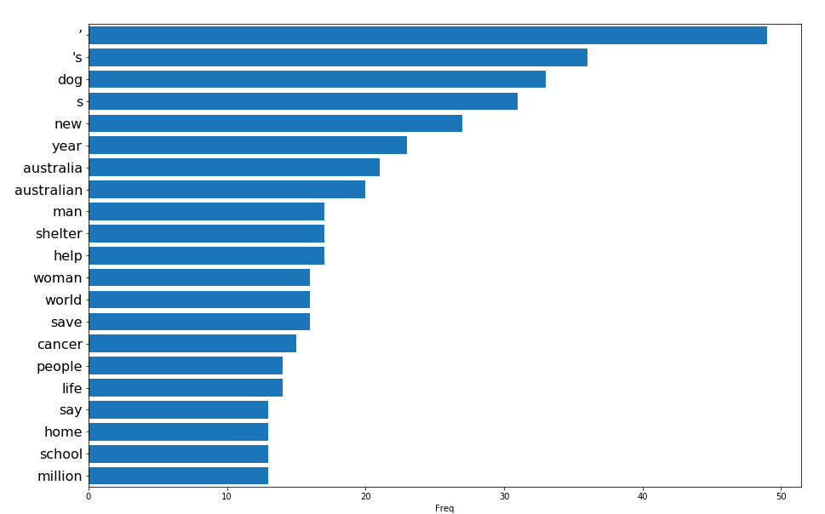
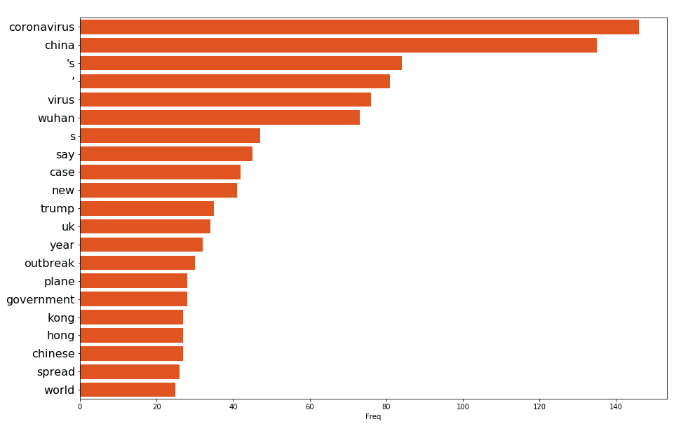
WORKFLOW - EDA
Boon Jun
Uplifting News
World News
Words related to current events, which make sense.
A few ‘dirty’ words remain after count vectorizing: ‘s, ‘, & s

Slide 16
WORKFLOW – MODEL VALIDATION
Boon Jun
VS
Logistic Regression
Multinomial
Vectorizing Method | Score
Count Vectorizer | 0.89
TFIDF | 0.83
Vectorizing Method | Score
Count Vectorizer | 0.88
TFIDF | 0.87

Slide 17
WORKFLOW – MODEL FITTING
Boon Jun
Logistic Regression
Cvec params | Max features = 400 Max_df = 0.5 Min_df = 2 Ngram_range = (1,2)
Penalty | l1
Training Score | 0.89
Testing Score | 0.82

Slide 18
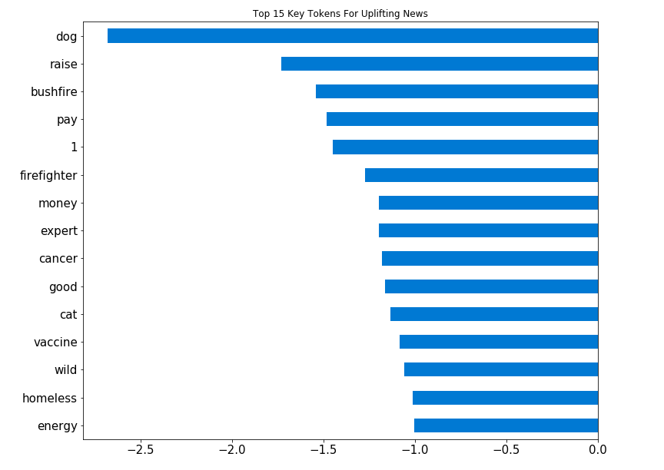
WORKFLOW – MODEL EVALUATION
Boon Jun
Logistic Regression
Key Tokens make senses.
Dogs are men’s best friend
Cats are the king of internet
Australian bushfire is getting better

Slide 19
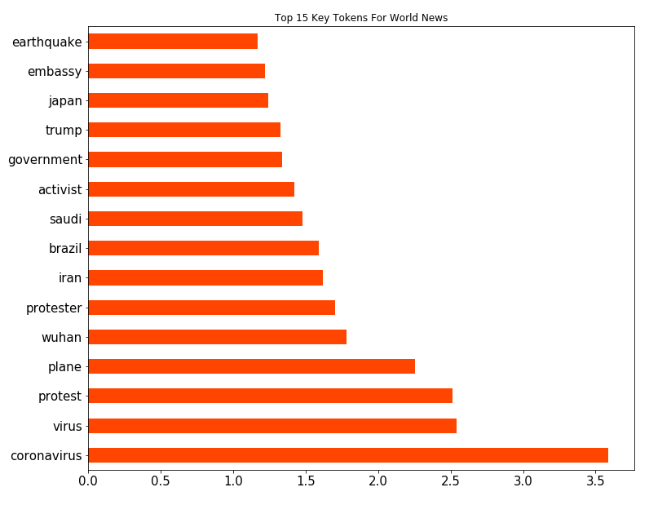
WORKFLOW – MODEL EVALUATION
Boon Jun
Logistic Regression
Key Tokens make senses.
Correspond to recent current event

Slide 20
WORKFLOW – MODEL EVALUATION
Boon Jun
Model perform as expected in classifying the 2 subreddit posts
Limitation
Classifying news related subreddit is very time specific
Tokens such as Corona Virus are not relevant for news last year
Logistic Regression
Confusion Matrix
True Negatives | 92
False Positives | 11
False Negatives | 40
True Positives | 128
Accuracy Comparison
Baseline | 0.62
Model | 0.81

Slide 21
RECOMMENDATIONS
Boon Jun
Only can be trained on the most recent 500-700 posts due to API limitation
Would be more accurate and less time-dependent if more historic data of the posts can be used to train the LR model

Slide 22
PROBLEM STATEMENT
Umar
The project is to find out the differences between these two environmental groups.
The groups are chosen due to their relative closeness of their nature in the topics.

Slide 23
DATA
Umar
r/Environment
r/Zerowaste
1351 post
1351 titles
63 selftext
2701 post
2701 titles
205 selftext

Slide 24
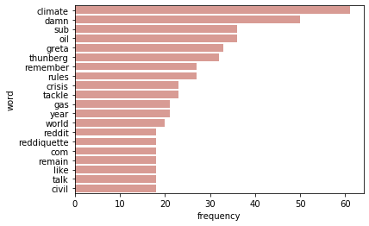
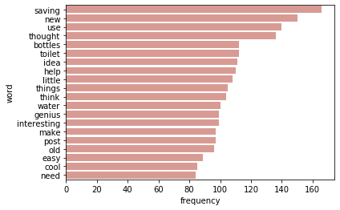
WORKFLOW - EDA
Umar
Environment
Zerowaste

Slide 25
WORKFLOW – MODEL VALIDATION
Umar
VS
Logistic Regression
Multinomial
Confusion Matrix
True Negatives | 214
False Positives | 0
False Negatives | 0
True Positives | 58
Confusion Matrix
True Negatives | 212
False Positives | 2
False Negatives | 2
True Positives | 56

Slide 26
WORKFLOW – MODEL FITTING
Umar
Logistic Regression
Cvec params | Max features = 500 Stop_words= ‘English’

Slide 27
CONCLUSION
Umar
It seems that although they are similar in topics but their word frequency used are much different.
Thus a simple logistic regression works very well

Slide 28
COMMON CHALLENGES
Reddit API limited to 1000 posts
Adding features which contribute to misclassification may not improve the model
Some key words are time specific (due to recent events), e.g Wuhan, Greta

Slide 29
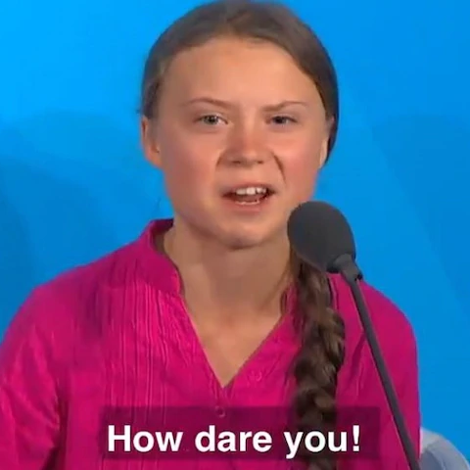
THANK YOU

