Slide 1

MRI DATA COLLECTION PROPOSAL & UPDATE
DIAGONOSTIC IMAGING DEPARTMENT, ALEXENDRA HOSPITAL
Lin Chen, Helen
DD/Jan/2021

Slide 2

How’s the department performance?
When is the best timing to but a new MR machine?
Are we efficient enough? Are we a competitive team?
Why the waiting time are so long?
How’s our performance compare to other hospital

Slide 3
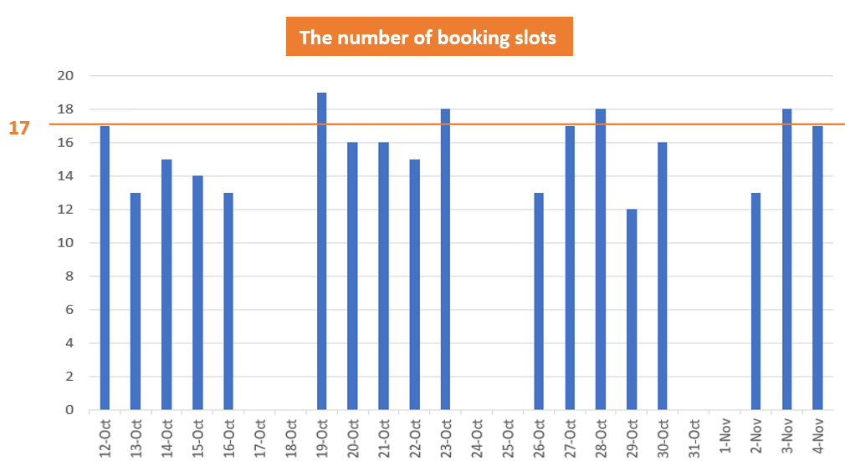

Are we really not doing well ?

Slide 4

Re-think the way how we look into things
Make decision with solid evidences
Optimize the processes by identifying the shortage
Predict the outcome with enhanced artificial intelligent
BIG DATA SOLUTION

Slide 5

UNDERSTAND THE CURRENT PERFORMANCE
Identify the flaw in the existing Procedure
Setup the baseline to plan for the next step
Data is the Fundamental of Progress

Slide 6


QUANTIFY THE SCAN-TIME
Explore the scan time in different patient conditions
Compare scan-time with others

Slide 7



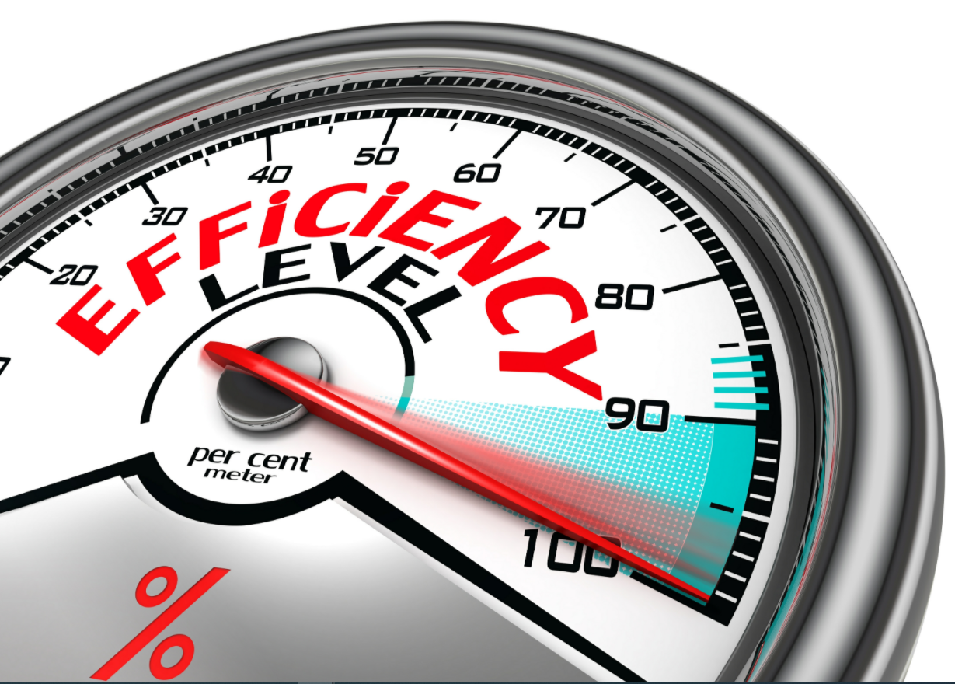
PREDICT THE SCAN-TIME & OPTIMIZE THE EFFICIENCY

Slide 8
OVERALL PROCESS
Review & Improve
Review the results and optimize the process based on the data.
Update Database
Calculate the average scan-time for different scans under different patient conditions and store up the database
Generate Results (Weekly)
Generate a weekly report to provide basic information such as patient demographic and scan detail.
Check the Data Integrity
Run script to identify and correct the invalid data point during the collection process (if any).
Data Collection (Daily)
Follows the template to collect all patient/ scan data. Collect in the daily basis.

Slide 9

DETAILED PROCESS 1/5
Review & Improve
An excel template containing all the required information and 6 sheets for the whole week.
Review the results and optimize the process based on the data.
Update Database
Calculate the average scan-time for different scans under different patient conditions and store up the database
Generate Results (Weekly)
Generate a weekly report to provide basic information such as patient demographic and scan detail.
Check the Data Integrity
Run script to identify and correct the invalid data point during the collection process (if any).
Data Collection (Daily)
Follows the template to collect all patient/ scan data. Collect in the daily basis.

Slide 10

DETAILED PROCESS 2/5
Review & Improve
An excel template containing all the required information and 6 sheets for the whole week.
Review the results and optimize the process based on the data.
Update Database
Calculate the average scan-time for different scans under different patient conditions and store up the database
Run Macro script to identify the invalid datapoint
Generate Results (Weekly)
Generate a weekly report to provide basic information such as patient demographic and scan detail.
Check the Data Integrity
Run script to identify and correct the invalid data point during the collection process (if any).
Data Collection (Daily)
Follows the template to collect all patient/ scan data. Collect in the daily basis.

Slide 11
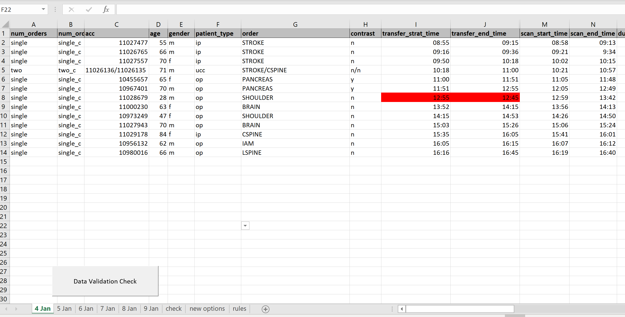
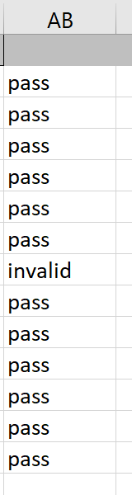
1
3
4
2
1
New column to select the number of orders.
3
Indicate whether the datapoint has passed the validation
2
Button to run the data validation script
4
Invalid or weird value will be highlighted in red or blue

Slide 12

DETAILED PROCESS 3/5
Information includes:
Patient demographic (age distribution, each patient type percentage, level of cooperation distribution)
Work-hour distribution (working hour allocation between the successful scan, failed scans, idle time, recalled subject)
Number of orders
Review & Improve
Review the results and optimize the process based on the data.
Update Database
Calculate the average scan-time for different scans under different patient conditions and store up the database
Generate Results (Weekly)
Generate a weekly report to provide basic information such as patient demographic and scan detail.
Check the Data Integrity
Run script to identify and correct the invalid data point during the collection process (if any).
Data Collection (Daily)
Follows the template to collect all patient/ scan data. Collect in the daily basis.

Slide 13
DETAILED PROCESS 4/5
Store the data to the database and generate results.
AVERAGE
# CASES
Review & Improve
AVERAGE
IN-ROOM TIME
Review the results and optimize the process based on the data.
different conditions
AVERAGE SCAN TIME
Update Database
Calculate the average scan-time for different scans under different patient conditions and store up the database
Generate Results (Weekly)
Generate a weekly report to provide basic information such as patient demographic and scan detail.
Check the Data Integrity
Run script to identify and correct the invalid data point during the collection process (if any).
Data Collection (Daily)
Follows the template to collect all patient/ scan data. Collect in the daily basis.

Slide 14
DETAILED PROCESS 4/5
Store the data to the database and generate results.
Review & Improve
AVERAGE
IN-ROOM TIME
different conditions
Review the results and optimize the process based on the data.
AVERAGE SCAN TIME
AVERAGE # CASES
Update Database
Calculate the average scan-time for different scans under different patient conditions and store up the database
Generate Results (Weekly)
Generate a weekly report to provide basic information such as patient demographic and scan detail.
Check the Data Integrity
Run script to identify and correct the invalid data point during the collection process (if any).
Data Collection (Daily)
Follows the template to collect all patient/ scan data. Collect in the daily basis.

Slide 15
Contrast vs. Non-contrast
C1
Non-contrast + young
Different patient type
In/Outpatient, ICU, UCC
C2
Non-contrast + old
C3
Contrast + young
C4
Contrast + old
…….
(Different combinations)
output
Scan | Condition 1 | Condition 2 | Condition 3 | Condition 4
Scan_A | Value* | Value* | Value* | Value*
Scan_B | Value* | Value* | Value* | Value*
Scan_C | Value* | Value* | Value* | Value*
Value* = average_scan_time ± std. (number of data point)
Notes:
To be more specific on who we can exploring the scan time based on the database, for example, we can starting with separating the patients to two populations (contrast and non-contrast) and to discuss the scan time of each scan.
Moreover, we can even group the patients to more groups based on more specific details. Such as looking at the patient type first, then consider four conditions based on two factors (contrast or the age).
By doing so, with the help of machine learning, I believe we can find a way (trying different combination of factors) to predict the scan time based on the patient profile before they even can to the hospital.

Slide 16
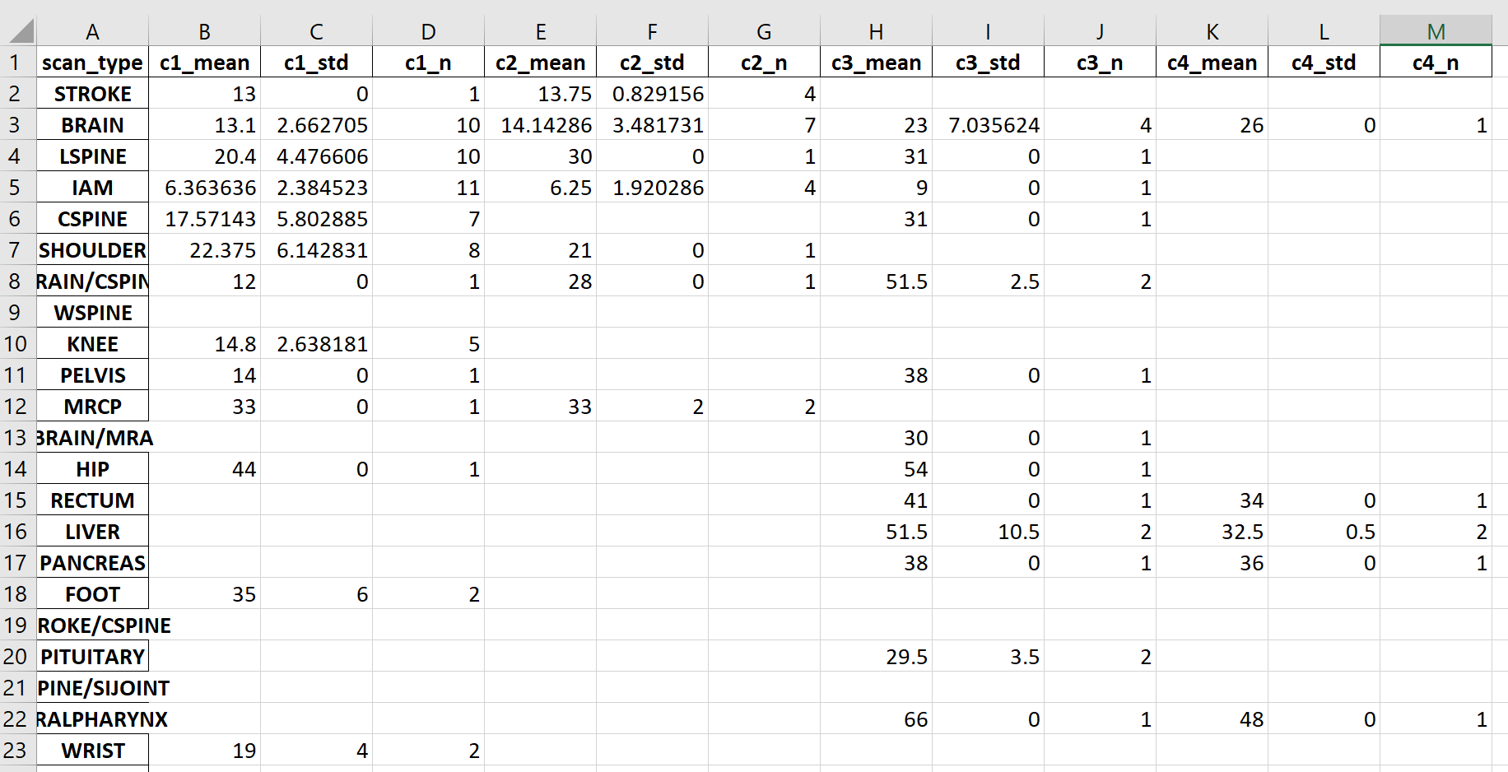
Contrast vs. Non-contrast
C1
Non-contrast + young
Different patient type
In/Outpatient, ICU, UCC
C2
Non-contrast + old
C3
Contrast + young
C4
Contrast + old
output
Notes:
To be more specific on who we can exploring the scan time based on the database, for example, we can starting with separating the patients to two populations (contrast and non-contrast) and to discuss the scan time of each scan.
Moreover, we can even group the patients to more groups based on more specific details. Such as looking at the patient type first, then consider four conditions based on two factors (contrast or the age).
By doing so, with the help of machine learning, I believe we can find a way (trying different combination of factors) to predict the scan time based on the patient profile before they even can to the hospital.

Slide 17
DETAILED PROCESS (5/5)
Review & Improve
Review the results and optimize the process based on the data.
Update Database
Calculate the average scan-time for different scans under different patient conditions and store up the database
Generate Results (Weekly)
Generate a weekly report to provide basic information such as patient demographic and scan detail.
Check the Data Integrity
Run script to identify and correct the invalid data point during the collection process (if any).
Data Collection (Daily)
Follows the template to collect all patient/ scan data. Collect in the daily basis.

Slide 18

NEXT STEP
Let’s Go!
QUANTIFY PERFORMANCE
DATABASE
PREDICT
Involved other modalities to understand the current performance
Can speed up the process of building up the database by cooperating with other hospitals
Increase the revenue by optimizing the scheduling system to maximum efficiency

Slide 19



