Slide 1
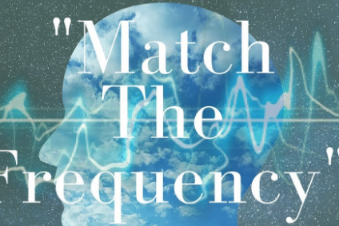

Frequency Matching Tool with GUI
BY : Swetha Kuruva
& Shashidhar Reddy Virupa

Slide 2

Objective
• Develop a tool to analyze and match images based on frequency spectrograms.
• Create a GUI to facilitate image selection and display results interactively.
• Implement functionality to compute and visualize spectrograms of images.

Slide 3
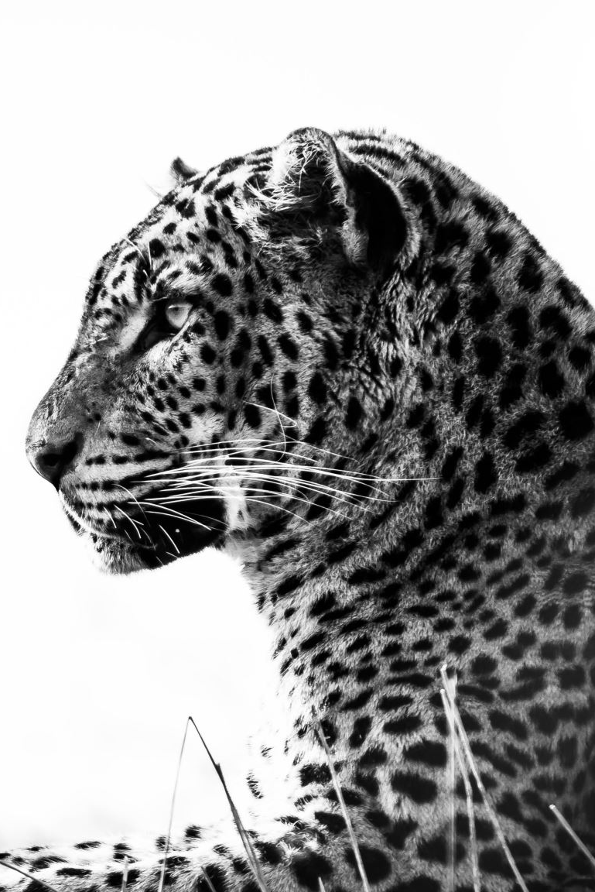
Dataset
• Used Kaggle Natural Images Dataset.
• Contains diverse image categories, including airplanes, landscapes, and animals.
• Images were preprocessed to grayscale for spectrogram analysis.

Slide 4
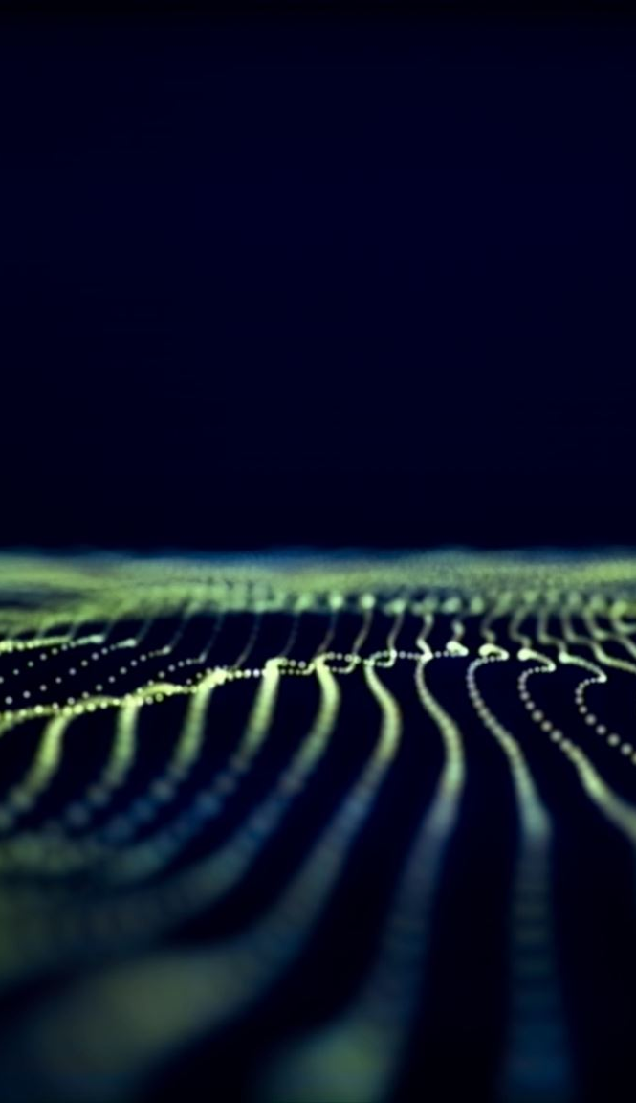
Methodology
1. Preprocessing: Images resized and converted to grayscale.
2. Spectrogram Computation: STFT used to calculate frequency spectrograms.
3. GUI Development: User interface created using Tkinter for:
• Browsing and selecting target images.
• Displaying results dynamically.
4. Image Matching: Similarity computed using correlation of spectrograms.

Slide 5
GUI Features
• User-friendly interface built with Tkinter.
• Image browsing functionality.
• Dynamic display of target image and its spectrogram.
• Visual representation of top-matching images with correlation scores.

Slide 6
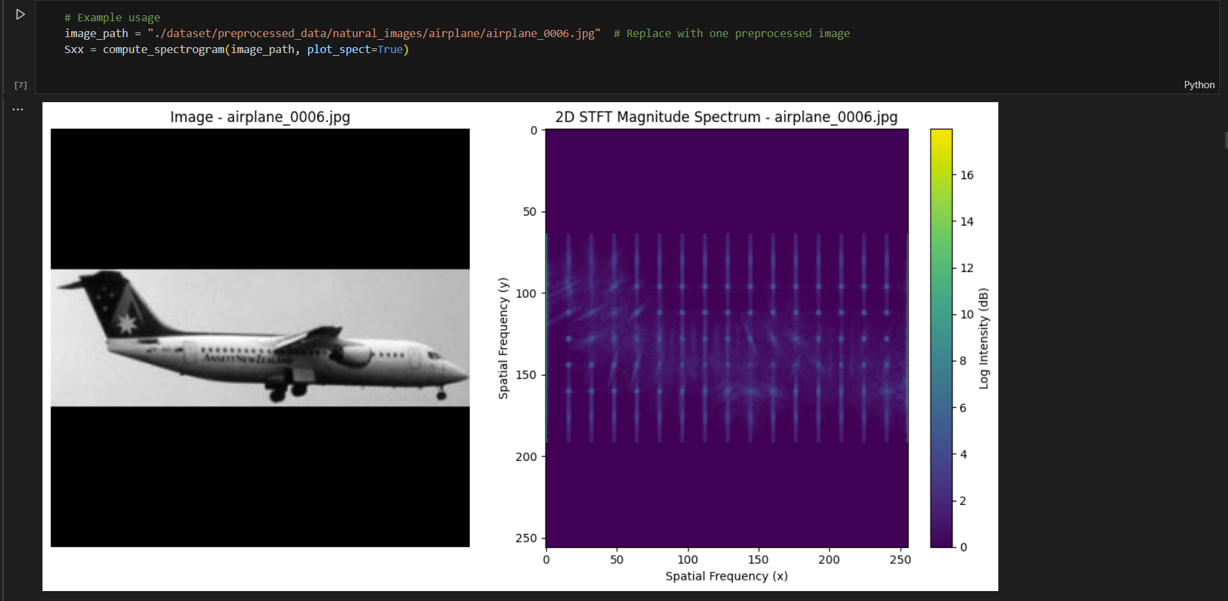
After the code implementation the computation of a 2D Short-Time Fourier Transform (STFT) to analyze a grayscale image. The main goal is to calculate a spectrogram that reveals the frequency content of the image in localized spatial regions. This is the resulted output.

Slide 7
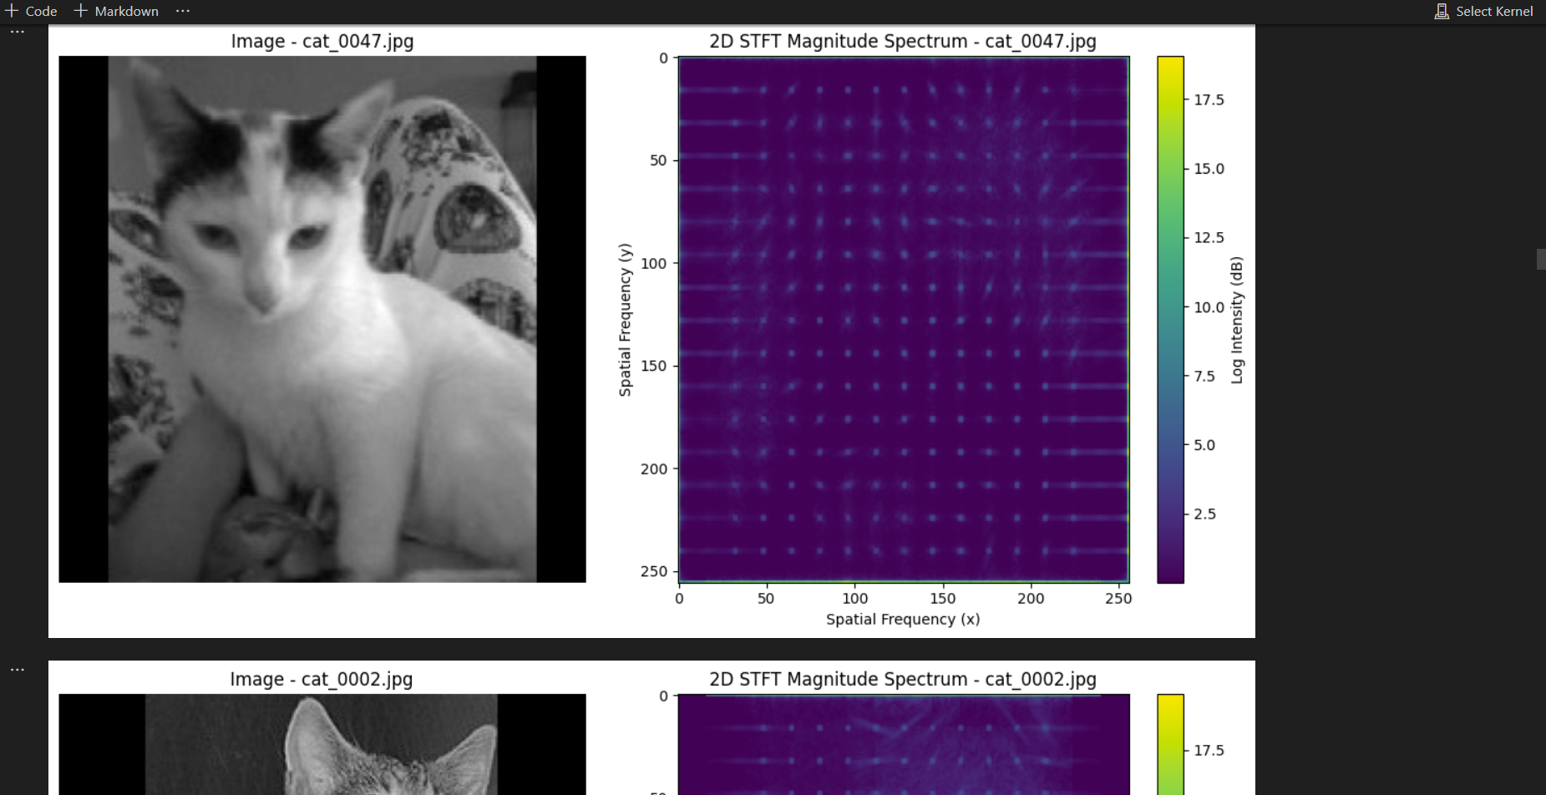
After running code here is a comparison of two spectrograms generated from images using similarity metrics.

Slide 8
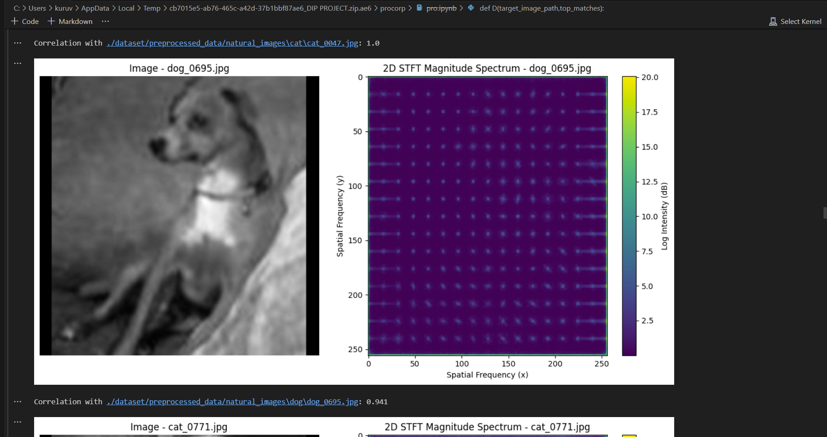
After Comparing a target image's spectrogram with a dataset of images' spectrograms. This is the resulted output. Here we Identifies the top similar images from the dataset based on a similarity metric (e.g., correlation).

Slide 9
• Successfully computed spectrograms for dataset images.
• Implemented GUI for real-time image analysis.
• Matched images based on spectrogram correlation.

Slide 10
• Reference Image:
Displayed alongside its spectrogram.
• Top Matches:
Images ranked by similarity, with spectrograms and correlation scores.

Slide 11
Challenges Faced
• Handling large datasets efficiently.
• GUI integration with image processing pipeline.
• Accurate similarity computation for frequency spectrograms.

Slide 12

Conclusion
• Developed a frequency matching tool with GUI.
• Demonstrated successful spectrogram-based image matching.
• The tool provides an interactive platform for image analysis.

