Slide 1
Slide 1: Title Slide Content: Title: Image Edge Detection and Object Segmentation in Python and MATLAB
Your Name:
SAI SUJANA KOLI – Z2370597
KAILASH ADAPA – Z23747408
BHARATH SAI VALLABHANENI – Z23813761
Date: 12/09/2024
Description:
This project involves implementing edge detection and object segmentation on a dataset of natural images using Python and MATLAB.
Metrics such as Edge Density, Mean Gradient Magnitude, Number of Objects, and Average Object Size were calculated to evaluate results.
The aim was to compare the performance of Python and MATLAB in terms of implementation, efficiency, and results.

Slide 2
Slide 2: Project Overview
Content:
This project focuses on detecting edges in images and segmenting objects using contours extracted from those edges.
Key Objectives:
Implement Canny Edge Detection and calculate metrics to quantify edges.
Perform Object Segmentation by identifying connected regions in the edge-detected images.
Compare results between Python (using OpenCV) and MATLAB (using built-in functions).
Why Edge Detection and Segmentation?
Edge detection helps identify boundaries of objects in an image.
Segmentation enhances image analysis by isolating meaningful objects for further processing.

Slide 3
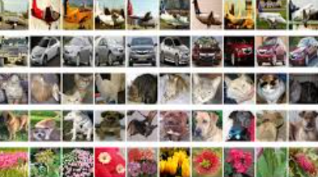
Slide 3: Dataset
Content:
Dataset Used: Natural Images Dataset
Number of Images: 6,899
Image Types: Categories include airplanes, cars, people, flowers, and buildings.
Preprocessing:
Converted all images to grayscale for consistent edge detection.
Used subsets of images (e.g., 5 images for testing) for demonstration and metrics calculations.
Source: Public dataset repository.

Slide 4
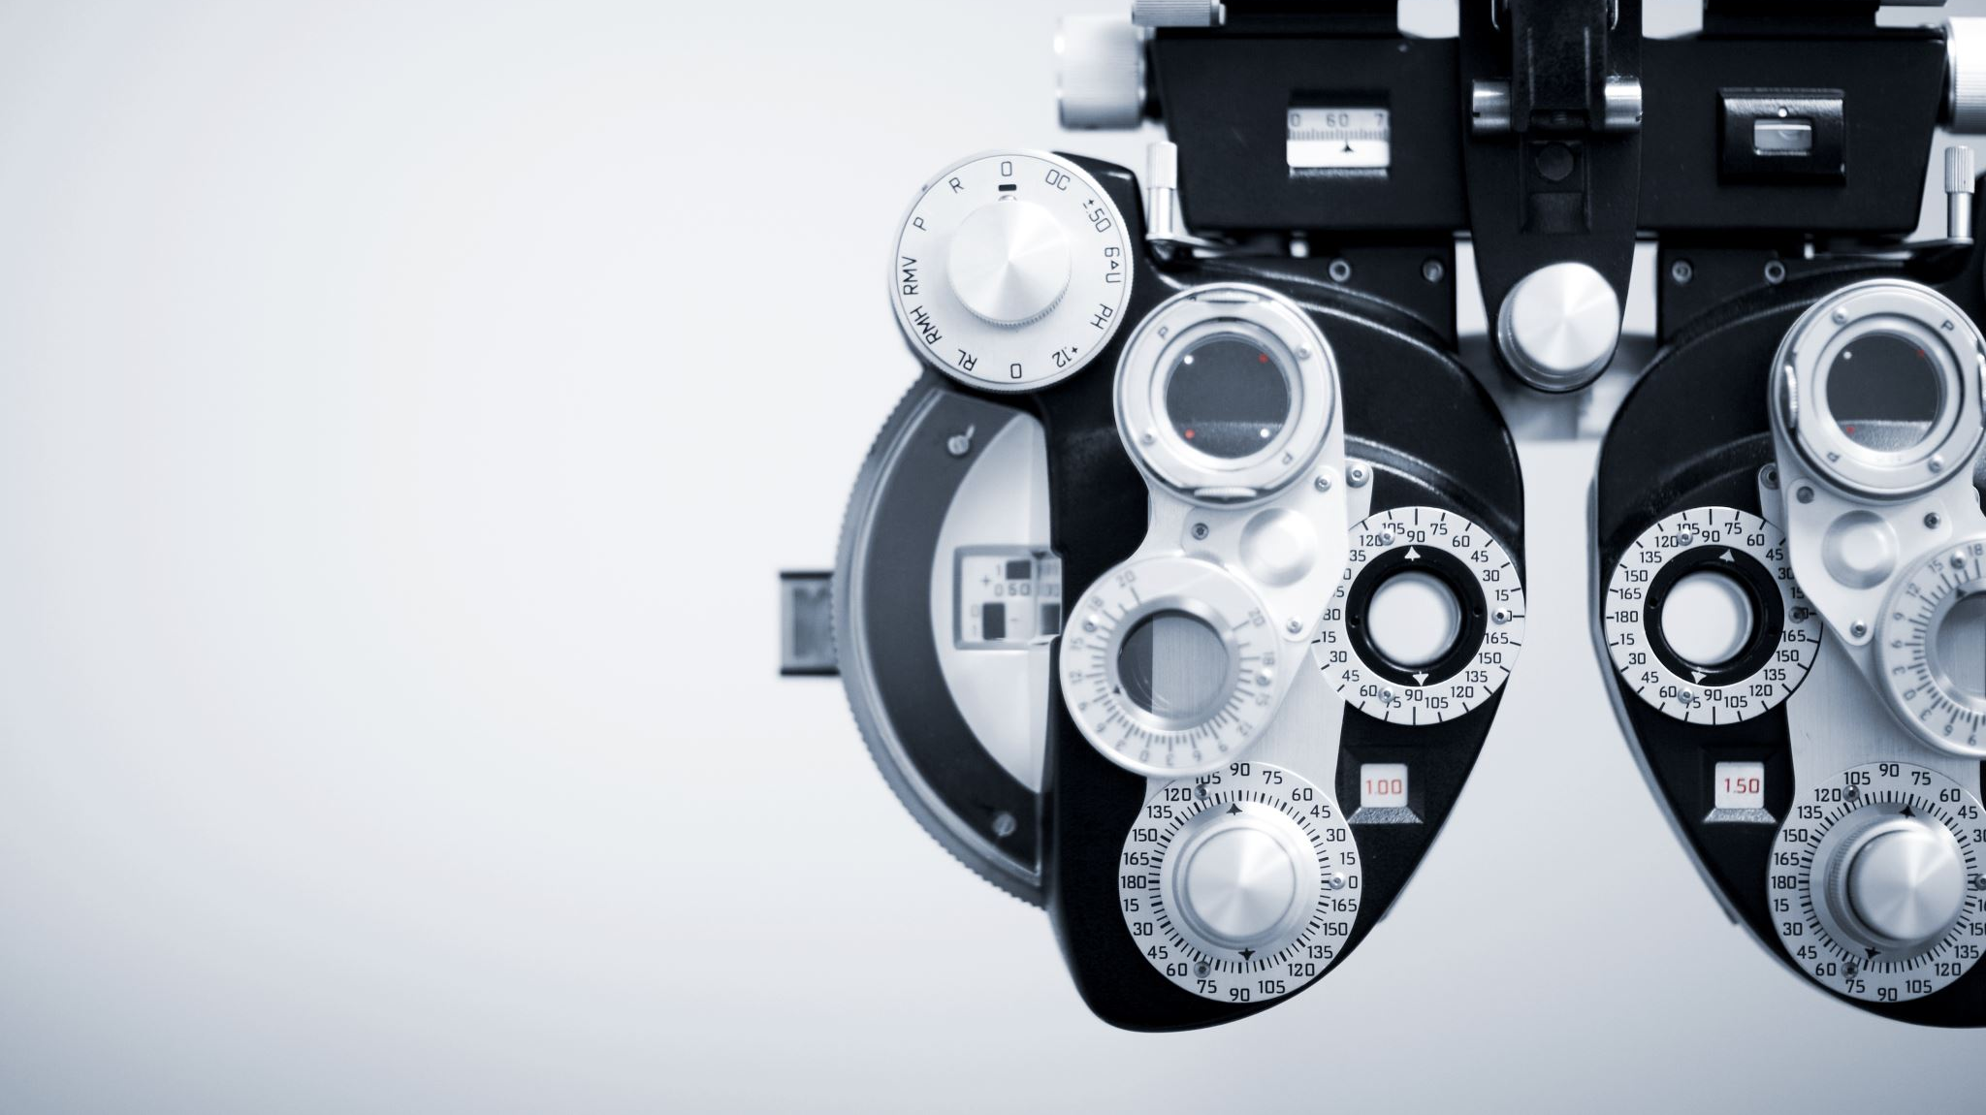
Slide 4: Python Implementation - Edge Detection
Content:
Tools Used: OpenCV, NumPy, and Matplotlib.
Steps:
Preprocessed images to grayscale.
Applied Canny Edge Detection using cv2.Canny().
Calculated metrics:
Edge Density: Ratio of edge pixels to total pixels.
Mean Gradient Magnitude: Calculated using Sobel filters.
Sample Output:
Displayed edge-detected images alongside original images.
Metrics printed in the console for comparison.

Slide 5
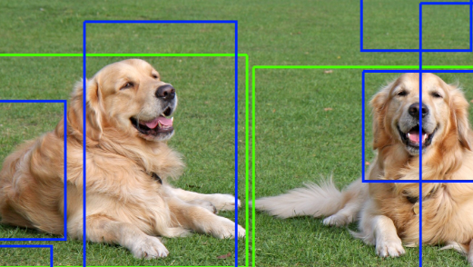
Slide 5: Python Implementation - Object Segmentation
Content:
Tools Used: OpenCV.
Steps:
Used cv2.findContours() to extract contours from edge-detected images.
Filtered out small contours to remove noise.
Drew green contours on the original images to highlight segmented objects.
Metrics Calculated:
Number of Objects: Counted distinct contours.
Average Object Size: Average area of detected contours.
Sample Output:
Side-by-side comparison of original images and segmented images with metrics.

Slide 6
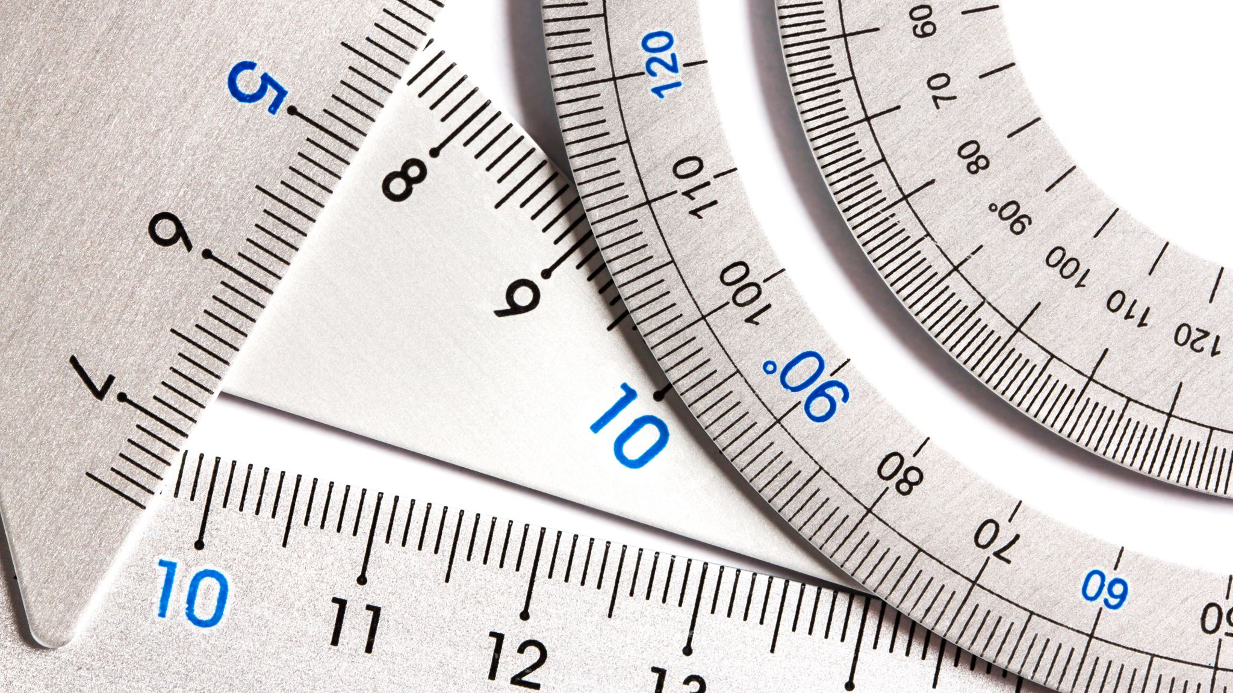
Slide 6: MATLAB Implementation - Edge Detection
Content:
Tools Used: MATLAB’s built-in functions (edge, imgradientxy).
Steps:
Converted images to grayscale using MATLAB functions.
Applied Canny Edge Detection using edge() with tuned thresholds.
Calculated metrics:
Edge Density: Ratio of edge pixels.
Mean Gradient Magnitude: Gradient intensity calculated using Sobel filters (imgradientxy).
Sample Output:
Displayed edge-detected images alongside metrics in MATLAB.

Slide 7
Slide 7: MATLAB Implementation - Object Segmentation
Content:
Tools Used: MATLAB’s bwconncomp and contour functions.
Steps:
Used bwconncomp() to identify connected components in edge-detected images.
Calculated object-related metrics:
Number of Objects: Total connected components.
Average Object Size: Area of each component.
Highlighted contours in green on the original images.
Output Comparison:
Displayed original and segmented images alongside calculated metrics.

Slide 8
Slide 8: Results Comparison
Content:
Edge Detection Results:
Python:
Fast processing for large datasets.
Open-source libraries offer flexibility.
MATLAB:
Built-in functions simplify implementation.
High accuracy with pre-defined edge functions.
Object Segmentation Results:
Python:
Detected more objects due to fine contour filtering.
MATLAB:
Provided clear segmentation with robust object metrics.
Metrics Comparison:
Edge Density, Gradient Magnitude, Number of Objects, and Object Size.

Slide 9
Slide 9: Conclusion and Future Work
Content:
Conclusion:
Both Python and MATLAB successfully implemented edge detection and segmentation.
Python is better for custom, scalable workflows.
MATLAB is effective for rapid prototyping with pre-built functions.
Future Work:
Extend to colored images for broader applications.
Explore advanced segmentation techniques (e.g., Mask R-CNN).
Optimize edge detection for real-time video analysis.

