Slide 1
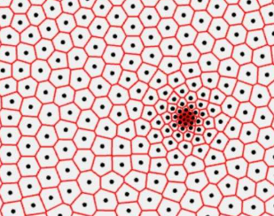
Slide 1: Title: Weighted Voronoi Image Stippling with GUI in MATLAB
Subtitle: Interactive Image Processing Tool for Stippling Using Voronoi Diagrams
Details:
Greeshma Reddy Vallapureddy Gari
Surendra Ramishetty

Slide 2
Slide 2: Project Overview
Title: Overview of the Project
Content:
Objective: To create a MATLAB tool for generating stippled images using Weighted Voronoi Diagrams, where the stippling density is based on pixel brightness.
Key Features:
  Image selection and preprocessing.
  Weighted point generation.
  Voronoi diagram construction.
  Interactive GUI with navigation and customization.

Slide 3
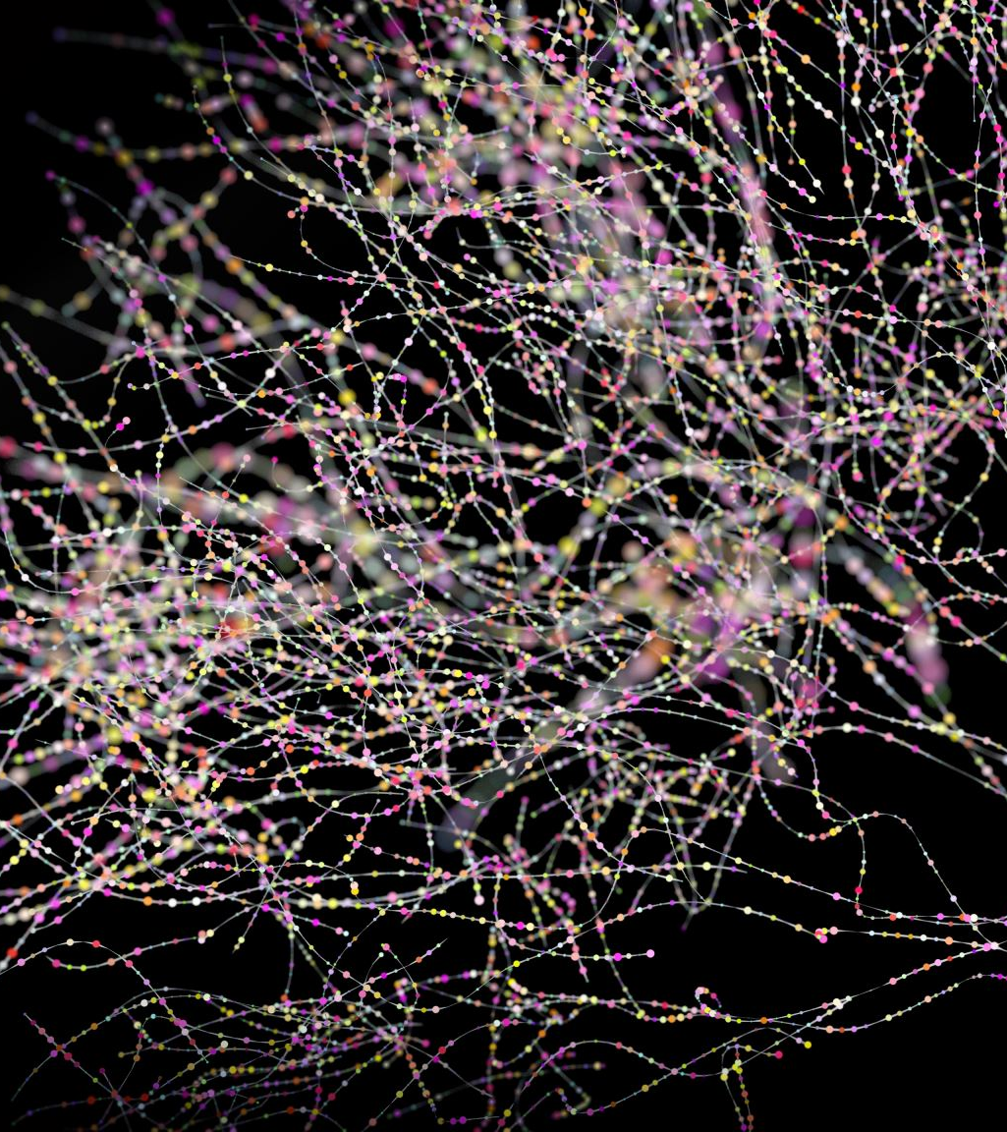
Slide 3: Dataset Details
Content:
Dataset Source: The dataset consists of high-resolution images (e.g., flower images).
Format: Images in .jpg or .png format.
Processing: Images are converted to grayscale for brightness-based stippling.
Screenshot: Show a few original images from your dataset.

Slide 4
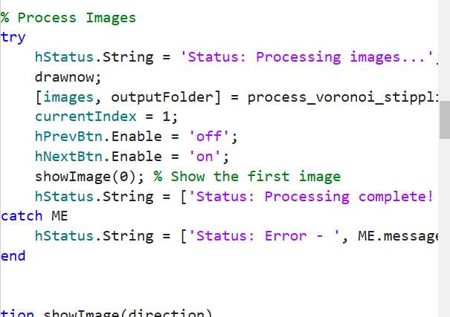
Slide 4: Methodology
Title: Step-by-Step Methodology
Content:
Load Dataset: Users select a dataset folder through the GUI.
Preprocessing: Images are converted to grayscale, and intensity values are normalized.
Weighted Point Generation: Points are generated with higher density in brighter regions of the image.
Voronoi Diagram Construction: Voronoi regions are calculated based on these points.
Visualization: The processed image is displayed with stippling (red dots) and Voronoi overlays (green lines).
Include a flowchart showing the entire workflow.

Slide 5
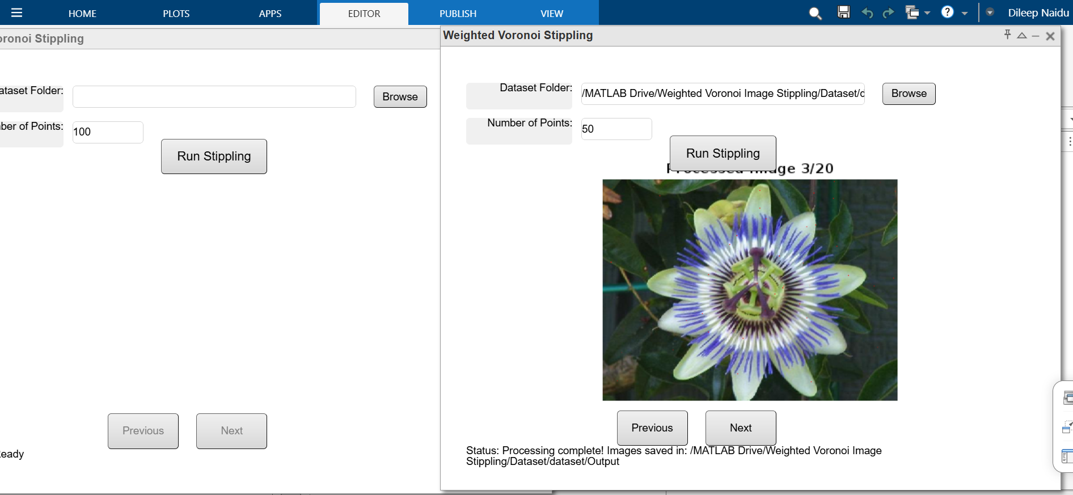
Slide 5: GUI Features
Title: Graphical User Interface (GUI)
Content:
Key Features:
  Dataset folder selection.
  Input for the number of stippling points.
  Navigation buttons (Previous/Next) for processed images.
  Status updates for the processing stage.
  Processed images displayed directly in the GUI.
Screenshot: Highlight the GUI elements in your image.

Slide 6
Slide 6: MATLAB Implementation
Content:
Key Functions:
  rgb2gray for grayscale conversion.
  voronoi for diagram generation.
  Custom functions for weighted point generation and visualization.
Code Highlights:
  Dynamic user inputs (number of points).
  Efficient image processing with error handling.
  Saving processed images in an output folder.
Screenshot: Show snippets of critical parts of your code.

Slide 7
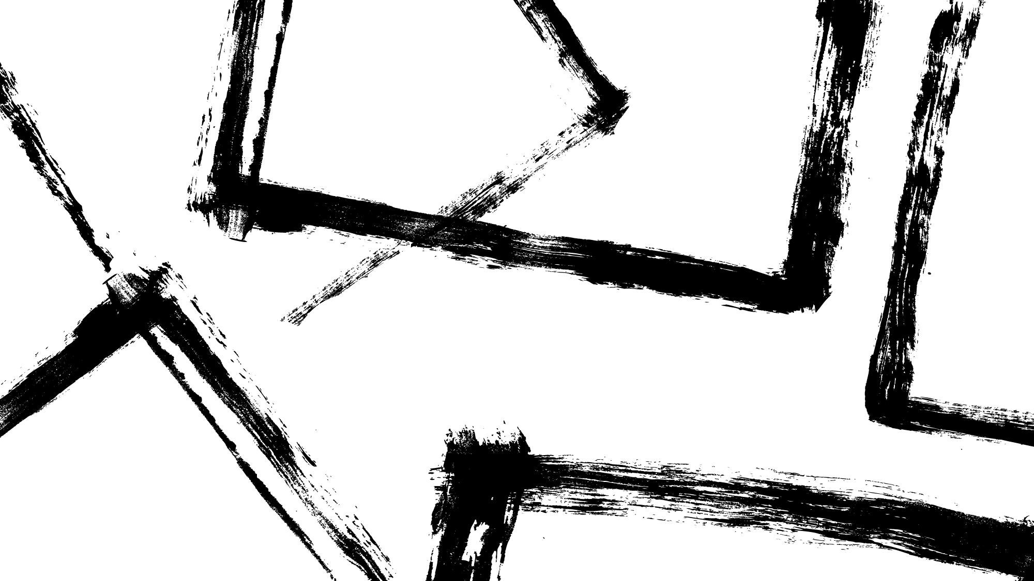
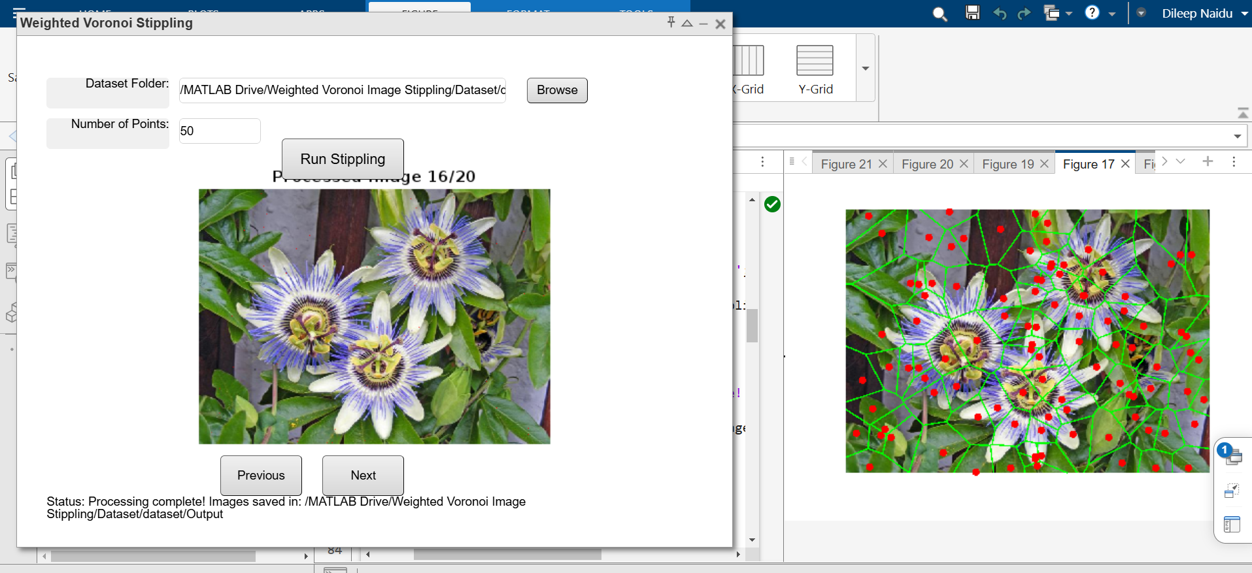
Slide 7: Results
Title: Results and Visualization
Content:
Processed Output: Stippled images with Voronoi overlays.
Example Results:
  Show original image and corresponding processed image side-by-side.
  Mention that brighter regions have denser stippling, validating the algorithm.

Slide 8
Slide 8: Challenges and Solutions
Content:
Challenges:
  Managing too many open figures in MATLAB Online.
  Ensuring correct Voronoi boundaries at image edges.
  Allowing dynamic user input for point density.
Solutions:
  Reused figure windows
  Added cropping for Voronoi regions.
  GUI for user-friendly interaction and input flexibility.

Slide 9

Slide 9: Conclusion
Title: Conclusion and Future Work
Content:
Conclusion:
  Successfully created an interactive MATLAB tool for Weighted Voronoi Image Stippling.
  GUI enhances usability and provides dynamic control over results.
Future Work:
  Add progress bars for better user feedback.
  Allow users to adjust the point color or Voronoi line style dynamically.
  Extend the tool for 3D images or real-time stippling.

