Slide 1
Capstone project:
Generative AI for Automated Text Assessment and Tailored Practice in Spanish Language Learning
2024W 136031-1 GenAI for Humanists
Felix Aufreiter

Slide 2

Goals
Create a RAG-pipeline using LlamaIndex
Automatically analyse students' written texts, identifying linguistic mistakes and assessing their overall proficiency according to the Common European Framework of Reference for Languages (CEFRL)
Level A2-B1
Generate personalised practice exercises that focus on the specific areas where each student struggles

Slide 3
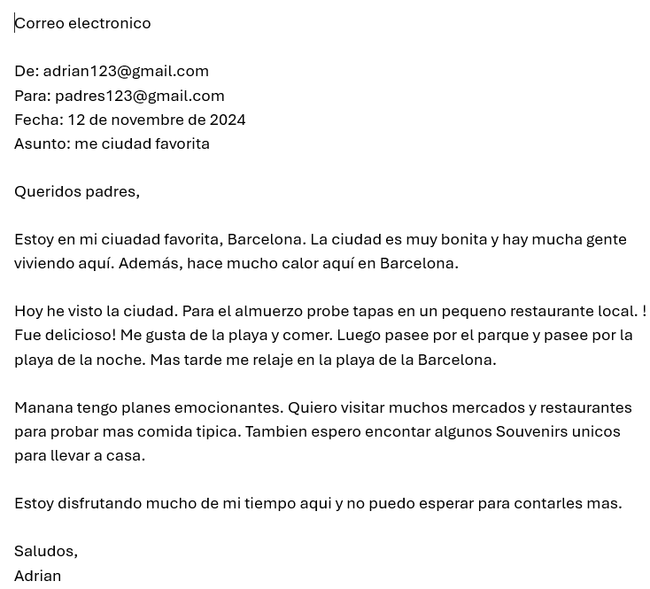
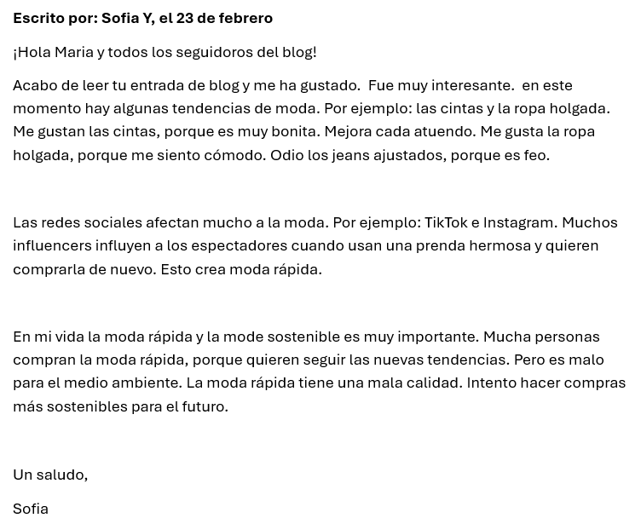
Real-world data

Slide 4
Current status of the project
RAG-pipeline 1 (Correction + CEFRL):
Data loaded and VectorStoreIndex created: ✅
Chatbot to ask questions about the data: ✅
Python code for correction of texts via OpenAI API: ✅
Creating a docx-file with corrected texts: ✅
Documentation: ✅
RAG-pipeline 2 (New Exercises):
Collection of data for exercise: ✅
Data loaded and VectorStoreIndex created: ❌
Python code for creation of new personalized exercises via OpenAI API: ❌
Combining RAG-pipeline 1 + 2: ❌

Slide 5
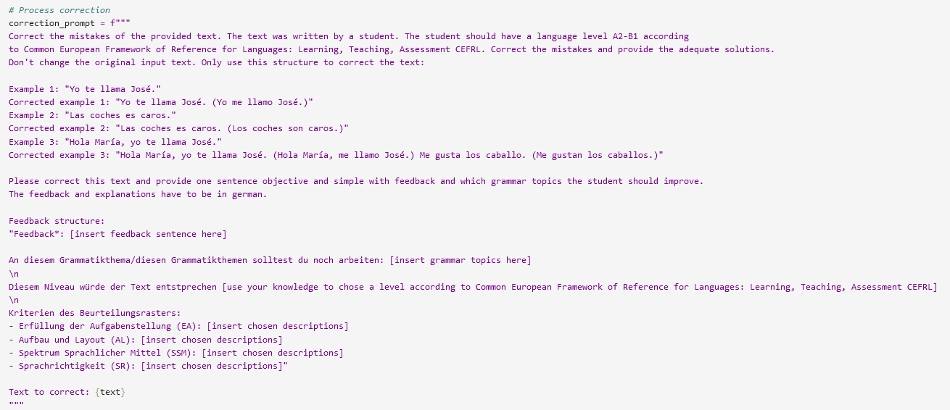
correction_prompt

Slide 6
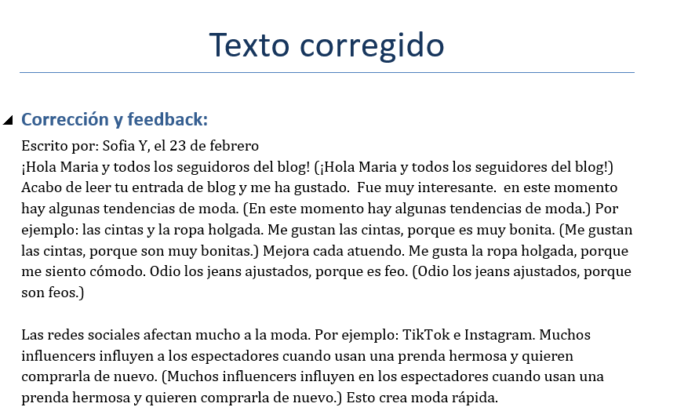
Output
docx-file
Contains:
Corrected text
Feedback according to official guidelines
To-do:
Add personalized exercises

Slide 7
Future Use
Can be adjusted or combined with my project of 2024W 136033-1 Research Seminar Digital Humanities
Relational database: collection of already used tasks of the official “Matura” exam
Uses OpenAI API to create new tasks
The project is still work in progress, but if you’d like to have a look: https://github.com/faufreiter/GenAI_project

