Slide 1

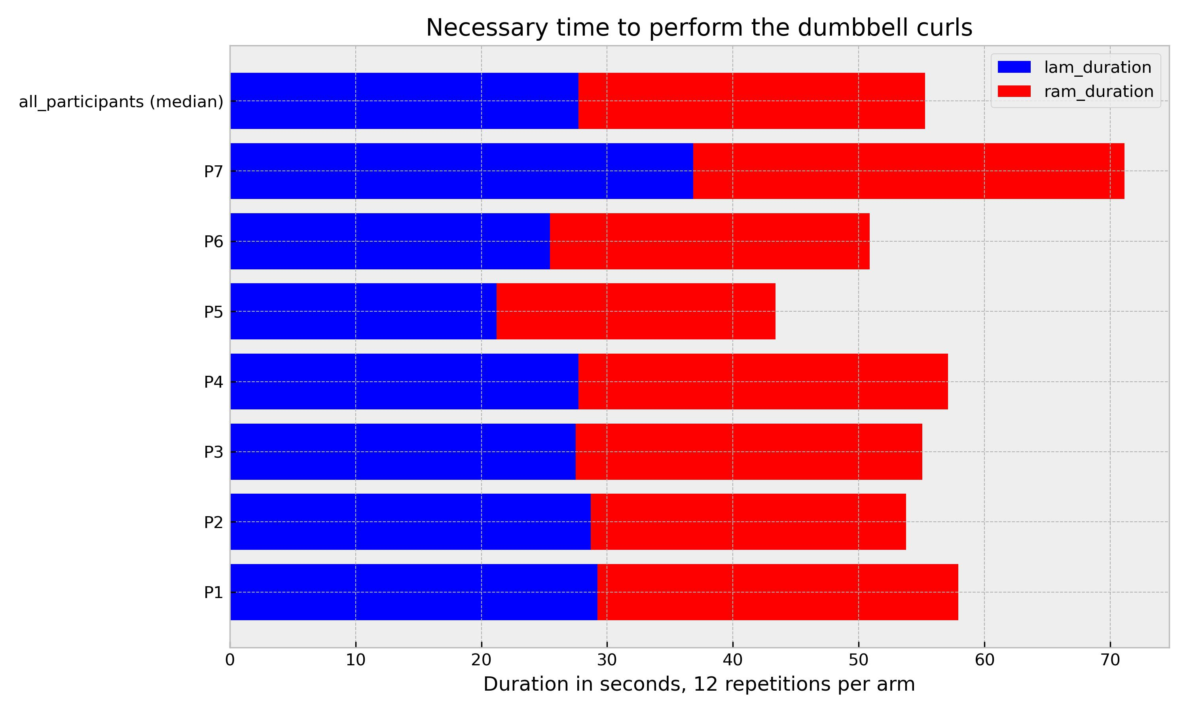
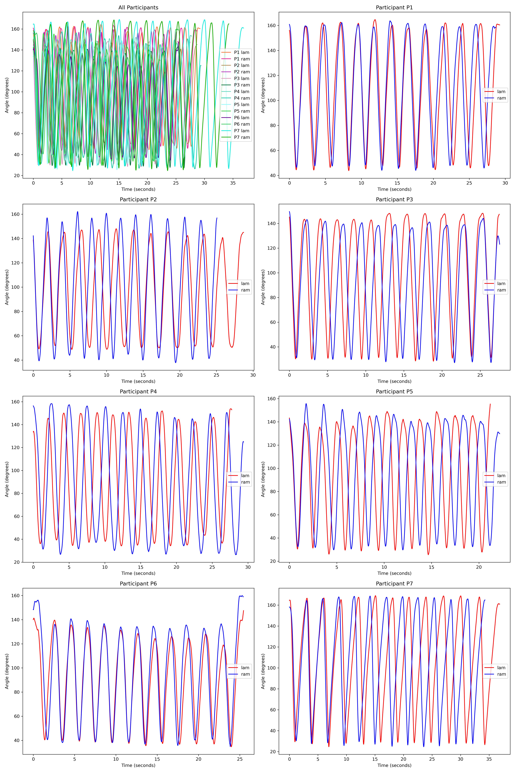
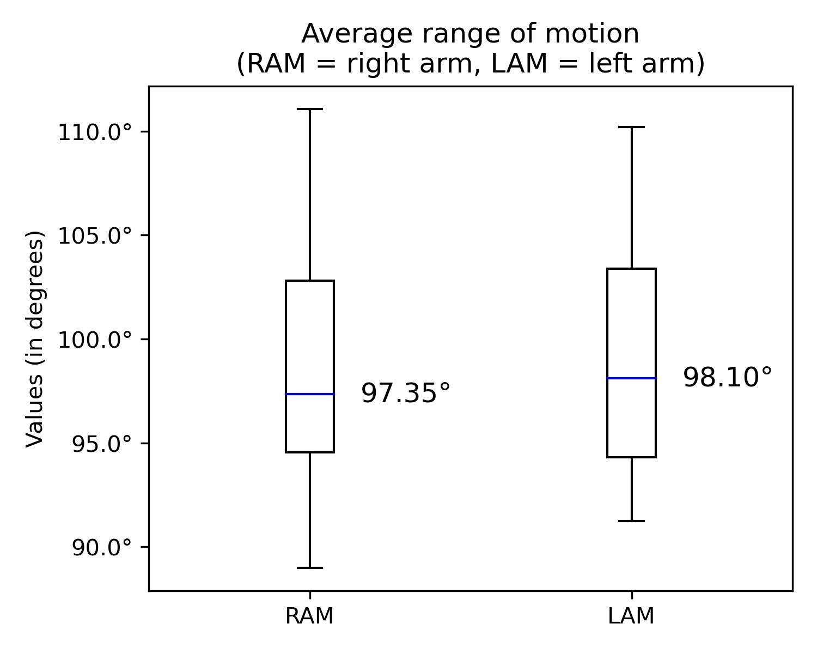
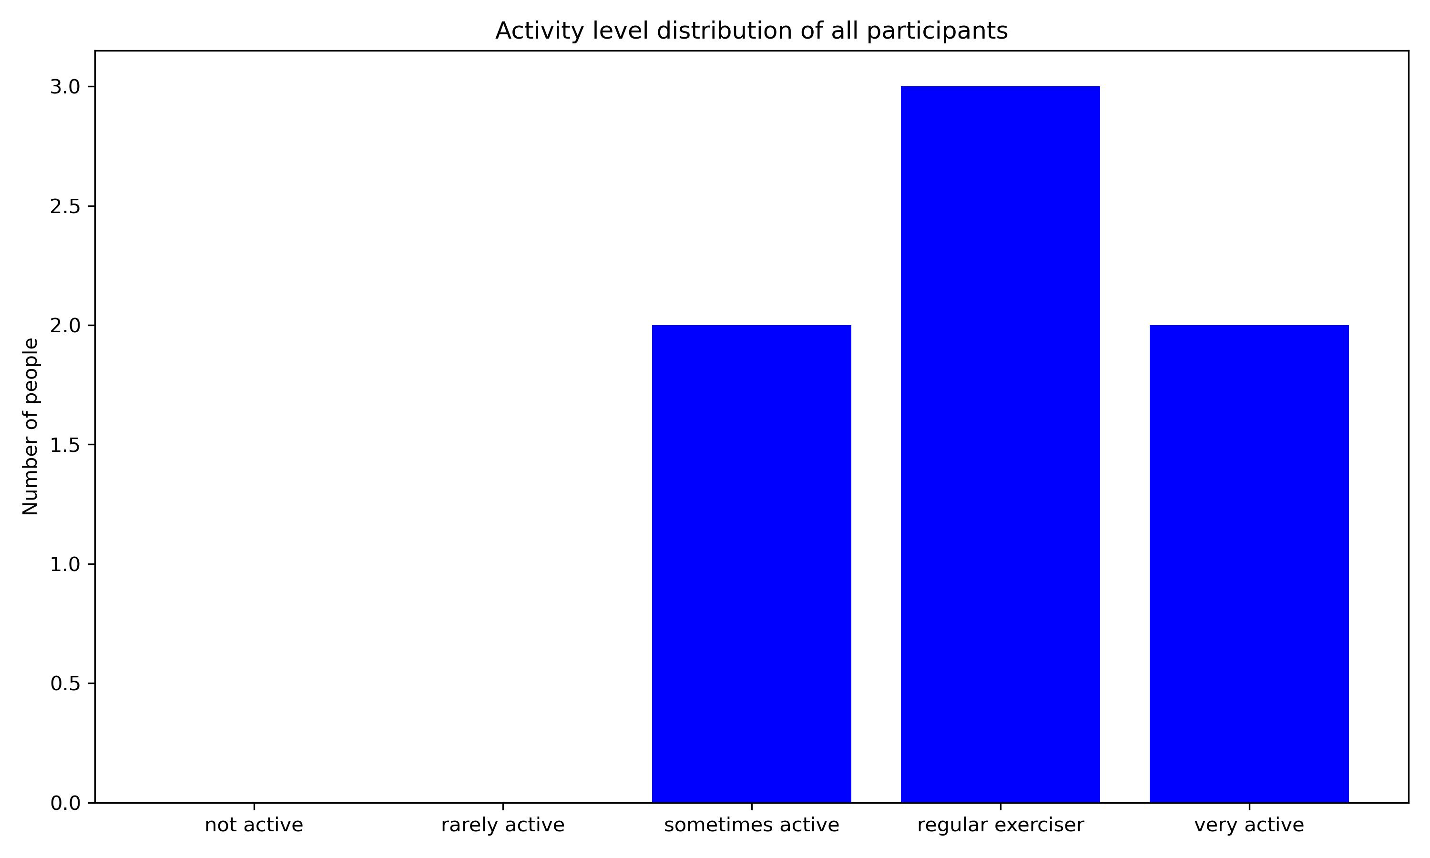
Exploring Natural Fitness Instincts:
Motion Capture, dumbbells and biceps curls
Felix Aufreiter
Universität Wien
INTRODUCTION
While other research focuses on muscle growth in certain areas, grip, tries to understand the muscles’ response to different amounts of load or detects anomalies the main research question is:
How does the natural use of dumbbells, especially in relation to the form and technique during biceps curls, vary among individuals?
Until now researchers did not try to analyze the intuitive use of dumbbells in weight training.
METHOD
During the experiment 7 participants were asked to perform 12 repetitions of biceps curls with each arm. A 5kg dumbbell was used for this task.
The exercises were recorded with a Qualisys motion capture system (100 fps) and a total of 8 markers per person. 3 markers were placed on each arm (shoulder, elbow, wrist) and 2 more markers on the dumbbell.
In order to be able to better assess the group of participants, they completed a questionnaire on the topics of weight training, sporting activity and previous experience.
RESULTS
„Variation (in various forms)“ can be identified as the main finding of the experiment, although a self-described "active" group with prior knowledge was studied.
The median of the average range of motion is approx. 98 degrees, although it should be noted that participants who described themselves as „very active“ tended to have a greater average range of motion (approx. 105 to 110 degrees). These two participants are also the slowest.
DISCUSSION
The results of this experiment raise numerous questions. Further research should aim to define the „perfect“ technique/form to be able to analyze the „correctness“ of fitness exercises. Parameters like skewness of movements, ideal starting points and a measurement scale for "wrongness" of execution should be considered.
Do more experienced participants train the initial range of motion more (to have “better” results)? Do participants who have less experience with weight training prefer the final range of motion because it is less exhausting?
Why must we pick sides? The new poster format is a revolution, or the new poster format is garbage! Take the good parts of the new format, keep the useful aspects of the traditional format, add in your own ideas, and create something better.
Variation in range of motion and duration.
Notes:
Notes:
In Powerpoint, click View > Guides
Keep text within gutter guides.
Author list: Don’t split names onto two lines (e.g., “Jimmy [break] Smith”). If that happens, use a new line, unless you need the space. Bold the first names of anybody who’s presenting in person.
Intro/methods/result: Do not drop below font size 28, but if you have extra space, jack up the font size until the space is full.
Do not use color in the sidebars except in graphs/figures. It’ll pull attention from the center and slow interpretation for passersby.
<Foliennummer>

