Slide 1

Twofish
Eddy Guo
WGT2
2008/05/06

Slide 2

Contents
Introduction
Twofish Design Goals
Twofish Building blocks
  Feistel Networks
  S-boxes
  MDS Matrices
  Pseudo-Hadamard Transforms
  Whitening
  Key Schedule
Twofish
  The function F
  The function g
  The Key Schedule
  Round Function Overview

Slide 3
Introduction

Slide 4
Introduction
128-bit block
128-, 192-, 256-bit key

Slide 5
Twofish Design Goals

Slide 6
Twofish Design Goals
A 128-bit symmetric block cipher
Key length of 128 bits, 192 bits and 256 bits
No weak keys

Slide 7
Twofish Building blocks

Slide 8
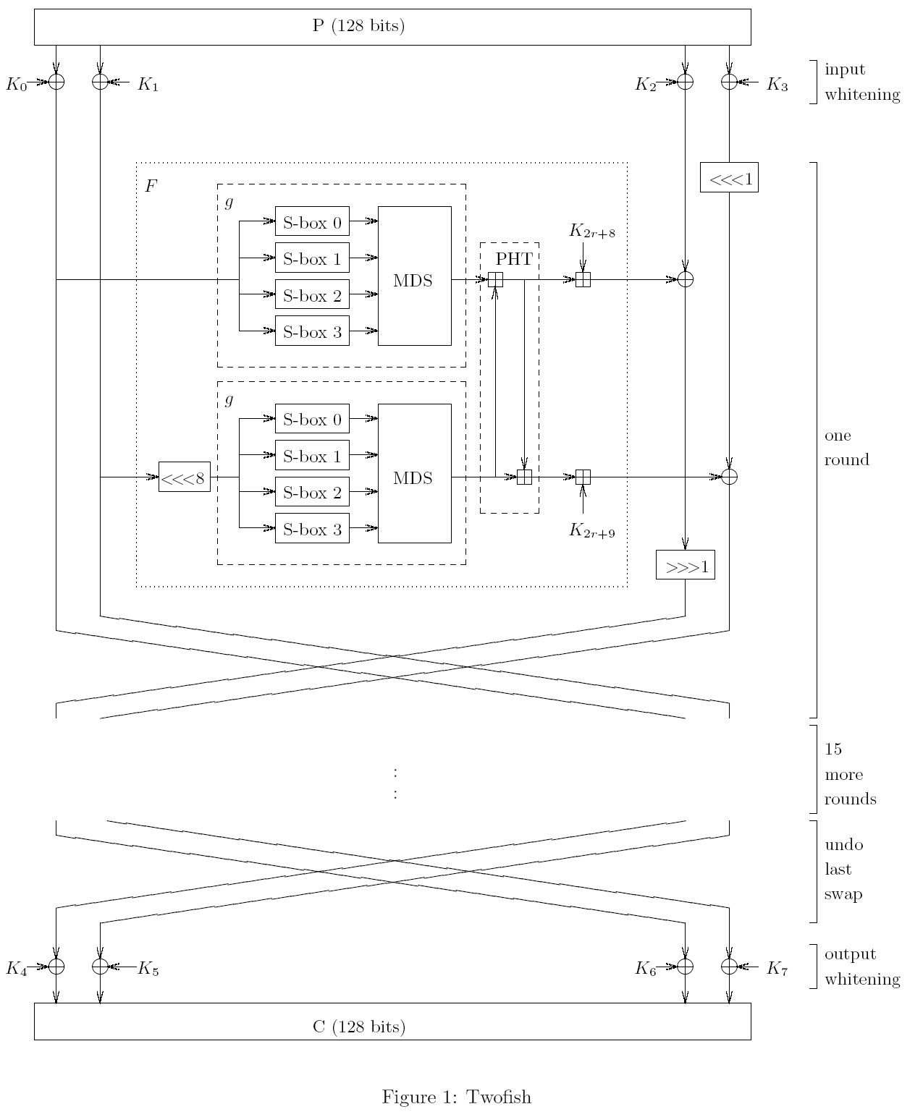
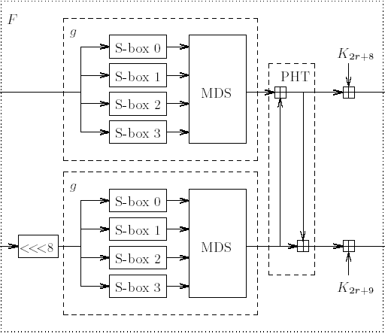
Twofish Building blocks

Slide 9
PHT
Given 2 inputs, a and b, the 32-bit PHT is defined as:
  a’ = a + b mod 2^32
  b’ = a + 2b mod 2^32

Slide 10
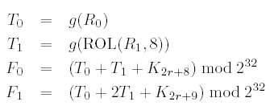
F definition

Slide 11
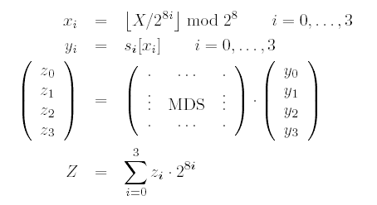
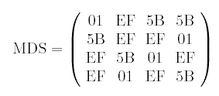
g Definition

Slide 12
Key Schedule

Slide 13


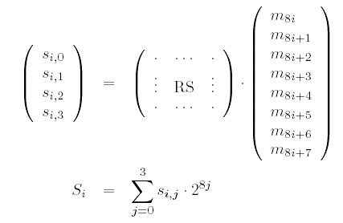

Slide 14

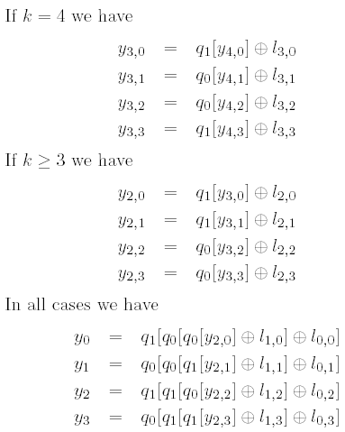
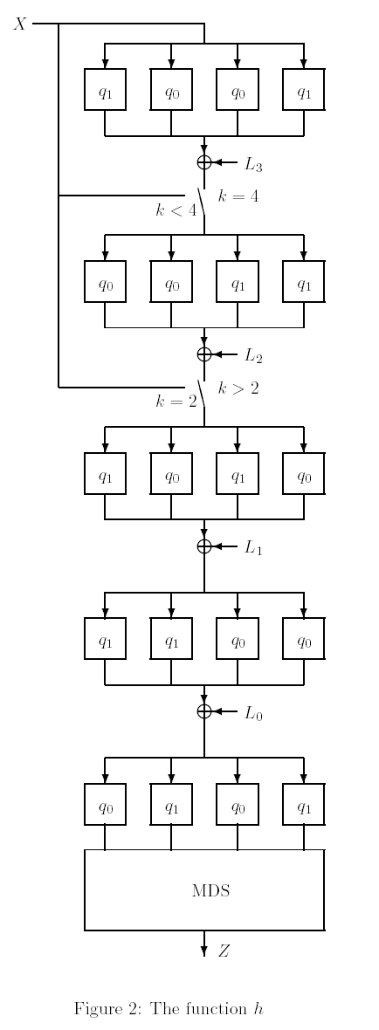


Slide 15
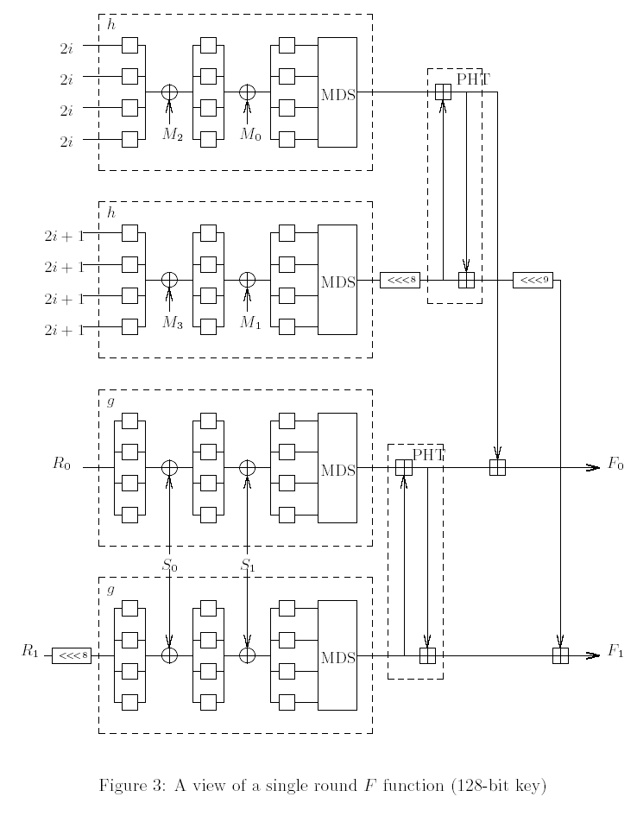

Slide 16
Twofish

Slide 18


