Slide 1

Architecture of platform tool
Alan Tu
WGT2
2008/04/23

Slide 2

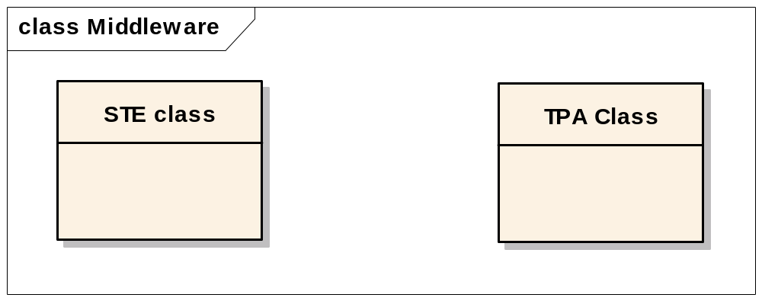
Implement the platform functions for Motorola
Must be clear to define the request.
Must be easy to debug.
Must be keep the future functions.
Must be able to complete the division.

Slide 3
Analysis
Each function has the same logic part.
Preprocess of the data to be command to comport
Send then data to comport
Wait and receive the data from comport
Process the data to be output

Slide 4
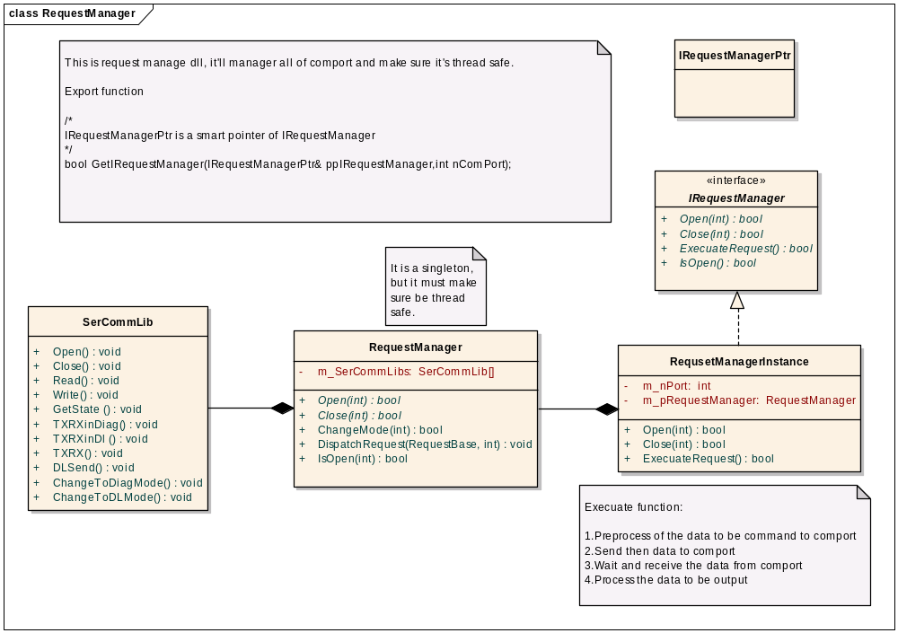

Slide 5
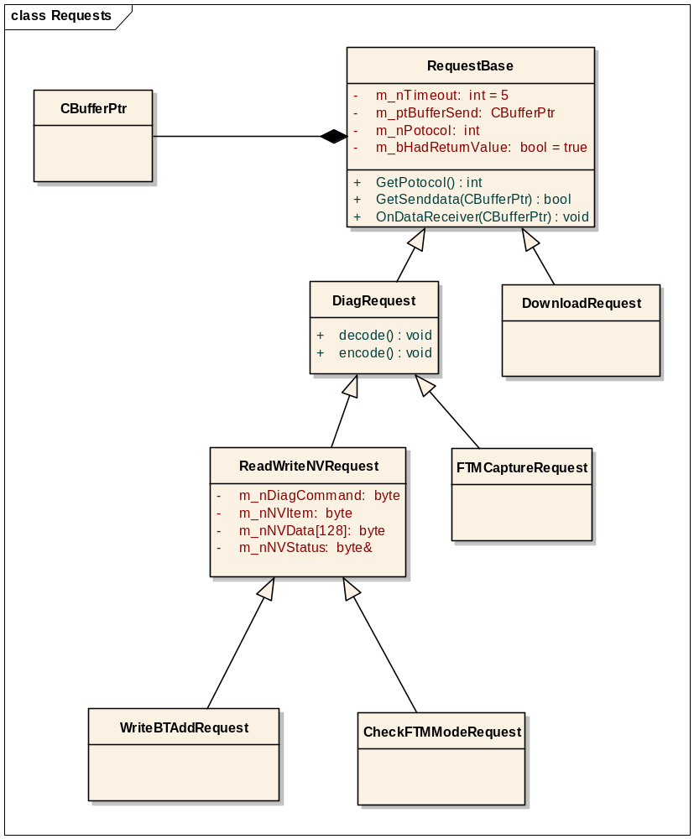

Slide 6
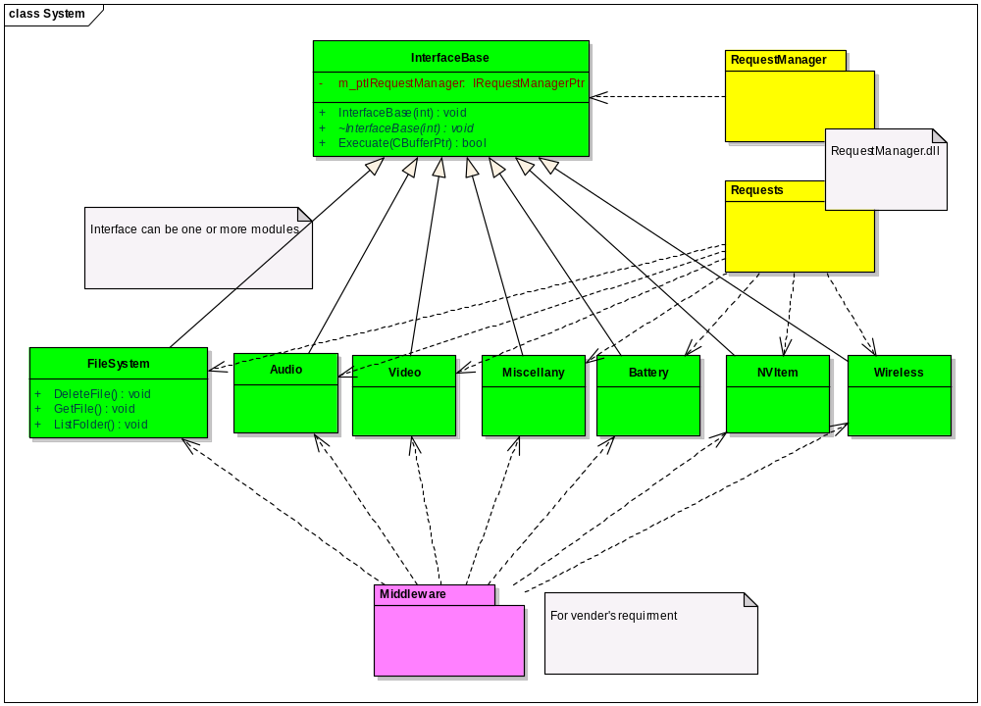

Slide 7

Schedule (include unit test)
Request manager
  Request base and (1 Day)
  Request manager (1 Day)
  Interface base (1 Day)
Interfaces and requests
  Need dispatch functions first for schedule (4/30)
  File system (QCS)
  Audio (QCS)
  Video (QCS)
  Battery (QTT)
  Miscellany (QTT)
  NV Item (QTT)
  Wireless (QTT)
Middleware
  Pending on interfaces
  STE
  TPA

Slide 8
