Slide 1
Script Process Unit
DEVELOP FLOW TOOL WITH SCRIPT
ALAN

Slide 2
Agenda
Functionality
Concept
History
Requirement analysis
Framework architecture
Module diagram
Role and Play
API
SPU
  State machine
  Module diagram
Loader
script
log

Slide 3
Functionality
Easy to customize flow
  The script language with flow control
  The script without any compiler
With UI mode and command line mode
Create formal log for any script
Stackable
Easy to develop and maintain

Slide 4
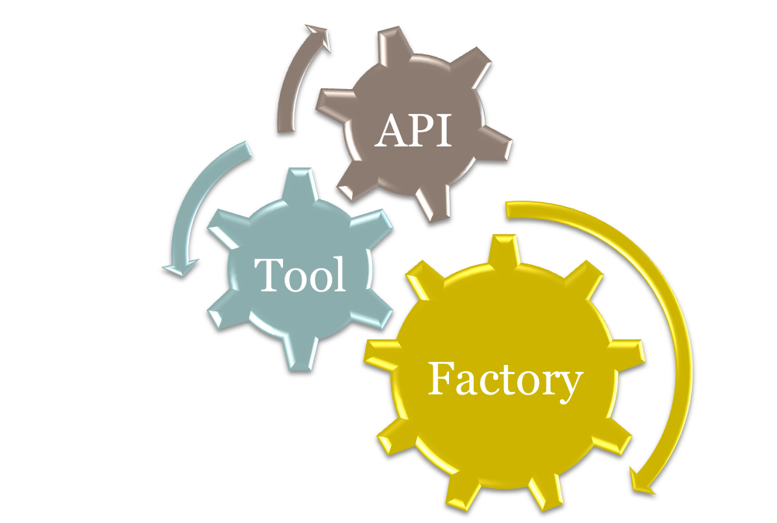
Concept

Slide 5
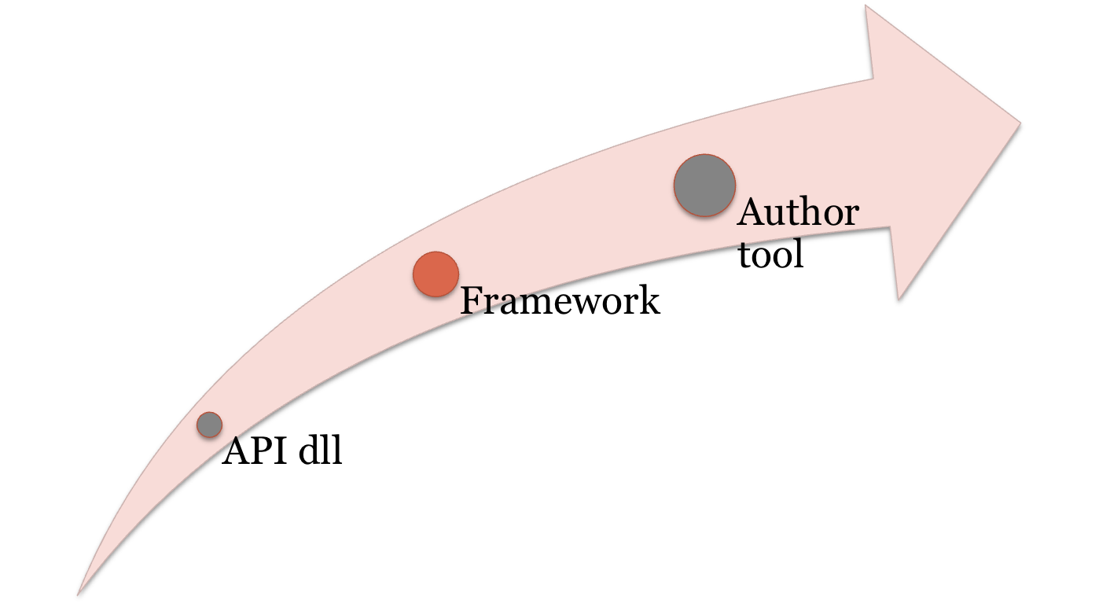
History

Slide 6
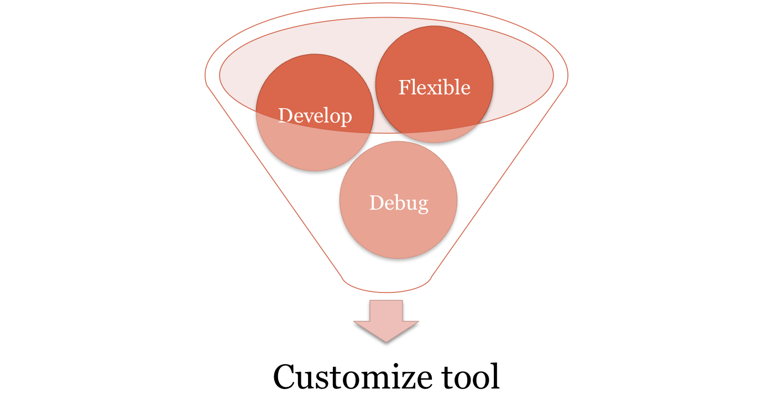
Requirement analysis

Slide 7
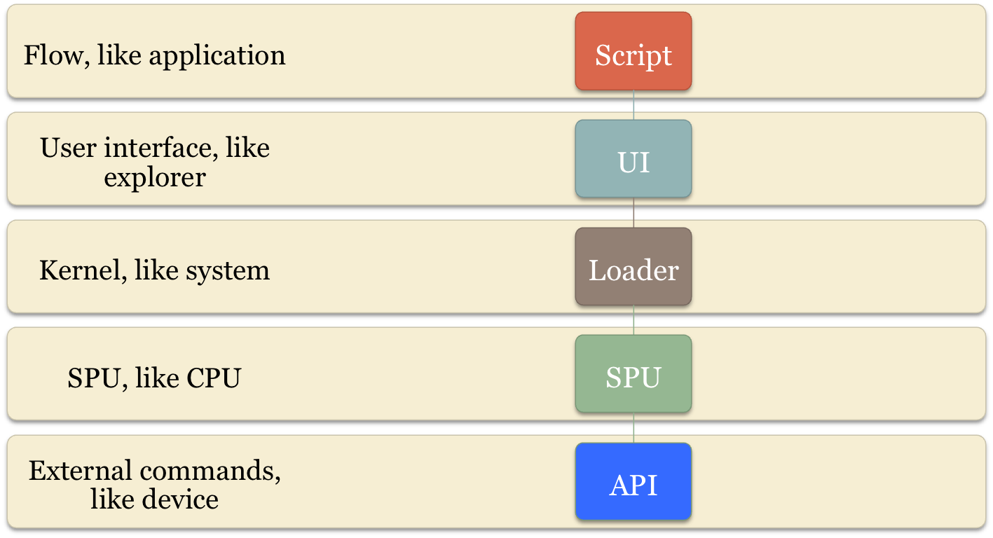
Framework architecture

Slide 8
Role and Play
UI
  Like explorer, select a script and launch it
  Provide “Break” event
  Provide “Input” event
  Handle “Output” event
Loader
  Example: Loader.exe IMEI.script COM5::[var1]
  Create a thread to read a instruction to memory
SPU
  Example: bool Run(std::vector<string>& vectCodeMemory)
  Internal Example: int Execute(“0x0001”,”print [var1]”)
  Return: SPU_SUCCESS or SPU_BREAK or SPU_ERROR
  Execute the instruction and change state and registers
API dlls
  Example: bool Function1(“Hello world”,0,strOutput)
  Provide external functions
  Execute the API and change registers from parameters

Slide 9
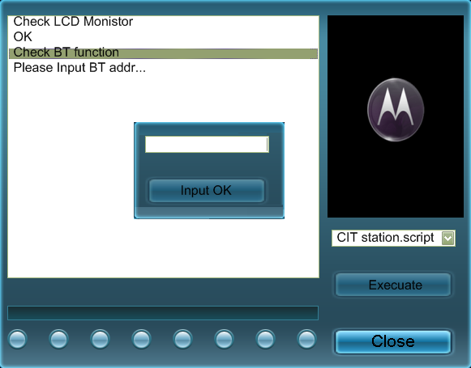
UI

Slide 10
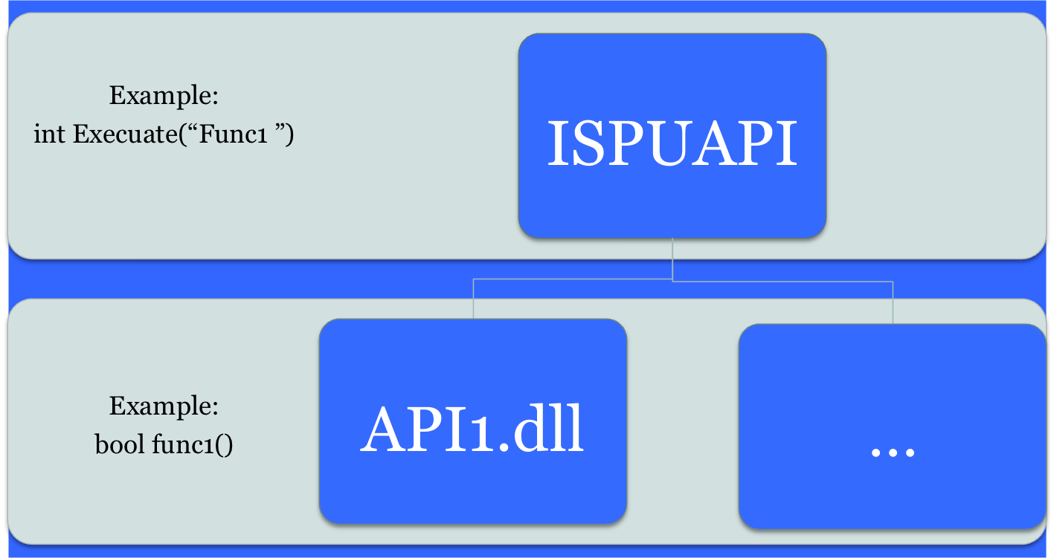
API

Slide 11
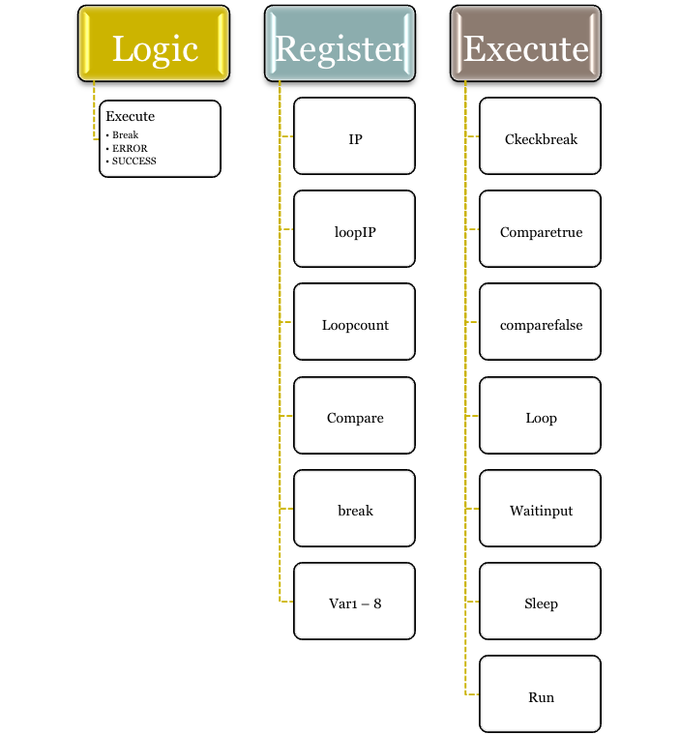







SPU

Slide 12
State machine
Launch a script
Read next instruction
EOF
Execute a instruction
false
true
Break
Error
Success
End

Slide 13
Module diagram
UI
Loader
SPU
SPU
…
API dlls

Slide 14
SPU functions
Export function:
  bool Run(std::vector<string>& vectCodeMemory)
  bool SetRegister(const string& strVarName, const string& strValue)
Internal function:
  bool ExecuateInstruction(“0x0001”, “sleep”,”5000”)

Slide 15
Loader
Example: Loader.exe “IMEI.script COM1::[var1]”
Create a thread to read script instruction to SPU
SPU execute the instruction to change state and registersand run external API’s command

Slide 16
Script
0x0000 sleep 5000
0x0001 waitforinput [var1]
0x0002 print [var1]
//start loop twice, and set [loopIP] to be 0x0004, [loopCount] to be 2
0x0003 loop 2
//check if [break] from UI
0x0004 checkbreak
//execuate the Function1 with parameters, it is external function from API.dll
//All of external functions are be formated like
//bool fun([const char* szCharVar1],...)
0x0005 run API.dll::Function1 [var1] [var2]::integer [var3]::output
//if [compare] is false, go to 0x0008
0x0006 comparefalse 0x9999
//decrease [loopCount] with 1, and go to [loopIP] if [loopCount] is zero
0x0007 loop

Slide 17
Log
Wednesday, October 22, 2008 17:25:56
Instruction :
0x0001 print [var1]
Variable:
[break]:false
[IP]:0x0001
[compare]:false
[loopIP]:0x0000
[loopcount]:0
[var1]:"Hello world!"
[var2]:
[var3]:
[var4]:
[var5]:
[var6]:
[var7]:
[var8]:

Slide 18
Thanks

