Slide 1
Recitation 4/22

Slide 2
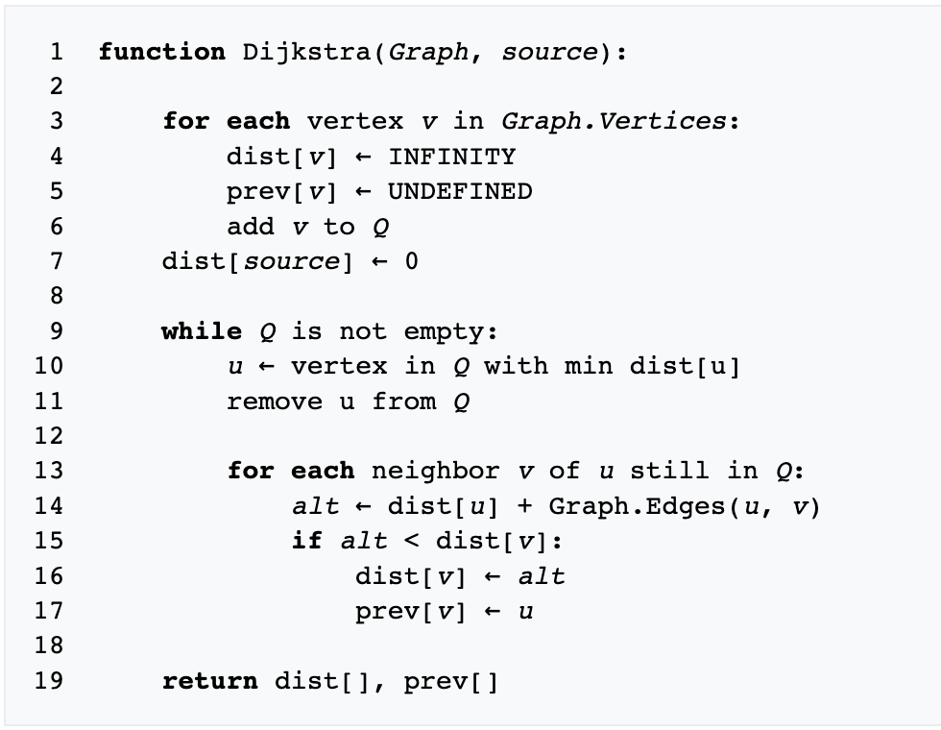
Dijkstra's algorithm

Slide 3
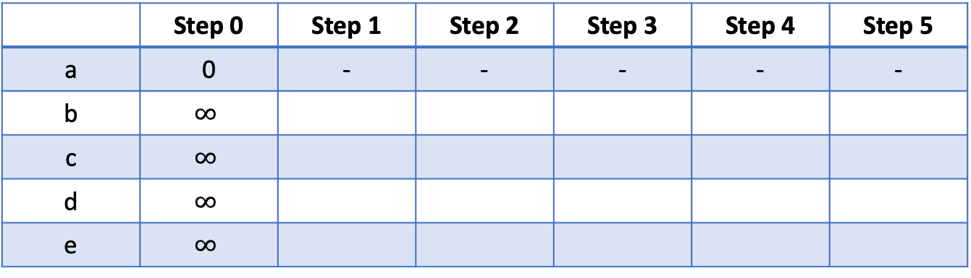
Dijkstra's algorithm
b
8
12
1
e
a
d
8
5
1
c
 | Step 0 | Step 1 | Step 2 | Step 3 | Step 4 | Step 5
a | 0 | - | - | - | - | -
b | $$∞$$
c | $$∞$$
d | $$∞$$
e | $$∞$$

Slide 4
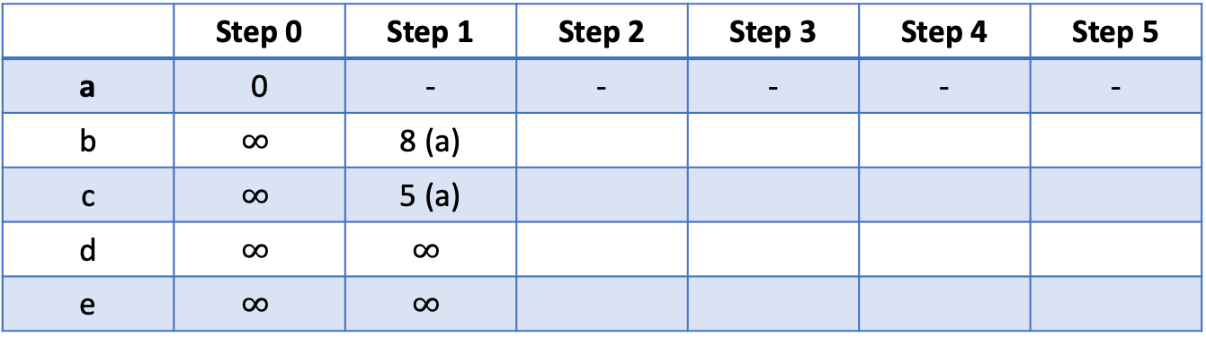
Dijkstra's algorithm
b
8
12
1
e
a
d
8
5
1
c
 | Step 0 | Step 1 | Step 2 | Step 3 | Step 4 | Step 5
a | 0 | - | - | - | - | -
b | $$∞$$ | 8 (a)
c | $$∞$$ | 5 (a)
d | $$∞$$ | $$∞$$
e | $$∞$$ | $$∞$$

Slide 5
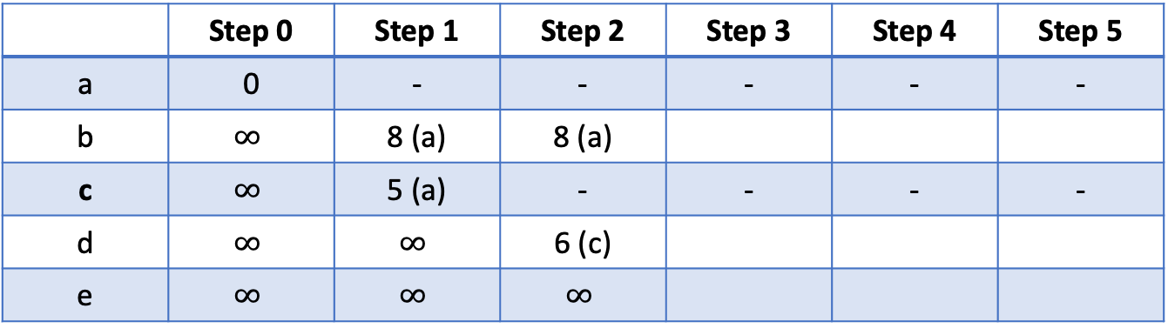
Dijkstra's algorithm
b
8
12
1
e
a
d
8
5
1
c
 | Step 0 | Step 1 | Step 2 | Step 3 | Step 4 | Step 5
a | 0 | - | - | - | - | -
b | $$∞$$ | 8 (a) | 8 (a)
c | $$∞$$ | 5 (a) | - | - | - | -
d | $$∞$$ | $$∞$$ | 6 (c)
e | $$∞$$ | $$∞$$ | $$∞$$

Slide 6
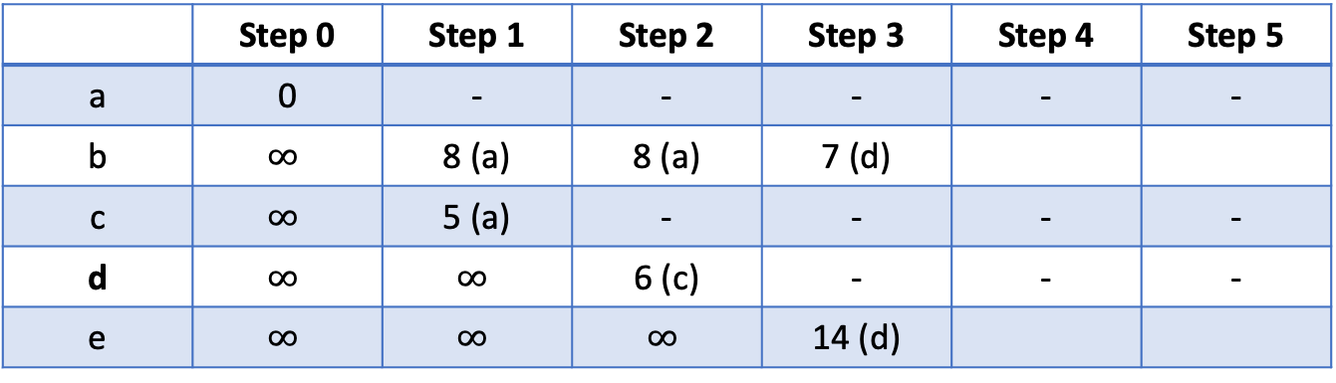
Dijkstra's algorithm
b
8
12
1
e
a
d
8
5
1
c
 | Step 0 | Step 1 | Step 2 | Step 3 | Step 4 | Step 5
a | 0 | - | - | - | - | -
b | $$∞$$ | 8 (a) | 8 (a) | 7 (d)
c | $$∞$$ | 5 (a) | - | - | - | -
d | $$∞$$ | $$∞$$ | 6 (c) | - | - | -
e | $$∞$$ | $$∞$$ | $$∞$$ | 14 (d)

Slide 7

Dijkstra's algorithm
b
8
12
1
e
a
d
8
5
1
c
 | Step 0 | Step 1 | Step 2 | Step 3 | Step 4 | Step 5
a | 0 | - | - | - | - | -
b | $$∞$$ | 8 (a) | 8 (a) | 7 (d) | - | -
c | $$∞$$ | 5 (a) | - | - | - | -
d | $$∞$$ | $$∞$$ | 6 (c) | - | - | -
e | $$∞$$ | $$∞$$ | $$∞$$ | 14 (d)

Slide 8
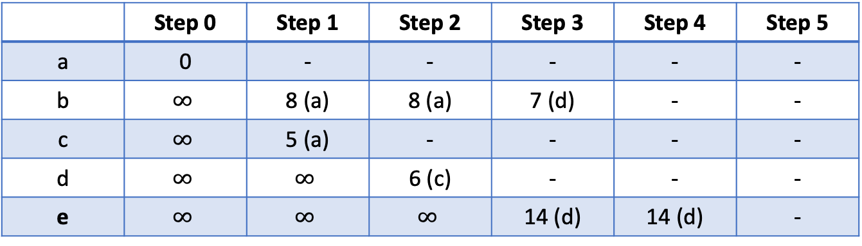
Dijkstra's algorithm
b
8
12
1
e
a
d
8
5
1
c
 | Step 0 | Step 1 | Step 2 | Step 3 | Step 4 | Step 5
a | 0 | - | - | - | - | -
b | $$∞$$ | 8 (a) | 8 (a) | 7 (d) | - | -
c | $$∞$$ | 5 (a) | - | - | - | -
d | $$∞$$ | $$∞$$ | 6 (c) | - | - | -
e | $$∞$$ | $$∞$$ | $$∞$$ | 14 (d) | 14 (d) | -

Slide 9
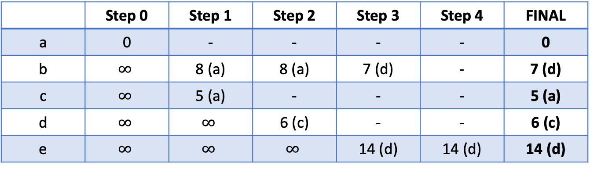
Dijkstra's algorithm
b
8
12
1
e
a
d
8
5
1
c
 | Step 0 | Step 1 | Step 2 | Step 3 | Step 4 | FINAL
a | 0 | - | - | - | - | 0
b | $$∞$$ | 8 (a) | 8 (a) | 7 (d) | - | 7 (d)
c | $$∞$$ | 5 (a) | - | - | - | 5 (a)
d | $$∞$$ | $$∞$$ | 6 (c) | - | - | 6 (c)
e | $$∞$$ | $$∞$$ | $$∞$$ | 14 (d) | 14 (d) | 14 (d)

Slide 10
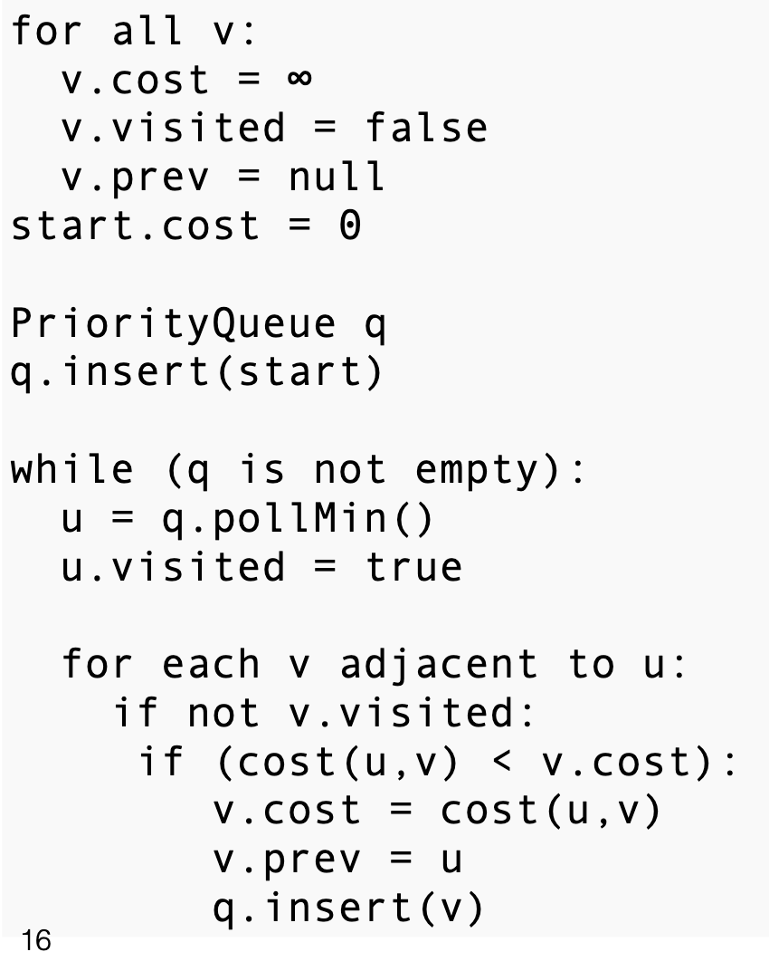
Prim's algorithm
b
8
12
1
e
a
10
8
d
5
1
14
c
 | Step 0 | Step 1 | Step 2 | Step 3 | Step 4 | Step 5
a | 0 | - | - | - | - | -
b | $$∞$$
c | $$∞$$
d | $$∞$$
e | $$∞$$

Slide 11
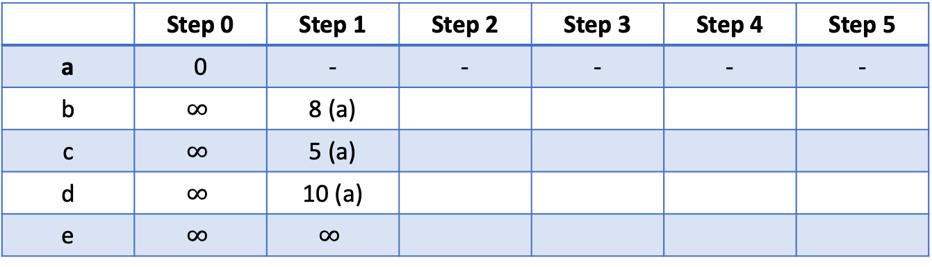
Prim's algorithm
b
8
12
1
e
a
10
8
d
5
1
14
c
 | Step 0 | Step 1 | Step 2 | Step 3 | Step 4 | Step 5
a | 0 | - | - | - | - | -
b | $$∞$$ | 8 (a)
c | $$∞$$ | 5 (a)
d | $$∞$$ | 10 (a)
e | $$∞$$ | $$∞$$

Slide 12
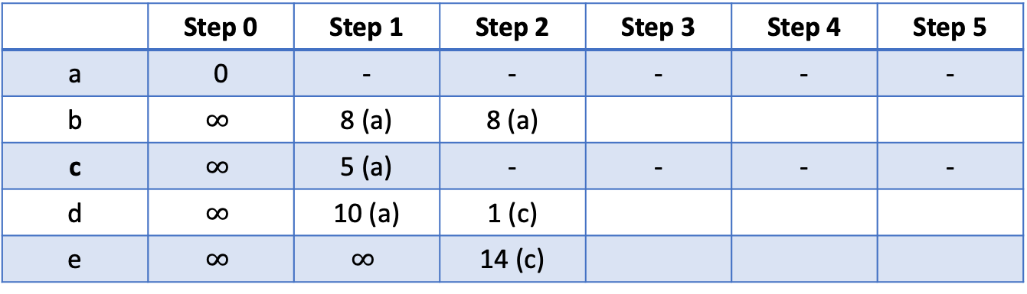
Prim's algorithm
b
8
12
1
e
a
10
8
d
5
1
14
c
 | Step 0 | Step 1 | Step 2 | Step 3 | Step 4 | Step 5
a | 0 | - | - | - | - | -
b | $$∞$$ | 8 (a) | 8 (a)
c | $$∞$$ | 5 (a) | - | - | - | -
d | $$∞$$ | 10 (a) | 1 (c)
e | $$∞$$ | $$∞$$ | 14 (c)

Slide 13
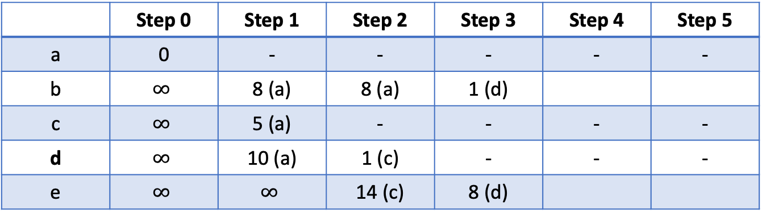
Prim's algorithm
b
8
12
1
e
a
10
8
d
5
1
14
c
 | Step 0 | Step 1 | Step 2 | Step 3 | Step 4 | Step 5
a | 0 | - | - | - | - | -
b | $$∞$$ | 8 (a) | 8 (a) | 1 (d)
c | $$∞$$ | 5 (a) | - | - | - | -
d | $$∞$$ | 10 (a) | 1 (c) | - | - | -
e | $$∞$$ | $$∞$$ | 14 (c) | 8 (d)

Slide 14
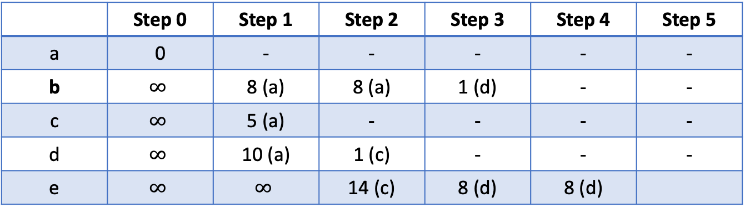
Prim's algorithm
b
8
12
1
e
a
10
8
d
5
1
14
c
 | Step 0 | Step 1 | Step 2 | Step 3 | Step 4 | Step 5
a | 0 | - | - | - | - | -
b | $$∞$$ | 8 (a) | 8 (a) | 1 (d) | - | -
c | $$∞$$ | 5 (a) | - | - | - | -
d | $$∞$$ | 10 (a) | 1 (c) | - | - | -
e | $$∞$$ | $$∞$$ | 14 (c) | 8 (d) | 8 (d)

Slide 15
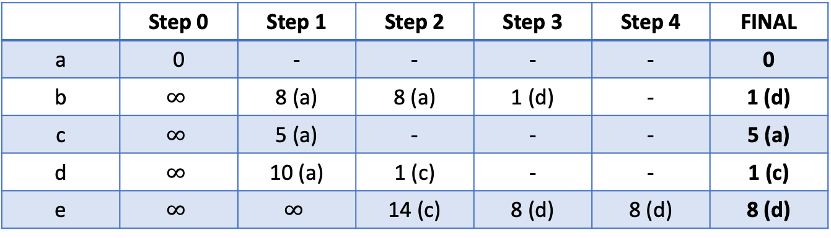
Prim's algorithm
b
1
e
a
8
d
5
1
c
 | Step 0 | Step 1 | Step 2 | Step 3 | Step 4 | FINAL
a | 0 | - | - | - | - | 0
b | $$∞$$ | 8 (a) | 8 (a) | 1 (d) | - | 1 (d)
c | $$∞$$ | 5 (a) | - | - | - | 5 (a)
d | $$∞$$ | 10 (a) | 1 (c) | - | - | 1 (c)
e | $$∞$$ | $$∞$$ | 14 (c) | 8 (d) | 8 (d) | 8 (d)

Slide 16
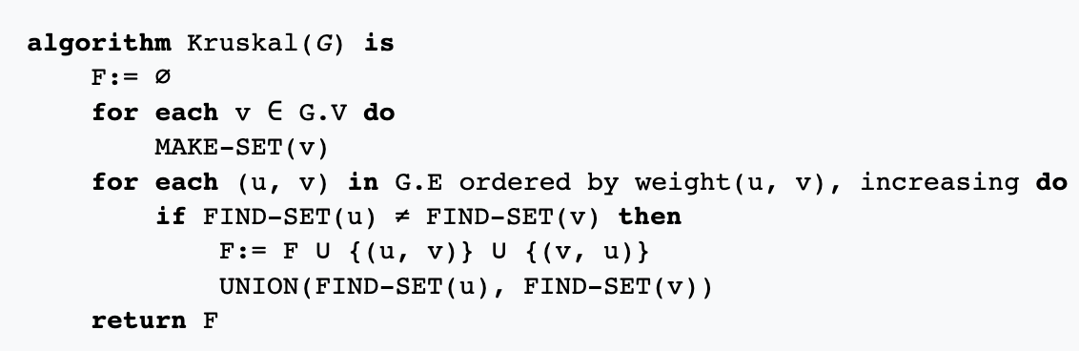
Kruskal's algorithm
b
8
12
1
e
a
10
8
d
5
1
14
c
(a,b) | 8
(a,c) | 5
(a,d) | 10
(b,d) | 1
(b,e) | 12
(c,d) | 1
(c,e) | 14
(d,e) | 8

Slide 17
Kruskal's algorithm
b
8
12
1
e
a
10
8
d
5
1
14
c
(b,d) | 1
(c,d) | 1
(a,c) | 5
(a,b) | 8
(d,e) | 8
(a,d) | 10
(b,e) | 12
(c,e) | 14

Slide 18
Kruskal's algorithm
b
8
12
1
e
a
10
8
d
5
1
14
c
(b,d) | 1
(c,d) | 1
(a,c) | 5
(a,b) | 8
(d,e) | 8
(a,d) | 10
(b,e) | 12
(c,e) | 14
yes

Slide 19
Kruskal's algorithm
b
8
12
1
e
a
10
8
d
5
1
14
c
(b,d) | 1
(c,d) | 1
(a,c) | 5
(a,b) | 8
(d,e) | 8
(a,d) | 10
(b,e) | 12
(c,e) | 14
yes
yes

Slide 20
Kruskal's algorithm
b
8
12
1
e
a
10
8
d
5
1
14
c
(b,d) | 1
(c,d) | 1
(a,c) | 5
(a,b) | 8
(d,e) | 8
(a,d) | 10
(b,e) | 12
(c,e) | 14
yes
yes
yes

Slide 21
Kruskal's algorithm
b
8
12
1
e
a
10
8
d
5
1
14
c
(b,d) | 1
(c,d) | 1
(a,c) | 5
(a,b) | 8
(d,e) | 8
(a,d) | 10
(b,e) | 12
(c,e) | 14
yes
yes
yes
no

Slide 22
Kruskal's algorithm
b
8
12
1
e
a
10
8
d
5
1
14
c
(b,d) | 1
(c,d) | 1
(a,c) | 5
(a,b) | 8
(d,e) | 8
(a,d) | 10
(b,e) | 12
(c,e) | 14
yes
yes
yes
no
yes

Slide 23
Kruskal's algorithm
b
8
12
1
e
a
10
8
d
5
1
14
c
(b,d) | 1
(c,d) | 1
(a,c) | 5
(a,b) | 8
(d,e) | 8
(a,d) | 10
(b,e) | 12
(c,e) | 14
yes
yes
yes
no
yes
no

Slide 24
Kruskal's algorithm
b
8
12
1
e
a
10
8
d
5
1
14
c
(b,d) | 1
(c,d) | 1
(a,c) | 5
(a,b) | 8
(d,e) | 8
(a,d) | 10
(b,e) | 12
(c,e) | 14
yes
yes
yes
no
yes
no
no

Slide 25
Kruskal's algorithm
b
8
12
1
e
a
10
8
d
5
1
14
c
(b,d) | 1
(c,d) | 1
(a,c) | 5
(a,b) | 8
(d,e) | 8
(a,d) | 10
(b,e) | 12
(c,e) | 14
yes
yes
yes
no
yes
no
no
no

