Slide 1

ROS - Lesson 1
Teaching Assistant: Roi Yehoshua
roiyeho@gmail.com

Slide 2
Agenda
Introduction to ROS
ROS Main Features
ROS Main Concepts
Basic ROS Commands
Turtlesim Demo

Slide 3
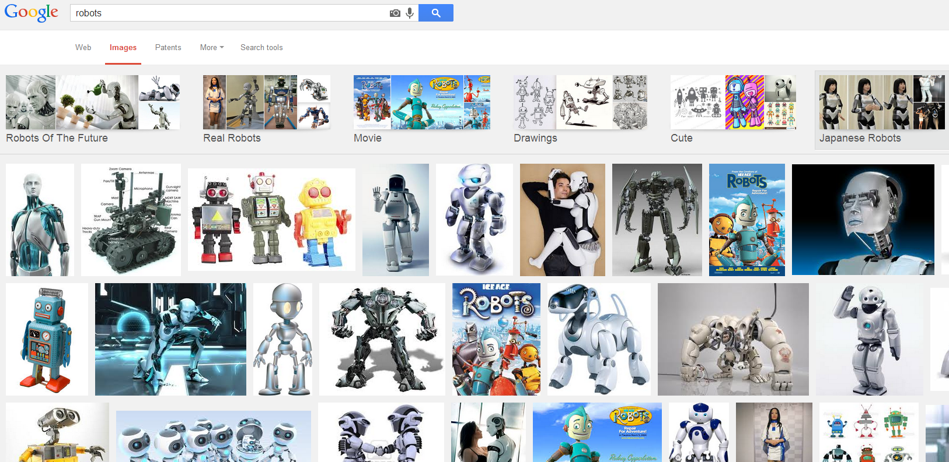
The Problem
Lack of standards for robotics

Slide 4
What is ROS?
ROS is an open-source robot operating system
The primary goal of ROS is to support code reuse in robotics research and development
ROS was originally developed in 2007 at the Stanford Artificial Intelligence Laboratory
Development continues primarily at Willow Garage, a robotics research institute/incubator

Slide 5
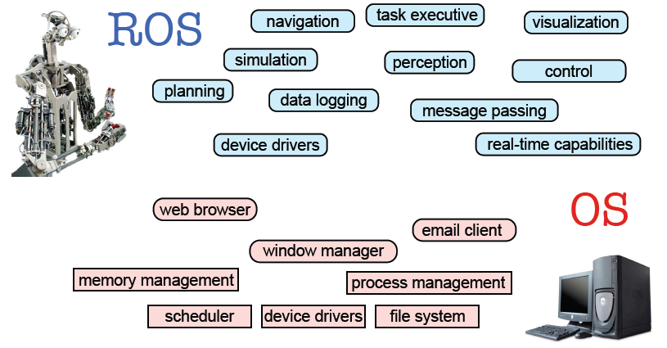
ROS Main Features
Taken from Sachin Chitta and Radu Rusu (Willow Garage)

Slide 6
ROS Main Features
Hardware and network abstraction
Low-level device control
Message-passing between processes
Implementation of commonly-used functionality
Package management

Slide 7
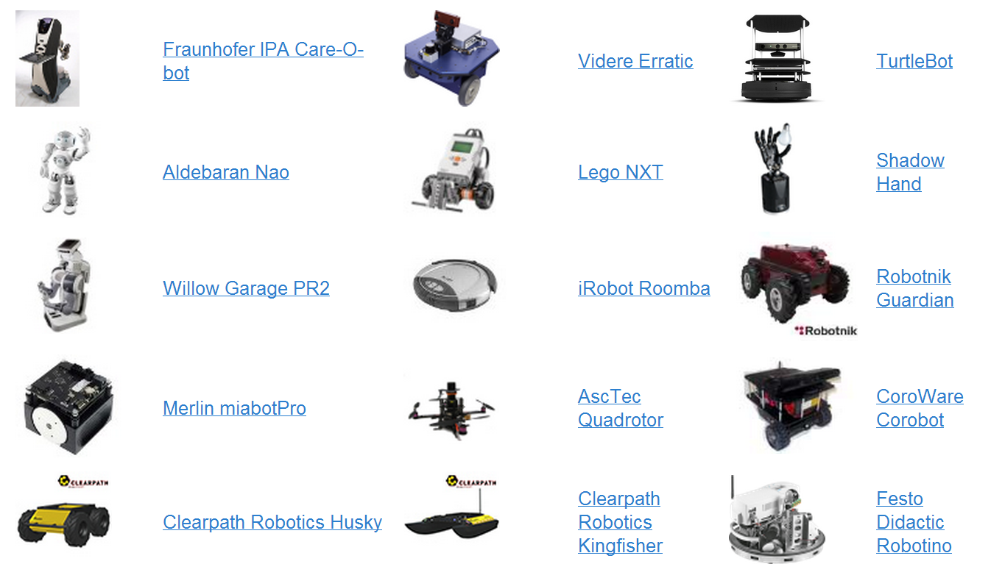
Robots using ROS
http://wiki.ros.org/Robots

Slide 8
ROS Philosophies
Modularity & Peer-to-peer
Language Independent
Thin
Free & Open-Source

Slide 9
Modularity & Peer-To-Peer
ROS consists of a number of processes
potentially on a number of different hosts,
connected at runtime in a peer-to-peer topology
No central server

Slide 10
Language Independent
Client interfaces:
Stable: roscpp, rospy, roslisp
Experimental: rosjava, roscs
Contributed: rosserial, roshask, ipc-bridge (MATLAB), etc...
Common message-passing layer
Interface Definition Language (IDL)

Slide 11
Thin
Library-style development
all development occurs in standalone libraries with minimal dependencies on ROS
ROS re-uses code from numerous other open-source projects, such as the navigation system simulators and vision algorithms from OpenCV

Slide 12
Free & Open-Source
Source code is publicly available
Contributed tools are under a variety of open-source (& closed-source) licenses
Promotes code-reuse and community-building

Slide 13
ROS Core Concepts
Nodes
Messages and Topics
Services
ROS Master
Parameters

Slide 14
ROS Nodes
Single-purposed executable programs
e.g. sensor driver(s), actuator driver(s), mapper, planner, UI, etc.
Modular design
Individually compiled, executed, and managed
Nodes are written with the use of a ROS client library
Nodelets

Slide 15
ROS Client Libraries
A collection of code that eases the job of the ROS programmer.
Libraries that let you write ROS nodes, publish and subscribe to topics, write and call services, and use the Parameter Server.
Main clients:
roscpp = C++ client library
rospy = python client library

Slide 16
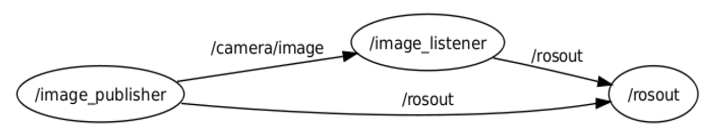
ROS Topics
Nodes communicate with each other by publishing messages to topics
Publish/Subscribe model: 1-to-N broadcasting
Examples:
provide sensor readings
provide actuator states / robot feedback

Slide 17
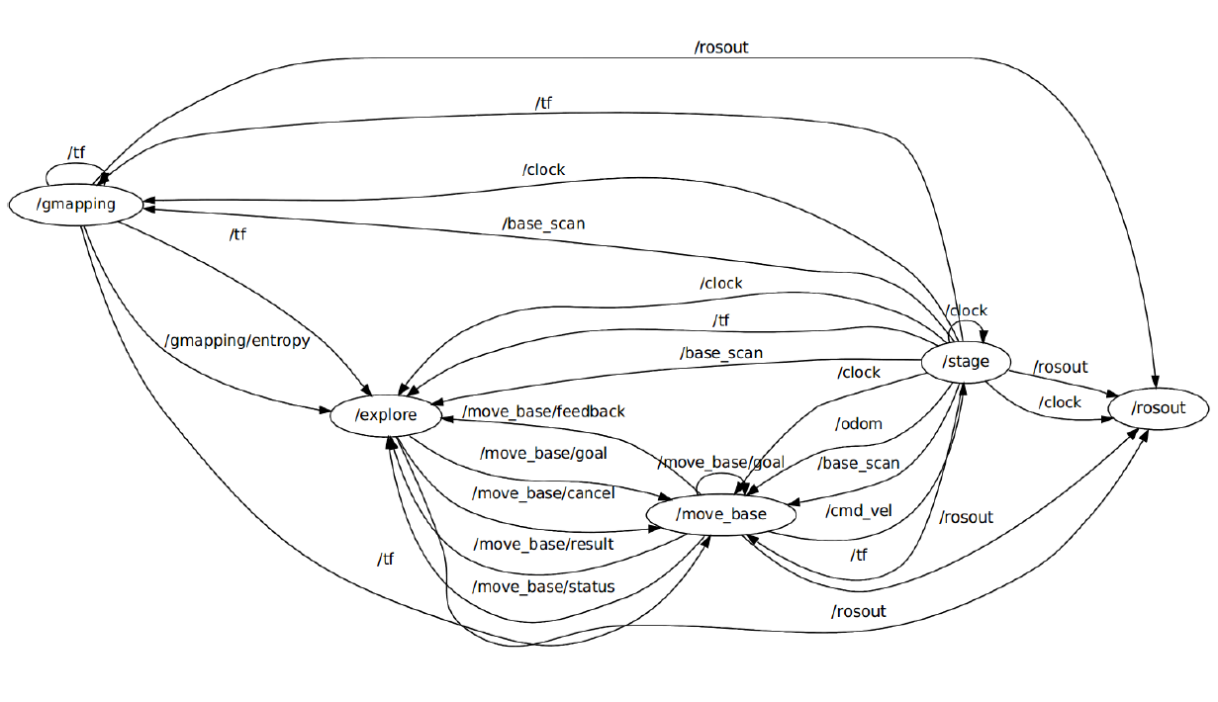
More Complex Example

Slide 18
ROS Messages
Strictly-typed data structures for inter-node communication
Messages can include:
Primitive types (integer, floating point, boolean, etc.)
Arrays of primitives
Arbitrarily nested structures and arrays (much like C structs)
For example, geometry_msgs/Twist.msg
Vector3 linear
Vector3 angular

Slide 19
ROS Services
Synchronous inter-node transactions / RPC
Service/Client model: 1-to-1 request-response
Service roles:
carry out remote computation
trigger functionality / behavior
For example, the explore package provides a service called explore_map which allows an external user to ask for the current map

Slide 20
ROS Master
The role of the master is to enable ROS nodes to locate one another
Naming & registration services for nodes, topics, services, etc
Run using the roscore command

Slide 21
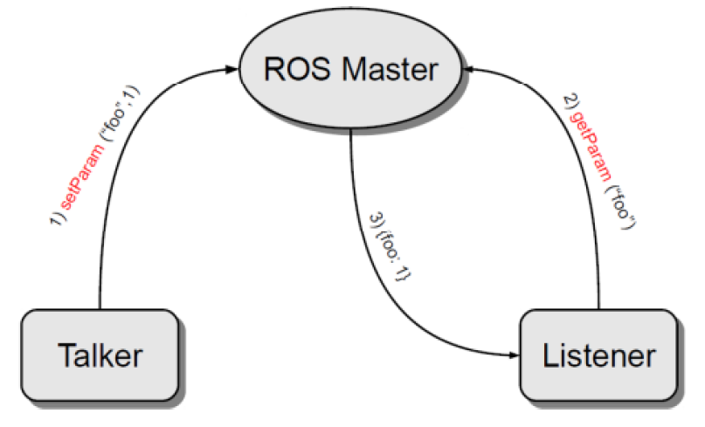
Parameter Server
A shared, multi-variate dictionary that is accessible via network APIs.
Best used for static, non-binary data such as configuration parameters.
Runs inside the ROS master

Slide 22
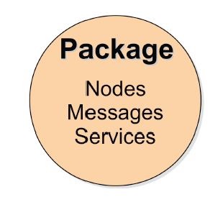
ROS Packages
Software in ROS is organized in packages.
A package contains one or more nodes and provides a ROS interface

Slide 23
Package Examples
explore - frontier-based exploration.
move base - implements the action of movement to a destination location
gmapping - provides laser-based SLAM (Simultaneous Localization and Mapping) using a grid map.
stageros - implements two-dimensional robot simulation using Stage.

Slide 24
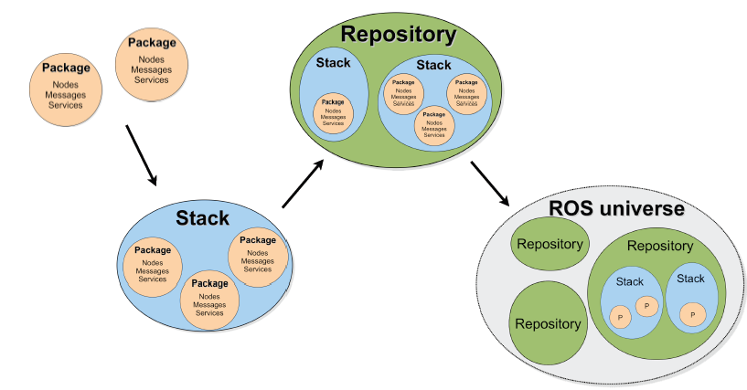
ROS Package System
Taken from Sachin Chitta and Radu Rusu (Willow Garage)

Slide 25
ROS Package Repositories
Collection of packages and stacks
Many repositories (>50): Stanford, CMU, Leuven, USC, …
Most of them hosted in GitHub
http://wiki.ros.org/RecommendedRepositoryUsage/CommonGitHubOrganizations

Slide 26
ROS Hydro
Latest ROS version is ROS Hydro Medusa
ROS Hydro Medusa is the 7th ROS distribution
Released on September 4th 2013
Moved to a new packaging system called catkin

Slide 27
ROS Supported Platforms
ROS is currently supported only on Ubuntu
other variants such as Windows and Mac OS X are considered experimental
ROS distribution supported is limited to <=3 latest Ubuntu versions
ROS Hydro supported on:
Ubuntu Precise (12.04 LTS)
Ubuntu Quantal (12.10)
Ubuntu Raring (13.04)

Slide 28
ROS Installation
Follow the instructions at:
http://wiki.ros.org/hydro/Installation/Ubuntu
Easy installation, takes about 20 mins
Note: Installation takes 2,442MB space of your HD
To test your installation, follow the ROS tutorials:
http://wiki.ros.org/ROS/Tutorials

Slide 29
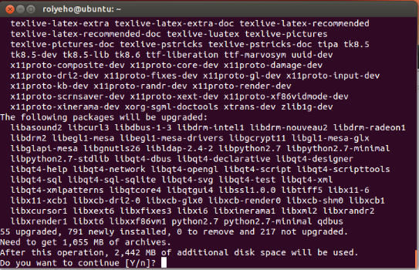
ROS Installation

Slide 30
Setting Up ROS Environment
Add the following line to your bash startup file (typically ~/.bashrc):
source /opt/ros/hydro/setup.bash

Slide 31
Basic ROS Commands
roscore – a collection of nodes and programs that are pre-requisites of a ROS-based system
roscore is defined as:
master
parameter server
rosout
Usage:
$roscore

Slide 32
Basic ROS Commands
rosrun – allows you to run an executable in an arbitrary package without having to cd (or roscd) there first
Usage:
$rosrun package executable
Example
Run turtlesim
$rosrun turtlesim turtlesim_node

Slide 33
Basic ROS Commands
rosnode – Displays debugging information about ROS nodes, including publications, subscriptions and connections
Commands:
 | Command
List active nodes | $rosnode list
Test connectivity to node | $rosnode ping
Print information about a node | $rosnode info
Kill a running node | $rosnode kill
List nodes running on a particular machine | $rosnode machine

Slide 34
Demo - Turtlesim
In separate terminal windows run:
roscore
rosrun turtlesim turtlesim_node
rosrun turtlesim turtle_teleop_key

Slide 35
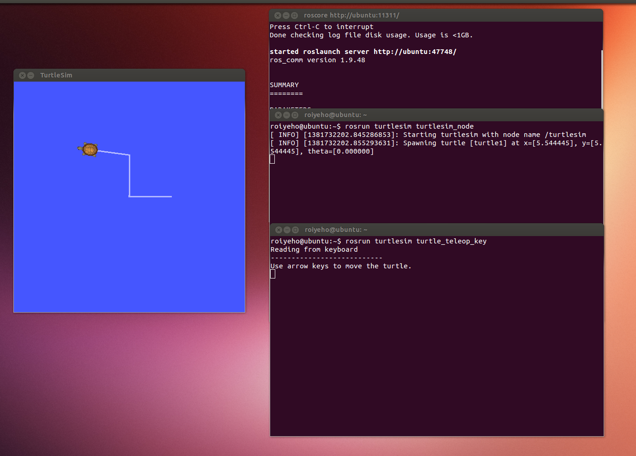
Demo - Turtlesim

Slide 36
ROS Simulators
Stage - 2D Simulator
Gazebo - 3D Simulator
In this course we will use Stage

Slide 37
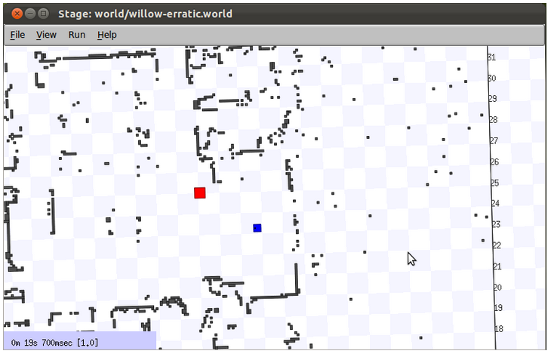
Stage Simulator

Slide 38
More Information about ROS
ROS Cheat Sheet
http://u.cs.biu.ac.il/~veredm/89-689/ROScheatsheet.pdf
ROS Tutorial Videos
http://www.youtube.com/playlist?list=PLDC89965A56E6A8D6

Slide 39
Homework (not for submission)
Install ROS
Read and perform all the Beginner Level tutorials
http://wiki.ros.org/ROS/Tutorials

