Slide 1

ROS - Lesson 11
Teaching Assistant: Roi Yehoshua
roiyeho@gmail.com

Slide 2
Agenda
Adding laser sensor to your URDF model
Gazebo sensor and motor plugins
Moving the robot with Gazebo
Run gmapping with Gazebo

Slide 3
Adding Laser Sensor
In this section we are going to add a laser sensor to our r2d2 URDF model
This sensor will be a new part on the robot
First you need to select where to put it
Then you need to add an appropriate sensor plugin that simulates the sensor itself

Slide 4
Adding Laser Sensor
We will first add a new link and joint to the URDF of the r2d2 robot
For the visual model of the we'll use a mesh from the hokuyo laser model from the Gazebo models repository
We will place the laser sensor at the center of the robot’s head
Open r2d2.urdf and add the following lines before the closing </robot> tag

Slide 5
Hokuyo Link
<!-- Hokuyo Laser -->
<link name="hokuyo_link">
<collision>
<origin xyz="0 0 0" rpy="0 0 0"/>
<geometry>
<box size="0.1 0.1 0.1"/>
</geometry>
</collision>
<visual>
<origin xyz="0 0 0" rpy="0 0 0"/>
<geometry>
<mesh filename="package://r2d2_description/meshes/hokuyo.dae"/>
</geometry>
</visual>
<inertial>
<mass value="1e-5" />
<origin xyz="0 0 0" rpy="0 0 0"/>
<inertia ixx="1e-6" ixy="0" ixz="0" iyy="1e-6" iyz="0" izz="1e-6" />
</inertial>
</link>

Slide 6
Hokuyo Joint
<joint name="hokuyo_joint" type="fixed">
<axis xyz="0 0 1" />
<origin xyz="0 0.22 0.05" rpy="0 0 1.570796"/>
<parent link="head"/>
<child link="hokuyo_link"/>
</joint>
The new <joint> connects the inserted hokuyo laser onto the head of the robot.
The joint is fixed to prevent the sensor from moving

Slide 7
Hokuyo Mesh File
Now copy the Hokuyo mesh file from the local Gazebo repository to r2d2_desciption package
If you don’t have hokuyo model in your local cache, then insert it once in Gazebo so it will be downloaded from Gazebo models repository
$ roscd r2d2_description
$ mkdir meshes
$ cp meshes
$ cp ~/.gazebo/models/hokuyo/meshes/hokuyo.dae .

Slide 8
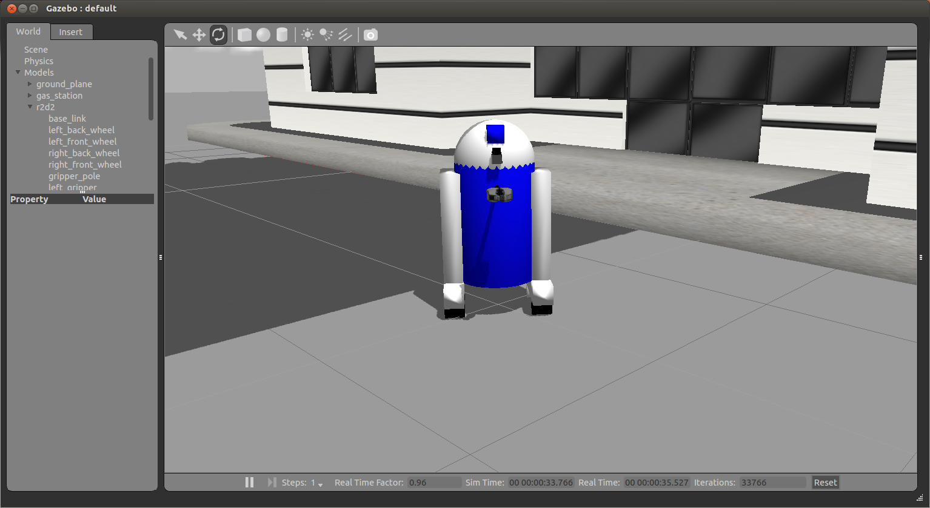
Adding Laser Sensor
Run r2d2.launch file to watch the hokuyo laser sensor in Gazebo

Slide 9
Motors and Sensors Plugins
In Gazebo you need to program the behaviors of the robot - joints, sensors, and so on.
Gazebo plugins give your URDF models greater functionality and can tie in ROS messages and service calls for sensor output and motor input.
For a list of available of plugins look at ROS Motor and Sensor Plugins

Slide 10
Adding Plugins
Plugins can be added to any of the main elements of a URDF - <robot>, <link>, or <joint>.
The <plugin> tag must be wrapped within a <gazebo> element
For example, adding a plugin to a link:
<gazebo reference="your_link_name">
<plugin name="your_link_laser_controller" filename="libgazebo_ros_laser.so">
... plugin parameters ...
</plugin>
</gazebo>

Slide 11
Adding Laser Sensor Plugin (1)
<gazebo reference="hokuyo_link">
<sensor type="ray" name="laser">
<pose>0 0 0 0 0 0</pose>
<visualize>true</visualize>
<update_rate>40</update_rate>
<ray>
<scan>
<horizontal>
<samples>720</samples>
<resolution>1</resolution>
<min_angle>-2.26889</min_angle>
<max_angle>2.2689</max_angle>
</horizontal>
</scan>
<range>
<min>0.10</min>
<max>30.0</max>
<resolution>0.01</resolution>
</range>
<noise>
<type>gaussian</type>-->
<!-- Noise parameters based on published spec for Hokuyo laser
achieving "+-30mm" accuracy at range < 10m. A mean of 0.0m and
stddev of 0.01m will put 99.7% of samples within 0.03m of the true reading. -->
<mean>0.0</mean>
<stddev>0.01</stddev>
</noise>
</ray>

Slide 12
Sensor Plugin Values
The sensor parameter values should match the manufacturer's specs on your physical hardware
Important params:
update_rate – number of times per second a new laser scan is performed within Gazebo
min_angle, max_angle – the scanner’s field of view
range – an upper and lower bound to the distance in which the cameras can see objects in the simulation

Slide 13
Sensor Noise
In the real world, sensors exhibit noise, in that they do not observe the world perfectly.
By default, Gazebo's sensors will observe the world perfectly
To present a more realistic environment in which to try out perception code, we need to explicitly add noise to the data generated by Gazebo's sensors.
For ray (laser) sensors, we add Gaussian noise to the range of each beam.
You can set the mean and the standard deviation of the Gaussian distribution from which noise values will be sampled.

Slide 14
Adding Laser Sensor Plugin (2)
<plugin name="gazebo_ros_head_hokuyo_controller" filename="libgazebo_ros_laser.so">
<topicName>/base_scan</topicName>
<frameName>hokuyo_link</frameName>
</plugin>
</sensor>
</gazebo>
Here you specify the file name of the plugin that will be linked to Gazebo as a shared object.
The code of the plugin is located at gazebo_plugins/src/gazebo_ros_laser.cpp
The topicName is the rostopic the laser scanner will be publishing to

Slide 15
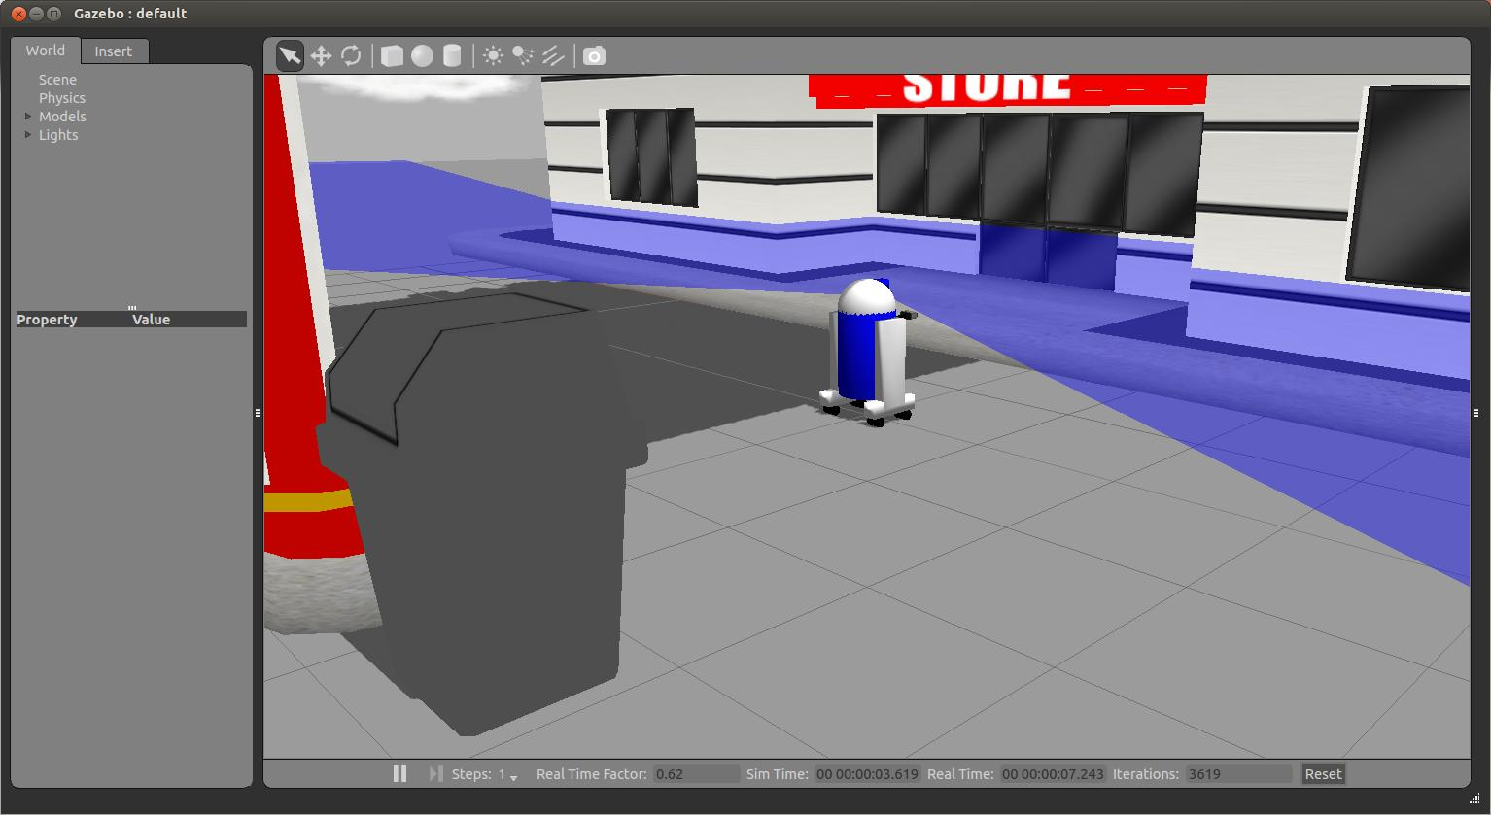
Laser Sensor Plugin

Slide 16
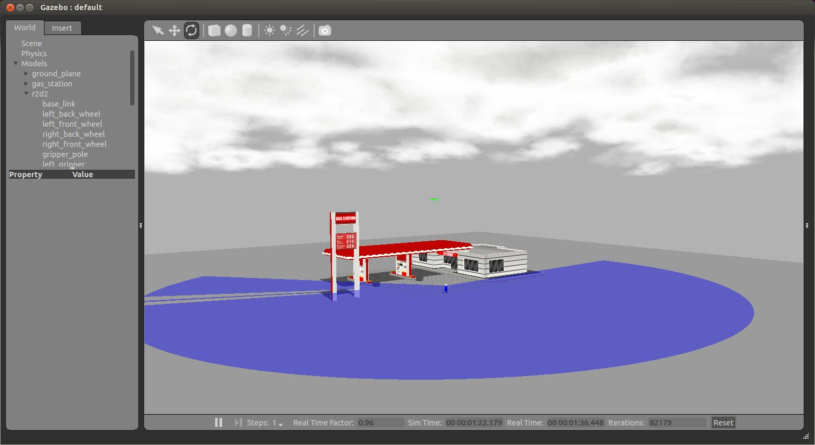
Laser Sensor Plugin
The full range of the sensor:

Slide 17
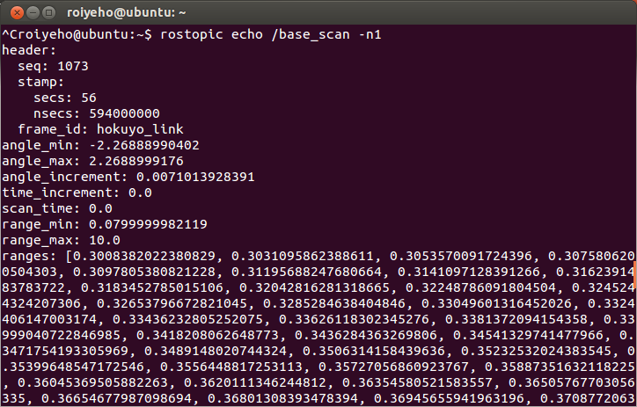
Laser Sensor Plugin
Make sure that the laser data is being published to /base_scan by using rostopic echo:

Slide 18
Add Joint and State Publishers
To work with the robot model in ROS, we need to publish its joint states and TF tree
For that purpose we need to start two nodes:
a joint_state_publisher node that reads the robot’s model from the URDF file (defined in the robot_description param) and publishes /joint_states messages
a robot_state_publisher node that listens to /joint_states messages from the joint_state_controller and then publishes the transforms to /tf.
This allows you to see your simulated robot in Rviz as well as do other tasks.

Slide 19
Add Joint and State Publishers
Add the following lines to r2d2.launch:
This allows you to see your simulated robot in Rviz as well as do other tasks.
<!-- start joint and robot state publishers -->
<param name="robot_description" textfile="$(find r2d2_description)/urdf/r2d2.urdf"/>
<node name="joint_state_publisher" pkg="joint_state_publisher" type="joint_state_publisher" ></node>
<node name="robot_state_publisher" pkg="robot_state_publisher" type="robot_state_publisher" output="screen" />

Slide 20
Watching the robot in rviz
First copy urdf.rviz from the urdf_tutorial package to r2d2_gazebo/launch directory
This rviz config file sets Fixed_Frame to base_link and adds a RobotModel display that shows the URDF model of the robot
Then add the following line to r2d2.launch
$ roscd urdf_tutorial
$ cp urdf.rviz ~/catkin_ws/src/r2d2_gazebo/launch
<node name="rviz" pkg="rviz" type="rviz" args="-d $(find r2d2_gazebo)/launch/urdf.rviz" />

Slide 21
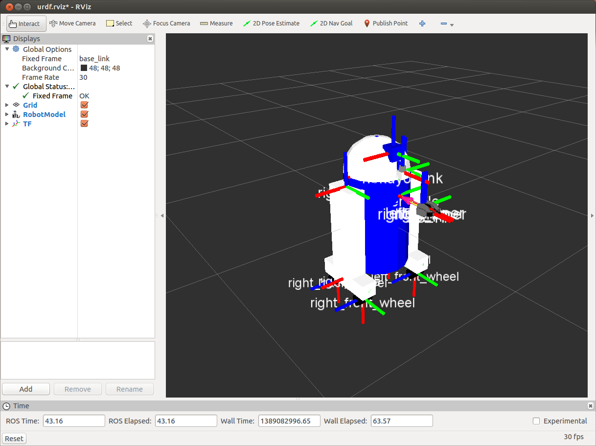
Watching the robot in rviz

Slide 22
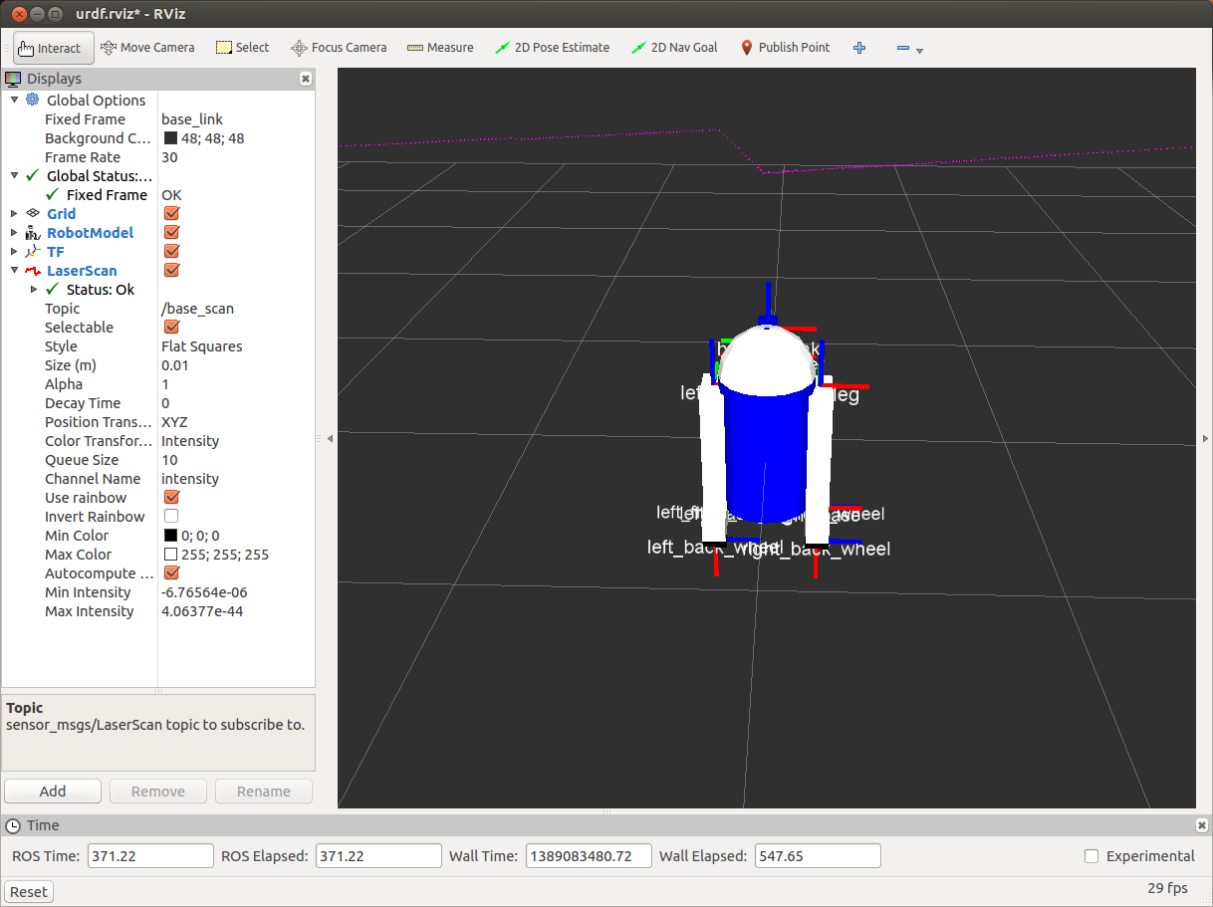
Watching the laser scan in rviz
Now add a LaserScan display and under Topic set it to /base_scan

Slide 23
Moving the Robot with Gazebo
Gazebo comes with a few built-in controllers to drive your robot already
differential_drive_controller is a plugin that can control robots whose movement is based on two wheels placed on either side of the robot body.
It can change the robot’s direction by varying the relative rate of rotation of its wheels and doesn’t require an additional steering motion.

Slide 24
Moving the Robot with Gazebo
The differential drive is meant for robots with only two wheels, but our robot has four wheels
So, we have a problem with the movement, since it will not be correct
For now, we will cause the controller to think the two wheels bigger than they are to make the movements less sharp.
However, it is better to adjust the code of the differential drive to account for four wheels.

Slide 25
Moving the Robot with Gazebo
Add the following lines at the end of r2d2.urdf
<gazebo>
<plugin name="differential_drive_controller" filename="libgazebo_ros_diff_drive.so">
<alwaysOn>true</alwaysOn>
<updateRate>100.0</updateRate>
<leftJoint>left_front_wheel_joint</leftJoint>
<rightJoint>right_front_wheel_joint</rightJoint>
<wheelSeparation>0.4</wheelSeparation>
<wheelDiameter>0.2</wheelDiameter>
<torque>20</torque>
<commandTopic>cmd_vel</commandTopic>
<odometryTopic>odom</odometryTopic>
<odometryFrame>odom</odometryFrame>
<robotBaseFrame>base_footprint</robotBaseFrame>
</plugin>
</gazebo>

Slide 26
Moving the Robot with Gazebo
Important parameters:
wheelDiameter – should be equal to twice the radius of the wheel cylinder (in our case it is 0.035, but we will make the differential drive think they are bigger to make the robot more stable)
wheelSeparation – ths distance between the wheels. In our case it is equal to the diameter of base_link (0.4)
commandTopic is the rostopic where we need to publish commands in order to control the robot.

Slide 27
Moving the Robot with Gazebo
For the controller to publish the needed frames for the navigation stack, we need to add a base_footprint link to our URDF model
The controller will make the transformation between base_link and base_foorprint and will also create another link called odom
The odom link will be used later on with the navigation stack

Slide 28
Moving the Robot with Gazebo
Add the following lines in r2d2.urdf after the definition of base_link:
<link name="base_footprint">
<visual>
<geometry>
<box size="0.001 0.001 0.001"/>
</geometry>
<origin rpy="0 0 0" xyz="0 0 0"/>
</visual>
<inertial>
<mass value="0.0001"/>
<inertia ixx="1.0" ixy="0.0" ixz="0.0" iyy="1.0" iyz="0.0" izz="1.0"/>
</inertial>
</link>
<gazebo reference="base_footprint">
<material>Gazebo/Blue</material>
</gazebo>
<joint name="base_footprint_joint" type="fixed">
<origin xyz="0 0 0" />
<parent link="base_footprint" />
<child link="base_link" />
</joint>

Slide 29
Moving the Robot with Teleop
Now we are going to move the robot using the teleop_twist_keyboard node.
Run the following command:
You should see console output that gives you the key-to-control mapping
$ rosrun teleop_twist_keyboard teleop_twist_keyboard.py

Slide 30
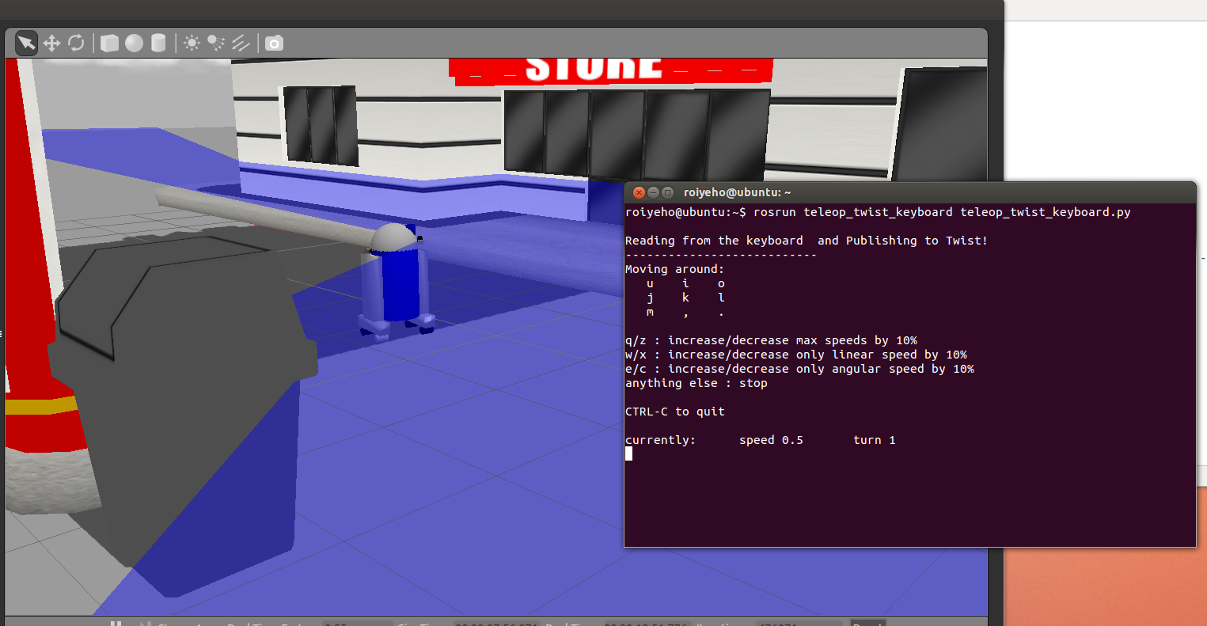
Moving the Robot with Teleop

Slide 31
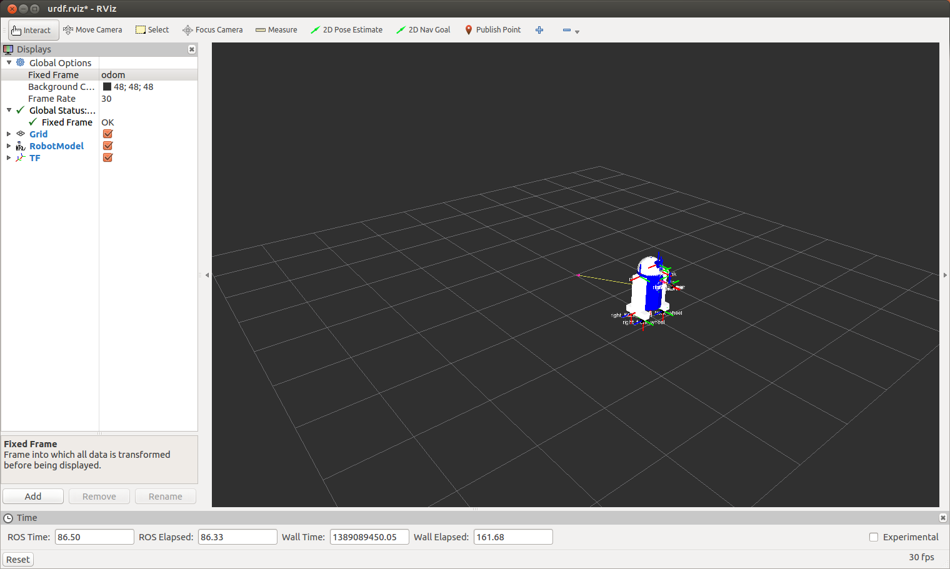
Moving the Robot with Teleop
In rviz, change the fixed frame to /odom and you will see the robot moving on rviz as well

Slide 32
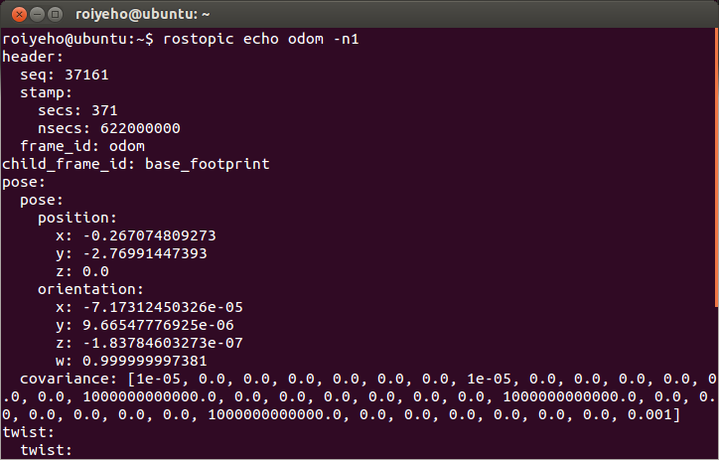
How Gazebo creates the odometry
The differential drive publishes the odometry generated in the simulated world to the topic /odom
Compare the published position of the robot to the pose property of the robot in Gazebo simulator

Slide 33
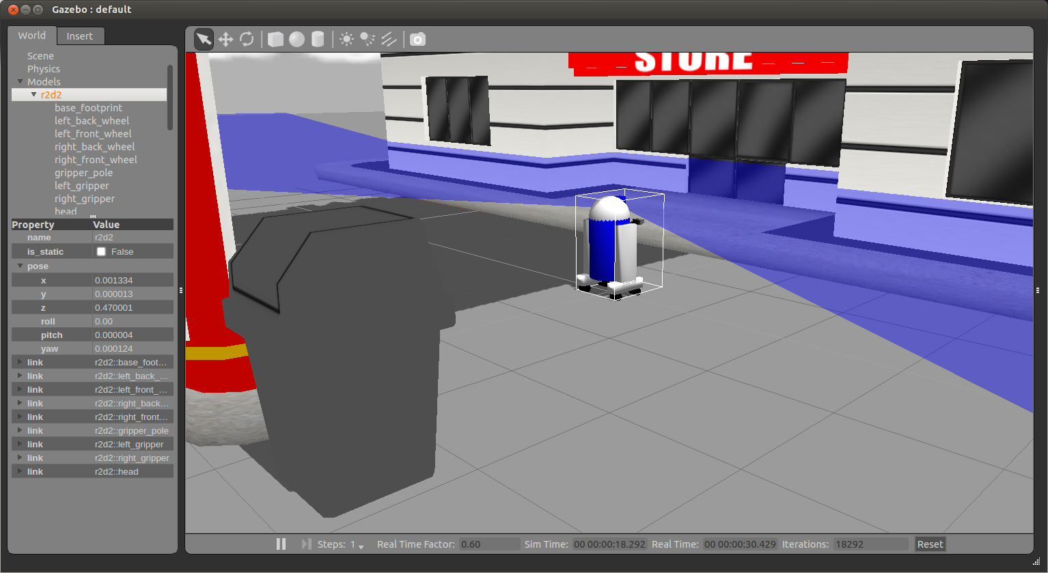
How Gazebo creates the odometry

Slide 34
DiffDrive Plugin
To obtain some insight of how Gazebo does that, we are going to have a sneak peek inside the gazebo_ros_diff_drive.cpp file

Slide 35
DiffDrive Plugin
The Load(...) function initializes some variables and performs the subscription to cmd_vel
// Load the controller
void GazeboRosDiffDrive::Load(physics::ModelPtr _parent, sdf::ElementPtr _sdf) {
this->parent = _parent;
this->world = _parent->GetWorld();
// Initialize velocity stuff
wheel_speed_[RIGHT] = 0;
wheel_speed_[LEFT] = 0;
x_ = 0;
rot_ = 0;
alive_ = true;
…
// ROS: Subscribe to the velocity command topic (usually "cmd_vel")
ros::SubscribeOptions so =
ros::SubscribeOptions::create<geometry_msgs::Twist>(command_topic_, 1,
boost::bind(&GazeboRosDiffDrive::cmdVelCallback, this, _1),
ros::VoidPtr(), &queue_);
}

Slide 36
DiffDrive Plugin
When a message arrives, the linear and angular velocities are stored in the internal variables to run some operations later:
void GazeboRosDiffDrive::cmdVelCallback(const geometry_msgs::Twist::ConstPtr& cmd_msg) {
boost::mutex::scoped_lock scoped_lock(lock);
x_ = cmd_msg->linear.x;
rot_ = cmd_msg->angular.z;
}

Slide 37
DiffDrive Plugin
The plugin estimates the velocity for each motor using the formulas from the kinematic model of the robot in the following manner:
// Update the controller
void GazeboRosDiffDrive::UpdateChild() {
common::Time current_time = this->world->GetSimTime();
double seconds_since_last_update = (current_time - last_update_time_).Double();
if (seconds_since_last_update > update_period_) {
publishOdometry(seconds_since_last_update);
// Update robot in case new velocities have been requested
getWheelVelocities();
joints[LEFT]->SetVelocity(0, wheel_speed_[LEFT] / wheel_diameter_);
joints[RIGHT]->SetVelocity(0, wheel_speed_[RIGHT] / wheel_diameter_);
last_update_time_+= common::Time(update_period_);
}
}

Slide 38
DiffDrive Plugin
And finally, it publishes the odometry data
void GazeboRosDiffDrive::publishOdometry(double step_time) {
ros::Time current_time = ros::Time::now();
std::string odom_frame = tf::resolve(tf_prefix_, odometry_frame_);
std::string base_footprint_frame = tf::resolve(tf_prefix_, robot_base_frame_);
// getting data for base_footprint to odom transform
math::Pose pose = this->parent->GetWorldPose();
tf::Quaternion qt(pose.rot.x, pose.rot.y, pose.rot.z, pose.rot.w);
tf::Vector3 vt(pose.pos.x, pose.pos.y, pose.pos.z);
tf::Transform base_footprint_to_odom(qt, vt);
transform_broadcaster_->sendTransform(tf::StampedTransform(base_footprint_to_odom, current_time, odom_frame, base_footprint_frame));
// publish odom topic
odom_.pose.pose.position.x = pose.pos.x;
odom_.pose.pose.position.y = pose.pos.y;
...
odometry_publisher_.publish(odom_);
}

Slide 39
Run gmapping
We will now integrate ROS navigation stack with our package
First copy move_base_config folder from ~/ros/stacks/navigation_tutorials/navigation_stage to r2d2_gazebo package
Add the following lines to r2d2.launch:
$ roscd r2d2_gazebo
$ cp -R ~/ros/stacks/navigation_tutorials/navigation_stage/move_base_config .
<!-- Run navigation stack with gmapping -->
<include file="$(find navigation_stage)/move_base_config/move_base.xml"/>
<include file="$(find navigation_stage)/move_base_config/slam_gmapping.xml"/>

Slide 40
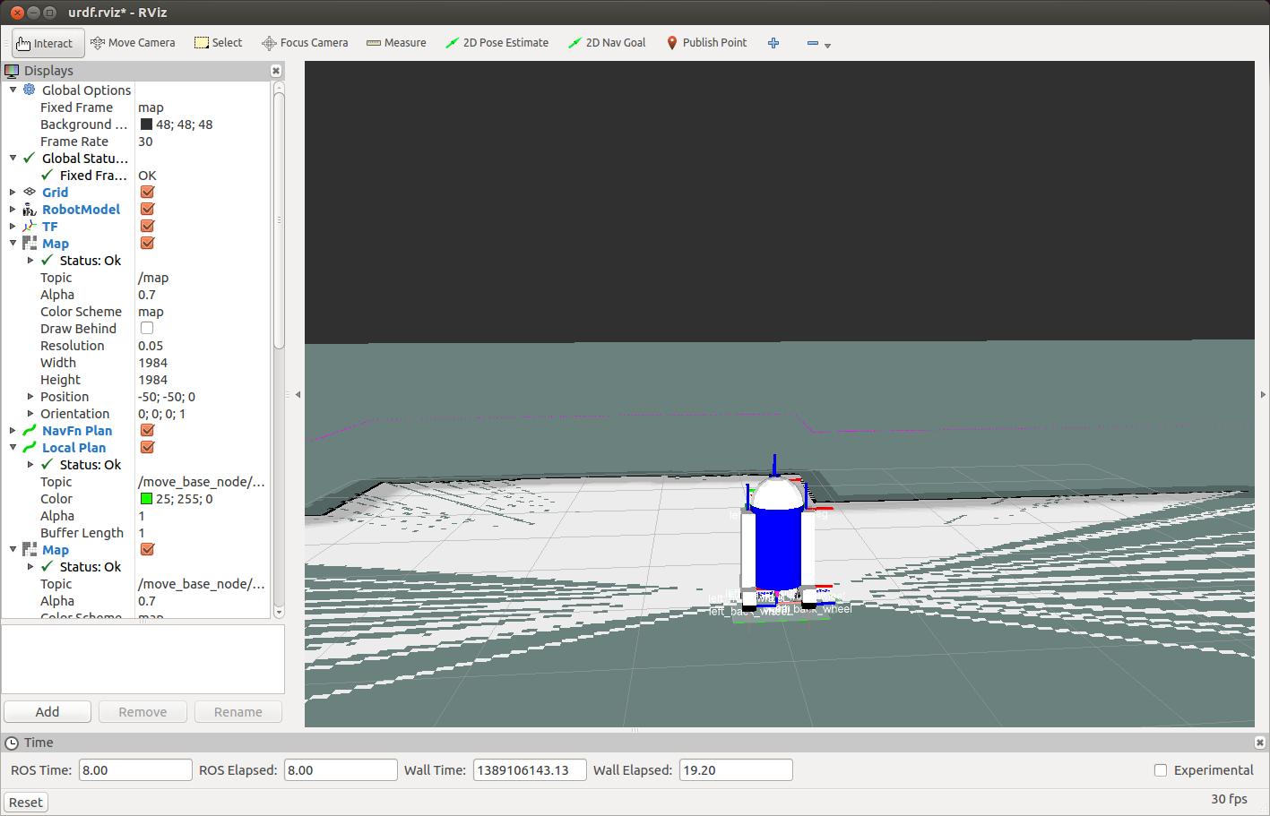
Run gmapping

Slide 41
Run gmapping
Move the robot around with teleop to map the environment
When you finish, save the map using the following command:
You can view the map by running:
$ rosrun map_server map_saver
$ eog map.pgm

Slide 42
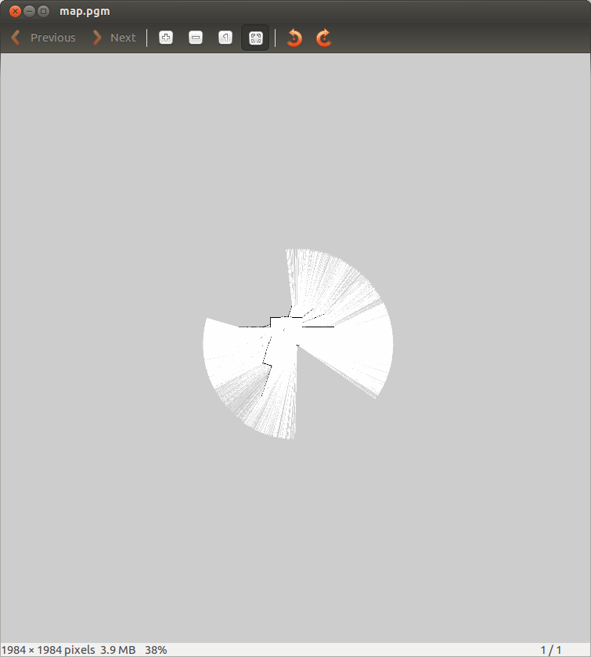
Run gmapping

Slide 43
Homework (for submission)
Create a 3D model of a robot and move it around a simulated world in Gazebo using a random walk algorithm
More details can be found at: http://u.cs.biu.ac.il/~yehoshr1/89-685/assignment3/assignment3.html

