Slide 1

ROS - Lesson 12
Teaching Assistant: Roi Yehoshua
roiyeho@gmail.com

Slide 2
Agenda
Robotic coverage problem
Loading occupancy grid maps
Stage world files and TF frames
Moving with odometry data
Where to go next?
Final project

Slide 3
Robotic Coverage Problem
In robotic coverage, a robot is required to visit every part of a given area using the most efficient path possible
Coverage has many applications in a many domains, such as search and rescue, mapping, and surveillance.
The general coverage problem is analogous to the TSP problem, which is NP-complete
However, it is possible to find solutions to this problem that are close to optimal in polynomial or even linear time through heuristics and reductions

Slide 4
Grid-Based Methods
Assume that the environment can be decomposed into a collection of uniform grid cells
Each cell is either occupied or free

Slide 5
STC Algorithm
Gabriely and Rimon [2001]
Assumption: the robot is equipped with a square shaped tool of size D (the coverage tool)
Switch to coarse grid, each cell of size 4D
Create Spanning Tree (ST) on the coarse grid
Using Prim or Kruskal’s algorithms
The robot walks along the ST, creating a Hamiltonian cycle visiting all cells of the fine grid.
Time complexity: O(E log V) time

Slide 6
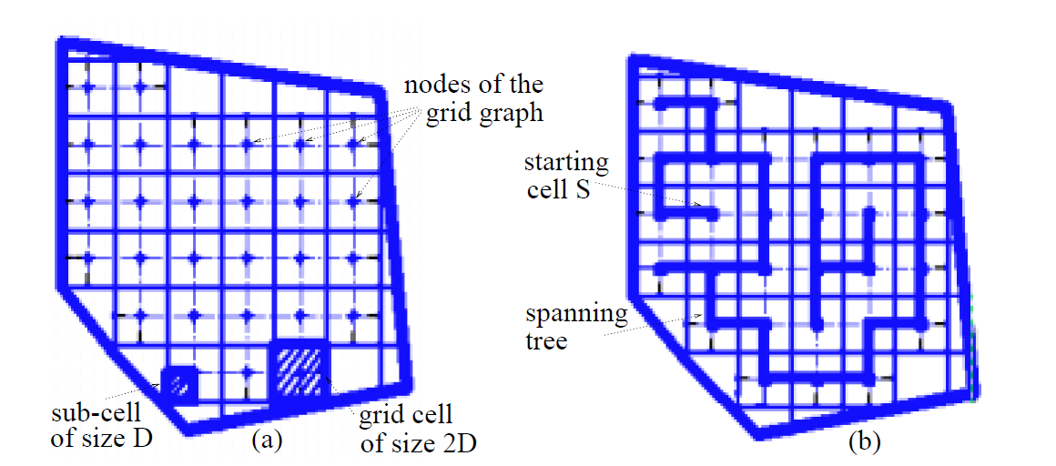
STC Algorithm
Taken from Gabriely and Rimon, 2001

Slide 7
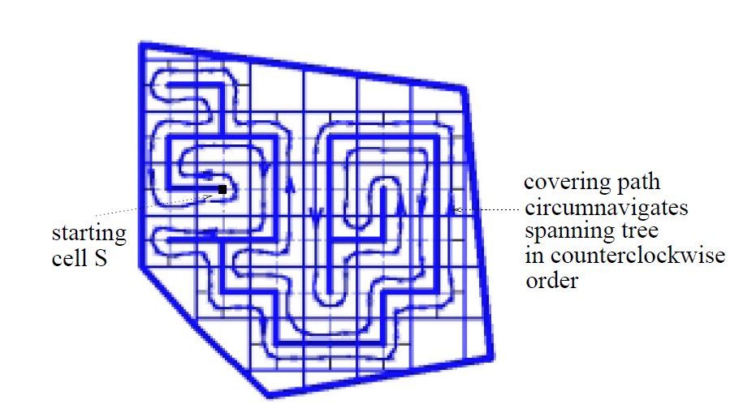
STC Execution Example
Taken from Gabriely and Rimon, 2001

Slide 8
Occupancy Grid Map
Maps the environment as an array of cells.
Cell sizes range from 5 to 50 cm.
Each cell holds a probability value that the cell is occupied.
Useful for combining different sensor scans, and even different sensor modalities.
Sonar, laser, IR, bump, etc.

Slide 9
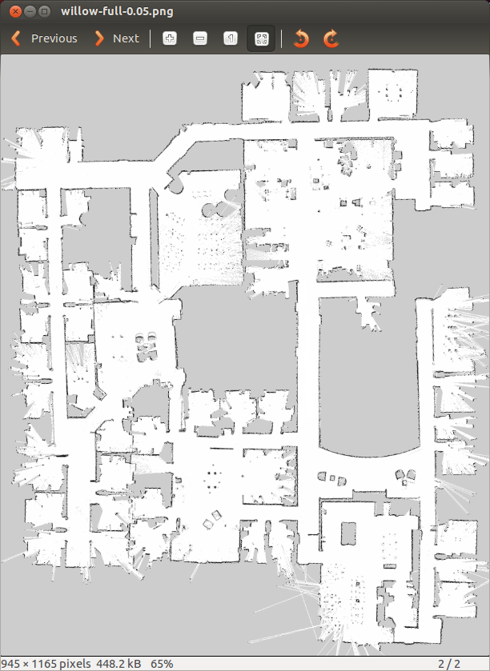
Occupancy Grid Map

Slide 10
Occupancy Grid Map
The occupancy grid map is published by the map_server node
The message type is nav_msgs/OccupancyGrid
Consists of two main structures:
MapMetaData – metdata of the map
int8[] data – the map’s data

Slide 11
Map Metadata
MapMetadata contains the following fields:
resolution – map resolution in m/cell
height – number of cells in the x axis
width – number of cells in the y axis
For example, in the willow garage map given above:
resolution = 0.05m/cell
height = 945 cells (pixels)
width = 1165 cells (pixels)

Slide 12
Map Data
The map data is ordered in row-major order starting with (0,0).
Occupancy probabilities are in the range [0, 100].
Unknown is -1.
Usually unknown areas are areas that the robot sensors cannot detect (beyond obstacles)
For our purposes we can treat 0 as a free cell and all the values as obstacles

Slide 13
Loading a Map
Copy a map file (.pgm) of your choice to a /map sub-directory of your package
Run the map_saver node
Takes as arguments the path to the map file and the map resolution
A sample launch file:
<launch>
<arg name="map_file" default="$(find coverage)/maps/willow-full-0.05.pgm"/>
<!-- Run the map server -->
<node name="map_server" pkg="map_server" type="map_server" args="$(arg map_file) 0.05" />
</launch>

Slide 14
Loading a Map
To get the OGM in a ROS node you can call the service static_map
This service gets no arguments and returns a message of type nav_msgs/OccupancyGrid

Slide 15
Loading a Map in C++ (1)
#include <ros/ros.h>
#include <nav_msgs/GetMap.h>
#include <vector>
using namespace std;
// grid map
int rows;
int cols;
double mapResolution;
vector<vector<bool> > grid;
bool requestMap(ros::NodeHandle &nh);
void readMap(const nav_msgs::OccupancyGrid& msg);
void printGrid();

Slide 16
Loading a Map in C++ (2)
int main(int argc, char** argv)
{
ros::init(argc, argv, "coverage_node");
ros::NodeHandle nh;
if (!requestMap(nh))
exit(-1);
printGrid();
return 0;
}

Slide 17
Loading a Map in C++ (3)
bool requestMap(ros::NodeHandle &nh)
{
nav_msgs::GetMap::Request req;
nav_msgs::GetMap::Response res;
while (!ros::service::waitForService("static_map", ros::Duration(3.0))) {
ROS_INFO("Waiting for service static_map to become available");
}
ROS_INFO("Requesting the map...");
ros::ServiceClient mapClient = nh.serviceClient<nav_msgs::GetMap>("static_map");
if (mapClient.call(req, res)) {
readMap(res.map);
return true;
}
else {
ROS_ERROR("Failed to call map service");
return false;
}
}

Slide 18
Loading a Map in C++ (4)
void readMap(const nav_msgs::OccupancyGrid& map)
{
ROS_INFO("Received a %d X %d map @ %.3f m/px\n",
map.info.width,
map.info.height,
map.info.resolution);
rows = map.info.height;
cols = map.info.width;
mapResolution = map.info.resolution;
// Dynamically resize the grid
grid.resize(rows);
for (int i = 0; i < rows; i++) {
grid[i].resize(cols);
}
int currCell = 0;
for (int i = 0; i < rows; i++) {
for (int j = 0; j < cols; j++) {
if (map.data[currCell] == 0) // unoccupied cell
grid[i][j] = false;
else
grid[i][j] = true; // occupied (100) or unknown cell (-1)
currCell++;
}
}
}

Slide 19
Loading a Map in C++ (5)
void printGrid()
{
printf("Grid map:\n");
for (int i = 0; i < rows; i++)
{
printf("Row no. %d\n", i);
for (int j = 0; j < cols; j++)
{
printf("%d ", grid[i][j] ? 1 : 0);
}
printf("\n");
}
}

Slide 20
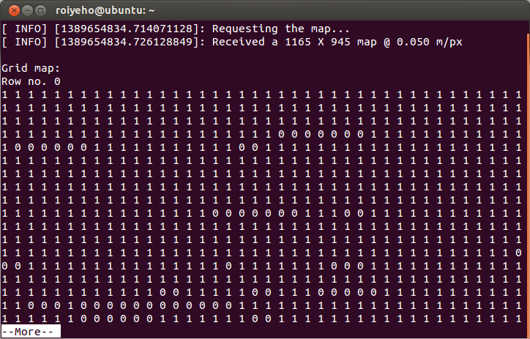
Loading the Map
$ roslaunch coverage coverage.launch

Slide 21
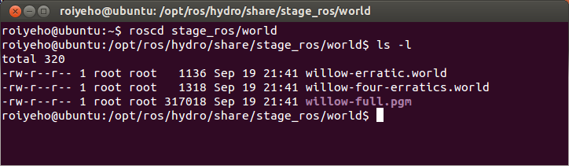
Stage World Files
The world file is a description of the world that Stage must simulate.
It describes robots, sensors, actuators, moveable and immovable objects.
Sample world files can be found at the /world subdirectory in ros_stage package

Slide 22
World File Format
The basic syntactic features of the world file format: types, entities and properties
Entities are indicated using type ( ... ) entries
For example: position ( ... ) creates a single position device
Entities may be nested to indicate that one entity is a child of another
position ( player() laser() ) creates a single position device with a Player server and laser attached to it

Slide 23
World File Format
Entities have properties, indicated using name value pairs
For example, position ( name "robot1" port 6665 pose [1 1 0] ... ) creates a position device named "robot1" attached to port 6665, with initial position (1, 1) and orientation of 0.
List of properties can be found here

Slide 24
World File Format
The define statement can be used to define new types of entities.
define myrobot position (player() laser() )
This entity may be instantiated using the standard syntax:
myrobot (name "robot1" port 6665 pose [1 1 0])
This entry creates a position device named “robot1” that has both player and laser devices attached.

Slide 25
Stage World File Example
define block model
(
size [0.5 0.5 0.75]
gui_nose 0
)
define topurg ranger
(
sensor(
range_max 30.0
fov 270.25
samples 1081
)
# generic model properties
color "black"
size [ 0.05 0.05 0.1 ]
)
define pr2 position
(
size [0.65 0.65 0.25]
origin [-0.05 0 0 0]
gui_nose 1
drive "omni"
topurg(pose [ 0.275 0.000 0 0.000 ])
)

Slide 26
Stage World File Example
define floorplan model
(
# sombre, sensible, artistic
color "gray30"
# most maps will need a bounding box
boundary 1
gui_nose 0
gui_grid 0
gui_outline 0
gripper_return 0
fiducial_return 0
ranger_return 1
)
# set the resolution of the underlying raytrace model in meters
resolution 0.02
interval_sim 100 # simulation timestep in milliseconds
window
(
size [ 745.000 448.000 ]
rotate [ 0.000 -1.560 ]
scale 18.806
)

Slide 27
Stage World File Example
# load an environment bitmap
floorplan
(
name "willow"
bitmap "../maps/willow-full-0.05.pgm"
size [58.25 47.25 1.0]
pose [ -23.625 29.125 0 90.000 ]
)
# throw in a robot
pr2( pose [ -28.610 13.562 0 99.786 ] name "pr2" color "blue")
block( pose [ -25.062 12.909 0 180.000 ] color "red")
block( pose [ -25.062 12.909 0 180.000 ] color "red")
block( pose [ -25.062 12.909 0 180.000 ] color "red“)

Slide 28
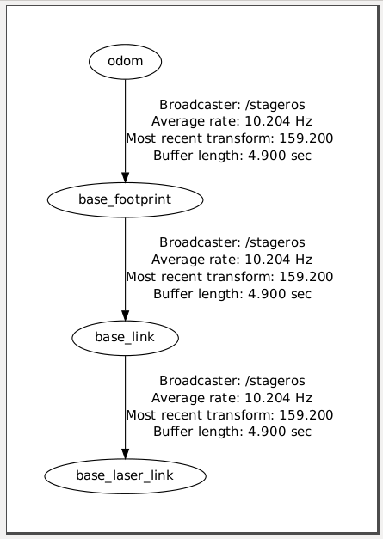
Stage TF Frames
Stage publishes the following TF frames:

Slide 29
Stage TF Frames
These transformations move relative to the /odom frame.
If we display the robot model in RViz and set the fixed frame to the /odom frame, the robot's position will reflect where the robot "thinks" it is relative to its starting position.
However the robot’s position will not be displayed correctly in relation to the map

Slide 30
Stage TF Frames
Since we are not running the navigation stack, we will have to publish a transformation between the /map and the /odom frames by ourselves
Add the following to the launch file:
The x and y axis are opposite in rviz and Stage ☹
Now you can set the Fixed Frame in rviz to /map
<launch>
<!-- Publish a static transformation between /map and /odom -->
<node name="tf" pkg="tf" type="static_transform_publisher" args="13.562 28.610 0 0 0 0 /map /odom 100" />
</launch>

Slide 31
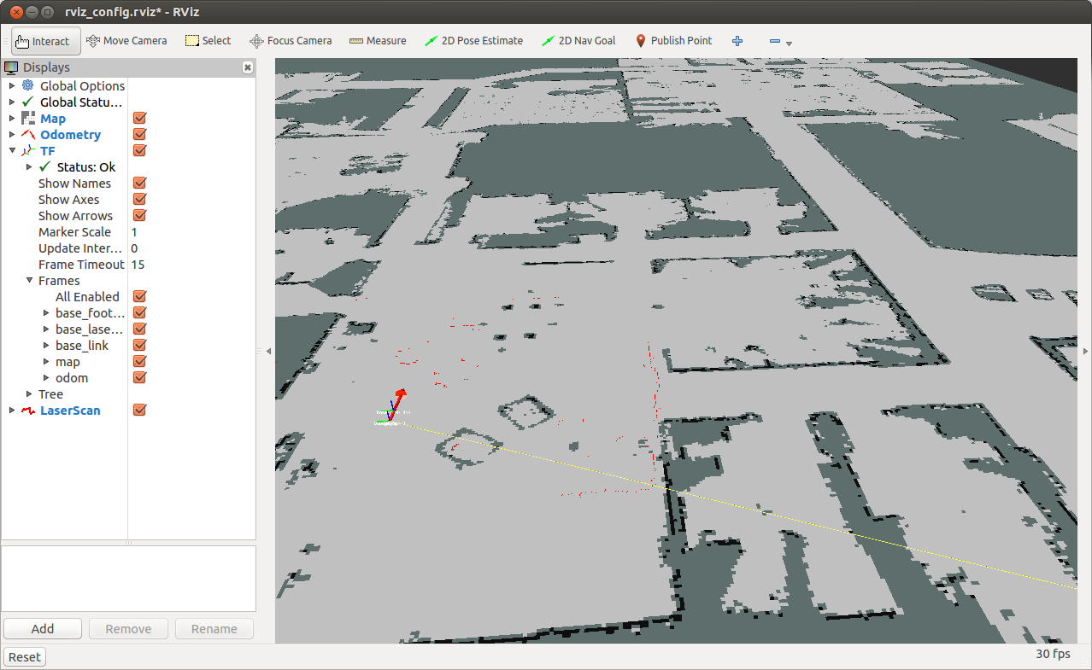
Stage TF Frames

Slide 32
Find Robot Location
You can use tf to determine the robot's current location in the world
Create a TF listener from the /base_footprint to the /odom frames and add it to the initial position of the robot

Slide 33
Find Robot Location
pair<float, float> initialPosition;
pair<float, float> currPosition;
void getRobotCurrentPosition()
{
tf::TransformListener listener;
tf::StampedTransform transform;
try {
listener.waitForTransform("/base_footprint", "/odom", ros::Time(0), ros::Duration(10.0));
listener.lookupTransform("/base_footprint", "/odom", ros::Time(0), transform);
currPosition.first = initialPosition.first + transform.getOrigin().x();
currPosition.second = initialPosition.second + transform.getOrigin().y();
}
catch (tf::TransformException &ex) {
ROS_ERROR("%s",ex.what());
}
}

Slide 34
Find Robot Location
Convert robot’s location in map to cell index
pair<int, int> currCell;
void convertCurrPositionToGridCell()
{
currCell.first = currPosition.first / mapResolution;
currCell.second = currPosition.second / mapResolution;
}

Slide 35
Moving with Odometry Data
As we have learned, you can publish Twist messages to the /cmd_vel topic to make the robot move in the environment
However, calculating the exact number of commands needed to send to the robot to make it move only one cell in the grid can be error-prone
Moreover, the accuracy and reliability of this process depend on the current condition of the robot and its internal sensors
For example, if the robot just started moving, the first velocity command will take some time to take effect

Slide 36
Moving with Odometry Data
Rather than guessing distances and angles based on time and speed, we can monitor the robot's position and orientation as reported by the transform between the /odom and /base_footprint frames (odometry data)
This way we can be more precise about moving our robot

Slide 37
Moving with Odometry Data
void moveToRightCell()
{
// Set the forward linear speed to 0.2 meters per second
float linearSpeed = 0.2f;
geometry_msgs::Twist move_msg;
move_msg.linear.x = linearSpeed;
// Set the target cell
int targetCell = currCell.first - 1;
// How fast will we update the robot's movement?
ros::Rate rate(20);
// Move until we reach the target cell
while (ros::ok() && currCell.first > targetCell)
{
cmdVelPublisher.publish(move_msg);
rate.sleep();
getRobotCurrentPosition();
showCurrentPosition();
}
// Stop the robot (in case the last command is still active)
geometry_msgs::Twist stop_msg;
cmdVelPublisher.publish(stop_msg);
sleep(1);
}

Slide 38
Launch File
<launch>
<param name="/use_sim_time" value="true"/>
<arg name="map_file" default="$(find coverage)/maps/willow-full-0.05.pgm"/>
<!-- Run the map server -->
<node name="map_server" pkg="map_server" type="map_server" args="$(arg map_file) 0.05" />
<!-- Run stage -->
<node pkg="stage_ros" type="stageros" name="stageros" args="$(find coverage)/worlds/willow-pr2-5cm.world" respawn="false">
<param name="base_watchdog_timeout" value="0.2"/>
</node>
<!-- Run rviz -->
<node name="rviz" pkg="rviz" type="rviz" args="-d $(find coverage)/rviz_config.rviz" />
<!-- Publish a static transformation between /map and /odom -->
<node name="tf" pkg="tf" type="static_transform_publisher" args="13.562 28.610 0 0 0 0 /map /odom 100" />
<!-- Run coverage node -->
<node name="coverage" pkg="coverage" type="coverage_node" output="screen" />
</launch>

Slide 39
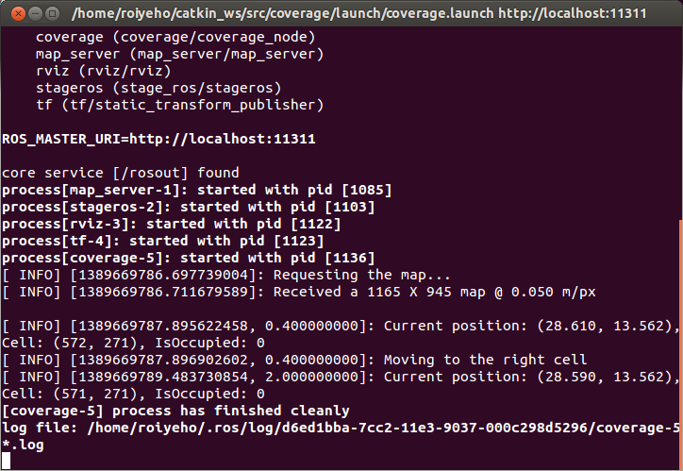
Moving with Odometry Data
Sample output:

Slide 40
Where To Go Next?
There are still many areas of ROS to explore:
Integrating computer vision using OpenCV
3-D image processing using PCL
Identifying your friends and family using face_recognition
Identifying and grasping objects on a table top
or how about playing chess?
Programming state machines using SMACH
Building knowledge bases with knowrob
Learning from experience using reinforcement_learning

Slide 41
Where To Go Next?
There are now over 2000 packages and libraries available for ROS.
Click on the Browse Software link at the top of the ROS Wiki for a list of all ROS packages and stacks that have been submitted for indexing.
When you are ready, you can contribute your own package(s) back to the ROS community.
Welcome to the future of robotics.
Have fun and good luck!

Slide 42


