Slide 1

ROS - Lesson 4
Teaching Assistant: Roi Yehoshua
roiyeho@gmail.com

Slide 2
Agenda
ROS Navigation Stack
Building a map with ROS
ROS visualization tool (rviz)

Slide 3
ROS Navigation Stack
A 2D navigation stack that takes in information from odometry, sensor streams, and a goal pose and outputs safe velocity commands that are sent to a mobile base.
The navigation stack can move your robot without problems (such as crashing or getting lost) to another position
ROS Navigation Introductory Video

Slide 4
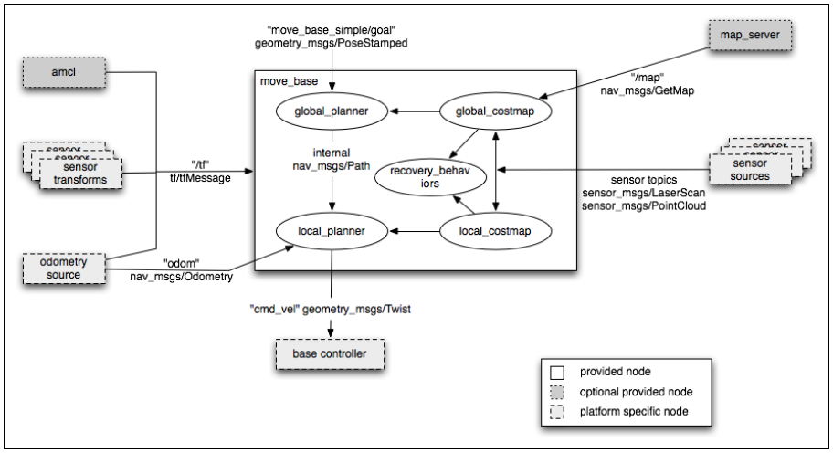
ROS Navigation Stack

Slide 5
Navigation Stack Requirements
There are three main hardware requirements:
The navigation stack can only handle a differential drive and holonomic wheeled robots.
It can also do certain things with biped robots, such as localization, as long as the robot does not move sideways
A planar laser must be mounted on the mobile base of the robot to create the map and localization
Alternatively, you can generate something equivalent to laser scans from other sensors (Kinect for example)
Its performance will be best on robots that are nearly square or circular

Slide 6
Building a map
Before we can start using the navigation stack, we need to provide the robot a map of the world
Different options to create the initial map:
Get the map from external source
Like the building’s floorplan
Manual navigation of the robot using teleoperation
Random walk algorithm
More sophisticated algorithms
e.g., Frontier-Based Exploration, Online Coverage

Slide 7
SLAM
Simultaneous localization and mapping (SLAM) is a technique used by robots to build up a map within an unknown environment while at the same time keeping track of their current location
SLAM can be thought of as a chicken or egg problem: An unbiased map is needed for localization while an accurate pose estimate is needed to build that map.

Slide 8
gmapping
http://wiki.ros.org/gmapping
The gmapping package provides laser-based SLAM as a ROS node called slam_gmapping.
It takes the laser scans and the odometry and builds a 2D occupancy grid map (OGM)
It updates the map state when the robot moves
or when (after some motion) it has a good estimate of the robot's location and how the map is.

Slide 9
gmapping
The map is published to a topic called /map
Message type is nav_msgs/OccupancyGrid
Occupancy is represented as an integer in the range [0,100], with:
0 meaning completely free
100 meaning completely occupied
the special value -1 for completely unknown

Slide 10
gmapping Algorithm
gmapping implements FastSLAM 2.0
This is a highly efficient particle filtering algorithm that provably converges
Kalman filter-based algorithms require time quadratic in the number of landmarks, while FastSLAM scales logarithmically with the number of landmarks in the map
See details in the following paper:
http://robots.stanford.edu/papers/Montemerlo03a.pdf

Slide 11
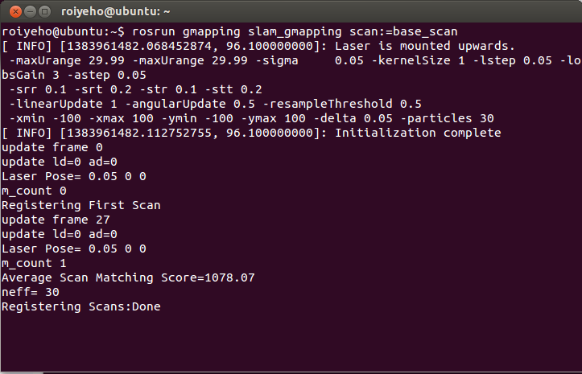
gmapping
Start mapping in a new terminal window
$ rosrun gmapping slam_gmapping scan:=base_scan

Slide 12
Saving the map using map_server
ROS map_server node allows dynamically generated maps to be saved to file.
Execute the following command in a new terminal:
map_saver retrieves map data and writes it out to map.pgm and map.yaml in the current directory
Use the -f option to provide a different base name for the output files.
To see the map, you can open the pgm file with the default Ubuntu image viewer program (eog)
$ rosrun map_server map_saver [-f mapname]

Slide 13
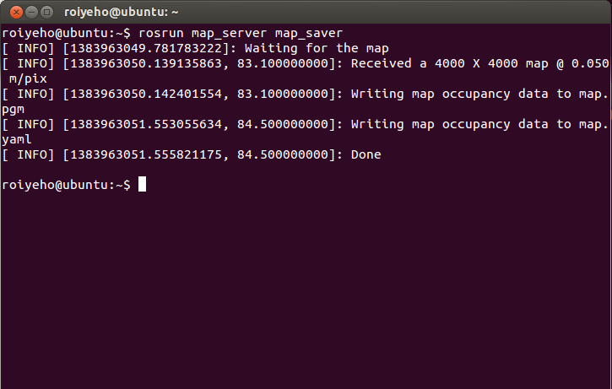
Saving the map using map_server

Slide 14
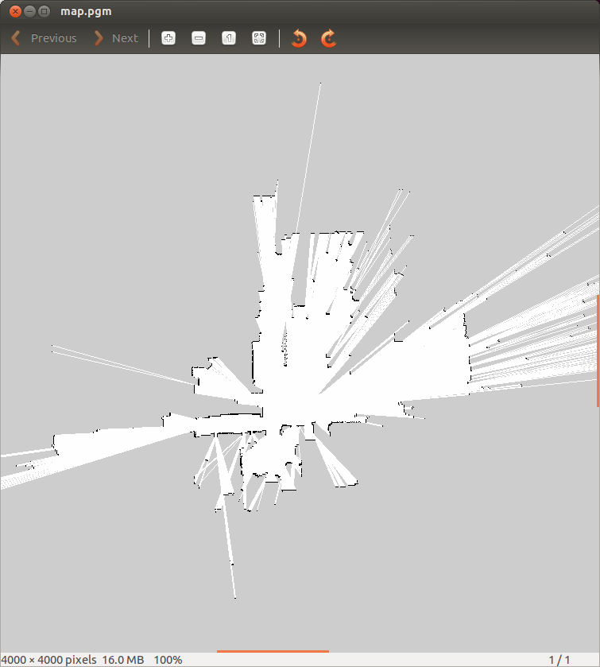
Saving the map using map_server

Slide 15
Image Format
The image describes the occupancy state of each cell of the world in the color of the corresponding pixel.
Whiter pixels are free, blacker pixels are occupied, and pixels in between are unknown.
The thresholds that divide the three categories are defined in a YAML file

Slide 16
Map YAML File
Important fields:
resolution: Resolution of the map, meters / pixel
origin: The 2-D pose of the lower-left pixel in the map as (x, y, yaw)
occupied_thresh: Pixels with occupancy probability greater than this threshold are considered completely occupied.
free_thresh: Pixels with occupancy probability less than this threshold are considered completely free.
image: map.pgm
resolution: 0.050000
origin: [-100.000000, -100.000000, 0.000000]
negate: 0
occupied_thresh: 0.65
free_thresh: 0.196

Slide 17
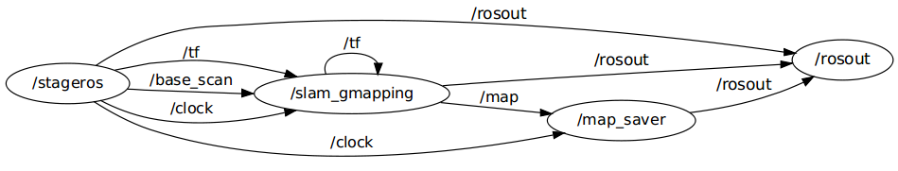
Nodes Graph

Slide 18
Watching the Mapping Progress
You can watch the mapping progress in rviz
rviz is a ROS 3D visualization tool that lets you see the world from a robot's perspective
Rviz user guide and tutorials can be found at:
http://wiki.ros.org/rviz
Execute the following code to run rviz:
$ rosrun rviz rviz

Slide 19
Turning off hardware acceleration
If your system uses the Mesa graphics drivers (e.g. for Intel GPUs, inside a VM), hardware acceleration can cause problems.
To get around this, disable this before running rviz:
$ export LIBGL_ALWAYS_SOFTWARE=1
$ rosrun rviz rviz

Slide 20
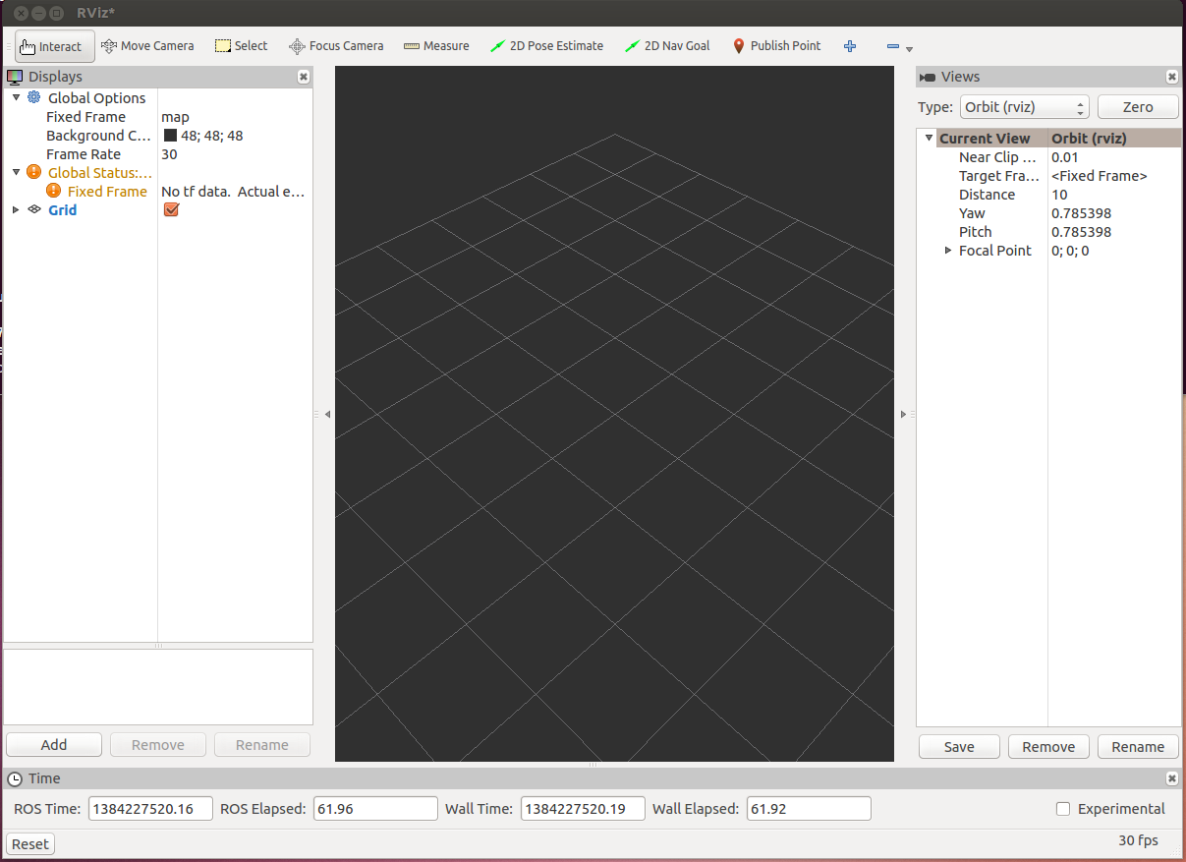
rviz

Slide 21
rviz
The first time you open rviz you will see an empty 3D view
On the left is the Displays area, which contains a list of different elements in the world, that appears in the middle.
Right now it just contains global options and grid
Below the Displays area, we have the Add button that allows the addition of more elements.

Slide 22
rviz Displays
Messages Used | Description | Display name
 | Displays a set of Axes | Axes
sensor_msgs/JointStates | Shows the effort being put into each revolute joint of a robot. | Effort
sensor_msgs/Image sensor_msgs/CameraInfo | Creates a new rendering window from the perspective of a camera, and overlays the image on top of it. | Camera
 | Displays a 2D or 3D grid along a plane | Grid
nav_msgs/GridCells | Draws cells from a grid, usually obstacles from a costmap from the navigation stack. | Grid Cells
sensor_msgs/Image | Creates a new rendering window with an Image. | Image
sensor_msgs/LaserScan | Shows data from a laser scan, with different options for rendering modes, accumulation, etc. | LaserScan
nav_msgs/OccupancyGrid | Displays a map on the ground plane. | Map

Slide 23
rviz Displays
Messages Used | Description | Display name
visualization_msgs/Marker visualization_msgs/MarkerArray | Allows programmers to display arbitrary primitive shapes through a topic | Markers
nav_msgs/Path | Shows a path from the navigation stack. | Path
geometry_msgs/PoseStamped | Draws a pose as either an arrow or axes | Pose
sensor_msgs/PointCloud sensor_msgs/PointCloud2 | Shows data from a point cloud, with different options for rendering modes, accumulation, etc. | Point Cloud(2)
nav_msgs/Odometry | Accumulates odometry poses from over time. | Odometry
sensor_msgs/Range | Displays cones representing range measurements from sonar or IR range sensors. | Range
 | Shows a visual representation of a robot in the correct pose (as defined by the current TF transforms). | RobotModel
 | Displays the tf transform hierarchy. | TF

Slide 24
LaserScan Display
Click the Add button under Displays and choose the LaserScan display
In the LaserScan display properties change the topic to /base_scan
In Global Options change Fixed Frame to odom
To see the robot’s position also add the TF display
The laser “map” that is built will disappear over time, because rviz can only buffer a finite number of laser scans

Slide 25
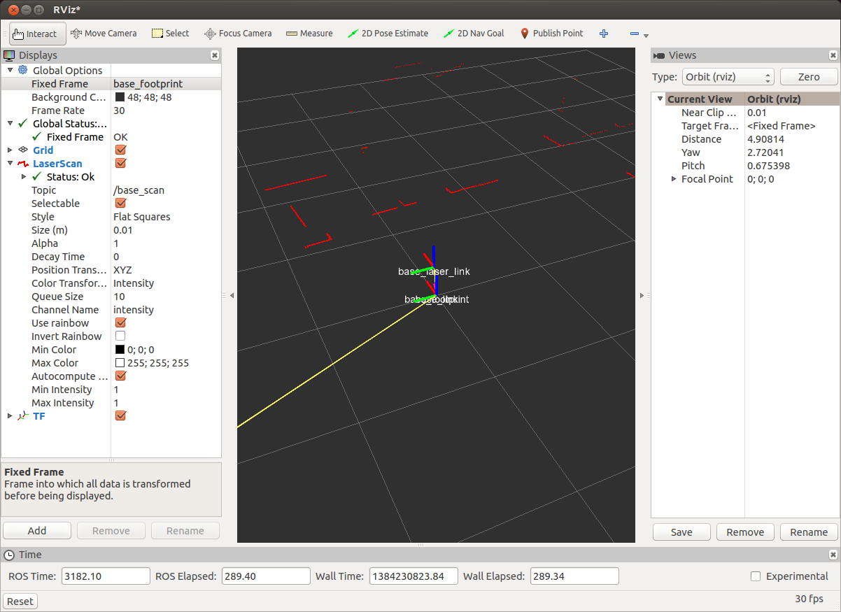
LaserScan Display

Slide 26
Map Display
Add the Map display
Set the topic to /map
Now you will be able to watch the mapping progress in rviz

Slide 27
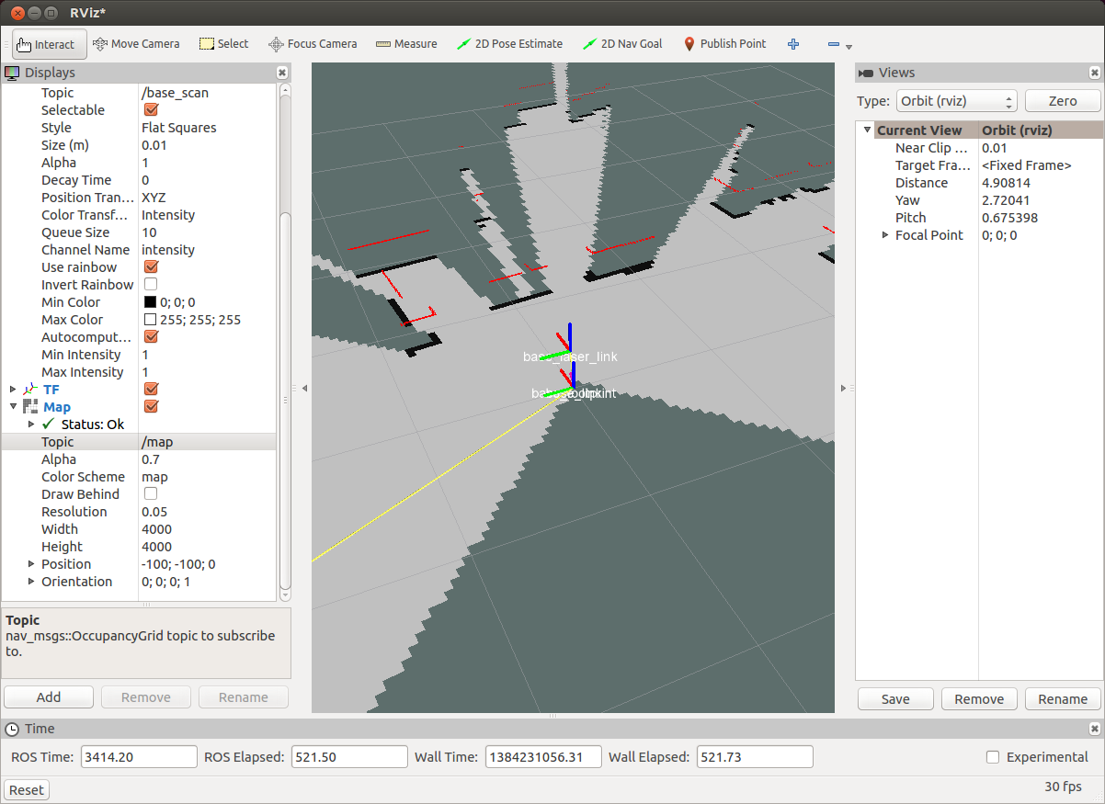
Map Display

Slide 28
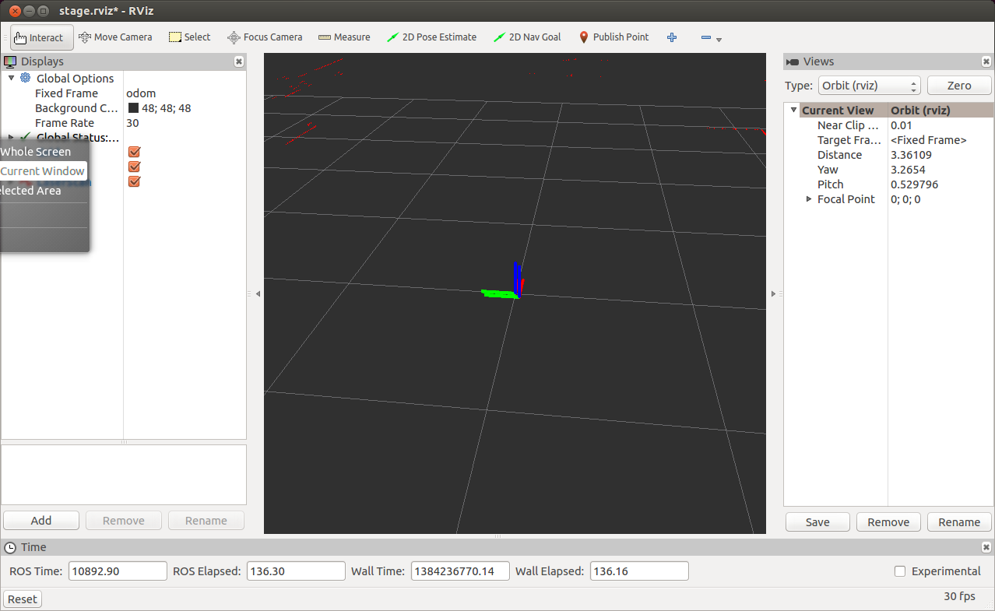
Run rosviz with Predfined Configuration
You can run rviz, using a configuration file that is already defined in the stage_ros package:
$ rosrun rviz rviz -d `rospack find stage_ros`/rviz/stage.rviz

Slide 29
Launch File for gmapping
<launch>
<node name="stage" pkg="stage_ros" type="stageros" args="$(find stage_ros)/world/willow-erratic.world"/>
<node name="slam_gmapping" pkg="gmapping" type="slam_gmapping">
<remap from="scan" to="base_scan"/>
</node>
<node name="rviz" pkg="rviz" type="rviz" args="-d $(find stage_ros)/rviz/stage.rviz"/>
</launch>

Slide 30
Homework (not for submission)
Create a map of the erratic world using your random walker from the previous assignment
Compare the resultant map to the original willow erratic world map located at /opt/ros/hydro/share/stage_ros/world/willow-full.pgm
How long did it take the random walker to create an accurate map of the area?

Slide 31
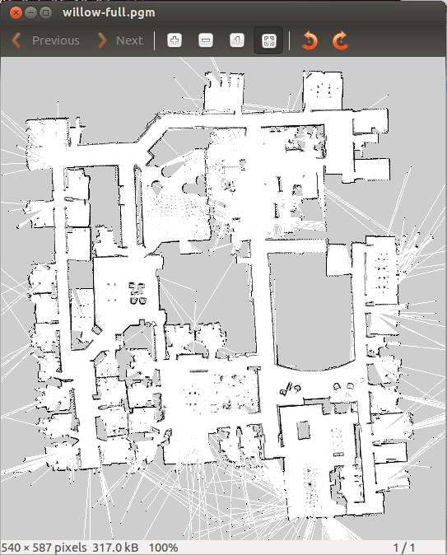
Homework (not for submission)

