Slide 1

ROS - Lesson 7
Teaching Assistant: Roi Yehoshua
roiyeho@gmail.com

Slide 2
Agenda
Sending move_base goal commands
actionlib
ROS parameters
ROS services
Making navigation plans

Slide 3
Sending Goal Commands
To specify a navigation goal using move_base, we provide a target pose (position and orientation) with respect to a particular frame of reference.
The message type geometry_msgs/PoseStamped is used for specifying the target pose.
To see the definition of this message type, run the command:
$ rosmsg show PoseStamped

Slide 4
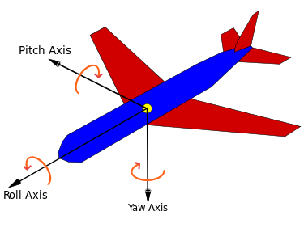
Rotation Representation
There are many ways to represent rotations:
Euler angles yaw, pitch, and roll about Z, Y, X axes respectively
Rotation matrix
Quaternions

Slide 5
Quaternions
In mathematics, quaternions are a number system that extends the complex numbers
The fundamental formula for quaternion multiplication (Hamilton, 1843):
Quaternions find uses in both theoretical and applied mathematics, in particular for calculations involving 3D rotations such as in computers graphics and computer vision.
i² = j² = k² = ijk = −1

Slide 6

Quaternions and Spatial Rotation
Any rotation in 3D can be represented as a combination of a vector u (the Euler axis) and a scalar θ (the rotation angle)
A rotation with an angle of rotation θ around the axis defined by the unit vector
is represented by

Slide 7
Quaternions and Spatial Rotation
Quaternions give a simple way to encode this axis–angle representation in 4 numbers
Can apply the corresponding rotation to a position vector using a simple formula
http://en.wikipedia.org/wiki/Quaternions_and_spatial_rotation
Advantages of using quaternions:
Nonsingular representation
there are 24 different possibilities to specify Euler angles
More compact (and faster) than matrices.

Slide 8
Sending Goal Command Example
Let's move the robot 1.0 meters directly forward
We first need to find the pose coordinates of the robot in the map
An easy way to find the pose coordinates is to point-and-click Nav Goals in rviz
The navigation goal is published in the topic move_base_simple/goal

Slide 9
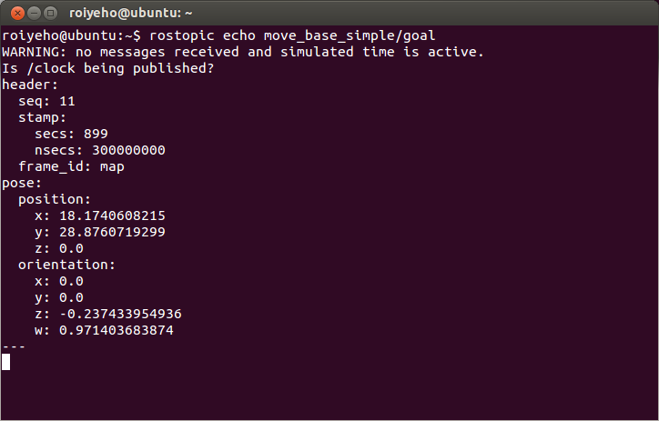
Finding Pose Coordinates In Map

Slide 10
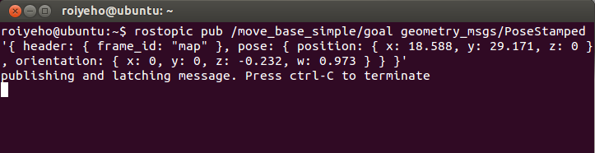
Sending Goal Command Example
To send a goal command to the robot via terminal we will need to publish a PoseStamped message to the topic /move_base_simple/goal
Example:

Slide 11
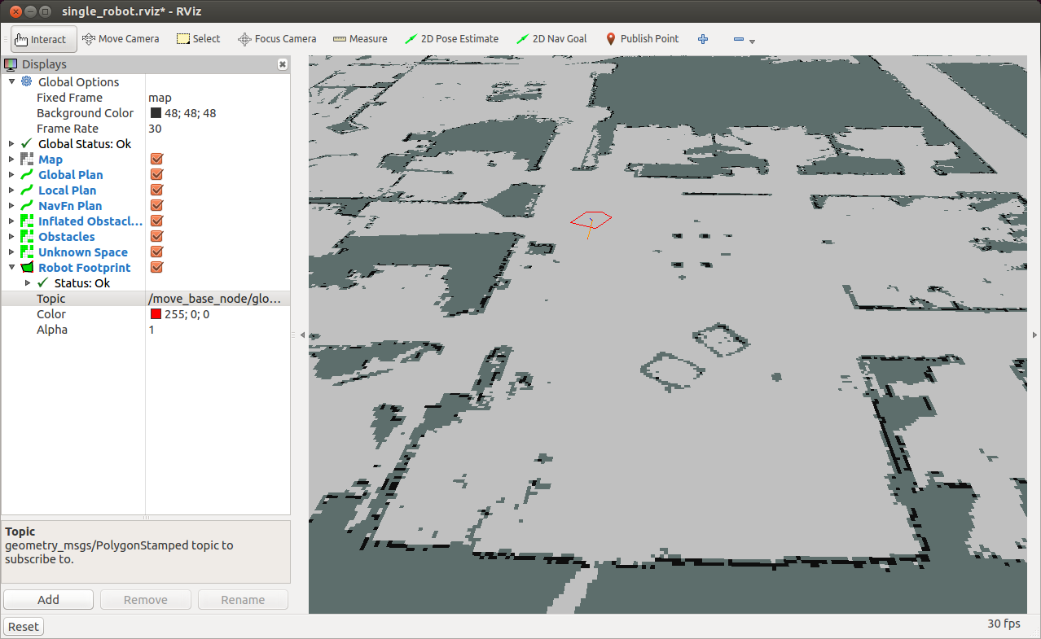
Sending Goal Command Example

Slide 12
actionlib
http://wiki.ros.org/actionlib
The actionlib stack provides a standardized interface for interfacing with tasks including:
Sending goals to the robot
Performing a laser scan
Detecting the handle of a door
Provides abilities that services don’t have:
cancel a long-running task during the execution
get periodic feedback about how the request is progressing

Slide 13
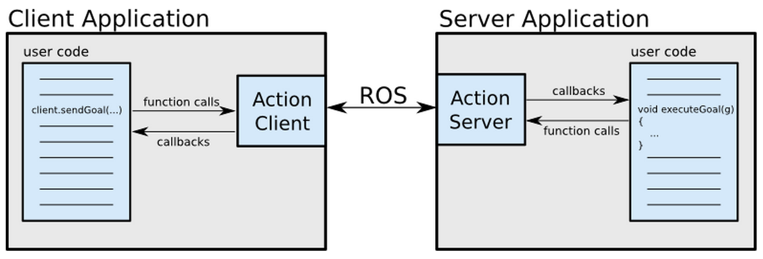
Client-Server Interaction

Slide 14
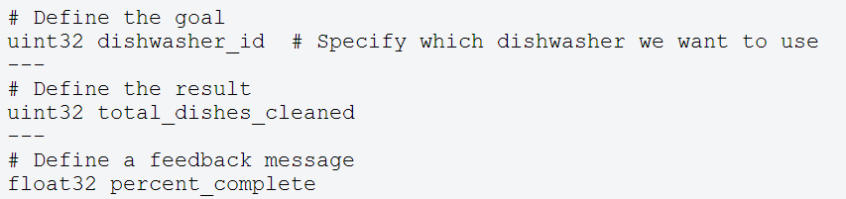
.action File
The action specification is defined using a .action file.
These files are placed in a package’s ./action directory
Example:

Slide 15
.action File
From the action file the following message types are generated:
DoDishesAction.msg
DoDishesActionGoal.msg
DoDishesActionResult.msg
DoDishesActionFeedback.msg
DoDishesGoal.msg
DoDishesResult.msg
DoDishesFeedback.msg
These messages are then used internally by actionlib to communicate between the ActionClient and ActionServer

Slide 16
SimpleActionClient
A Simple client implementation which supports only one goal at a time
Tutorial for creating a simple action client
The action client is templated on the action definition, specifying what message types to communicate to the action server with.
The action client c’tor also takes two arguments:
The server name to connect to
A boolean option to automatically spin a thread.
If you prefer not to use threads (and you want actionlib to do the 'thread magic' behind the scenes), this is a good option for you.

Slide 17
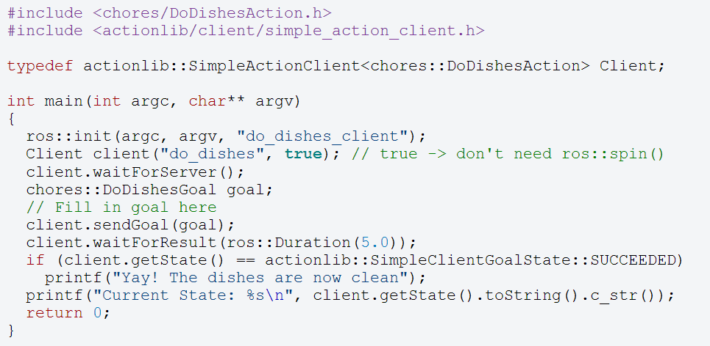
SimpleActionClient

Slide 18
SendGoals Example
The next code is a simple example to send a goal to move the robot
In this case the goal would be a PoseStamped message that contains information about where the robot should move to in the world

Slide 19
SendGoals Example
First create a new package called send_goals
This package depends on the following packages:
actionlib
geometry_msgs
move_base_msgs
$ cd ~/catkin_ws/src
$ catkin_create_pkg send_goals std_msgs rospy roscpp actionlib tf geometry_msgs move_base_msgs
$ catkin_make --force-cmake -G"Eclipse CDT4 - Unix Makefiles"

Slide 20
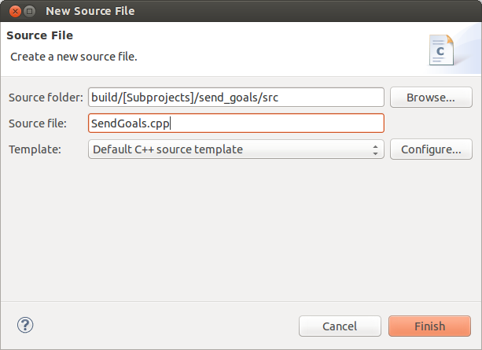
SendGoals Example
Open the project file in Eclipse
Under the src subdirectory, create a new file called SendGoals.cpp

Slide 21
SendGoals.cpp (1)
#include <ros/ros.h>
#include <move_base_msgs/MoveBaseAction.h>
#include <actionlib/client/simple_action_client.h>
typedef actionlib::SimpleActionClient<move_base_msgs::MoveBaseAction> MoveBaseClient;
int main(int argc, char** argv) {
ros::init(argc, argv, "send_goals_node");
// create the action client
// true causes the client to spin its own thread
MoveBaseClient ac("move_base", true);
// Wait 60 seconds for the action server to become available
ROS_INFO("Waiting for the move_base action server");
ac.waitForServer(ros::Duration(60));
ROS_INFO("Connected to move base server");

Slide 22
SendGoals.cpp (2)
// Send a goal to move_base
move_base_msgs::MoveBaseGoal goal;
goal.target_pose.header.frame_id = "map";
goal.target_pose.header.stamp = ros::Time::now();
goal.target_pose.pose.position.x = 18.174;
goal.target_pose.pose.position.y = 28.876;
goal.target_pose.pose.orientation.w = 1;
ROS_INFO("Sending goal");
ac.sendGoal(goal);
// Wait for the action to return
ac.waitForResult();
if (ac.getState() == actionlib::SimpleClientGoalState::SUCCEEDED)
ROS_INFO("You have reached the goal!");
else
ROS_INFO("The base failed for some reason");
return 0;
}

Slide 23
Compiling the Node
Add the following lines to CMakeLists.txt:
Call catkin_make
add_executable(send_goals_node src/SendGoals.cpp)
target_link_libraries(send_goals_node
${catkin_LIBRARIES}
)

Slide 24
Running the Node
First run the navigation stack:
Set the initial pose of the robot in rviz
Then run send_goals_node:
cd ~/ros/stacks/navigation_tutorials/navigation_stage/launch
roslaunch move_base_amcl_5cm.launch
rosrun send_goals send_goals_node

Slide 25
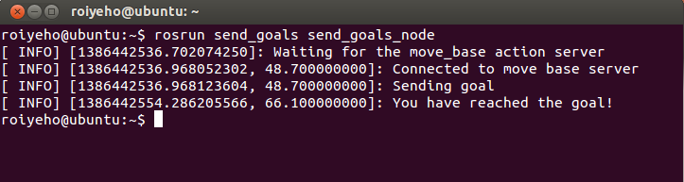
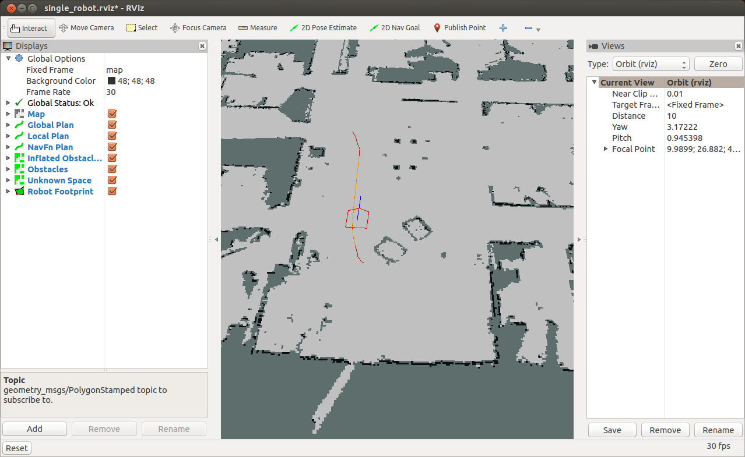
Running the Node

Slide 26
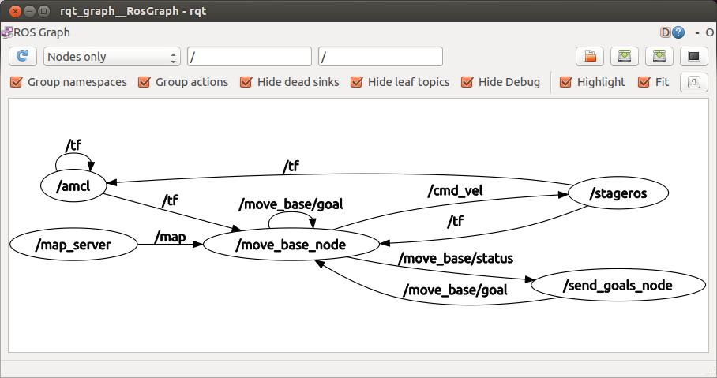
Nodes Graph
The graph shows that the client is subscribing to the status channel of move_base and publishing to the goal channel as expected.

Slide 27
Converting Euler Angles to Quaternions
Now let’s specify the desired orientation of the robot in the final pose as 90 degrees
It will be easier to define it with Euler angles and convert it to a quaternion message:
double theta = 90.0;
double radians = theta * (M_PI/180);
tf::Quaternion quaternion;
quaternion = tf::createQuaternionFromYaw(radians);
geometry_msgs::Quaternion qMsg;
tf::quaternionTFToMsg(quaternion, qMsg);
goal.target_pose.pose.orientation = qMsg;

Slide 28
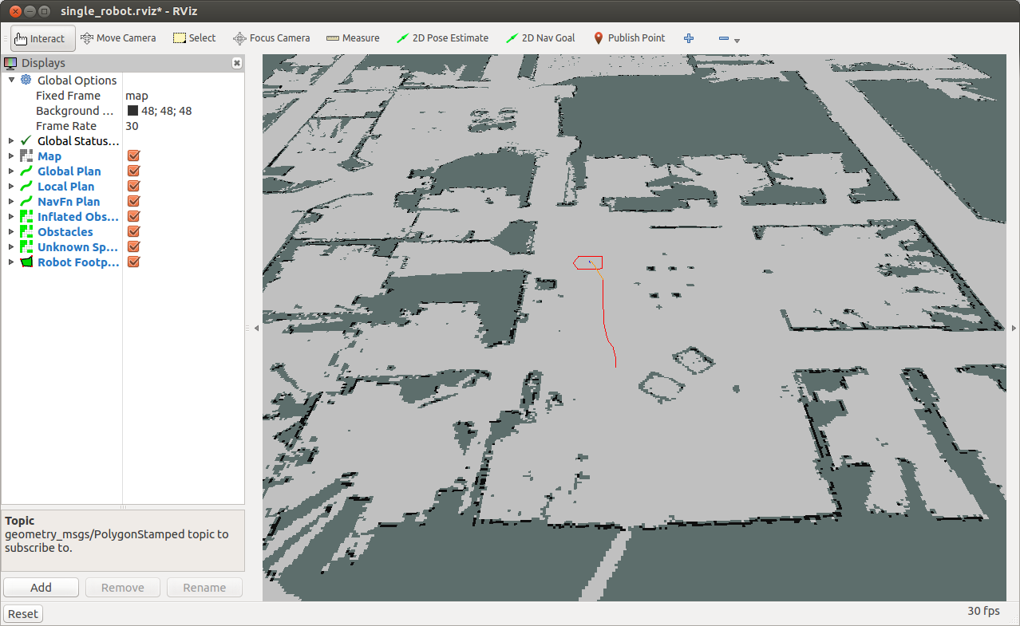
Converting Euler Angles to Quaternions

Slide 29
ROS Parameters
Now let us make the desired pose of the robot configurable in a launch file, so we can send different goals to the robot from the terminal
You can set a parameter using the <param> tag in the ROS launch file:
<launch>
<param name="goal_x" value="18.5" />
<param name="goal_y" value="27.5" />
<param name="goal_theta" value="45" />
<node name="send_goals_node" pkg="send_goals" type="send_goals_node" output="screen"/>
</launch>

Slide 30
Retrieving Parameters
There are two methods to retrieve parameters with NodeHandle:
getParam(key, output_value)
param() is similar to getParam(), but allows you to specify a default value in the case that the parameter could not be retrieved
Example:
// Read x, y and angle params
ros::NodeHandle nh;
double x, y, theta;
nh.getParam("goal_x", x);
nh.getParam("goal_y", y);
nh.getParam("goal_theta", theta);

Slide 31
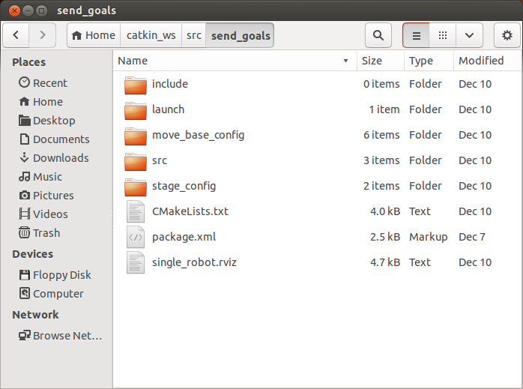
Integrating with move_base
Copy the following directories and files from the navigation_tutorials stack to the package directory:

Slide 32
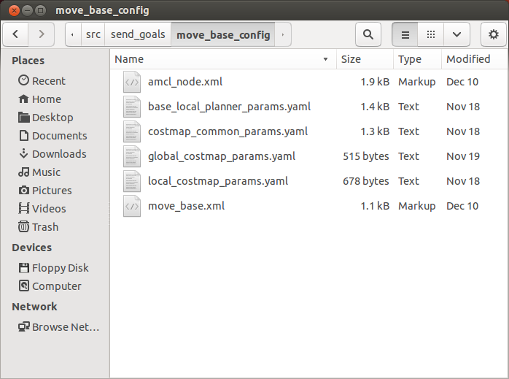
Integrating with move_base
move_base_config files:

Slide 33
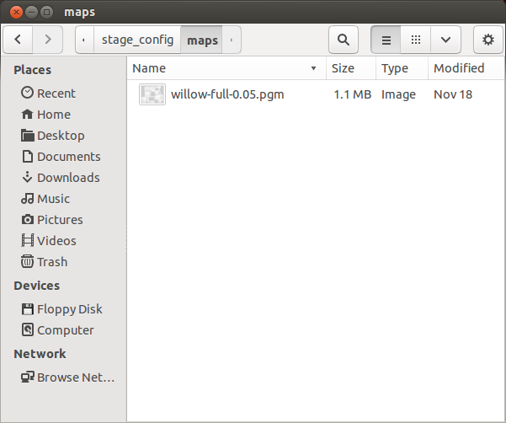
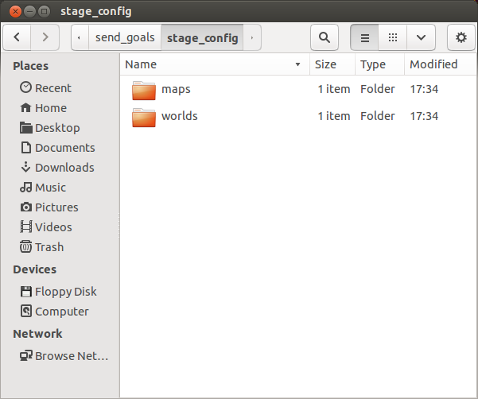
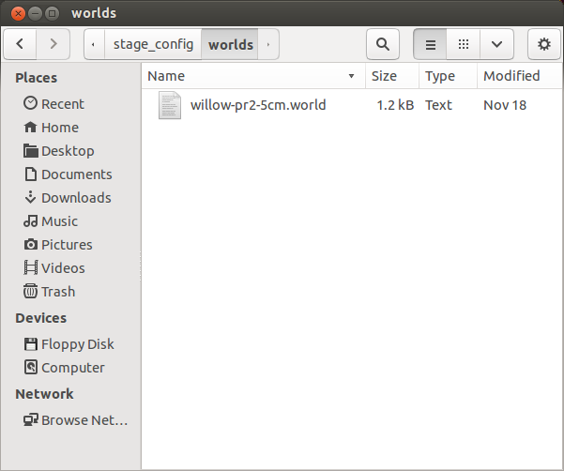
Integrating with move_base
stage_config files:

Slide 34
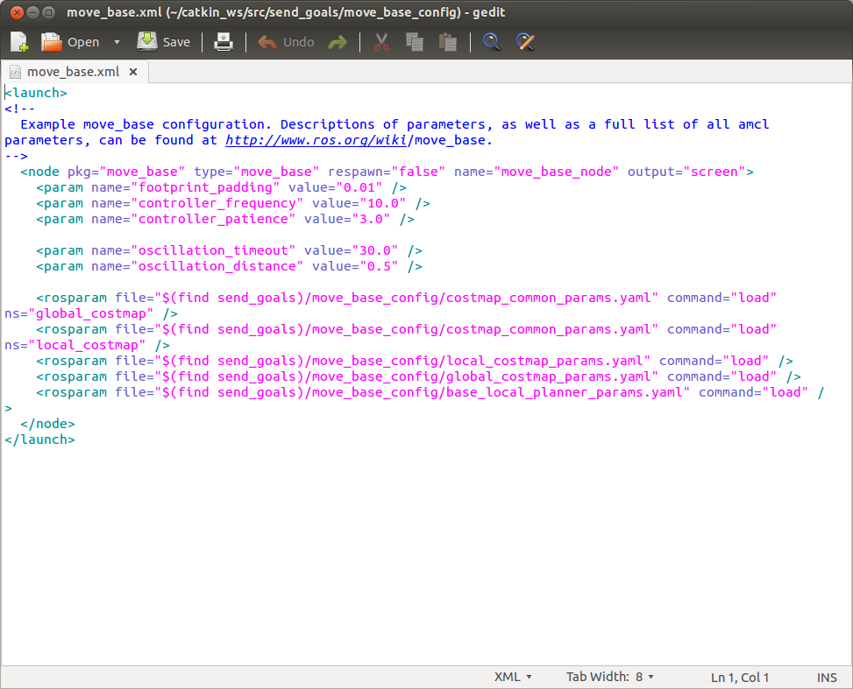
Integrating with move_base
Fix move_base.xml to use the correct package name:

Slide 35
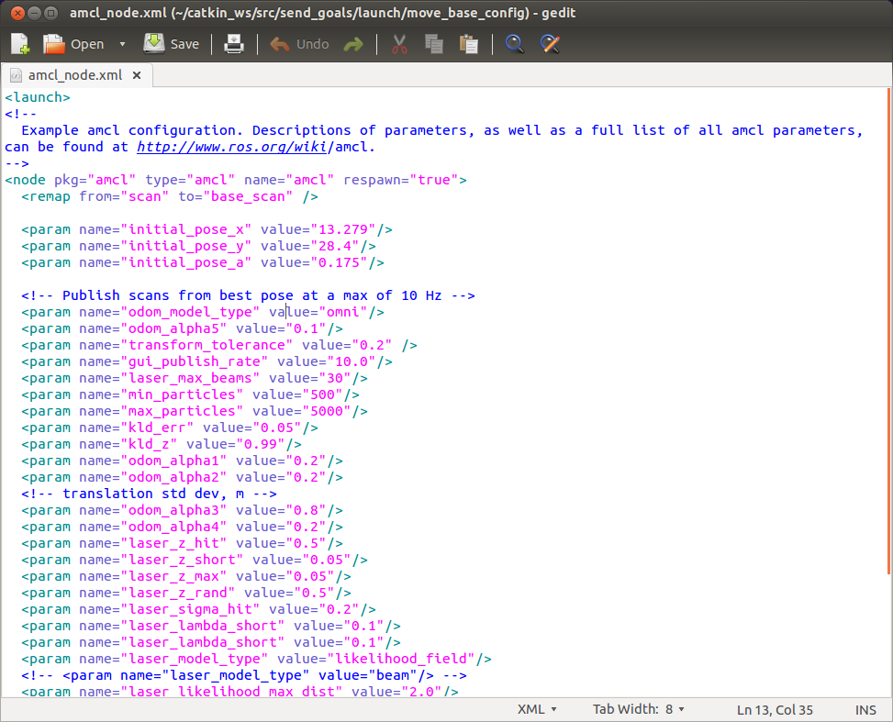
Integrating with move_base
Set the robot’s initial pose in amcl_node.xml:

Slide 36
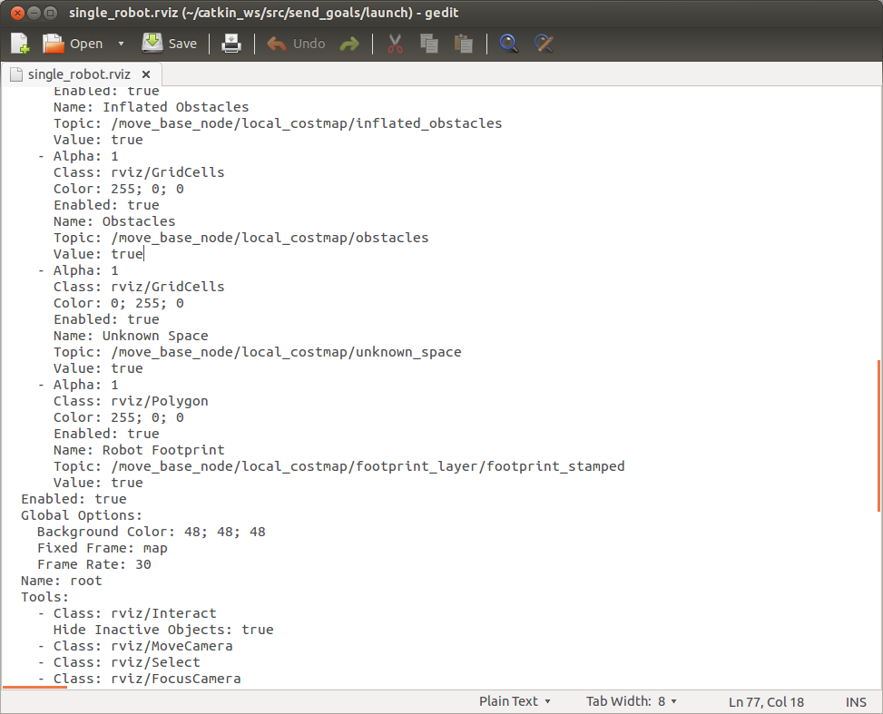
Integrating with move_base
Fix the single_robot.rviz file
Change topic name for the robot footprint

Slide 37
Integrating with move_base
Edit the send_goals.launch file:
<launch>
<param name="goal_x" value="18.5" />
<param name="goal_y" value="27.5" />
<param name="goal_theta" value="45" />
<param name="/use_sim_time" value="true"/>
<include file="$(find send_goals)/move_base_config/move_base.xml"/>
<node name="map_server" pkg="map_server" type="map_server" args="$(find send_goals)/stage_config/maps/willow-full-0.05.pgm 0.05"/>
<node pkg="stage_ros" type="stageros" name="stageros" args="$(find send_goals)/stage_config/worlds/willow-pr2-5cm.world"/>
<include file="$(find send_goals)/move_base_config/amcl_node.xml"/>
<node name="rviz" pkg="rviz" type="rviz" args="-d $(find send_goals)/single_robot.rviz" />
<node name="send_goals_node" pkg="send_goals" type="send_goals_node" output="screen"/>
</launch>

Slide 38
Run the Launch File
Edit the send_goals.launch file:
You should now see rviz opens and the robot moves from its initial pose to the target pose defined in the launch file
$ roslaunch send_goals send_goals.launch

Slide 39
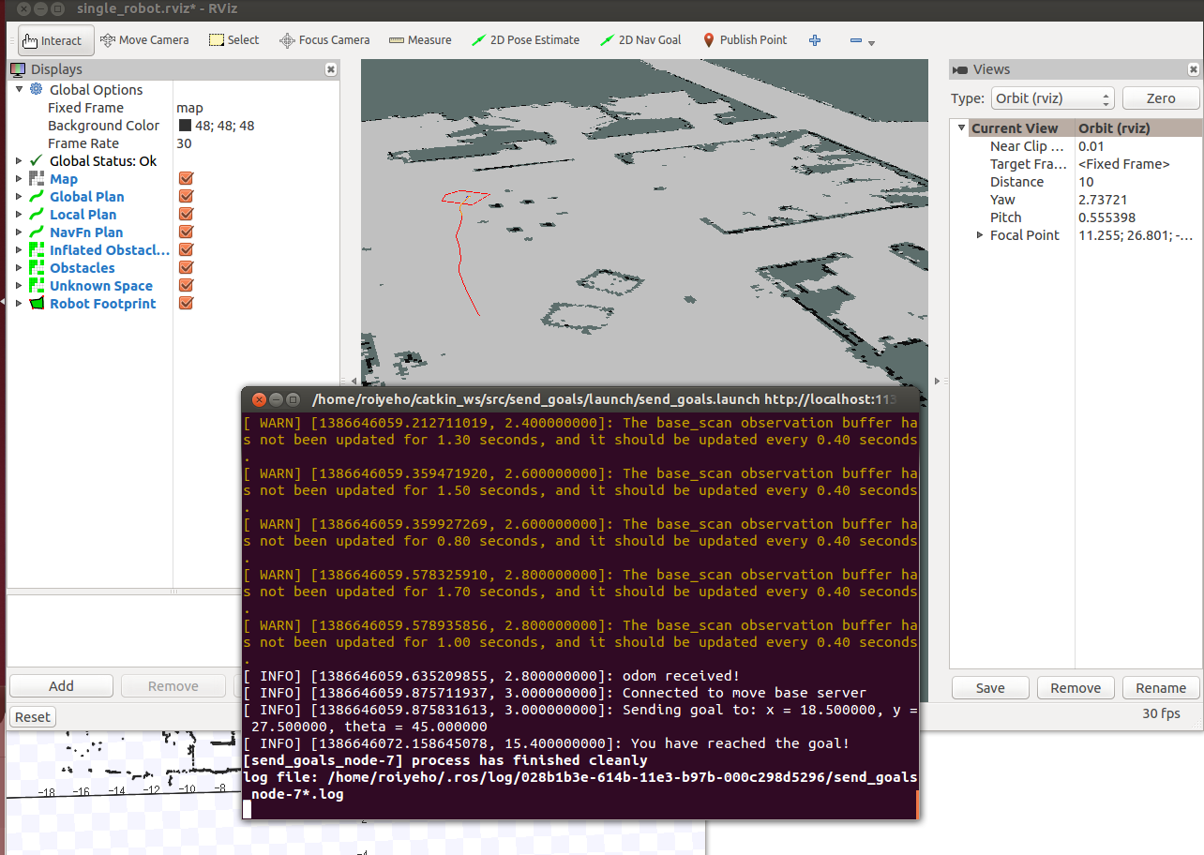
Run the Launch File

Slide 40
ROS Services
The publish/subscribe model is a very flexible communication paradigm
However its many-to-many one-way transport is not appropriate for RPC request/reply interactions, which are often required in a distributed system.
Request/reply is done via a Service
A providing ROS node offers a service under a string name, and a client calls the service by sending the request message and awaiting the reply.
Client libraries usually present this interaction to the programmer as if it were a remote procedure call.

Slide 41
Service Definitions
ROS Services are defined by srv files, which contains a request message and a response message.
These are identical to the messages used with ROS Topics
roscpp converts these srv files into C++ source code and creates 3 classes
The names of these classes come directly from the srv filename:
my_package/srv/Foo.srv →
my_package::Foo – service definition
my_package::Foo::Request – request message
my_package::Foo::Response – response message

Slide 42
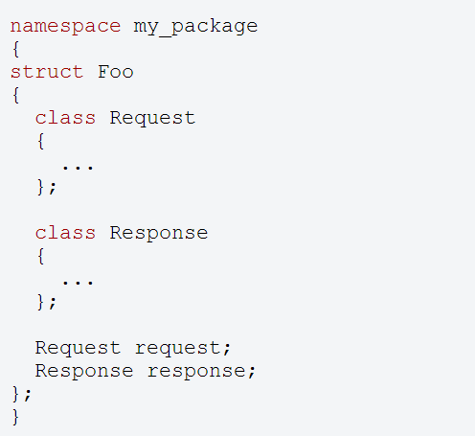
Generated Structure

Slide 43
Calling Services
ros::NodeHandle nh;
ros::ServiceClient client = nh.serviceClient<my_package::Foo>("my_service_name");
my_package::Foo foo;
foo.request.<var> = <value>;
...
if (client.call(foo)) {
...
}
Since service calls are blocking, it will return once the call is done.
If the service call succeeded, call() will return true and the value in srv.response will be valid.
If the call did not succeed, call() will return false and the value in srv.response will be invalid.

Slide 44
Persistent Connections
ROS also allows for persistent connections to services
With a persistent connection, a client stays connected to a service. Otherwise, a client normally does a lookup and reconnects to a service each time.
Persistent connections should be used carefully.
They greatly improve performance for repeated requests, but they also make your client more fragile to service failures.

Slide 45
Persistent Connections
You can create a persistent connection by using the optional second argument toros::NodeHandle::serviceClient():
You can tell if the connection failed by testing the handle:
ros::ServiceClient client = nh.serviceClient<my_package::Foo>("my_service_name", true);
if (client)
{
...
}

Slide 46
ROS Services Useful Commands
 | Command
Lists the active services | $rosservice list
Prints information about the service | $rosservice info /service
Prints the service type | $rosservice type /service
Finds services by the service type | $rosservice find msg-type
Calls the service with the provided arguments | $rosservice call /service args

Slide 47
move_base make_plan service
Allows an external user to ask for a plan to a given pose from move_base without causing move_base to execute that plan.
Arguments:
Start pose
Goal pose
Goal tolerance
Returns:
a message of type nav_msgs/GetPlan

Slide 48
make_plan Node
In our send_goal package we will now create a make_plan_node that will call the make_plan service and print the output path fof the plan
Create a new C++ file called MakePlan.cpp

Slide 49
MakePlan.cpp (1)
#include <ros/ros.h>
#include <nav_msgs/GetPlan.h>
#include <geometry_msgs/PoseStamped.h>
#include <string>
using std::string;
#include <boost/foreach.hpp>
#define forEach BOOST_FOREACH
double g_GoalTolerance = 0.5;
string g_WorldFrame = "map";
void fillPathRequest(nav_msgs::GetPlan::Request &req);
void callPlanningService(ros::ServiceClient &serviceClient, nav_msgs::GetPlan &srv);

Slide 50
MakePlan.cpp (2)
int main(int argc, char** argv)
{
ros::init(argc, argv, "make_plan_node");
ros::NodeHandle nh;
// Init service query for make plan
string service_name = "move_base_node/make_plan";
while (!ros::service::waitForService(service_name, ros::Duration(3.0))) {
ROS_INFO("Waiting for service move_base/make_plan to become available");
}
ros::ServiceClient serviceClient = nh.serviceClient<nav_msgs::GetPlan>(service_name, true);
if (!serviceClient) {
ROS_FATAL("Could not initialize get plan service from %s", serviceClient.getService().c_str());
return -1;
}
nav_msgs::GetPlan srv;
fillPathRequest(srv.request);
if (!serviceClient) {
ROS_FATAL("Persistent service connection to %s failed", serviceClient.getService().c_str());
return -1;
}
callPlanningService(serviceClient, srv);
}

Slide 51
MakePlan.cpp (3)
void fillPathRequest(nav_msgs::GetPlan::Request &request)
{
request.start.header.frame_id = g_WorldFrame;
request.start.pose.position.x = 12.378;
request.start.pose.position.y = 28.638;
request.start.pose.orientation.w = 1.0;
request.goal.header.frame_id = g_WorldFrame;
request.goal.pose.position.x = 18.792;
request.goal.pose.position.y = 29.544;
request.goal.pose.orientation.w = 1.0;
request.tolerance = g_GoalTolerance;
}

Slide 52
MakePlan.cpp (4)
void callPlanningService(ros::ServiceClient &serviceClient, nav_msgs::GetPlan &srv)
{
// Perform the actual path planner call
if (serviceClient.call(srv)) {
if (!srv.response.plan.poses.empty()) {
forEach(const geometry_msgs::PoseStamped &p, srv.response.plan.poses) {
ROS_INFO("x = %f, y = %f", p.pose.position.x, p.pose.position.y);
}
}
else {
ROS_WARN("Got empty plan");
}
}
else {
ROS_ERROR("Failed to call service %s - is the robot moving?", serviceClient.getService().c_str());
}
}

Slide 53
Compiling the make_plan Node
Add the following lines to CMakeLists.txt:
Call catkin_make
add_executable(make_plan src/MakePlan.cpp)
target_link_libraries(make_plan
${catkin_LIBRARIES}
)

Slide 54
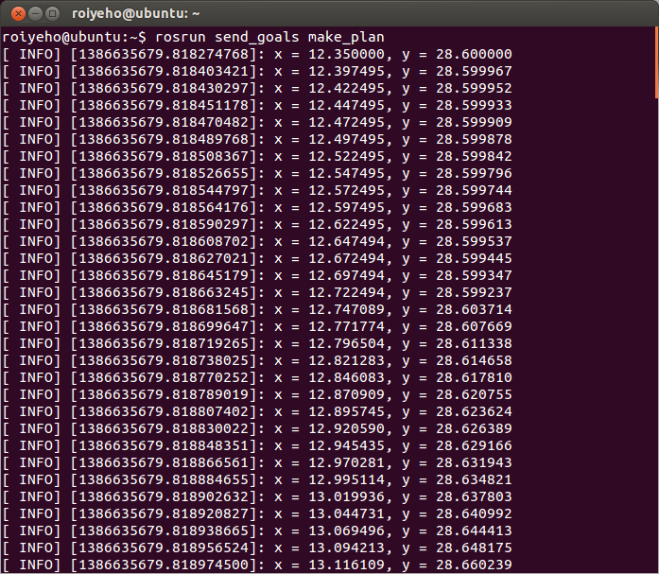
Running make_plan Node

Slide 55
Homework (for submission)
Create a patrolling bot application
Details can be found at: Assignment2

