Slide 1

ROS - Lesson 8
Teaching Assistant: Roi Yehoshua
roiyeho@gmail.com

Slide 2
Agenda
tf package and tools
Writing a tf broadcaster
Writing a tf listener
Robot state publisher

Slide 3
What is tf?
A standardized protocol for publishing transform data to a distributed system
tf lets the user keep track of multiple coordinate frames over time.
tf APIs allow making computations in one frame and then transforming them to another at any desired point in time
Full documentation at:
http://www.ros.org/wiki/tf

Slide 4
What is tf?
tf allows you to ask questions like:
What is the pose of the object in my gripper relative to my base?
What is the current pose of the base frame in the map frame?
Where was the head frame relative to the world frame, 5 seconds ago?

Slide 5
tf Nodes
There are two types of tf nodes:
Publishers
Listeners
Publishers – publish transforms between coordinate frames on /tf
Listeners – listen to /tf and cache all data heard up to cache limit
tf is distributed - there is no central source of tf information

Slide 6
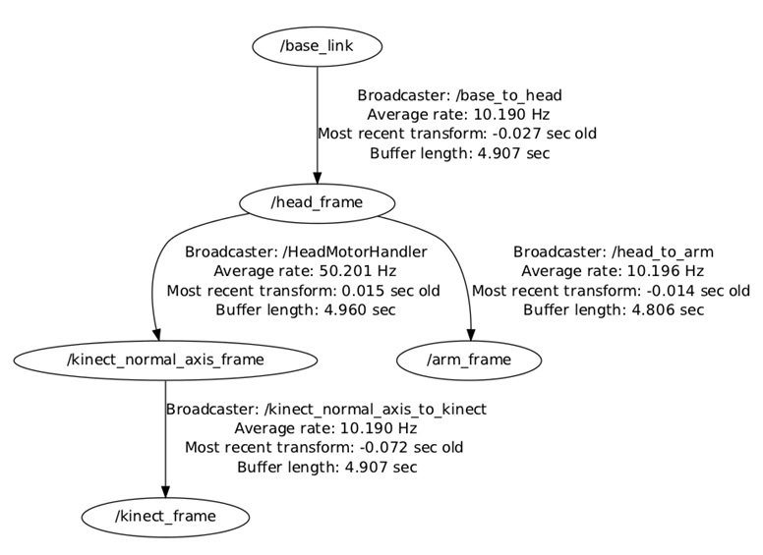
Transform Tree
TF builds a tree of transforms between frames
Can support multiple disconnected trees
Transforms only work within the same tree

Slide 7
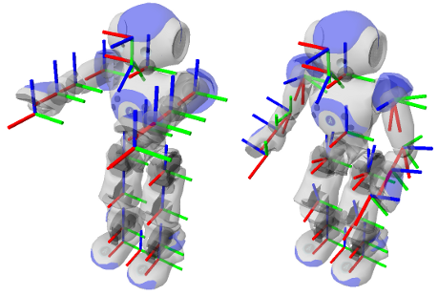
More Complex Example
Nao’s TF tree

Slide 8
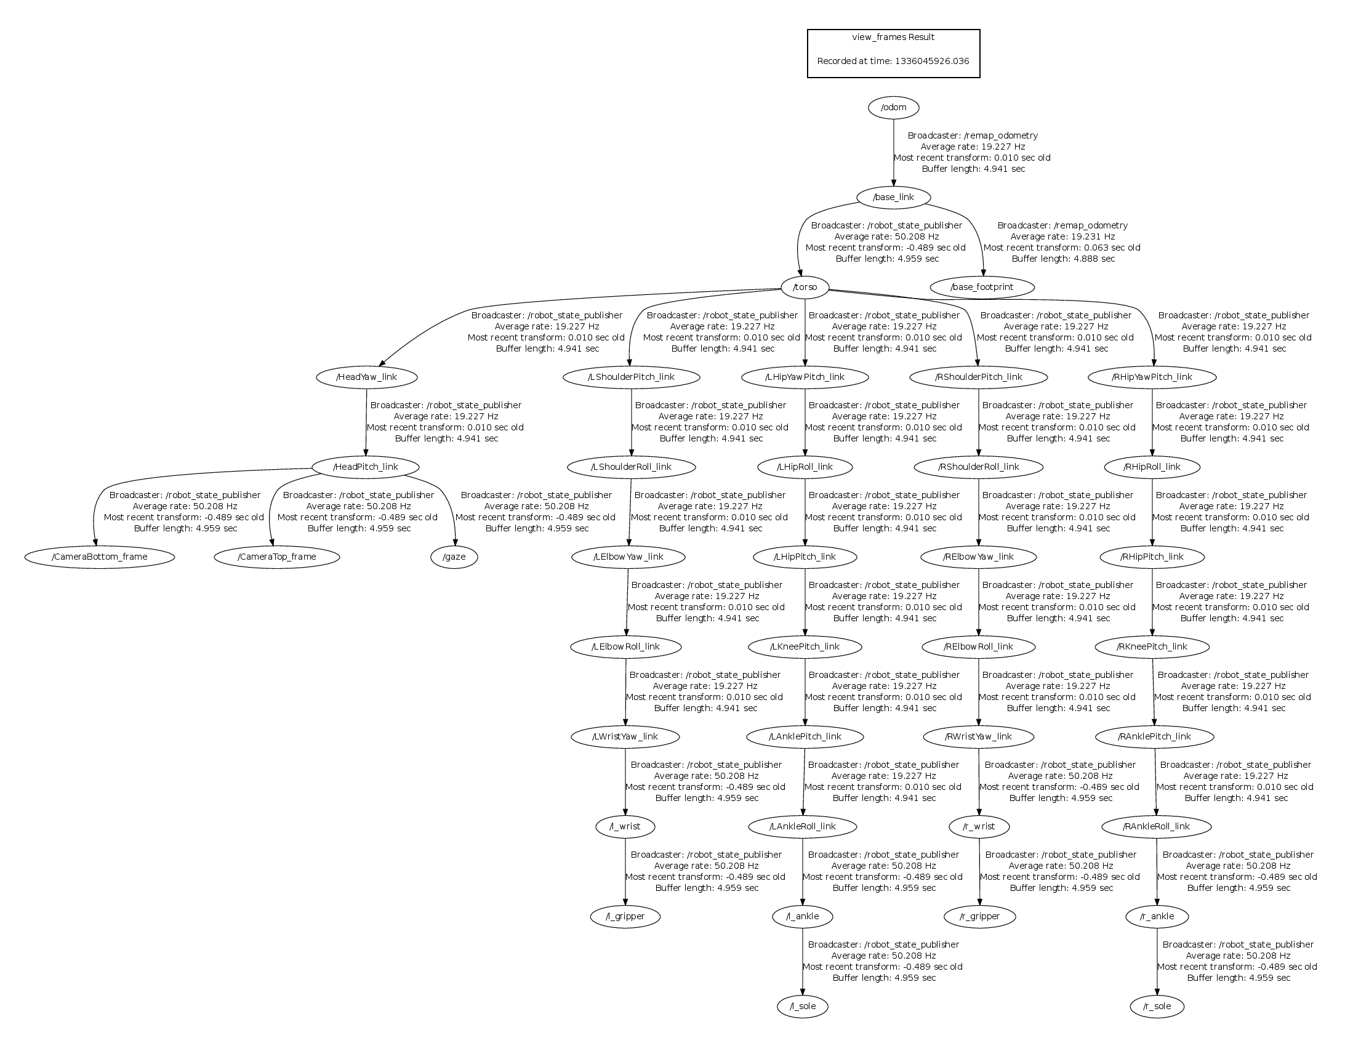
More Complex Example
Nao’s TF tree

Slide 9
Values of tf
No data loss when transforming multiple times
No computational cost of intermediate data transformations between coordinate frames
The user does not need to worry about which frame their data started
Information about past locations is also stored and accessible (after local recording was started)

Slide 10
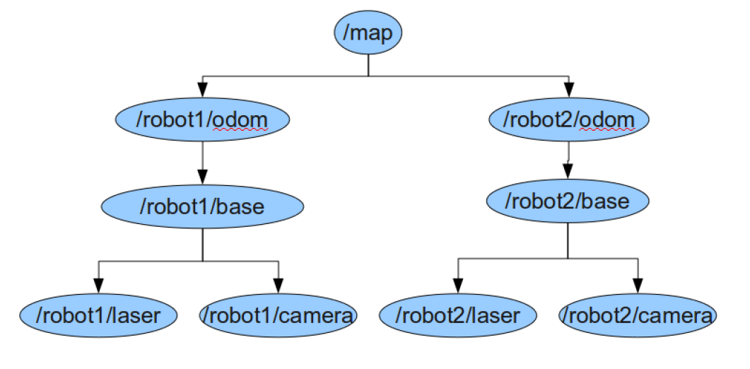
How does this work?
Given the following TF tree, let’s say we want robot2 to navigate based on the laser data coming from robot1

Slide 11
How does this work?
Inverse Transform
Forward Transform

Slide 12
tf Demo
Launch the turetle_tf_demo by typing:
In another terminal run the turtle_tf_listener
Now you should see a window with two turtles where one follows the other.
You can drive the center turtle around in the turtlesim using the keyboard arrow keys
$ roslaunch turtle_tf turtle_tf_demo.launch
$ rosrun turtle_tf turtle_tf_listener

Slide 13
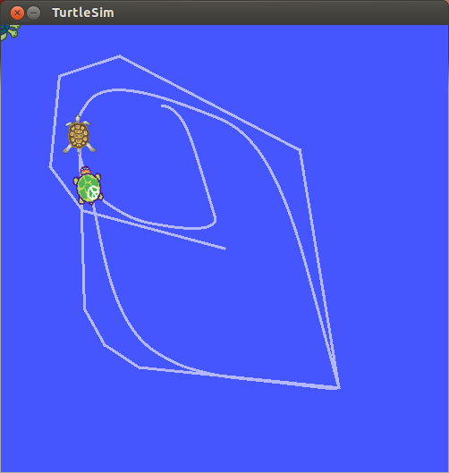
tf Demo

Slide 14
tf Demo
This demo is using the tf library to create three coordinate frames: a world frame, a turtle1 frame, and a turtle2 frame.
It uses a tf broadcaster to publish the turtle coordinate frames and a tf listener to compute the difference in the turtle frames and move one turtle to follow the other.

Slide 15
tf Command-line Tools
view_frames: visualizes the full tree of coordinate transforms.
tf_monitor: monitors transforms between frames.
tf_echo: prints specified transform to screen
roswtf: with the tfwtf plugin, helps you track down problems with tf.
static_transform_publisher is a command line tool for sending static transforms.

Slide 16
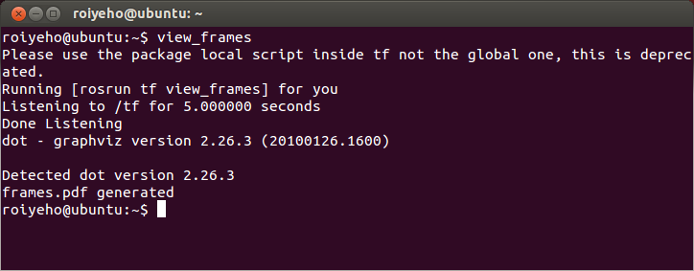
view_frames
view_frames creates a diagram of the frames being broadcast by tf over ROS
Here a tf listener is listening to the frames that are being broadcast over ROS and drawing a tree of how the frames are connected

Slide 17
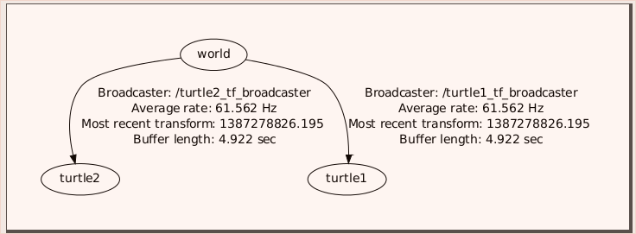
view_frames
To view the tree:
$ evince frames.pdf

Slide 18
tf_echo
tf_echo reports the transform between any two frames broadcast over ROS.
Usage:
Let's look at the transform of the turtle2 frame with respect to turtle1 frame which is equivalent to: T_{turtle1_turtle2} = T_{turtle1_world} * T_{world_turtle2}
$ rosrun tf tf_echo [reference_frame] [target_frame]
$ rosrun tf tf_echo turtle1 turtle2

Slide 19
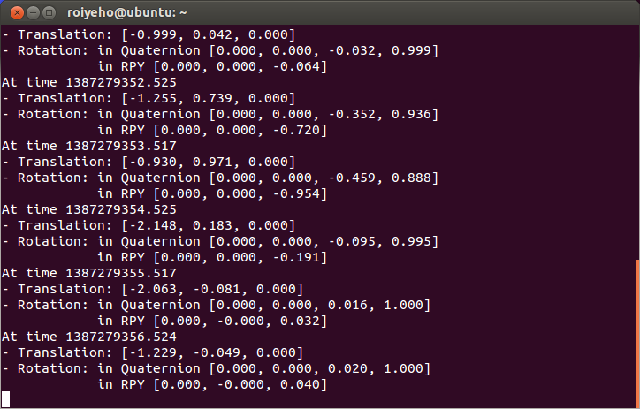
tf_echo
As you drive your turtle around you will see the transform change as the two turtles move relative to each other.

Slide 20
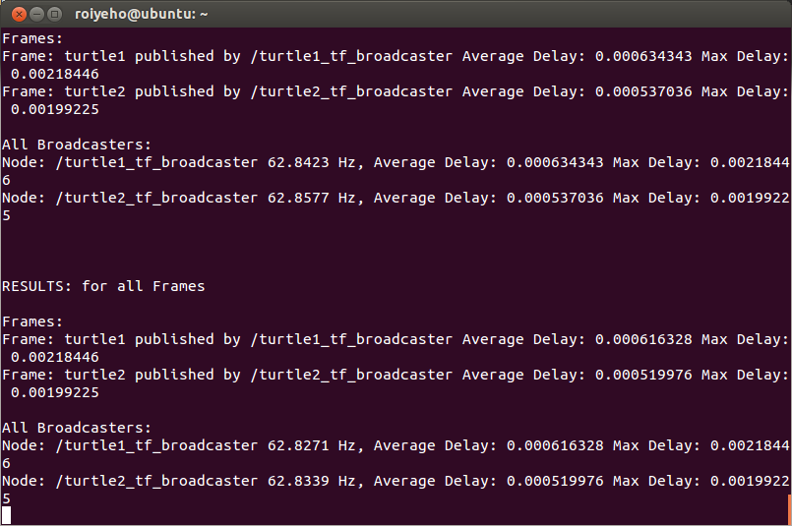
tf_monitor
Print information about the current coordinate transform tree to console
$ rosrun tf tf_monitor

Slide 21
roswtf
roswtf is a tool for diagnosing issues with a running ROS system
Can detect file-system issues and online/graph issues, such as:
potential configuration issues
packages that haven't been built properly
unresponsive nodes
missing connections between nodes
Two publishers publishing the same transform with conflicting data or conflicting parent

Slide 22
roswtf
Move with roscd to the package you want to analyze, and then run roswtf
$ roscd turtle_tf
$ roswtf

Slide 23
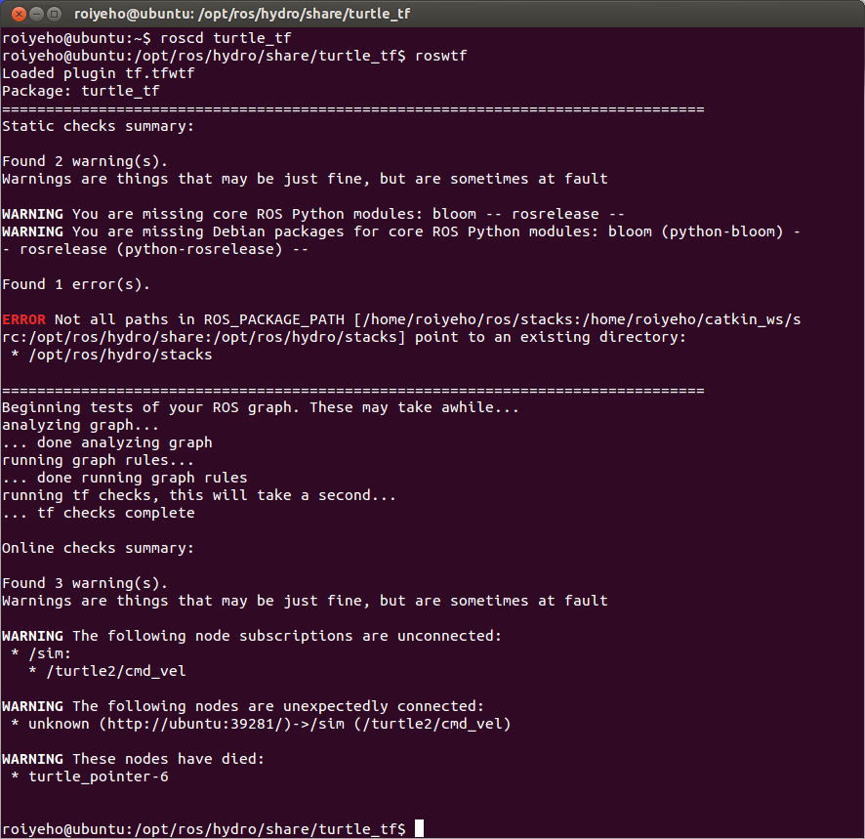
roswtf

Slide 24
rviz and tf
Let's look at our turtle frames using rviz.
Let's start rviz with the turtle_tf configuration file using the -d option for rviz:
In the side bar you will see the frames broadcast by tf.
Note that the fixed frame is /world
The fixed frame is assumed not to be moving over time
As you drive the turtle around you will see the frames move in rviz.
$ rosrun rviz rviz -d `rospack find turtle_tf`/rviz/turtle_rviz.rviz

Slide 25
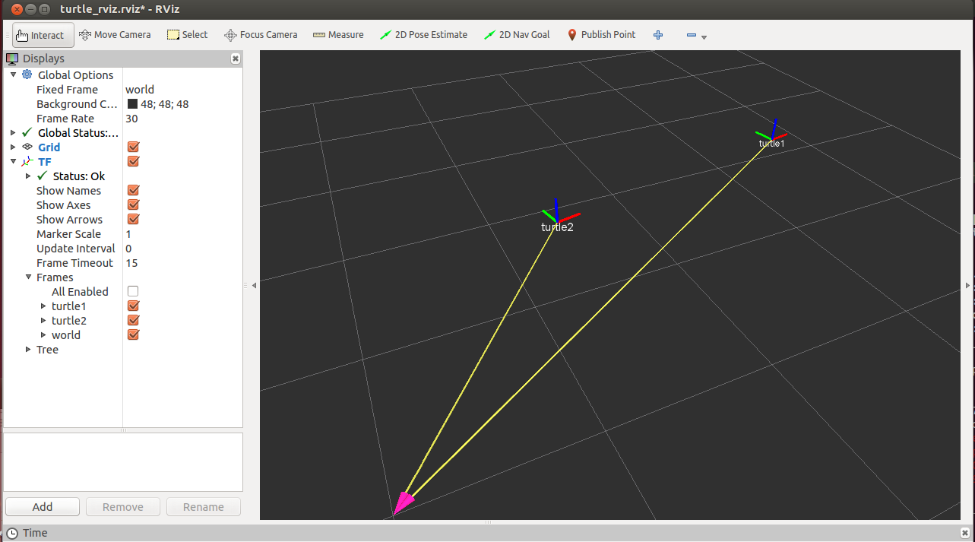
rviz and tf

Slide 26
Broadcasting Transforms
A tf broadcaster sends out the relative pose of coordinate frames to the rest of the system.
A system can have many broadcasters, each provides information about a different part of the robot.
We will now write the code to reproduce the tf demo

Slide 27
Writing a tf broadcaster
First create a new package called tf_demo that depends on tf, roscpp, rospy and turtlesim
Build the package by calling catkin_make
Open the package in Eclipse and add a new source file called tf_broadcaster.cpp
$ cd ~/catkin_ws/src
$ catkin_create_pkg tf_demo tf roscpp rospy turtlesim

Slide 28
tf_broadcaster.cpp (1)
#include <ros/ros.h>
#include <tf/transform_broadcaster.h>
#include <turtlesim/Pose.h>
std::string turtle_name;
void poseCallback(const turtlesim::PoseConstPtr& msg){
static tf::TransformBroadcaster br;
tf::Transform transform;
transform.setOrigin( tf::Vector3(msg->x, msg->y, 0.0) );
tf::Quaternion quaternion;
transform.setRotation( tf::createQuaternionFromYaw(msg->theta) );
br.sendTransform(tf::StampedTransform(transform, ros::Time::now(), "world", turtle_name));
}

Slide 29
tf_broadcaster.cpp (2)
int main(int argc, char** argv){
ros::init(argc, argv, "my_tf_broadcaster");
if (argc != 2) {
ROS_ERROR("need turtle name as argument");
return -1;
};
turtle_name = argv[1];
ros::NodeHandle node;
ros::Subscriber sub = node.subscribe(turtle_name+"/pose", 10, &poseCallback);
ros::spin();
return 0;
};

Slide 30
Sending Transforms
Sending a transform with a TransformBroadcaster requires 4 arguments:
The transform itself.
A timestamp, usually we can just stamp it with the current time, ros::Time::now().
The name of the parent frame of the link we're creating, in this case "world"
The name of the child frame of the link we're creating, in this case this is the name of the turtle itself.
br.sendTransform(tf::StampedTransform(transform, ros::Time::now(), "world", turtle_name));

Slide 31
Running the Broadcaster
Add the following lines to CMakeLists.txt
Build the package by calling catkin_make
add_executable(tf_broadcaster src/tf_broadcaster.cpp)
target_link_libraries(tf_broadcaster
${catkin_LIBRARIES}
)

Slide 32
Running the Broadcaster
Create tf_demo.launch in the /launch subfolder
Run the launch file
<launch>
<!-- Turtlesim Node-->
<node pkg="turtlesim" type="turtlesim_node" name="sim"/>
<node pkg="turtlesim" type="turtle_teleop_key" name="teleop" output="screen"/>
<!-- tf broadcaster node -->
<node pkg="tf_demo" type="turtle_tf_broadcaster"
args="/turtle1" name="turtle1_tf_broadcaster" />
</launch>
$ cd ~/catkin_ws/src
$ roslaunch tf_demo tf_demo.launch

Slide 33
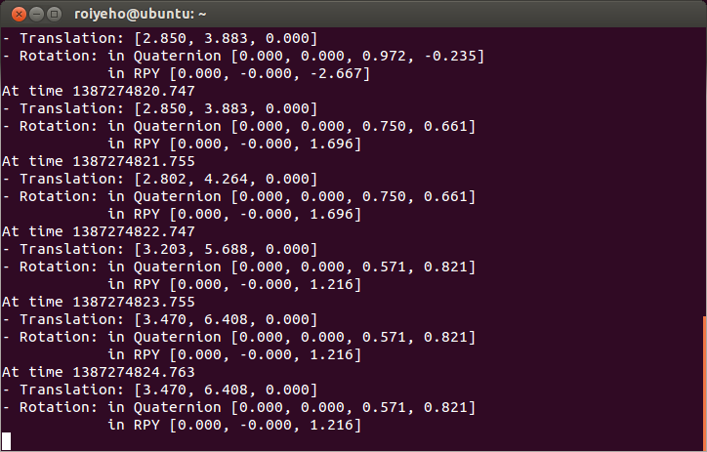
Checking the Results
Use the tf_echo tool to check if the turtle pose is actually getting broadcast to tf:
$ rosrun tf tf_echo /world /turtle1

Slide 34
Writing a tf listener
A tf listener receives and buffers all coordinate frames that are broadcasted in the system, and queries for specific transforms between frames
Next we'll create a tf listener that will listen to the transformations coming from the tf broadcaster
Add tf_listener.cpp to your project with the following code

Slide 35
tf_listener.cpp (1)
#include <ros/ros.h>
#include <tf/transform_listener.h>
#include <turtlesim/Spawn.h>
#include <geometry_msgs/Twist.h>
int main(int argc, char** argv){
ros::init(argc, argv, "my_tf_listener");
ros::NodeHandle node;
ros::service::waitForService("spawn");
ros::ServiceClient add_turtle =
node.serviceClient<turtlesim::Spawn>("spawn");
turtlesim::Spawn srv;
add_turtle.call(srv);
ros::Publisher turtle_vel =
node.advertise<geometry_msgs::Twist>("turtle2/cmd_vel", 10);
tf::TransformListener listener;
ros::Rate rate(10.0);

Slide 36
tf_listener.cpp (2)
while (node.ok()){
tf::StampedTransform transform;
try {
listener.waitForTransform("/turtle2", "/turtle1", ros::Time(0), ros::Duration(10.0) );
listener.lookupTransform("/turtle2", "/turtle1", ros::Time(0), transform);
} catch (tf::TransformException ex) {
ROS_ERROR("%s",ex.what());
}
geometry_msgs::Twist vel_msg;
vel_msg.angular.z = 4 * atan2(transform.getOrigin().y(),
transform.getOrigin().x());
vel_msg.linear.x = 0.5 * sqrt(pow(transform.getOrigin().x(), 2) +
pow(transform.getOrigin().y(), 2));
turtle_vel.publish(vel_msg);
rate.sleep();
}
return 0;
};

Slide 37
Creating a TransformListener
To use the TransformListener, we need to include the tf/transform_listener.h header file.
Once the listener is created, it starts receiving tf transformations over the wire, and buffers them for up to 10 seconds.
The TransformListener object should be scoped to persist otherwise its cache will be unable to fill and almost every query will fail.
A common method is to make the TransformListener object a member variable of a class

Slide 38
Core Methods of Transformer
LookupTransform
Get the transform between two coordinate frames
CanTransform
Test if a transform is possible between to coordinate frames

Slide 39
lookupTransform
To query the listener for a specific transformation, you need to pass 4 arguments:
We want the transform from this frame ...
... to this frame.
The time at which we want to transform. Providing ros::Time(0) will get us the latest available transform.
The object in which we store the resulting transform.
listener.lookupTransform("/turtle2", "/turtle1", ros::Time(0), transform);

Slide 40
Synchronization Methods
WaitForTransform
Block until timeout or transform is available.
tf::MessageFilter
Subscribe to a topic an provide the callbacks only when there is enough tf messages to tansform the data.

Slide 41
Running the Listener
Add the following lines to CMakeLists.txt
Build the package by calling catkin_make
add_executable(tf_listener src/tf_listener.cpp)
target_link_libraries(tf_listener
${catkin_LIBRARIES}
)

Slide 42
Launch File
Add the following lines to tf_demo.launch
<launch>
<!-- Turtlesim Node-->
<node pkg="turtlesim" type="turtlesim_node" name="sim"/>
<node pkg="turtlesim" type="turtle_teleop_key" name="teleop" output="screen"/>
<!-- tf broadcaster node -->
<node pkg="tf_demo" type="tf_broadcaster"
args="/turtle1" name="turtle1_tf_broadcaster" />
<!-- Second broadcaster node -->
<node pkg="tf_demo" type="tf_broadcaster"
args="/turtle2" name="turtle2_tf_broadcaster" />
<!-- tf listener node -->
<node pkg="tf_demo" type="tf_listener" name="listener" />
</launch>

Slide 43
Checking the Results
To see if things work, simply drive around the first turtle using the arrow keys (make sure your terminal window is active, not your simulator window), and you'll see the second turtle following the first one!

Slide 44
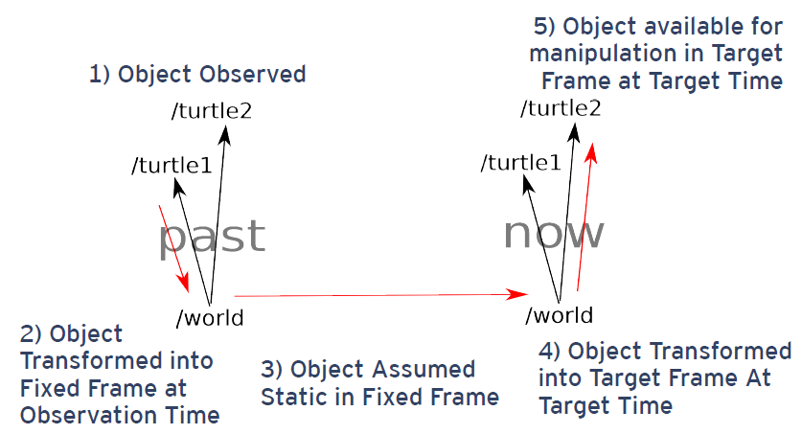
Advanced Scenario

Slide 45
lookupTransform Query Examples
Compute the position of an observed ball in the target frame at the target time assuming it was stationary in the fixed frame
lookupTransform(ball_frame, ball_time, target_frame, target_time, fixed_frame, result_transform)
Compute how far the robot moved between t = 1 and t = 2 in the map frame
lookupTransform(robot_frame, t = 1,robot_frame, t = 2, map_frame, result_transform)

Slide 46
Navigation Stack Frames
For the navigation stack to work properly, the robot needs to publish the tf relationships between the following frames:
map – The coordinate frame fixed to the map
odom – The self consistent coordinate frame using the odometry measurements only (this will not change on localization updates)
The map → odom transform is published by amcl or gmapping
base_footprint – The base of the robot at zero height above the ground
base_link – The base link of the robot, placed at the rotational center of the robot

Slide 47
Robot State Publisher
http://wiki.ros.org/robot_state_publisher
When you are working with a robot that has many relevant frames, it becomes quite a task to publish them all to tf.
This package allows you to publish the state of a robot to tf.
The package takes the joint angles of the robot as input and publishes the 3D poses of the robot links, using a kinematic tree model of the robot.

Slide 48
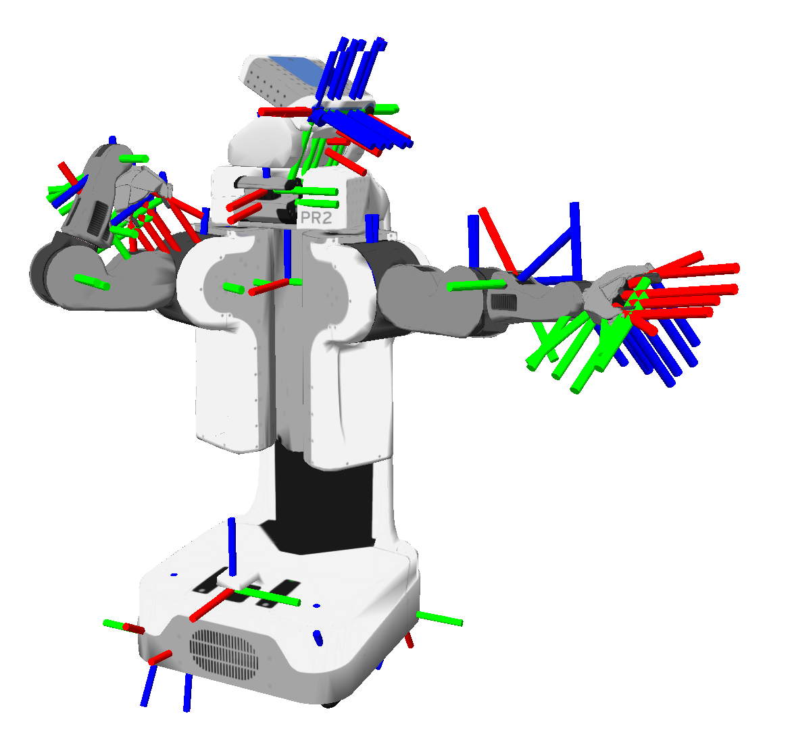
PR2 – The tf tree
Different frames represent either joints or other significant points of interest on the robot body.
You have to define a given joint relative to some other joint or reference point.
For instance, the elbow joint will be described relative to the shoulder joint.
Image taken from http://www.ros.org/wiki/tf

Slide 49
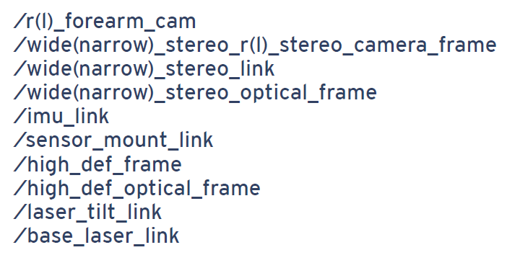
PR2 Sensor Frames

Slide 50
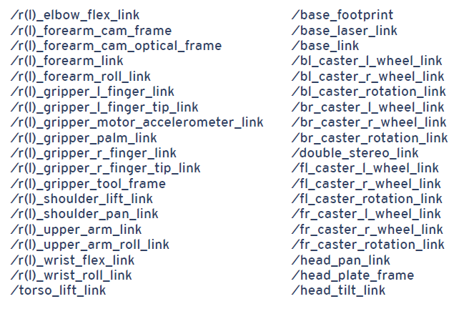
PR2 Manipulation Frames

Slide 51
Homework (not for submission)
Run the navigation stack
Create a node that prints the robot’s location in the map using a TF listener

