Slide 1

Multi-Robot Systems with ROS Lesson 1
Teaching Assistant: Roi Yehoshua
roiyeho@gmail.com

Slide 2
Course Agenda
Working with multi robots in ROS
Handling communication and synchronization between robots
Canonical multi-robot problems in ROS
Patrolling, Formation, Coverage, etc.
Decision making system
We will be using CogniTAO, a decision making system developed by Cogniteam

Slide 3
Course Requirements
Course grade will be composed of:
40% Assignments
40% Project
20% Exam

Slide 4
Who am I?
My name is Roi Yehoshua
PhD Student at Bar-Ilan Robotics lab headed by Prof. Gal Kaminka
Teaching assistant at the courses:
Introduction to Robotics (89-685)
Multi-Robot Systems (89-689)
My home page: http://u.cs.biu.ac.il/~yehoshr1/

Slide 5
Today’s Agenda
ROS Recap
Turtlesim Demo
Intro to Multi-Robots Systems in ROS

Slide 6

What is ROS?
ROS is an open-source robot operating system
The primary goal of ROS is to support code reuse in robotics research and development
ROS was originally developed in 2007 at the Stanford Artificial Intelligence Laboratory and development continued at Willow Garage
Today managed by the Open Source Robotics Foundation
ROS Wiki

Slide 7
ROS Main Features
ROS has two basic "sides"
The operating system side, which provides standard opearting system services such as:
hardware abstraction
low-level device control
implementation of commonly used functionality
message-passing between processes
package management
A suite of user contributed packages (organized into sets called stacks) that implement common robot functionality such as SLAM, planning, perception, simulation etc.

Slide 8
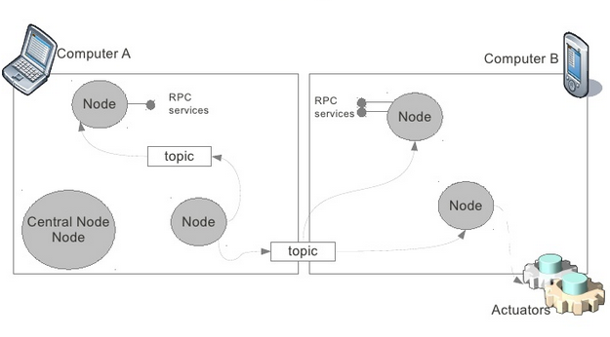
ROS Distributed Architecture

Slide 9
ROS Core Concepts
Nodes
Messages and Topics
Services
ROS Master
Parameters
Stacks and packages

Slide 10
ROS Nodes
Single-purposed executable programs
e.g. sensor driver(s), actuator driver(s), mapper, planner, UI, etc.
Modular design
Individually compiled, executed, and managed
Nodes are written using a ROS client library
roscpp – C++ client library
rospy – python client library
Nodes can publish or subscribe to a Topic
Nodes can also provide or use a Service

Slide 11
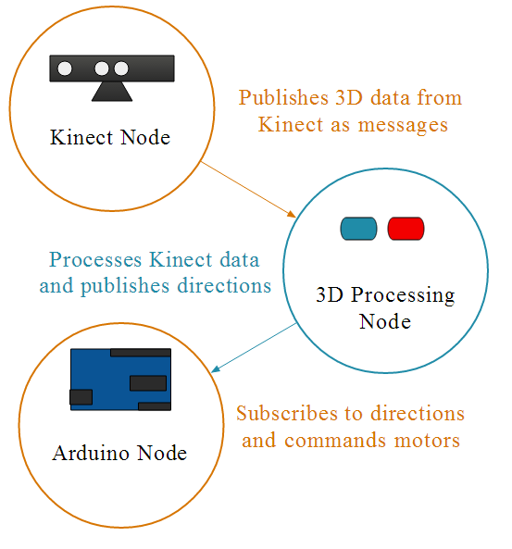
ROS Topics
Nodes communicate with each other by publishing messages to topics
Publish/Subscribe model: 1-to-N broadcasting

Slide 12
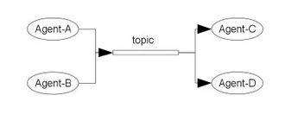
ROS Topics
A shared topic can be used to send messages between different robots

Slide 13
ROS Messages
Strictly-typed data structures for inter-node communication
For example, geometry_msgs/Twist is used to express velocity broken into linear and angular parts:
Vector3 is another message type composed of:
Vector3 linear
Vector3 angular
float64 x
float64 y
float64 z

Slide 14
ROS Services
Synchronous inter-node transactions / RPC
Service/Client model: 1-to-1 request-response
Service roles:
carry out remote computation
trigger functionality / behavior
Example:
map_server/static_map – retrieves the current occupancy grid map

Slide 15
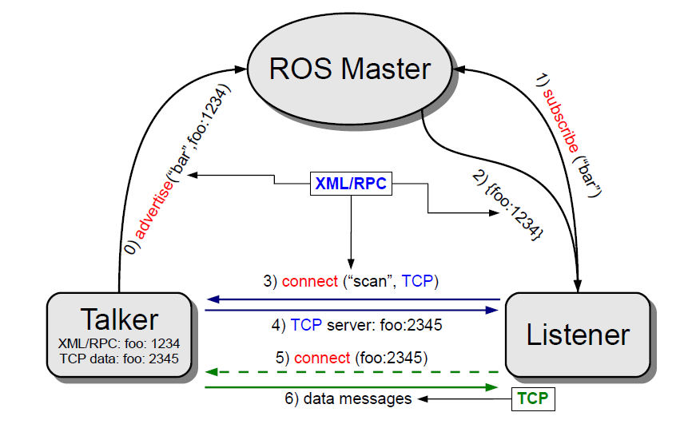
ROS Master
Enable ROS nodes to locate one another
Think of it as a ROS directory service, sort of DNS
Provides naming & registration services for nodes, topics, services, etc

Slide 16
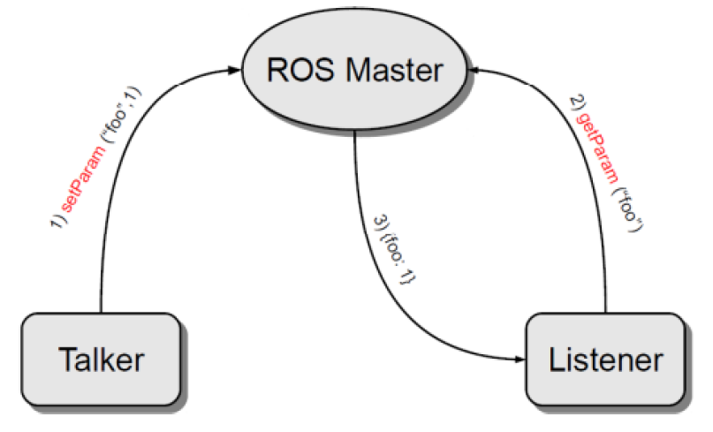
Parameter Server
A shared, multi-variate dictionary that is accessible via network APIs.
Best used for static, non-binary data such as configuration parameters.
Runs inside the ROS master

Slide 17
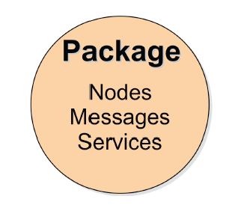
ROS Packages
Software in ROS is organized in packages.
A package contains one or more nodes and provides a ROS interface

Slide 18
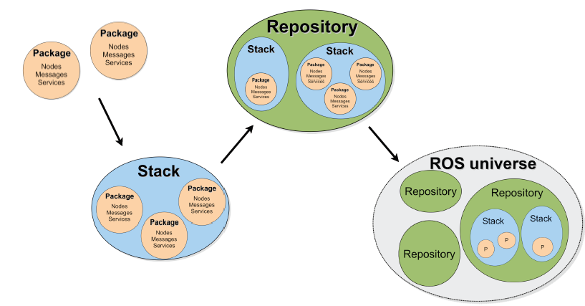
ROS Package System
Taken from Sachin Chitta and Radu Rusu (Willow Garage)

Slide 19
ROS Important Packages
 | Package
Maintains the relationship between multiple coordinate frames over time | TF
Provides a standardized interface for interfacing with preemptable tasks. | actionlib
Provides laser-based SLAM (Simultaneous Localization and Mapping) using a grid map | gmapping
a probabilistic localization system for a robot moving in 2D | amcl
Print information about a node | move_base
Stage 2-D multi-robot simulator | stage_ros

Slide 20
ROS Command-Line Tools
rostopic (Topics)
rosservice (Services)
rosnode (Nodes)
rosparam (Parameters)
rosmsg (Messages)
rossrv (Services)
roswtf (General debugging)

Slide 21
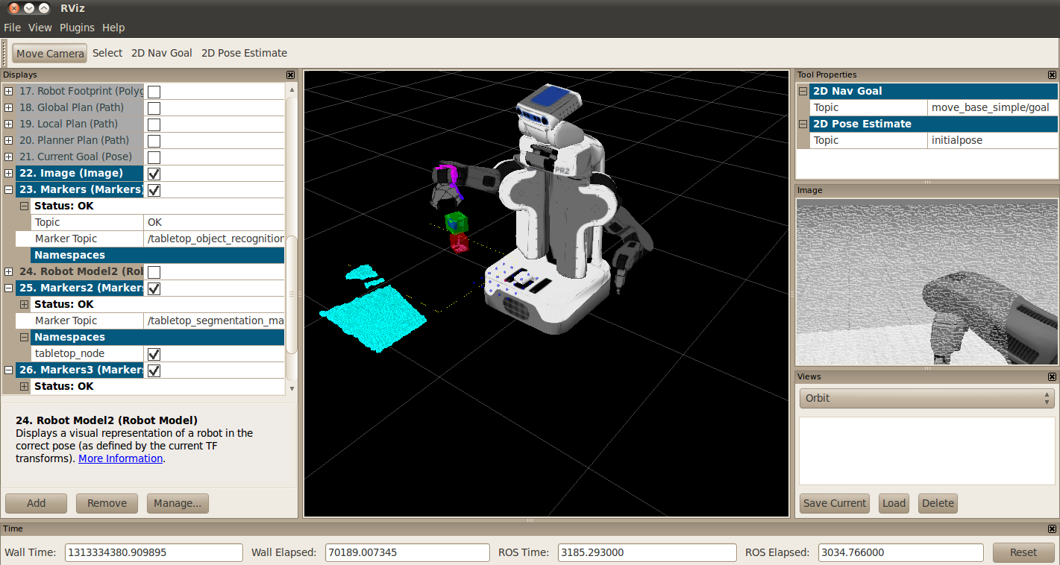
ROS Visualization Tools
rqt – ROS integrated graphical user interface
rviz – 3D visualization tool for ROS

Slide 22
Installing ROS
Make sure you have a recent Linux Ubuntu installation (12.04 and above)
64bit installation is recommended
Latest version of ROS is called Hydro (released on September 2013)
Follow the installation instructions in http://wiki.ros.org/hydro/Installation/Ubuntu

Slide 23
Install Terminator
Terminator is a program that allows you to manage multiple terminals in one window and use key bindings to switch between them.
To install terminator type:
To run terminator for the first time type:
By right clicking on the terminator window you can choose to split it horizontally/vertically
$ sudo apt-get install terminator
$ terminator

Slide 24
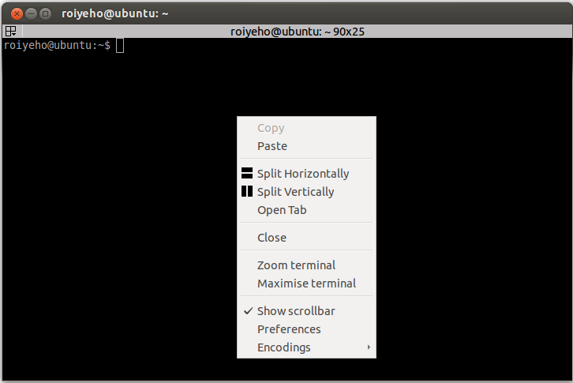
Terminator

Slide 25
roscore
roscore is the first thing you should run when using ROS
roscore will start up:
a ROS Master
a ROS Parameter Server
a rosout logging node
$ roscore

Slide 26
rosrun
rosrun allows you to use the package name to directly run a node within a package
Usage:
Example:
$ rosrun <package> <executable>
$ rosrun turtlesim turtlesim_node

Slide 27
TurtleSim Demo
Now we will try to run two turtlesim nodes at the same time
First start the ROS infrastructure by running in a terminal the command:
Then start the first turtle simulator node by running in a new terminal:
$ roscore
$ rosrun turtlesim turtlesim_node

Slide 28
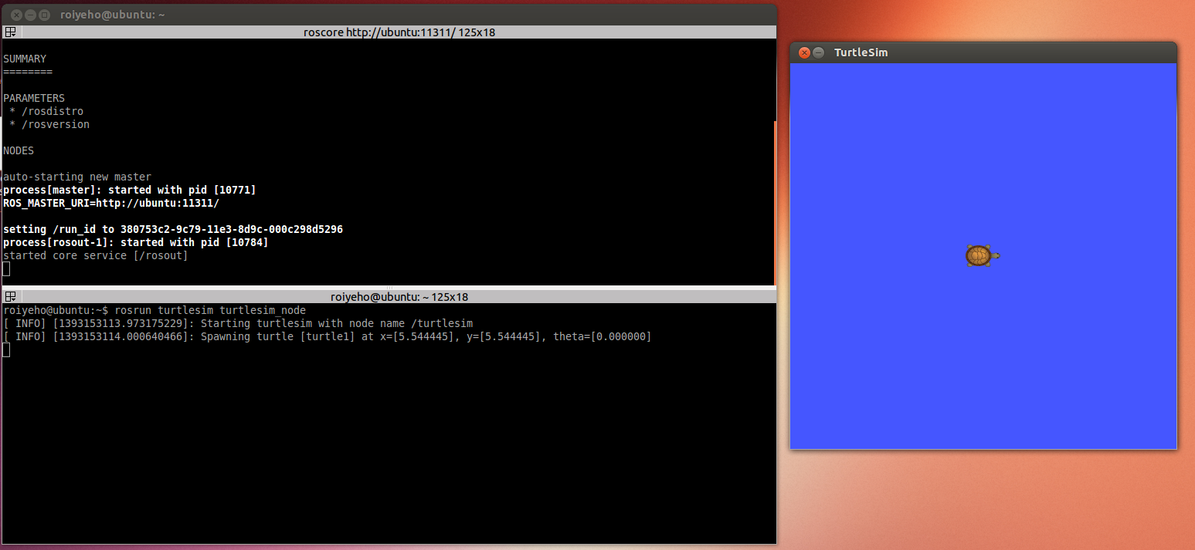
TurtleSim Demo

Slide 29
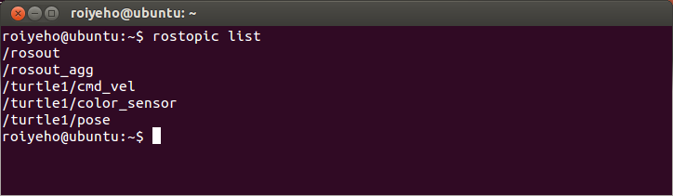
ROS Topics
To display the list of current topics, use the following command:
$ rostopic list

Slide 30
Publish to ROS Topic
Use the rostopic pub command to publish messages to a topic
For example, to make the turtle move forward at a 0.2m/s speed, you can publish a cmd_vel message to the topic /turtle1/cmd_vel:
You can specify only the linear x velocity:
$ rostopic pub /turtle1/cmd_vel geometry_msgs/Twist '{linear: {x: 0.2, y: 0, z: 0}, angular: {x: 0, y: 0, z: 0}}'
$ rostopic pub /turtle1/cmd_vel geometry_msgs/Twist '{linear: {x: 0.2}}'

Slide 31
Publish to ROS Topic
Some of the messages like cmd_vel have a predefined timeout
If you want to publish a message continously use the argument -r with the loop rate in Hz (default is 10Hz)
For example, to make the turtle turn in circles: continuously
$ rostopic pub /turtle1/cmd_vel -r 10 geometry_msgs/Twist '{linear: {x: 0.2, y: 0, z: 0}, angular: {x: 0, y: 0, z: 0.5}}'

Slide 32
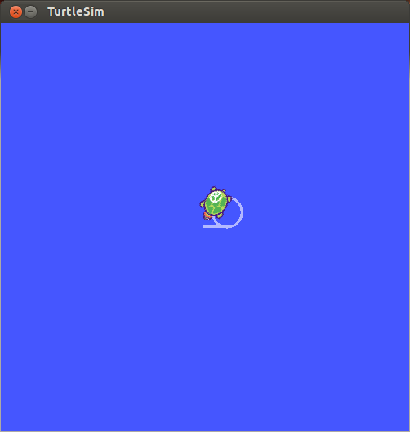
Publish to ROS Topic

Slide 33
rqt
rqt provides the main to start an instance of the ROS integrated graphical user
rqt contains many plugins that can help you perform various operations in ROS
List of plugins
To start rqt type the following command:
$ rqt

Slide 34
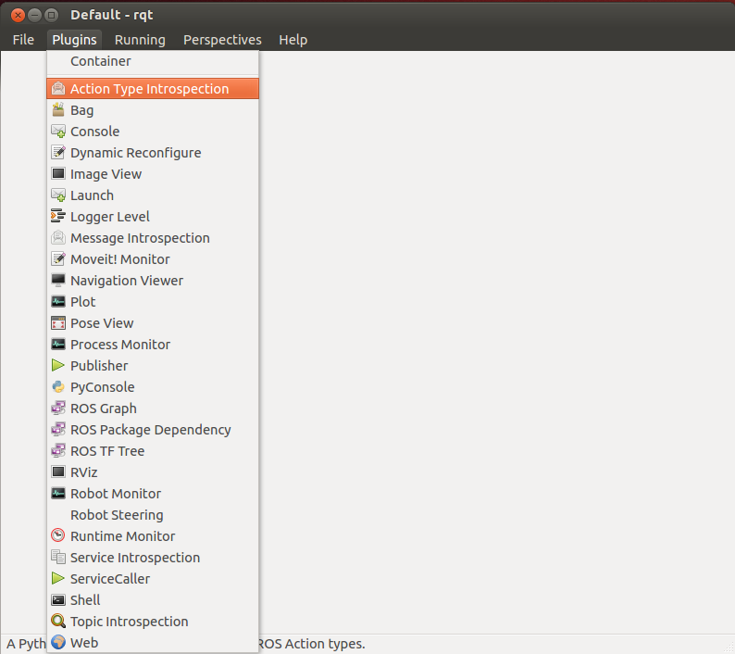
rqt

Slide 35
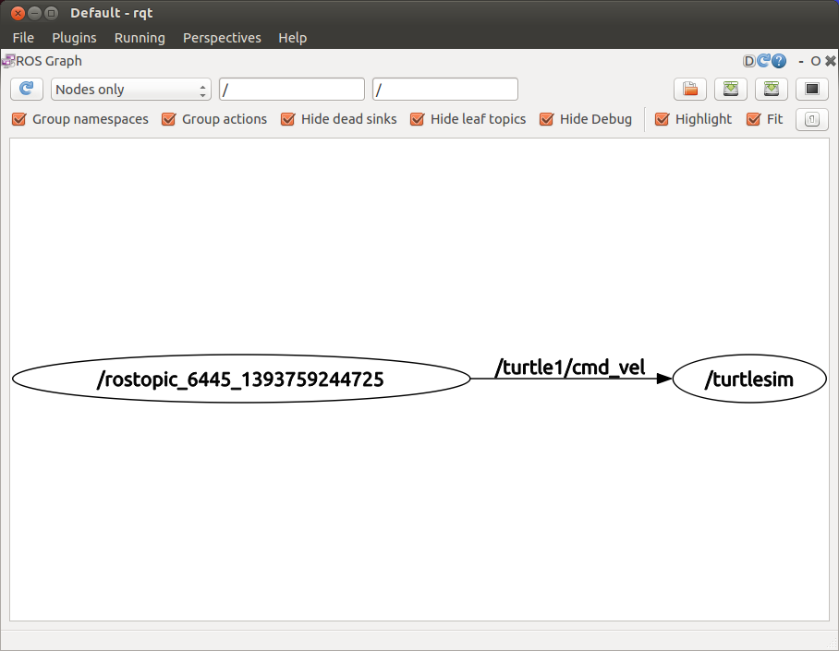
ROS Graph Plugin
Visualizes the ROS computation graph

Slide 36
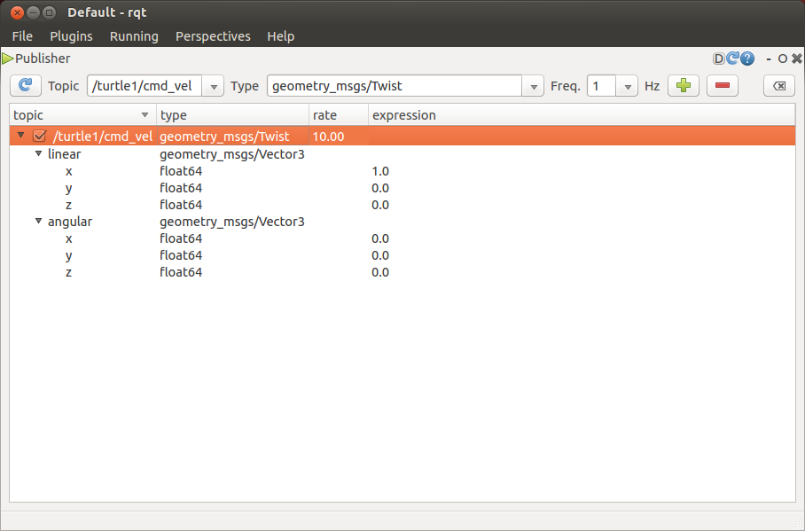
Publisher Plugin
Publishes arbitrary messages (similar functionality to rostopic pub).

Slide 37
Intro to Multi Robot Systems in ROS
Three options to run a multi-robot system in ROS:
Running multiple instances of the same node on the same computer
Running multiple nodes on different computers using one common roscore
Establishing a multi-master network

Slide 38
Homework (not for submission)
Make sure you have a working installation of ROS Hydro
If you are unfamiliar with ROS perform all the Beginner Level tutorials
http://wiki.ros.org/ROS/Tutorials

