Slide 1

Multi-Robot Systems with ROS Lesson 3
Teaching Assistant: Roi Yehoshua
roiyeho@gmail.com

Slide 2
Agenda
Simulating multiple robots in Stage
Creating nodes for multiple robots
Collision avoidance

Slide 3
ROS Stage Simulator
http://wiki.ros.org/simulator_stage
Stage simulates a population of mobile robots, sensors and objects in a 2D bitmapped environment.
Stage is designed to support research of multi-agent autonomous systems, so it provides fairly simple, computationally cheap models of lots of devices rather than attempting to emulate any device with great fidelity.
Multi-Robot Patrolling Task - Simulation in Stage/ROS

Slide 4
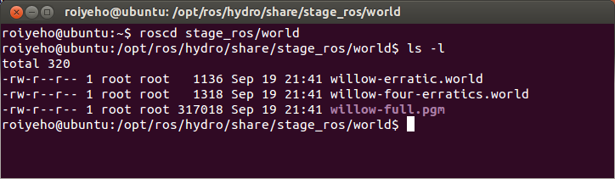
Stage World Files
The world file is a description of the world that Stage must simulate.
It describes robots, sensors, actuators, moveable and immovable objects.
Sample world files can be found at the /world subdirectory in ros_stage package

Slide 5
World File Format
The basic syntactic features of the world file format: entities, properties and comments
The define statement can be used to define new types of entities.
For example: define topurg ranger defines a ranger device named topurg
Entities may be instantiated using the syntax:
topurg(pose [ 0.050 0.000 0 0.000 ])
This entry creates a ranger device with initial position (0.05, 0) and orientation of 0

Slide 6
World File Format
Entities may be nested to indicate that one entity is a child of another
Defines a single position device with a ranger sensor attached to it
define erratic position
(
size [0.35 0.35 0.25]
origin [-0.05 0 0 0]
gui_nose 1
drive "diff"
topurg(pose [ 0.050 0.000 0 0.000 ])
)

Slide 7
willow-erratic.world
define block model
(
size [0.5 0.5 0.5]
gui_nose 0
)
define topurg ranger
(
sensor(
range [ 0.0 30.0 ]
fov 270.25
samples 1081
)
# generic model properties
color "black"
size [ 0.05 0.05 0.1 ]
)
define erratic position
(
#size [0.415 0.392 0.25]
size [0.35 0.35 0.25]
origin [-0.05 0 0 0]
gui_nose 1
drive "diff"
topurg(pose [ 0.050 0.000 0 0.000 ])
)

Slide 8
willow-erratic.world
# set the resolution of the underlying raytrace model in meters
resolution 0.02
interval_sim 100 # simulation timestep in milliseconds
window
(
size [ 745.000 448.000 ]
rotate [ 0.000 -1.560 ]
scale 28.806
)
# load an environment bitmap
floorplan
(
name "willow"
bitmap "willow-full.pgm"
size [54.0 58.7 0.5]
pose [ -29.350 27.000 0 90.000 ]
)
# throw in a robot
erratic( pose [ -11.277 23.266 0 180.000 ] name "era" color "blue")
block( pose [ -13.924 25.020 0 180.000 ] color "red")

Slide 9
Running Stage
To run Stage with a specific world file use the following command:
Browsing the stage window should show up 2 little squares: a red square which is a red box and a blue square which is the erratic robot.
rosrun stage_ros stageros `rospack find stage_ros`/world/willow-erratic.world

Slide 10
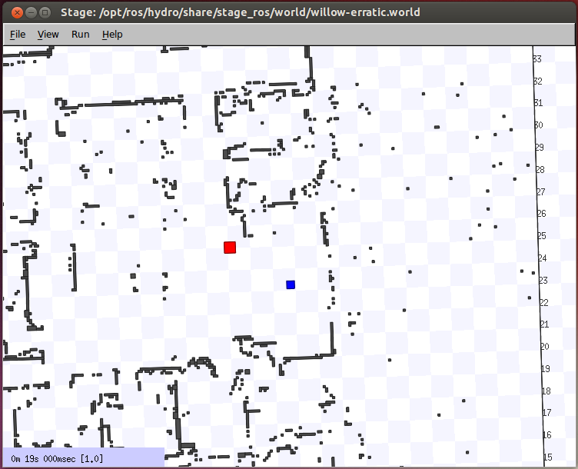
Running Stage

Slide 11
Simulating Multiple Robots in Stage
First, you need to build a model of every robot you need in the world file
For example, let’s add 3 more robots to the previous world file
First we will copy it to the home directory and change its name to willow_multi_erratic.world
Notice that you also need to copy willow-full.pgm
$ cd ~
$ cp /opt/ros/hydro/share/stage_ros/world/willow-erratic.world willow-multi-erratic.world
$ cp /opt/ros/hydro/share/stage_ros/world/willow-full.pgm .

Slide 12
Simulating Multiple Robots in Stage
Now add the following lines at the end of the file willow-multi-erratic.world
Then run again the stage simulator
# robots
erratic( pose [ -11.5 23.5 0 0 ] name "robot0" color "blue")
erratic( pose [ -13.5 23.5 0 0 ] name "robot1" color "red")
erratic( pose [ -11.5 21.5 0 0 ] name "robot2" color "green")
erratic( pose [ -13.5 21.5 0 0 ] name "robot3" color "magenta")
# block( pose [ -13.924 25.020 0 180.000 ] color "red")
rosrun stage_ros stageros willow-multi-erratic.world

Slide 13
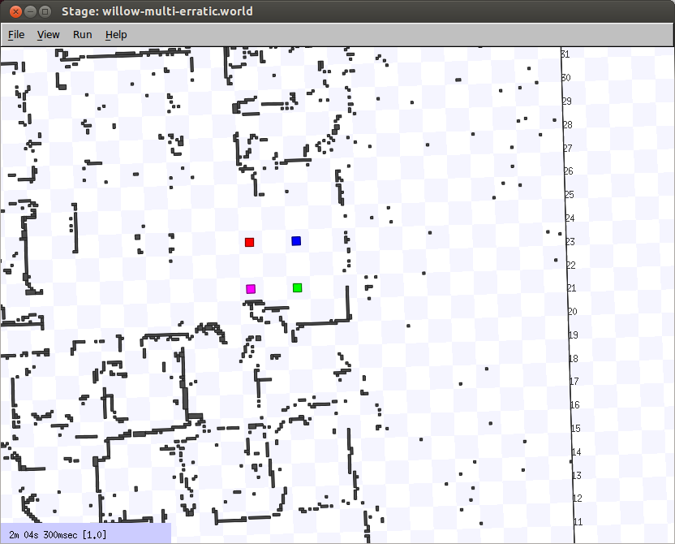
Simulating Multiple Robots in Stage

Slide 14
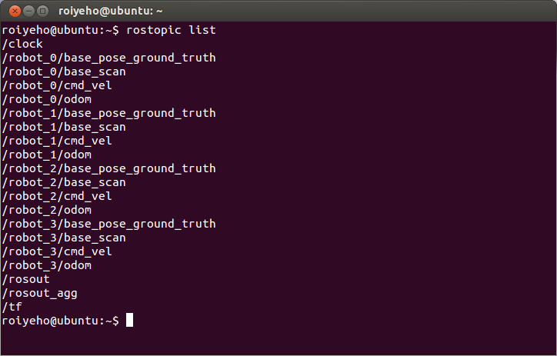
Simulating Multiple Robots in Stage
Each robot subscribes and publishes its own topics

Slide 15
Simulating Multiple Robots in Stage
You can move one of the robots by publishing to /robot_X/cmd_vel topic
For example, to make robot 2 move forward type:
rostopic pub /robot_2/cmd_vel -r 10 geometry_msgs/Twist '{linear: {x: 0.2}}'

Slide 16
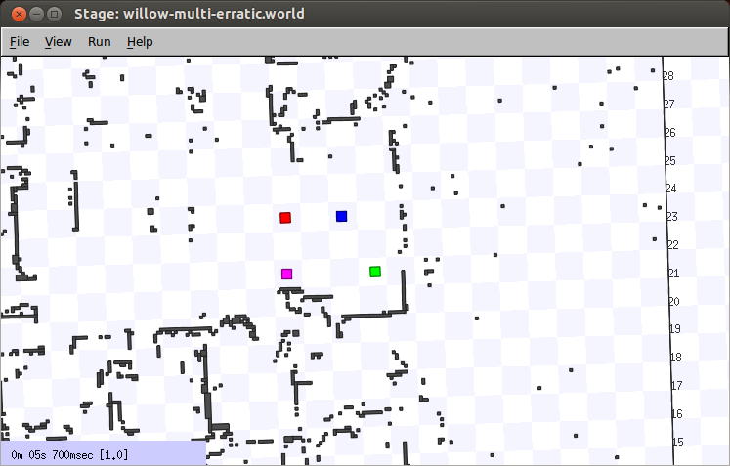
Simulating Multiple Robots in Stage

Slide 17
Creating a ROS Package
Now we will create a ROS node that will make one of the robots move forward
The ID of the robot will be given as a command-line argument to the node

Slide 18
catkin Workspace
Make sure you have a catkin workspace ready
If you don’t have, run the following commands:
And add the following line to your bashrc
$ mkdir catkin_ws catkin_ws/src
$ cd catkin_ws/src $ catkin_init_workspace $ cd .. $ catkin_make
source ~/catkin_ws/devel/setup.bash

Slide 19
Creating a ROS Package
Create a new ROS package called stage_multi
Create a world subdirectory in the package and copy the world files into it
$ cd ~/catkin_ws/src
$ catkin_create_pkg stage_multi std_msgs rospy roscpp
$ mkdir ~/catkin_ws/src/stage_multi/world
$ cp ~/willow-multi-erratic.world ~/catkin_ws/src/stage_multi/world
$ cp ~/willow-full.pgm ~/catkin_ws/src/stage_multi/world

Slide 20
Creating a ROS Package
Now compile the package and create an Eclipse project file for it:
$ cd ~/catkin_ws
$ catkin_make --force-cmake -G"Eclipse CDT4 - Unix Makefiles"

Slide 21
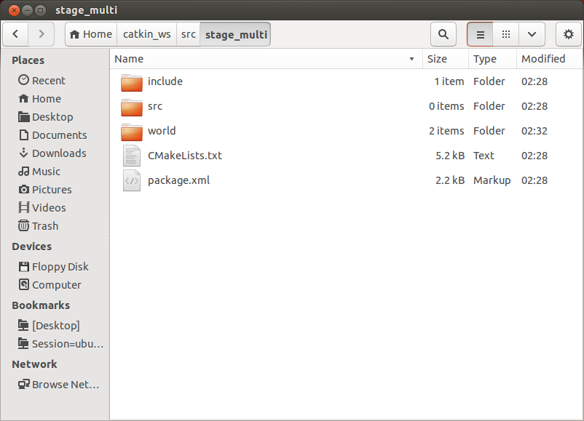
Directory Structure

Slide 22
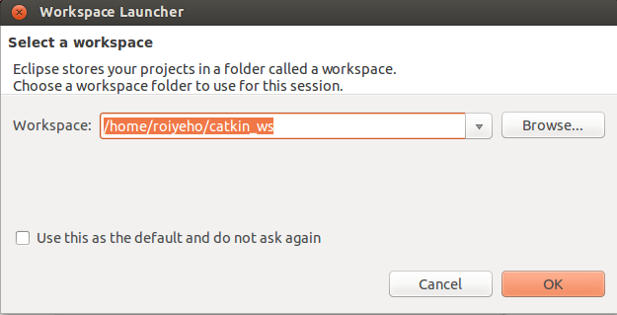
Import the Project into Eclipse
Now start Eclipse
Choose catkin_ws folder as the workspace folder

Slide 23
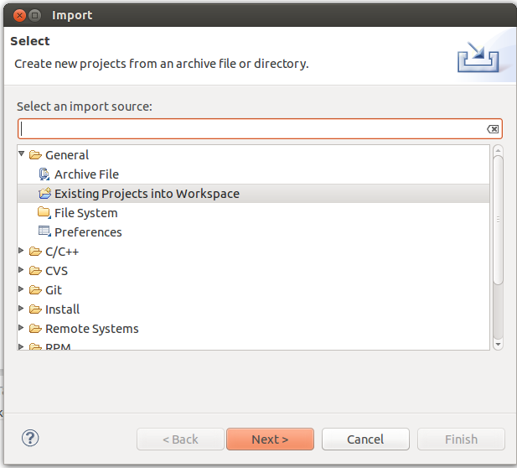
Import the Project into Eclipse
Choose File --> Import --> General --> Existing Projects into Workspace

Slide 24
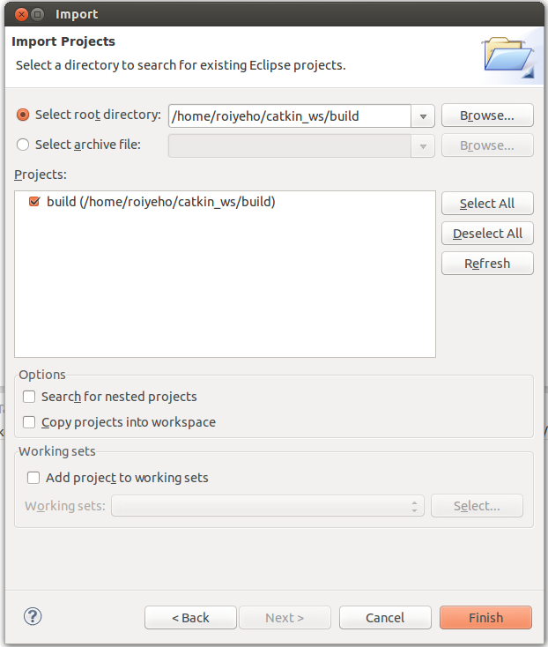
Import the Project into Eclipse
Now choose the ~/catkin_ws/build folder

Slide 25
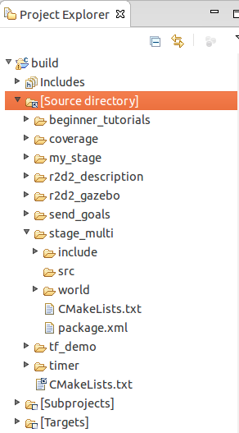
Project Structure
Open the "Source directory" within the project so that you can edit the source code

Slide 26
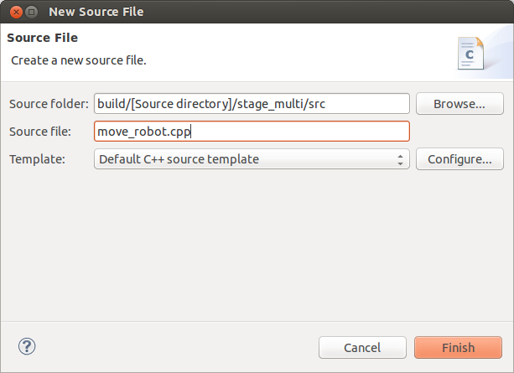
Add New Source File
Right click on src and select New –> Source File, and create a file named move_robot.cpp

Slide 27
ROS Init
A version of ros::init() must be called before using any of the rest of the ROS system
Typical call in the main() function:
Node names must be unique in a running system
We will make the node names unique by concatenating the robot’s number to the end of the node name
For that purpose we will need to supply the robot’s number as a command-line argument
ros::init(argc, argv, "Node name");

Slide 28
move_robot.cpp (1)
#include "ros/ros.h"
#include "geometry_msgs/Twist.h"
#include <string>
using namespace std;
#define MAX_ROBOTS_NUM 20
#define FORWARD_SPEED 0.2
int robot_id;
ros::Publisher cmd_vel_pub; // publisher for movement commands
void move_forward();

Slide 29
move_robot.cpp (2)
int main(int argc, char **argv)
{
if (argc < 2) {
ROS_ERROR("You must specify robot id.");
return -1;
}
char *id = argv[1];
robot_id = atoi(id);
// Check that robot id is between 0 and MAX_ROBOTS_NUM
if (robot_id > MAX_ROBOTS_NUM || robot_id < 0 ) {
ROS_ERROR("The robot's ID must be an integer number between 0 an 19");
return -1;
}
ROS_INFO("moving robot no. %d", robot_id);
// Create a unique node name
string node_name = "move_robot_";
node_name += id;
cout << node_name;
ros::init(argc, argv, node_name);
ros::NodeHandle nh;

Slide 30
move_robot.cpp (3)
// cmd_vel_topic = "robot_X/cmd_vel"
string cmd_vel_topic_name = "robot_";
cmd_vel_topic_name += id;
cmd_vel_topic_name += "/cmd_vel";
cmd_vel_pub = nh.advertise<geometry_msgs::Twist>(cmd_vel_topic_name, 10);
move_forward();
return 0;
}

Slide 31
Twist Message
http://docs.ros.org/api/geometry_msgs/html/msg/Twist.html
This message has a linear component for the (x,y,z) velocities, and an angular component for the angular rate about the (x,y,z) axes.
geometry_msgs/Vector3 linear
float64 x
float64 y
float64 z
geometry_msgs/Vector3 angular
float64 x
float64 y
float64 z

Slide 32
move_forward
void move_forward()
{
// Drive forward at a given speed.
geometry_msgs::Twist cmd_vel;
cmd_vel.linear.x = FORWARD_SPEED;
cmd_vel.angular.z = 0.0;
// Loop at 10Hz, publishing movement commands until we shut down
ros::Rate rate(10);
while (ros::ok()) // Keep spinning loop until user presses Ctrl+C
{
cmd_vel_pub.publish(cmd_vel);
rate.sleep();
}
// Stop the robot
geometry_msgs::Twist stop_cmd_vel;
stop_cmd_vel.linear.x = 0.0;
stop_cmd_vel.angular.z = 0.0;
cmd_vel_pub.publish(stop_cmd_vel);
ROS_INFO("robot no. %d stopped", robot_id);
}

Slide 33
Compiling the Node
Before building your node, you should modify the generated CMakeLists.txt in the package
Change the lines marked in red:
After changing the file call catkin_make
cmake_minimum_required(VERSION 2.8.3)
project(stage_multi)
…
## Declare a cpp executable
add_executable(multi_sync src/SyncRobots.cpp)
## Add cmake target dependencies of the executable/library
## as an example, message headers may need to be generated before nodes
# add_dependencies(stage_multi_node stage_multi_generate_messages_cpp)
## Specify libraries to link a library or executable target against
target_link_libraries(move_robot ${catkin_LIBRARIES})

Slide 34
Running the Node Inside Eclipse
Create a new launch configuration, by clicking on Run --> Run configurations... --> C/C++ Application (double click or click on New).
Select the correct binary on the main tab (use the Browse… button)
~/catkin_ws/devel/lib/stage_multi/move_robot
Make sure roscore and stage are running
Click Run

Slide 35
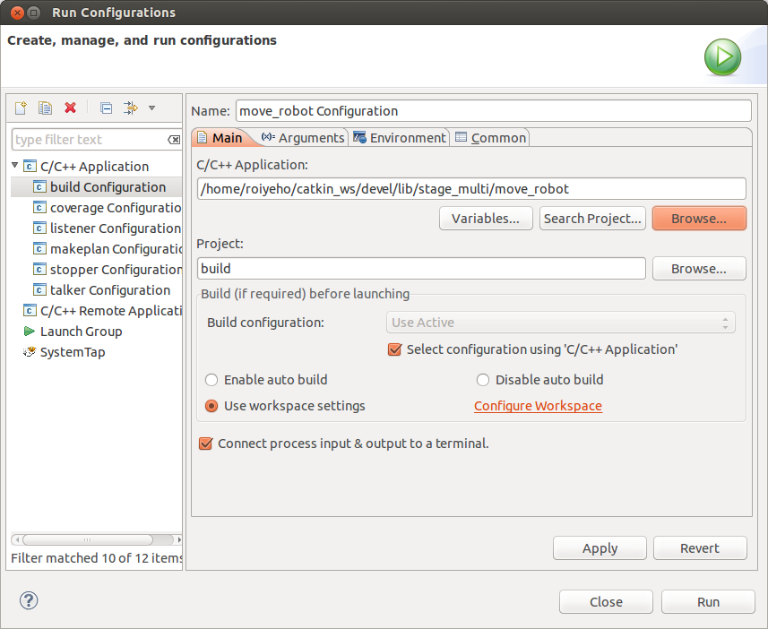
Running the Node Inside Eclipse

Slide 36
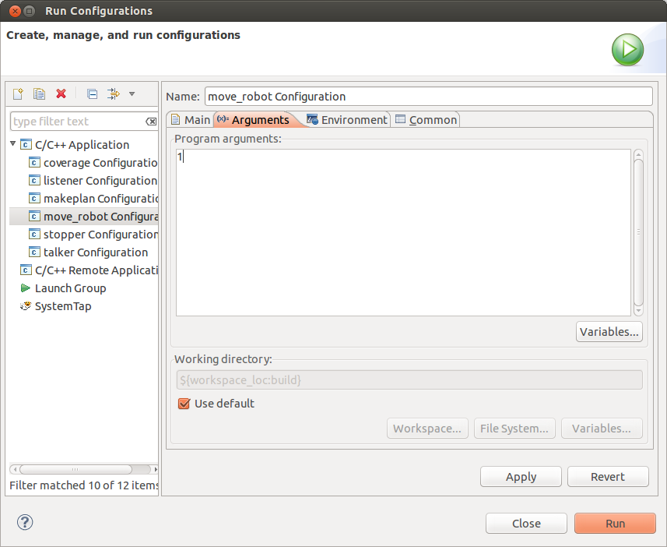
Setting Command Line Arguments

Slide 37
Running the Node Inside Eclipse

Slide 38
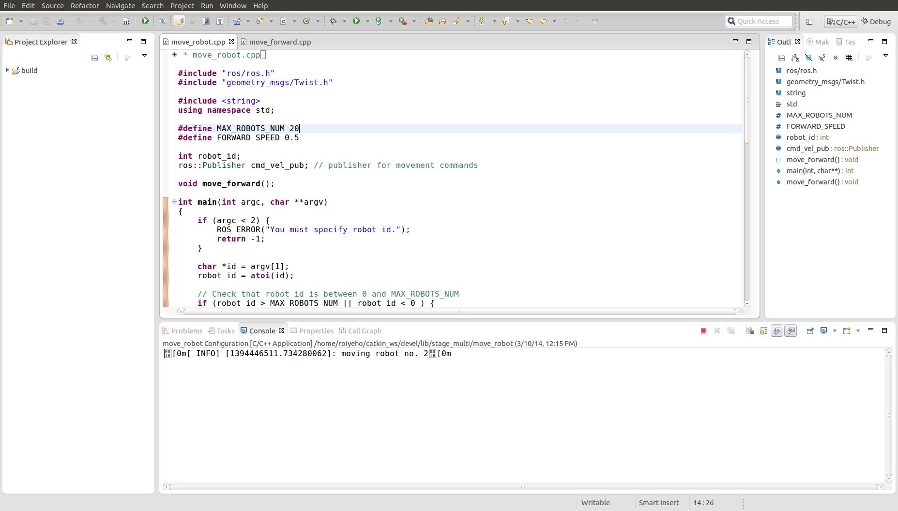
Running the Node Inside Eclipse

Slide 39
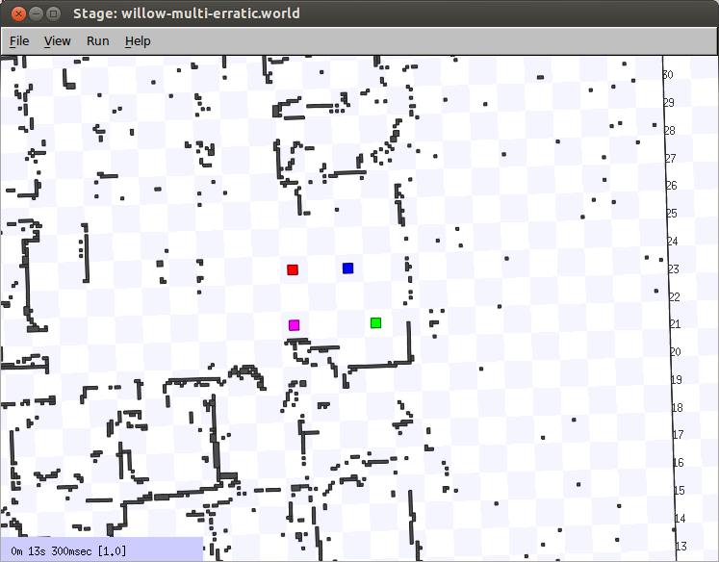
Running the Node Inside Eclipse

Slide 40
Launch File
Now we will create a launch file that will make all the 4 robots move forward
We will use the args attribute in the <node> tag to specify the command line arguments
Create a launch subdirectory in stage_multi package
Add stage_multi.launch file to this directory and copy the following code

Slide 41
Launch File
<launch>
<node name="stage" pkg="stage_ros" type="stageros" args="$(find stage_multi)/world/willow-multi-erratic.world"/>
<node name="move_robot_0" pkg="stage_multi" type="move_robot" args="0" output="screen"/>
<node name="move_robot_1" pkg="stage_multi" type="move_robot" args="1" output="screen"/>
<node name="move_robot_2" pkg="stage_multi" type="move_robot" args="2" output="screen"/>
<node name="move_robot_3" pkg="stage_multi" type="move_robot" args="3" output="screen"/>
</launch>
Note that the node names must be unique

Slide 42
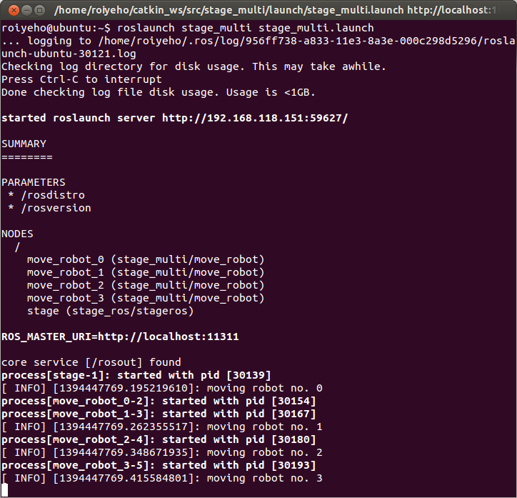
Launch File
Run the launch file using the following command:
roslaunch stage_multi stage_multi.launch

Slide 43
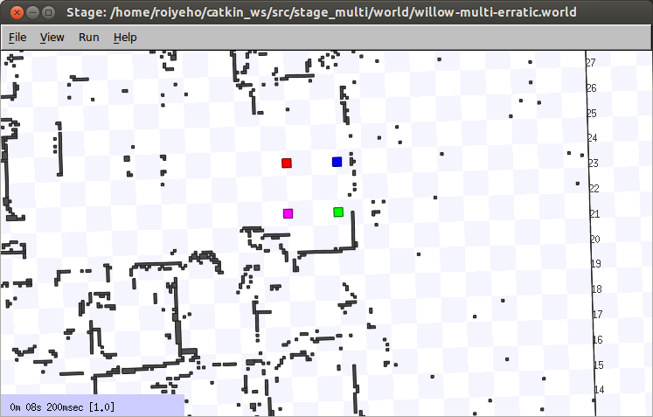
Launch File

Slide 44
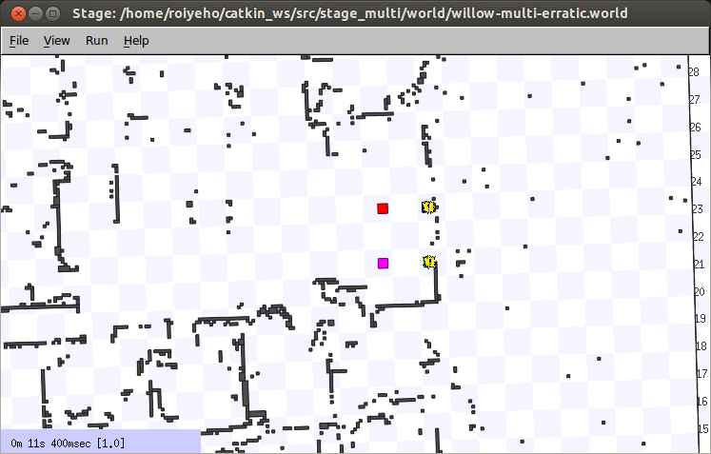
Launch File
The robots will eventually bump into the obstacles:

Slide 45
Reading Sensors
Now we will make the robots move until they sense an obstacle
Will they be able to sense each other as obstacles?
For that purpose we will use the laser data published on the topic /base_scan
The message type used to send information of the laser is sensor_msgs/LaserScan

Slide 46
move_robot.cpp (1)
#include "ros/ros.h"
#include "geometry_msgs/Twist.h"
#include "sensor_msgs/LaserScan.h"
#include <string>
using namespace std;
#define MAX_ROBOTS_NUM 20
#define FORWARD_SPEED 0.2
#define MIN_SCAN_ANGLE -60.0/180*M_PI
#define MAX_SCAN_ANGLE +60.0/180*M_PI
#define MIN_PROXIMITY_RANGE 0.5
int robot_id;
ros::Publisher cmd_vel_pub; // publisher for movement commands
ros::Subscriber laser_scan_sub; // subscriber to the robot's laser scan topic
bool keepMoving = true;
void move_forward();
void scanCallback(const sensor_msgs::LaserScan::ConstPtr& scan);

Slide 47
move_robot.cpp (2)
int main(int argc, char **argv)
{
if (argc < 2) {
ROS_ERROR("You must specify robot id.");
return -1;
}
char *id = argv[1];
robot_id = atoi(id);
...
// subscribe to robot's laser scan topic "robot_X/base_scan"
string laser_scan_topic_name = "robot_";
laser_scan_topic_name += id;
laser_scan_topic_name += "/base_scan";
laser_scan_sub = nh.subscribe(laser_scan_topic_name, 1, &scanCallback);
move_forward();
return 0;
}

Slide 48
move_robot.cpp (2)
void move_forward()
{
// Drive forward at a given speed.
geometry_msgs::Twist cmd_vel;
cmd_vel.linear.x = FORWARD_SPEED;
cmd_vel.angular.z = 0.0;
// Loop at 10Hz, publishing movement commands until we shut down
ros::Rate rate(10);
while (ros::ok() && keepMoving) // Keep spinning loop until user presses Ctrl+C
{
cmd_vel_pub.publish(cmd_vel);
ros::spinOnce(); // Need to call this function often to allow ROS to process incoming messages
rate.sleep();
}
...
}

Slide 49
scanCallback
// Process the incoming laser scan message
void scanCallback(const sensor_msgs::LaserScan::ConstPtr& scan)
{
// Find the closest range between the defined minimum and maximum angles
int minIndex = ceil((MIN_SCAN_ANGLE - scan->angle_min) / scan->angle_increment);
int maxIndex = floor((MAX_SCAN_ANGLE - scan->angle_min) / scan->angle_increment);
float closestRange = scan->ranges[minIndex];
for (int currIndex = minIndex + 1; currIndex <= maxIndex; currIndex++) {
if (scan->ranges[currIndex] < closestRange) {
closestRange = scan->ranges[currIndex];
}
}
//ROS_INFO_STREAM("Closest range: " << closestRange);
if (closestRange < MIN_PROXIMITY_RANGE) {
keepMoving = false;
}
}

Slide 50
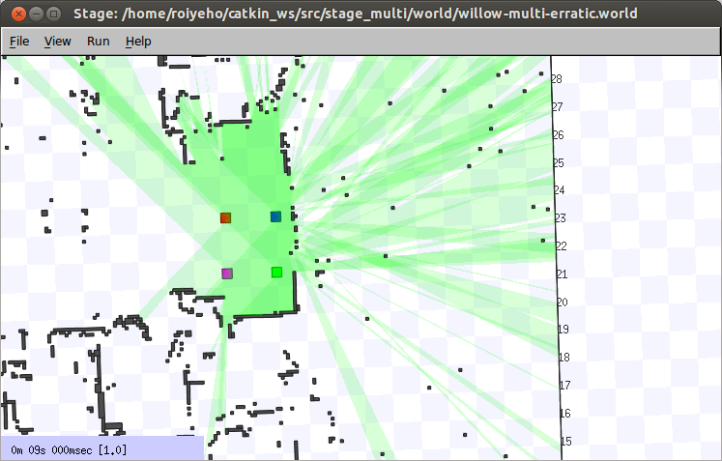
Reading Sensors

Slide 51
Collision Avoidance
All models in Stage (including lasers and robot bases) have heights
A sensor will only "see" other models at the same height
In Stage .world examples, the robots have lasers mounted on their tops in such a way that a robot's laser only sees other robots' lasers, not their bases
This is the correct result for such a robot configuration, since in the real world, the laser planes don't intersect the robot bases.
If you want to simulate a different (perhaps less realistic) kind of robot, you can adjust the laser heights

Slide 52
Collision Avoidance
define erratic position
(
#size [0.415 0.392 0.25]
size [0.35 0.35 0.25]
origin [-0.05 0 0 0]
gui_nose 1
drive "diff"
topurg(pose [ 0.050 0.000 -0.1 0.000 ])
)

Slide 53
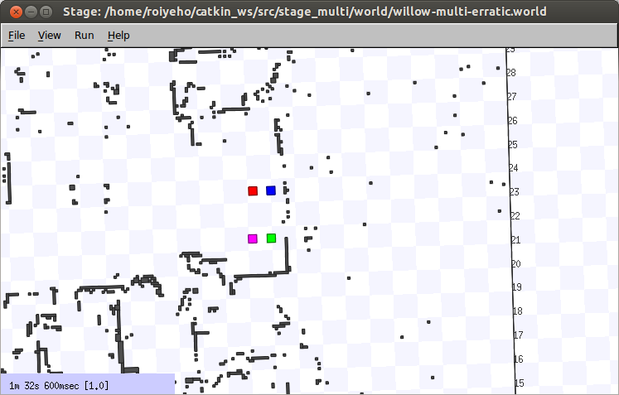
Collision Avoidance

Slide 54
Collision Avoidance
A more difficult problem related to collision avoidance is that when two lasers see each other directly, they often get "dazzled", and the data are discarded.
Laser-based obstacle avoidance among a group of homogeneous robots is difficult
Can you think of a solution to this problem?

Slide 55
Homework (not for submission)
Make the robots synchronize the beginning of their movement (i.e., each robot should wait until all the other robots are ready to start moving)

