Slide 1
CPTs 483 ROS Tutorial
Computation Graph

Slide 2
Review Graph Concept
Nodes
  Executables used by ROS to communicate with other nodes i.e. C++ programs
  {link ROS_Tutorial_IntroGraph_concept.odp /s31}
Messages
  ROS data type, published / subscribed to a topic
  {link ROS_Tutorial_IntroGraph_concept.odp/s37}
Topics
  One-way transport Nodes can publish messages and subscribe to get messages
  {link ROS_Tutorial_IntroGraph_concept.odp/s38 }
Service
  A Node service provider can publish Messages to ROS Master, Other Nodes can request the service from ROS Master
  Services are pair of struct {reply, request}
  {link ROS_Tutorial_IntroGraph_concept.odp/s42}
Master
  Links Everything in ROS helps nodes find each other. Akin to Internet DNS
  {link ROS_Tutorial_IntroGraph_concept.odp/s32 }

Slide 3
More Graph Concepts
rosout – similar to stdout / stderr (standard output )
Roscore – Master + rosout + parameter server (rosparam)
  ROS Master must be started before any other node.

Slide 4
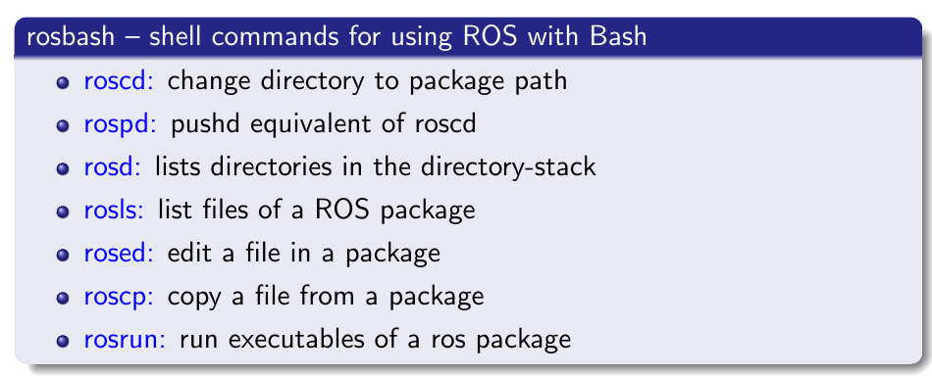
Navigating ROS File System
Filesystem tools –
  Eliminates need to use standard bash commands such as cd and ls to navigate package directories.

Slide 5
Navigating ROS File System
Using rospack
get information about packages
possible to:
  list packages currently available
  find the path of packages
  lists dependencies of packages
  and more. . .
e.g. $ rospack find turtlesim
  /opt/ros/hydro/share/turtlesim

Slide 6
roscd
Usage: roscd [package name[/subdir]]
Change to package directory
Packages must be within directories listed in ROS PACKAGE PATH
Executing roscd without specifying a package changes directory to ROS WORKSPACE (if set)

Slide 7

rosls
Usage: rosls [package name[/subdir]]
allow listing the contents of a package by name rather than by absolute path
packages must be within directories listed in ROS PACKAGE PATH

Slide 8
Understanding Nodes
rosnode
  A command line tool for printing information about ROS Nodes currently running
rosnode list
  Lists the active Nodes
rosnode info /<node name>
e.g.
$ roscore
$ rosnode list – will display a node /rosout
$ rosnode info /rosout
  Prints information about node /rosout

Slide 9
Brining up a Node
Rosrun
  Allows the use of package name to directly run a node (executable program) within the package
  Usage : rosrun [package_name] [node_name]
  e.g. $ rosrun turtlesim turtlesim_node
faustino@kubuntu:~$ rosrun turtlesim turtlesim_node
[ INFO] [1401570010.868917634]: Starting turtlesim with node name /turtlesim
[ INFO] [1401570010.885764196]: Spawning turtle [turtle1] at x=[5.544445], y=[5.544445], theta=[0.000000]

Slide 10
Activity 1: Nodes hands on
Open a terminal and run roscore
$ roscore
$ rosrun turtlesim turtlesim_node
Analyzing nodes currently running
Open a new terminal or a tab
$ rosnode list
$ rosnode info /turtlesim
$ rosnode pint /turtlesim
$ rosrun turtlesim turtlesim_teleop_keyo

Slide 11
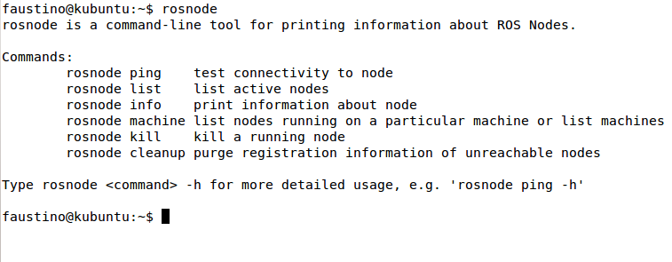
rosnode

Slide 12
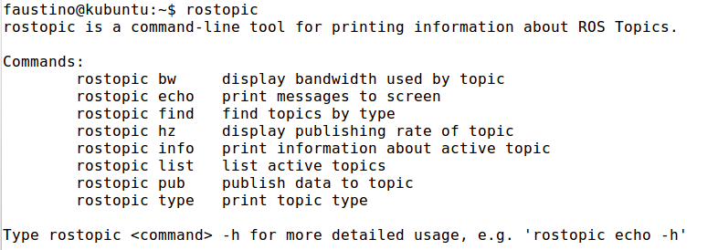
Understanding Topics

Slide 13
Activity 2 Topics Hands on
$ roscore - If not running
$ rosrun turtlesim turtlesim_node
$ rosrun turtlesim turtle_teleop_key
Getting information about topics:
$ rostopic list
$ rostopic

Slide 14
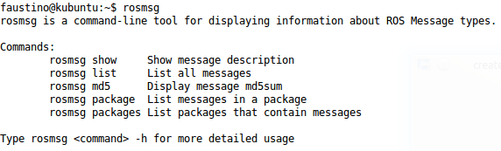
rosmsg
Command line tool for displaying information about ros message type

Slide 15
Activity 3 rosmsg
Hands on
$ roscore – if not running
$ rosrun turtlesim turtlesim_node

