Slide 1
CPTs 483 Intro to Robotics
Simplified ROS Tutorials
By: Faustino

Slide 2
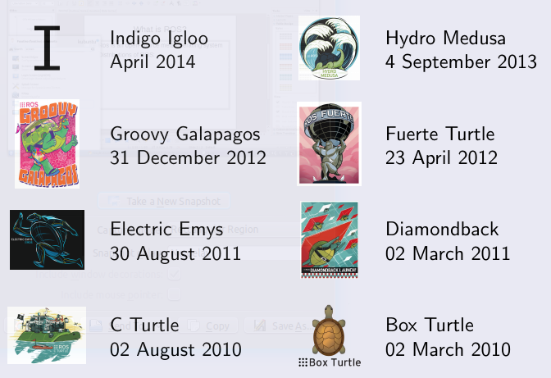
What is ROS?
Ros is an open-source meta operating system
Distributions of ROS:

Slide 3
Key Features
Hardware abstraction and low level control
Message passing between process
  OS independent:
    Ubuntu Linux (Native support)
    Windows, Mac OSX (Experimental)
Programming language independence
    C++
    Python 2 (Hydro) & Python 3 (Indigo)
Implementation of wide range of commonly used algorithm

Slide 4
Key Features
Standardized package management
  Catkin (Standard recommended)
  Rosbuild (retired / Not used in hydro or indigo)
Useful set of shell commends and utilities
Tab Completition!!!

Slide 5
Inherently Distributed
ROS is structured as a peer-to-peer network of processes called Nodes
Loosely coupled at runtime
Can share messages at runtime using:
  Synchronous RPC communication
    ROS Services
  Asynchronous data streaming communication
    ROS Topics
Store Data
    ROS parameter server

Slide 6
Client Libraries
Main supported Client Libraries
  Python 2 & 3
  C++
  Lisp
Experimental
  Java (Supports android)
  Lua
  R

Slide 7
Sensors IO
1D / 2D / and 3D range finders
  e.g. Microsoft Kinect
Cameras
  Mono and Stereo
  USB and Firewire
  Streaming video (gstreamer)
Force / Torque / and Touch
Motion Capture

Slide 8
Sensors IO
Pose estimation (gps and IMU)
Audio and speech recognition
RFID
Sensor and Actuator interface
  e.g. Arduino, Lego NXT
And more

Slide 9
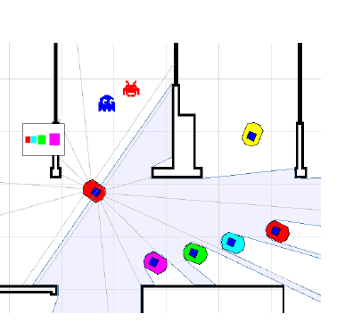
Simulators
Stage:
  Stage is an Open-Source 2D simulator for multiple (large scale) mobile robots
  Models:
    sensors (e.g. Laser, Sonar …)
    Actuators (e.g. gripper)
    Simple objects for manipulation
    No physics model

Slide 10
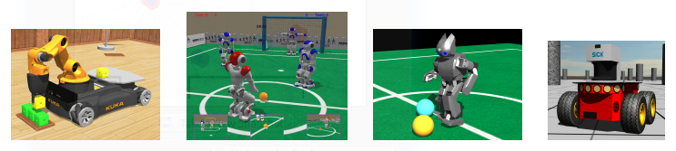
Simulators
Webots:
  Webots is a development environment used to program and simulate robots
  Advantages:
    Complex and realistic 3D simulation of physics / dynamics
    Vast Collection of robots, sensors, and models
    Vast Library of indoor and outdoor objects
  Disadvantage:
    Cross-platform, but propitiatory (and very expensive)

Slide 11
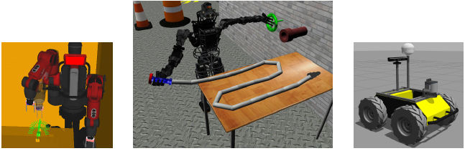
Simulators
Gazebo:
  Gazebo is a 3D robot simulator in realistic environment
  Advantages:
    Realistic simulation of
      Rigid body physics / dynamics (ODE / Bullet)
    Models for complex robots, actuators and sensors
    Official simulator of DARPA Robotics Challenge
    Open-Source and free to the public!!

Slide 12
ROS Installation
Ubuntu (Recommended):
  Follow the ROS hydro installation in the ROS wiki
  http://wiki.ros.org/hydro/Installation/Ubuntu
Windows Users (Virtual Machine)
  Download ROS Hydro Medusa Virtualbox ova image
  http://nootrix.com/2014/04/virtualized-ros-hydro/

Slide 13
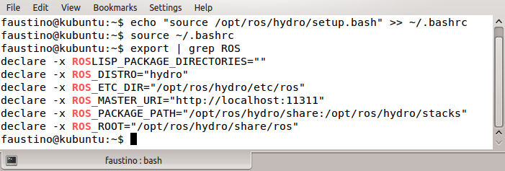
Environment Setup
From fresh install of Hydro
Open Terminal
Notes:
Add the command within double quotes to the end of the ∼/.bashrc file
Source (reload) the settings in ∼/.bashrc in the current terminal
Output environment variables containing “ROS” to terminal

Slide 14
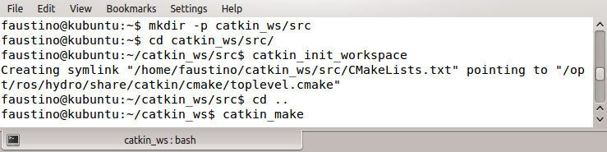
Environment Setup
Create a new directory e.g. mkdir workspacename/src
Navigate to /src directory of your workspace
  /src is the directory for all your packages i.e. ROS Package Path
Create a link to point to /src directory i.e. catkin_init_workspace
Finally build the workspace
Note!
This is only done once per workspace. You can have multiple workspace but can only source
One workspace at a time.
Notes:
Create cascaded directories catkin_ws/ and src/ within user home
folder
Change directory to ∼/catkin_ws/src/
initialize catkin workspace
Change directory to ∼/catkin_ws/
Build catkin workspace (i.e., the ROS packages within src/ folder)

Slide 15
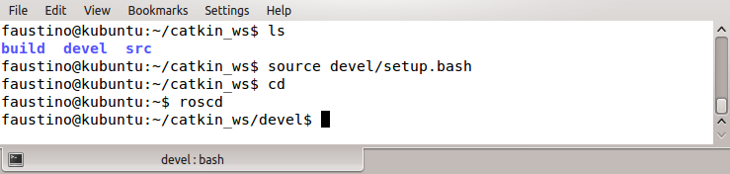
Environment Setup
Once you have build your catkin space you can begin using this workspace but first
  Source your devel folder this allows the terminal to point to your ROS workspace directory when running $ roscd

Slide 16
ROS Filesystem
ROS Packages
  Lowest level of ROS software organization
  Single functionality
  (e.g. acquisition and publication of laser data messages)
  Only one package per folder per workspace
Types of packages:
  Rosbuild packages (also known as dry packages)
  Catkin Packages (recommended aka wet packages)

Slide 17
Rosbuild Packages (dry! deprecated)
Maifest.xml:
  Information about the package
  e.g. Author, License etc.
  Defines the dependencies on other packages
Makefile:
  Make build specifications
CMakeLists.txt:
  CMake build specifications

Slide 18
Catkin Packages (wet)
Package.xml:
  Information about the package
  e.g. Author, License etc.
CMakeLists.txt:
  Contains CMake build specifications
  Uses catkin macros
Note!!! Catkin packages cannot depend on Rosbuild packages

Slide 19
Stacks – rosbuild (deprecated!)
Group packages to provide a more abstract functionality
Packages within stack folder are consider part of the stack
Stack.xml:
  Metadata and declared dependencies on other stacks

Slide 20
Metapackages – catkin (recommended)
Grouping packages as a single logical package
package.xml:
  Includes meta data
  Can only have dependencies on packages grouped by the metapackage
  Other packages which are not in the metapackage can not depend on the meta package

Slide 21
A typical rosbuild package
my_pkg/
  CmakeLists.txt
    CMake build settings for my_pkg
  manifest.xml
    Metadata and dependencies
  mainpage.dox
    Doc info of package my_pkg
  Include/my_pkg:
    C++ header files
  Src/:
    source code directory

Slide 22
A typical rosbuild package
my_pkg/
  Bin/:
    Compiled binary files
  Launch/:
    Where launch files is store
  Msg/:
    Message (.msg) types
  Srv/:
    Service (.srv) types
  Scripts/:
    Executable scripts

Slide 23
A typical catkin package
my_pkg/
  CmakeLists.txt
    CMake build settings for my_pkg
  manifest.xml
    Metadata and dependencies required by my_pkg/
  mainpage.dox
    Doxygen info of package my_pkg
  Include/my_pkg:
    C++ header files
  Src/:
    source code directory

Slide 24
A typical rosbuild package
my_pkg/
  Launch/:
    Where launch files is store
  Msg/:
    Message (.msg) types
  Srv/:
    Service (.srv) types
  Scripts/:
    Executable (python) scripts

Slide 25
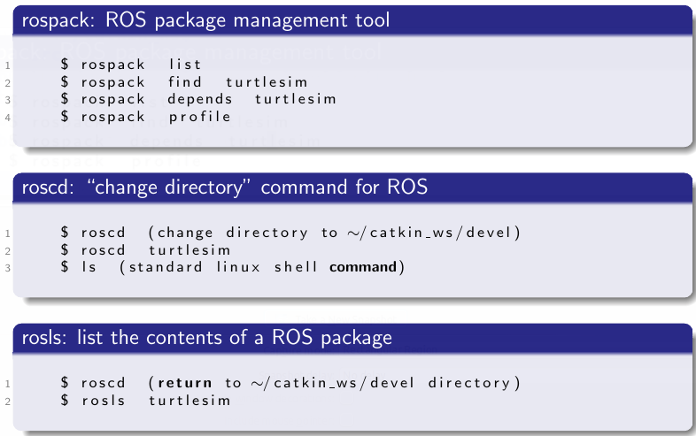
Rosbash – Ros command line tools

Slide 26
Creating catkin packages
Overview:
rosed:
  quickly see/edit a file of a given package
  rosed is part of the rosbash suite.
$ echo $EDITOR (default is vi, if blank)
$ export EDITOR=gedit
$ rosed <pkg name> <file name>
e.g. $ rosed turtlesim package.xml

Slide 27
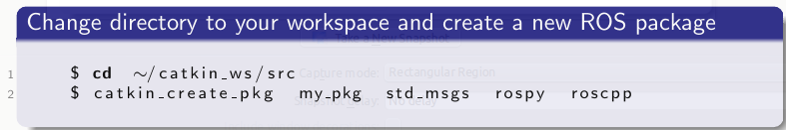
Creating catkin packages
Format:
Catkin_creak_pkg <package name> <depends 1> <depends 2> ......

Slide 28
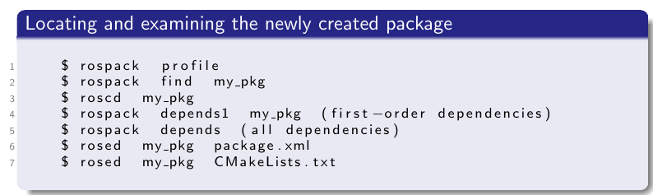
Examining new my_pkg
$ rospack profile : displays all the directories that contain packages
  Read more: http://wiki.ros.org/rospack

Slide 29
Building ROS packages
Before you can user your new packages you must first build your package
Change directorys to catkin workspace directory
$ cd ~/catkin_ws
Then:
$ catkin_make

Slide 30
ROS Structure - Nodes
Process which perform specific computation
e.g.
  Control robot wheel motors / servos etc.
  Obtain data from sensor i.e. laser sensor, vision etc.
  Acquire image and sound i.e. from camera / microphone
  Perform localization (later topic) / compute path planning
  Graphical representation of the overall system

Slide 31
Nodes
Exchange Data via Ros messages
Can run multiple Nodes via Nodelets
Advantages to Nodelets (multiple Nodes):
Provide a way to run multiple nodes (algorithms) on:
  Single machine
  Single process
  Reduce cost interprocess message passing
Master is the core / main node for ROS, called roscore!

Slide 32
Master (roscore)
Akin to Internet DNS (domain name server)
Core node of ROS
Provides name registration and lookup to the rest of the computation computation graph(the visual representation of the system)
Every node registers with Master upon startup / at runtime
  Fetch registration information (subscribe or publish to a given topic)
  Establish direct connections as appropriate
  Make callbacks to nodes when registration information changes (i.e. Event handler)
  Allows nodes to dynamically create connections as necessary (i.e. new nodes are run)

Slide 33
Parameter Server
Akin to dictionary in c# or python
Shared
Accessible via network APIs
Belongs to ROS Master
Storage space for parameters
Accessed by Nodes at runtime
Not designed for high performance / Better suited for configuration parameters (arguments / data passed to functions)
Follows ROS naming (namespaces) convention to Avoid conflicts

Slide 34
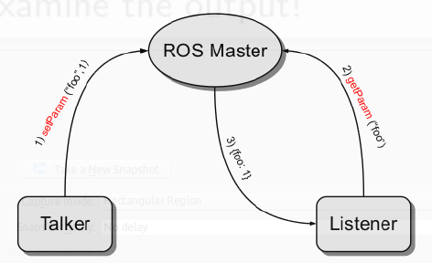
Parameter Server

Slide 35
Parameter Server Example:
Commands : list and get
Open a terminal window and run:
$ roscore
In a new terminal windows / tab
List parameters
$ rosparam list
Get distribution / version
$ rosparam get /rosdistro

Slide 36
ROS Messages
A data structure which consists of typed fields
Data types Supported:
Primitive types:
  Int{8, 16, 32, 64} i.e. short uint int long unsigned long
  Float {32, 64}
  String
  Time
  Duration (seconds)
  Array [ ]

Slide 37
ROS Messages
Nodes communicate by exchanging Messages
Messages are routed via transport system with publish / subscribe semantics
Non-blocking when used with topic *.msg (n:n)
  You can have as many ROS topics publishing and subscribing
Blocking when used with service *.serv (1:1 request + respond)
  Services must only provide and request the same type

Slide 38
ROS Topics
Nodes send messages by publishing it to a given ROS Topic
Topic type must match the message type
  Defined by the message type published to it
If a Node needs a certain type of data it must subscribe to the appropriate Topic
Multiple Nodes can publish and subscribe to the same topic
A single Node may publish / subscribe to multiple Topics
Publishers and Subscribers are unaware of each other's existence WHY?
Publish / Subscribe model flexible paradigm i.e. many-to-many one way transport
There is no order of execution

Slide 39
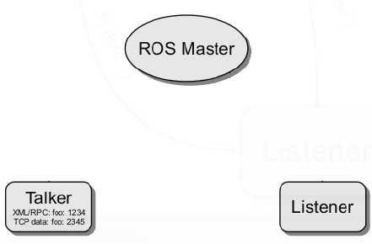
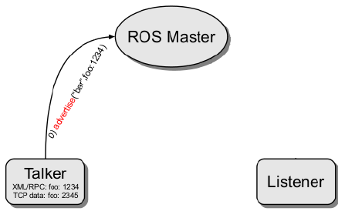
ROS Topic Diagram
Publish over
topic
Two Nodes Talker and Listener
Talker publishes/ Advertises to ROS Master
e.g. advertise(“bar”, “foo”, 123)

Slide 40
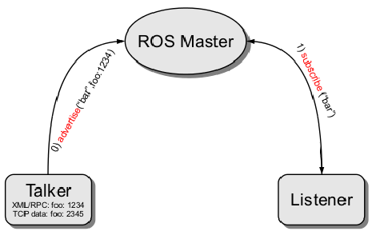
ROS Topics Diagram
Listener subscribes to a
Topic to retrieve data publish to said Topic

Slide 41
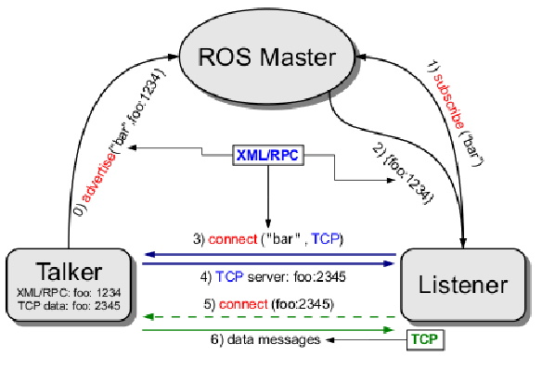
ROS Topics Diagram
Inorder for Nodes to connect to other Nodes they must subscribe or publish over
Topics.
Topics data type depend on the type of message that is being
A Node can subscribe / publish to multiple topics

Slide 42
ROS Services
ROS services implement the request / reply functionality
Pair of message struct : {reply, request}
Node provider (Server) offer service under specific names
A client node uses the service by sending the request message and awaits a reply
e.g. Remote procedure call

Slide 43
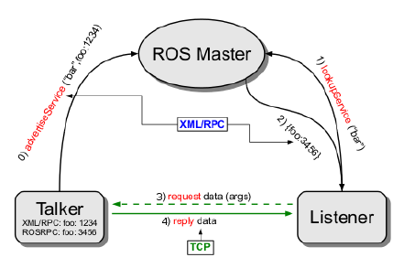
ROS Services Diagram
The Listener Node request service from ROS Master
Talker Node publishes service to ROS master

Slide 44

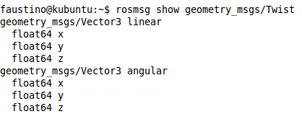
ROS Messages Commands
$ rosmsg list : lists the current messages
$ rosmsg show <message name>/Type : Show the contents of message i.e. Message type :
e.g.
$ rosmsg show geometry_msgs/Vector3
$ rosmsg show geometry_msgs/Twist
Twist is a ROS message for motor
Control. It has two components a
Linear and angular velocity.
Note!
Twist accepts a Vector3 Message
For linear and angular velocity

Slide 45
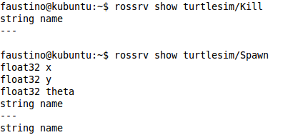
ROS Services Commands
To View details of ROS services
$ rossrv list : lists all available services
$ rossrv show <Node_name>/<service name or double tab to list all avaialble>
e.g.
As you can see the service offered by the turtlesim Node in the example above tells us what
Data type to expect from this service. This is important when you want to request a service
But unsure about the data type.

Slide 46
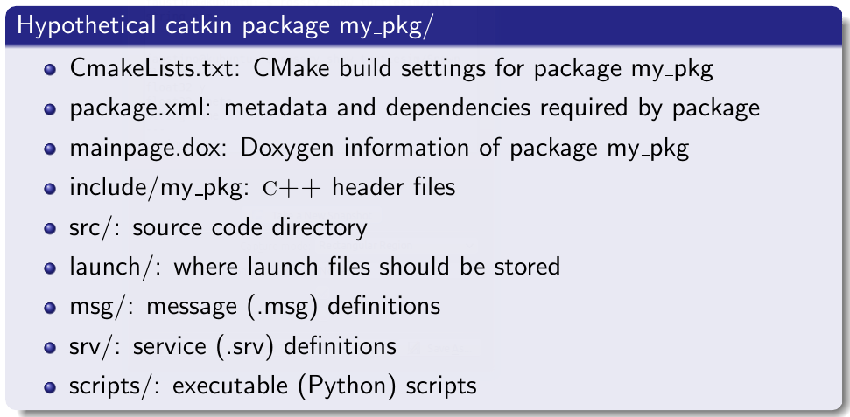
Recall: ROS file system
Catkin package structure

