Slide 1

ROS - Lesson 3
Teaching Assistant: Roi Yehoshua
roiyeho@gmail.com

Slide 2
Agenda
Writing a subscriber node
Stage simulator
Writing a simple walker
Reading sensor data
roslaunch
Your first assignment
<number>

Slide 3
Subscribing to a Topic
To start listening to a topic, call the method subscribe() of the node handle
This returns a Subscriber object that you must hold on to until you want to unsubscribe.
Example for creating a subscriber:
First parameter is the topic name
Second parameter is the queue size
Third parameter is the function to handle the mssage
ros::Subscriber sub = node.subscribe("chatter", 1000, messageCallback);
<number>

Slide 4
C++ Subscriber Node Example
#include "ros/ros.h"
#include "std_msgs/String.h"
// Topic messages callback
void chatterCallback(const std_msgs::String::ConstPtr& msg)
{
ROS_INFO("I heard: [%s]", msg->data.c_str());
}
int main(int argc, char **argv)
{
// Initiate a new ROS node named "listener"
ros::init(argc, argv, "listener");
ros::NodeHandle node;
// Subscribe to a given topic
ros::Subscriber sub = node.subscribe("chatter", 1000, chatterCallback);
// Enter a loop, pumping callbacks
ros::spin();
return 0;
}
(C)2013 Roi Yehoshua
<number>

Slide 5
ros::spin()
The ros::spin() creates a loop where the node starts to read the topic, and when a message arrives messageCallback is called.
ros::spin() will exit once ros::ok() returns false
For example, when the user presses Ctrl+C or when ros::shutdown() is called
<number>

Slide 6
Using Class Methods as Callbacks
Suppose you have a simple class, Listener:
Then the NodeHandle::subscribe() call using the class method looks like this:
class Listener
{
public: void callback(const std_msgs::String::ConstPtr& msg);
};
Listener listener;
ros::Subscriber sub = node.subscribe("chatter", 1000, &Listener::callback, &listener);
<number>

Slide 7
Editing the CMakeLists.txt File
Add the subscriber node’s executable to the end of the CMakeLists.txt file
cmake_minimum_required(VERSION 2.8.3)
project(beginner_tutorials)
…
## Declare a cpp executable
add_executable(talker src/talker.cpp)
add_executable(listener src/listener.cpp)
## Specify libraries to link a library or executable target against
target_link_libraries(talker ${catkin_LIBRARIES})
target_link_libraries(listener ${catkin_LIBRARIES})
<number>

Slide 8
Building the Nodes
Now build the package and compile all the nodes using the catkin_make tool:
This will create two executables, talker and listener, at ~/catkin_ws/devel/lib/<package>
cd ~/catkin_ws
catkin_make
<number>

Slide 9
Running the Nodes Inside Eclipse
Create a new launch configuration, by clicking on Run --> Run configurations... --> C/C++ Application (double click or click on New).
Select the listener binary on the main tab (use the Browse… button)
~/catkin_ws/devel/lib/beginner_tutorials/listener
Make sure roscore is running in a terminal
Click Run
(C)2013 Roi Yehoshua
<number>

Slide 10
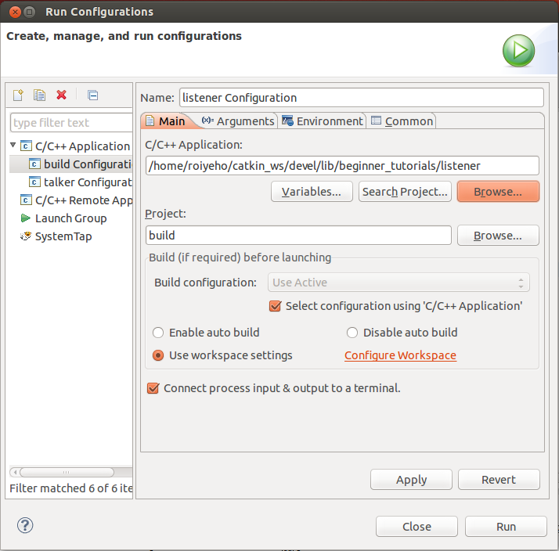
Running the Nodes Inside Eclipse
(C)2013 Roi Yehoshua
<number>

Slide 11
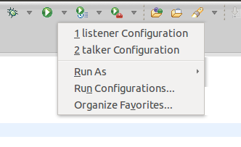
Running the Nodes Inside Eclipse
Now run the talker node by choosing the talker configuration from the Run menu
(C)2013 Roi Yehoshua
<number>

Slide 12
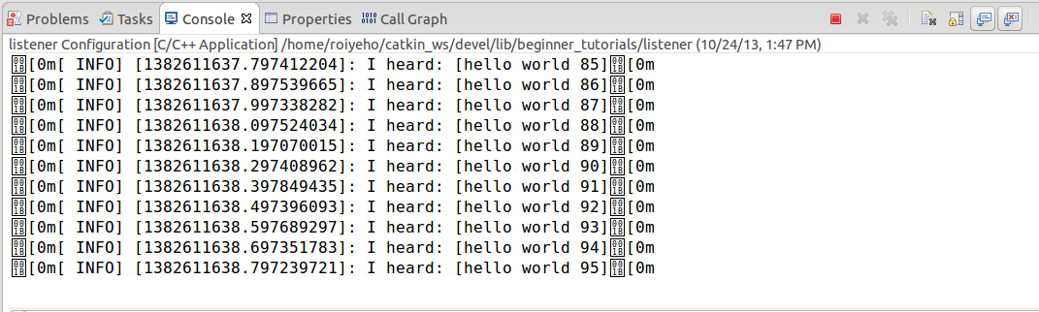
Running the Nodes Inside Eclipse
(C)2013 Roi Yehoshua
<number>

Slide 13
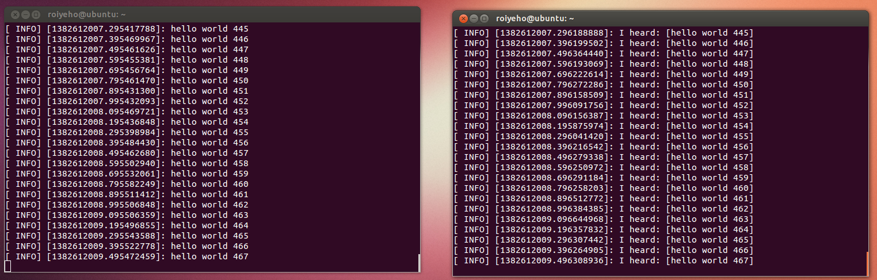
Running the Nodes From Terminal
Run the nodes in two different terminals:
$ rosrun beginner_tutorials talker
$ rosrun beginner_tutorials listener
(C)2013 Roi Yehoshua
<number>

Slide 14
Running the Nodes From Terminal
You can use rosnode and rostopic to debug and see what the nodes are doing
Examples:
$rosnode info /talker
$rosnode info /listener
$rostopic list
$rostopic info /chatter
$rostopic echo /chatter
(C)2013 Roi Yehoshua
<number>

Slide 15
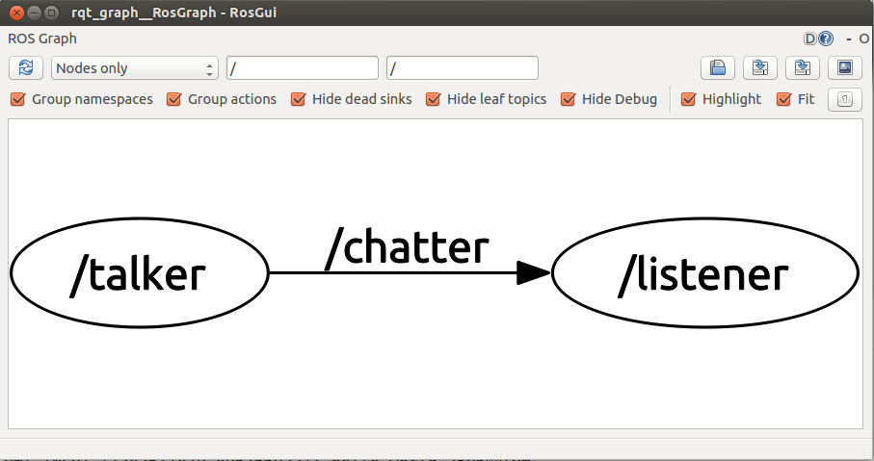
rqt_graph
rqt_graph creates a dynamic graph of what's going on in the system
Use the following command to run it:
$ rosrun rqt_graph rqt_graph
(C)2013 Roi Yehoshua
<number>

Slide 16
ROS Stage Simulator
http://wiki.ros.org/simulator_stage
A simulator that provides a virtual world populated by mobile robots and sensors, along with various objects for the robots to sense and manipulate.
Stage provides several sensor and actuator models:
sonar or infrared rangers
scanning laser rangefinder
color-blob tracking
bumpers
grippers
odometric localization
and more
<number>

Slide 17
Run Stage with an existing world file
Stage is already installed with ROS Hydro
Stage ships with some example world files, including one that puts an Erratic-like robot in a Willow Garage-like environment.
To run it:
Browsing the stage window should show up 2 little squares: a red square which is a red box and a blue square which is the erratic robot.
rosrun stage_ros stageros `rospack find stage_ros`/world/willow-erratic.world
<number>

Slide 18
Run Stage with an existing world file
Stage is already installed with ROS Hydro
Stage ships with some example world files, including one that puts an Erratic-like robot in a Willow Garage-like environment.
To run it:
Browsing the stage window should show up 2 little squares: a red square which is a red box and a blue square which is the erratic robot.
rosrun stage_ros stageros `rospack find stage_ros`/world/willow-erratic.world
<number>

Slide 19
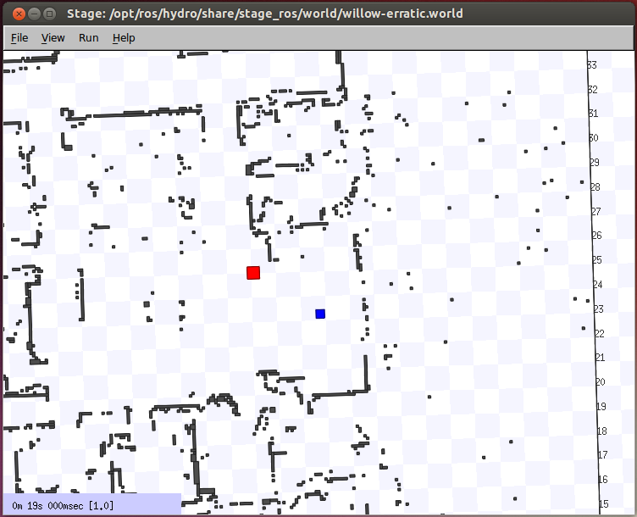
Run Stage with an existing world file
<number>

Slide 20
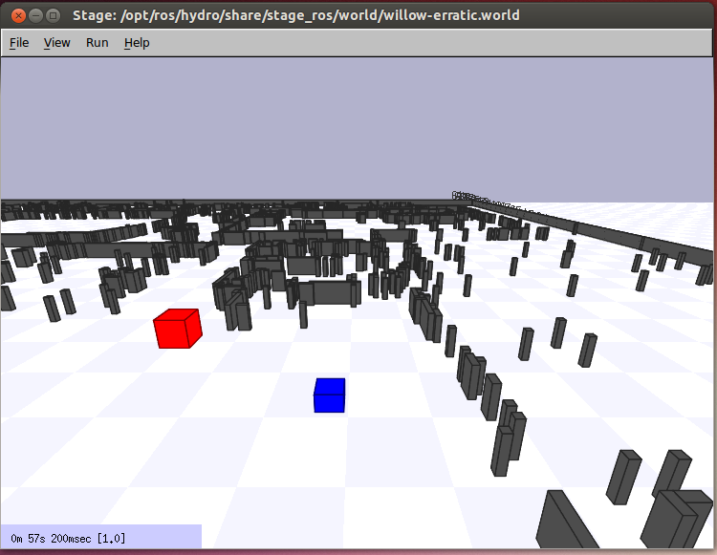
Run Stage with an existing world file
Click on the stage window and press R to see the perspective view.
<number>

Slide 21
Move the robot around
You have a simulated robot - let's make it move.
An easy way to do this is keyboard-based teleoperation.
For keyboard teleoperation, you need to get a package called teleop_twist_keyboard which is part of the brown_remotelab stack
http://wiki.ros.org/brown_remotelab
<number>

Slide 22
Installing External ROS Packages
Create a directory for downloaded packages
For example, ~/ros/stacks
Edit ROS_PACKAGE_PATH in your .bashrc to include your own ros stacks directory
Check the package out from the SVN:
Compile the package
export ROS_PACKAGE_PATH=~/ros/stacks:${ROS_PACKAGE_PATH}
$cd ~/ros/stacks
$svn co https://brown-ros-pkg.googlecode.com/svn/trunk/distribution/brown_remotelab
$rosmake brown_remotelab
<number>

Slide 23
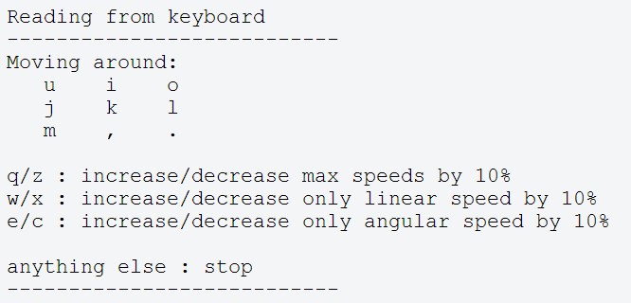
Move the robot around
Now run teleop_twist_keyboard:
You should see console output that gives you the key-to-control mapping, something like this:
Hold down any of those keys to drive the robot. E.g., to drive forward, hold down the i key.
rosrun teleop_twist_keyboard teleop_twist_keyboard.py
<number>

Slide 24
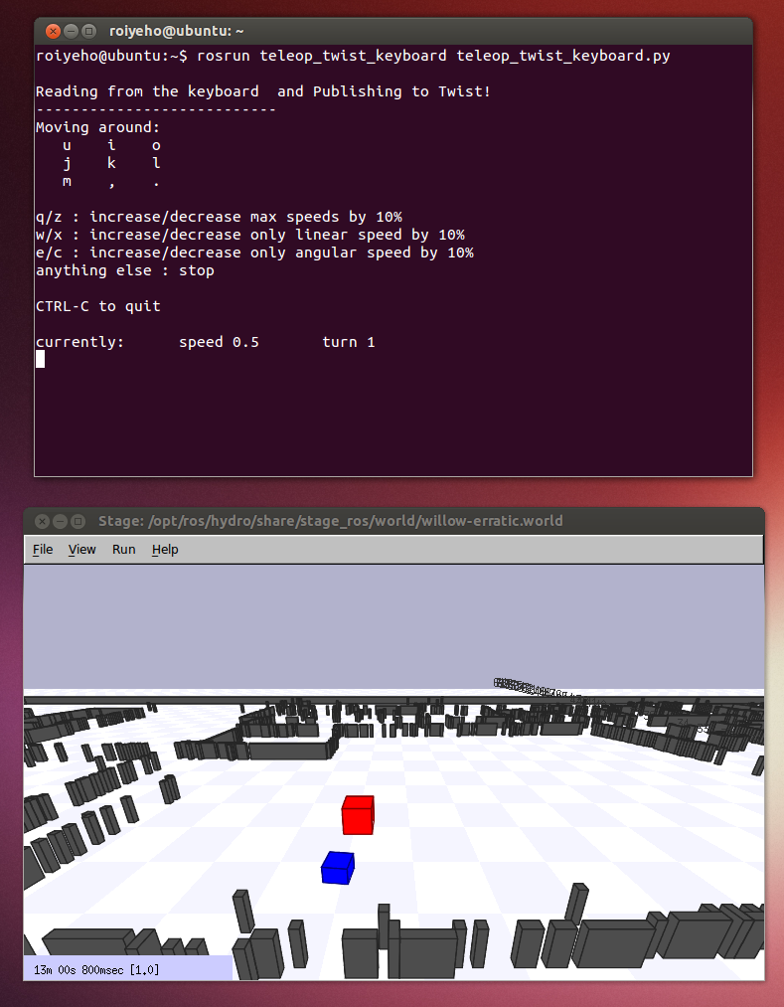
Move the robot around
<number>

Slide 25
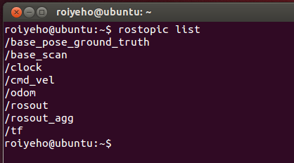
Stage Published Topics
The stage simulator publishes several topics
See what topics are available using rostopic list
You can use rostopic echo -n 1 to look at an instance of the data on one of the topics
<number>

Slide 26
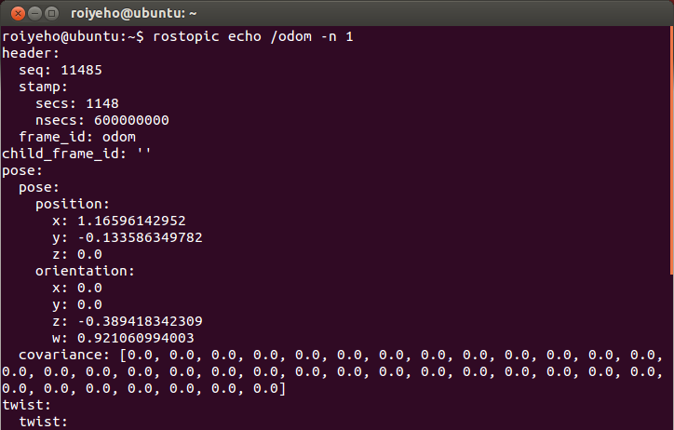
Odometer Messages
<number>

Slide 27
A Move Forward Node
Now we will write a node that drives the robot forward until it bumps into an obstacle
For that purpose we will need to publish Twist messages to the topic cmd_vel
This topic is responsible for sending velocity commands
<number>

Slide 28
A Move Forward Node
Now we will write a node that drives the robot forward until it bumps into an obstacle
For that purpose we will need to publish Twist messages to the topic cmd_vel
This topic is responsible for sending velocity commands
<number>

Slide 29
Twist Message
http://docs.ros.org/api/geometry_msgs/html/msg/Twist.html
This message has a linear component for the (x,y,z) velocities, and an angular component for the angular rate about the (x,y,z) axes.
geometry_msgs/Vector3 linear
float64 x
float64 y
float64 z
geometry_msgs/Vector3 angular
float64 x
float64 y
float64 z
<number>

Slide 30
Create a new ROS package
For the demo, we will create a new ROS package called my_stage
In Eclipse add a new source file to the package called move_forward.cpp
Add the following code
$cd ~/catkin_ws/src
$ catkin_create_pkg my_stage std_msgs rospy roscpp
<number>

Slide 31
move_forward.cpp
#include "ros/ros.h"
#include "geometry_msgs/Twist.h"
int main(int argc, char **argv)
{
const double FORWARD_SPEED_MPS = 0.2;
// Initialize the node
ros::init(argc, argv, "move_forward");
ros::NodeHandle node;
// A publisher for the movement data
ros::Publisher pub = node.advertise<geometry_msgs::Twist>("cmd_vel", 10);
// Drive forward at a given speed. The robot points up the x-axis.
// The default constructor will set all commands to 0
geometry_msgs::Twist msg;
msg.linear.x = FORWARD_SPEED_MPS;
// Loop at 10Hz, publishing movement commands until we shut down
ros::Rate rate(10);
ROS_INFO("Starting to move forward");
while (ros::ok()) {
pub.publish(msg);
rate.sleep();
}
}
<number>

Slide 32
CMakeLists.txt
cmake_minimum_required(VERSION 2.8.3)
project(beginner_tutorials)
## Find catkin macros and libraries
find_package(catkin REQUIRED COMPONENTS roscpp rospy std_msgs genmsg)
## Declare ROS messages and services
# add_message_files(FILES Message1.msg Message2.msg)
# add_service_files(FILES Service1.srv Service2.srv)
## Generate added messages and services
# generate_messages(DEPENDENCIES std_msgs)
## Declare catkin package
catkin_package()
## Specify additional locations of header files
include_directories(${catkin_INCLUDE_DIRS})
## Declare a cpp executable
add_executable(move_forward src/move_forward.cpp)
## Specify libraries to link a library or executable target against
target_link_libraries(move_forward ${catkin_LIBRARIES})
(C)2013 Roi Yehoshua
<number>

Slide 33
Move Forward Demo
Compile the package and run your node
You should see the robot in the simulator constantly moving forward until it bumps into an object
$ rosrun my_stage move_forward
<number>

Slide 34
A Stopper Node
Our next step is to make the robot stop before it bumps into an obstacle
We will need to read sensor data to achieve this
We will create a new node called stopper
<number>

Slide 35
A Stopper Node
Our next step is to make the robot stop before it bumps into an obstacle
We will need to read sensor data to achieve this
We will create a new node called stopper
<number>

Slide 36
Sensor Data
The simulation is also producing sensor data
Laser data is published to the topic /base_scan
The message type that used to send information of the laser is sensor_msgs/LaserScan
You can see the structure of the message using
Note that Stage produces perfect laser scans
Real robots and real lasers exhibit noise that Stage isn't simulating
$rosmsg show sensor_msgs/LaserScan
<number>

Slide 37
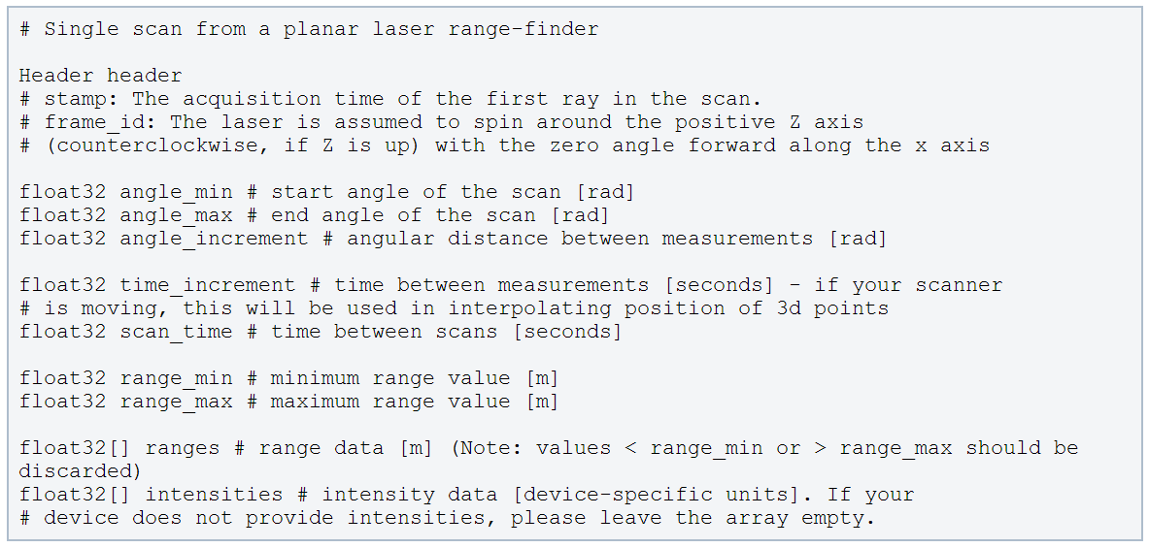
LaserScan Message
http://docs.ros.org/api/sensor_msgs/html/msg/LaserScan.html
<number>

Slide 38
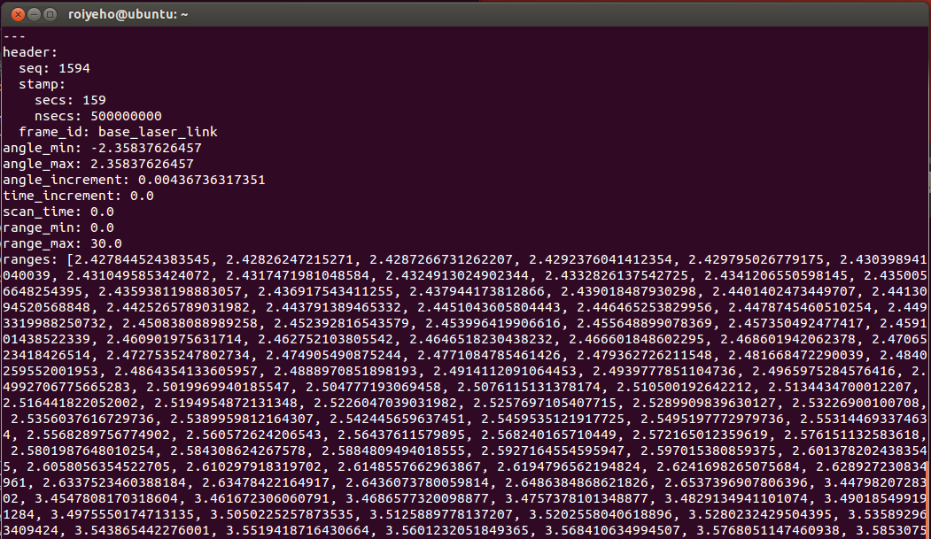
LaserScan Message
Example of a laser scan message from Stage simulator:
<number>

Slide 39
Stopper.h
#include "ros/ros.h"
#include "sensor_msgs/LaserScan.h"
class Stopper
{
public:
// Tunable parameters
const static double FORWARD_SPEED_MPS = 0.2;
const static double MIN_SCAN_ANGLE_RAD = -30.0/180*M_PI;
const static double MAX_SCAN_ANGLE_RAD = +30.0/180*M_PI;
const static float MIN_PROXIMITY_RANGE_M = 0.5; // Should be smaller than sensor_msgs::LaserScan::range_max
Stopper();
void startMoving();
private:
ros::NodeHandle node;
ros::Publisher commandPub; // Publisher to the simulated robot's velocity command topic
ros::Subscriber laserSub; // Subscriber to the simulated robot's laser scan topic
bool keepMoving; // Indicates whether the robot should continue moving
void moveForward();
void scanCallback(const sensor_msgs::LaserScan::ConstPtr& scan);
};
<number>

Slide 40
Stopper.cpp (1)
#include "Stopper.h"
#include "geometry_msgs/Twist.h"
Stopper::Stopper()
{
keepMoving = true;
// Advertise a new publisher for the simulated robot's velocity command topic
commandPub = node.advertise<geometry_msgs::Twist>("cmd_vel", 10);
// Subscribe to the simulated robot's laser scan topic
laserSub = node.subscribe("base_scan", 1, &Stopper::scanCallback, this);
}
// Send a velocity command
void Stopper::moveForward() {
geometry_msgs::Twist msg; // The default constructor will set all commands to 0
msg.linear.x = FORWARD_SPEED_MPS;
commandPub.publish(msg);
};
<number>

Slide 41
Stopper.cpp (2)
// Process the incoming laser scan message
void Stopper::scanCallback(const sensor_msgs::LaserScan::ConstPtr& scan)
{
// Find the closest range between the defined minimum and maximum angles
int minIndex = ceil((MIN_SCAN_ANGLE_RAD - scan->angle_min) / scan->angle_increment);
int maxIndex = floor((MAX_SCAN_ANGLE_RAD - scan->angle_min) / scan->angle_increment);
float closestRange = scan->ranges[minIndex];
for (int currIndex = minIndex + 1; currIndex <= maxIndex; currIndex++) {
if (scan->ranges[currIndex] < closestRange) {
closestRange = scan->ranges[currIndex];
}
}
ROS_INFO_STREAM("Closest range: " << closestRange);
if (closestRange < MIN_PROXIMITY_RANGE_M) {
ROS_INFO("Stop!");
keepMoving = false;
}
}
<number>

Slide 42
Stopper.cpp (3)
void Stopper::startMoving()
{
ros::Rate rate(10);
ROS_INFO("Start moving");
// Keep spinning loop until user presses Ctrl+C or the robot got too close to an obstacle
while (ros::ok() && keepMoving) {
moveForward();
ros::spinOnce(); // Need to call this function often to allow ROS to process incoming messages
rate.sleep();
}
}
<number>

Slide 43
run_stopper.cpp
#include "Stopper.h"
int main(int argc, char **argv) {
// Initiate new ROS node named "stopper"
ros::init(argc, argv, "stopper");
// Create new stopper object
Stopper stopper;
// Start the movement
stopper.startMoving();
return 0;
};
<number>

Slide 44
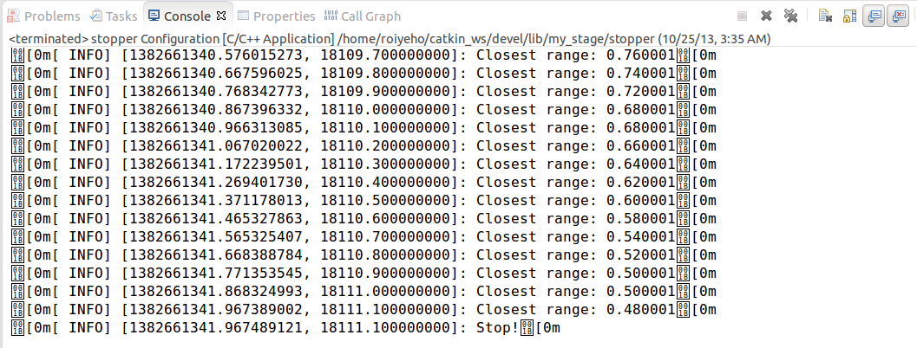
Stopper Output
<number>

Slide 45
roslaunch
roslaunch is a tool for easily launching multiple ROS nodes locally and remotely via SSH, as well as setting parameters on the Parameter Server.
It takes in one or more XML configuration files (with the .launch extension) that specify the parameters to set and nodes to launch
If you use roslaunch, you do not have to run roscore manually.
<number>

Slide 46
Launch File Example
Launch file for launching both the Stage simulator and the stopper node:
To run a launch file use:
<launch>
<node name="stage" pkg="stage_ros" type="stageros" args="$(find stage_ros)/world/willow-erratic.world"/>
<node name="stopper" pkg="my_stage" type="stopper"/>
</launch>
$roslaunch package_name file.launch
<number>

Slide 47
Assignment #1
In your first assignment you will implement a simple random walk algorithm much like a Roomba robot vaccum cleaner
Read assignment details at http://u.cs.biu.ac.il/~yehoshr1/89-685/assignment1/assignment1.html
<number>

