Slide 1
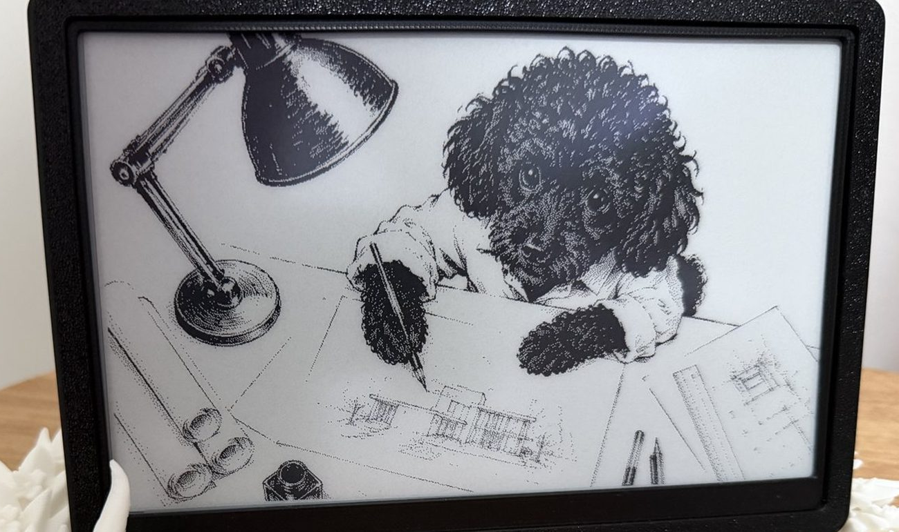
Lanternina
THE NEED
Lanternina.
Something to do after school.
For teenagers with cognitive disabilities, finding a suitable activity can require daily support.
AI proposes. A parent chooses.
The e-paper display between activities.
Parents set interests, language and timing.
Fausto Palma | Glauco Rocco | Hackathon 2026
lanternina.com
01
Notes:
Suggested speaking time: 35 seconds. Total plan: 170 seconds plus 10 seconds for transitions. Start speaking on this slide; the existing section divider needs no separate introduction.,SPEAK: For a teenager with cognitive disabilities, finding something suitable to do after school can require daily support. Lanternina proposes activities on paper and with objects at home. A parent sets interests, language and timing, then reviews the initial proposal before approving it. The house makes the activity available at the chosen time. Between activities, the e-paper display shows a picture.,REFERENCE ONLY: Sources: https://www.lanternina.com/en/present/#1 and #2; site/src/i18n/presentation.ts and README.md, checked on 15 September 2026. These four slides follow the existing Lanternina / Fausto Palma divider. Opening photograph: https://www.lanternina.com/images/hero.jpg, cropped only at the sides to emphasize the display. The screen shows an illustration between activities.

Slide 2
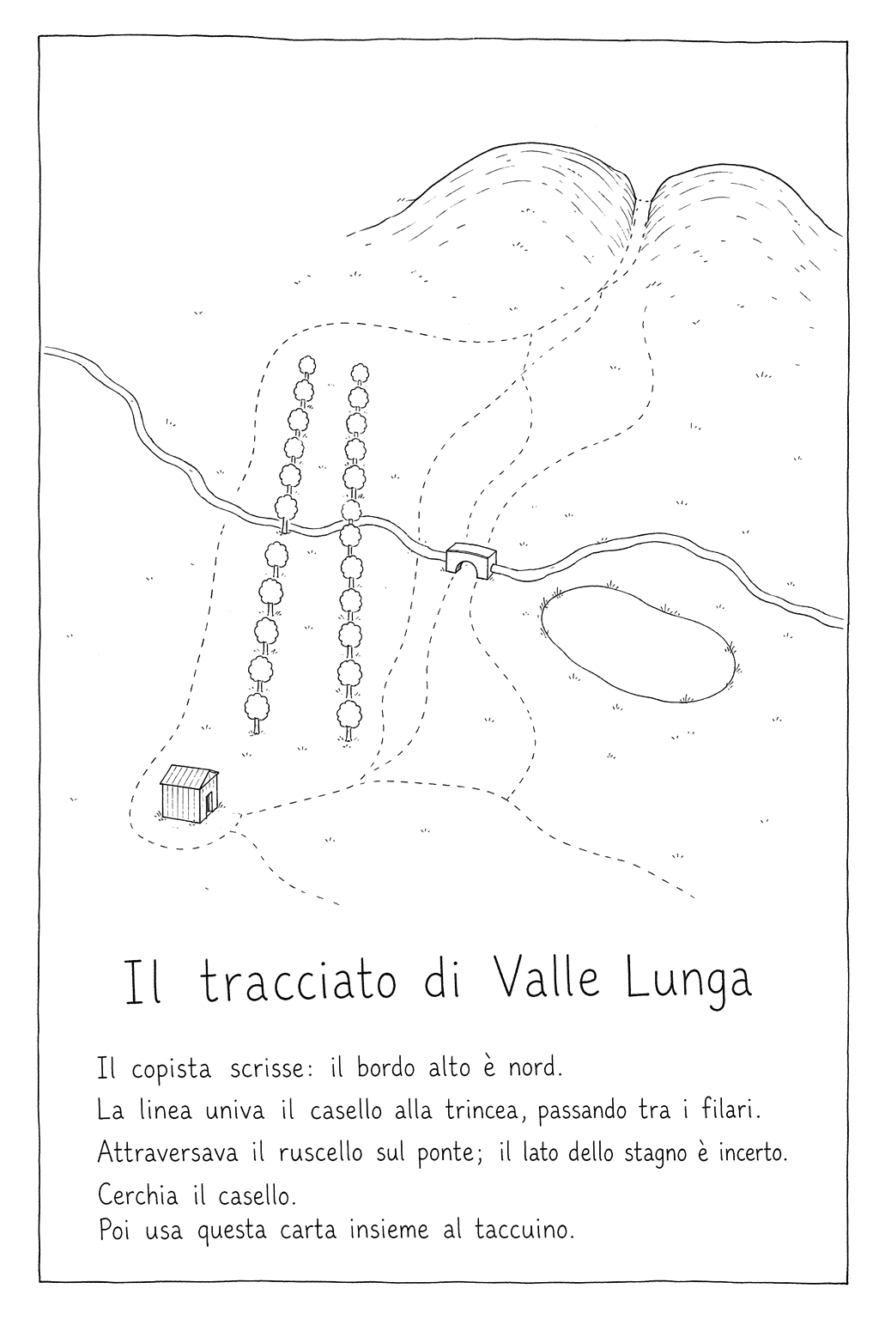
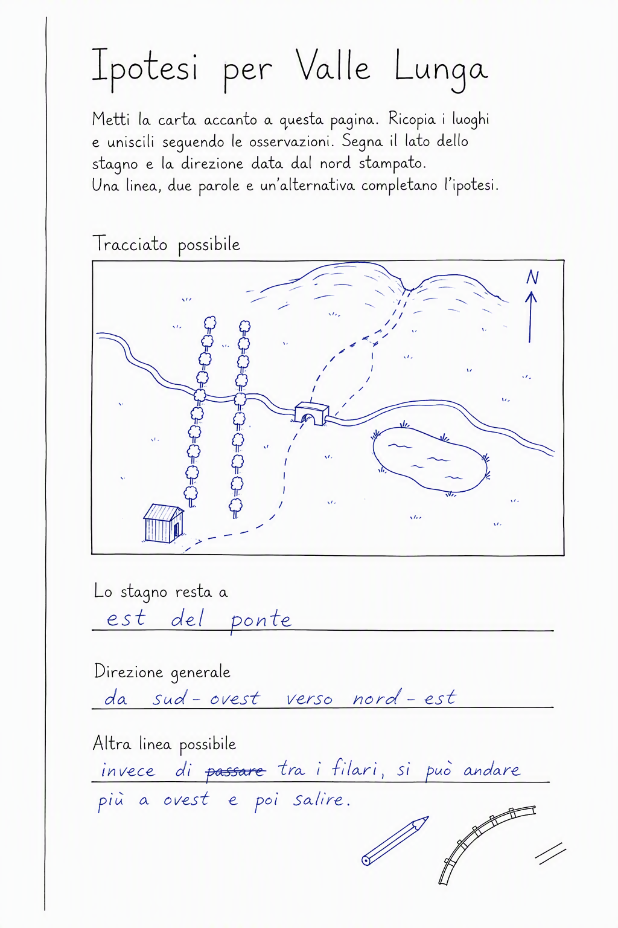
Lanternina
THE ACTIVITY
The reply changes the next step.
01
Prepare
AI creates the activity and its sheets.
02
Do and return
Work on paper; send a photograph.
03
Read and continue
AI reads the additions and prepares the next step.
A railway to reconstruct
A simulated reply
Example in Italian. The blue additions were simulated by a model, not made by a participant.
Fausto Palma | Glauco Rocco | Hackathon 2026
lanternina.com
02
Notes:
Suggested speaking time: 45 seconds.,SPEAK: Here the activity is to reconstruct an old railway from a map and clues. A second sheet leaves room to propose a route. The teenager works on paper and returns a photograph. Vision compares it with the blank sheet and describes the additions. The next response uses that reading and the original activity, so what comes back can change the next step. These blue additions were simulated by a model: they show the mechanism, not a trial with a person.,REFERENCE ONLY: Source: https://www.lanternina.com/en/present/#3. Assets: valle-lunga-map.webp and valle-lunga-written.webp. The supported photo path is separate from the unfinished handheld camera activity input. No educational or clinical benefit is established by this example.

Slide 3
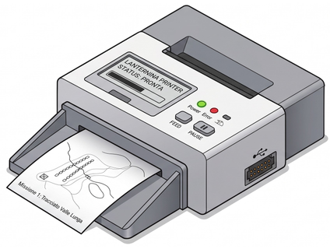
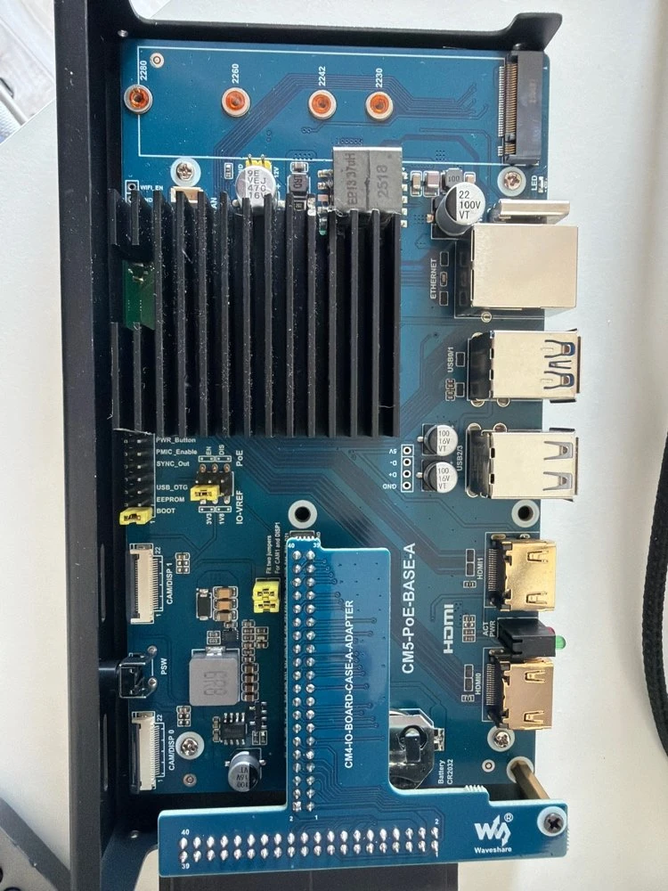
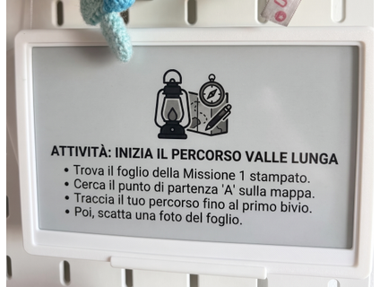
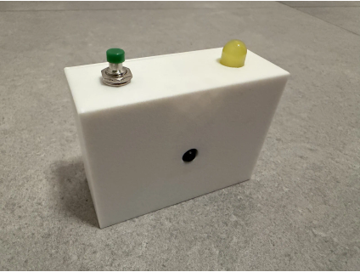

Lanternina
THE SYSTEM
Agents plan. The hub executes.
Printer
Agents in Azure
Linux hub
Prints pages
Running on Azure Container Apps
Plan
Illustration
E-paper
Plan
Activity and next steps
Shows steps
Draw
Pages to print
Replies
Camera
Read
Photographed replies
Executes the plan
Calls Microsoft Foundry models
Reply photos
Prototype
Photographs return through the hub to the agents.
Initial parent approval. Text checks and Content Safety. The hub opens connections to Azure.
Fausto Palma | Glauco Rocco | Hackathon 2026
lanternina.com
03
Notes:
Suggested speaking time: 35 seconds.,SPEAK: Agents in Azure plan the activity, draw the pages and interpret replies, using Microsoft Foundry models. The home hub requests and executes the plan: the printer produces pages and the display shows instructions. Photographs return through the hub to the agents, which prepare the next step. The hub opens connections to Azure. The parent approves the initial activity; generated text receives safety checks.,REFERENCE ONLY: Based on the updated local site/src/i18n/presentation.ts and the technology slide at https://www.lanternina.com/en/present/#4, checked on 15 September 2026. The public page fetch still returned the preceding layout. Arrows show logical content flow, not inbound network sessions from Azure. Agents run in Azure Container Apps and call Microsoft Foundry models; this diagram does not assert use of Foundry Agent Service. Printer image is an illustration; hub, display and camera images are photographs. Camera is labelled as a prototype: this diagram describes its intended activity role, not a freshly verified handheld-input implementation. Continuations receive automatic checks without a second parental approval. No model runs in the house. Educational value still needs trials with people.

Slide 4
Lanternina
THE PRINCIPLES
Interest should lead to learning.
01
02
03
Cybersecurity
Pedagogy
Responsible AI
Protect the home and its data.
Choice, reasoning and autonomy.
Not attention for its own sake.
Authenticated access and limited permissions.
Activities designed to support learning.
Ask for effort suited to the person: choosing, trying and reasoning.
Effort should support learning, not longer use.
Fausto Palma | Glauco Rocco | Hackathon 2026
lanternina.com
04
Notes:
Suggested speaking time: 55 seconds. Finish by 2:50 to leave 10 seconds of margin.,SPEAK: Three principles guide the project. Cybersecurity protects the home and its data. Pedagogy asks whether the activities help people learn, through choice, reasoning and autonomy. Responsible AI connects directly to that purpose. We do not want another system that absorbs attention without giving anything back. Activities should be engaging, but should ask for effort suited to the person: choosing, trying and reasoning. That effort should support learning, not longer use. An activity has an ending. Success should be judged by educational value, not time spent. That value still needs to be tested with people.,REFERENCE ONLY: Source: site/src/i18n/presentation.ts, principles and speaker notes updated locally on 15 September 2026; user clarification in this presentation session. The public https://www.lanternina.com/en/present/#6 still returned the previous generic Responsible AI wording when fetched. Fairness, inclusion, transparency, content checks and human oversight remain necessary. Engagement and educational benefit are design goals, not measured outcomes. Appropriate effort means a challenge suited to the person, not difficulty for its own sake.

