Slide 1
COMPUTER PROGRAMMING IN C & SHELL SCRIPTING (24ESC126)

Slide 2
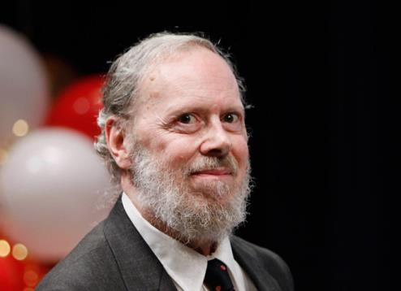
Introduction
C is a general-purpose computer programming language.
C is also said to be structures programming language or function oriented programming language.
C is a High level programming language.
C Language was developed by Dennis Ritchie in the year of 1972.
Notes:
Used for many types of programs With C, you can write operating systems, games, applications, and programs for small devices like microcontrollers. It is not limited to one specific task.

Slide 3
Module 1
Basic structure of C program: Character set, Tokens, Identifiers in C, Variables .
Data Types , Constants,
Preprocessor Directives - Formatted and Unformatted statements I/O statements
Operators and Expressions - Arithmetic Operators, Relational and Logical Operators, Conditional operator, sizeof operator , Assignment operator and Bitwise Operators, Expressions. Operators-Precedence and Associativity .
Control Flow Statements - if Statement, switch statement,while loop, do while loop, for Loop, nested loops , break and continue statements

Slide 4
First C Program
/* my first program in C */
#include<stdio.h>
int main( )
{
printf(“Hello World!”); // print
return 0;
}

Slide 5
Compiling and Executing in GCC
Open a text editor and add the above-mentioned code.
Save the file as hello.c
Open a command prompt/terminal and go to the directory where you have saved the file.
Type gcc hello.c and press enter to compile your code. If there are no errors in your code, the command prompt will take you to the next line and would generate a.out executable file.
Now, type ./a.out to execute your program.
You will see the output "Hello World" printed on the screen.
$ gcc hello.c
$ ./a.out
Hello, World!
Notes:
GCC (GNU Compiler Collection) is a software tool used to convert programs written in C and other languages into machine code that a computer can understand.

Slide 6
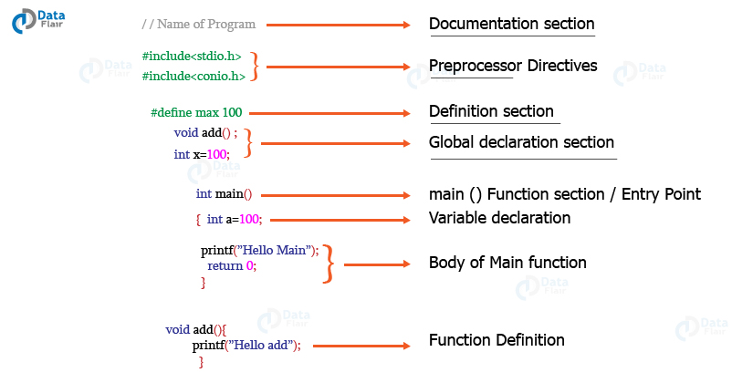
Structure of C Program

Slide 7
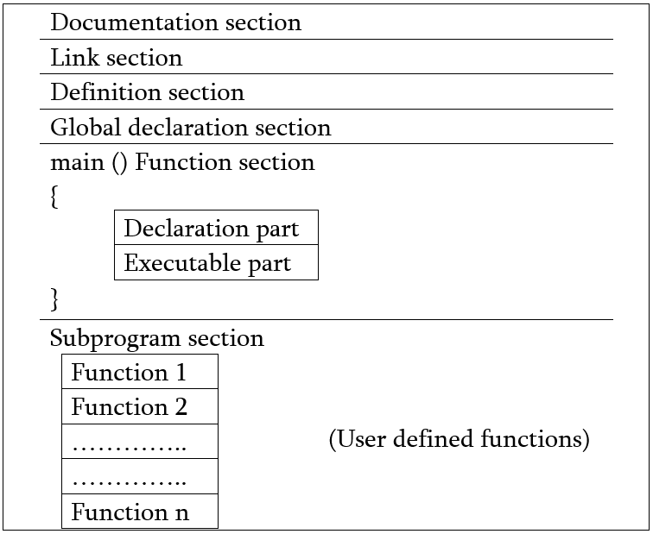

Slide 8
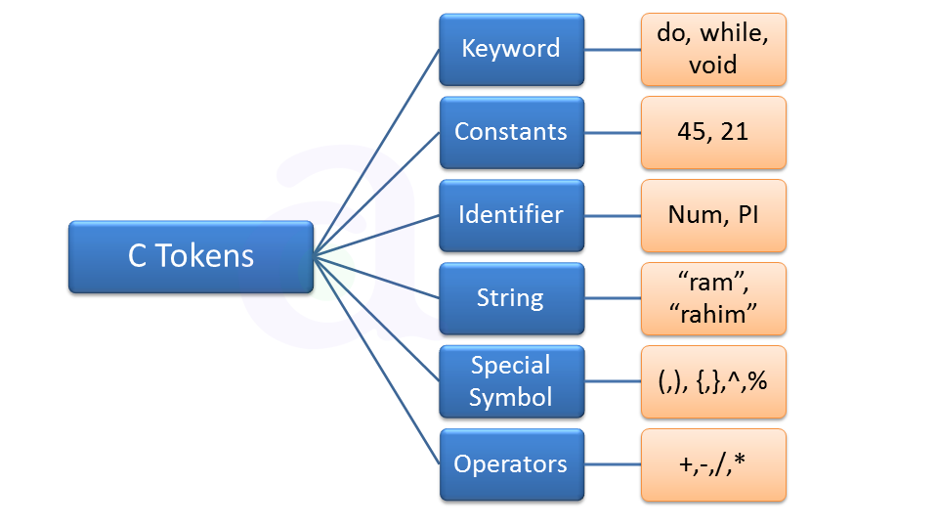
tokens
Tokens are the smallest building block or smallest unit of a C program.

Slide 9
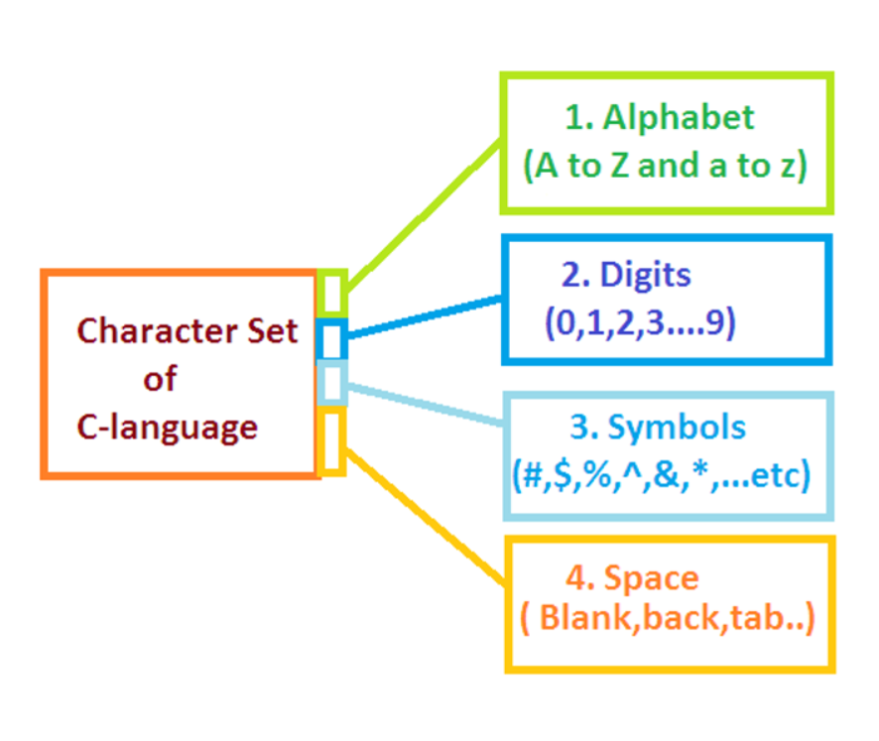
The C Character Set
A character denotes any alphabet, digit or special symbol used to represent information.

Slide 10
Special Characters
Symbol | Meaning
! | Exclamation mark
# | Hash/ Number sign
$ | Dollar sign
% | Percent sign
^ | Cap/Caret
& | Ampersand
* | Asterisk
_ | Underscore
+ | Plus sign
– | Minus sign
= | Equal to sign

Slide 11
Special Characters
Symbol | Meaning
~ | Tilde
| | Vertical bar
/ | Slash
\ | Backslash
( | Left parenthesis
) | Right parenthesis
{ | Left brace
} | Right brace
[ | Left bracket
] | Right bracket

Slide 12
Special Characters
Symbol | Meaning
` | Apostrophe
” | Quotation mark
: | Colon
; | Semicolon
< | Opening angle bracket/Less than
> | Closing angle bracket/Greater than
? | Question mark
, | Comma
. | Period/Dot
White Spaces | Tab Or New line Or Space

Slide 13
Keywords
Keywords are predefined, reserved words used in programming that have special meanings to the compiler.
Keywords are part of the syntax and they cannot be used as an identifier.
For example:
int money;
Here, int is a keyword that indicates money is a variable of type int (integer).
As C is a case sensitive language, all keywords must be written in lowercase.

Slide 14
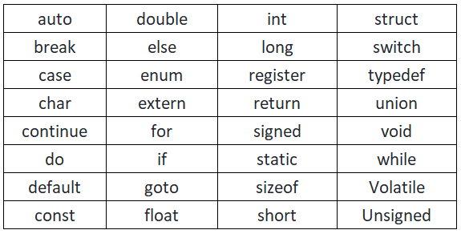
32 keywords in ANSI C

Slide 15
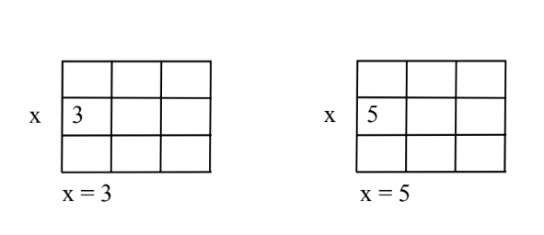
Identifiers
Names given to various elements
Variables
Functions
Arrays
Here 3 is stored in a memory location and a name x is given to it.
Then we are assigning a new value 5 to the same memory location x.
This would overwrite the earlier value 3, since a memory location can hold only one value at a time.

Slide 16
Rules for naming:
Can only have alphanumeric characters(a-z, A-Z , 0-9) and underscore(_).
No special characters, such as semicolon, period, whitespaces, slash or comma are permitted to be used in or as Identifier.
The first character of an identifier can only contain alphabet(a-z , A-Z) or underscore (_).
case sensitive in C. Eg: name and Name are two different identifiers in C.
Keywords are not allowed to be used as Identifiers.
There is no rule on how long an identifier can be. However, you may run into problems in some compilers if the identifier is longer than 31 characters.

Slide 17
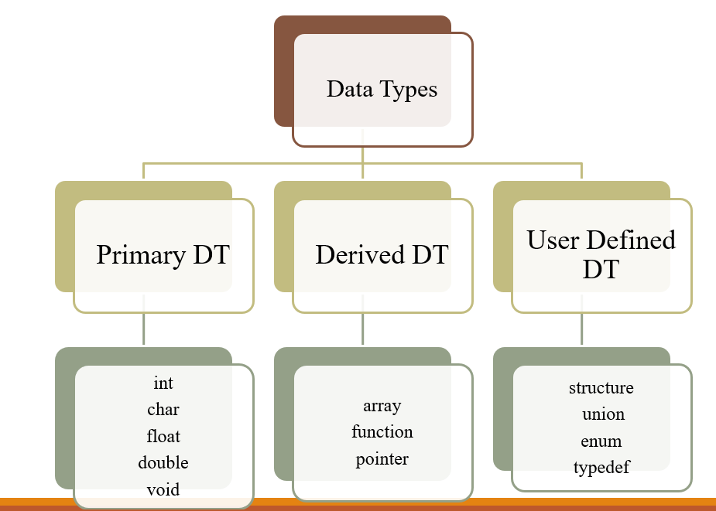
Data Types
Collection of data with values having fixed meaning as well as characteristics.
A datatype is a specification that defines the type of data a variable can store, the amount of memory allocated, the range of values permitted, and the operations that can be performed on that data.

Slide 18
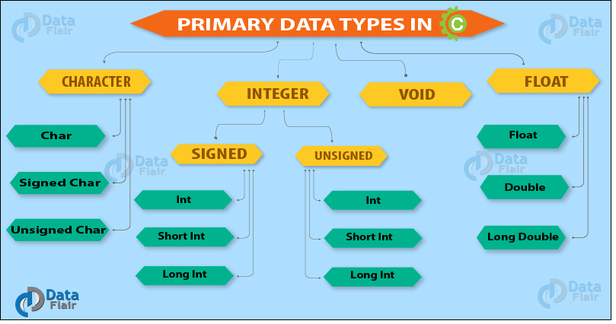

Slide 19
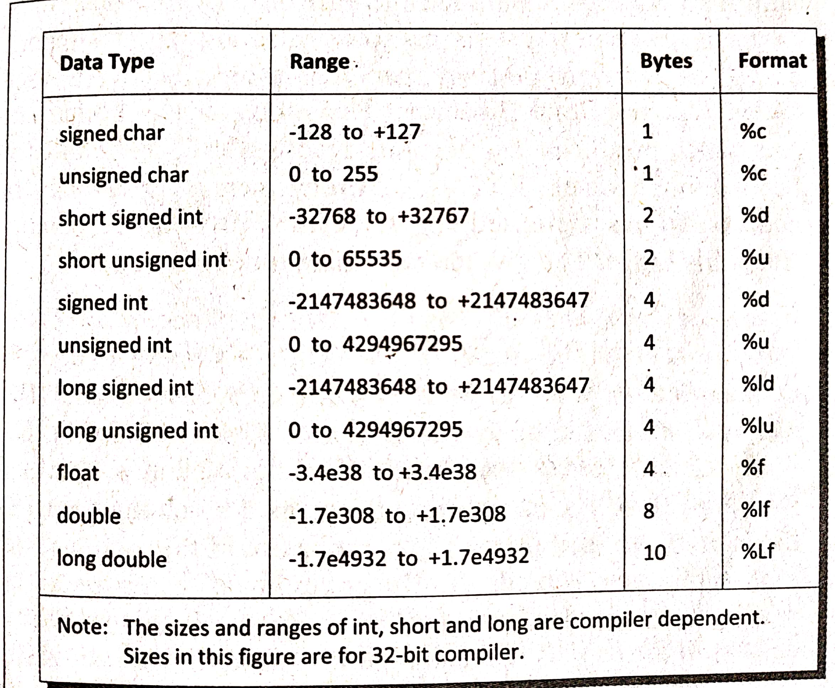

Slide 20
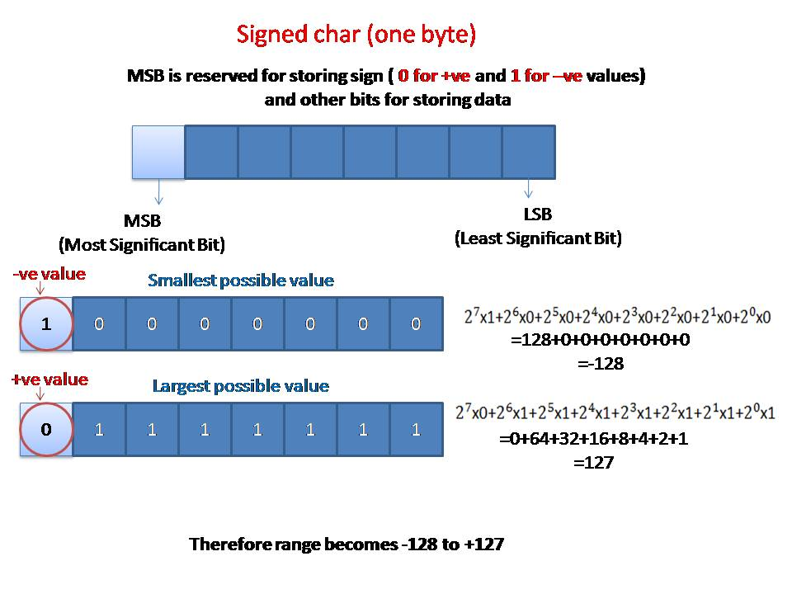

Slide 21
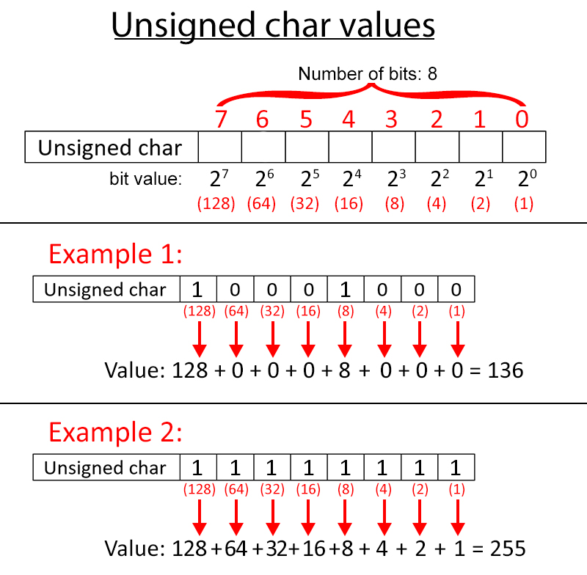

Slide 22
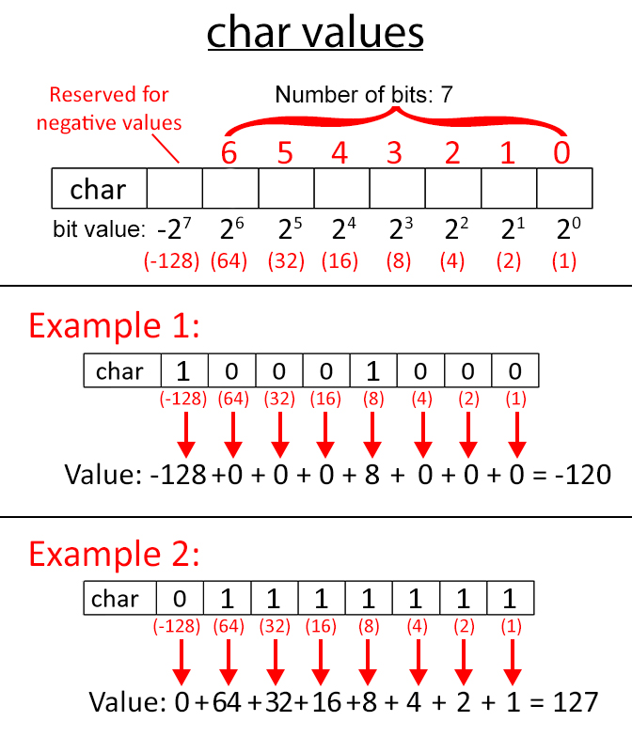

Slide 23
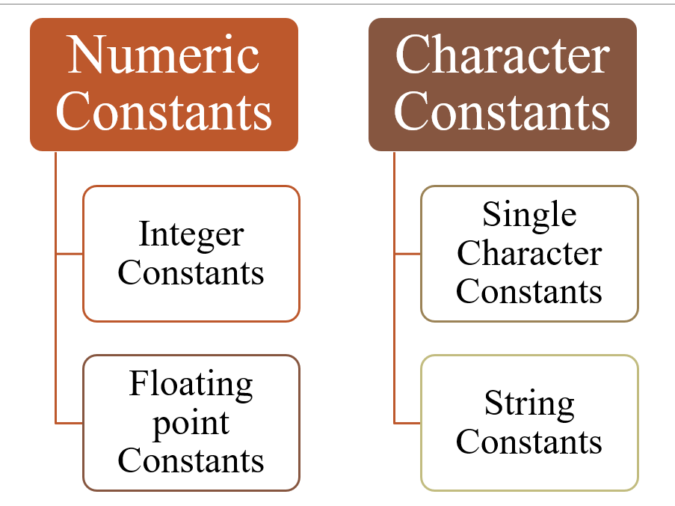
Constants

Slide 24
constants
Integer Constants
Decimal – 0 1 743 32767 9999
Octal – 0 01 0743 07777
Hexadecimal – 0x 0X1 0X7FFF 0xabcd
Real/Floating point Constants
0.2 827.602
Character Constants- Single character constant enclosed in apostrophes(Single quotations)
‘A’ ‘x’ ‘?’
String Constants
Consists of number of consecutive characters (including space) enclosed in double quotation marks

Slide 25
Char Constants
ASCII
American Standard Code for Information Interchange
Every character is numerically encoded with its own unique 7-bit combination (128 characters)

Slide 26
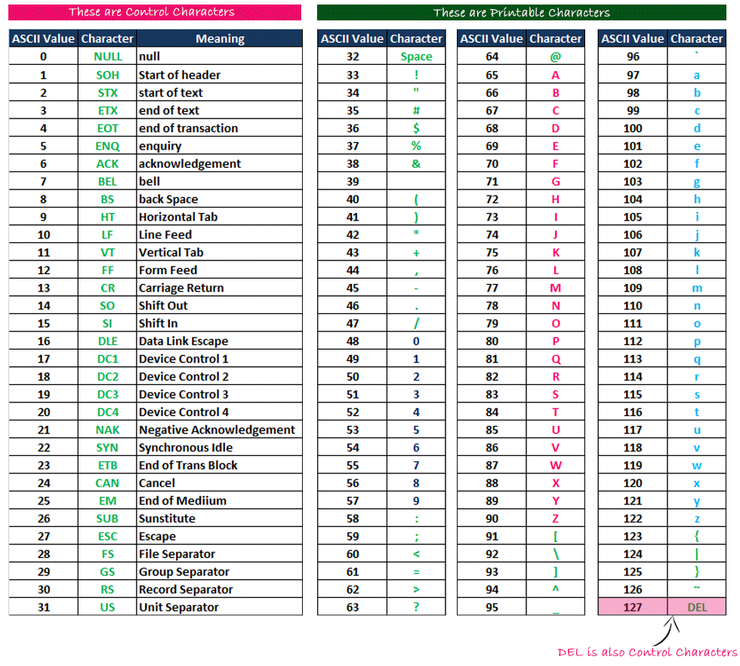

Slide 27
Escape Sequences
An Escape Sequence in C is a sequence of characters that doesn’t represent itself when used inside a character or a string literal but has its own specific function.
Begins with a backslash \ and is followed by one or more special characters.

Slide 28
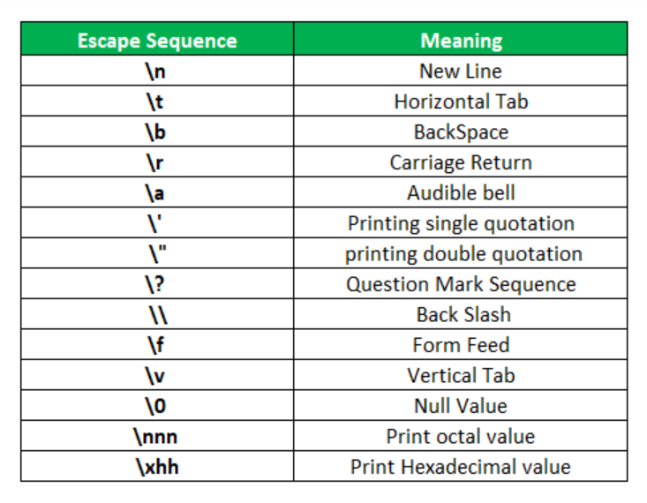

Slide 29
Const Keyword
The const qualifier to declare a variable as constant.
We cannot change the value once the variable has been initialized.
eg: const int i=10;
const float pi=3.14;

Slide 30
Variables
A variable is a data name that may be used to store a data value.
A variable is nothing but a name given to a storage area that our programs can manipulate.
Each variable in C has a specific type,
which determines the size and layout of the variable's memory;
the range of values that can be stored within that memory;
and the set of operations that can be applied to the variable.

Slide 31
Variables
Variable Name can be chosen by the programmer in a meaningful way so as to reflect its function in the program.
Eg.
Average ,height ,Counter_1, class_strength
A variable name can have only letters (both uppercase and lowercase letters), digits and underscore.
The first letter of a variable should be either a letter or an underscore.
Lowercase and Uppercase are significant. Total not same as total.
There is no rule on how long a variable name (identifier) can be. However, you may run into problems in some compilers if the variable name is longer than 31 characters.
Should not be a keyword
White Space not allowed

Slide 32
Declaration Of Variables
Typical syntax:
datatype variable_name;
for multiple variables:
datatype variable1, variable2, variable3; Names of variables separated by commas
Eg.
int a;
char a,name,addr1;
Defining and Initializing
datatype variable_name= values;
Eg. int a=10 ; declaring 2 variable of integer type
float f=20.8; int a=10,b=20;
char c='A'; int width, height=5;

Slide 33
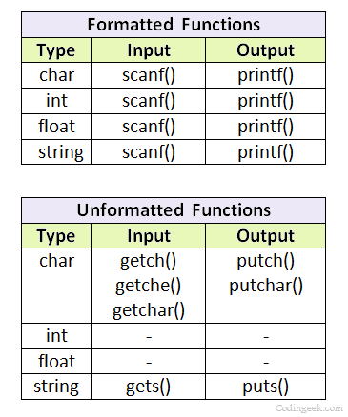
Console I/O functions
#include<stdio.h>
Notes:
Unformatted functions perform direct input/output without format conversion
When a program works internally, data exists in raw binary form:
Numbers are stored as bits
Characters are stored as numeric codes
formatted string defines the rules that convert internal data into readable output.

Slide 34
Scanf & Printf Functions
scanf( ) - is used to take input from the user
The function scanf() is used to read formatted input from stdin in C language.
printf( ) - is used to display output result on the screen
The C library function sends formatted output to stdout.
Syntax:
Format specifiers start with a percentage % operator and followed by a special character for identifying the type of data.
scanf("control string/format specifier", arg1, arg2, ..., argn);
printf("control string/format specifier", arg1, arg2, ..., argn);

Slide 35
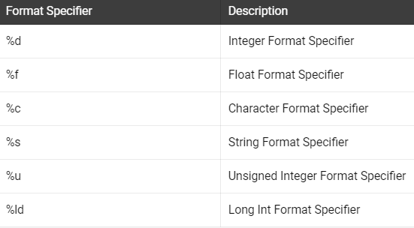

Slide 36
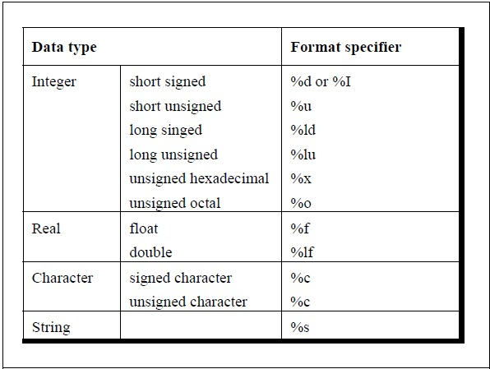

Slide 37
printf("%d",<variable name>);
/* c program to print value of a variable */
#include<stdio.h>
void main()
{
int age = 20;
printf("I am %d years old.\n", age);
}

Slide 38
scanf("%d",&<variable name>);
#include <stdio.h>
int main()
{
char chr;
printf("Enter a character: ");
scanf("%c",&chr);
printf("You entered %c.", chr);
return 0;
}
Output
Enter a character: g
You entered g.
Notes:
scanf() needs this address to store the input value
Without &, scanf() would not know where to place the data.

Slide 39
#include <stdio.h>
int main()
{
char chr;
printf("Enter a character: ");
scanf("%c",&chr);
// When %c is used, a character is displayed
printf("You entered %c.\n",chr);
// When %d is used, ASCII value is displayed
printf("ASCII value is % d.", chr);
}
Output
Enter a character: g
You entered g.
ASCII value is 103.

Slide 40
Multiple values I/O
// Taking multiple inputs
scanf("%d %f", &a, &b);
printf("You entered %d and %f", a, b);

Slide 41
Other I/O functions
getchar()
The getchar() function is used to read a single character from the standard input unit.
It takes the following form:
variable_name= getchar();
char c;
c=getchar();
getchar can be used only with character data types, whereas scanf can be used with any data types

Slide 42
getch()
Reads a single character from the keyboard, but doesn’t display to the screen
getche()
Does the same, but displays the character entered back to the user(echoes back)

Slide 43
getch()Reads one character from the keyboard without showing it on the screen and without pressing Enter.
getche()Reads one character, shows it on the screen, and does not need Enter.
getchar()Reads one character after pressing Enter and shows it on the screen.

Slide 44
#include<stdio.h>
#include<conio.h>
void main()
{
char ch,ch1,ch2;
printf("Enter character : ");
ch=getchar();
printf("%c",ch);
printf("\nEnter character : ");
ch1=getch();
printf("%c",ch1);
printf("\nEnter character : ");
ch2=getche();
printf("%c",ch2);
printf("\n%c",ch1);
}

Slide 45
gets( )
Receives a string from the keyboard.
putchar()
It displays a single character on the screen.
It takes the following form:
putchar ( variable-name);
Eg: char ans=’y’;
putchar (ans);

Slide 46
puts( )
Outputs a string to the screen
Eg: char vehicle [40];
printf(“Enter your vehicle name”);
gets (vehicle);
puts (vehicle);

Slide 47
Operators
An operator is a symbol that tell the computer to perform certain mathematical or logical manipulation.
C language uses many types of operators as listed below:-
1) Arithmetic Operators
2) Relational Operators
3) Logical Operators
4) Unary, Increment and Decrement Operators
5) Assignment Operators
6) Conditional Operators
7) Bitwise Operators
8) Special Operators

Slide 48
Arithmetic Operators
Operator Meaning
+ Addition or unary plus
- Subtraction or unary minus
* Multiplication
/ Division
% Modulo division (remainder)
There’s no exponent operator in C, a library function pow() is used to carry out exponentiation

Slide 49
Integer arithmetic
Here, a and b are integers, if a= 14 and b=4 then,
a –b = 10
a + b = 18
a * b = 56
a / b = 3 (decimal part truncated)
a % b = 2 (remainder of division)
When both the operands in a single arithmetic expression are integers, the expression is called an integer expression , and the operation is called integer arithmetic.

Slide 50
Real Arithmetic
An arithmetic involving only real operands is called real arithmetic.
A real operand may can have values either in decimal notation or in exponent notation.
Since floating point values are rounded to the number of significant digits permissible, the final value is an approximation of the correct result.
i.e, 6.0/7.0 =0.857143
-2.0/3.0 = -0.666667
The operator modulo(%) cannot be used with real operands

Slide 51
Mixed mode
When one operand is real & other is integer
Eg: 15 / 10.0 = 1.5
where as,
15 / 10 = 1
If either operand is of real type, then only the real operation is performed and the result is always a real number.
In division, if any operand is real, the result is real; if both are integers, the result is integer.

Slide 52
Relational operators
< is less than
<= is less than or equal to
> is greater than
>= is greater than or equal to
== is equal to
!= is not equal to
These operators' ca be used to represent logical expressions, represent conditions that are true or false(1 or 0 resp.).
i=1 and j=2,
then expression i< j → TRUE or 1

Slide 53
Assignment operators
Assignment operators are used to assign the result of an expression to a variable.
Assignment operator is ‘ = ‘
What is the difference between ‘=‘ and ‘= =‘ operators?
Eg: i = 5;
i = j = 5.9;
if (i == 5)
identifier = expression

Slide 54
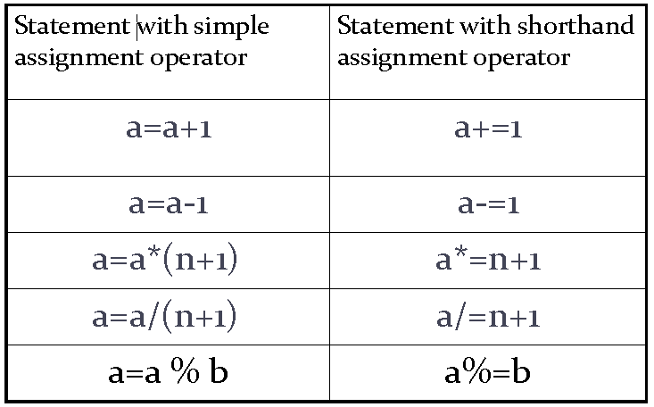
Short Hand Assignment Operators +=, -=, *=, /=, %=

Slide 55
Logical Operators
&& logical AND
|| logical OR
! logical NOT
Logical Operators are used when we want to test more than one condition and make decisions

Slide 56
Logical Operators
OP1 | OP2 | OP1 && OP2 | OP1 || OP2 | !OP1
0 | 0 | 0 | 0 | 1
0 | 1 | 0 | 1 | 1
1 | 0 | 0 | 1 | 0
1 | 1 | 1 | 1 | 0

Slide 57
if x=7, f=5.2, c=‘w’
x>=6 && c==‘w’
TRUE
f<11 && x>100
FALSE
c!=‘p’ || (x+f) <=10
TRUE
Eg: If a=5 ,b=5
!(a != b)
evaluates to 1 because operand (a != b) is 0 (false). Hence, !(a != b) is 1 (true).
!(a == b)
evaluates to 0 because (a == b) is 1 (true). Hence, !(a == b) is 0 (false).

Slide 58
Unary Operators
Increment/decrement operator(++/--)
Increments or decrements the operand by 1
Eg: x=5 , ++x =6 and x ++ = 6
While ++x and x++ means the same, when they form statements independently they behave differently
Eg: x=5
y=x++ y=5, x=6
y=++x y=6, x=6
Unary Minus (-)
int a = 5;
int b;
b = -a;

Slide 59
++x → pre-increment operator or prefix operator
First increments 1 to the operand and result is assigned to the variable on the left
When pre-increment operator is used, variable incremented first and then expression is evaluated using new value of the variable
x++ → post-increment operator or postfix operator
Expression is evaluated first using the original value of the variable and then variable is incremented
Similarly pre-decrement and post-decrement

Slide 60
Increment/decrement operator(++/--)
Eg: a=10, b=20
Find values of x and y after the expressions are evaluated
x=50 + ++a;
x=____ a=____
y=100 + b++
y=____ b=____
61
11
120
21

Slide 61
Conditional Operator- Ternary Operator
Syntax: exp1 ? exp2 : exp3
where exp1,2,3 are expressions
Eg: a=10;b=15;
x=(a>b)?a:b (Ans. Since the condition is false the result will be “b”)
Similar to if…else

Slide 62
Bitwise Operator
& Bitwise AND
| Bitwise OR
^ Bitwise exclusive OR
<< Shift left
>> Shift right
~ Bitwise complement operator

Slide 63
Bitwise complement operator (~)
The bitwise complement operator is also known as one's complement operator.
It is represented by the symbol tilde (~).
It takes only one operand or variable and performs complement operation on an operand.
When we apply the complement operation on any bits, then 0 becomes 1 and 1 becomes 0.
If we have a variable named 'a', a = 8;
The binary representation a = 1000
When we apply the bitwise complement operator to the operand, then
Result = 0111

Slide 64
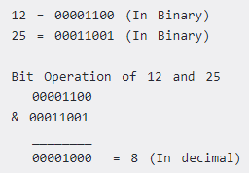
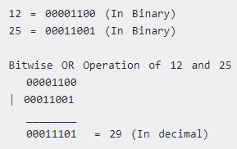
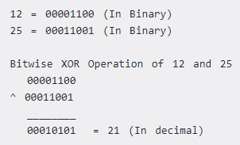

Slide 65
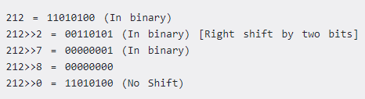
Right Shift Operator
Right shift operator shifts all bits towards right by certain number of specified bits.
It is denoted by >>.

Slide 66

Left Shift Operator
Left shift operator shifts all bits towards left by certain number of specified bits.
It is denoted by <<

Slide 67
// C Program to demonstrate use of bitwise operators
#include <stdio.h>
int main()
{
// a = 5(00000101), b = 9(00001001)
int a = 5, b = 9;
// The result is 00000001
printf("a = %d, b = %d\n", a, b);
printf("a&b = %d\n", a & b);
// The result is 00001101
printf("a|b = %d\n", a | b);
// The result is 00001100
printf("a^b = %d\n", a ^ b);
// The result is 11111010
printf("~a = %d\n", a = ~a);
// The result is 00010010
printf("b<<1 = %d\n", b << 1);
// The result is 00000100
printf("b>>1 = %d\n", b >> 1);
return 0;
}

Slide 68
sizeof Operator
sizeof is an operator which returns the number of bytes occupied the operand.
sizeof operand
The operand may be datatype, variable or constant
#include<stdio.h>
void main()
{
int s;
s=sizeof(int);
printf("%d",s);
}
Output
4

Slide 69
Operator Precedence & Associativity
Operator Precedence : a rule used to clarify unambiguously which operations (operator and operands) should be performed first in the given (mathematical) expression.
Use precedence levels that conform to the order commonly used in mathematics.
Precedence and associativity of C operators affect the grouping and evaluation of operands in expressions.
Expressions with higher-precedence operators are evaluated first.
the order in which the operands are evaluated

Slide 70
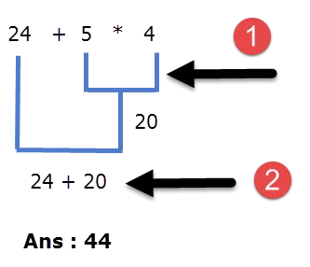
Operator precedence: It dictates the order of evaluation of operators in an expression.
Associativity: It defines the order in which operators of the same precedence are evaluated in an expression. Associativity can be either from left to right or right to left.
Consider the following example:
24 + 5 * 4

Slide 71
If several operators appear together, they have equal precedence and are evaluated according to their associativity.
Operators with equal precedence evaluation proceeds according to the associativity of the operator
For operators of the same priority like + and -, evaluation is from left to right as they appear
Parenthesis may be used to change the precedence of operator evaluation

Slide 72
a + b * c – d / e ➔ a + (b * c) – (d / e)
a * – b + d % e – f ➔ a * (– b) + (d % e) – f
a – b + c + d ➔ (((a – b) + c) + d)
x * y * z ➔ ((x * y) * z)
a + b + c * d * e ➔ (a + b) + ((c * d) * e)

Slide 73
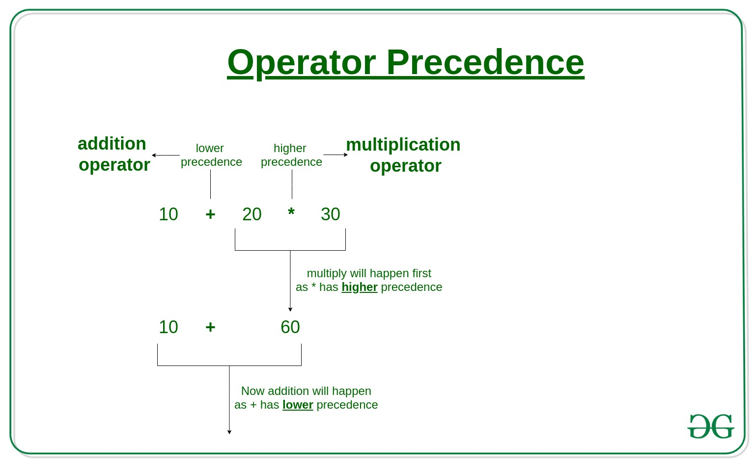

Slide 74
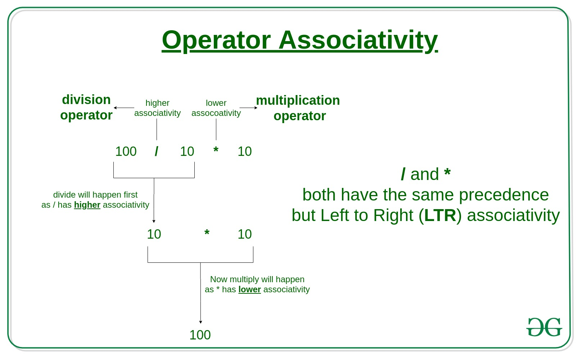

Slide 75
Type Conversion (Type Casting)
Implicit type conversion
When operands differ in type, final result will be expressed in the highest precision possible
If operands are of different type, lower type is automatically converted to higher type
Eg: operation b/w int and float results in float

Slide 76
#include <stdio.h>
int main()
{
int x = 15;
float y = 4;
printf("Result = %f\n", x / y);
return 0;
}
x is converted from 15 → 15.0
Division is performed in floating-point
Output: 3.750000

Slide 77
Type Conversion (Type Casting)
Explicit Type Conversion
Converting one datatype into another is known as type casting or, type-conversion.
For example, if you want to store a 'long' value into a simple integer then you can type cast 'long' to 'int'.
Convert the values from one type to another explicitly using the cast operator as follows −
(type) expression
Eg. c= (float) a/b where c is float and a,b are int

Slide 78
#include <stdio.h>
int main()
{
int a = 5, b = 2;
float c;
c = (float)a / b; // explicit casting
printf("Result = %f\n", c);
return 0;
}
a is explicitly cast from int → float
Expression becomes 5.0 / 2
Result is computed in floating-point arithmetic
Output: 2.500000

Slide 79
Library Functions
To use a Library function we must include a Preprocessor Directive statement #include< >
#include<stdio.h>
h designates the header file
Other common header files are
stdlib.h,
math.h,
ctype.h
string.h
Notes:
#include instructs the preprocessor to insert the contents of the stdio.h header file
This enables access to library functions like printf() and scanf()
Without this directive, the compiler cannot recognize these function

Slide 80
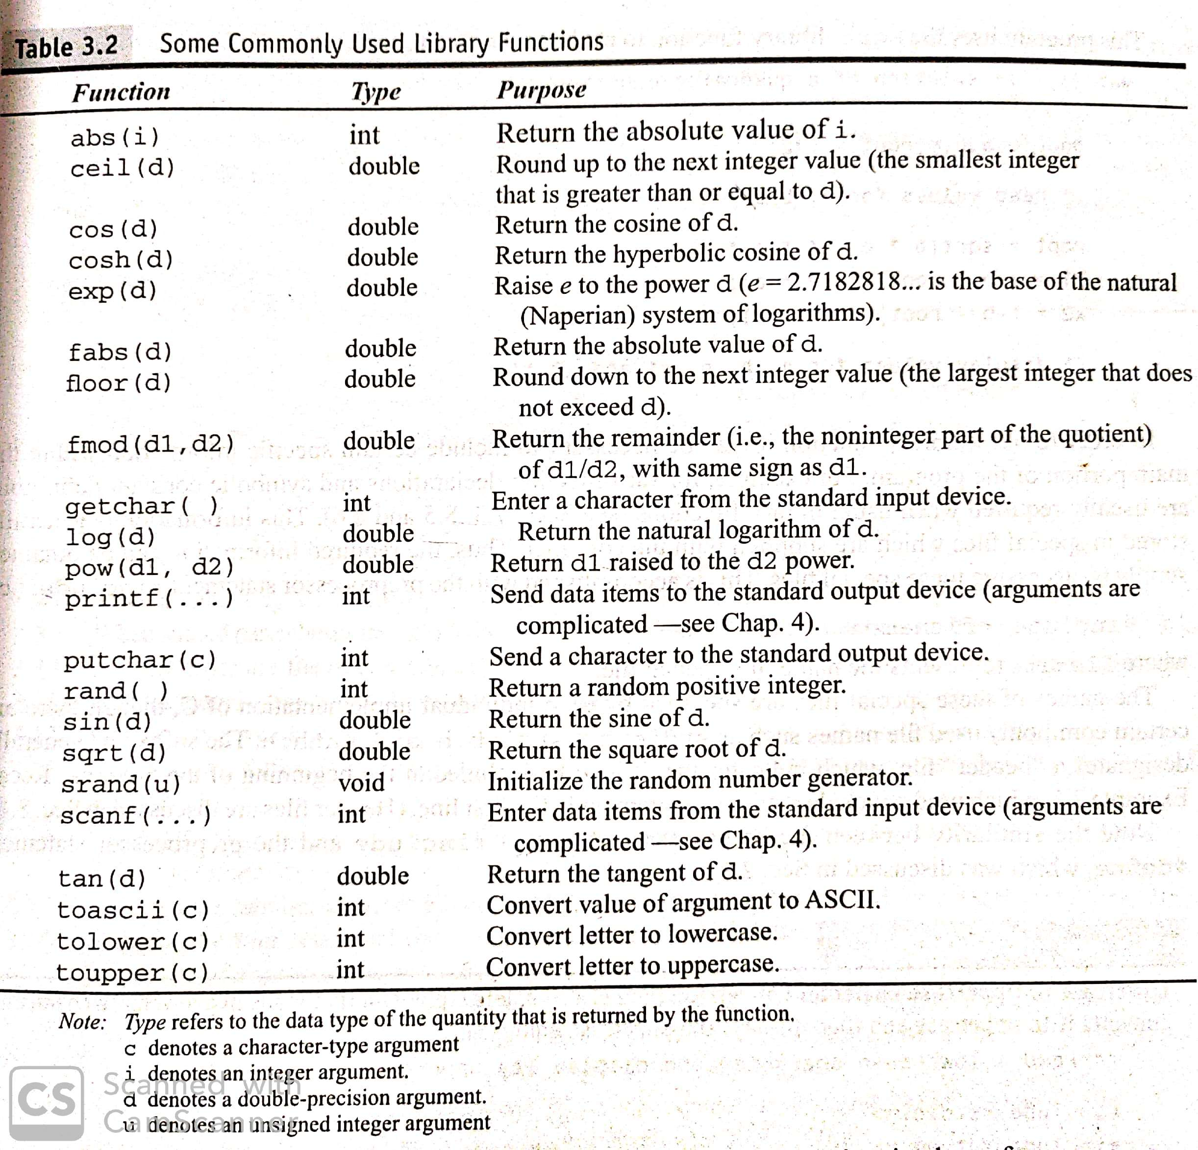

Slide 81
Expressions
The expression may consist of a single entity, such as a constant or variable, or it may consist of some combination of such entities, interconnected by one or more operators.
Expressions can also represent logical conditions which are either true or false.
An expression is something that gives a value.
It calculates something.
Examples
5 + 3
a * 10
x > y
5 + 3 gives 8
a * 10 gives a value
x > y gives true or false
Expression = calculation

Slide 82
Statements
A statement , the smallest independent computational unit ,causes the computer to carry out some definite action.
A statement is a complete instruction that tells the computer to do something.
It usually ends with a semicolon (;).
a = 5; → Store a value
printf("Hello"); → Print something
Statement = action

Slide 83
x = y + 2;
y + 2 → Expression (it calculates)
x = y + 2; → Statement (it tells the computer to store the result)

Slide 84
Three different classes
expression statements,
compound statements, and
control statements.
An expression statement consists of an expression followed by a semicolon.
The execution of such a statement causes the associated expression to be evaluated.
For example: a = 6;
c = a + b;

Slide 85
A compound statement consists of several individual statements enclosed within a pair of braces { }.
The individual statements may themselves be expression statements, compound statements, or control statements.
A typical compound statement is shown below:
{
pi = 3.141593;
circumference = 2. * pi * radius;
area = pi * radius * radius;
}

Slide 86
Control statements are used to alter the natural flow of control in a program.
Decisions, Loops and Branches

