Slide 1
Data Driven Dollars
Can Machine Learning Predict Future
Stock Prices & Stock Movement?
Notes:
Chris

Slide 2
This we didn’t know…
Goldman Sachs' ex-chief investment strategist had an average of 35% accuracy in predicting market direction (strategist average: 47%).
Experts' stock market price estimates differed by an average of 8.3% from actual index prices.
Source: EFT.com
Notes:
Chris
Funfact: 1 - Average accuracy over 1000s of investment decision over time.

Slide 3
This motivated us to…
Explore the potential of Machine Learning in forecasting the closing price of US tech stocks for the upcoming day.
How accurately can we predict tomorrow’s stock price & can we predict whether it goes up or down?
Notes:
To whom is it? Why is it interesting and challenging = Current state of financial trading and algo-trading
Why predicting actual price is so difficult and an ongoing industry wide question. Because of human decision making it follows some kind of random walk (brownian model) Disclaimer: lets get this out of the way that we are not giving any kind of financial advice or wealth management advice, this product is just a playground for potential investors to play with and get informed for potential trading strategy.

Slide 4
Table of Contents
Data
Features & Target
ML Models
Evaluation
Stock App
Limitations & Next steps
Notes:
To whom is it? Why is it interesting and challenging = Current state of financial trading and algo-trading

Slide 5
Data Sources & Libraries

Slide 6
Data
Numerical data pulled from Yfinance library.
Financial news scraped from FinViz.com
SP500 stock price data snippet from Yfinance
Date | Open | High | Low | Close | Adj Close | Volume
2018-03-27 | 12168.08.00 | 15674.29.00 | 4597.57.00 | 12947.17.00 | 12947.17.00 | 3761320000
2018-03-28 | 7611.49.00 | 13463.42.00 | 3593.59.00 | 2605.00.00 | 2605.00.00 | 3875720000
2018-03-29 | 9445.52.00 | 3826.48.00 | 14608.31.00 | 17141.57.00 | 17141.57.00 | 3572360000
2018-04-02 | 10132.11.00 | 7638.49.00 | 15887.09.00 | 17245.43.00 | 17245.43.00 | 3635780000
2018-04-03 | 5424.02.00 | 4950.33.00 | 10741.30.00 | 10113.11.00 | 10113.11.00 | 3395840000
Notes:
Just raw data
Present the features: High, Low, Close, Volume

Slide 7

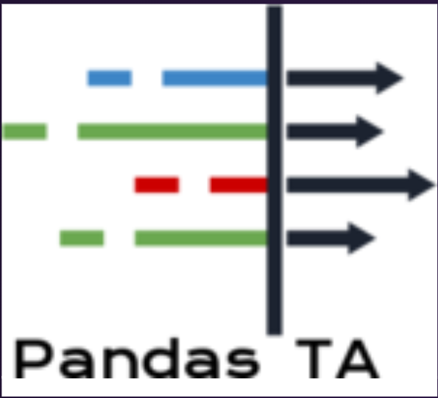





Libraries
Notes:
Libs we use

Slide 8
Features & Targets

Slide 9
Features
High, Low, Close & Volume
Exponential Moving Averages (EMA)
Moving Average Convergence Divergence (MACD)
Relative Strength Index (RSI)
Alpha & Beta
Stochastic Momentum Index
Financial News Headlines
Notes:
Features and feature extraction
Next EDA -

Slide 10
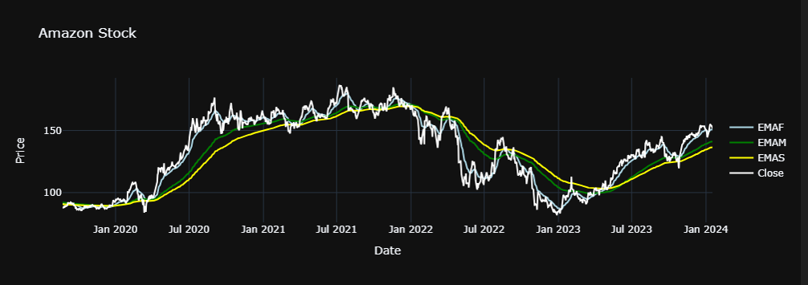
Exponential Moving Averages & Close Price
Notes:
EDA -> No predictions, just representation of movement, correlation with Close Price

Slide 11
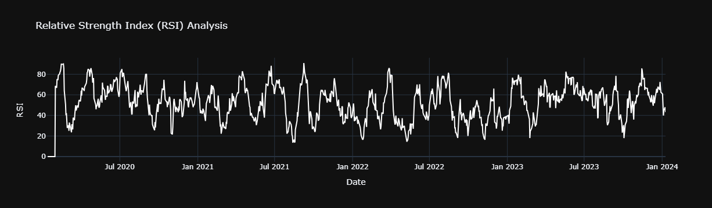
Relative Strength Index (RSI)

Slide 12
Targets
Price target:
What is tomorrow’s stock price?
Binary target:
Will tomorrow’s price go up or down?
Notes:
Main Goal to predict mvmt and $

Slide 13
Machine Learning Models
Notes:
Hand over to Jonas

Slide 14
XGBoost Classifier & Regressor
XGBoost is a leading gradient boosting algorithm known for its robust performance.
Proven to be powerful in both classification and regression tasks.
Popular model for stock market predictions.

Slide 15
Long Short-Term Memory (LSTM)
Long Short-Term Memory (LSTM) is a recurrent neural network (RNN) architecture.
Effective in capturing and learning long-term dependencies in sequential data.
Well-suited for time series forecasting and also popular among traders.
Notes:
Fauzan

Slide 16
FinBERT
FinBERT is a pre-trained natural language processing model (NLP), fine-tuned on financial texts.
Designed to understand and analyze complex financial language for sentiment analysis, market predictions, and financial research.
Notes:
Chris;

Slide 17
Evaluation

Slide 18
Baseline Models
Classification task: By random guessing of “Up” or “Down”, we could expect an accuracy of 50%. …although not very applicable to finance.
Regression task: Simple moving average model with a window of 10 days = tomorrow’s price.
RMSE: 5.74
MAPE: 3.27%
Notes:
Explain different metrics - finance (Api). DIfficulties collecting data (sentiment = expensive)

Slide 19
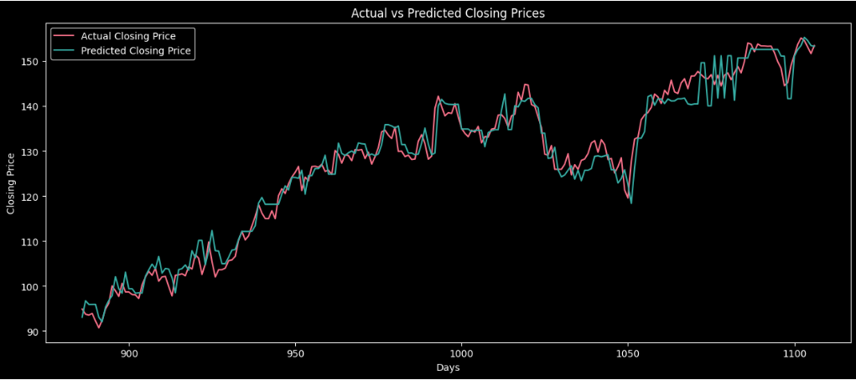
XGB Regressor (Amazon)
Test RMSE: 3.07
Test MAPE: 1.89%
Notes:
Explain different metrics - finance (Api). DIfficulties collecting data (sentiment = expensive)

Slide 20
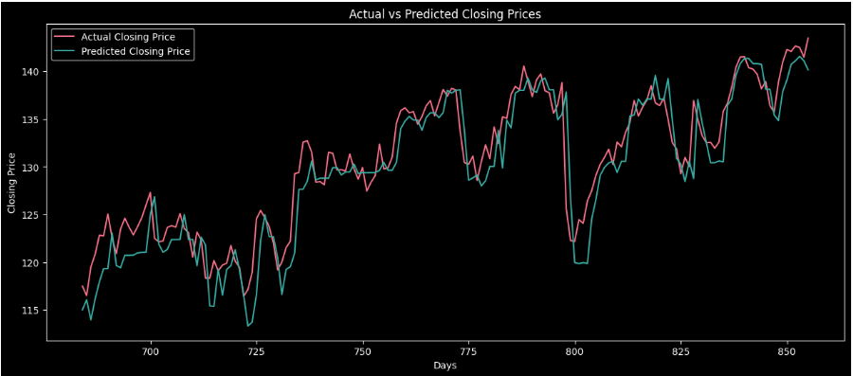
XGB Regressor (Google)
Test RMSE: 2.79
Test MAPE: 1.62%
Notes:
Explain different metrics - finance (Api). DIfficulties collecting data (sentiment = expensive)

Slide 21
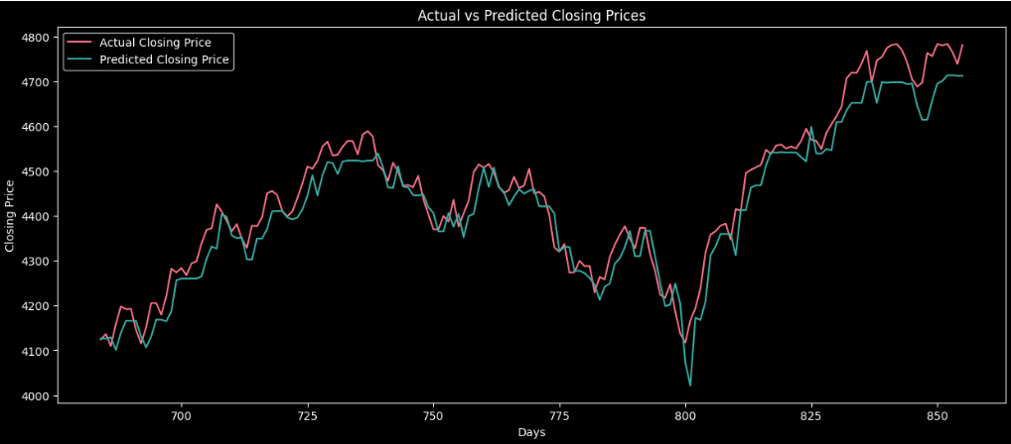
XGB Regressor (S&P500)
Test RMSE: 49.27
Test MAPE: 0.89%
Notes:
Explain different metrics - finance (Api). DIfficulties collecting data (sentiment = expensive)

Slide 22
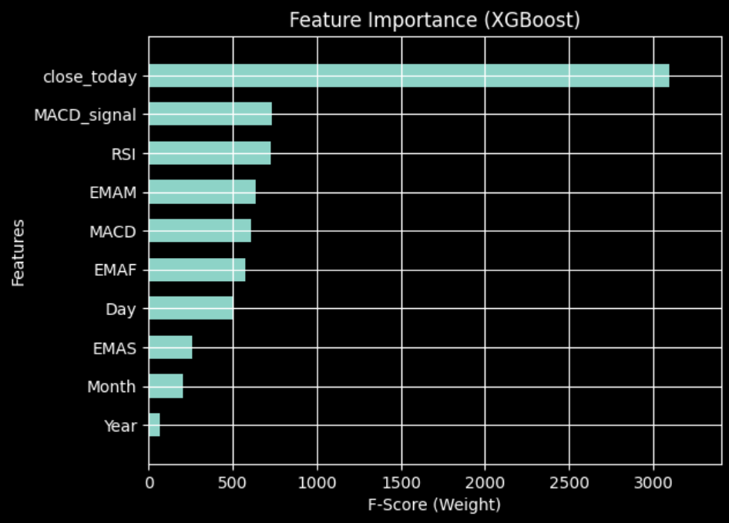
XGB Regressor (Amazon)
Hyperparameters:
Gamma = 0.01
Learning Rate = 0.01
Max depth = 5
N estimators = 300
Train data = ~ 4 years
Notes:
Explain different metrics - finance (Api). DIfficulties collecting data (sentiment = expensive)
Dig into all features
Add SMA_200 (TBT)
Review features

Slide 23
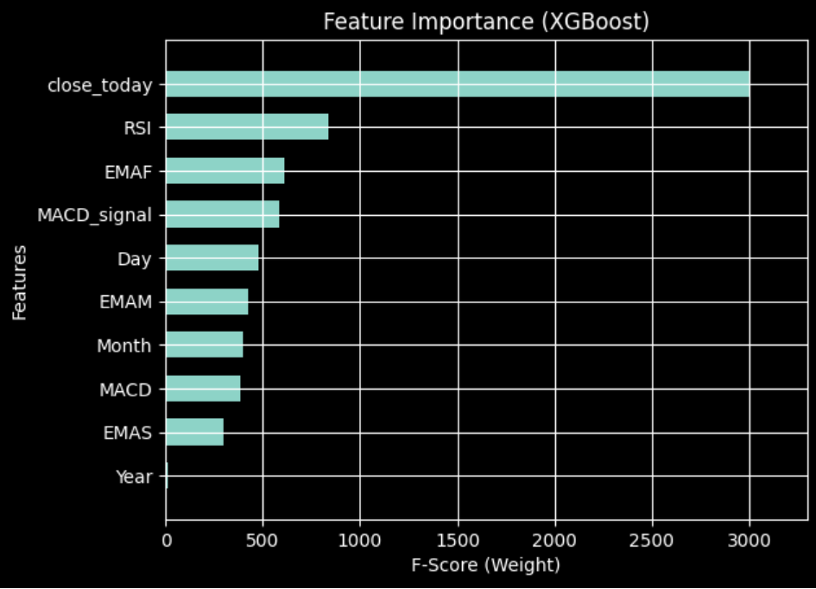
XGB Regressor (Meta)
Hyperparameters:
Gamma = 0.01
Learning Rate = 0.01
Max depth = 5
N estimators = 300
Train data = ~ 3 years
Notes:
Close_today still largest weight
Following features are the same, but with different hierachies

Slide 24
XGB Classifier (Apple)
Class | Precision | Recall | F1-score
0 | 0,63 | 0,51 | 0,56
1 | 0,58 | 0,69 | 0,63
Accuray | 60%
Hyperparameters:
Subsample = 0.8, Learning Rate = 0.01, Max depth = 3
N estimators = 300, CV = 5 splits, Threshold = 0.55%
Train data = ~ 6 years
Notes:
Part of meth?

Slide 25
XGB Classifier - Important Features
High, Low and Close Price
Alpha (Stock Risk)
Beta (Market Risk)
Stochastic Momentum Index

Slide 26
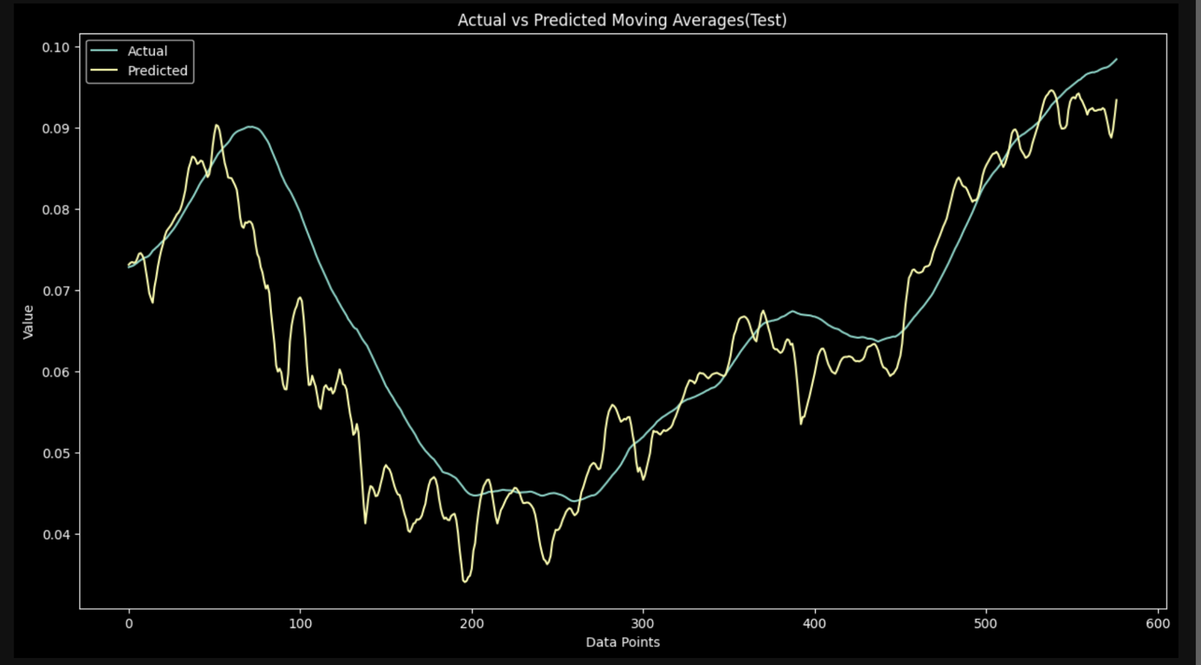
LSTM - Predicting MA (Change of Direction)
Test R-squared : 0.78

Slide 27
The DDD Stock APP

Slide 28
Limitations
Our ML Models are sensitive to train data length.
The stock market is unpredictable. Regulatory changes, new market conditions are not learned on training data.
Sentiment implementation in model training. Current and historical news data is costly.
Project is for educational purposes.
Notes:
Explain different metrics - finance (Api). DIfficulties collecting data (sentiment = expensive)

Slide 29
Next steps
Sentiment analysis in model training.
Create a more robust and less sensitive model.
Expand feature selection.
Implement a framework in the app to allow users to create portfolios.
Implement chatbot.

Slide 30
Thank You for Listening

Slide 31
EXTRA ILLUSTRATIONS

Slide 32
SlidesCarnival icons are editable shapes. This means that you can:
Resize them without losing quality.
Change fill color and opacity.
Change line color, width and style.
Isn’t that nice? :) Examples:
Find more icons at slidescarnival.com/extra-free-resources-icons-and-maps

Slide 33
Sentiment analysis via FinBERT
Date | Headlines | Probabilities | Sentiment
jul. 16 2020 | Amazon India demands product listings have cou... | [[0.02140732, 0.02336918, 0.95522356]] | positive
jul. 15 2020 | India's Reliance seen emerging as bigger threa... | [[0.18353687, 0.77087814, 0.04558501]] | neutral
jul. 14 2020 | Amazon extends work from home policy, still re... | [[0.09093143, 0.0315794, 0.8774892 ]] | positive

Slide 34
DIAGRAMS AND INFOGRAPHICS

Slide 35
You can also use any emoji as an icon! And of course it resizes without losing quality.
How? Follow Google instructions https://twitter.com/googledocs/status/730087240156643328
✋👆👉👍👤👦👧👨👩👪💃🏃💑❤😂😉😋😒😭👶😸🐟🍒🍔💣📌📖🔨🎃🎈🎨🏈🏰🌏🔌🔑 and many more...

