Slide 1
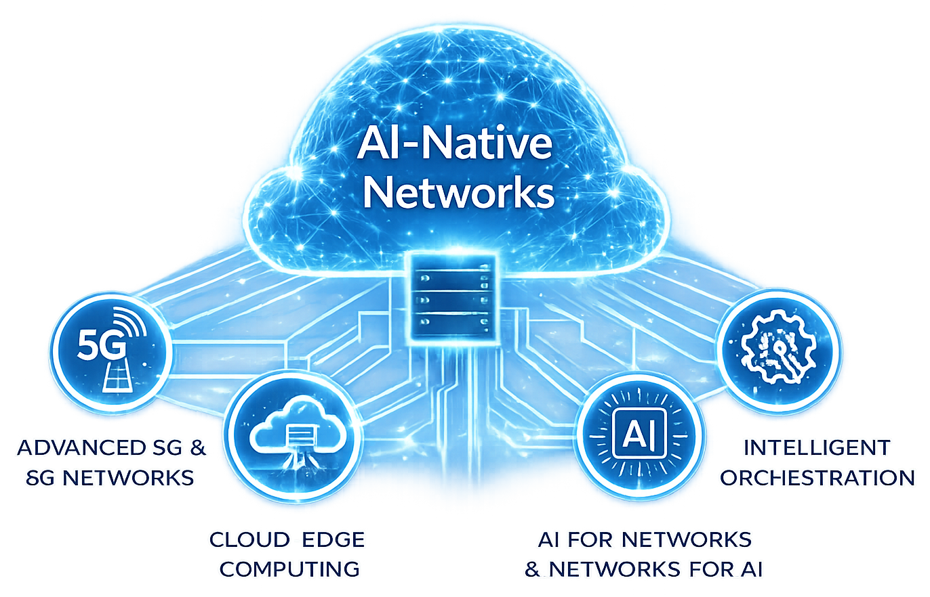
ADVANCED STEM PROGRAM
AI-Native Networks:
Engineering the Infrastructure of the AI Era
Postgraduate Course
2026
https://www.5gacademy.unina.it/
CO-DESIGN BY
Notes:
FAUZAN - 0:00-0:30
Good morning, we're Team 4, presenting AEGIS: a zero-trust identity check for the AI agents and automations that now operate the 5G network.

Slide 2
AEGIS
- Team 4
Index
01
What We're Building
02
The 5G Network, In Plain Terms
03
The Agents We Modelled
04
How We Built The Prototype
05
Technologies & Synthetic Data
06
The Attacks We Simulated
07
How AEGIS Decides
CO-DESIGN BY
08
Proof It Works
09
Project Plan: Schedule, Feasibility & Business Case
2
Notes:
FAUZAN - 0:30-1:00
Here's how we'll walk through this: first, we'll explain what AEGIS actually is and how it works in plain language, no assumed background needed. Then in the last section we'll cover our project schedule, feasibility, and the business case, which is exactly what Gate 1 asks us to demonstrate.

Slide 3
Credentials prove what you have, AEGIS verifies how you behave.
Runs entirely on open-source tools, no licensing cost.
No specialised hardware, works on a standard laptop.
AEGIS is a zero-trust identity check for the AI agents and automations that call the 5G network's control systems. It combines the 5G Service-Based Architecture (the network's internal API layer), a zero-trust security model, and behavioural machine learning: it learns each agent's normal working pattern and scores every request against it, using open-source tools (Python, scikit-learn, Streamlit) end to end, no specialised hardware, no licensing cost.
et dolore magna aliqua.
Learns each agent's own normal behaviour automatically.
Every decision comes with a plain-language reason.
Notes:
FAUZAN - 1:00-2:30
One line to remember us by: credentials prove what you have, AEGIS verifies how you behave. Today, an automated agent proves who it is with a password or token, and that's the only check. A stolen credential still passes that check every time. AEGIS adds a second, continuous layer: it learns how each agent normally behaves and checks every request against that pattern. It's built entirely on open-source tools, runs on a laptop, and every decision it makes comes with a plain-language reason, never a black box.

Slide 4
PART 2 OF 8 · PLAIN-LANGUAGE WALKTHROUGH
The 5G Network, In Plain Terms
A 5G network is a set of specialised systems, each handling one job, that talk to each other over standard APIs, like departments in a company.
AMF
SMF
NRF
Access & Mobility
Session Management
Network Repository
Keeps track of where a device is and whether it's reachable.
Opens, updates and closes a device's data session.
The internal directory: lets systems find each other.
PCF
UDM
NEF
Policy Control
Unified Data Management
Network Exposure
Decides and enforces the rules a session must follow.
Holds and serves subscriber data on request.
The controlled front door for outside apps and automations.
Notes:
ADITHYA - 2:30-4:00
Before we go further, quick grounding: a 5G network isn't one big machine, it's six specialised systems, each handling one job, like departments in a company. AMF tracks where a device is. SMF manages sessions. NRF is the internal directory. PCF enforces policy. UDM holds subscriber data. NEF is the controlled front door for outside automations. Every agent we model talks to these six systems, and that's the surface AEGIS protects.

Slide 5
PART 3 OF 8 · PLAIN-LANGUAGE WALKTHROUGH
The Agents We Modelled
Five automations, each with its own job, schedule and routine, so AEGIS can tell when one of them starts acting unlike itself.
Session orchestrator
Opens/closes sessions across AMF, SMF, PCF - runs 24/7, steady pace.
Inventory job
Reads records from NRF, UDM only - runs briefly overnight.
Closed-loop assurance
Subscribes to live events on AMF, NEF, PCF - runs 24/7.
NRF heartbeat service
Registers and pings NRF only - very steady, low volume.
Provisioning agent
Updates subscriber data via NEF, UDM - business hours only.
Notes:
ADITHYA - 4:00-5:30
We modelled five distinct automated agents, each with its own job, schedule, and normal routine: a session orchestrator running around the clock, a nightly inventory job, a closed-loop monitoring agent, a simple NRF heartbeat service, and a business-hours provisioning agent. This matters because AEGIS doesn't look for 'bad behaviour' in the abstract, it looks for behaviour that doesn't match what that specific agent normally does, so each needed a genuinely distinct personality to prove the idea works.

Slide 6
PART 4 OF 8 · PLAIN-LANGUAGE WALKTHROUGH
How We Built The Prototype
1. Traffic simulator (not AI)
A program we wrote ourselves that plays out a virtual week of activity for all 5 agents. This is a scripted simulation, not a machine-learning model - it produced about 210,000 requests.
2. Injected attacks
Into that traffic we inserted 7 kinds of attack episodes, each labelled, so we know exactly which requests are attacks - only possible because the data is simulated.
3. Detection engine (the real ML)
A separate program reads the traffic, builds a behavioural fingerprint per agent, and scores every window for risk. This is where an actual machine-learning model, an Isolation Forest, is used.
Notes:
ADITHYA - 5:30-7:00
We built this in three parts. First, a traffic simulator we wrote ourselves, not AI, a scripted program that generated about 210,000 realistic requests for a virtual week. Second, we injected seven kinds of attacks into that traffic, each labelled, so we know exactly which requests are attacks, only possible because the data is simulated. Third, the actual detection engine, this is where real machine learning, an Isolation Forest, is used to spot the attacks we hid inside.

Slide 7
PART 5 OF 8 · PLAIN-LANGUAGE WALKTHROUGH
Technologies & Synthetic Data
What we actually built with, and how we built the traffic the prototype learns from and is tested against.
TECHNOLOGY STACK
HOW THE SYNTHETIC DATA WAS BUILT
Python
- 6 Network Functions modelled (AMF, SMF, NRF, PCF, UDM, NEF), each with realistic SBI endpoints.
- 5 agent profiles, each with its own scope, schedule, and call sequence, played out over a simulated week (~210k requests).
- 7 attack types (T1-T7) injected on top of that legitimate traffic, each one ground-truth labelled for evaluation.
- Everything is free and open-source; real M2M/API-gateway logs are pluggable later if Fastweb/Vodafone can share them.
The language everything is written in - free, open-source, industry-standard.
pandas / numpy
Handle the 210,000 simulated requests as structured, queryable data.
scikit-learn
Standard ML library - this is where the Isolation Forest model comes from.
Streamlit
Turns the Python detector into the live, interactive gate dashboard.
The data generator is a scripted simulation, not AI. The Isolation Forest is the only place machine learning is actually used, on the detection side.
Notes:
ADITHYA - 7:00-8:30
Quick word on what this actually runs on, since it matters for feasibility: everything is open-source, Python, pandas and numpy for the data, scikit-learn for the Isolation Forest model, and Streamlit for the live dashboard you'll see in a moment. No licensing cost, no specialised hardware, it runs on a standard laptop. And to be precise about the synthetic data itself: we modelled all six Network Functions with realistic SBI endpoints, five agent profiles playing out a full simulated week, about 210,000 requests total, then injected the seven attack types on top, each one ground-truth labelled. If Fastweb or Vodafone can share real M2M or API-gateway logs later, they plug into the exact same pipeline, this is an upgrade path, not a rebuild.

Slide 8
PART 6 OF 8 · PLAIN-LANGUAGE WALKTHROUGH
The Attacks We Simulated
We assume the attacker already has a valid credential. What changes is the behaviour, not the credential.
T1
Impersonation
T2
Compromised agent
T3
Recon / scanning
T4
Volumetric flood
acts like a different agent
drifts to new behaviour
probes broadly, many errors
request rate spikes hard
T5
Slow exfiltration
T6
Broken sequence
T7
Scope creep
quiet, large data pulls
closes what was never opened
touches systems outside its role
Notes:
GHAZANFAR - 8:30-10:30
We assume the attacker already has a valid credential, the realistic, hard case, so what changes is behaviour, not the password. We modelled seven attacks: impersonation, a compromised agent drifting into new behaviour, reconnaissance scanning, a volumetric flood, slow data exfiltration, a broken call sequence, and scope creep. All seven are built into our prototype, and as we'll show, all seven are currently detected.

Slide 9
PART 7 OF 8 · PLAIN-LANGUAGE WALKTHROUGH
How AEGIS Decides
OBSERVE
FINGERPRINT
SCORE
DECIDE
Log every request: agent, target, timing, size, status.
Compare the last 60s of activity to that agent's own normal.
Hard rules + an ML model (trained on legit traffic only) combine into one risk number.
Fixed thresholds turn the risk number into PASS / STEP-UP / BLOCK, automatically.
PASS
STEP-UP
BLOCK
behaves like itself
challenge / re-verify
quarantine, alert a human
There is no person watching in real time. The decision is fully automatic - a human only reviews after a STEP-UP or BLOCK is raised.
Notes:
GHAZANFAR - 10:30-13:00
Here's how the gate actually decides, four steps, fully automatic, no person watching in real time. Observe: every request gets logged. Fingerprint: we compare the last 60 seconds of an agent's activity against its own normal pattern. Score: hard rules plus a machine-learning model, trained only on legitimate traffic, combine into one risk number. Decide: fixed thresholds turn that number into pass, step-up, or block. A human only gets involved afterwards, reviewing a step-up or block once it's already been raised.

Slide 10
PART 8 OF 8 · PLAIN-LANGUAGE WALKTHROUGH
Proof It Works
0.99
98%
0.8%
7 / 7
ROC-AUC
RECALL
FALSE POSITIVES
THREATS COVERED
Measured on 11,343 held-out windows the model never trained on: attacks separate cleanly from normal traffic at 0.99 ROC-AUC, 98% of injected attacks caught, only 0.8% of legitimate traffic wrongly flagged.
THE HONEST CAVEAT
This is synthetic-first: it proves the method works and is well-calibrated, not that it holds up on real network traffic yet - that validation is exactly what real or anonymised data from Fastweb + Vodafone would give us.
Notes:
GHAZANFAR - 13:00-15:00
This isn't a design target, it's a working prototype with real numbers. On over eleven thousand test windows the model never trained on: 0.99 ROC-AUC, 98% of injected attacks caught, only 0.8% of legitimate traffic wrongly flagged, all seven threats detected. The honest caveat: this proves the method works on data we built ourselves, real traffic validation is the next step, which is exactly what we're asking Fastweb and Vodafone for.

Slide 11
Project Roadmap & Timeline
July
August
June
September
October
May
2 Sep
Fastweb meeting
1 Nov
Final video
27 Jul
Traffic generator
22 Sep
Gate 2 performance analysis
Oct - Video shoot
24 Jul
Threat model
10 Aug
Baseline detector
24 Sep - Storyboard
Oct - PoC evaluation
7 Sep
Gate 1 proposal
15 Oct
Gate 3 PoC demo
Notes:
LLAGAMI - 15:00-16:30
Now the part Gate 1 specifically asks us to cover: our schedule, feasibility and business case. Here's our full timeline. Everything up to and including today's Gate 1 milestone is already complete, this isn't a plan, it's work already done.

Slide 12
High level plan
Activities | May | June |  | July | August | September
 |  | 17 | 29 | 22 |  | 6 | 30
Data foundation & threat model
Synthetic traffic generator + baseline detector
Gate 1 - Project proposal
Gate 2 - Technical solution & performance analysis
Real-data integration (if granted by Fastweb/Vodafone)
Gate 3 - Proof of Concept & live demo
Storyboard, shooting & final video
Threat model
Traffic gen. built
Kick-off project works
Gate 1 - 7 Sep
1st Gate deadline
Fastweb meeting
Progress review
Hardening + real data
Gate 2 - 22 Sep
2nd Gate deadline
3rd Gate deadline
Gate 3 - 15 Oct
Closing Cerimony
Notes:
LLAGAMI - 16:30-18:00
Breaking that down by phase: the data foundation and baseline detector you just saw results from are complete. From here, we harden the detector, submit Gate 2 on 22 September, integrate real data if it's granted, and deliver the full live demo at Gate 3 on 15 October.

Slide 13
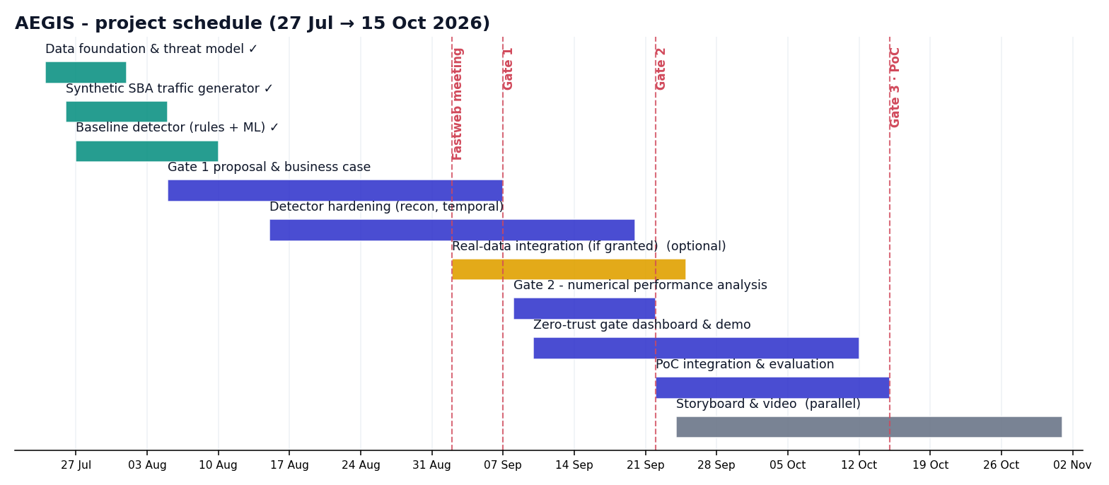
High level plan
Notes:
LLAGAMI - 18:00-19:30
And here's that same schedule as a Gantt chart. Green is done, blue is upcoming work, amber is the optional real-data integration track. We're currently ahead of where we need to be for Gate 2.

Slide 14
Risk Analysis
Risk | Likelihood | Severity | Remediation
Risk #1 - Real data not shared in time | Medium | High | Stay synthetic-first: the baseline PoC already works without real data; real data upgrades the result, it does not block delivery.
Risk #2 - FASTedge has no inline policy hook | Medium | Medium | Demo as a passive observe-and-alert system feeding a SOC workflow instead of inline enforcement, still a complete, useful PoC.
Risk #3 - Detector doesn't generalise to real traffic noise | Low | High | Validate early against any real sample offered; keep the deterministic rules layer as a robust fallback alongside the ML model.
Risk #4 - Timeline slip before Gate 2 / Gate 3 | Low | Medium | Foundation and baseline detector are already complete ahead of schedule, giving buffer through the Sep-Oct plan.
Risk #5 - Team bandwidth / academic workload conflicts | Medium | Low | Clear task ownership per member, weekly sync, captain tracks blockers early.
Notes:
LLAGAMI - 19:30-22:00
On feasibility: we identified five real risks and a mitigation for each, from data not being shared in time, to FASTedge not exposing an inline hook, to the detector not generalising to real traffic noise. The biggest one, data access, is fully mitigated already: we're synthetic-first, so no data approval process blocks us from having a working system today. Real data only makes the result stronger, it isn't a dependency.

Slide 15
Open points
Area | Actions/Notes | Status
Financial | Cost: no licensing, 100% open-source, runs on a laptop; production adds only light edge compute. Value: cuts detection time from hours to seconds, enables safer network automation, and gives audit-ready evidence for NIS2/GDPR/EU AI Act. To be jointly costed and validated with Fastweb + Vodafone.
 |  | Completed
 |  | Completed
Engineering | Detector hardening (recon, temporal features): on going. Real-data integration if Fastweb/Vodafone grant access: to be confirmed. Synthetic traffic generator + baseline detector (rules + ML): completed. | On going
 |  | To be confirmed
 |  | Completed
Communication | 2 Sep dev meeting with Fastweb + Vodafone: completed. Follow-up on data access, FASTedge hook, priority agent types: tbd. Gate 1 presentation slot & internal review: defined. | Completed
 |  | tbd
 |  | Defined
Presentation | Gate 1 slide deck & speaking roles across all 4 members: tbd until final rehearsal. Live dashboard walkthrough script: tbd until dry-run timing confirmed. Presentation structure (this deck): defined. | tbd
 |  | tbd
 |  | Defined
Next Steps | Gate 2 numerical performance hardening (recon/temporal features). Real-data integration: delayed pending Fastweb/Vodafone data-sharing decision. Gate 3 live end-to-end dashboard demo. | tbd
 |  | Delay
 |  | tbd
AoB | None raised at this time.
1
2
3
4
5
6
Notes:
LLAGAMI - 22:00-25:00
On business value: this cuts detection time from hours to seconds, it's the guardrail that lets an operator safely expand network automation, and every decision is logged and explainable, which is direct audit evidence for NIS2, GDPR, and the EU AI Act. We're tracking this work area by area, financial, engineering, communication, and next steps, so nothing falls through the cracks before Gate 2.

Slide 16
Next steps
Week 1
Week 2
Week 3
Week 4
Final week
Sep 8-14: kick off Gate 2 hardening, add recon/temporal detection features and expand attack variants.
Sep 15-21: finish the numerical performance analysis and prepare the Gate 2 report and deck.
Sep 22-28: Gate 2 submitted; start dashboard hardening and the demo-video storyboard.
Sep 29-Oct 5: integrate real data if granted; refine the live zero-trust gate dashboard.
Oct 6-15: final PoC integration, rehearsal, and the Gate 3 live demo delivery.
Notes:
FAUZAN - 25:00-27:30
So, week by week from here: hardening the detector, finishing the numerical performance analysis for Gate 2, then integrating real data if granted, and finally the live end-to-end dashboard demo for Gate 3 on 15 October.

Slide 17
ADVANCED STEM PROGRAM
AI-Native Networks:
Engineering the Infrastructure of the AI Era
Thank you
CO-DESIGN BY
This presentation contains information that may be privileged or confidential and is the property of 5G Academy 2025/26.​
Copyright © 2025/26 5G Academy. All rights reserved.
Notes:
FAUZAN - 27:30-29:30
To close: the hardest part, proving the detection method actually works, is already done, working, and in front of you today. We're confident in this direction and looking forward to your questions. Thank you.

