Slide 1
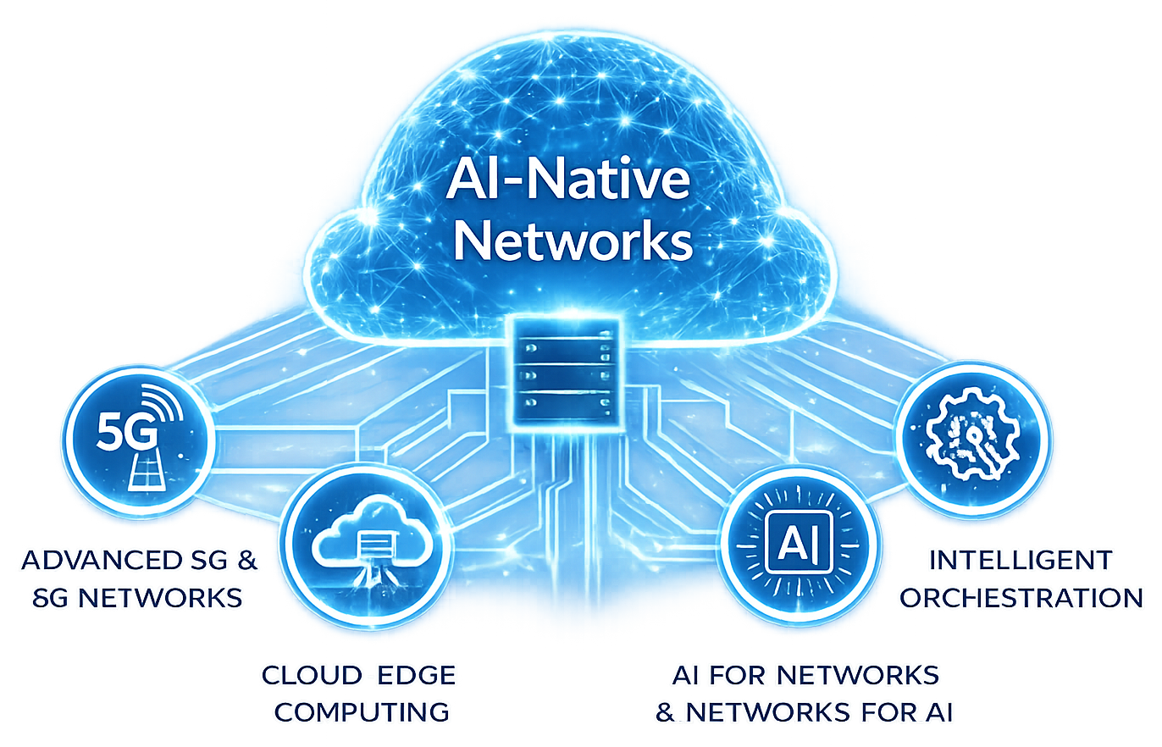
ADVANCED STEM PROGRAM
AI-Native Networks:
Engineering the Infrastructure of the AI Era
Postgraduate Course
2026
https://www.5gacademy.unina.it/
CO-DESIGN BY

Slide 2
AEGIS
Index
01
What We're Building
02
The 5G Network, In Plain Terms
03
The Agents We Modelled
Team 4 –
Fauzan Ejaz (Captain)
Adithya Zacharia Valavi
Ghazanfar Anees Siddiqui
Llagami Tedi
04
How We Built The Prototype
05
The Attacks We Simulated
06
How AEGIS Decides
CO-DESIGN BY
07
Proof It Works
08
Project Plan: Schedule, Feasibility & Business Case
2

Slide 3
Credentials prove what you have, AEGIS verifies how you behave.
Runs entirely on open-source tools, no licensing cost.
No specialised hardware, works on a standard laptop.
AEGIS is a zero-trust identity check for the AI agents and automations that call the 5G network's control systems. It combines the 5G Service-Based Architecture (the network's internal API layer), a zero-trust security model, and behavioural machine learning: it learns each agent's normal working pattern and scores every request against it, using open-source tools (Python, scikit-learn, Streamlit) end to end, no specialised hardware, no licensing cost.
Learns each agent's own normal behaviour automatically.
Every decision comes with a plain-language reason.

Slide 4
PART 2 OF 7 · PLAIN-LANGUAGE WALKTHROUGH
The 5G Network, In Plain Terms
A 5G network is a set of specialised systems, each handling one job, that talk to each other over standard APIs, like departments in a company.
AMF
SMF
NRF
Access & Mobility
Session Management
Network Repository
Keeps track of where a device is and whether it's reachable.
Opens, updates and closes a device's data session.
The internal directory: lets systems find each other.
PCF
UDM
NEF
Policy Control
Unified Data Management
Network Exposure
Decides and enforces the rules a session must follow.
Holds and serves subscriber data on request.
The controlled front door for outside apps and automations.

Slide 5
PART 3 OF 7 · PLAIN-LANGUAGE WALKTHROUGH
The Agents We Modelled
Five automations, each with its own job, schedule and routine, so AEGIS can tell when one of them starts acting unlike itself.
Session orchestrator
Opens/closes sessions across AMF, SMF, PCF - runs 24/7, steady pace.
Inventory job
Reads records from NRF, UDM only - runs briefly overnight.
Closed-loop assurance
Subscribes to live events on AMF, NEF, PCF - runs 24/7.
NRF heartbeat service
Registers and pings NRF only - very steady, low volume.
Provisioning agent
Updates subscriber data via NEF, UDM - business hours only.

Slide 6
PART 4 OF 7 · PLAIN-LANGUAGE WALKTHROUGH
How We Built The Prototype
1. Traffic simulator (not AI)
A program we wrote ourselves that plays out a virtual week of activity for all 5 agents. This is a scripted simulation, not a machine-learning model - it produced about 210,000 requests.
2. Injected attacks
Into that traffic we inserted 7 kinds of attack episodes, each labelled, so we know exactly which requests are attacks - only possible because the data is simulated.
3. Detection engine (the real ML)
A separate program reads the traffic, builds a behavioural fingerprint per agent, and scores every window for risk. This is where an actual machine-learning model, an Isolation Forest, is used.

Slide 7
PLAIN-LANGUAGE WALKTHROUGH
Technologies & Synthetic Data
What we actually built with, and how we built the traffic the prototype learns from and is tested against.
TECHNOLOGY STACK
HOW THE SYNTHETIC DATA WAS BUILT
Python
- 6 Network Functions modelled (AMF, SMF, NRF, PCF, UDM, NEF), each with realistic SBI endpoints.
- 5 agent profiles, each with its own scope, schedule, and call sequence, played out over a simulated week (approx. 210k requests).
- 7 attack types (T1-T7) injected on top of that legitimate traffic, each one ground-truth labelled for evaluation.
- Everything is free and open-source; real M2M/API-gateway logs are pluggable later if Fastweb/Vodafone can share them.
The language everything is written in - free, open-source, industry-standard.
pandas / numpy
Handle the 210,000 simulated requests as structured, queryable data.
scikit-learn
Standard ML library - this is where the Isolation Forest model comes from.
Streamlit
Turns the Python detector into the live, interactive gate dashboard.
The data generator is a scripted simulation, not AI. The Isolation Forest is the only place machine learning is actually used, on the detection side.

Slide 8
PART 5 OF 7 · PLAIN-LANGUAGE WALKTHROUGH
The Attacks We Simulated
We assume the attacker already has a valid credential. What changes is the behaviour, not the credential.
T1
Impersonation
T2
Compromised agent
T3
Recon / scanning
acts like a different agent
drifts to new behaviour
probes broadly, many errors
T4
T5
Slow exfiltration
T6
Volumetric flood
Broken sequence
request rate spikes hard
quiet, large data pulls
closes what was never opened
T7
Scope creep
touches systems outside its role

Slide 9
PART 6 OF 7 · PLAIN-LANGUAGE WALKTHROUGH
How AEGIS Decides
OBSERVE
FINGERPRINT
SCORE
DECIDE
Log every request: agent, target, timing, size, status.
Compare the last 60s of activity to that agent's own normal.
Hard rules + an ML model (trained on legit traffic only) combine into one risk number.
Fixed thresholds turn the risk number into PASS / STEP-UP / BLOCK, automatically.
PASS
STEP-UP
BLOCK
behaves like itself
challenge / re-verify
quarantine, alert a human
There is no person watching in real time. The decision is fully automatic - a human only reviews after a STEP-UP or BLOCK is raised.

Slide 10
PART 7 OF 7 · PLAIN-LANGUAGE WALKTHROUGH
Proof It Works
0.99
98%
0.8%
7 / 7
ROC-AUC
RECALL
FALSE POSITIVES
THREATS COVERED
Measured on 11,343 held-out windows the model never trained on: attacks separate cleanly from normal traffic at 0.99 ROC-AUC, 98% of injected attacks caught, only 0.8% of legitimate traffic wrongly flagged.
THE HONEST CAVEAT
This is synthetic-first: it proves the method works and is well-calibrated, not that it holds up on real network traffic yet - that validation is exactly what real or anonymised data from Fastweb + Vodafone would give us.

Slide 11
Project Roadmap & Timeline
July
August
June
September
October
May
2 Sep
Fastweb meeting
1 Nov
Final video
27 Jul
Traffic generator
22 Sep
Gate 2 performance analysis
Oct - Video shoot
November
24 Jul
Threat model
10 Aug
Baseline detector
24 Sep - Storyboard
Oct - PoC evaluation
7 Sep
Gate 1 proposal
15 Oct
Gate 3 PoC demo

Slide 12
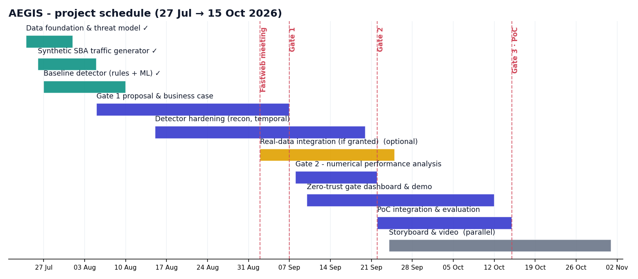
High level plan

Slide 13
Risk Analysis
Risk | Likelihood | Severity | Remediation
Risk #1 - Real data not shared in time | Medium | High | Stay synthetic-first: the baseline PoC already works without real data; real data upgrades the result, it does not block delivery.
Risk #2 - FASTedge has no inline policy hook | Medium | Medium | Demo as a passive observe-and-alert system feeding a SOC workflow instead of inline enforcement, still a complete, useful PoC.
Risk #3 - Detector doesn't generalise to real traffic noise | Low | High | Validate early against any real sample offered; keep the deterministic rules layer as a robust fallback alongside the ML model.
Risk #4 - Timeline slip before Gate 2 / Gate 3 | Low | Medium | Foundation and baseline detector are already complete ahead of schedule, giving buffer through the Sep-Oct plan.
Risk #5 - Team bandwidth / academic workload conflicts | Medium | Low | Clear task ownership per member, weekly sync, captain tracks blockers early.

Slide 14
Open points
Area | Actions/Notes | Status
Financial | Cost: no licensing, 100% open-source, runs on a laptop; production adds only light edge compute. Value: cuts detection time from hours to seconds, enables safer network automation, and gives audit-ready evidence for NIS2/GDPR/EU AI Act. To be jointly costed and validated with Fastweb + Vodafone.
 |  | Completed
 |  | Completed
Engineering | Detector hardening (recon, temporal features): on going. Real-data integration if Fastweb/Vodafone grant access: to be confirmed. Synthetic traffic generator + baseline detector (rules + ML): completed. | On going
 |  | To be confirmed
 |  | Completed
Communication | 2 Sep dev meeting with Fastweb + Vodafone: completed. Follow-up on data access, FASTedge hook, priority agent types: tbd. Gate 1 presentation slot & internal review: defined. | Completed
 |  | tbd
 |  | Defined
Presentation | Gate 1 slide deck & speaking roles across all 4 members: tbd until final rehearsal. Live dashboard walkthrough script: tbd until dry-run timing confirmed. Presentation structure (this deck): defined. | tbd
 |  | tbd
 |  | Defined
Next Steps | Gate 2 numerical performance hardening (recon/temporal features). Real-data integration: delayed pending Fastweb/Vodafone data-sharing decision. Gate 3 live end-to-end dashboard demo. | tbd
 |  | Delay
 |  | tbd
AOB | None raised at this time.
1
2
3
4
5
6

Slide 15
Next steps
Week 1
Week 2
Week 3
Week 4
Final week
Sep 8-14: kick off Gate 2 hardening, add recon/temporal detection features and expand attack variants.
Sep 15-21: finish the numerical performance analysis and prepare the Gate 2 report and deck.
Sep 22-28: Gate 2 submitted; start dashboard hardening and the demo-video storyboard.
Sep 29-Oct 5: integrate real data if granted; refine the live zero-trust gate dashboard.
Oct 6-15: final PoC integration, rehearsal, and the Gate 3 live demo delivery.

Slide 16
ADVANCED STEM PROGRAM
AI-Native Networks:
Engineering the Infrastructure of the AI Era
Thank you
CO-DESIGN BY
This presentation contains information that may be privileged or confidential and is the property of 5G Academy 2025/26.​
Copyright © 2025/26 5G Academy. All rights reserved.

