Slide 1
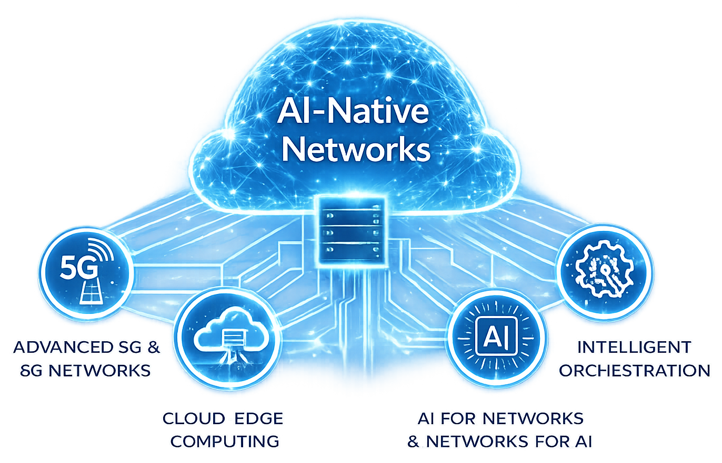
ADVANCED STEM PROGRAM
AI-Native Networks:
Engineering the Infrastructure of the AI Era
Postgraduate Course
2026
https://www.5gacademy.unina.it/
CO-DESIGN BY

Slide 2
Index
AEGIS
Gate 2
01
Proposed Technical Solution
02
Architecture
03
Implementation Strategy
Team 4 :
Fauzan Ejaz (Captain)
Adithya Zacharia Valavi
Ghazanfar Anees Siddiqui
Llagami Tedi
Numerical Performance Analysis
04
05
Expected Proof of Concept
Path to Gate 3
06
CO-DESIGN BY
2

Slide 3
PART 1 OF 6 - GATE 2: TECHNICAL SOLUTION & ARCHITECTURE
Proposed Technical Solution
A stolen credential still passes authentication. AEGIS answers the question authentication never asks: is this really our agent, behaving the way it always does?
“Credentials prove what you have, AEGIS verifies how you behave.”
OBSERVE -> FINGERPRINT -> SCORE -> DECIDE (zero-trust gate dashboard)
T1
Identity spoofing
T2
Compromised agent
T3
Reconnaissance
wrong endpoint mix, timing, sequence for that identity
drift from its own baseline: new endpoints, elevated errors
high cardinality of endpoints/targets, many 403/404s
T4
T5
Slow exfiltration
T6
Sequence anomaly
Volumetric abuse
request-rate spike far above the agent's normal envelope
abnormal payload sizes, off-hours persistence
broken call-sequence pattern vs the agent's normal graph
T7
Scope creep
calls to NFs never in the agent's baseline scope

Slide 4
PART 1 OF 6 - GATE 2: TECHNICAL SOLUTION & ARCHITECTURE
The Gap, Our Solution, and the State of the Art
THE GAP
OUR SOLUTION
VS. STATE OF THE ART
A credential check proves you have the right token, once, at the door. It never asks whether the traffic behind that token still behaves like the agent it claims to be - a stolen or misused identity passes every time.
A behavioural fingerprint per agent, scored continuously: observe, fingerprint, score, decide. Rules (fast, explainable) fused with an Isolation Forest (trained on legit traffic only) - gated PASS / STEP-UP / BLOCK.
Named, reimplemented, and run on our own data - not cited: a Statistical Process Control z-score baseline scores 0.944 ROC-AUC / 63.4% recall. AEGIS scores 0.965 / 90.7% - a statistically significant gap (paired bootstrap, p=0.015).
PASS
STEP-UP
BLOCK
Behaves like its known-good self
Challenge: re-authenticate, approve, throttle
Quarantine the identity, alert the SOC
One line: credentials prove what you have, AEGIS verifies how you behave - and we can show, not just claim, that this beats the classic baseline.

Slide 5
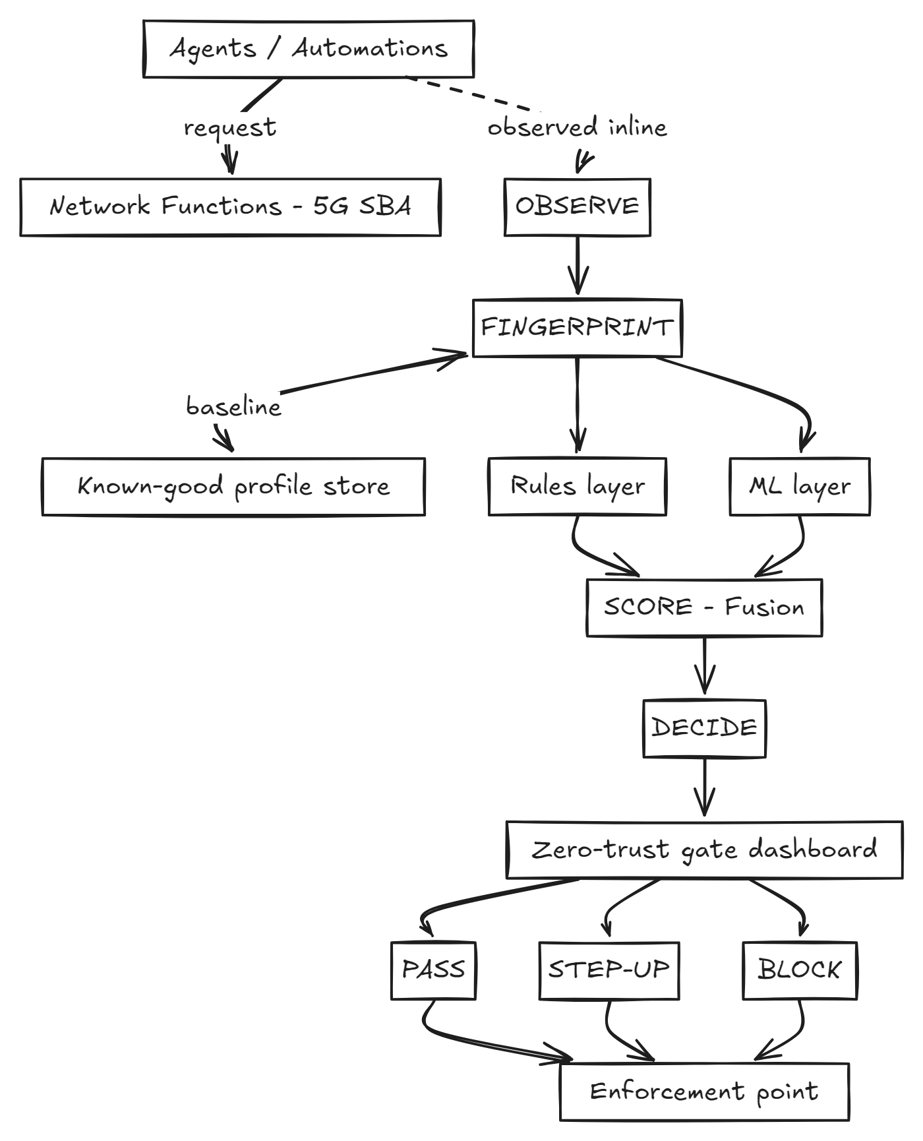
PART 2 OF 6 - ARCHITECTURE
System Architecture
A four-stage pipeline sitting in front of the network's control-plane APIs. Every request an agent sends to a Network Function is observed by the gate.
OBSERVE
Parse request + metadata; assemble a per-agent stream.
FINGERPRINT
Windowed feature vector: volume, surface, method mix, sequence, errors, payload, temporal, cross-window breadth.
SCORE
Rules (scope, session state, rolling accumulators) + an Isolation Forest, fused: risk = max(rule, ml).
DECIDE
Thresholds map risk to PASS / STEP-UP / BLOCK, automatically.

Slide 6
PART 2 OF 6 - ARCHITECTURE
Scoring: Rules + ML, Fused
RULES LAYER
ML LAYER
FUSION
Fast, explainable. Hard caps and forbidden transitions: an out-of-scope NF call is flagged immediately. Includes a session-state machine and rolling 5-minute accumulators for breadth, errors, and peak payload.
An Isolation Forest, trained only on legitimate traffic - no labelled attacks needed. Engages once an agent has at least 10 requests in the trailing 5 minutes.
risk = max(rule_score, ml_score). The rules layer has veto power on hard violations; the ML layer catches subtler drift the rules never anticipated.
PASS
STEP-UP
BLOCK
Behaves like its known-good self
Challenge: re-authenticate, approve, throttle
Quarantine the identity, alert the SOC
Operating point: thresholds are tuned for a realistic ~1.5% false-positive budget rather than maximum sensitivity, so detection is intentionally not uniform across threats (see Part 4).

Slide 7
PART 3 OF 6 - IMPLEMENTATION STRATEGY
Tools, Platforms & Build Phases
Built bottom-up, PoC-first, and evaluation-driven: the ML/security equivalent of test-driven development.
TOOLS & PLATFORMS
SEVEN BUILD PHASES
Python 3.12 + pandas/NumPy
1. Synthetic environment - 210,000 labelled requests, 5 agents, T1-T7.
2. Fingerprinting - windowed behavioral feature vectors.
3. Rules layer - deterministic scope/session/rolling checks.
4. ML layer - Isolation Forest fit on legit-only traffic.
5. Fusion & decision policy - PASS / STEP-UP / BLOCK.
6. Dashboard - live zero-trust gate UI.
7. Evaluation & iteration - re-score after every change.
Traffic generation, windowing, feature engineering.
scikit-learn (Isolation Forest)
Unsupervised ML layer, trained on legit traffic only.
Streamlit + Matplotlib
The live zero-trust gate dashboard and evaluation charts.
python-docx / python-pptx
Reproducible generation of every Gate report and deck.

Slide 8
PART 3 OF 6 - IMPLEMENTATION STRATEGY
What The Evaluation Loop Found & Fixed
Real engineering evidence, not just tuning cosmetics - two concrete bugs were found and fixed by re-scoring after every change.
Bug 1: T6 window-count heuristic false-fired
An earlier heuristic flagged legitimate bursty traffic as sequence anomalies. Replaced with a proper session-ID state machine that tracks PDU-session lifecycle.
Bug 2: T2 and T5 attacks were trivially caught by the wrong rule
Both initially had the agent call a Network Function outside its own scope - indistinguishable from T7 to the rules layer. Redesigned both to stay within the agent's own scope, a more realistic model, which forced detection to rely on the intended statistical signal.
This is the origin of the non-uniform per-threat detection numbers in Part 4 - a feature, not a flaw.

Slide 9
PART 4 OF 6 - NUMERICAL PERFORMANCE ANALYSIS
Numerical Analysis: State of the Art & Headline Metrics
A PoC that reports 100% detection on everything is a red flag, not a strength. We researched how comparable systems perform in practice.
- We named a specific state of the art and ran it ourselves: a Statistical Process Control (SPC) z-score control-chart detector, the classic baseline this kind of behavioural monitoring descends from - not a citation from a different dataset.
- SPC on our own data: 0.944 ROC-AUC, 63.4% recall at a matched 1.43% FPR. AEGIS: 0.965 ROC-AUC, 90.7% recall at the same FPR - a real head-to-head, detailed on the next slide.
- The improvement is statistically significant, not just a bigger number: a paired bootstrap on the AUC difference gives p=0.015, 95% CI [0.004, 0.040], excluding zero.
0.965
90.7%
1.4%
0.67
ROC-AUC
RECALL
FALSE POSITIVES
PRECISION
These headline numbers are AEGIS's own; the next slide shows the SPC baseline comparison that grounds them against a concrete alternative, not just literature ranges.

Slide 10
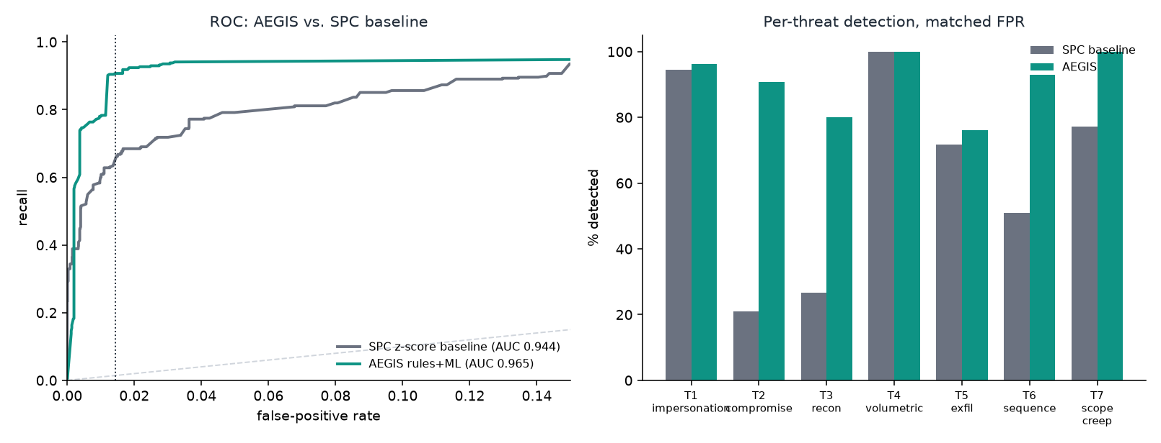
PART 4 OF 6 - NUMERICAL PERFORMANCE ANALYSIS
State of the Art, Head-to-Head
Statistical Process Control (SPC), the classic control-chart baseline, implemented and evaluated on the identical train/test split as AEGIS. SPC detects loud, single-feature deviations effectively (T4 100%, T1 94%) but is structurally blind to threats without a single-feature signature - T2 compromise (21%), T3 recon (27%), T6 sequence (51%). This measured gap quantifies the value of behavioural fingerprinting combined with rule-based fusion.

Slide 11
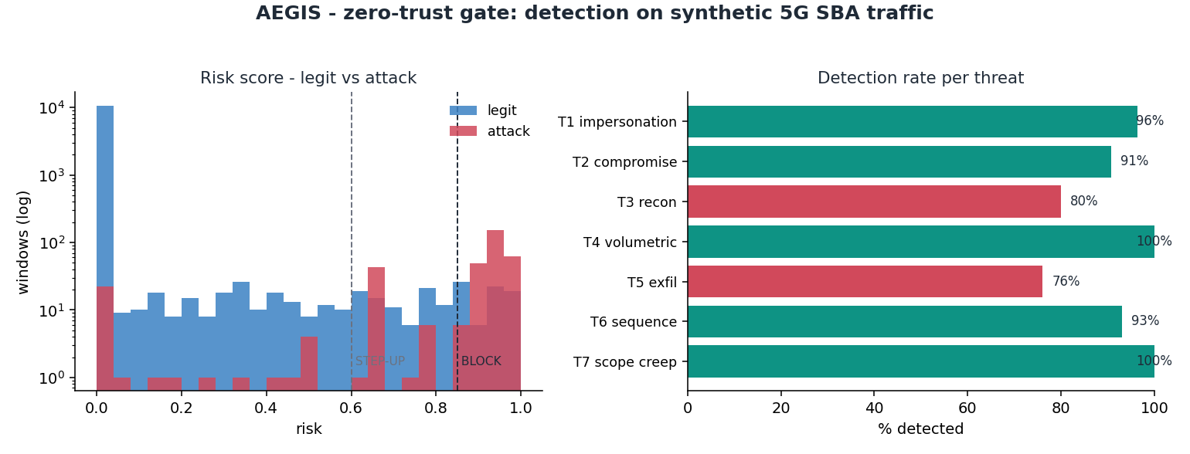
PART 4 OF 6 - NUMERICAL PERFORMANCE ANALYSIS
Detection Rate Per Threat - Deliberately Not Uniform
T4 (volumetric) and T7 (scope creep) sit at 100% because they are deterministic policy/rate checks, not statistical inference. The other five span a genuine 76-96% range that tracks the strength of their underlying behavioural signal: loud beats subtle, and diffuse, low-and-slow attacks are always the hardest.

Slide 12
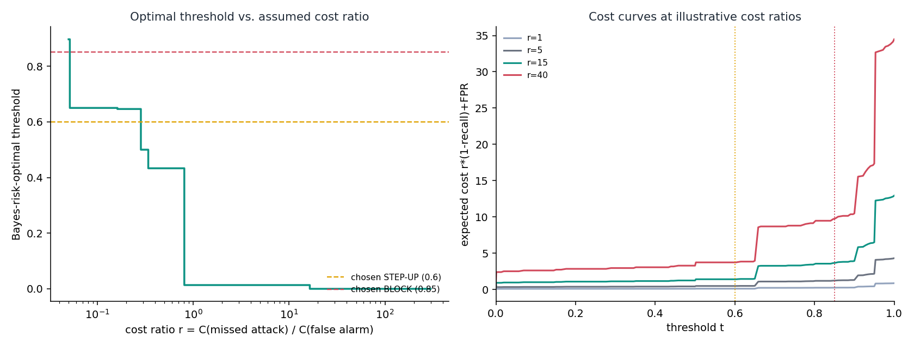
PART 4 OF 6 - NUMERICAL PERFORMANCE ANALYSIS
ROC Operating-Point Analysis
The chosen threshold is justified with respect to a stated, checkable statistical objective.
The chosen threshold (0.60) is Pareto-efficient - no alternative threshold improves both recall and false-positive rate simultaneously - and lies within 0.2 percentage points of FPR of the Neyman-Pearson-achievable frontier for this risk score. The threshold minimises Cost(t) = r times (1-recall) + FPR for a stated cost ratio r, providing a named, checkable statistical objective.

Slide 13
PART 5 OF 6 - EXPECTED PROOF OF CONCEPT
Live Demo Details
AEGIS has a working, demonstrable baseline - this is not a forward-looking description, it's a walkthrough of what exists today.
1. Agent overview
2. Trigger a threat
3. Incident inspector
All 5 agents, live risk scores, all sitting in PASS.
Select a scored window; watch the dashboard flip to BLOCK live.
Plain-language why: which feature tripped, and which layer caught it.
4. Cycle through difficulty
5. Show the numbers
6. Make zero-trust concrete
A spoofing case, a quiet drift case, a low-and-slow case.
ROC-AUC, recall, false-positive rate, per-threat table, live.
A valid credential, still blocked on behaviour.

Slide 14
PART 5 OF 6 - EXPECTED PROOF OF CONCEPT
PoC Readiness at Gate 2
DONE
Synthetic traffic generator (5 agents, T1-T7)
DONE
Fingerprinting, rules, ML, fusion, decision policy
DONE
Live dashboard with incident inspector
DONE
Numerical evaluation (ROC-AUC, recall, precision, FPR)
DONE
ROC operating-point / threshold sensitivity analysis
NOT YET
Real M2M / API-gateway traffic
Real M2M/API-gateway traffic is the natural next validation step - the pipeline is already built to take it in without rework.

Slide 15
PART 6 OF 6 - PATH TO GATE 3
What's Next
Close the gap on the hardest threats (T3 recon 80%, T5 exfiltration 76%) with richer features, such as per-target-ID cardinality.
Extend the pipeline to real M2M/API-gateway traffic as the next validation step - already designed in, pursued as it becomes available.
Record the final video demonstration from the live demo script in Part 5.
Expand the number of agent and attack variants to stress-test generalization beyond the current 5-agent / 7-threat catalogue.

Slide 16
ADVANCED STEM PROGRAM
AI-Native Networks:
Engineering the Infrastructure of the AI Era
GITHUB : https://github.com/fauzan111/AEGIS
GITHUB Live : https://fauzan111.github.io/AEGIS/#gate1
Dashboard Live : https://aegis5gacademy.streamlit.app/
Thank you
CO-DESIGN BY
This presentation contains information that may be privileged or confidential and is the property of 5G Academy 2025/26.​
Copyright © 2025/26 5G Academy. All rights reserved.

Slide 17
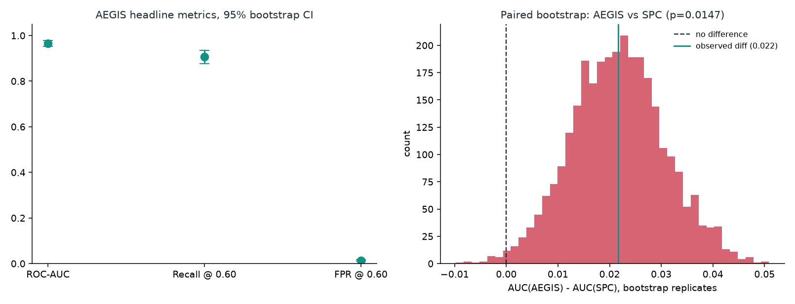
APPENDIX - EXTRA STATISTICAL EVIDENCE
Appendix: Bootstrap Confidence Intervals
Point estimates alone overstate precision on a ~350-window attack sample. Stratified bootstrap (3,000 replicates): ROC-AUC 0.965 [0.951, 0.977], recall 90.7% [87.6%, 93.5%], FPR 1.43% [1.21%, 1.64%] - and the AEGIS-vs-SPC AUC gap is significant at p=0.015.

Slide 18
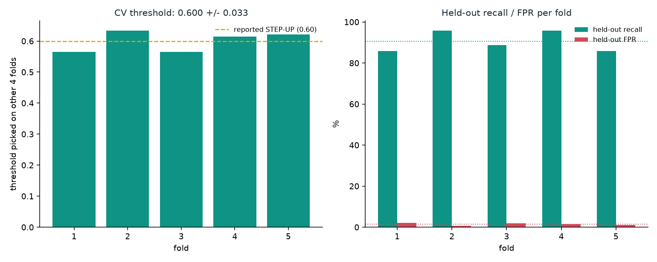
APPENDIX - EXTRA STATISTICAL EVIDENCE
Appendix: Cross-Validated Threshold Stability
The 0.60 threshold was picked on the same test set final numbers are reported on - a fair concern. 5-fold CV (threshold picked on 4 folds, evaluated on the 5th): threshold 0.600 +/- 0.033, recall 90.4% +/- 5.0%, FPR 1.41% +/- 0.55% - not cherry-picked to one slice of data.

Slide 19
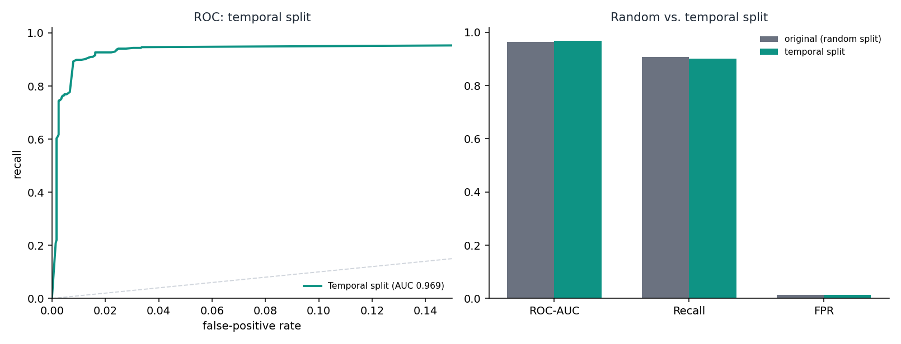
APPENDIX - EXTRA STATISTICAL EVIDENCE
Appendix: Temporal Split Robustness
The main pipeline splits legit windows randomly across the week; real deployment fits on the past and scores the future. Rerun with a strict chronological split (1 day training, 4 days test): ROC-AUC 0.969, recall 90.1%, FPR 1.24% - held up, even with far less training data.

Slide 20
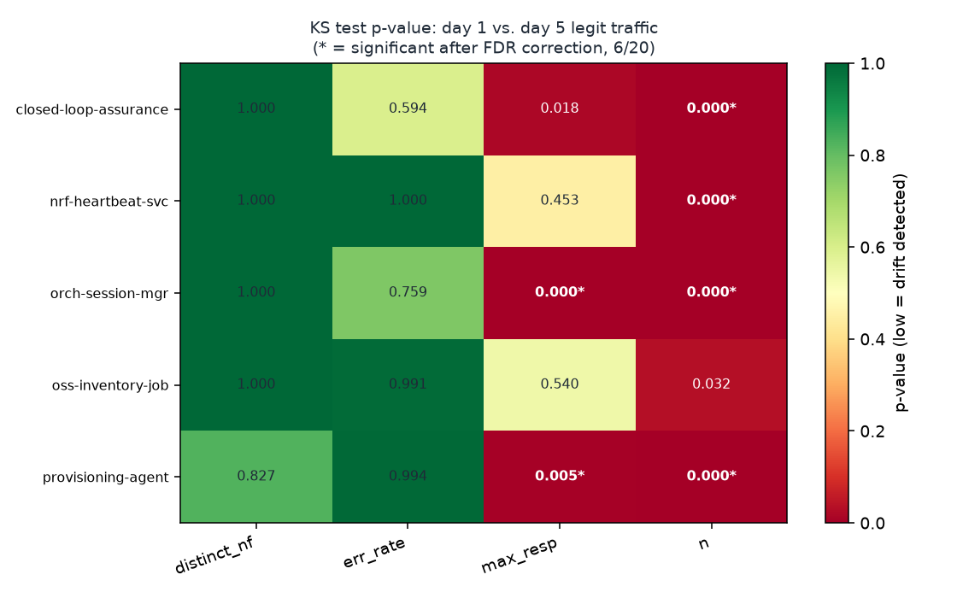
APPENDIX - EXTRA STATISTICAL EVIDENCE
Appendix: Concept-Drift / Stationarity Check
Does an agent's 'normal' stay stable long enough for a one-time baseline to hold? KS-tests (day 1 vs. last day, FDR-corrected): 6 of 20 agent/feature pairs show real drift even within 5 synthetic days - motivating a periodic re-baselining cadence as an explicit Gate 3 requirement, not an assumption.

Slide 21
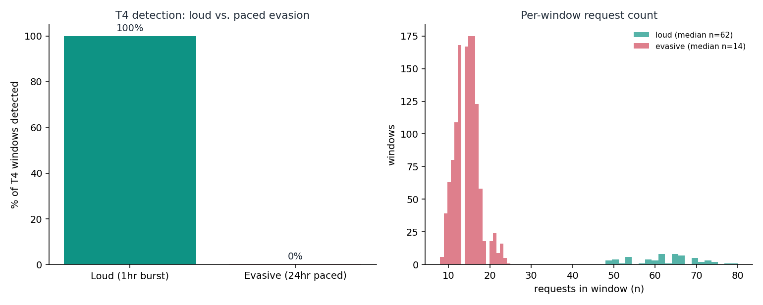
APPENDIX - EXTRA STATISTICAL EVIDENCE
Appendix: Adversarial Evasion Stress Test
All seven threats in the main evaluation are naive - none paced against our thresholds deliberately. Pacing the same T4 flood volume over 24 hours instead of 1 drops detection 100% to 0%. A real, demonstrated gap - the direct fix (a rolling volumetric accumulator, mirroring T3/T5) is now a named Gate 3 priority.

