Slide 1
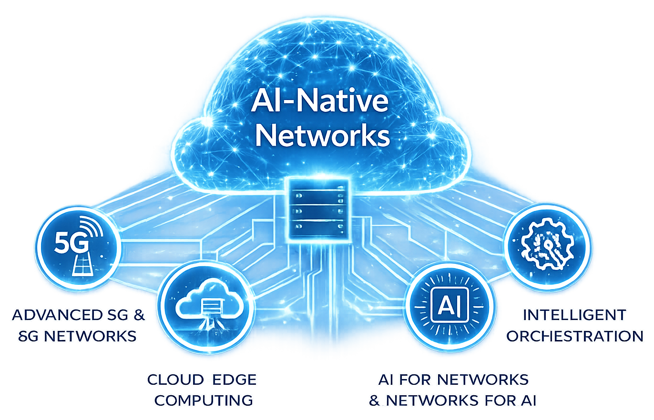
ADVANCED STEM PROGRAM
AI-Native Networks:
Engineering the Infrastructure of the AI Era
Postgraduate Course
2026
https://www.5gacademy.unina.it/
CO-DESIGN BY

Slide 2
AEGIS
Zero-Trust Identity for AI Agents
Index
01
Proposed Technical Solution
02
Architecture
03
Implementation Strategy
04
Numerical Performance Analysis
05
Remaining Work
Team 4 :
Fauzan Ejaz (Captain)
Llagami Tedi
06
Expected Proof of Concept
CO-DESIGN BY
2

Slide 3
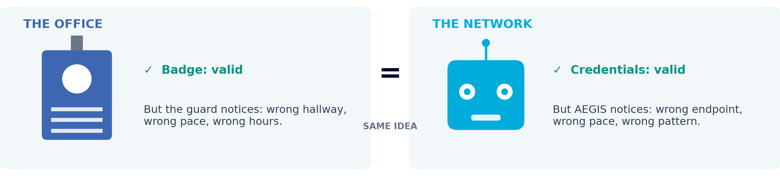
BEFORE WE GO TECHNICAL
A Stolen Badge Still Opens The Door.
A good guard doesn't just check the badge - they notice when the person wearing it stops walking, working, and behaving like they always have. That's what AEGIS does for every AI agent talking to your network.
PASS
STEP-UP
BLOCK
Acts like itself
Something's off - verify
Impersonator - stop it
One idea to carry through this whole talk: a badge proves who you're supposed to be. AEGIS proves whether you're still acting like them.

Slide 4




PART 1 OF 6 - TECHNICAL SOLUTION & ARCHITECTURE
Proposed Technical Solution
A stolen credential still passes authentication. AEGIS answers the question authentication never asks: is this really our agent, behaving the way it always does?
“Credentials prove what you have, AEGIS verifies how you behave.”
>
>
>
OBSERVE
FINGERPRINT
SCORE
DECIDE
Every request an agent sends to the network is captured - who sent it, what it touched, when, and how.
That stream becomes a behavioural profile per agent: its normal endpoints, pace, and call sequence.
Live behaviour is compared to that profile in real time - fast rule checks fused with a machine-learning anomaly score.
The score becomes an action instantly: let the request through, challenge it, or shut it down.
Agent-07 calls NRF
40x per minute
Normal endpoint mix,
but rate is elevated
Risk score: 0.71
STEP-UP:
re-authenticate
WORKED EXAMPLE
>
>
>

Slide 5
PART 1 OF 6 - TECHNICAL SOLUTION & ARCHITECTURE
The Seven Threats We Watch For
Same four-stage pipeline. Seven different ways an identity can go wrong - three (T1, T4, T7) also have a harder v2/slow-ramp variant, 10 attack forms in total.
# | Threat | Behavioural signal AEGIS keys on
T1 v1/v2 | Identity spoofing | wrong endpoint mix, timing, sequence for that identity
T2 | Compromised agent | drift from its own baseline: new endpoints, elevated errors
T3 | Reconnaissance | high cardinality of endpoints/targets, many 403/404s
T4 v1/v2 | Volumetric abuse | request-rate spike far above the agent's normal envelope
T5 | Slow exfiltration | abnormal payload sizes, off-hours persistence
T6 | Sequence anomaly | broken call-sequence pattern vs the agent's normal graph
T7 v1/v2 | Scope creep | calls to NFs never in the agent's baseline scope

Slide 6
PART 1 OF 6 - TECHNICAL SOLUTION & ARCHITECTURE
The Gap, Our Solution, and the State of the Art
THE GAP
OUR SOLUTION
VS. STATE OF THE ART
Credentials are checked once, at the door - never again. A stolen or misused identity passes every time.
A continuous behavioural fingerprint per agent: rules + an Isolation Forest, fused, gated PASS / STEP-UP / BLOCK.
A Statistical Process Control baseline, run on our own data: 0.944 ROC-AUC / 63.4% recall. AEGIS: 0.965 / 90.7% - a significant gap (p=0.015).
Credentials prove what you have, AEGIS verifies how you behave - and we can show it beats the classic baseline.
PASS
STEP-UP
BLOCK
Behaves like its known-good self
Challenge: re-authenticate, approve, throttle
Quarantine the identity, alert the SOC

Slide 7
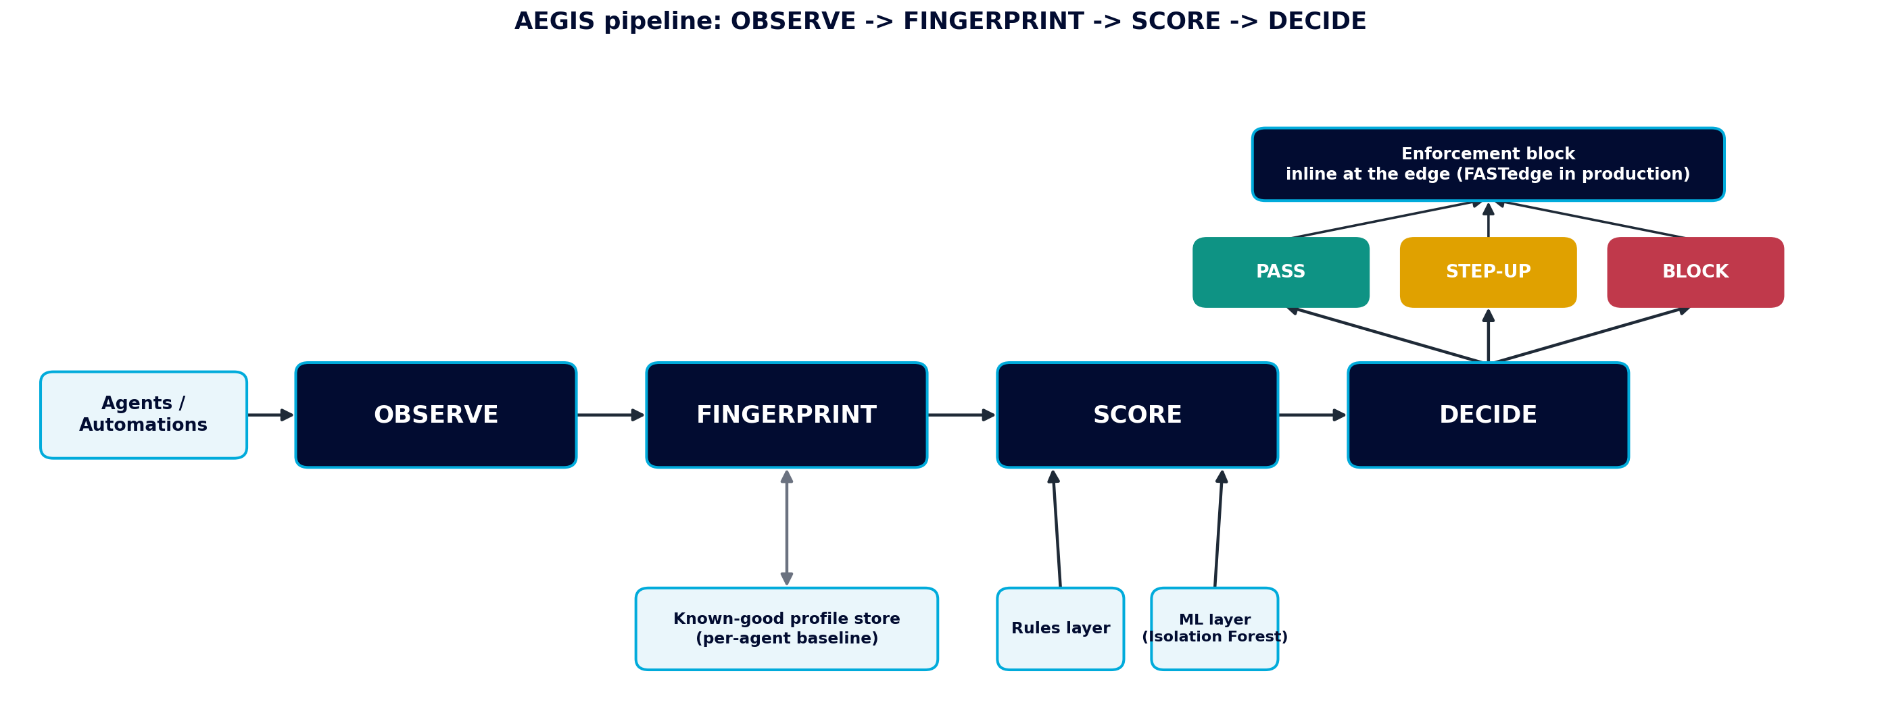
PART 2 OF 6 - ARCHITECTURE
System Architecture
A four-stage pipeline sitting in front of the network's control-plane APIs. Every request an agent sends to a Network Function is observed by the gate.

Slide 8
PART 2 OF 6 - ARCHITECTURE
Scoring: Rules + ML, Fused
RULES LAYER
ML LAYER
FUSION
Fast, explainable. Flags out-of-scope calls immediately.
An Isolation Forest, trained only on legitimate traffic - no labelled attacks needed.
risk = max(rule_score, ml_score) - rules veto hard violations, ML catches subtler drift.
Tuned for a ~1.5% false-positive budget, not maximum sensitivity - detection is intentionally uneven across threats.
PASS
STEP-UP
BLOCK
Behaves like its known-good self
Challenge: re-authenticate, approve, throttle
Quarantine the identity, alert the SOC

Slide 9
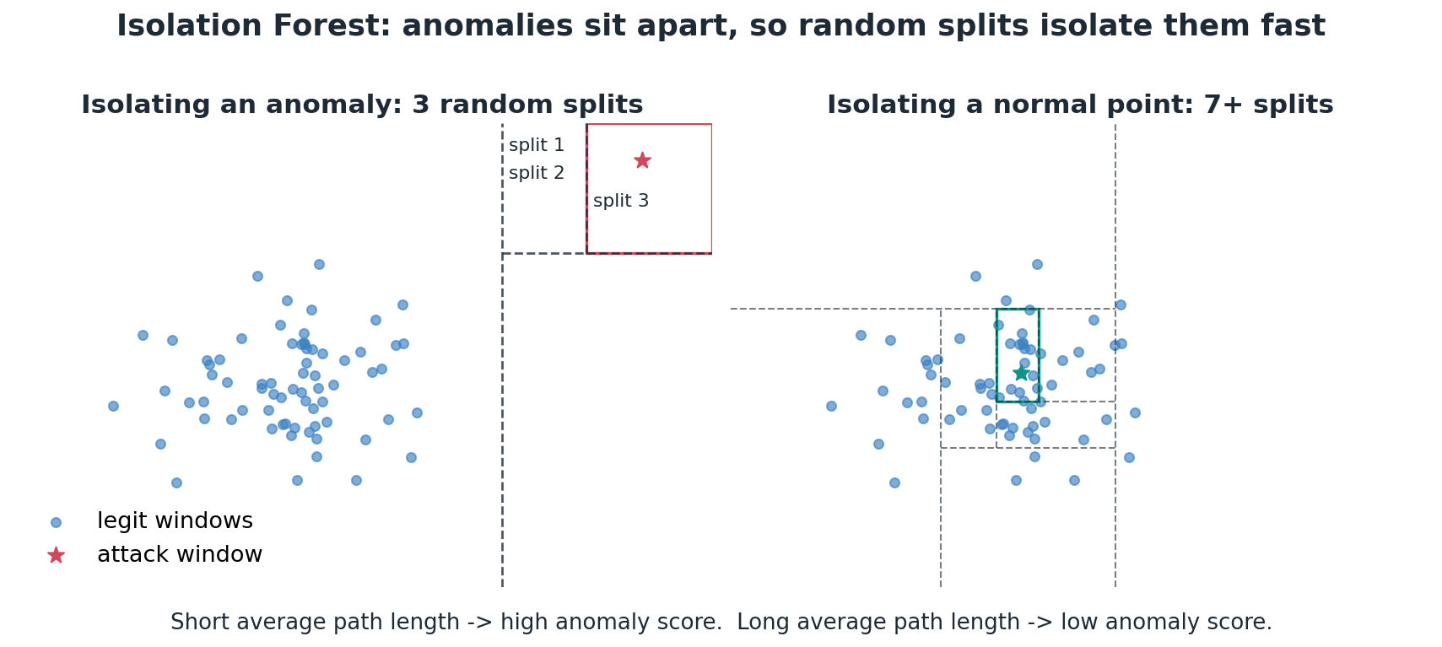
PART 3 OF 6 - IMPLEMENTATION STRATEGY
How Isolation Forest Works
The model that does the heavy lifting in the ML layer - no labelled attacks, just a simple idea applied many times over.
- Builds many random-split trees: each node picks a random feature and a random split value.
- Anomalies sit apart, so a few random splits isolate them. Normal points, surrounded by similar ones, take many more splits.
- Score = how short the average isolation path is, normalised to 0..1. Short path -> high score -> looks like an attack.

Slide 10
PART 3 OF 6 - IMPLEMENTATION STRATEGY
Training, Features & Calibration
Unsupervised by design - the gate has to recognise drift from agents it has never seen attacked, not just the attacks in our synthetic catalogue.
10 INPUT FEATURES PER WINDOW
WHY IT FITS A ZERO-TRUST GATE
- n - request count
- distinct_nf - Network Functions touched
- distinct_ep - distinct endpoints
- err_rate - fraction of 4xx/5xx
- get_frac / write_frac - method mix
- mean_resp / max_resp - payload size
- hour - time of day
- distinct_target_roll - rolling subscriber/record breadth
No labelled attacks needed
Fit only on each agent's own legit traffic - an unlabelled 'normal', which is all a new agent's own history ever gives you.
Per-agent identity, one-hot
The model learns each agent's own normal, so impersonation (T1) shows up as unlike-itself, not unlike-everyone-else.
300 trees, contamination 0.02
scikit-learn IsolationForest: 300 trees, contamination 0.02. Engages after 10+ requests in 5 minutes.
Calibrated on held-out legit data
Scores are mapped to 0..1 using a legit split the model never trained on - avoids understating the tail and inflating false positives.

Slide 11
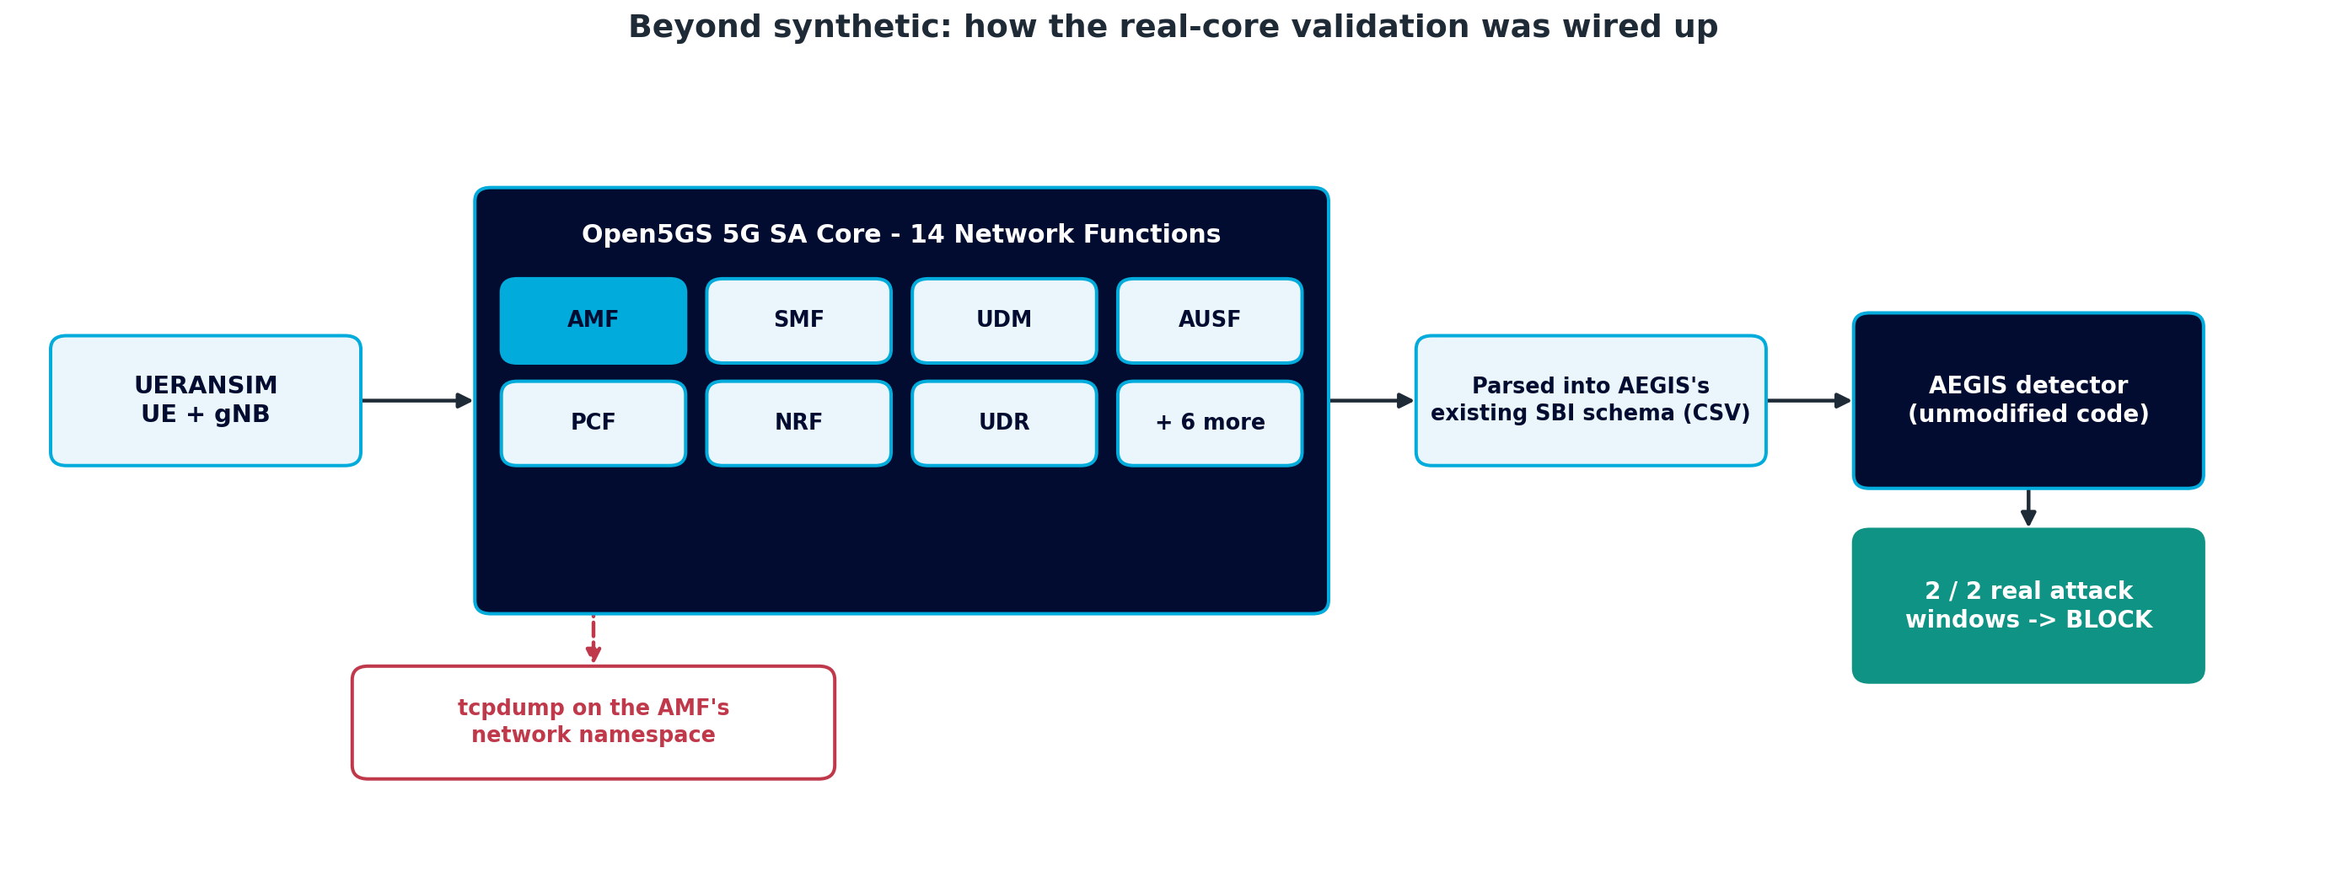
PART 3 OF 6 - IMPLEMENTATION STRATEGY
Beyond Synthetic: A Real 5G Core
A core validation question for any synthetic-first approach: does detection still hold up against real M2M / API-gateway traffic, not just the generator?
Stood up a real core
A full Open5GS SA deployment (14 NFs) plus a UERANSIM gNB/UE - a genuine registration and PDU session, not simulated logs.
Captured real SBI traffic
tcpdump on the AMF's network namespace, parsed into the same schema AEGIS's detector already expects.
Schema matches, confirmed
Real captured paths (/nudm-sdm/v2/..., /nsmf-pdusession/v1/sm-contexts) line up with our synthetic generator's naming convention almost exactly.
Detection validated on real traffic
AEGIS's own unmodified detection code: 2 of 2 real attack-like windows correctly flagged BLOCK.
Honest scope: a short, single-agent capture - rules-dominant, not a replacement for the full synthetic evaluation's statistical rigor.

Slide 12
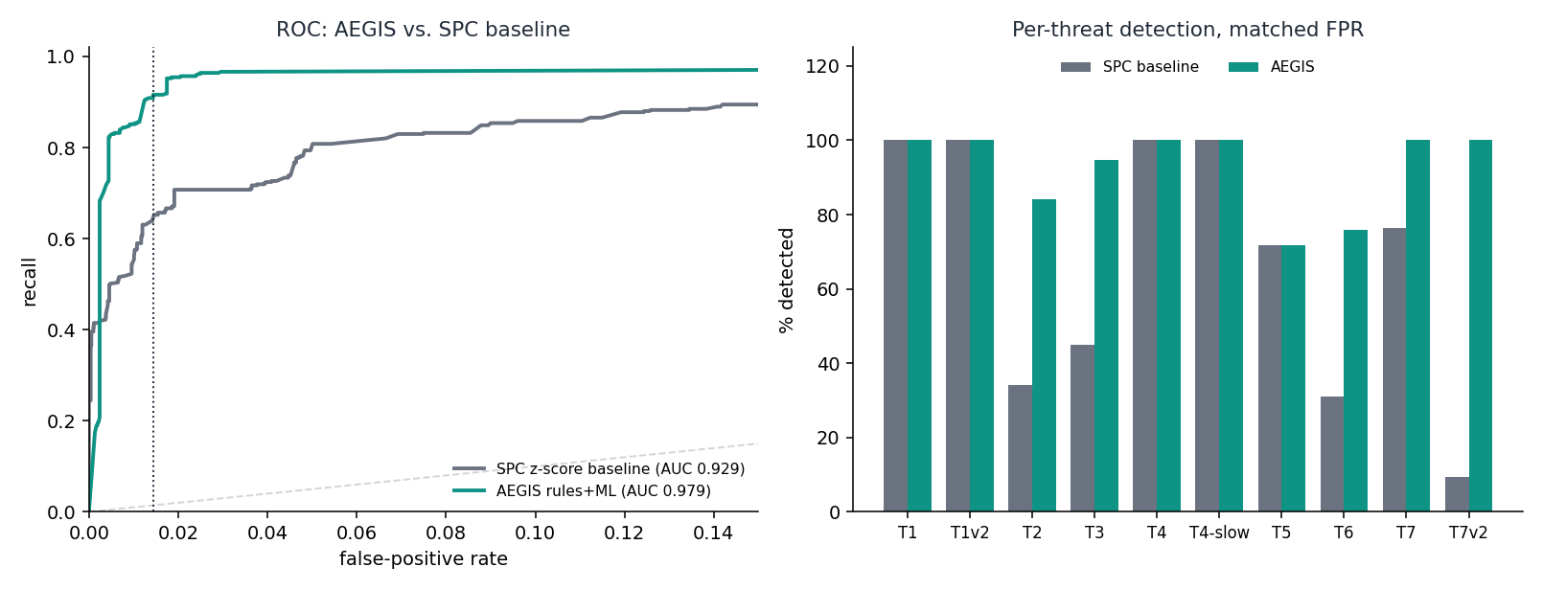
PART 4 OF 6 - NUMERICAL PERFORMANCE ANALYSIS
State of the Art, Head-to-Head
SPC, the classic control-chart baseline, run on the same split as AEGIS: strong on loud signals (T4 100%, T1 100%), blind to subtler ones (T2 34%, T3 45%, T6 31%) - the measured case for behavioural fingerprinting + fusion.

Slide 13
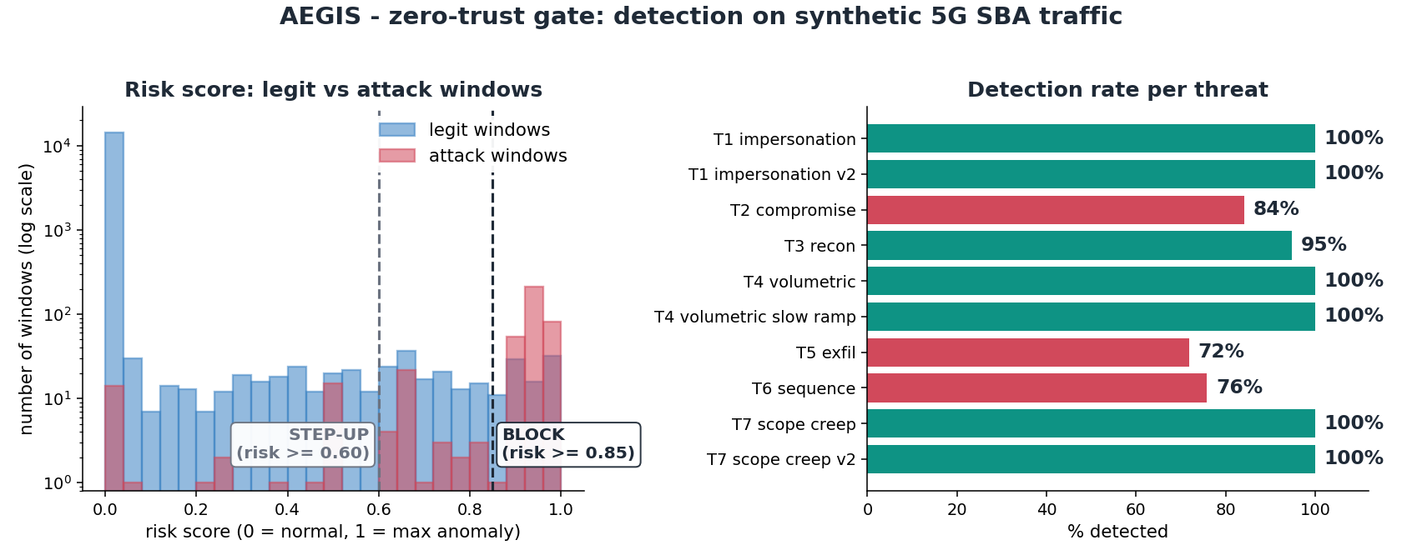
PART 4 OF 6 - NUMERICAL PERFORMANCE ANALYSIS
Detection Rate Per Threat - Deliberately Not Uniform
T1, T4 and T7 (plus their harder v2 / slow-ramp variants) sit at 100% - deterministic policy or rate checks, not statistical inference. The other four span a genuine 72-95% range: loud beats subtle, and low-and-slow attacks are hardest.

Slide 14
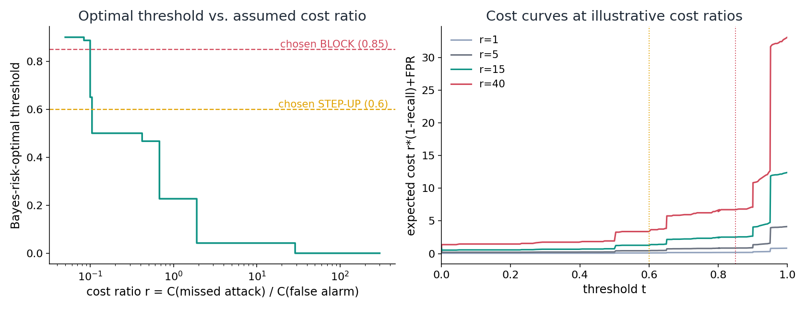
PART 4 OF 6 - NUMERICAL PERFORMANCE ANALYSIS
ROC Operating-Point Analysis
The chosen threshold is justified with respect to a stated, checkable statistical objective.
0.60 is Pareto-efficient - no alternative threshold beats it on both recall and FPR - and sits within 0.2 points of the Neyman-Pearson frontier. It minimises a stated cost function, not an unlabelled 'optimal'.

Slide 15
PART 5 OF 6 - REMAINING WORK
Remaining Work Before Final Submission
Record and edit the final video demonstration from the live demo script - storyboard and supporting animations are already built.
Continue hardening the two remaining softer spots, T5 exfiltration (72%) and T6 sequence (76%), with further rolling-signal refinement.
.
Deploy the project on AWS once credentials are received

Slide 16
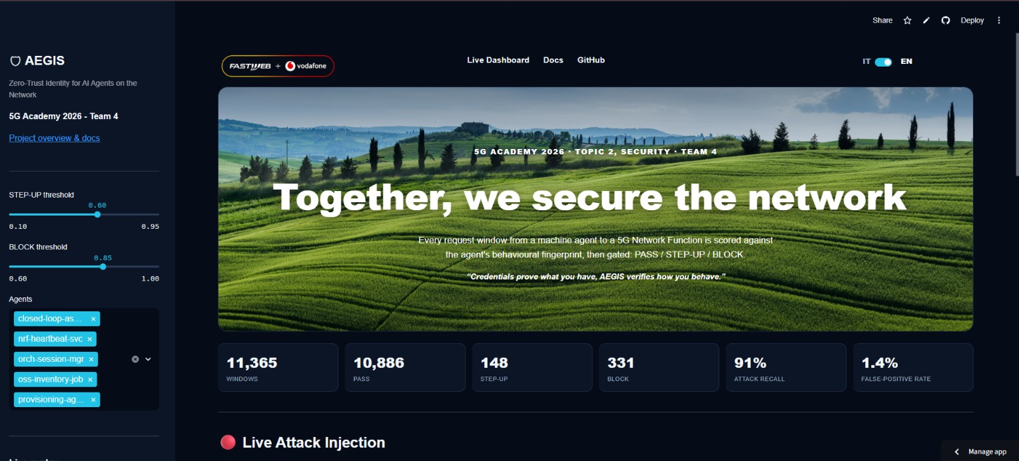
PART 6 OF 6 - EXPECTED PROOF OF CONCEPT
Live Demo Details
AEGIS has a working, demonstrable baseline - this is not a forward-looking description, it's a walkthrough of what exists today.

Slide 17
ADVANCED STEM PROGRAM
AI-Native Networks:
Engineering the Infrastructure of the AI Era
GITHUB : https://github.com/fauzan111/AEGIS
GITHUB Live : https://fauzan111.github.io/AEGIS/#gate1
Dashboard Live : https://aegis5gacademy.streamlit.app/
Thank you
CO-DESIGN BY
This presentation contains information that may be privileged or confidential and is the property of 5G Academy 2025/26.​
Copyright © 2025/26 5G Academy. All rights reserved.
Notes:
BACKUP SLIDES BELOW

Slide 18
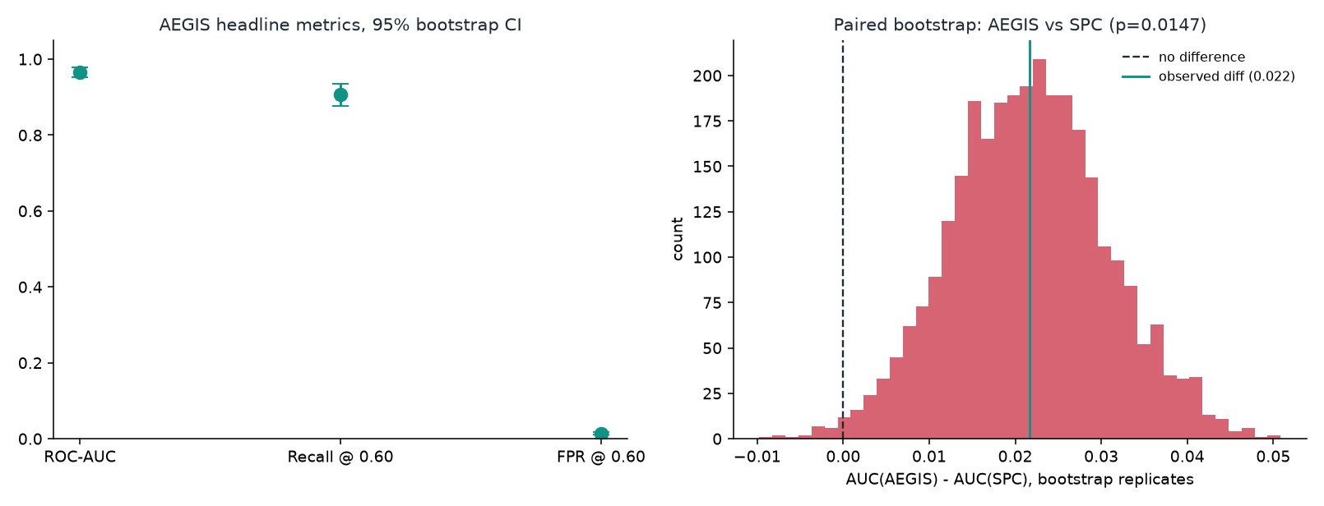
APPENDIX - EXTRA STATISTICAL EVIDENCE
Appendix: Bootstrap Confidence Intervals
Point estimates alone overstate precision on a ~350-window attack sample. Stratified bootstrap (3,000 replicates): ROC-AUC 0.965 [0.951, 0.977], recall 90.7% [87.6%, 93.5%], FPR 1.43% [1.21%, 1.64%] - and the AEGIS-vs-SPC AUC gap is significant at p=0.015.

Slide 19
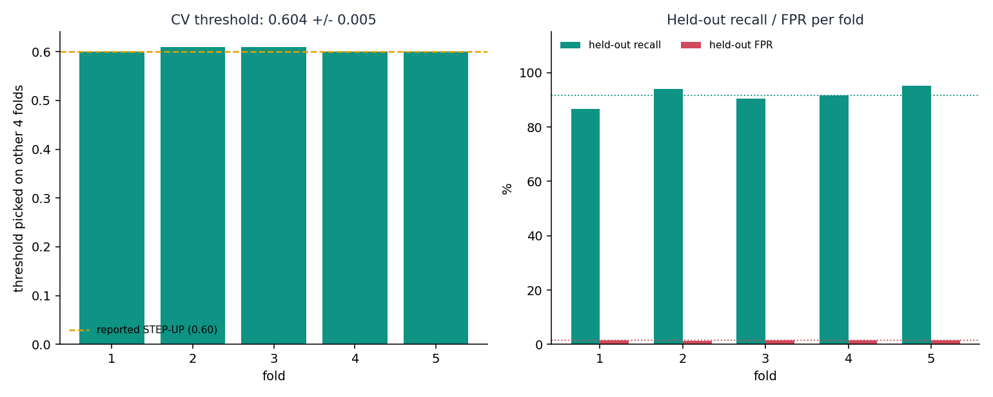
APPENDIX - EXTRA STATISTICAL EVIDENCE
Appendix: Cross-Validated Threshold Stability
The 0.60 threshold was picked on the same test set final numbers are reported on - a fair concern. 5-fold CV (threshold picked on 4 folds, evaluated on the 5th): threshold 0.604 +/- 0.005, recall 91.6% +/- 3.3%, FPR 1.43% +/- 0.16% - not cherry-picked to one slice of data.

Slide 20
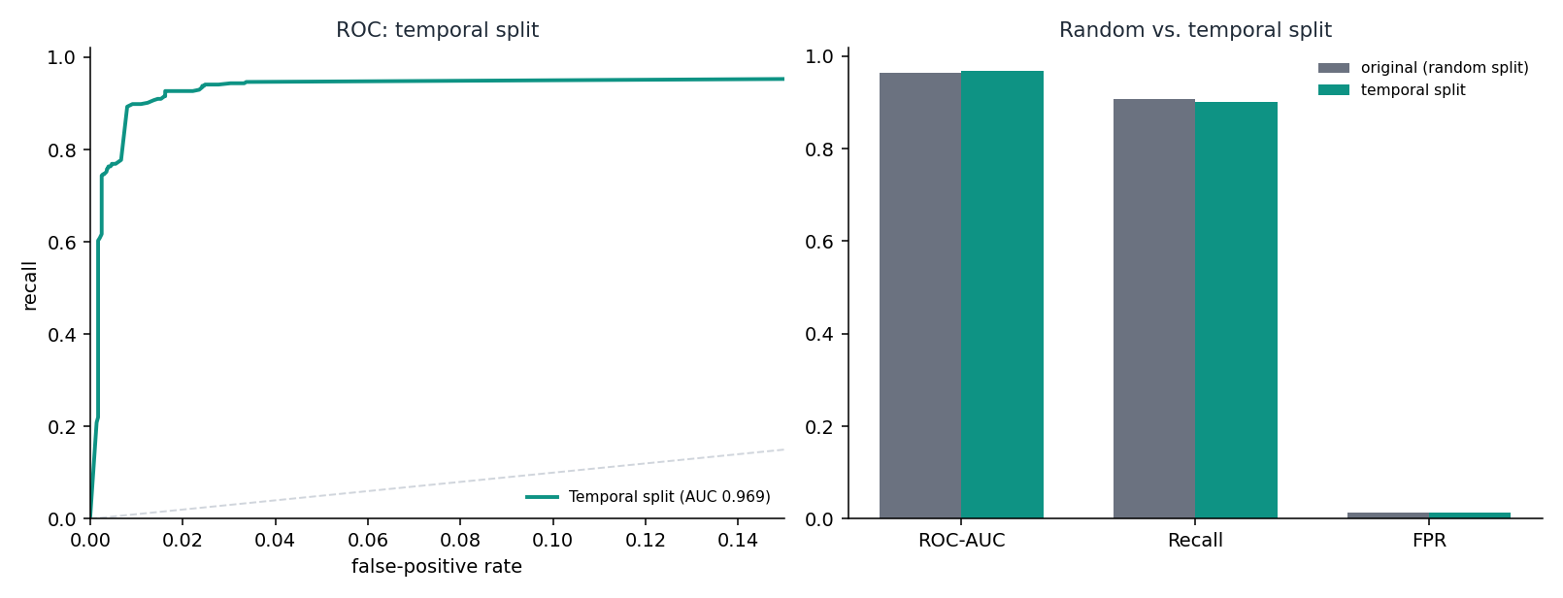
APPENDIX - EXTRA STATISTICAL EVIDENCE
Appendix: Temporal Split Robustness
The main pipeline splits legit windows randomly across the week; real deployment fits on the past and scores the future. Rerun with a strict chronological split (1 day training, 4 days test): ROC-AUC 0.969, recall 90.1%, FPR 1.24% - held up, even with far less training data.

Slide 21
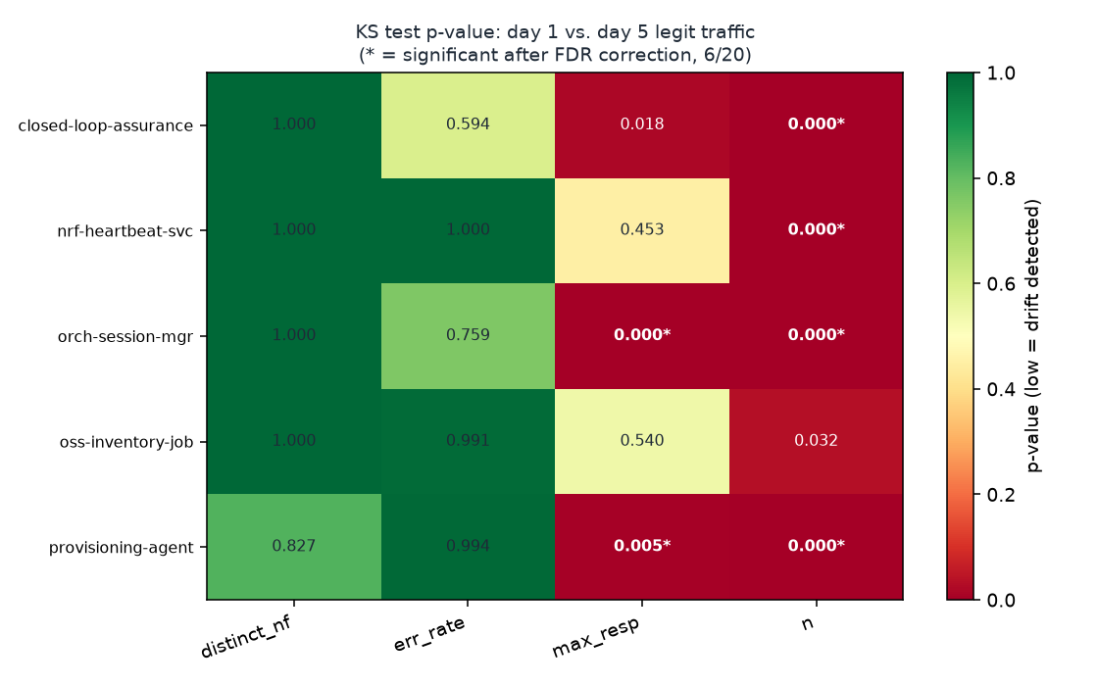
APPENDIX - EXTRA STATISTICAL EVIDENCE
Appendix: Concept-Drift / Stationarity Check
Does an agent's 'normal' stay stable long enough for a one-time baseline to hold? KS-tests (day 1 vs. last day, FDR-corrected): 6 of 20 agent/feature pairs show real drift even within 5 synthetic days - motivating a periodic re-baselining cadence as an explicit requirement, not an assumption.

Slide 22
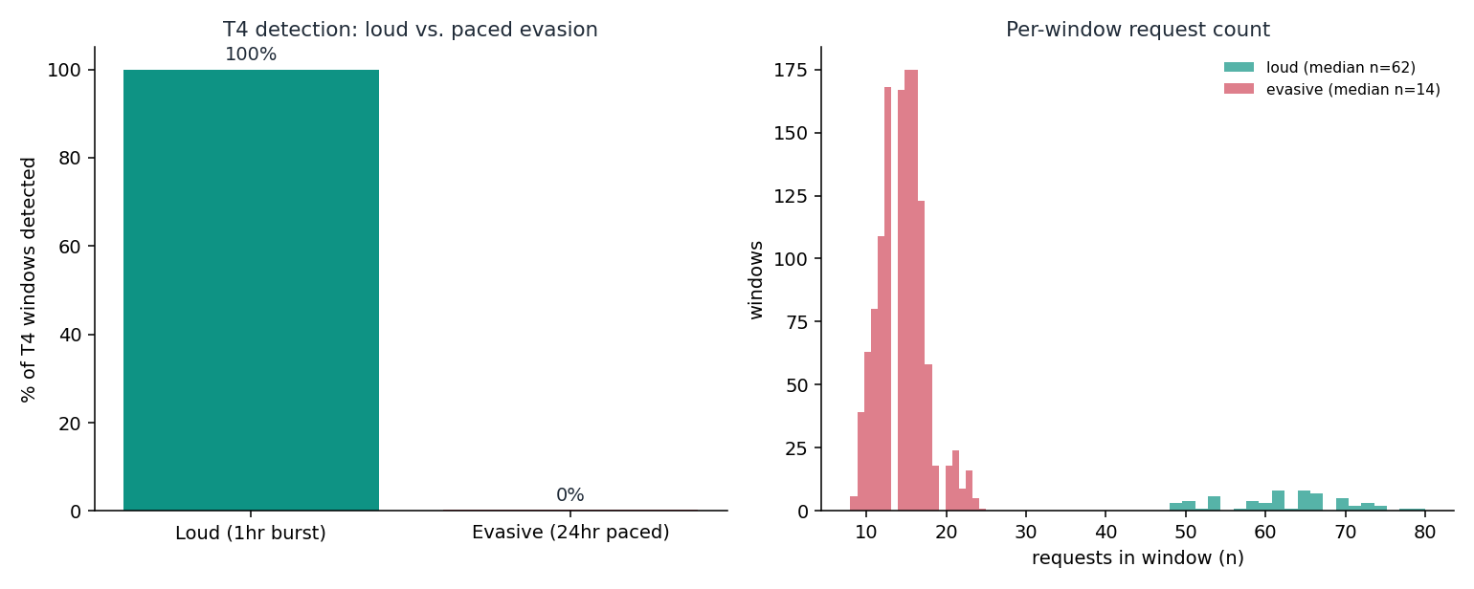
APPENDIX - EXTRA STATISTICAL EVIDENCE
Appendix: Adversarial Evasion Stress Test
All seven threats in the main evaluation are naive - none paced against our thresholds deliberately. Pacing the same T4 flood volume over 24 hours instead of 1 drops detection 100% to 0%. A real, demonstrated gap - the direct fix (a rolling volumetric accumulator, mirroring T3/T5) is now a named priority.

