Slide 1

Chapter 1: Introduction to Project Management
Information Technology Project Management, Eighth Edition
Note: See the text itself for full citations.

Slide 2
Learning Objectives
Understand the growing need for better project management, especially for information technology (IT) projects
Explain what a project is, provide examples of IT projects, list various attributes of projects, and describe the triple constraint of project management
Describe project management and discuss key elements of the project management framework, including project stakeholders, the project management knowledge areas, common tools and techniques, and project success

Slide 3
Learning Objectives
Discuss the relationship between project, program, and portfolio management and the contributions each makes to enterprise success
Understand the role of project managers by describing what they do, what skills they need, and career opportunities for IT project managers
Describe the project management profession, including its history, the role of professional organizations like the Project Management Institute (PMI), the importance of certification and ethics, and the advancement of project management software

Slide 4
Introduction
Many organizations today have a new or renewed interest in project management
Worldwide IT spending was $3.8 trillion in 2014, a 3.2 percent increase from 2013 spending
The Project Management Institute estimates demand for 15.7 million project management jobs from 2010 to 2020, with 6.2 million of those jobs in the United States

Slide 5
Project Management Statistics
In 2013 (the most recent year of PMI’s salary survey), the average salary in U.S. dollars for someone in the project management profession was $108,000 per year in the United States; $134,658 in Australia, (the highest-paid country); and $24,201 in Egypt (the lowest-paid country)
The top skills employers look for in new college graduates are all related to project management: team-work, decision-making, problem-solving, and verbal communications
Organizations waste $109 million for every $1 billion spent on projects, according to PMI’s Pulse of the Profession® report

Slide 6
Motivation for Studying Information Technology (IT) Project Management
IT Projects have a terrible track record, as described in the What Went Wrong?
A 1995 Standish Group study (CHAOS) found that only 16.2% of IT projects were successful in meeting scope, time, and cost goals; over 31% of IT projects were canceled before completion
A PricewaterhouseCoopers study found that overall half of all projects fail and only 2.5% of corporations consistently meet their targets for scope, time, and cost goals for all types of project.

Slide 7
Advantages of Using Formal Project Management
Better control of financial, physical, and human resources
Improved customer relations
Shorter development times
Lower costs
Higher quality and increased reliability
Higher profit margins
Improved productivity
Better internal coordination
Higher worker morale

Slide 8
What Is a Project?
A project is “a temporary endeavor undertaken to create a unique product, service, or result” (PMBOK® Guide, Fifth Edition, 2013)
Operations is work done to sustain the business
Projects end when their objectives have been reached or the project has been terminated
Projects can be large or small and take a short or long time to complete

Slide 9
Examples of IT Projects
A team of students creates a smartphone application and sells it online
A company develops a driverless car
A government group develops a system to track child immunizations
A global bank acquires other financial institutions and needs to consolidate systems and procedures

Slide 10
Top Strategic Technologies for 2012 (Gartner)
Computing everywhere
The Internet of things
3D printing
Advanced, pervasive, and invisible analytics

Slide 11
Media Snapshot: Unproductive Apps
Gartner predicted that by 2014, there would be more than 70 billion mobile application downloads every year, but it was almost double
Facebook is by far the most downloaded app, and the most popular category of all apps continues to be games
The challenge is to develop useful apps and get workers to focus on them instead of the many distracting options available

Slide 12
Project Attributes
A project
has a unique purpose
is temporary
is developed using progressive elaboration
requires resources, often from various areas
should have a primary customer or sponsor
The project sponsor usually provides the direction and funding for the project
involves uncertainty

Slide 13
Project and Program Managers
Project managers work with project sponsors, project team, and other people involved in a project to meet project goals
Program: group of related projects managed in a coordinated way to obtain benefits and control not available from managing them individually (PMBOK® Guide, Fifth Edition, 2013)
Program managers oversee programs; often act as bosses for project managers

Slide 14
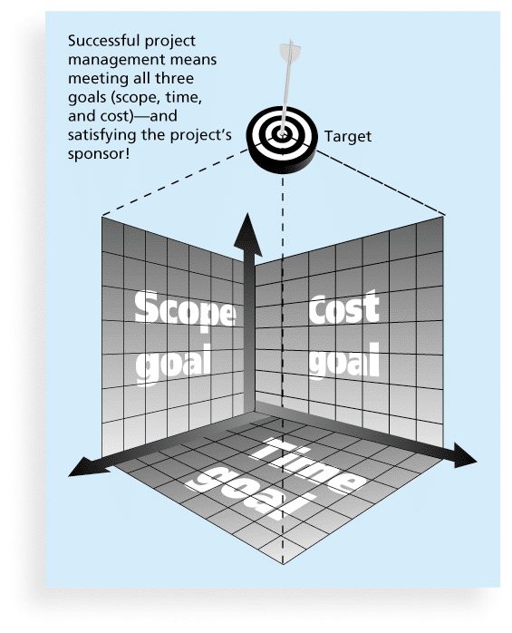
Figure 1-1 The Triple Constraint of Project Management

Slide 15
What is Project Management?
Project management is “the application of knowledge, skills, tools and techniques to project activities to meet project requirements” (PMBOK® Guide, Fourth Edition, 2013)
Project managers strive to meet the triple constraint (project scope, time, and cost goals) and also facilitate the entire process to meet the needs and expectations of project stakeholders

Slide 16
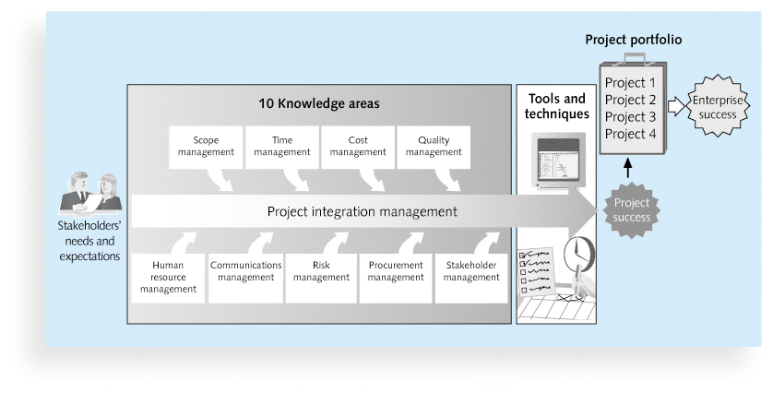
Figure 1-2 Project Management Framework

Slide 17
Project Stakeholders
Stakeholders are the people involved in or affected by project activities
Stakeholders include
the project sponsor
the project manager
the project team
support staff
customers
users
suppliers
opponents to the project

Slide 18
10 Project Management Knowledge Areas
Knowledge areas describe the key competencies that project managers must develop
Project managers must have knowledge and skills in all 10 knowledge areas (project integration, scope, time, cost, quality, human resource, communications, risk, procurement, and stakeholder management)
This text includes an entire chapter on each knowledge area

Slide 19
Project Management Tools and Techniques
Project management tools and techniques assist project managers and their teams in various aspects of project management
Some specific ones include
Project charter, scope statement, and WBS (scope)
Gantt charts, network diagrams, critical path analysis, critical chain scheduling (time)
Cost estimates and earned value management (cost)
See Table 1-1 for many more

Slide 20
Super Tools
“Super tools” are those tools that have high use and high potential for improving project success, such as:
Software for task scheduling (such as project management software)
Scope statements
Requirements analyses
Lessons-learned reports
Tools already extensively used that have been found to improve project importance include:
Progress reports
Kick-off meetings
Gantt charts
Change requests

Slide 21
What Went Right? Improved Project Performance
The Standish Group’s CHAOS studies show improvements in IT projects in the past decade:
The number of successful IT projects has more than doubled, from 16 percent in 1994 to 39 percent in 2012
The number of failed projects decreased from 31 percent in 1994 to 18 percent in 2012
Success rates were much higher for small projects than large ones – 76 percent versus 10 percent

Slide 22
Project Success
There are several ways to define project success:
The project met scope, time, and cost goals
The project satisfied the customer/sponsor
The results of the project met its main objective, such as making or saving a certain amount of money, providing a good return on investment, or simply making the sponsors happy

Slide 23
Table 1-2: What Helps Projects Succeed?*
1. Executive support
2. User involvement
3. Clear business objectives
4. Emotional maturity
5. Optimizing scope
6. Agile process
7. Project management expertise
8. Skilled resources
9. Execution
10. Tools and infrastructure
*The Standish Group, “CHAOS Manifesto 2013: Think Big,
Act Small” (2013).

Slide 24
Top Three Reasons Why Federal Technology Project Succeed
Adequate funding
Staff expertise
Engagement from all stakeholders

Slide 25
What the Winners Do…
Recent research findings show that companies that excel in project delivery capability:
Use an integrated project management toolbox (use standard/advanced PM tools, lots of templates)
Grow project leaders, emphasizing business and soft skills
Develop a streamlined project delivery process
Measure project health using metrics, like customer satisfaction or return on investment

Slide 26
Program and Project Portfolio Management
A program is “a group of related projects managed in a coordinated way to obtain benefits and control not available from managing them individually” (PMBOK® Guide, Fifth Edition, 2013)
A program manager provides leadership and direction for the project managers heading the projects within the program
Examples of common programs in the IT field include infrastructure, applications development, and user support

Slide 27
Project Portfolio Management
As part of project portfolio management, organizations group and manage projects and programs as a portfolio of investments that contribute to the entire enterprise’s success
Portfolio managers help their organizations make wise investment decisions by helping to select and analyze projects from a strategic perspective

Slide 28
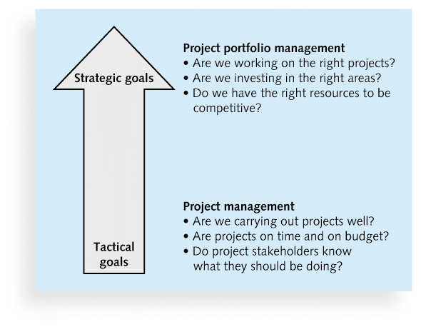
Figure 1-3. Project Management Compared to Project Portfolio Management

Slide 29
Best Practice
A best practice is “an optimal way recognized by industry to achieve a stated goal or objective”*
Robert Butrick suggests that organizations need to follow basic principles of project management, including these two mentioned earlier in this chapter:
Make sure your projects are driven by your strategy. Be able to demonstrate how each project you undertake fits your business strategy, and screen out unwanted projects as soon as possible
Engage your stakeholders. Ignoring stakeholders often leads to project failure. Be sure to engage stakeholders at all stages of a project, and encourage teamwork and commitment at all times
*Project Management Institute, Organizational Project Management Maturity Model
(OPM3) Knowledge Foundation (2003), p. 13.

Slide 30
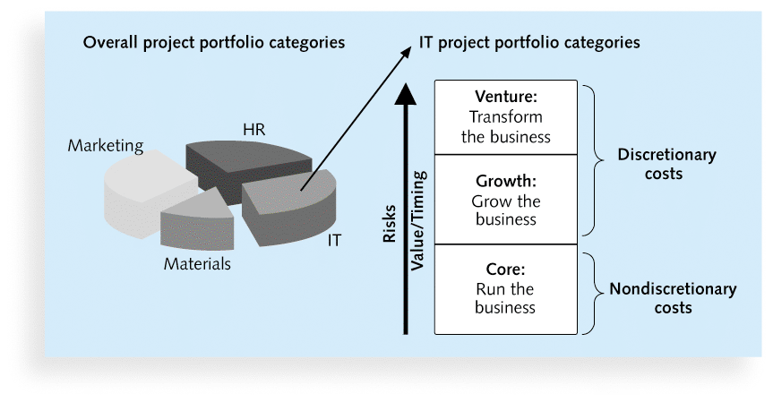
Figure 1-4. Sample Project Portfolio Approach

Slide 31
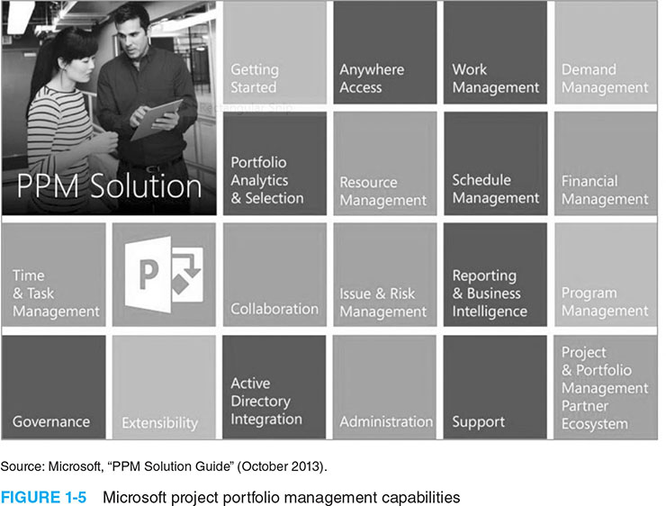
Figure 1-5. Microsoft project portfolio management capabilities

Slide 32
The Role of the Project Manager
Job descriptions vary, but most include responsibilities like planning, scheduling, coordinating, and working with people to achieve project goals
Remember that 97% of successful projects were led by experienced project managers, who can often help influence success factors

Slide 33
Suggested Skills for Project Managers
The Project Management Body of Knowledge
Application area knowledge, standards, and regulations
Project environment knowledge
General management knowledge and skills
Soft skills or human relations skills

Slide 34
Table 1-3 Ten Most Important Skills and Competencies for Project Managers
1. People skills
2. Leadership
3. Listening
4. Integrity, ethical behavior, consistent
5. Strong at building trust
6. Verbal communication
7. Strong at building teams
8. Conflict resolution, conflict management
9. Critical thinking, problem solving
10. Understands, balances priorities

Slide 35
Different Skills Needed in Different Situations
Large projects: Leadership, relevant prior experience, planning, people skills, verbal communication, and team-building skills were most important
High uncertainty projects: Risk management, expectation management, leadership, people skills, and planning skills were most important
Very novel projects: Leadership, people skills, having vision and goals, self confidence, expectations management, and listening skills were most important

Slide 36
Importance of Leadership Skills
Effective project managers provide leadership by example
A leader focuses on long-term goals and big-picture objectives while inspiring people to reach those goals
A manager deals with the day-to-day details of meeting specific goals
Project managers often take on the role of both leader and manager

Slide 37
Careers for IT Project Managers
In a 2014 survey, IT executives listed the “ten hottest skills” they planned to hire for in 2015
Project management was second only to programming and application development
Even if you choose to stay in a technical role, you still need project management knowledge and skills to help your team and organization

Slide 38
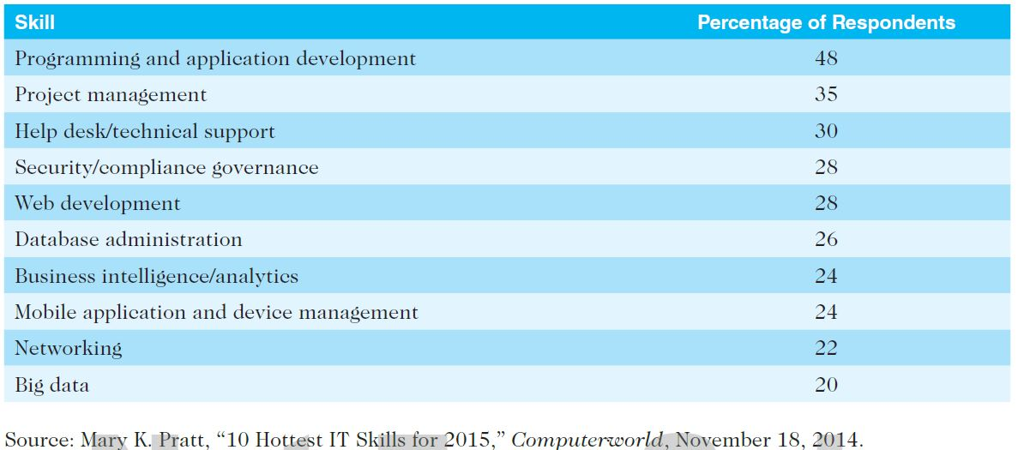
Table 1-4. Ten Hottest IT Skills

Slide 39
The Project Management Profession
The profession of project management is growing at a very rapid pace
It is helpful to understand the history of the field, the role of professional societies like the Project Management Institute, and the growth in project management software

Slide 40
History of Project Management
Some people argue that building the Egyptian pyramids was a project, as was building the Great Wall of China
Most people consider the Manhattan Project to be the first project to use “modern” project management
This three-year, $2 billion (in 1946 dollars) project had a separate project manager and a technical manager

Slide 41
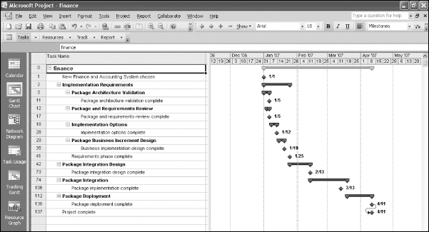
Figure 1-6. Sample Gantt Chart Created with Project 2013

Slide 42
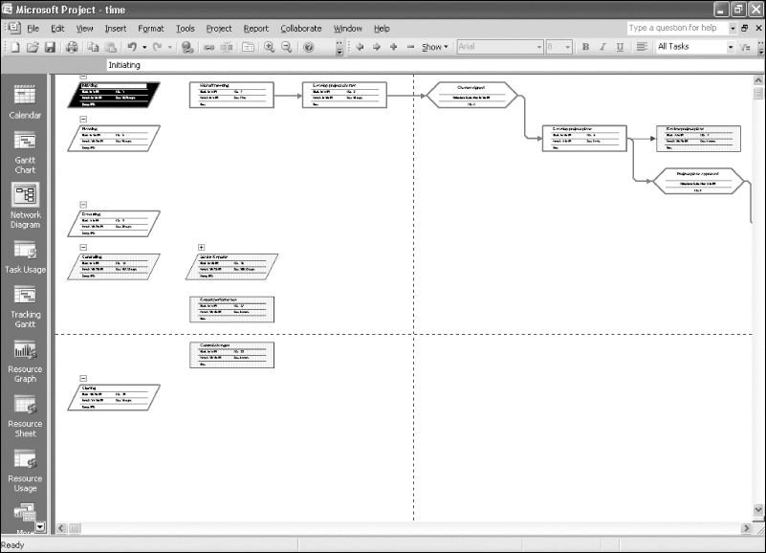
Figure 1-7. Sample Network Diagram Created with Project 2013

Slide 43
Project Management Offices
In the 100s, many companies began creating PMOs to help them handle the increasing number and complexity of projects
A Project Management Office (PMO) is an organizational group responsible for coordinating the project management function throughout an organization

Slide 44
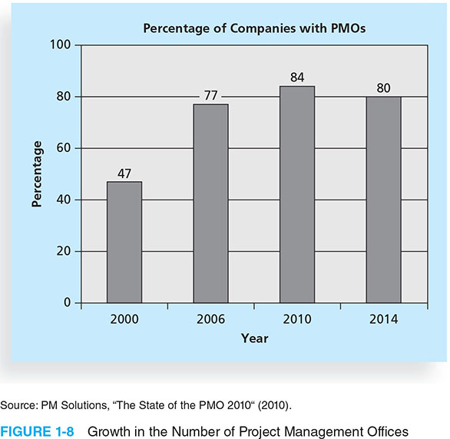
Figure 1-8. Growth in the Number of Project Management Offices

Slide 45
Global Issues
Several global dynamics are forcing organizations to rethink their practices:
Talent development for project and program managers is a top concern
Good project portfolio management is crucial in tight economic conditions
Basic project management techniques are core competencies
Organizations want to use more agile approaches to project management
Benefits realization of projects is a key metric

Slide 46
The Project Management Institute
The Project Management Institute (PMI) is an international professional society for project managers founded in 1969
PMI has continued to attract and retain members, reporting more than 449,000 members worldwide by late 2014
There are communities of practices in many areas, like information systems, financial services, and health care
Project management research and certification programs continue to grow
Students can join PMI at a reduced fee and earn the Certified Associate in Project Management (CAPM) certification(see www.pmi.org for details)

Slide 47
Project Management Certification
PMI provides certification as a Project Management Professional (PMP)
A PMP has documented sufficient project experience, agreed to follow a code of ethics, and passed the PMP exam
The number of people earning PMP certification is increasing quickly

Slide 48
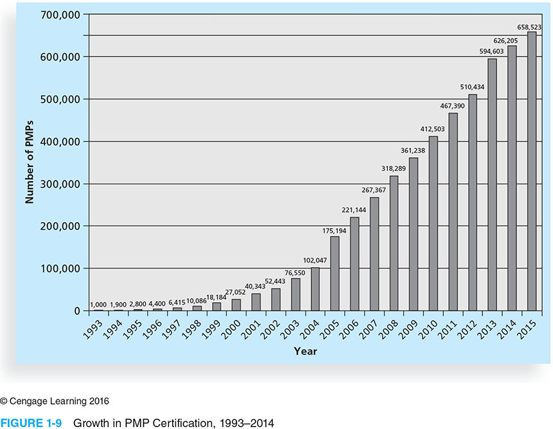
Figure 1-9 Growth in PMP Certification, 1993-2014

Slide 49
Ethics in Project Management
Ethics, loosely defined, is a set of principles that guide our decision making based on personal values of what is “right” and “wrong”
Project managers often face ethical dilemmas
In order to earn PMP certification, applicants must agree to PMI’s Code of Ethics and Professional Conduct
Several questions on the PMP exam are related to professional responsibility, including ethics

Slide 50
Project Management Software
There are hundreds of different products to assist in performing project management
Three main categories of tools:
Low-end tools: Handle single or smaller projects well, cost under $200 per user
Midrange tools: Handle multiple projects and users, cost $200-$1,000 per user, Project 2013 most popular
High-end tools: Also called enterprise project management software, often licensed on a per-user basis
Several free or open-source tools are also available

Slide 51
Chapter Summary
A project is a temporary endeavor undertaken to create a unique product, service, or result
Project management is the application of knowledge, skills, tools, and techniques to project activities to meet project requirements
A program is a group of related projects managed in a coordinated way
Project portfolio management involves organizing and managing projects and programs as a portfolio of investments
Project managers play a key role in helping projects and organizations succeed
The project management profession continues to grow and mature

