Slide 1

Network Behavior Anomaly Detection
Fauzan Isnaini
faisna@iu.edu

Slide 2
Network Threats
Malware: virus, trojan, worm, rootkit, etc.
Insider threat: spy, grumbled employees, uneducated employees, etc.
APT: Cybercrime directed at business and political targets, using a wide variety of intrusion technologies and malware, applied persistently and effectively to specific targets over an extended period, often attributed to state-sponsored organizations (e.g.: Stuxnet)
Zero-day attack (e.g.: wannacry)
Notes:
Goal of network security: protect Confidentiality, Integrity, and Availability.
To achieve its goal, it has to defend against network threats:
Malware: general term of malicious software
BYOD: employees can bring un-updated laptops and spread malwares inside the company’s network

Slide 3
Problems of Traditional Defense Mechanisms
Polymorphic viruses
Too many IT assets to monitor
Sophisticated attacks: APT, Zero-day attack, etc.
Higher computational power (It used to take 10.79 quintillions (10¹⁸) years to break 128-bit AES key. Now quantum computing can crack it in 6 months)
Notes:
Stuxnet: targeting nuclear reactor in Iran. It attacks the industrial control system software, causing the fast-spinning centrifuges to tear themselves apart. It causes physical damages.
Wannacry: the ransomware has spread to hundreds of PCs, and it took months to clean. The server's data can be restored with the backups, but many users' data remain locked.

Slide 4
Machine Learning in Detecting Threats
Most techniques are based on anomaly detection:
UEBA (User and Entity Behavioral Analytics): “Too many failed logins”
NTA (Network Traffic Anomaly): “A lot of traffic sent from A to B”

Slide 5
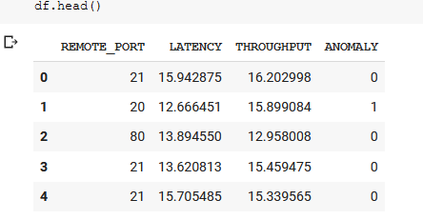
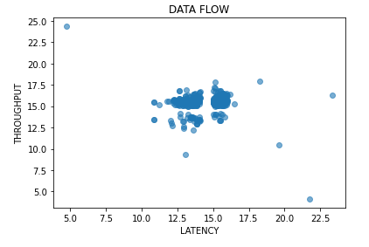
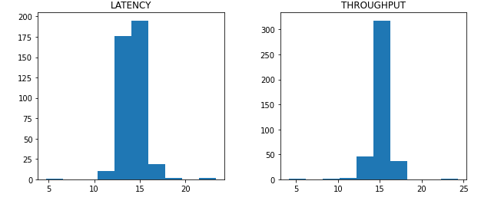
Dataset Overview

Slide 6
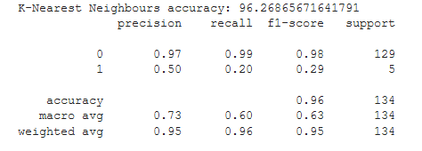
Model 1: K-Nearest Neighbor

Slide 7
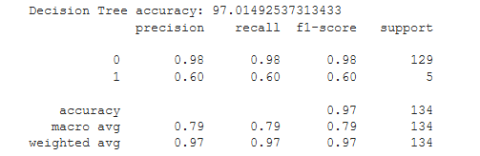
Model 2: Decision Tree

Slide 8
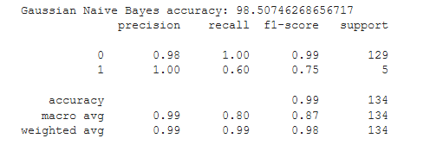
Model 3: Gaussian Naive Bayes

Slide 9
Results and Discussions
Gaussian Naive Bayes performs better than k-nearest neighbor and decision tree in detecting anomalous network traffic
Our dataset only consists of network throughput and latency, which is far from ideal. If we have enough time, we will use the KDD dataset to train our model, which contains a wide variety of intrusions simulated in a military network environment.
In the real-world scenario, the result of anomaly detection will be aggregated with other security events in a Security Information and Event Management (SIEM). SIEM will then correlate these events and classify them as either critical or non-critical.

