Slide 1

Comparison of Classifier-Based Machine Learning Algorithms for Intrusion Detection System
Fauzan Isnaini
faisna@iu.edu

Slide 2
Network Threats
Malware: virus, trojan, worm, rootkit, etc.
Insider threat: spy, grumbled employees, uneducated employees, etc.
APT: Cybercrime directed at business and political targets, using a wide variety of intrusion technologies and malware, applied persistently and effectively to specific targets over an extended period, often attributed to state-sponsored organizations (e.g.: Stuxnet)
Zero-day attack (e.g.: wannacry)
Notes:
Goal of network security: protect Confidentiality, Integrity, and Availability.
To achieve its goal, it has to defend against network threats:
Malware: general term of malicious software
BYOD: employees can bring un-updated laptops and spread malwares inside the company’s network

Slide 3
Problems of Traditional Defense Mechanisms
Polymorphic viruses
Too many IT assets to monitor
Sophisticated attacks: APT, Zero-day attack, etc.
Higher computational power (It used to take 10.79 quintillions (10¹⁸) years to break 128-bit AES key. Now quantum computing can crack it in 6 months)
Notes:
Stuxnet: targeting nuclear reactor in Iran. It attacks the industrial control system software, causing the fast-spinning centrifuges to tear themselves apart. It causes physical damages.
Wannacry: the ransomware has spread to hundreds of PCs, and it took months to clean. The server's data can be restored with the backups, but many users' data remain locked.

Slide 4
Machine Learning Techniques for Detecting Threats
Most common classifier-based techniques are:
KNN
Decision Tree
SVM
ANN
References:
A. Phadke, M. Kulkarni, P. Bhawalkar, and R. Bhattad, “A review of machine learning methodologies for network intrusion detection,” 2019 3rd International Conference on Computing Methodologies and Communication (ICCMC), 2019.
Z. Ahmad, A. Shahid Khan, C. Wai Shiang, J. Abdullah, and F. Ahmad, “Network intrusion detection system: A systematic study of machine learning and Deep Learning Approaches,” Transactions on Emerging Telecommunications Technologies, vol. 32, no. 1, 2020.

Slide 5
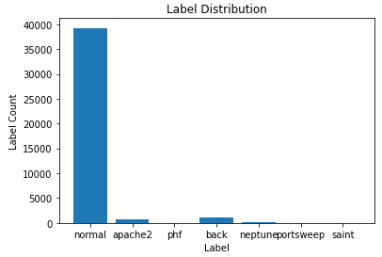
Dataset Overview

Slide 6
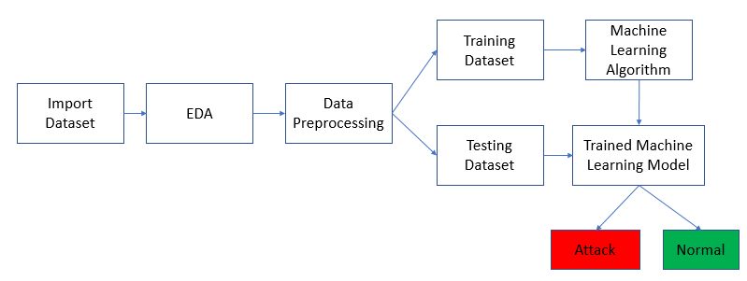
Methods

Slide 7
Methods
No. | ML Model | Parameters
1 | KNN | Number of neighbors: 2, distance metric: Euclidean
2 | Decision tree | Split criterion: Gini impurity, split strategy: best
3 | SVM | Kernel type: linear (using LinearSVC), maximum number of iterations: 40,000
4 | ANN | Input layer with 40 input dimensions, one hidden layer with 50 neurons and relu activation function, output layer with one neuron and sigmoid activation function, loss: binary crossentropy, optimizer: adam, epochs: 10

Slide 8
Results
No. | ML Model | Accuracy | Precision | Recall | F1-score | FPR
1 | KNN | 99.9030 | 99.6604 | 98.3250 | 98.9882 | 0.017
2 | Decision tree | 99.9030 | 99.6604 | 98.3250 | 98.9882 | 0.017
3 | SVM | 99.8626 | 99.1525 | 97.9899 | 98.5678 | 0.042
4 | ANN | 99.9030 | 99.3255 | 98.6600 | 98.9916 | 0.034

Slide 9
Discussions
All four models have FPR below 0.1%, surpassing DARPA’s FPR baseline.
Our models are binary classification models, which means they only classify network traffics as either normal or anomalous.
A good training data is important to achieve good performance
In order for classifier-based machine learning techniques to perform well, all the traffics in the dataset need to be labeled as either normal or anomalous for training the models. Further study may be conducted to analyze the performance of clustering-based machine learning when labeled datasets are not available

