Slide 1
Image Paragraph Captioning
By
Parvathy Ramakrishnan P
Muhammed Favas
Shubham Kanojia

Slide 2
Dataset
Stanford Image Paragraph Captioning dataset- A subset of Visual Genome dataset is used where 19551 images are labelled with corresponding captions.
14575 training samples
2489 validation samples
2887 test samples

Slide 3
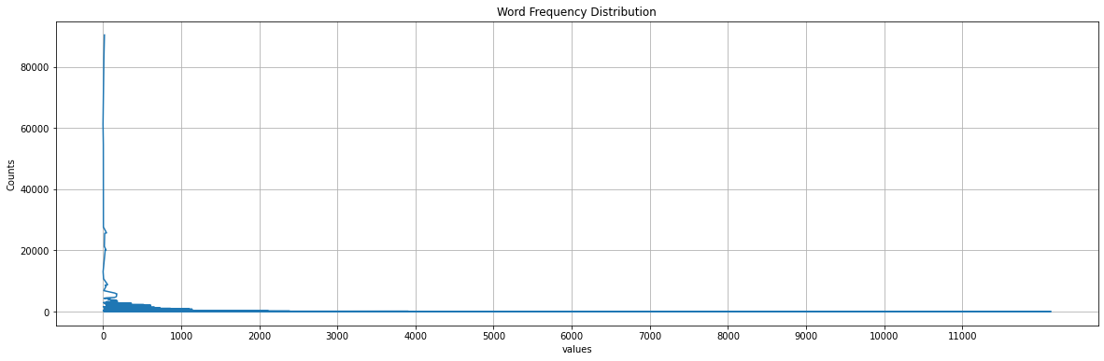
Exploratory Data Analysis

Slide 4
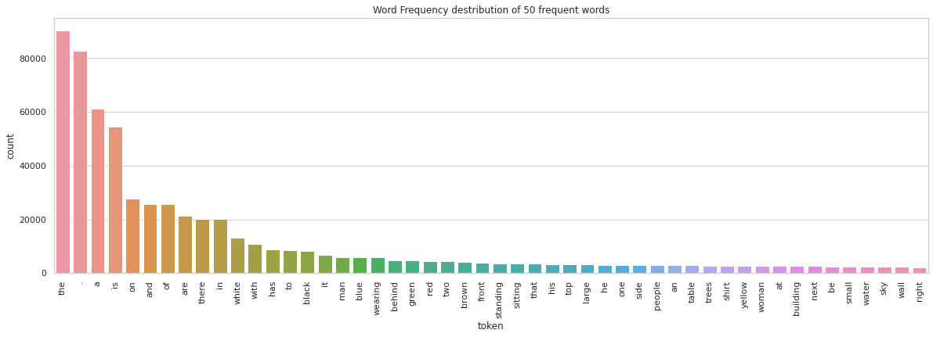
Exploratory Data Analysis

Slide 5
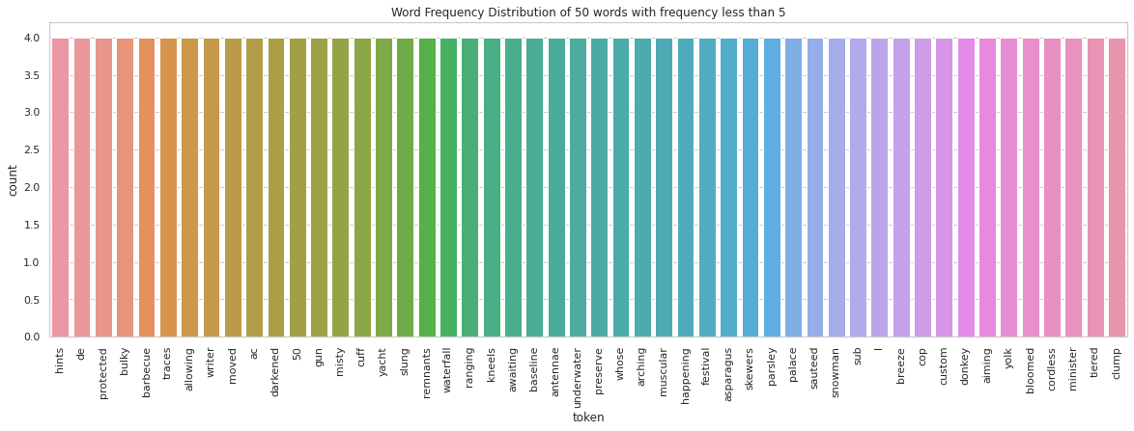
Exploratory Data Analysis

Slide 6
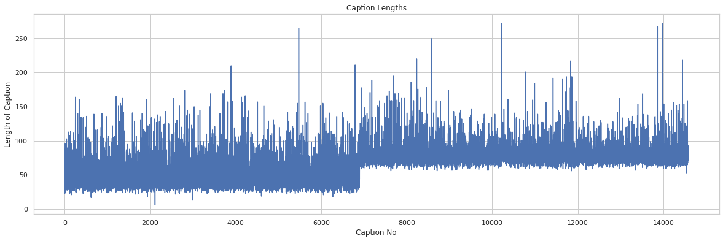
Exploratory Data Analysis

Slide 7
Model Architectures

Slide 8
Image Paragraph Captioning
Two main components
CNN’s as encoder- For preserving the image features and it’s information
RNN’s as decoder- For dealing with any kind of sequential data and for generating sequence of words.

Slide 9
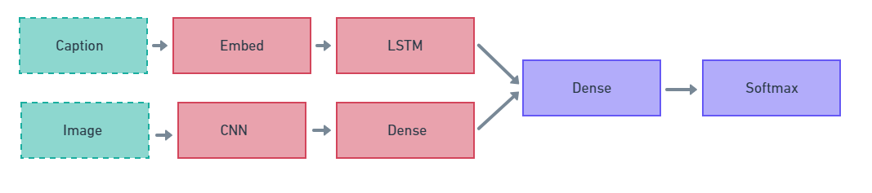
Encoder Decoder Merge Model

Slide 10
Encoder Decoder Merge Model
The image information is fed to the neural network in a layer following the RNN – conditioning the language model by ‘merging’ image features.
The image vector is left out of the RNN sub-cell and hence RNN deals purely with the linguistic info.
This allows the RNN’s hidden state vector to shrink in size by up to four times.
After the prefix has been vectorized, it is merged with the image vector in a separate ‘multi-model layer’ which comes after the RNN sub-network.

Slide 11
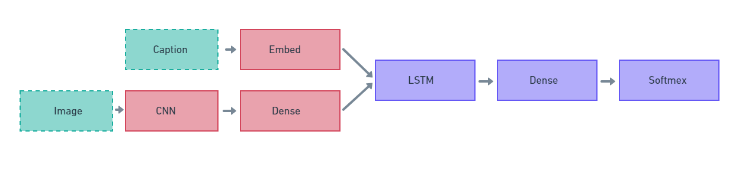
Encoder Decoder Inject Model

Slide 12
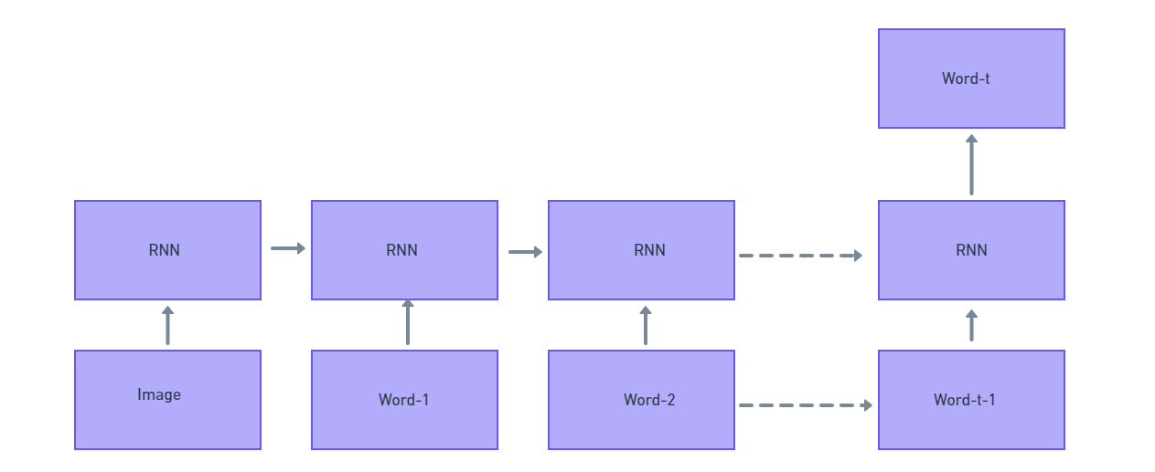
Encoder Decoder Inject Model
Pre-Inject Model (decoder)
Source: Where to put the Image in an Image Caption Generator

Slide 13
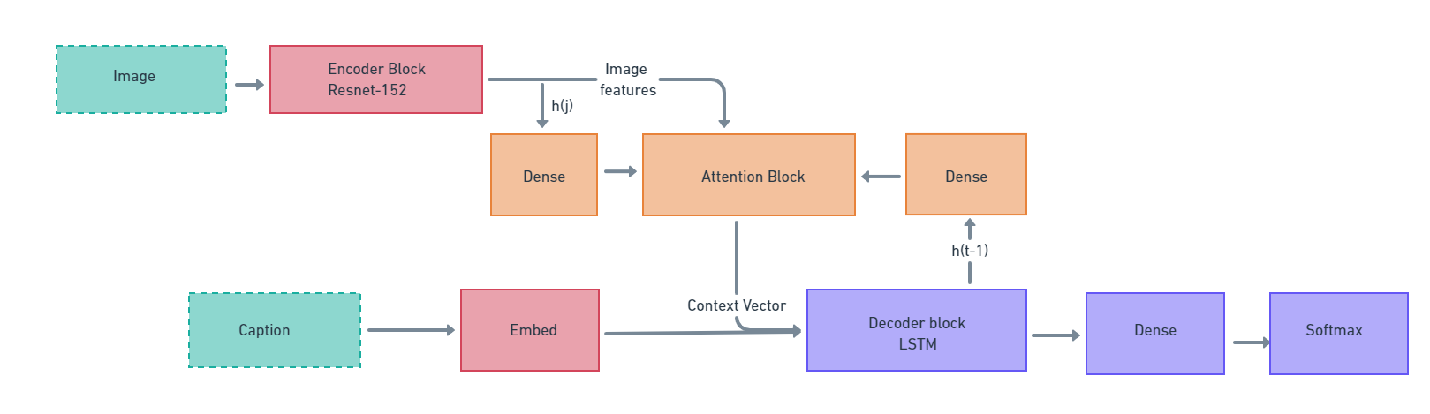
Encoder Decoder with Visual Attention
Source: Show, Attend and Tell: Neural Image Caption Generation with Visual Attention

Slide 14
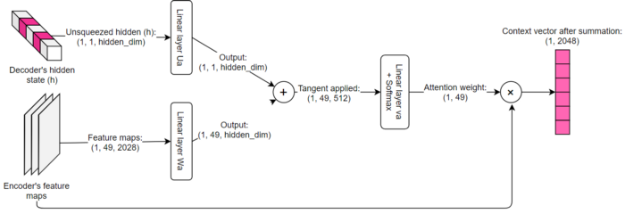

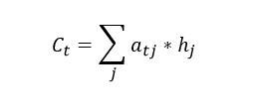
Encoder Decoder with Visual Attention
Attention Block

Slide 15
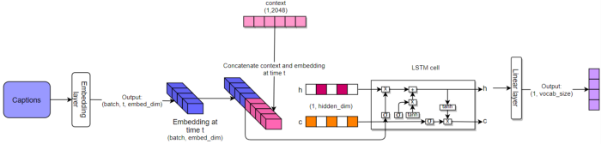
Encoder Decoder with Visual Attention
Decoder Block

Slide 16
Results and Inference

Slide 17
Results Comparisons
Model | BLUE-1 | BLUE-2 | BLUE-3 | BLUE-4
Merge (150 epoch) | 0.03 | 0.12 | 0.22 | 0.26
Inject (100 epoch) | 0.05 | 0.15 | 0.22 | 0.20
Attention (50 epoch) | 0.08 | 0.10 | 0.03 | 0.04

Slide 18
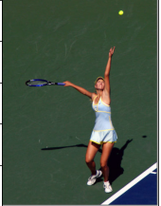
Sample Outputs
Merge Model: a man is standing on a tennis court . he is wearing a short sleeve shirt, shorts and a white wristband . the man is holding a racket in his hands . the court is green with white painted lines on it . part of a wall can be seen behind the man . part of a green sky can be seen above the fence
Inject Model: a man is standing on a tennis court playing tennis . he is wearing a white shirt and black shorts . the man is holding a racket in his hand . a white ball is soaring in the air towards the man . a tall chain link fence is standing behind the court .
Attention Model: a man is playing tennis . the tennis is wearing a white shirt and white shorts . the man is wearing a white shirt and white shorts . the man is wearing a white shirt .

Slide 19
Demo

Slide 20
Contributions
Parvathy | Shubham | Favas
Data Preprocessing Merge Model Training and Inference Hyperparameter Tuning Explored alternate pretrained CNN models and RNN architecture using LSTM layers | Data Preprocessing Tried various Image encoding in InceptionV3 ,RESNET50 , for merge model and RNN architectures . Used GloVe word Embedding to increase the performance of model and other hyperparameter tuning. Deployed the image captioning model using FLASK . | Exploratory data analysis. Image encoding with VGG16 for merge model. Inject model (InceptionV3 and LSTM) training with image augmentation and inference. Attention model (Resnet-152 and LSTM) training with image augmentation and inference.

Slide 21
Thank You !!

