Slide 1
Lecture 1: Graphing 1 Variable
Intro Stats with Nathan Favero
American University (Washington, DC) August 2, 2024
Except where indicated, this material is licensed under CC-BY 4.0

Slide 2
Some important concepts
Observation: one unit (e.g., event, object, or person) in a dataset; often represented as a row of data
Variable: characteristics of observations that can take on different values or amounts; often represented as a column of data
Lecture 1: Graphing 1 Variable
2 / 18

Slide 3
Some important concepts
Qualitative variable (also called categorical or nominal): a variable consisting of categories that are not obviously ordered in any way
Examples: race (white, black, Latino, other), industry (manufacturing, agriculture, technology, etc.), pregnancy (pregnant, not pregnant)
Quantitative variable: a variable where values have a numerical ordering (can be arranged from least to greatest)
Examples: age, income, education level
Lecture 1: Graphing 1 Variable
2 / 18

Slide 4
Some important concepts
Three types of quantitative variables:
Ordinal variable: a variable with values that can be clearly arranged from least to greatest but where the distances between values cannot be easily quantified
Examples: education (high school diploma or less, some college, 4-year college degree, advanced degree), Likert scales (strongly disagree, somewhat disagree, somewhat agree, strongly agree)
Discrete variable: a variable that can only take on certain values within a range (e.g., whole numbers) and that is not ordinal (with a discrete variable, one can quantify the distance between different values)
Examples: number of children, number of visits to office
Continuous variable: a variable that can be measured to many decimal places (at least theoretically)
Examples: weight, income, response time
Lecture 1: Graphing 1 Variable
2 / 18

Slide 5
Percentiles
Basic definition: p% of the data falls (at or) below the
pth percentile
Example: if the 25th percentile of age is 30, then 25% of the observations are younger than (or equal to) 30 years old; conversely, 75% of the observations must be older than (or equal to) 30
To find the pth percentile, line all values up from least to greatest and then pick the value that marks the p% point in this lineup (e.g, for 50th percentile, pick the middle point)
There are various methods that can be used to deal with ties, rounding, etc., but we won’t worry about learning those for this class
Lecture 1: Graphing 1 Variable
2 / 18

Slide 6
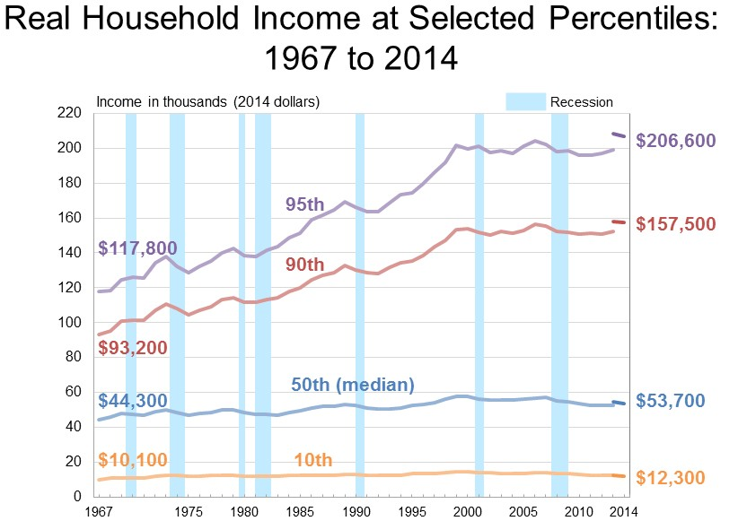
Percentiles: example
(Image: Public domain, U.S. Census Bureau)
Lecture 1: Graphing 1 Variable
2 / 18

Slide 7
Histograms
A type of bar chart
Each bar represents either (1) a single value (for qualitative, ordinal, or discrete variables) or (2) a range of values (known as a “bin”) (for continuous variables)
The height of each bar represents how many data points (1) are equal to the corresponding value or (2) fall within the corresponding range of values (bin)
Lecture 1: Graphing 1 Variable
2 / 18

Slide 8
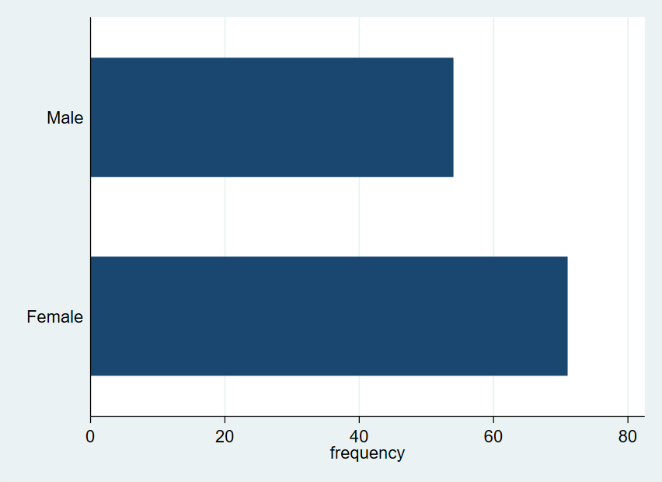
Histograms: example with qualitative variable
Lecture 1: Graphing 1 Variable
2 / 18

Slide 9
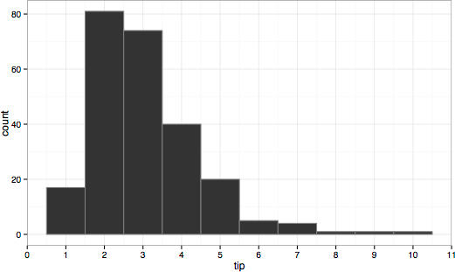
Histograms: example with continuous variable ($1 bin width)
(Image: CC BY-SA 4.0, “Tips-histogram1.png” by Visnut)
Lecture 1: Graphing 1 Variable
2 / 18

Slide 10
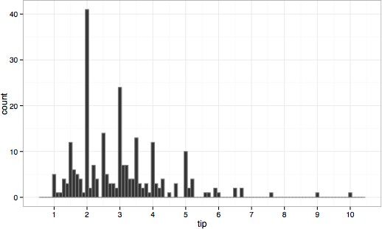
Histograms: example with continuous variable (10-cent bin width)
(Image: CC BY-SA 4.0, “Tips-histogram2.png” by Visnut)
Lecture 1: Graphing 1 Variable

Slide 11
Boxplots
Another way of depicting continuous variables
Especially useful for making comparisons (e.g., do college men binge drink more than women?)
Middle line is the 50th percentile (median)
Edges of box are 25th and 75th percentiles
“Whiskers” usually indicate range (max and min), although outliers (extreme values) might be ignored
Outliers may be shown as dots
Lecture 1: Graphing 1 Variable

Slide 12
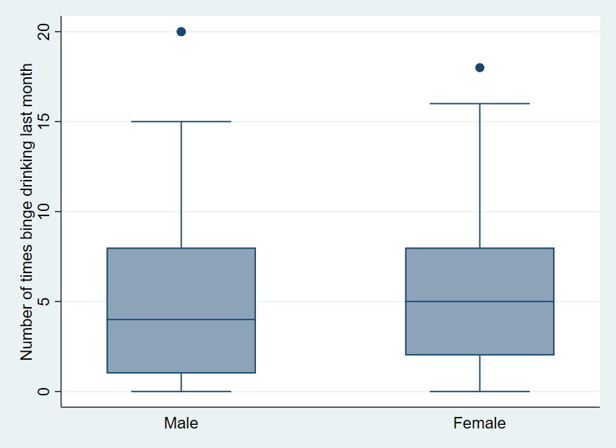
Boxplots: example
Lecture 1: Graphing 1 Variable

Slide 13
Graphing pitfalls
Simpler is usually better (3D, etc., can be deceptive)
Histograms: Be aware that the graph might look different depending on how bins are drawn (bin widths and starting points)
Axes: Always pay attention to how the X and Y axes have been drawn; in general, any variation/change can be made to look very small or very big depending on how the axes are chosen; for example, see https://peltiertech.com/
tax-the-rich-or-deceptive-axis-scales/
Lecture 1: Graphing 1 Variable

Slide 14
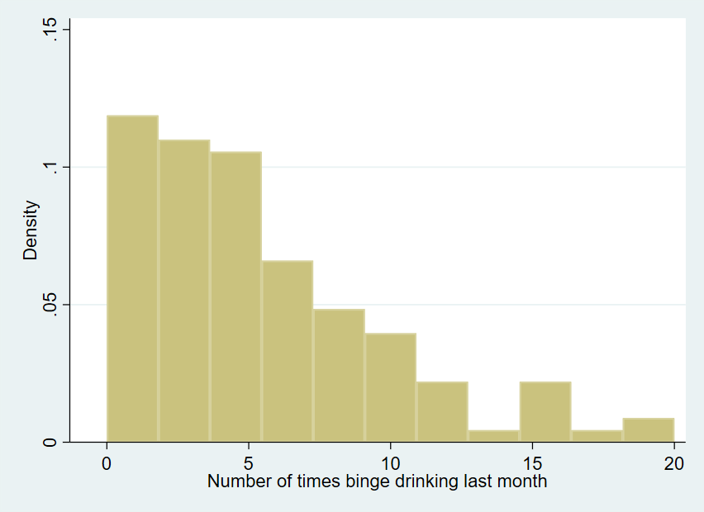
Appendix: Comparing graphs - Histogram
Lecture 1: Graphing 1 Variable

Slide 15
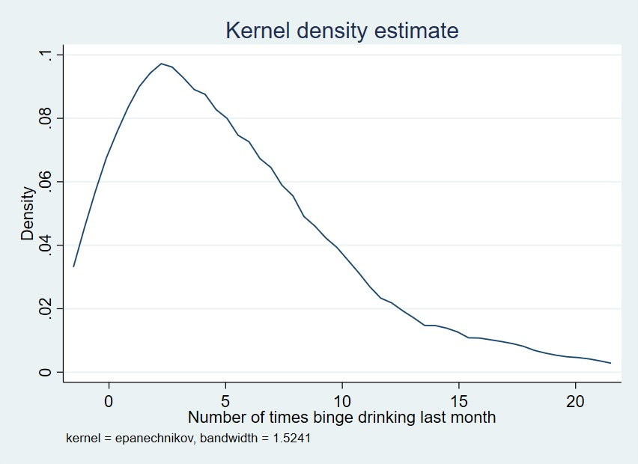
Appendix: Comparing graphs - K-density
Lecture 1: Graphing 1 Variable

Slide 16
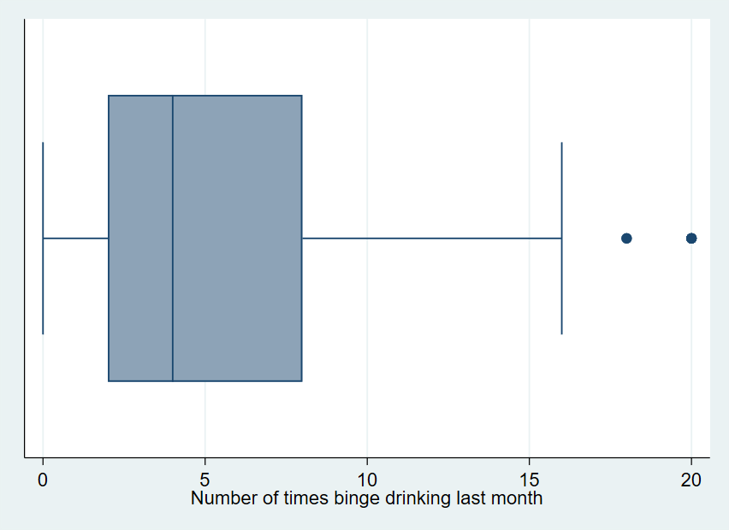
Appendix: Comparing graphs - Boxplot
Lecture 1: Graphing 1 Variable

Slide 17
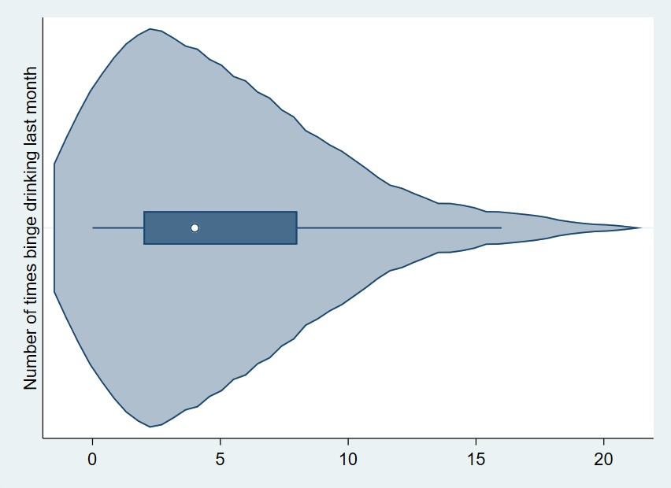
Appendix: Comparing graphs - Violin
Lecture 1: Graphing 1 Variable

Slide 18
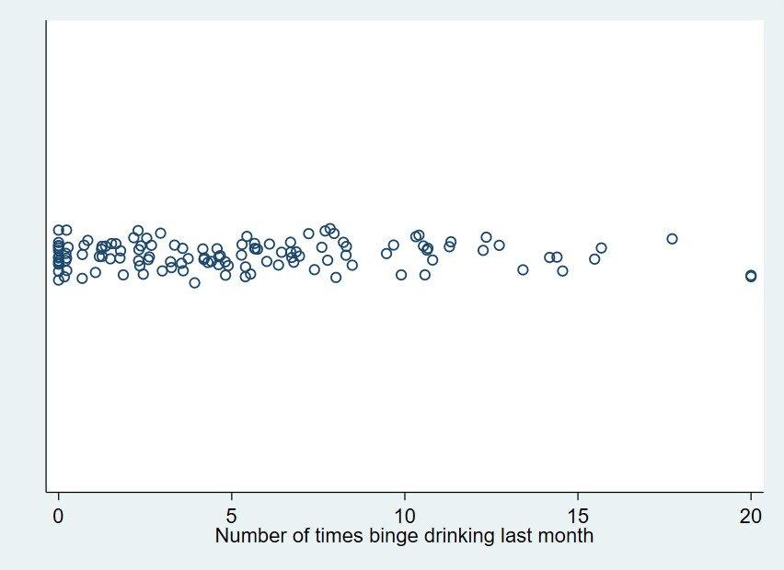
Appendix: Comparing graphs - Strip plot
Lecture 1: Graphing 1 Variable

