Slide 1
Lecture 2: Statistics for 1 Variable
Intro Stats with Nathan Favero
American University (Washington, DC) August 2, 2024
Except where indicated, this material is licensed under CC-BY 4.0

Slide 2
Measures of central tendency
Q: What is the typical value for this variable? (Can only answer with one number; can’t give me a range)
A: We want a measure of central tendency
Lecture 2: Statistics for 1 Variable

Slide 3
Measures of central tendency
Mean: average; add up all values and then divide by total number of observations
∑
x
µ =
i
N
Median: 50th percentile; line all values up from least to greatest and then pick the value in the very middle. If two values are tied, take the average of the two.
Mode: most frequently occurring value
Lecture 2: Statistics for 1 Variable

Slide 4
Measures of central tendency
Mean: sensitive to outliers (unusually large or small values)
Median: not sensitive to outliers
Mode
Usually not ideal for continuous variables (especially when measured to many digits), although can use bins instead with continuous variables
There may be more than one mode
Lecture 2: Statistics for 1 Variable

Slide 5
Measures of spread
Q: How tightly is the data clustered around the center of the distribution? Are most data points pretty close to the mean/median?
A: We want a measure of spread
Lecture 2: Statistics for 1 Variable

Slide 6
Measures of spread
Range: maximum value minus minimum value
Doesn’t necessarily tell us anything about whether most observations are close to the mean/median
Interquartile range (IQR): 75th percentile minus 25th percentile
25th and 75th percentile calculated like median, except they mark the 25% point and 75% point (as opposed to the middle, or 50% point) when data is arranged from least to greatest
IQR is depicted in a bloxplot
Lecture 2: Statistics for 1 Variable

Slide 7
Measures of spread
Most common measures of spread: variance and
standard deviation
Variance
∑
(x − µ)
2
σ² =
i
N
This is equal to the average squared deviation (or squared error)—in other words, the average squared difference between each data point and the mean
Lecture 2: Statistics for 1 Variable

Slide 8
Measures of spread
Standard deviation
σ =
√
∑
(x − µ)
2
i
N
This is just the square root of the variance
You can think of it as the typical distance between a data point and the mean (not quite right but a good approximation)
Lecture 2: Statistics for 1 Variable

Slide 9
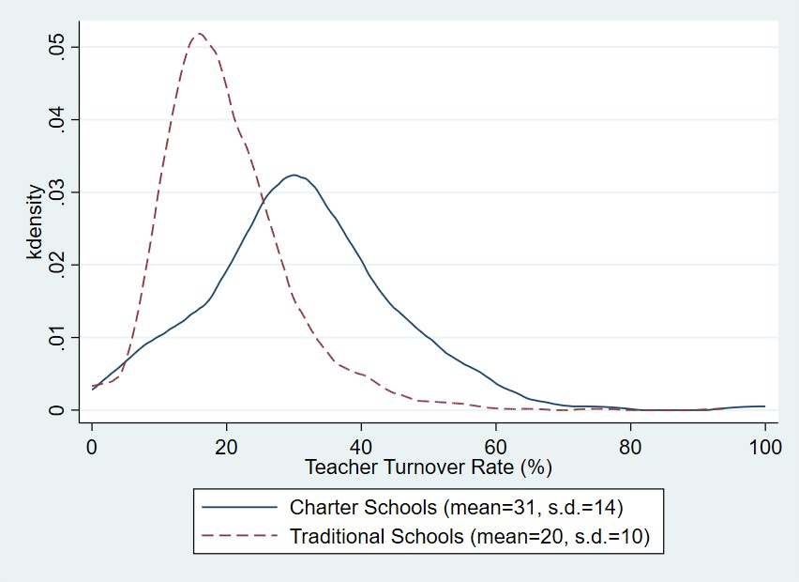
Measures of spread
Lecture 2: Statistics for 1 Variable

Slide 10
Standardization
Sometimes it’s useful to convert a variable in a dataset into a different scale so that it has a mean of 0 and a standard deviation of 1 (just like the standard normal distribution)
Standardization: converting a variable so that its values indicate how many standard deviation-units each data point is from the mean of the distribution (creating a distribution with a mean of 0 and a standard deviation of 1)
Z-score: how we refer to a variable (or data point) that has been standardized
Lecture 2: Statistics for 1 Variable

Slide 11
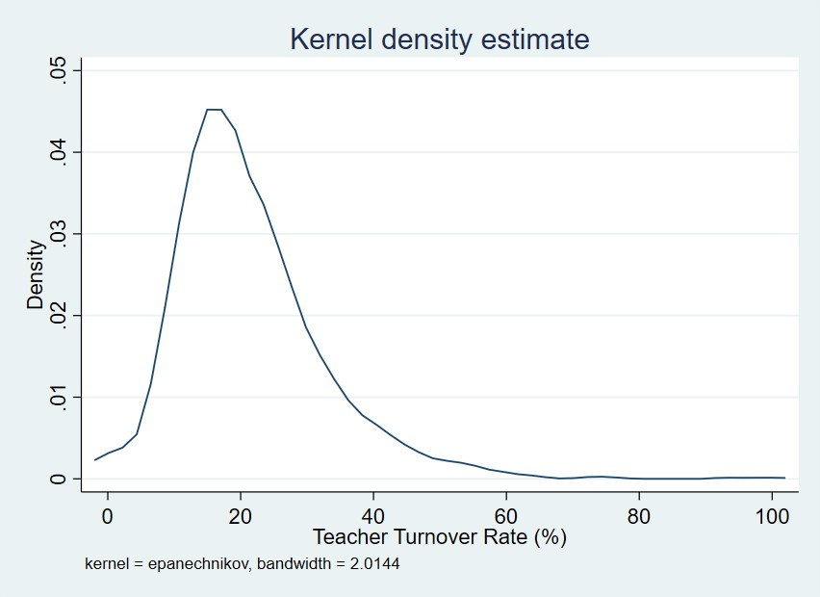
Standardization: Texas school districts
Lecture 2: Statistics for 1 Variable

Slide 12
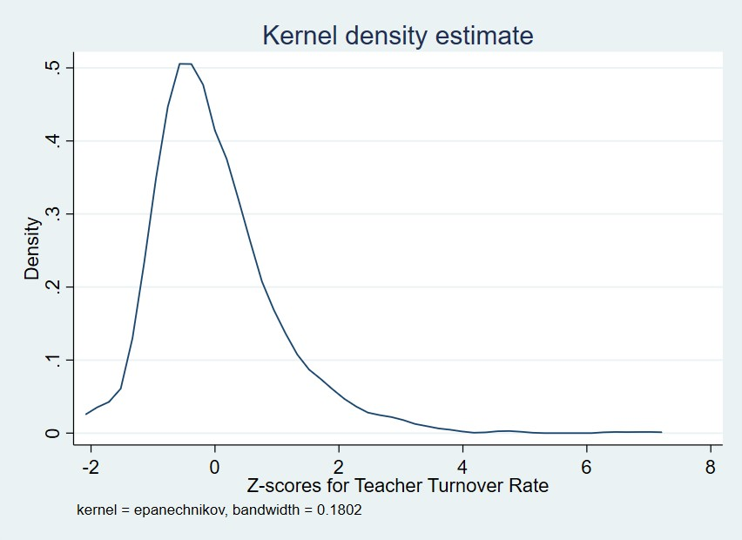
Standardization: Texas school districts
Lecture 2: Statistics for 1 Variable

Slide 13
Standardization
_{z =} x − µ
σ
Standardizing doesn’t change the shape of the distribution (similar to re-labeling the x axis on a histogram)
Subtracting the mean moves the distribution horizontally so that it’s centered at zero
Dividing by the standard deviation stretches or squishes the distribution so that the standard deviation is equal to one
Lecture 2: Statistics for 1 Variable

Slide 14
Standardization
Z scores allow us to make comparisons among distributions with similar shapes but different means/standard deviations
Example: comparing two students if one took the ACT and the other took the SAT (could also use percentiles)
Lecture 2: Statistics for 1 Variable

Slide 15
Log transformation
Using a logarithmic transformation can help to make outliers less pronounced if most of the outliers are on the right side of the distribution (are extremely large values); log transformation won’t help with outliers
that are on the left side of the distribution
While logging a variable may help with outliers, logged variables are typically harder to interpret
Example: salary data often has outliers on the right side of the distribution
Lecture 2: Statistics for 1 Variable

Slide 16
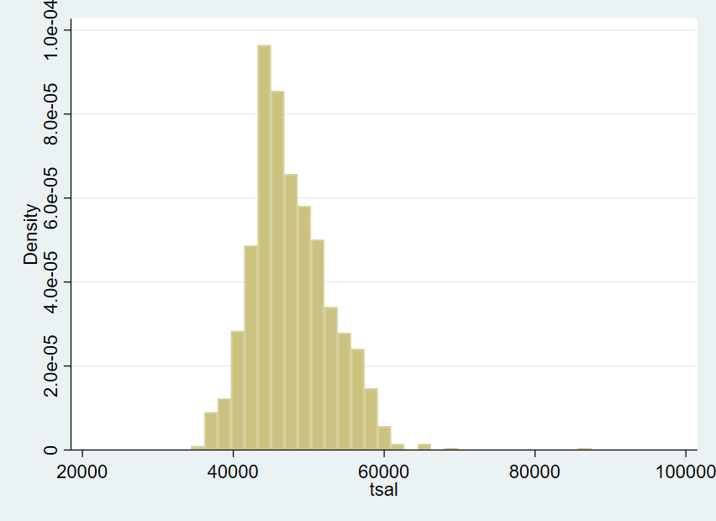
Average teacher salaries (before log transformation)
Log transformation
Lecture 2: Statistics for 1 Variable

Slide 17
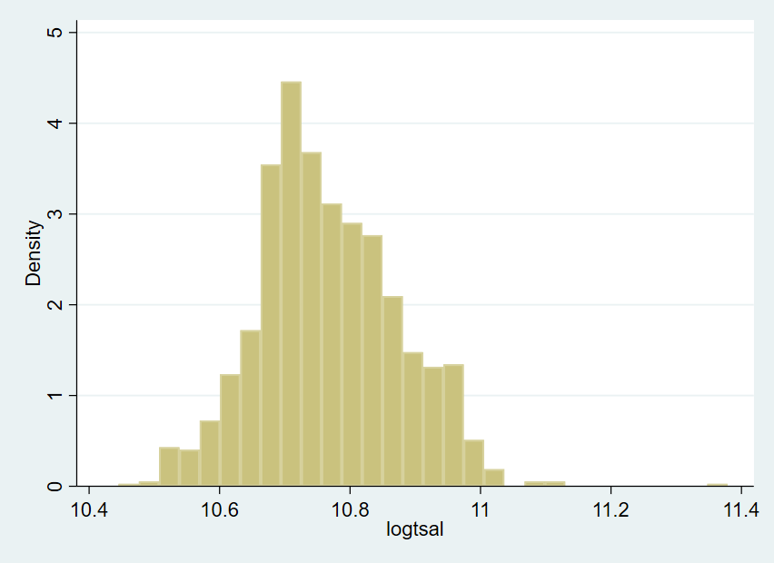
Log transformation
Logged average teacher salaries
Lecture 2: Statistics for 1 Variable

Slide 18
Log transformation
Average teacher salaries (before log transformation) – compare mean to median
. sum tsal, detail
tsal
 | Percentiles | Smallest
1% | 37300 | 34376
5% | 40144 | 36091
10% | 41748 | 36391 | Obs | 1,196
25% | 44057.5 | 36760 | Sum of Wgt. | 1,196
50% 46801 |  |  | Mean | 47653.11
Largest |  |  | Std. Dev. | 5251.786
75% | 50924 | 66004
90% | 55099 | 66176 | Variance | 2.76e+07
95% | 57102 | 68072 | Skewness | .8008082
99% | 60203 | 87448 | Kurtosis | 5.517889
Lecture 2: Statistics for 1 Variable

Slide 19
Log transformation
Logged teacher salaries – note that the mean and median are now closer
. sum logtsal, detail
logtsal
 | Percentiles | Smallest
1% | 10.52675 | 10.44511
5% | 10.60023 | 10.4938
10% | 10.63941 | 10.50208 | Obs | 1,196
25% | 10.69325 | 10.51217 | Sum of Wgt. | 1,196
50% 10.75366 |  |  | Mean | 10.76584
Largest |  |  | Std. Dev. | .1076784
75% | 10.83809 | 11.09747
90% | 10.91689 | 11.10007 | Variance | .0115946
95% | 10.95259 | 11.12832 | Skewness | .3394967
99%
11.00548
11.3788
Kurtosis
3.538327
19 / 20
Lecture 2: Statistics for 1 Variable

Slide 20
Log transformation
Log transformations can also sometimes be useful if we want to examine things in percentage terms (e.g., the Black-White wage gap example in Wheelan)
To convert from a log-change to a percentage-change (approximated), calculate the change in the log values, and then move the decimal place over two places to the right to get the percentage (just as when converting a proportion to a percentage)
Suppose a teacher used to have a log salary of 10.5 but now it is 10.6. That is a .1 (or a .10) increase. Moving over the decimal point two places and adding a percentage sign gives us 10%.
Similarly, a teacher making a log-salary of 10.9 makes about 10% more than someone making 10.8
Feel free to try out the math for this on your own with
a couple examples
Intro Stats with Nathan Favero
Lecture 2: Statistics for 1 Variable

