Slide 1
Lecture 3: The Relationship Between 2 Variables
Intro Stats with Nathan Favero
American University (Washington, DC) August 2, 2024
Except where indicated, this material is licensed under CC-BY 4.0

Slide 2
Associations among variables
So far, we’ve mostly focused on learning tools to help us describe a single variable
Now, we want to start thinking about describing two variables jointly
We often use words like “association,” “related,” or “correlated” when describing two variables
The statistical tools we’ll use to describe the relationship between two variables will depend on whether our variables are quantitative or qualitative
Lecture 3: The Relationship Between 2 Variables 2 / 32

Slide 3
Cheatsheet: Which measure of association?
1 quantitative and 1 qualitative variable: compare means/medians across groups
2 qualitative variables: use a contingency table (crosstabs) to compare rates across groups
2 quantitative variables: correlation/regression
Ordinal variables can be treated as quantitative or qualitative
Calculating a mean or a correlation with an ordinal variable requires you to assign specific numerical values to the ordered response options and treat the variable as though it is discrete/continuous; this is often a fine approximation
Alternatively, you can always treat ordinal variables like qualitative variables, though this will often make the analysis slightly more complex
Lecture 3: The Relationship Between 2 Variables 2 / 32

Slide 4
1 quantitative & 1 qualitative variable
Example: Charter vs traditional schools
The pass rate is a quantitative (continuous) variable
The school type (charter vs traditional) is a qualitative variable
We can calculate a median (or mean) pass rate for each category (a median for charter schools, and a median for traditional schools)
Then we can compare the medians (means) to see which of the two groups (charters vs traditional) has a higher typical pass rate and how big the difference is
Lecture 3: The Relationship Between 2 Variables 2 / 32

Slide 5
1 quantitative & 1 qualitative variable
Example: Charter vs traditional schools
. sum passrate if charter==0
Variable | Obs Mean Std. Dev.
-------------+----------------------------------------
passrate | 1,021 45.01175 11.4699
. sum passrate if charter==1
Variable | Obs Mean Std. Dev.
-------------+----------------------------------------
passrate | 166 40.86747 16.44257
Lecture 3: The Relationship Between 2 Variables 5 / 32

Slide 6
1 quantitative & 1 qualitative variable
Example: Charter vs traditional schools
Based on this output, we would conclude that traditional schools have a higher average pass rate than charter schools
More specifically, we would say that the pass rate is about four percentage points higher in traditional schools
Thus, the two variables (pass rate and school type) are related
Based on the standard deviations, we can also conclude that charter schools have a wider spread (less consistency) than traditional schools
Lecture 3: The Relationship Between 2 Variables 10 / 32

Slide 7
1 quantitative & 1 qualitative variable
Example: Charter vs traditional schools
Instead of using means, we could compare median pass rates
Using medians might be better if we are worried that the difference in means might be driven by a few outliers
Lecture 3: The Relationship Between 2 Variables 10 / 32

Slide 8
1 quantitative & 1 qualitative variable
Example: Charter vs traditional schools
. tabstat passrate, s(median) by(charter)
Summary for variables: passrate by categories of: charter
charter | p50
-----------------+----------
Traditional Scho | 44
Charter Schools | 39.5
-----------------+----------
Total | 43
Lecture 3: The Relationship Between 2 Variables 10 / 32

Slide 9
1 quantitative & 1 qualitative variable
Example: Charter vs traditional schools
Comparing the medians provides very similar results to what we saw with the means
According to the results on the prior slide, the median pass rate is 4.5 percentage points higher in traditional schools
We can also study the association between pass rate and school type using a visual depiction of the data (and we’ll reach a similar conclusion)
Lecture 3: The Relationship Between 2 Variables 10 / 32

Slide 10
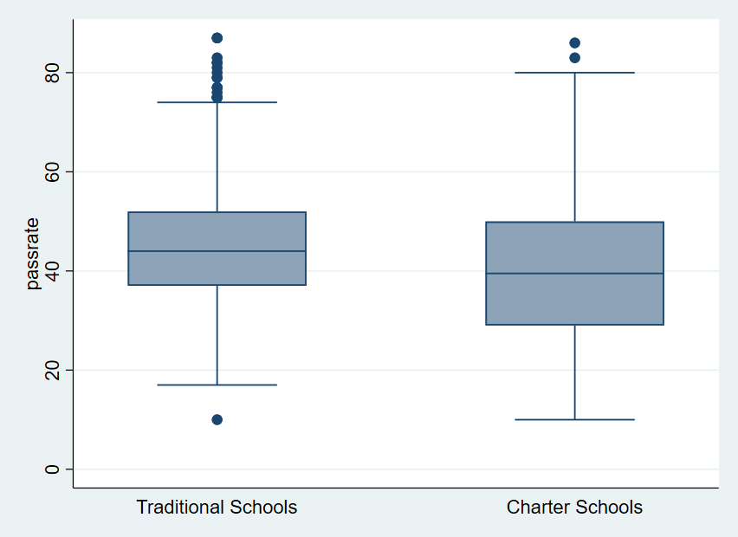
1 quantitative & 1 qualitative variable
Example: Charter vs traditional schools
Lecture 3: The Relationship Between 2 Variables 10 / 32

Slide 11
2 qualitative variables: Crosstabs
If we have two qualitative variables, we can create a contingency table showing the number of cases that fall into each cell
Often a contingency table will show both raw numbers and proportions/percentages
For determining whether there is an association, focus on the proportions/percentages rather than the raw counts
Specifically, you want to note whether the percentage breakdown for one variable changes depending on the value of the other variable
Lecture 3: The Relationship Between 2 Variables 10 / 32

Slide 12
2 qualitative variables: Crosstabs
Example: Are charter-school districts more likely to have only 1 school?
. tab oneschooldist charter, col
+-------------------+
| Key |
|-------------------|
| frequency |
| column percentage |
+-------------------+
Single-Sch |
ool | District Type District | Tradition Charter S |
(continued on next slide)
Total
Lecture 3: The Relationship Between 2 Variables 10 / 32

Slide 13
2 qualitative variables: Crosstabs
Example: Are charter-school districts more likely to have only 1 school?
Single-Sch |
ool | District Type
District | Tradition Charter S | Total
-----------+----------------------+----------
-----------+----------------------+----------
-----------+----------------------+----------
0 | | 819 | 109 | | 928
| | 80.06 | 61.58 | | 77.33
1 | | 204 | 68 | | 272
| | 19.94 | 38.42 | | 22.67
Total | | 1,023 | 177 | | 1,200
| | 100.00 | 100.00 | | 100.00
Lecture 3: The Relationship Between 2 Variables 10 / 32

Slide 14
2 qualitative variables: Crosstabs
Example: Who lives on campus?
Again, focus on the percentages listed, and the task is actually similar to comparing means
Based on the table in the prior slide, 19.9% of traditional districts have only 1 school, while 38.4% of charter districts are single-school districts
We conclude that there is an association between district type and the single-school district variable: charter districts are more likely to be single-school districts
More specifically, charter districts are around 18 percentage points (38% - 20% = 18%) more likely to be single-school districts
Lecture 3: The Relationship Between 2 Variables 10 / 32

Slide 15
2 quantitative variables: Correlation
Correlation is a statistic we often use to describe the relationship between two quantitative variables
Correlation will tell us whether higher values in one variable (X) predict higher values in another variable (Y)
Lecture 3: The Relationship Between 2 Variables 10 / 32

Slide 16
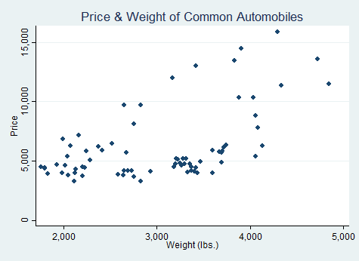
2 quantitative variables: Correlation
Graphs can help us explain correlation (for a more
technical explanation of the math, see the
appendix )
We often graph two quantitative variables using a scatter plot (each axis corresponds to one of the variables)
Lecture 3: The Relationship Between 2 Variables 10 / 32

Slide 17
2 quantitative variables: Correlation
Correlations always fall between -1 and 1
One way to understand correlation is to think about drawing a straight line through the data and seeing how closely the data map to the line
If the data falls perfectly along a straight line that points upward (going from left to right), the correlation will be 1
If the data falls perfectly along a straight line that points downward (going from left to right), the correlation will be -1
If the two variables are totally unrelated to one another, the correlation will be 0
Many real-world correlations are non-zero but also don’t fall perfectly along a line; we’ll look at a couple
examples now, but see the for more details
appendix
Lecture 3: The Relationship Between 2 Variables 10 / 32

Slide 18
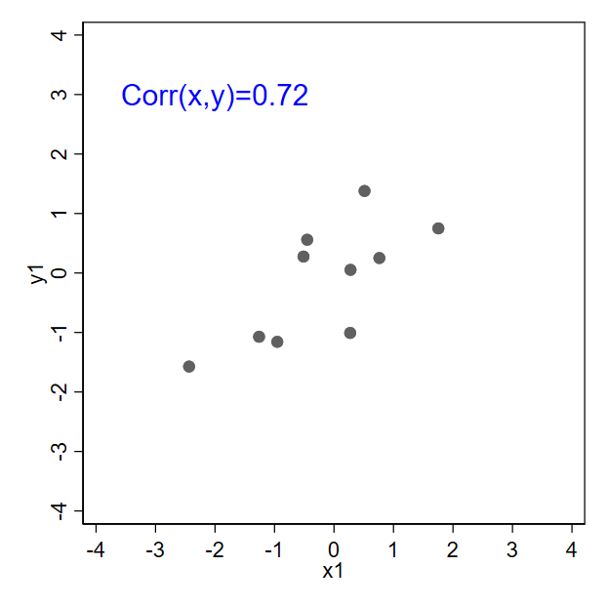
2 quantitative variables: Correlation
Positive values of correlation indicate a “positive relationship” (higher values of x are associated with higher values of y)
Lecture 3: The Relationship Between 2 Variables 10 / 32

Slide 19
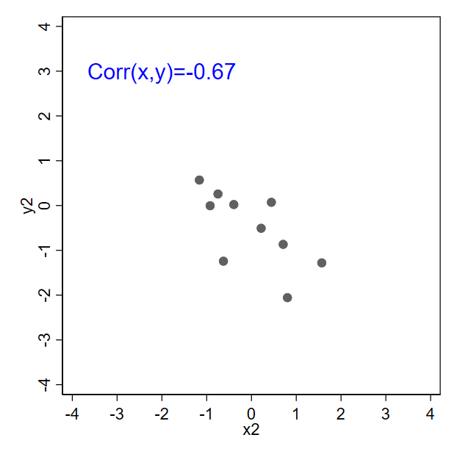
2 quantitative variables: Correlation
Negative values of correlation indicate a “negative relationship” (higher values of x are associated with lower values of y)
Lecture 3: The Relationship Between 2 Variables 19 / 32

Slide 20
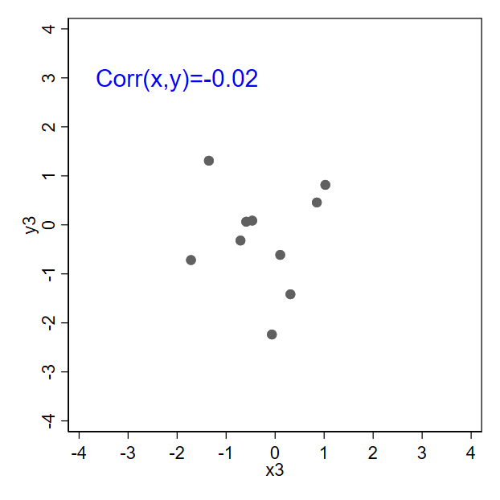
2 quantitative variables: Correlation
A correlation of zero (-0.02 is very close to 0) indicates no “linear” relationship between x and y
(More explanation of “linear” in the appendix )
Lecture 3: The Relationship Between 2 Variables 27 / 32

Slide 21
Linear regression
For regression, it is important to distinguish between independent and dependent variables
Independent variable: a variable that affects or explains another variable
Dependent variable: a variable that is affected or explained by another variable
Whenever we create graphs, the convention is to plot the independent variable (x) on the horizontal axis and the dependent variable (y) on the vertical axis
Lecture 3: The Relationship Between 2 Variables 27 / 32

Slide 22
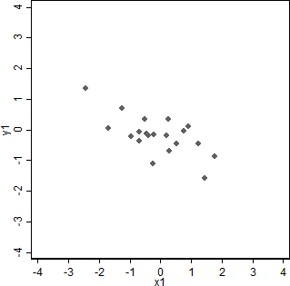
Linear regression
Linear regression: drawing a line through some data
Lecture 3: The Relationship Between 2 Variables 27 / 32

Slide 23
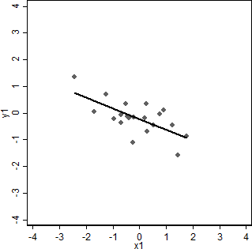
Linear regression
Linear regression: drawing a line through some data
Lecture 3: The Relationship Between 2 Variables 27 / 32

Slide 24
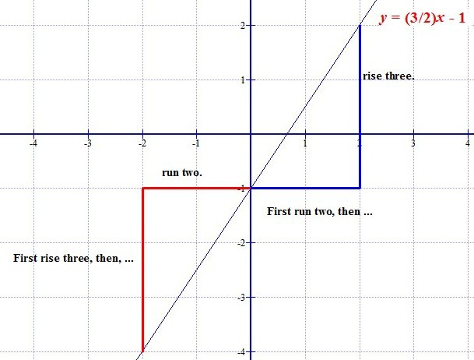
Linear functions
To write the equation for a straight line, we need to know the y-intercept and the slope: y = mx + b
(Image: Public domain, Dino)
Lecture 3: The Relationship Between 2 Variables 27 / 32

Slide 25
Linear functions
In math class you might have seen lines represented as:
y = mx + b
For regression we’ll use the following notation:
a: the intercept (or constant, sometimes also written as α or β₀)
b: the slope (calculated as rise-over-run, sometimes also written as β or β₁)
It is assumed that Y is the dependent variable and X
is the independent variable
Y^{ˆ} = a + bX
Lecture 3: The Relationship Between 2 Variables 27 / 32

Slide 26
Linear regression
Once we’ve estimated our line, what we usually care about most is the values of a and b
We call a and b “regression coefficients”
We typically care more about b (the slope) since it tells us something about how the two variables are related
Lecture 3: The Relationship Between 2 Variables 27 / 32

Slide 27
Cheatsheet: Interpreting slope coefficients
Significance: is relationship strong enough to be considered reliable?
If p < .05: relationship is significant; look at sign and size
If p > .05: results somewhat indeterminate;
relationship could be caused by coincidence or by “chance.”
Sign: is relationship positive or negative?
Positive coefficient: when independent variable is bigger, dependent variable tends to be bigger
Negative coefficient: when independent variable is bigger, dependent variable tends to be smaller
Size: how big is the effect?
If b is a positive coefficient, a one-unit increase in the independent variable (e.g., a 1-year increase in age) predicts a b -unit increase in the dependent variable
If b is negative, predicts a b -unit decrease
Lecture 3: The Relationship Between 2 Variables 27 / 32

Slide 28
Linear regression
Example: Predicting university grades (https:
//onlinestatbook.com/2/regression/intro.html)
DV: University grade point average (GPA; how good their grades are)
IV: High school GPA
How much better do I expect a student to do at university (in terms of GPA) if they had a high GPA in high school?
Lecture 3: The Relationship Between 2 Variables 27 / 32

Slide 29
Linear regression
Example: Predicting university grades
Type into Stata:
insheet using "https://onlinestatbook.com/2/case_studies/data/sat.txt", ///
two^{de}w^{l}a^{im}y^{ite}s^{r}c^{("}at^{")}ter univ_gpa high_gpa corr univ_gpa high_gpa
We can see there’s a strong correlation (r=0.78), but this still doesn’t tell us how much higher the university GPA is expected to be if high school GPA goes up by a point
We still need to run a regression
Lecture 3: The Relationship Between 2 Variables 27 / 32

Slide 30
Linear regression
Example: Predicting university grades
Type into Stata:
reg univ_gpa high_gpa
twoway (scatter univ_gpa high_gpa) /// (lfit univ_gpa high_gpa)
Significance: p=0.000, which is < .05, so we conclude there’s a reliable relationship between high school GPA and university GPA
Sign: The coefficient (.67) for high_GPA is positive, so doing well in high school predicts doing well at university
Size: The coefficient for high_GPA is .67, so a
one-point increase in high school GPA predicts a 0.67-point increase in university GPA
Lecture 3: The Relationship Between 2 Variables 27 / 32

Slide 31
Linear regression
Linear regression is a very powerful tool, so we have only scratched the surface with this brief explanation
For example, the shows how we can use
appendix
linear regression to make predictions
We can also have a regression with multiple independent variables; the interpretation of coefficients remains similar to what we’ve already
seen, but there is more explanation in the
appendix
Lecture 3: The Relationship Between 2 Variables 27 / 32

Slide 32
Correlation vs. regression
Like the correlation coefficient, regression coefficients tell us something about the relationship between two variables
But correlation and regression coefficients are interpreted differently
Correlation coefficient: tells us how closely the data fall along a straight line
Regression coefficients: tell us what the line looks like (b tells us how steep it is)
Both allow us to draw conclusions about whether two (continuous) variables are (linearly) associated with one another
The correlation coefficient and the regression slope coefficient will always have the same sign (positive or negative), but their magnitudes are usually different
Regression coefficients aren’t bounded by -1 and 1
Lecture 3: The Relationship Between 2 Variables 27 / 32

Slide 33
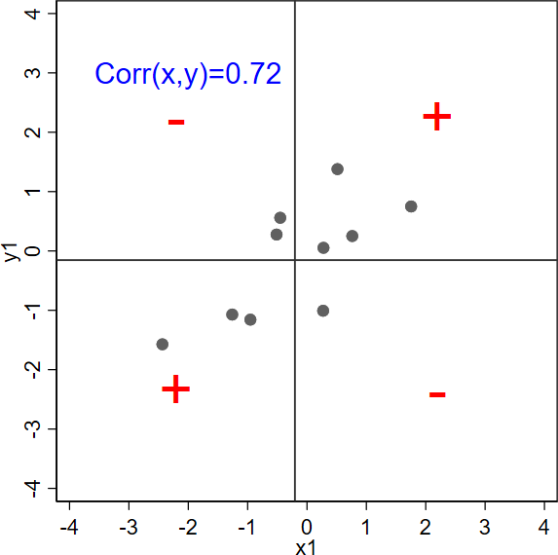
Appendix 1: Quadrants for correlation
Return to main slides
Using lines for the means of x and y, we can divide the plot into 4 quadrants indicating whether each data point positively or negatively contributes to the correlation
Lecture 3: The Relationship Between 2 Variables 1 / 34

Slide 34
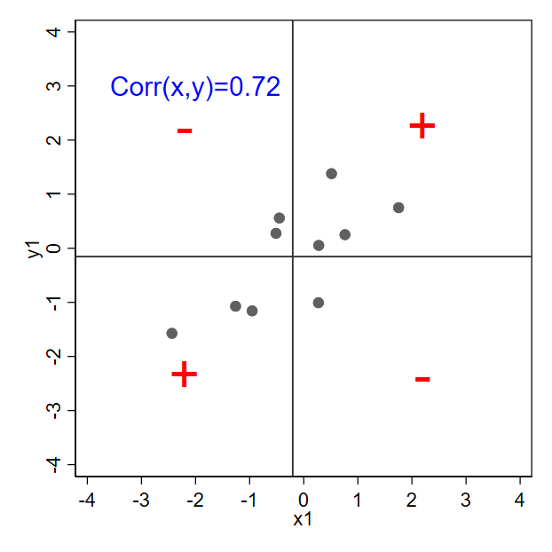
Appendix 1: Quadrants for correlation
If most data points are in the upper-right and lower-left quadrants, the correlation will be positive
Lecture 3: The Relationship Between 2 Variables 2 / 34

Slide 35
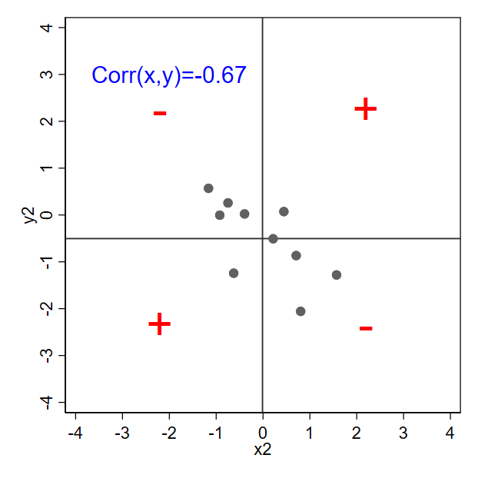
Appendix 1: Quadrants for correlation
If most data points are in the upper-left and lower-right quadrants, the correlation will be negative
Lecture 3: The Relationship Between 2 Variables 3 / 34

Slide 36
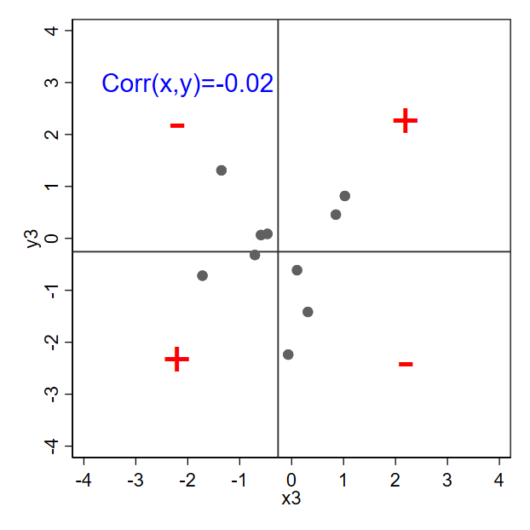
Appendix 1: Quadrants for correlation
If the data is spread fairly evenly among all quadrants, the correlation will be close to zero
Lecture 3: The Relationship Between 2 Variables 4 / 34

Slide 37
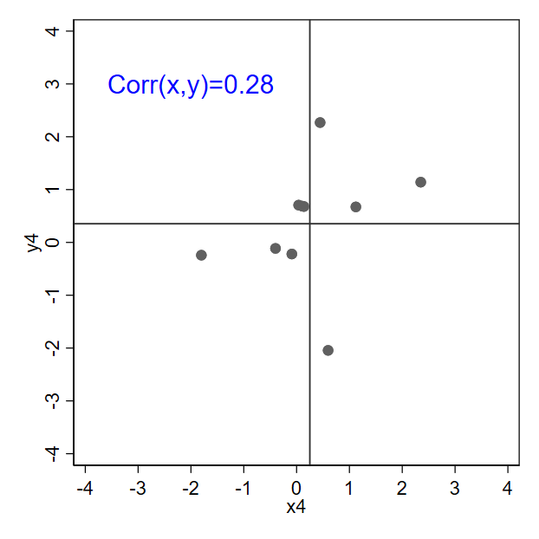
Appendix 1: Quadrants for correlation
Weaker correlations are harder to visually detect, but the quadrants can help
Lecture 3: The Relationship Between 2 Variables 5 / 34

Slide 38
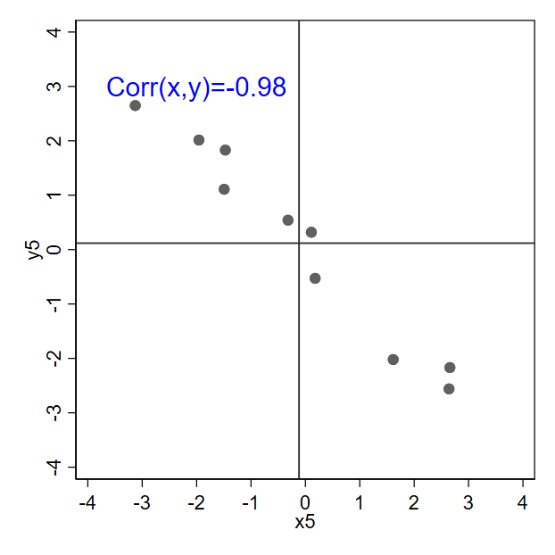
Appendix 1: Quadrants for correlation
The steepness of the line doesn’t matter for correlation. Instead, focus on how closely the data fall along a line, or focus on the quadrants.
Lecture 3: The Relationship Between 2 Variables 6 / 34

Slide 39
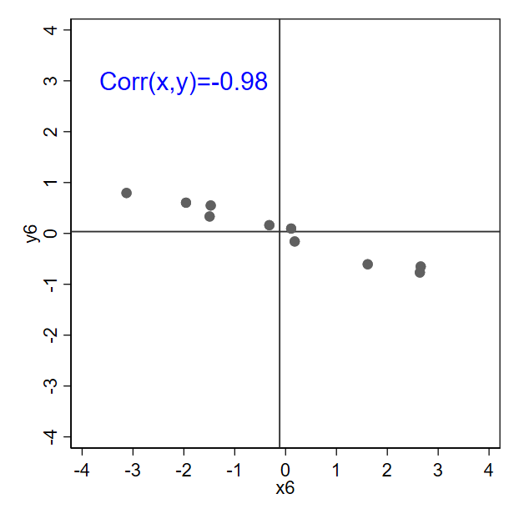
Appendix 1: Quadrants for correlation
Notice the correlation hasn’t changed though the line is now flatter
Lecture 3: The Relationship Between 2 Variables 7 / 34

Slide 40
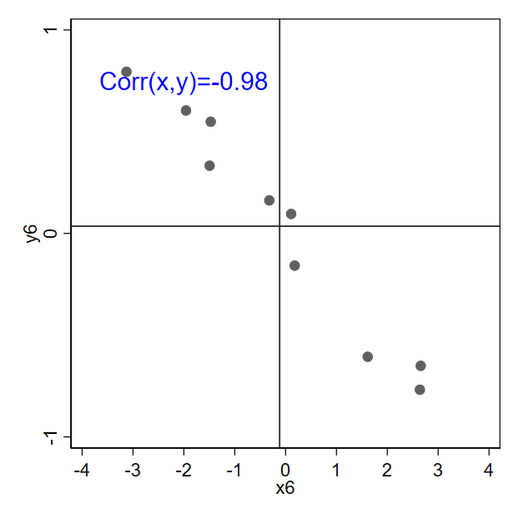
Appendix 1: Quadrants for correlation
In fact, how steep the line appears depends on how the axes are drawn; this is the exact same data from the prior slide with a different y axis
Return to main slides
Lecture 3: The Relationship Between 2 Variables 8 / 34

Slide 41
Appendix 2: Correlation, nonlinearity, etc.
Return to main slides
There are multiple versions of the correlation formula which yield equivalent results (except that a population correlation differs from a sample correlation, but don’t worry about that for now)
The textbook version of the formula can be found by rearranging the version I just showed you (although the textbook notation is still a bit different; it will show X instead of x_{i})
Important note: If the data appears to follow a pattern but the pattern is not in the form of a straight line, there is a nonlinear relationship; nonlinear relationships may produce correlations of zero (or close to zero) even if the two variables are strongly related to one another
Lecture 3: The Relationship Between 2 Variables 9 / 34

Slide 42
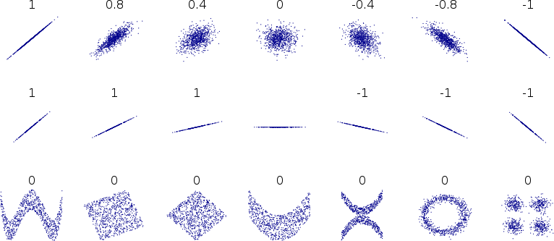
Appendix 2: Correlation, nonlinearity, etc.
Some more examples:
(Image: Public domain, Denis Boigelot)
Lecture 3: The Relationship Between 2 Variables 10 / 34

Slide 43
Appendix 2: Correlation, nonlinearity, etc.
There are some other types of correlation coefficients that are designed to handle limitations of the Pearson correlation coefficient
Some are designed to handle data that isn’t measured continuously (e.g., ordered responses to a question—“strongly disagree,” “disagree,” “agree,” “strongly agree”—where we don’t want to assume equal distance between each option)
Some are able to detect certain types of nonlinear relationships
If someone doesn’t specify which correlation coefficient they’re using, it’s generally safe to assume they’re referring to the Pearson correlation coefficient
Return to main slides
Lecture 3: The Relationship Between 2 Variables 11 / 34

Slide 44
Appendix 3: The math behind correlation
Return to main slides
Before examining correlation, we’ll look at covariance since the formula is simpler:
∑
(x_{i} − µ_{x})(y_{i} − µ_{y})
Cov(x, y) = σ =
xy
N
µ_{x} represents the mean (average) of x while µ_{y}
represents the mean of y
Notice the similarity to the variance formula. In fact, the covariance of x with itself (covariance of x and x) is equal to the variance of x:
∑ ∑
(x − µ )(x − µ ) (x − µ )
2
Cov(x, x) =
i
x i x i
x
2
= = σ_{x}
N N
Lecture 3: The Relationship Between 2 Variables 12 / 34

Slide 45
Appendix 3: The math behind correlation
Positive values of covariance indicate a “positive relationship” (higher values of x are associated with higher values of y)
Negative values of covariance indicate a “negative relationship” (higher values of x are associated with lower values of y)
A covariance of zero indicates no “linear” relationship between x and y (we’ll define “linear” later)
Lecture 3: The Relationship Between 2 Variables 13 / 34

Slide 46
Appendix 3: The math behind correlation
∑
(x_{i} − µ_{x})(y_{i} − µ_{y})
Cov(x, y) = σ =
xy
N
Example:
i
1
x_{i} y_{i}
5 5
2 2 4
3 2 0
Lecture 3: The Relationship Between 2 Variables 14 / 34

Slide 47
Appendix 3: The math behind correlation
∑
(x_{i} − µ_{x})(y_{i} − µ_{y})
Cov(x, y) = σ =
xy
N
Example:
i | x_{i} | y_{i} | x¯ | y¯
1 | 5 | 5 | 3 | 3
2 | 2 | 4 | 3 | 3
3 | 2 | 0 | 3 | 3
Lecture 3: The Relationship Between 2 Variables 15 / 34

Slide 48
Appendix 3: The math behind correlation
∑
(x_{i} − µ_{x})(y_{i} − µ_{y})
Cov(x, y) = σ =
xy
N
Example:
i x_{i} y_{i} x¯ y¯ x_{i} − x¯ y_{i} − y¯
1 5 5 3 3 2
2 2 4 3 3 -1
3 2 0 3 3 -1
2
1
-3
Lecture 3: The Relationship Between 2 Variables 16 / 34

Slide 49
Appendix 3: The math behind correlation
∑
(x_{i} − µ_{x})(y_{i} − µ_{y})
Cov(x, y) = σ =
xy
N
Example:
i x_{i} y_{i} x¯ y¯ x_{i} − x¯ y_{i} − y¯
1 5 5 3 3 2
2 2 4 3 3 -1
3 2 0 3 3 -1
(x_{i} − x¯)(y_{i} − y¯)
2
1
-3
4
-1
3
Cov(x, y) = ⁴ ⁻ ¹ ⁺ ³ = ⁶ = 2
3 3
Lecture 3: The Relationship Between 2 Variables 17 / 34

Slide 50
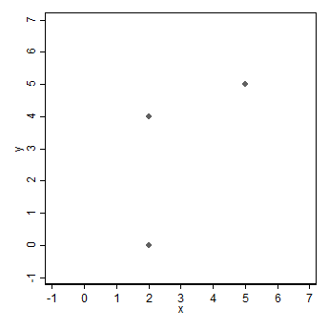
Appendix 3: The math behind correlation
Cov(x, y) =
∑
(x_{i} − µ_{x})(y_{i} − µ_{y})
N
i
1
x_{i} y_{i}
5 5
2 2 4
3 2 0
Lecture 3: The Relationship Between 2 Variables 18 / 34

Slide 51
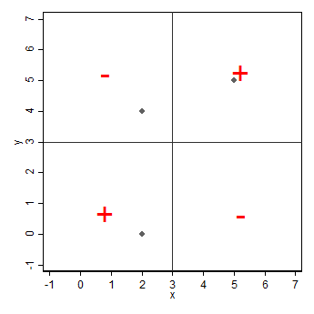
Appendix 3: The math behind correlation
Using lines for
x¯ and y¯
(x¯ = 3; y¯ = 3), we can divide the plot into 4 quadrants indicating whether data points positively or negatively contribute to covariance
Lecture 3: The Relationship Between 2 Variables 19 / 34

Slide 52
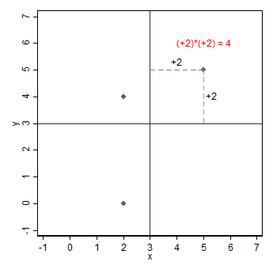
Appendix 3: The math behind correlation
Cov(x, y) =
∑
(x_{i} − µ_{x})(y_{i} − µ_{y})
N
i (x_{i} − x¯)(y_{i} − y¯)
1
4
-1
3
2
3
Lecture 3: The Relationship Between 2 Variables 20 / 34

Slide 53
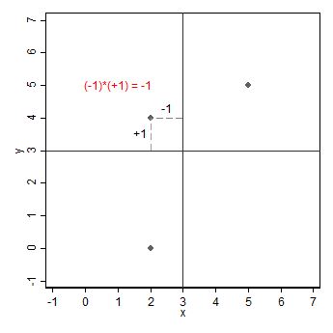
Appendix 3: The math behind correlation
Cov(x, y) =
∑
(x_{i} − µ_{x})(y_{i} − µ_{y})
N
i (x_{i} − x¯)(y_{i} − y¯)
1
4
-1
3
2
3
Intro Stats with Nathan Favero
Lecture 3: The Relationship Between 2 Variables 21 / 34

Slide 54
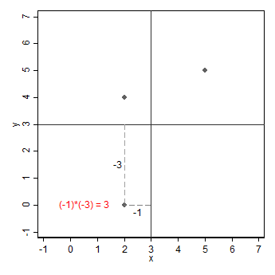
Appendix 3: The math behind correlation
Cov(x, y) =
∑
(x_{i} − µ_{x})(y_{i} − µ_{y})
N
i (x_{i} − x¯)(y_{i} − y¯)
1
4
-1
3
2
3
Lecture 3: The Relationship Between 2 Variables 22 / 34

Slide 55
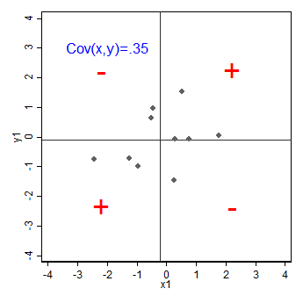
Appendix 3: The math behind correlation
If most data points are in the upper-right and lower-left quadrants, the covariance (and correlation) will be positive
Lecture 3: The Relationship Between 2 Variables 23 / 34

Slide 56
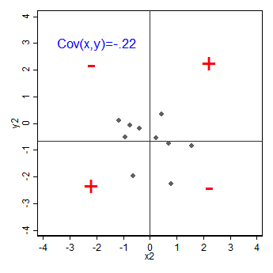
Appendix 3: The math behind correlation
If most data points are in the upper-left and lower-right quadrants, the covariance (and correlation) will be negative
Lecture 3: The Relationship Between 2 Variables 24 / 34

Slide 57
Appendix 3: The math behind correlation
Correlation (more specifically, the Pearson correlation coefficient) is covariance scaled to the variance of the two variables
Correlation is reported much more frequently than covariance since it can be used to compare variables measured in different units
Correlations always fall between -1 and 1, with 0 indicating that the covariance is 0
σ_{xy} Cov(x, y)
r
^{xy =} σxσy ^{= √}Var(x)Var(y)
Return to main slides
Lecture 3: The Relationship Between 2 Variables 25 / 34

Slide 58
Appendix 4: Using regression for prediction
Return to main slides
Example: Predicting university grades
Continuing on with our regression example from the main slides...
We can write the function for our estimated regression line by substituting our coefficient estimates into the regression model
Y^{ˆ} = a + bX
colleg^{ˆ}e_gpa = 1.10 + 0.67 × high_gpa
Lecture 3: The Relationship Between 2 Variables 26 / 34

Slide 59
Appendix 4: Using regression for prediction
Example: Predicting university grades
colleg^{ˆ}e_gpa = 1.10 + 0.67 × high_gpa
We can substitute in values to see the expected university GPA for different high school GPAs
For someone with a high school GPA of 2.5 (between a B and C), we predict they’ll have a GPA of 2.78 in college:
colleg^{ˆ}e_gpa = 1.10 + 0.67 × (2.5) = 2.78
For someone with a high school GPA of 3.5 (between an A and B), we estimate they’ll have a GPA of 3.45 in college:
colleg^{ˆ}e_gpa = 1.10 + 0.67 × (3.5) = 3.45
Return to main slides
Lecture 3: The Relationship Between 2 Variables 27 / 34

Slide 60
Appendix 5: Multiple linear regression
Return to main slides
If we have a second independent variable that we care about, we can rewrite the regression equation as follows:
Y^{ˆ} = a + b₁X₁ + b₂X₂
Now, X₁ is our first independent variable and X₂ is our second independent variable
Each variable has it’s own coefficient: b₁ is the coefficient for X₁ and b₂ is the coefficient for X₂
If we want to assume that X₁ and X₂ cause Y, we can say that b₁ is the effect of X₁ (on Y) and b₂ is the effect of X₂ (on Y)
Lecture 3: The Relationship Between 2 Variables 28 / 34

Slide 61
Appendix 5: Multiple linear regression
Example: Predicting university grades
Let’s add another variable to our model: the student’s SAT score
Type into Stata:
gen sat = math_sat + verb_sat twoway scatter univ_gpa sat reg univ_gpa high_gpa sat
We get:
ˆ
Y = a + b₁X₁ + b₂X₂
univ^{ˆ}_gpa = 0.540 + 0.541 × high_gpa + 0.0008 × sat
Lecture 3: The Relationship Between 2 Variables 29 / 34

Slide 62
Appendix 5: Multiple linear regression
Example: Predicting university grades
High school GPA
Significance: p=0.000, which is < .05, so we conclude there’s a reliable relationship between high school GPA and university GPA
Sign: The coefficient (.54) for high_GPA is positive, so doing well in high school predicts doing well at university
Size: The coefficient for high_GPA is .54, so a
one-point increase in high school GPA predicts a 0.54-point increase in university GPA
The effect size is smaller than what was estimated in the prior regression model because now we’re effectively estimating the difference between two students with different high school GPAs but the same SAT score
Lecture 3: The Relationship Between 2 Variables 30 / 34

Slide 63
Appendix 5: Multiple linear regression
Example: Predicting university grades
SAT score
Significance: p=0.043, which is < .05, so we conclude there’s a reliable relationship between SAT score and university GPA
Sign: The coefficient (.0008) for sat is positive, so
doing well on the SAT predicts doing well at university
Size: The coefficient for sat is .0008, so a one-point increase in SAT score predicts a 0.0008-point
increase in university GPA
This effect sounds tiny, but SAT scores range from 1034 to 1450 in this sample, so a one-point increase in SAT score is almost nothing
Since a one-point increase on the SAT predicts a
0.0008-point increase in university GPA, a 200-point increase in SAT score predicts a 0.16-point
increase in university GPA (200 × .0008 = .16)
Lecture 3: The Relationship Between 2 Variables 31 / 34

Slide 64
Appendix 5: Multiple linear regression
When we include multiple independent variables in the same regression:
We’re asking: what is the effect of changing one factor at a time while holding all other factors constant?
The coefficient for X₁ tells me how much I expect Y to increase if X₁ goes up by one unit but all other independent variables (e.g., X₂) are left unchanged
Or, we can think about comparing two people (units) that are identical on all independent variables except there is a one-unit difference in X₁; the X₁ coefficient tells us how different we expect those two people to be
Lecture 3: The Relationship Between 2 Variables 32 / 34

Slide 65
Appendix 5: Multiple linear regression
univ^{ˆ}_gpa = 0.540 + 0.541 × high_gpa + 0.0008 × sat
Imagine two students, both with the same SAT score (1200) but different high school GPAs (2.5 and 3.5)
Student with 2.5 GPA in high school:
univ^{ˆ}_gpa = 0.540+0.541×(2.5)+0.0008×(1200) = 2.853
Student with 3.5 GPA in high school:
univ^{ˆ}_gpa = 0.540+0.541×(3.5)+0.0008×(1200) = 3.394
The student with the high school GPA that is one point higher is expected to have a university GPA that is 0.541 points higher (3.394 − 2.853 = 0.541)
Notice that this difference (0.541) is exactly equal to the high_gpa coefficient
Lecture 3: The Relationship Between 2 Variables 33 / 34

Slide 66
Appendix 5: Multiple linear regression
univ^{ˆ}_gpa = 0.540 + 0.541 × high_gpa + 0.0008 × sat
The same approach also applies to the interpretation of the sat coefficient
We can imagine two students with the same high school GPA (3.0) and different SAT scores (1200 vs 1201)
Student with 1200 on SAT:
univ^{ˆ}_gpa = 0.540+0.541×(3)+0.0008×(1200) = 3.1230
Student with 1201 on SAT:
univ^{ˆ}_gpa = 0.540+0.541×(3)+0.0008×(1201) = 3.1238
The student with the SAT score that is one point higher is expected to have a university GPA that is 0.0008 points higher (3.1238 − 3.1230 = 0.0008)
Return to main slides
Lecture 3: The Relationship Between 2 Variables 34 / 34

