Slide 1
Lecture 5: Distributions
Intro Stats with Nathan Favero
American University (Washington, DC) August 2, 2024
Except where indicated, this material is licensed under CC-BY 4.0

Slide 2
Describing distributions
Distribution: all of the values (and the frequency of each of these values) for a variable
Distributions can be depicted in tables or figures
Descriptive statistics (e.g., mean, median, variance) can be used to describe a distribution
Lecture 5: Distributions
5 / 19

Slide 3
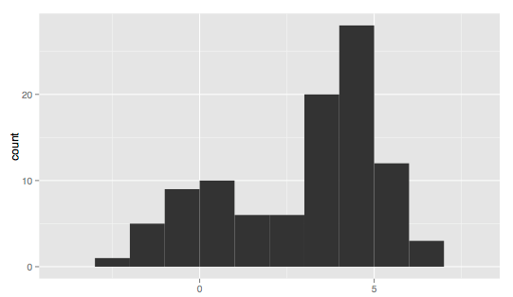
Describing distributions
Unimodal: has only one (local) mode
Multimodal: has more than one (local) mode
Bimodal: has two (local) modes
(Image: Public domain, Visnut)
Lecture 5: Distributions
5 / 19

Slide 4
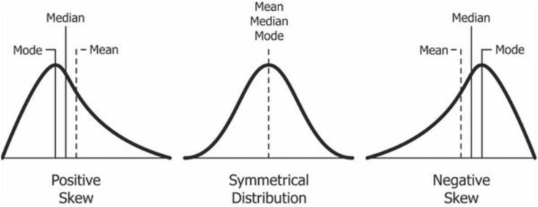
Describing distributions
Skew: asymmetry in a distribution
Positively skewed (or right-skewed) : the mean is higher than the median (opposite is negatively skewed)
(Image: CC BY-SA 4.0, “Relationship between mean and median under different skewness.png” by BoruW)
Lecture 5: Distributions
5 / 19

Slide 5
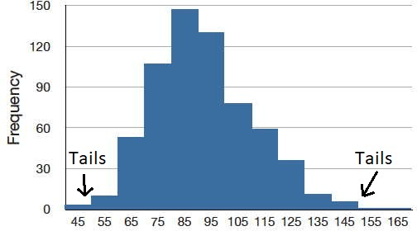
Describing distributions
Tails: ends of the distribution (highest and lowest values), typically describing ranges of values where
there are few observations (short bars in a histogram)
(Adapted from public domain image, onlinestatbook.com)
Lecture 5: Distributions
5 / 19

Slide 6
Probability distributions
To understand the models we use to do statistical inference, we first need to get familiar with the language and logic of probability distributions
We learned before that a distribution describes how frequently every possible value for a variable occurs
in a dataset (i.e., what you see when you use the tab
command in Stata)
Probability distributions don’t describe data we’ve collected; instead, they describe a random process and indicate how likely we are to obtain different possible values from this random process
Before proceeding, you might want to check out the appendix with an example of applying key concpets
from this lecture:
example: ER visits
Lecture 5: Distributions
5 / 19

Slide 7
Probability distributions
Probability is going to be central to the way that we talk about data and distributions
Using probabilities to describe things allows us to acknowledge that there are things we can’t know...
that we’re not looking to predict or explain things with 100% certainty
Random variable: has a set of possible values that can be described by a probability distribution
Probability distribution: a list of all possible values and the associated probabilities
Lecture 5: Distributions
5 / 19

Slide 8
Probability distributions
Probability distributions can be very simple
Example:
Heads: 0.5
Tails: 0.5
Example:
1: 1/6
2: 1/6
3: 1/6
4: 1/6
5: 1/6
6: 1/6
Lecture 5: Distributions
8 / 19

Slide 9
Probability distributions
Most of the distributions we’ll think about in this class will be more complex, and we’ll mainly depict them graphically
We generally depict complex (continuous) distributions using a probability density function (PDF)
Our statistics software will be doing a lot of fancy math behind the scenes based on these PDFs, but you don’t need to worry about such details in this class
You can basically interpret a graph of a PDF like a kernel density plot (or even a histogram)
Lecture 5: Distributions

Slide 10
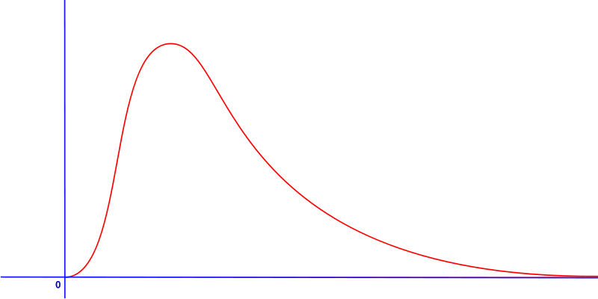
Probability distributions
Statisticians have developed PDFs for distributions with lots of different shapes
Here’s a skewed distribution:
(Image: Public domain, HiTe)
Lecture 5: Distributions

Slide 11
Probability distributions
With PDF graphs, wherever the height is greater, the values are more likely to be observed (just like a histogram)
But kernal desnity plots or histograms are generally used for data that we’ve already collected; PDF graphs depict a probability distribution from which data is “drawn” (the distinction is subtle, and you can’t necessarily tell from just looking at the graph)
Lecture 5: Distributions

Slide 12
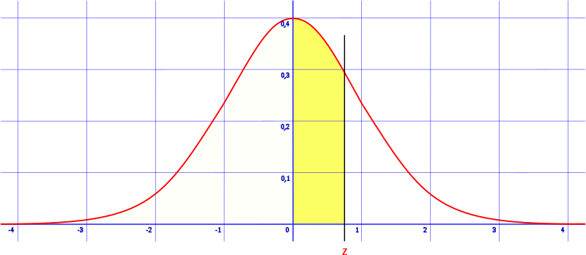
Probability distributions
A precise interpretation for PDFs is a bit tricky since any value can be measured to infinite digits (and
therefore has infinitely small probability of being selected)
Total area under line equals 1
Probability for a range of possible values (e.g., probability of drawing a value between 0 and 0.7) equals the area under the line within that range (requires calculus)
(Image: Public domain, HiTe & Notyourbroom)
Lecture 5: Distributions

Slide 13
Probability distributions
When we talked about distributions the last few weeks, we were talking about data that had already been collected
Probability distributions describe a (theoretical) random process from which we get data
Example:
If we write out the (theoretical) probabilities for each possible outcome of a coin flip (heads, tails) or a die roll (1, 2, 3, etc.), we’re talking about a probability distribution
If we flip a coin (rolled a die) 20 times and record the results, we’re looking at a distribution of data, which we might depict with a histogram
Lecture 5: Distributions

Slide 14
Probability distributions
Another way to think about this distinction is that for a distribution of data we’ve collected, each observation was (theoretically) drawn from the probability distribution
Example:
If we have a distribution (PDF graph) that describes how likely we think it is that we get various numbers of patients visiting the ER on a given day, we’re looking at a probability distribution
If we’re looking at data (e.g., a histogram) of past daily totals for the number of patients who visited the ER, we’re looking at a distribution of data
Lecture 5: Distributions

Slide 15
Probability distributions
Many of the same statistics and words we use to describe data that’s been collected can also be used (with a bit of adaptation) to describe probability distributions.
For example, a probability distribution will (often) have a mean and a variance
Lecture 5: Distributions

Slide 16
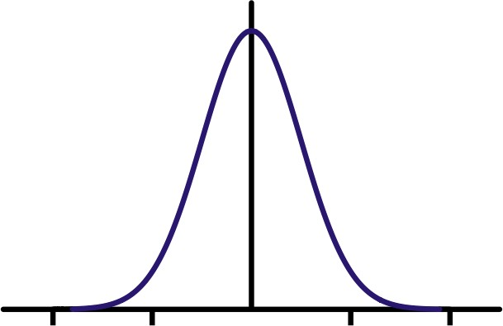
Probability distributions
The normal distribution is one of the most important and commonly-used probability distributions
(Image: Public domain, Vierge Marie)
All normal distributions have this basic shape, but it can be shifted to the left or right, squished, or expanded
Lecture 5: Distributions

Slide 17
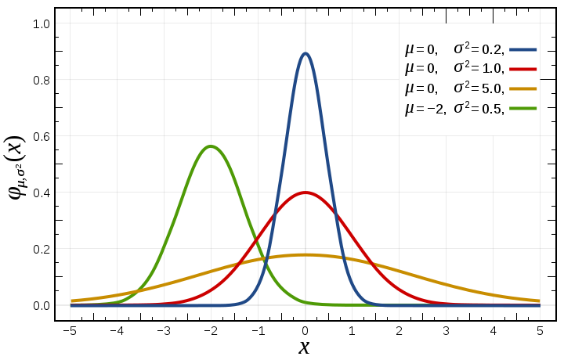
Probability distributions
For normal distribution, two parameters needed to identify exact distribution: mean (µ) and variance (σ²)
(Image: Public domain, Inductiveload)
Lecture 5: Distributions

Slide 18
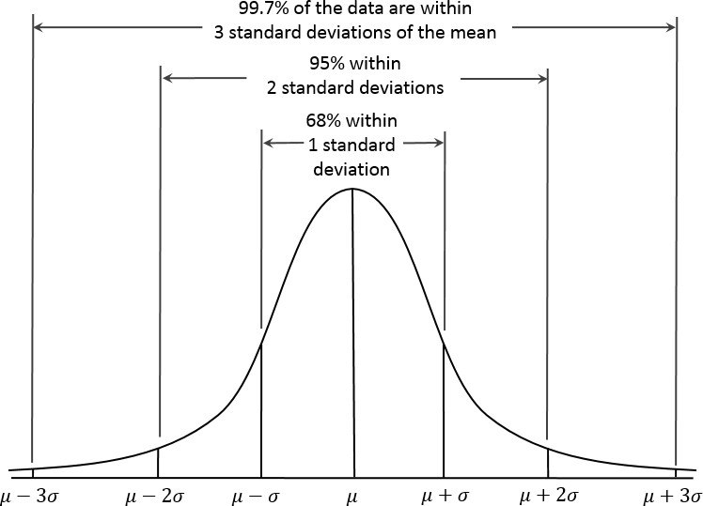
Probability distributions
Important characteristics of the normal PDF
(Image: CC BY-SA 4.0, “Empirical Rule.PNG” by Dan Kernler)
Lecture 5: Distributions

Slide 19
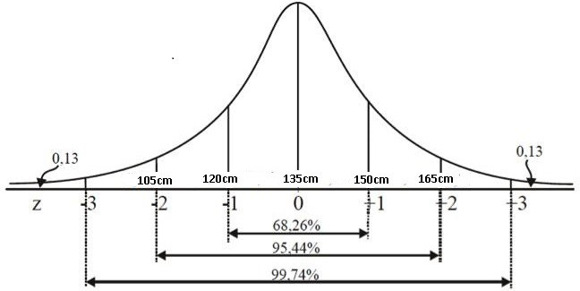
Probability distributions
Standard normal distribution: normal distribution with mean of 0 and standard deviation of 1 (µ = 0; σ = 1)
When you hear “standard” normal, think of standardization (Lecture 2); you can transform any normal distribution into a standard normal distribution by standardizing the values in the original distribution
(Image: CC BY-SA 4.0, “Curva normal 2.jpg” by Matheus otoni)
Lecture 5: Distributions

Slide 20
Appendix 1: Example problem: ER visits
Return to main slides
I’m a hospital administrator, and I want to be able to estimate how many emergency room (ER) visits
there will be tomorrow
I have daily data from the past year, which indicates the number of ER visits each day
How might I go about creating an estimate of how many ER visits there will be tomorrow?
Lecture 5: Distributions

Slide 21
Example problem: ER visits
There will be many factors I can’t predict that will influence how many people visit the ER tomorrow (air quality, people’s physical activities, accidents, etc.)
I’ve downloaded some data on ER visits (combined data from 30 hospitals in Seoul; I used the 2011 data only) that were used in a published research project (https://doi.org/10.1371/journal.pone.0183224)
| date circ |
|-------------------| 1. | 2011-01-01 134 |
2. | 2011-01-02 126 |
3. | 2011-01-03 149 |
4. | 2011-01-04 115 |
Lecture 5: Distributions

Slide 22
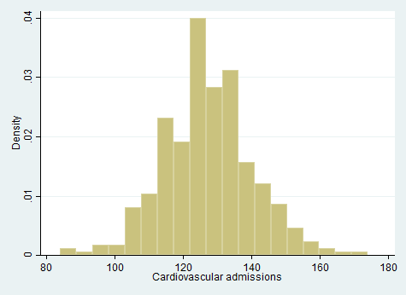
Example problem: ER visits
Lecture 5: Distributions

Slide 23
Example problem: ER visits
When it comes to making a prediction, we could give our best guess as a single number (maybe 130)
Or, if we want to give a more sophisticated (and informative) guess, we could list out a bunch of possible values and indicate their relative likelihood
We could could present this information either graphically or in a table; either way, it’s called a probability distribution
Perhaps the simplest probability distribution we could create as an estimate for tomorrow’s ER visits would just be to use the exact percentage of times each value was observed in the past year
Lecture 5: Distributions

Slide 24
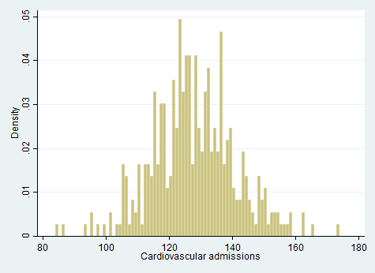
Example problem: ER visits
Lecture 5: Distributions

Slide 25
Example problem: ER visits
. tab circ
Cardiovascu |
lar |
admissions | Freq. Percent
Cum.
------------+-----------------------------------
84 |
86 |
93 |
114 |
115 |
116 |
117 |
1
1
1
5
12
6
11
0.27
0.27
0.27
1.37
3.29
1.64
3.01
0.27
0.55
0.82
14.25
17.53
19.18
22.19
...
Lecture 5: Distributions

Slide 26
Example problem: ER visits
There are a couple problems with this simplistic approach:
Some values (e.g., 91, 92) were never observed in the last year, but we might not want to rule them out for tomorrow
The data is sometimes choppy (e.g., 115: 3.29%, 116: 1.64%, 117: 3.01%), and we might want to smooth it out
One potential solution: use one of the well-known distributions that statisticians have come up with to model different types of data-generation processes
Let’s try a normal distribution with our data
Lecture 5: Distributions

Slide 27
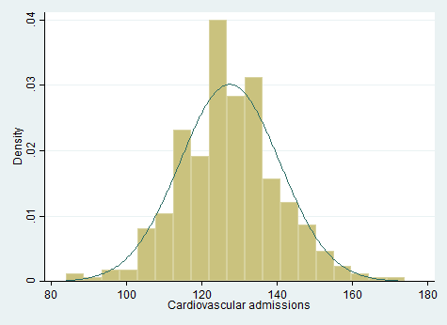
Example problem: ER visits
Lecture 5: Distributions

Slide 28
More on example problem: ER visits
We can make our analyisis a bit more sophisticated if we think about making different predictions under
different conditions (e.g., for different days of the week)
One way to approach this is to think about there being a different probability distribution for each day of the week
Lecture 5: Distributions

Slide 29
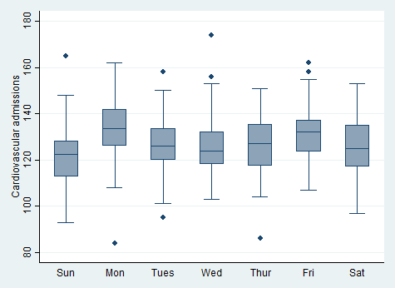
Example problem: ER visits
Lecture 5: Distributions

Slide 30
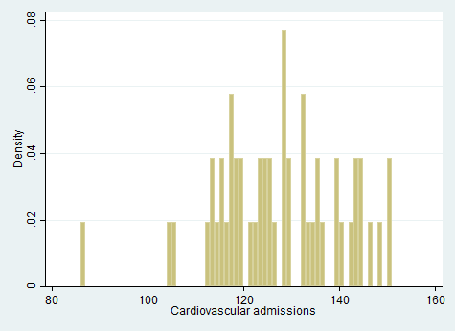
Example problem: ER visits
If we look at data for just Thursdays (from the last year), the data gets even choppier (because there are fewer observations)
Lecture 5: Distributions

Slide 31
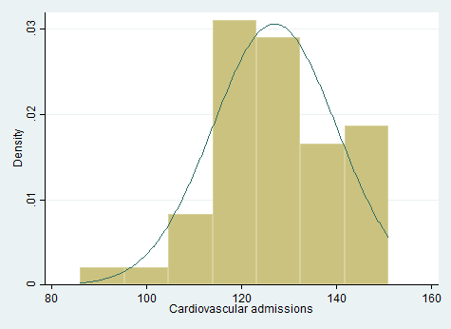
Example problem: ER visits
Thursday gets its own normal distribution
Lecture 5: Distributions

Slide 32
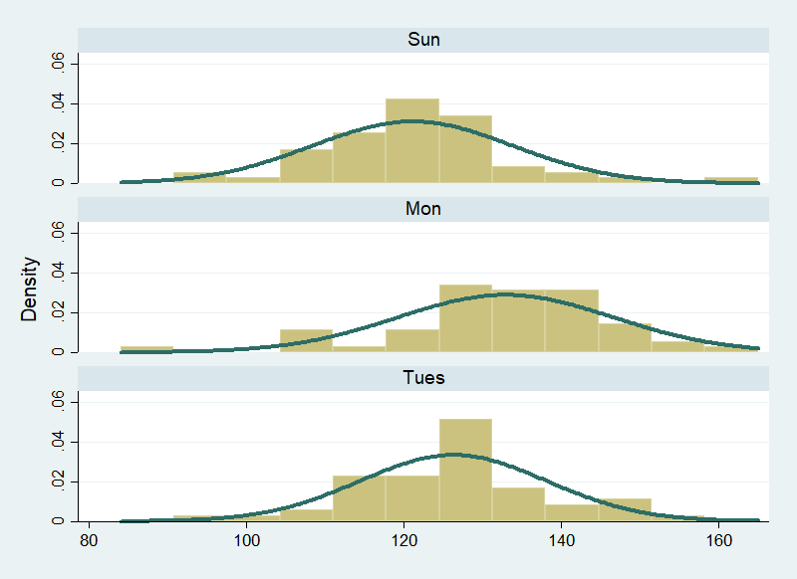
Example problem: ER visits
Lecture 5: Distributions

Slide 33
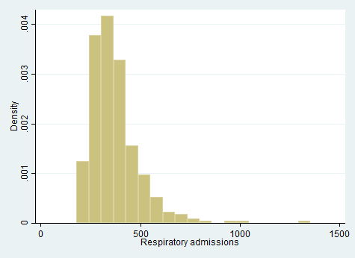
Example problem: ER visits
Note that not all data from the real world looks like a normal distribution:
Lecture 5: Distributions

